Slide 1

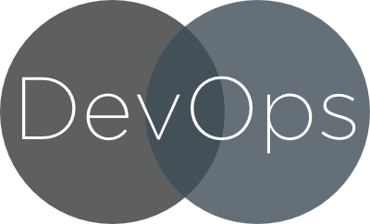

Slide 2



Group Members
Presented By:
Naveen Kumar Chandaluri
S530742
Yeshwant Muppaneni
S530478
Sree Lakshmi Onteddu
S530746

Slide 3
Topics Going To Covered
Introduction to Devops.
Software Development Life Cycle.
Continuous Software delivery.
Phases of Devops Model(waterfall model and agile model).
DevOps Life Cycle

Slide 4

Introduction
DevOps is an approach the gap between software development and operations.
It is not a software, it is a combination of tools.
It reduce the time to develop a project.
Lower failure rate of new releases.
It increases the organizations ability to deliver applications.
Presented by: Sreelakshmi Onteddu
1
http://labs.sogeti.com/sometimes-its-ok-to-waterfall/

Slide 5

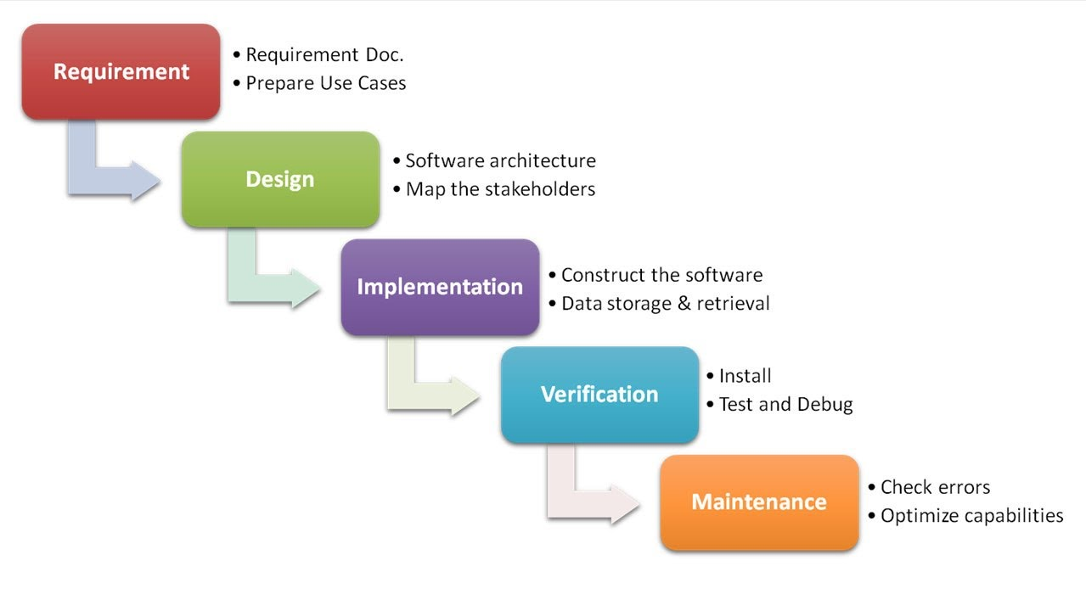
Software Development Life Cycle
Fig 1: Software Development Life Cycle
Presented by: Sreelakshmi Onteddu
https://www.invisionapp.com/blog/integrate-idays-into-sdlc/
2

Slide 6

Traditional Software Delivery
It takes 3 to 6 months to deliver code.
Infrastructure set up takes longer time and errors may occur.
Manual deployment of software take more time but limited success
Presented by: Sreelakshmi Onteddu
https://www.slideshare.net/nishanthnow/introducing-devops
3

Slide 7
Continuous Software Delivery
Delivers code continuously like multiple times in a week.
It has automated infrastructure & configuration takes less time.
It can launch more steps at a time.
Presented by: Sreelakshmi Onteddu
https://www.slideshare.net/nishanthnow/introducing-devops
4

Slide 8
Waterfall Model
The waterfall development model was first discovered by Herbert D.
Advantages: | Disadvantages:
1.Model required fulfillment of one phase unless it will not allow to go to next phase. 2.All the testing and modification is done is the same phase, chances of defect multiplication reduced. | This model doesn’t suitable for randomly changing requirement. Takes lot of time to change and update the project documents.
1 month
Presented by: Yeshwant Muppaneni
5
http://www.softwaretestingandistqb.com/waterfall-model-advantages-and-disadvantages/

Slide 9
Agile Model
In the Agile development model the requirements change frequently.
The development is to be fast compared to the waterfall model
Advantages: | Disadvantages:
Collaborative Effort Transparency | No Fixed Pricing Poor client participation directly affects product quality.
1 month
Presented by: Yeshwant Muppaneni
http://www.nearshoreamericas.com/agile-methodology-advantages-disadvantages/
6

Slide 10
Devops Model
In devops approach the requirements change frequently.
The developments and operations need to agile.
Advantages: | Disadvantages:
1.Continuous software delivery. 2.Less complexity to manage. 3.Faster resolution of problems. (technical,cultural,business) | 1.Lack of domain knowledge. 2.Expensive
1 month
Presented by: Yeshwant Muppaneni
https://www.quora.com/What-is-the-advantage-or-disadvantage-of-using-a-DevOp
7

Slide 11
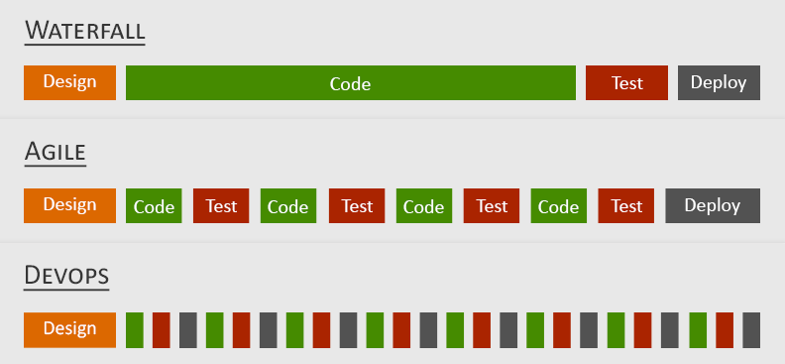
Stages of devops model
Presented by: Yeshwant Muppaneni
https://www.google.com/url?sa=i&rct=j&q=&esrc=s&source=images&cd=&cad=rja&uact=8&ved=0ahUKEwjwmeidvZ7XAhVr8IMKHZsnAs8QjhwIBQ&url=https%3A%2F%2Fblog.spec-india.com%2Ffrom-waterfall-to-agile-to-devops-a-cultural-and-technological-shift%2F&psig=AOvVaw1Q64ZNlzCA0htL-GPnXMIy&ust=1509663580416141
Fig no 1: The stages for creation of devops model.
8

Slide 12
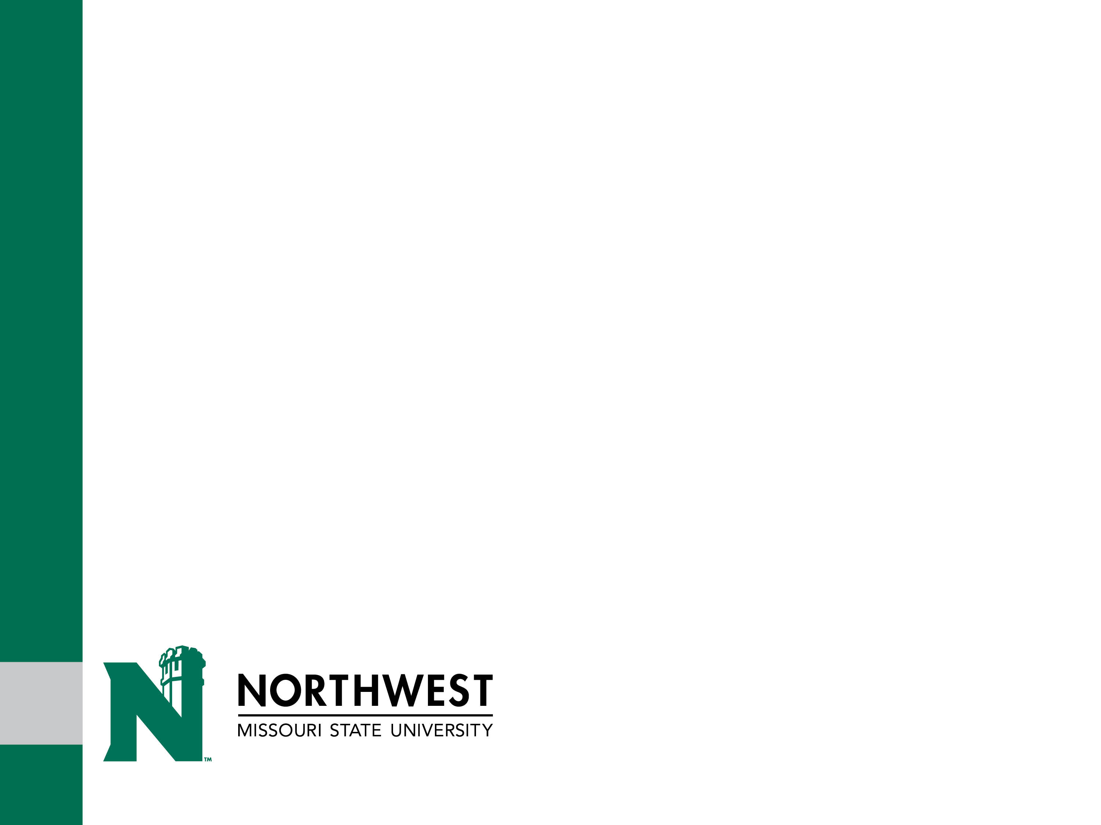
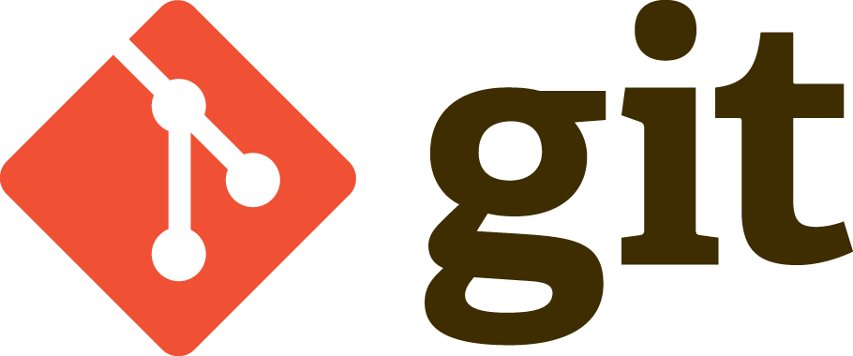
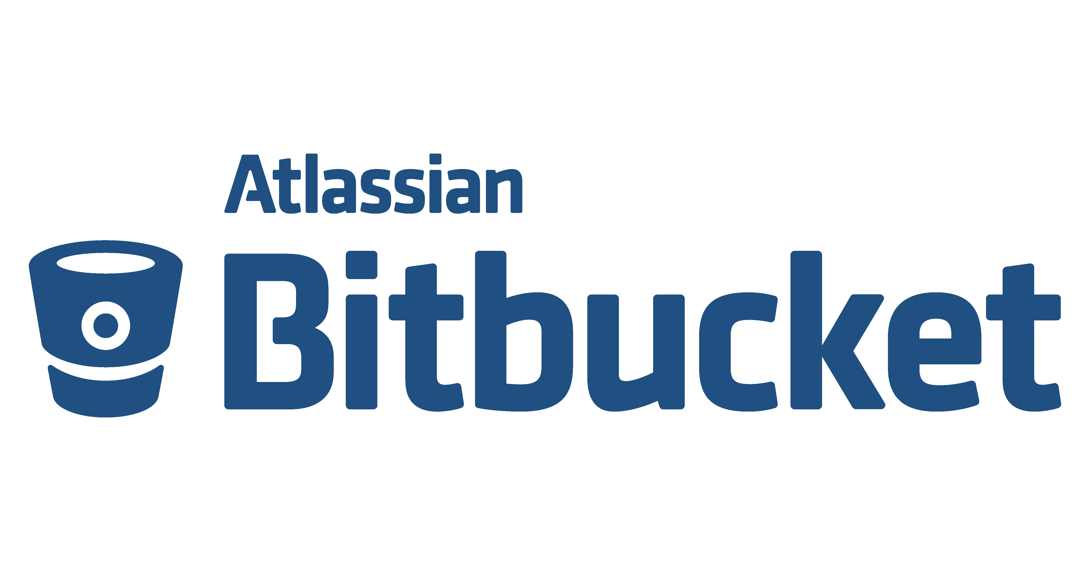

Version Control System (VCS)
Allow developers to work simultaneously.
Do not overwrite each other’s changes.
Maintain history of every version of everything.
Types:
SVN – Subversion - http://subversion.tigris.org/
Repositories:
GIT - https://git-scm.com/
Bit Bucket - https://bitbucket.org/
Presented by : Naveen Kumar C
https://www.slideshare.net/phpcodemonkey/introduction-to-version-control-presentation
9

Slide 13
Build and Testing Tools
DevOps Tools: Building
ANT - http://ant.apache.org/
Maven - https://maven.apache.org/
Gradle - https://gradle.org/
DevOps Tools: Testing
Junit - http://junit.org/junit5/
Selenium - http://www.seleniumhq.org/
Presented by : Naveen Kumar C
https://www.mulesoft.com/resources/api/top-devops-tools
10

Slide 14
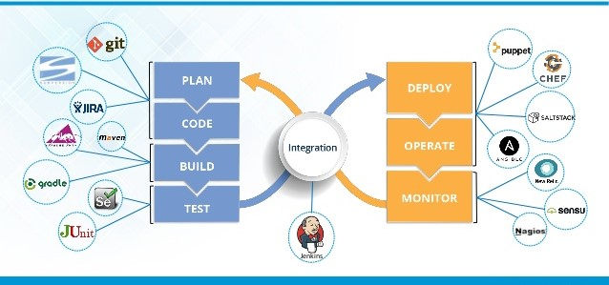
DevOps Life Cycle
https://www.edureka.co/blog/devops-tutorial
Presented by : Naveen Kumar C
11

Slide 15
Deploying Tools
Configuration Management Tools:
It reduces redundant work
It effectively manages simultaneous updates
It avoids configuration related problems
It simplifies coordination between team members
It is helpful in tracking defects
Presented by : Naveen Kumar C
12
http://opensourceforu.com/2015/03/ten-tools-for-configuration-management/

Slide 16
Summary
DevOps is the continuous integration and continuous delivery.
DevOps is the model that is more efficient than the waterfall model and the Agile model.
DevOps encourages automation of the change, configuration, and deploy processes.
13

Slide 17

??

Slide 18

☺

Slide 19
Reference
Jeffrey S. Hammond (9 September 2011). "The Relationship between DevOps and Continuous Delivery".
"Is DevOps a Title? - DevOps.com". DevOps.com. 2014-03-20.Retrieved 2017-07-22.
"Applied Lean Startup Ideas: Continuous Deployment at kaChing".
13

