Slide 1


CHIP-SEQ DATA PROCESSING PIPELINE FOR TRANSCRIPTION FACTOR BINDING SITE ANALYSIS

Slide 2

INTRODUCTION
What is ChIP-Seq?
  Chromatin Immunoprecipitation followed by Sequencing (ChIP-Seq) is a high-throughput method to study protein–DNA interactions across the genome.
  Identifies DNA regions bound by transcription factors (TFs), histone modifications, or chromatin regulators.
  Provides genome-wide binding profiles with high resolution.
  Helps in understanding gene regulation, epigenetic modifications, and cell-type specific functions.
  Can be applied to normal vs diseased states to uncover regulatory differences.
  Widely used in projects like ENCODE to map regulatory elements in the genome.

Slide 3
HOW DOES IT WORK?
Cells / Tissue
⬇️
Crosslink DNA + Protein
⬇️
Fragment Chromatin (Sonication/Enzyme)
⬇️
Immunoprecipitation (Antibody for TF)
⬇️
Reverse Crosslink & Purify DNA
⬇️
High-Throughput Sequencing
⬇️
Read Alignment to Reference Genome
⬇️
Peak Calling (Identify TF Binding Sites)

Slide 4


OBJECTIVE
To process and analyze ChIP-Seq data in Drosophila melanogaster.
To identify genome-wide transcription factor (TF) binding sites using the MACS2 peak calling algorithm.
To visualize TF binding enrichment across the genome using IGV.
To assess peak characteristics such as the distribution of peak widths to understand TF binding behavior.
To annotate peaks with nearby genes and perform functional enrichment analysis.

Slide 5


ANALYSIS WORKFLOW
Raw Data (FASTQ)
⬇️
Quality Check (FastQC)
⬇️
Read Trimming (Trimmomatic)
⬇️
Alignment to Reference Genome (BWA)
⬇️
Sort & Index BAM Files (Samtools)
⬇️
Peak Calling (MACS2)
⬇️
Peak Visualization (IGV / UCSC Genome Browser)

Slide 6
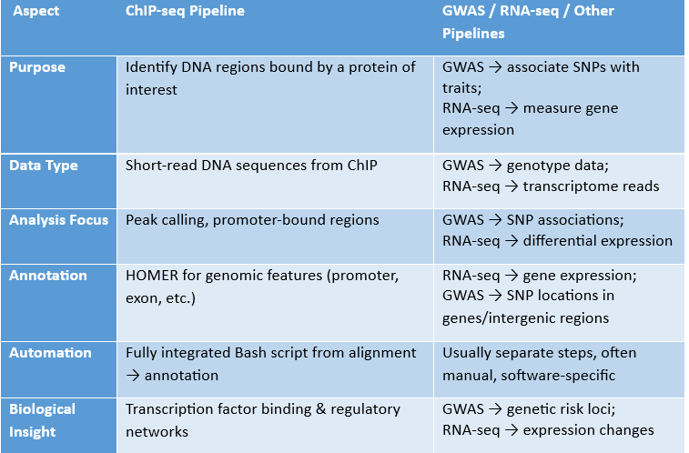
COMPARISON WITH OTHER PIPELINES

Slide 7
DATASET INFORMATION
Source: ENCODE Project (Experiment ID: ENCSR128VHN)
Organism: Drosophila melanogaster (genome build: dm6)
Factor: dsx (Doublesex transcription factor)
Sequencing platform: Illumina HiSeq 4000
Read type: Single-end
Read length: 50 bp
Total reads: ~426–635 MB per replicate (Replicate 1: 426 MB)

Slide 8
COMMANDS
1. Download Data
Downloaded data from Encode database using wget command
2. Quality Check
fastqc raw_data/*.fastq.gz -o qc_results/
3. Trimming (adapter & low-quality bases)
trimmomatic SE -threads 4 \
ENCFF086MDA.fastq.gz \
../trim/ ENCFF086MDA _trimmed.fq.gz \
ILLUMINACLIP:/home/karuna/miniconda3/envs/env_sda/share/trimmomatic/adapters/TruSeq3-SE.fa:2:30:10 \
LEADING:3 TRAILING:3 SLIDINGWINDOW:4:20 MINLEN:36
4. Alignment
bwa index /genomes/dm6.fa
bwa mem -t 4 ~/genomes/dm6.fa /home/karuna/Chip_Seq/trim/ENCFF863UPI_trimmed.fq.gz > /home/karuna/Chip_Seq/aligned/ ENCFF086MDA.sam

Slide 9
5. Convert SAM → BAM, sort, and index
samtools view -bS /home/karuna/Chip_Seq/aligned/ ENCFF086MDA.sam >
/home/karuna/Chip_Seq/aligned/ ENCFF086MDA.bam
samtools sort /home/karuna/Chip_Seq/aligned/ ENCFF086MDA.bam –o
/home/karuna/Chip_Seq/aligned/ ENCFF086MDA.sorted.bam
samtools index /home/karuna/Chip_Seq/aligned/ ENCFF086MDA.sorted.bam

Slide 10
6. Peak Calling with MACS2
macs2 callpeak \
-t /home/karuna/Chip_Seq/aligned/ ENCFF086MDA.sorted.bam \
-c /home/karuna/Chip_Seq/aligned/control.sorted.bam \
-f BAM \
-g dm \
-n ENCFF086MDA \
--outdir /home/karuna/Chip_Seq/macs2/
-t → your ChIP-seq BAM (treatment)
-c → control/input BAM (optional but recommended; if none, skip this)
-f BAM → input file format
-g dm → genome size for Drosophila
-n ENCFF086MDA → name prefix for output files
--outdir → directory to save peak files

Slide 11

7. Peak Annotation
annotatePeaks.pl ENCFF086MDA_peaks.narrowPeak dm6 > ENCFF086MDA_annotated.txt--
Uses HOMER's annotatePeaks.pl to add gene annotations to ChIP-seq peaks.
ENCFF086MDA_peaks.narrowPeak: input peak file.
dm6: Drosophila melanogaster genome (build 6).
Output -- is saved to ENCFF086MDA_annotated.txt

Slide 12
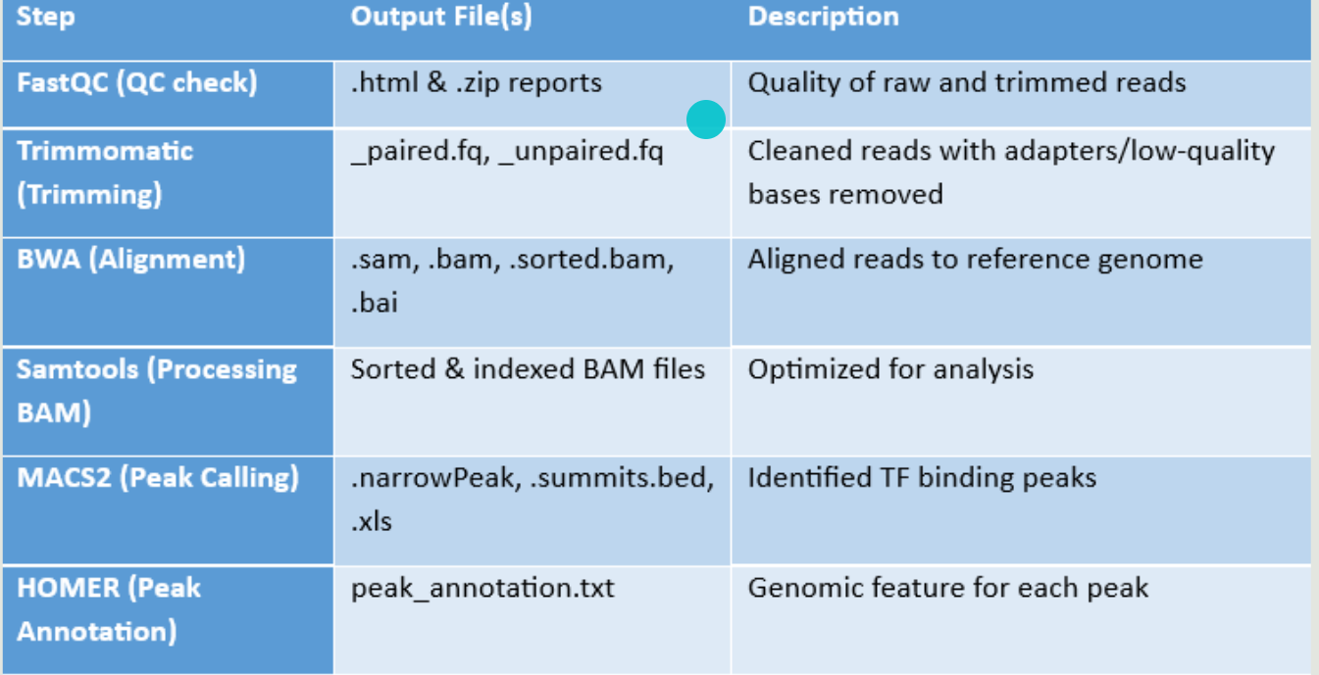
OUTPUT

Slide 13
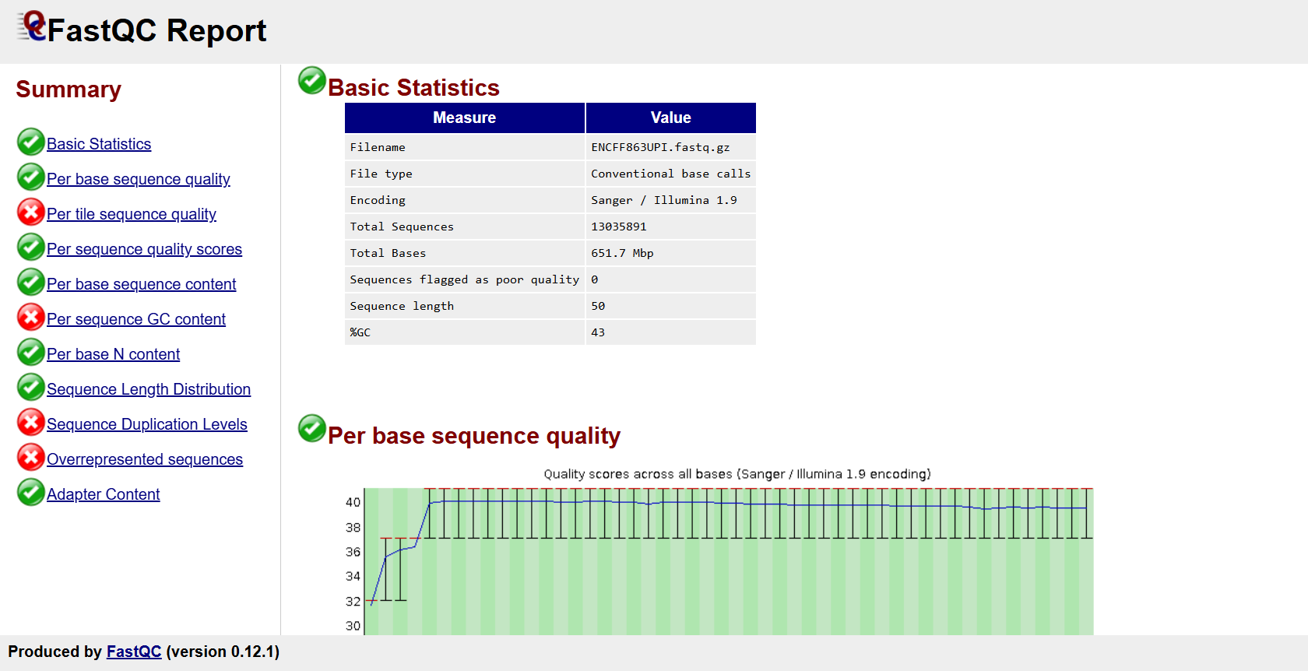
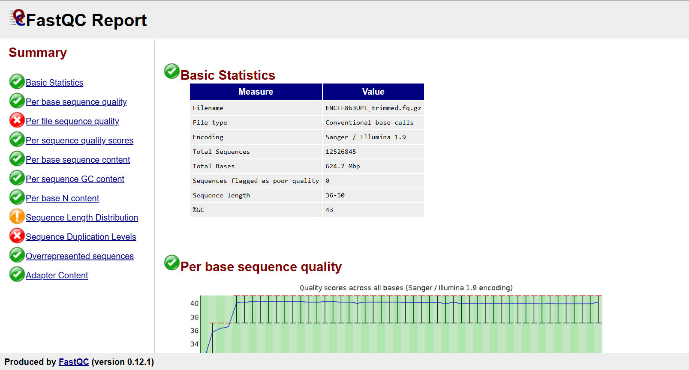
RESULTS
Fastqc Reports

Slide 14
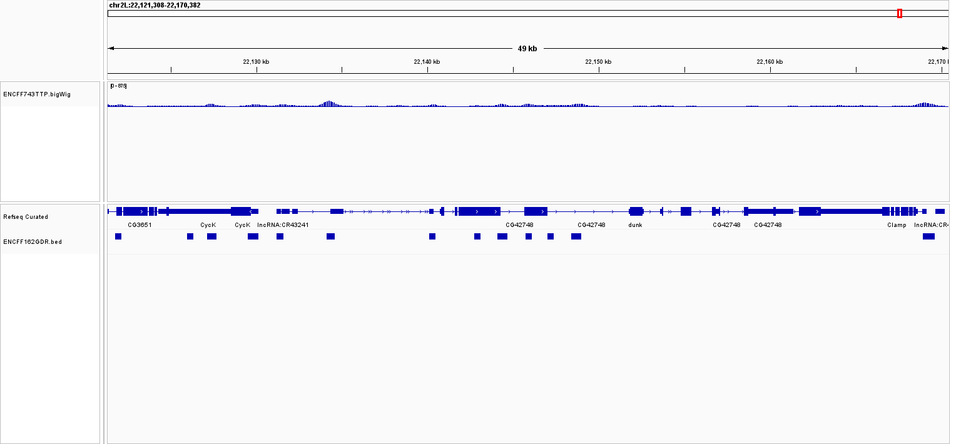
IGV Visualization of TF Binding Peak
This IGV view shows ChIP-seq signal enrichment (bigWig) and MACS2-identified peaks (BED) across a ~49 kb region of chr2L, highlighting transcription factor binding near multiple genes, including CycK and Clamp.

Slide 15

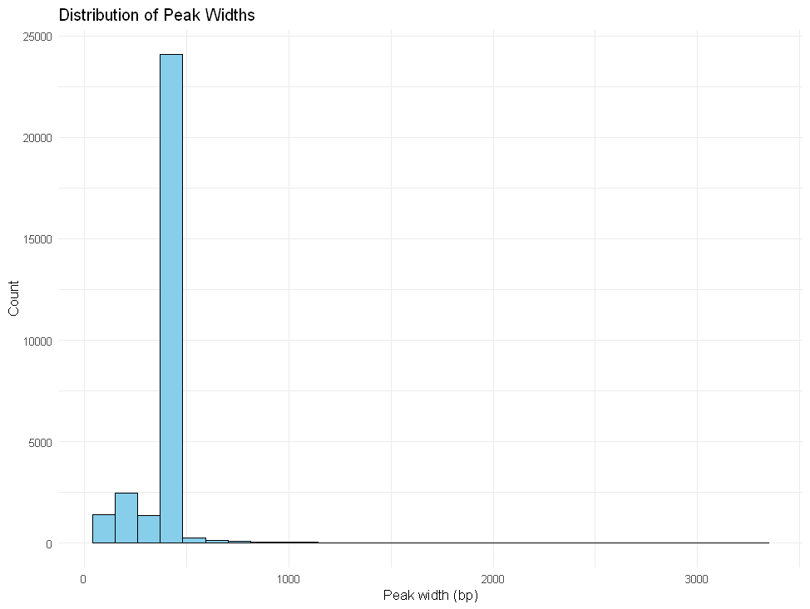

Distribution of Peak Widths
The distribution of peak widths shows that most ChIP-seq peaks are narrow (100–300 bp), consistent with transcription factor binding to specific DNA motifs. A smaller number of broader peaks (>500 bp) may correspond to regulatory regions with multiple binding sites or open chromatin.

Slide 16
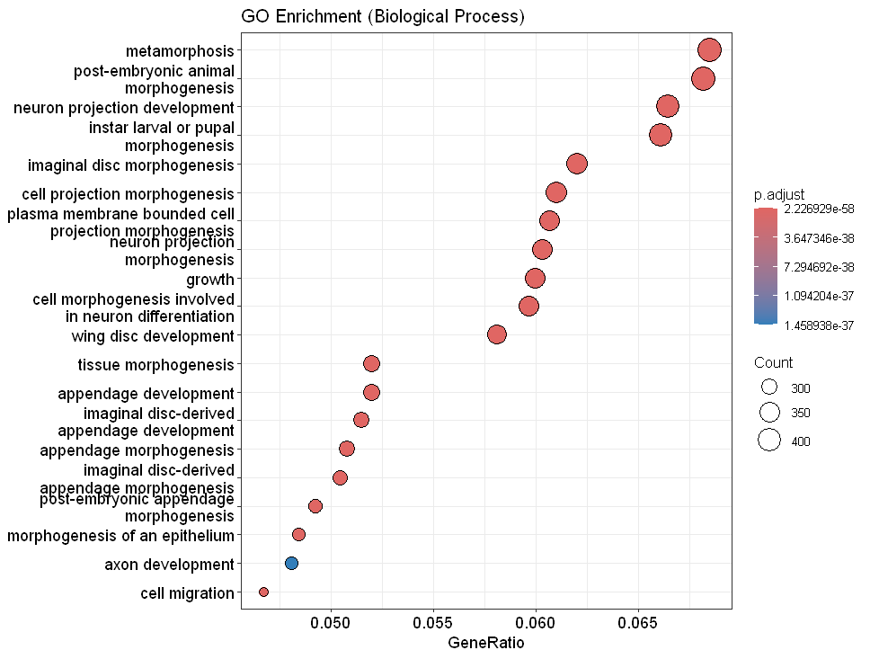
GO Biological Process Enrichment: Key Functional Themes in Gene Set
This bubble plot visualizes enriched Gene Ontology (GO) Biological Processes associated with the input gene set. Each dot represents a GO term, where:
X-axis (GeneRatio): Proportion of genes from the dataset associated with the GO term.
Dot Size (Count): Number of genes enriched in each biological process.
Dot Color (p.adjust): Statistical significance of enrichment (adjusted p-value), with darker red indicating more significant terms.
The analysis highlights a strong enrichment in processes related to:
Development and morphogenesis (e.g., metamorphosis, tissue morphogenesis, appendage development),
Neuronal processes (e.g., neuron projection development, axon development),
and cellular structural organization (e.g., cell projection morphogenesis).

Slide 17


Thank You

