Slide 1
NUTRI FIT:DIET RECOMMENDATION SYSTEM
USING AI
TEAM MEMBERS
Kanitha S A 3122215002044
Karthick V 3122215002045
Karunagaran R 3122215002046

Slide 2
Problem Statement
Maintaining a healthy lifestyle with proper nutrition and physical workouts can be challenging for individuals in this fast-paced world. To Develop an AI-powered software designed to provide Nutritional and Fitness guidance based on the user’s current fitness level .
The Software should serve as a lifestyle guide by providing recipes and workout demonstration helping the individuals to attain a healthy lifestyle.

Slide 3
Objectives
Design a user-friendly web interface to improve accessibility and engagement.
Apply Fuzzy logic algorithm to identify the body category of the individual based on user input.
Develop a Knowledge Based system using the databases for diet ,recipes and workouts.
Offer recommendation by providing meal plan and workout split dynamically.
Integrate detailed recipe generation and video demonstration for workouts .

Slide 4
Innovative Ideas
Optimized plan using knowledge-based system
A knowledge-based system uses stored information on diets and workouts to offer personalized recommendations via AI.
It analyzes user input and preferences to suggest tailored diet plans and workout routines based on available data, providing targeted guidance for better health and fitness outcomes.
Using Fuzzy-logic algorithm
Fuzzy logic helps categorize individuals based on input variables like body metrics, lifestyle, and goals.
It allows for nuanced recommendations by considering the "fuzziness" or uncertainty in these factors, aiding in more personalized diet and workout suggestions that better match individual needs and preferences.

Slide 5
Requirements and Specifications
Functional Requirements:
Fuzzy logic processing: Process user-provided data using a Fuzzy Logic algorithm to determine the user's current state .
Diet plan recommendation: Generate a weekly diet plan consisting of low, moderate, and high-carb days based on the user's state. Offer food recommendations for each eating day.
Workout plan recommendation: Create a workout plan combining cardio and gym exercises tailored to the user's state.
Diet and workout page: Allow users to access detailed recipes for suggested dishes via an “Diet" page. Provide exercise descriptions and guidance for each workout on a “Workout" page.
User-Friendly Interface: Design an intuitive web interface for easy interaction.

Slide 6
Non-functional Requirements:
Performance: Optimize system performance to deliver real-time responses during user
interactions.
Scalability: Design the system to scale efficiently as the user base grows, maintaining
responsiveness.
Security: Implement robust security measures for user authentication and data transmission,
ensuring the protection of sensitive information.
Usability: Prioritize an intuitive and user-friendly interface, enhancing overall user satisfaction.
Reliability: Ensure high system availability, minimizing downtime through effective data backup and
recovery mechanisms.

Slide 7
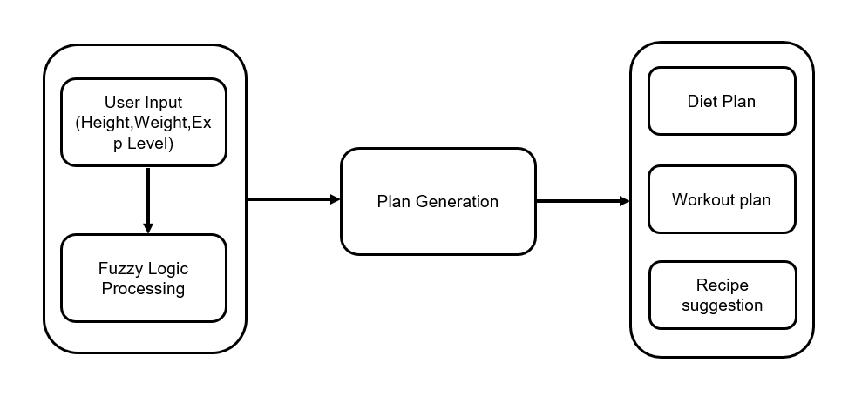
Block Diagram:

Slide 8
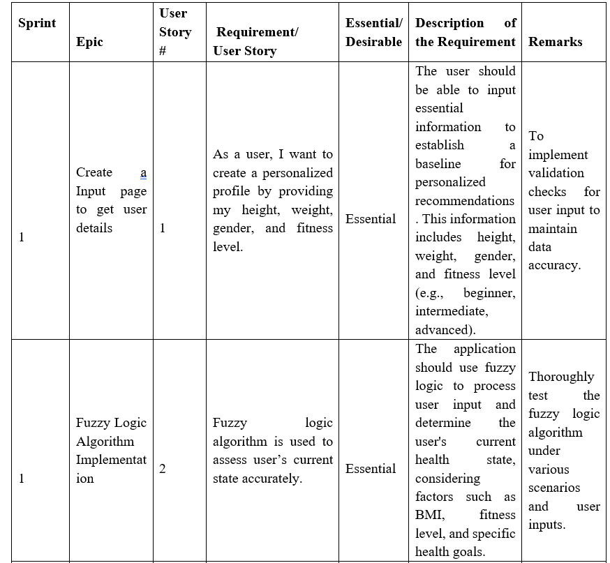
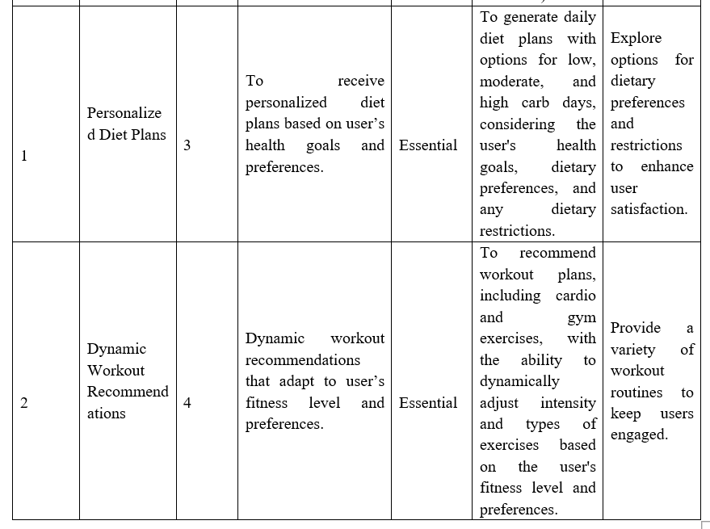
List of All Functional Modules

Slide 9
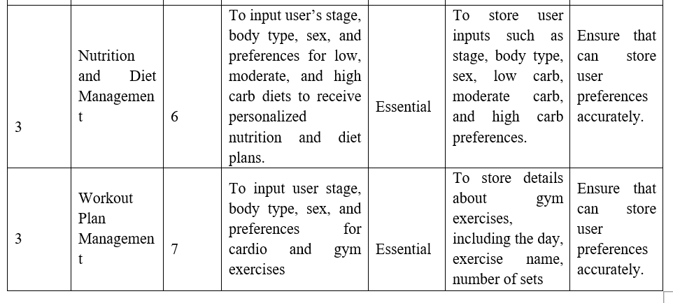
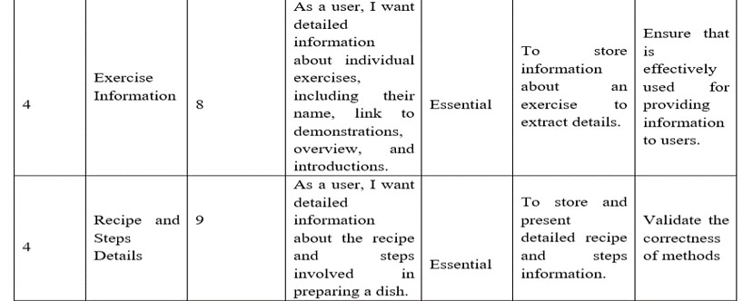
List of All Functional Modules

Slide 10
Tools
Streamlit: Streamlit is used to create an interactive and user-friendly interface for the application, allowing users to input their information and receive personalized recommendations easily.
SQLite: SQLite is probably used to store and manage data related to dietary information, workout plans, and other relevant data in a structured manner.
Matplotlib: Used to generate graphs or charts to visualize aspects of the user's progress, such as weight loss over time or workout intensity.
Python: Implementing AI algorithms.

Slide 11
Software Requirements
User Interface (UI) and User Experience (UX):An intuitive and visually appealing interface allowing easy navigation and interaction for users to input data and access recommendations.
Database Usage: Utilizing structured databases to store comprehensive information about diets, recipes, workouts, and user profiles.
AI Algorithm: Apply Fuzzy Logic to process user inputs, determining their current state for personalized diet and workout recommendations.
Jira: Use Jira to track and manage various tasks involved in the project, such as UI development, database structuring, algorithm implementation, and testing.

Slide 12
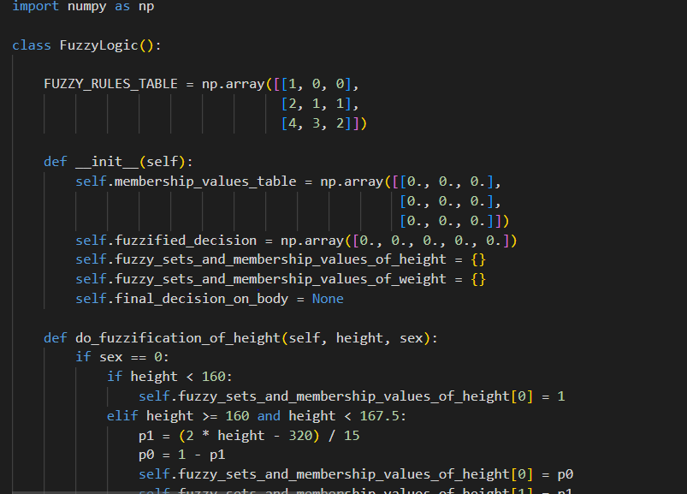
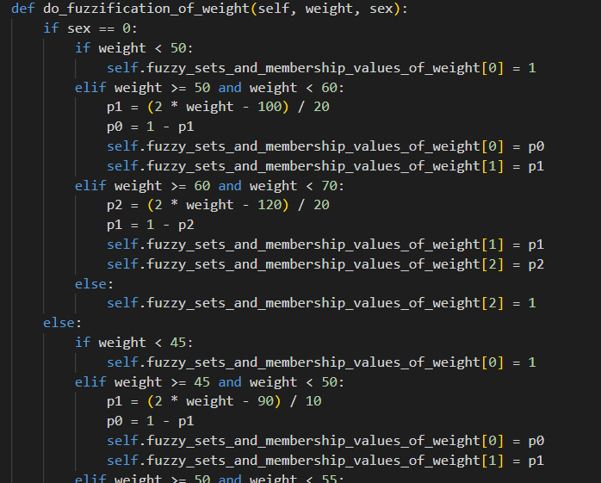
Project Screenshots

Slide 13
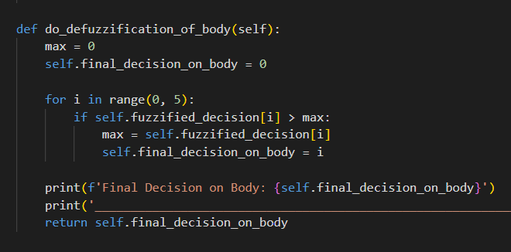
Project Screenshots

Slide 14
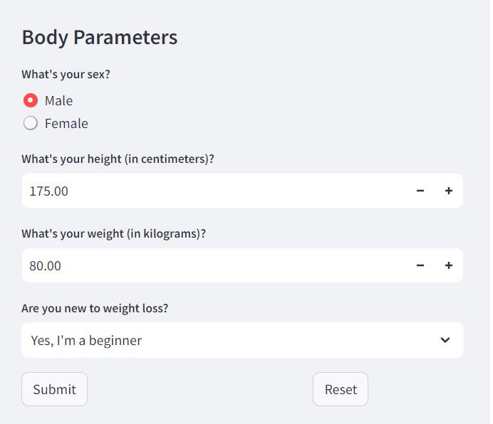
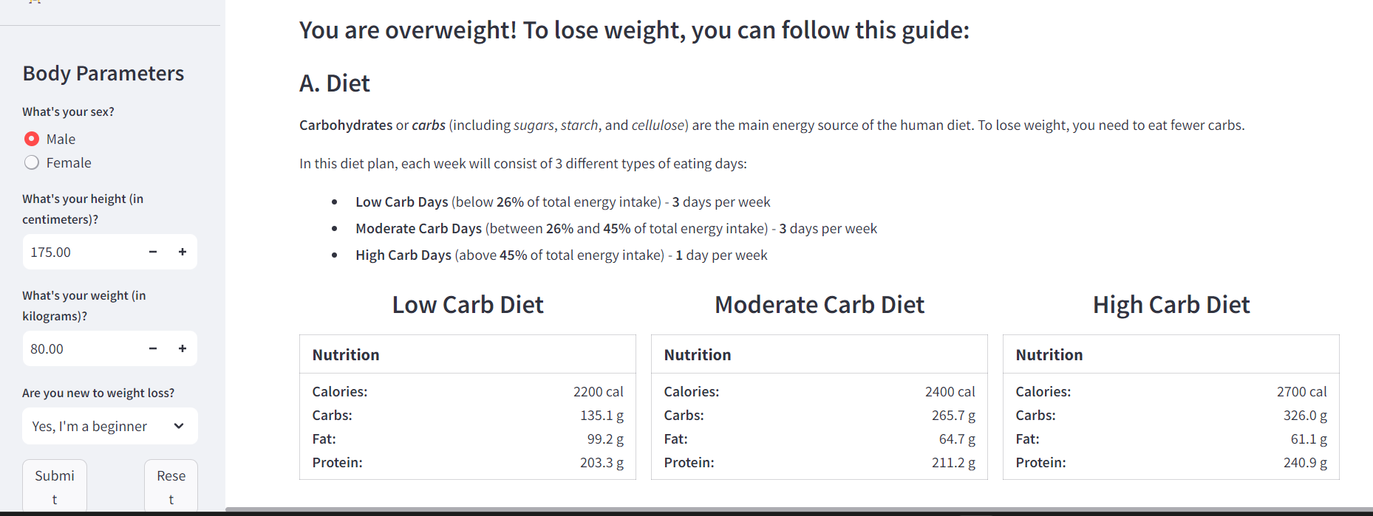
Project Outcomes
INPUT PAGE RESULT

Slide 15
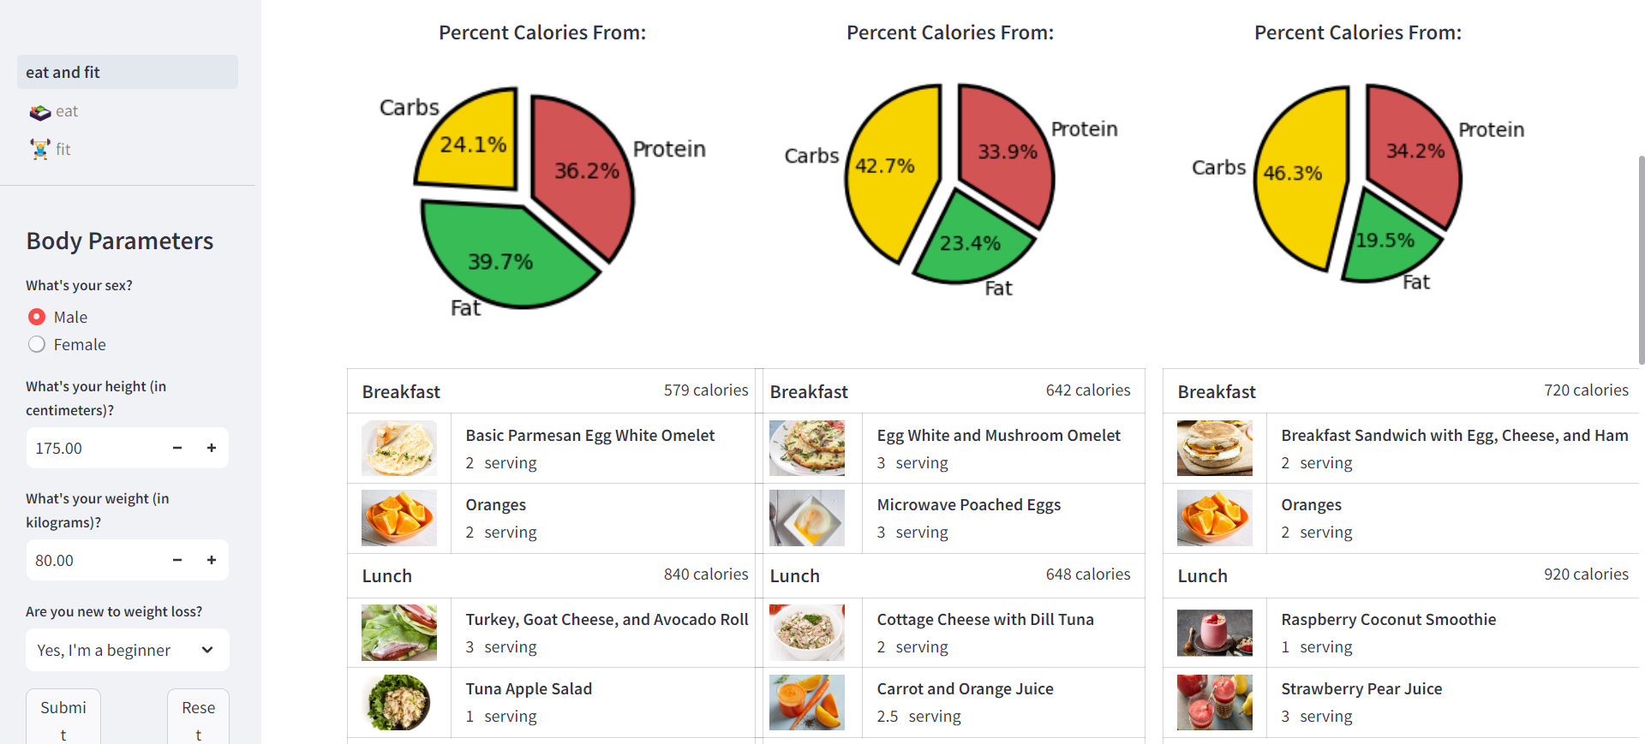
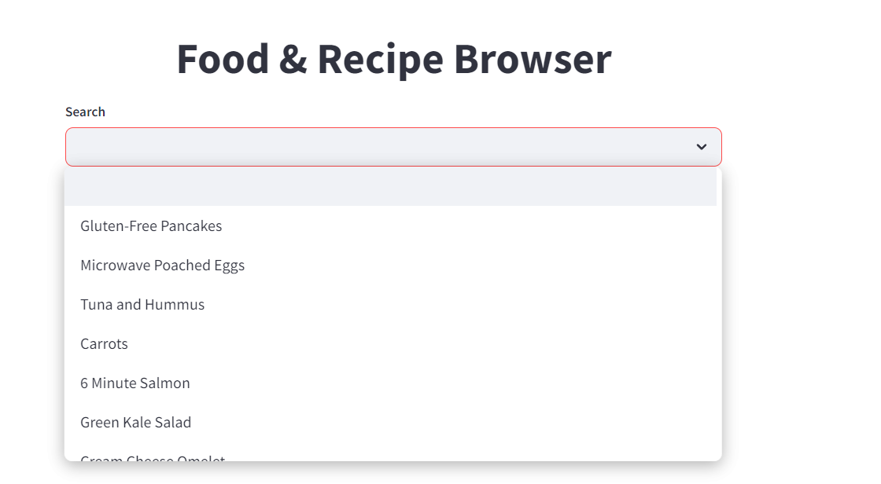
Project Outcomes
FOOD & RECIPE BROWSER PAGE

Slide 16
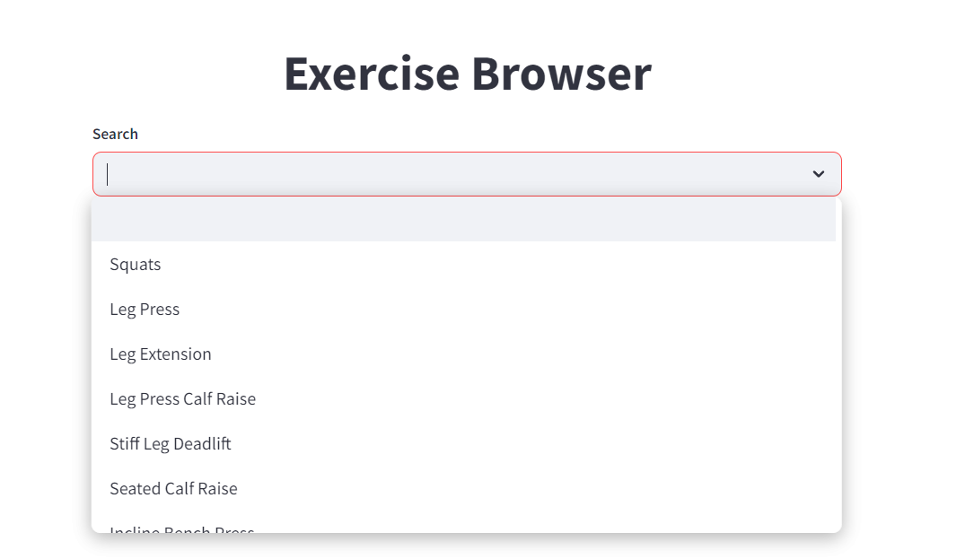
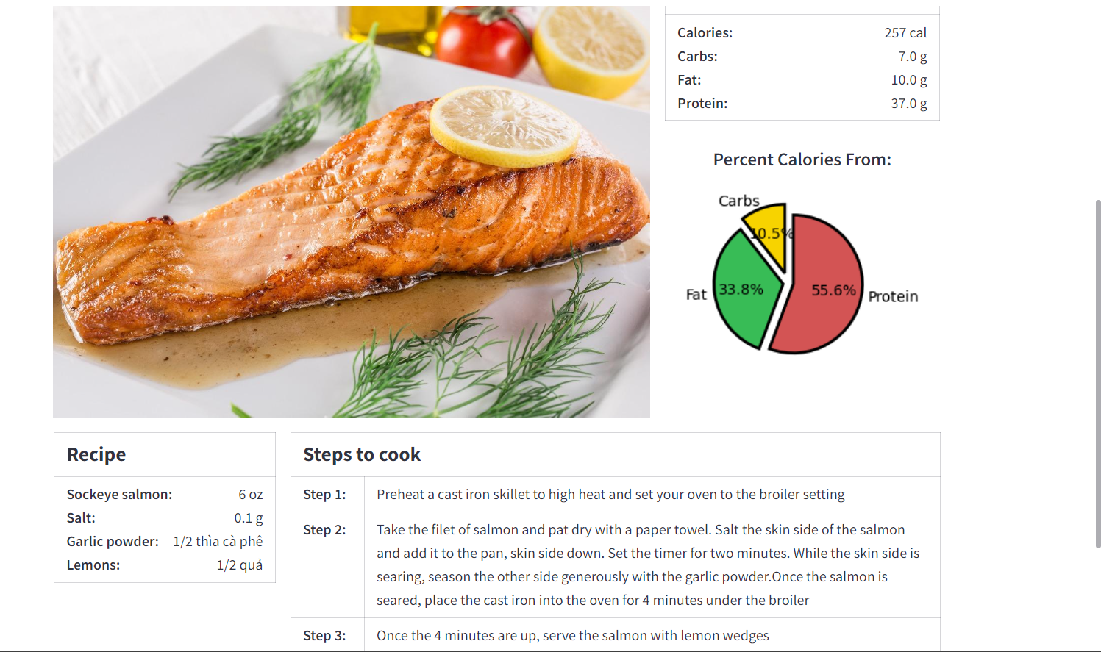
Project Outcomes
FOOD & RECIPE BROWSER RESULT
EXERCISE BROWSER PAGE

Slide 17
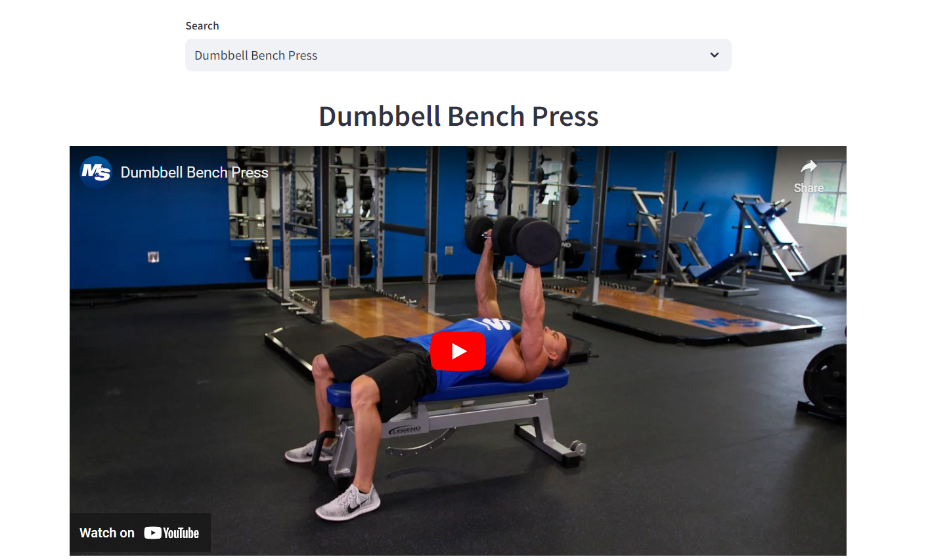
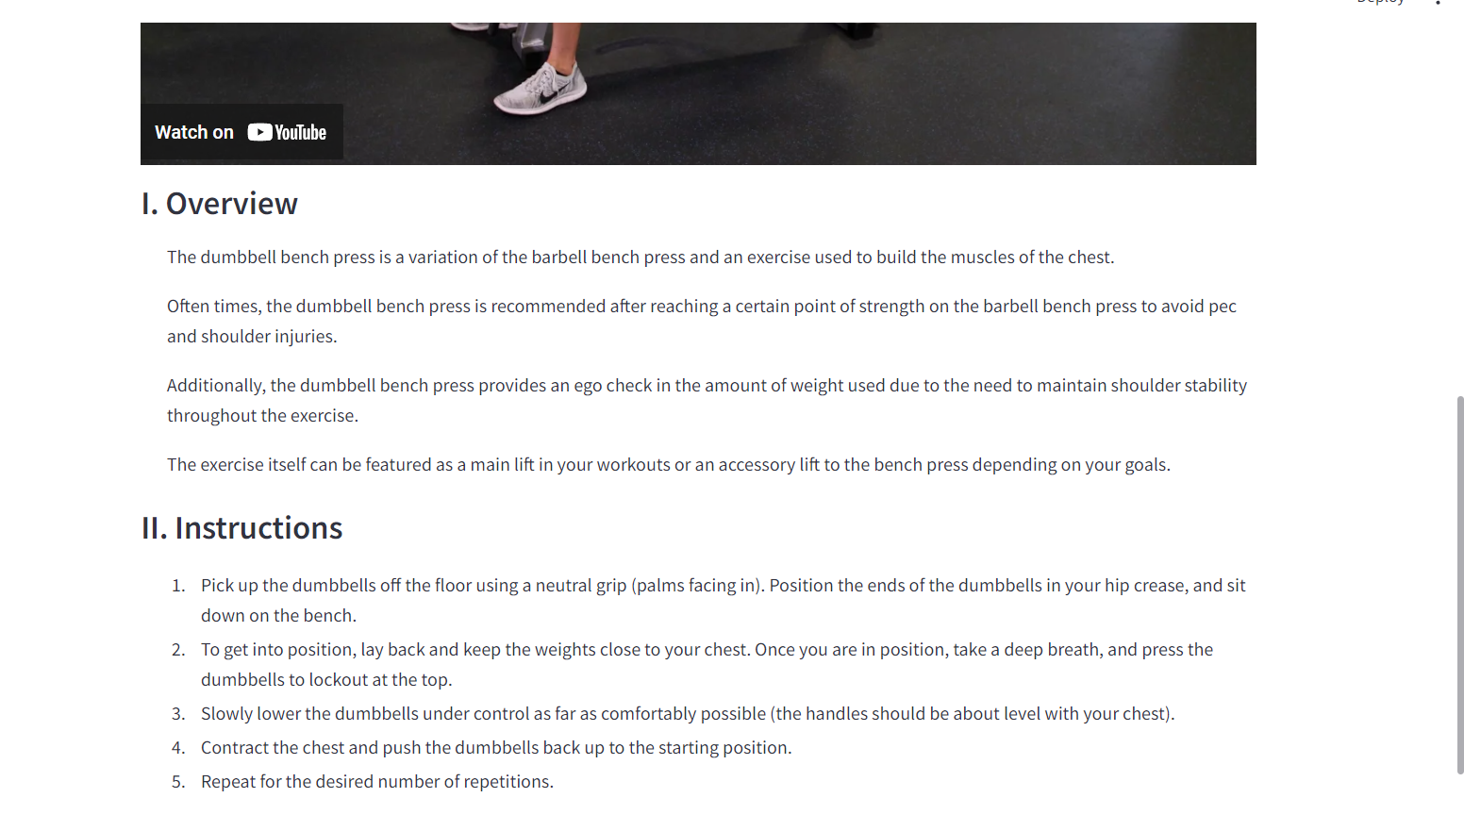
Project Outcomes
EXERCISE BROWSER RESULT

Slide 18
Conclusion
The development of Nutri Fit: Diet Workout Recommendation system using AI has
really been an informative and knowledgeable process wherein each of us have learnt a lot of
things unknown to us and most importantly gained exposure to HTML, Streamlit, CSS, NumPy,
Matplotlib which form the backbone of Web Development. By using all this gained knowledge
to use software tool has thus been successfully developed.

Slide 19
References
[1] jasenka gajdoš kljusurić*, želimir kurtanjek(2012). Fuzzy logic modeling in nutrition planning -Application on meals in boarding schools 36(3), 1453–1464.
[2]Alexa Lauren Kuziel- The Utilization of technology as an approach to improve meal planning and dietary intake improve meal planning and dietary intake(2019)-10.13023.
[3]J. Bulka; A. Izworski; J. Koleszynska; J. Lis; I. Wochlik
Automatic meal planning using artificial intelligence algorithms in computer aided diabetes therapy(2009) 978-1-4244-2712-3
[4],Shraddha Mithbavkar;-Diet Planner Using Deep Learning(2023)E2104
[5] Exercise recommendation based on knowledge concept prediction by Zhengyang Wu , Ming Li , Yong Tang, Qingyu Liang
[6] Plan-Cook-Eat: A Meal Planner App with Optimal Macronutrient Distribution of Calories Based on Personal Total Daily Energy Expenditure-Manuel B. Garcia-2019
DATASET: Indian Food Dataset.csv
DATASET: Indian Food Dataset.csv

