Slide 1

Prepared by group 1
Portfolio Prediction Model
Leveraging Machine Learning for Financial Forecasting
05 December, 2024
Notes:
Good Evening, everyone. Thank you for joining us today. My name is Manisha Manchana, and I’m here with my team members Rahul, Karunakar, Slesha and Dinesh. Together, we are excited to present our project, Portfolio Prediction Model. This project focuses on leveraging machine learning techniques to forecast stock prices and provide actionable insights for portfolio management.

Slide 2
Team Members
Rahul Saini
Manisha Manchana
Karunakar Nuvvula
Member
Member
Member
Slesha Bucchireddy
Dinesh Kumar Barla
Member
Member

Slide 3
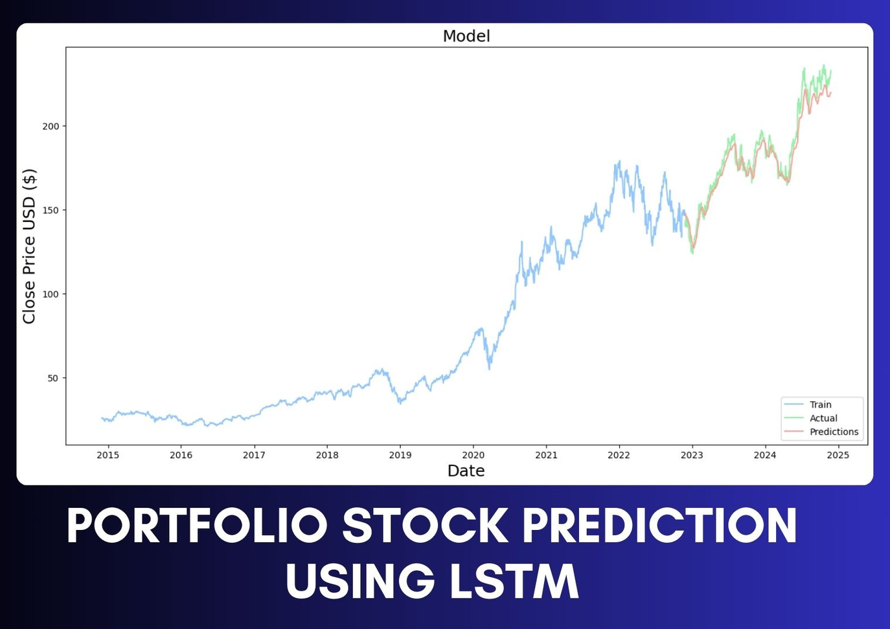
Project Overview
Objective:
Forecast stock prices and analyze portfolio performance using machine learning
Key Components:
  Data preprocessing and feature engineering.
  Model training and evaluation.
  Profit/loss analysis for portfolio management.
Notes:
Let me start by giving you an overview of the project.
The primary objective of this project is to forecast stock prices and analyze portfolio performance using advanced machine learning techniques.”
“Our work involves three key components:
1. Data Preprocessing and Feature Engineering to prepare clean and meaningful data for analysis.
2. Model Training and Evaluation to build predictive models that accurately capture market trends.
3. Profit and Loss Analysis to assess the financial performance of the portfolio.”
• “Overall, the system is designed to assist portfolio managers in making informed decisions.

Slide 4
Introduction
This project creates a Portfolio Prediction Model that forecasts stock prices and provides actionable insights for portfolio managers. The model utilizes Long Short-Term Memory (LSTM) networks to capture sequential dependencies in stock market data.
Notes:
To set the stage, let me explain the foundation of this project.
“Stock price prediction plays a critical role in volatile markets, where even small deviations can have significant financial impacts.”
For example recent case of ADANI groups

Slide 5

Introduction
Using:
Close Price of a stock, for predicting stock prices in volatile markets.
Integration of:
  Data mining techniques.
  Sequential modeling (LSTM).
  Financial insights through profit/loss metrics.
Portfolio conists of:
Apple (AAPL): 50%
Tesla (TSLA): 30%
Google (GOOGL): 20%
Notes:
•We used a combination of techniques to address this challenge:
1. we used Data Mining Techniques to extract and preprocess financial data.
2. Performed Sequential Modeling using LSTM, a deep learning approach that captures temporal dependencies in time-series data.
3. Also Profit/Loss Metrics to measure and analyze portfolio performance.
•For this project, our portfolio includes three major stocks: Apple (50%), Tesla (30%), and Google (20%). These weights reflect their influence and market significance.”

Slide 6



Data Collection and Preparation
Data Source
Features
Preprocessing Steps
  Data is extracted using the ‘yfinance’ library, which provides historical stock data.
  Open, High, Low, and Close prices.
  Volume, Dividends, Stock Splits.
  Handle missing data with forward-fill.
  Remove outliers.
  Drop irrelevant columns
Notes:
Next, let me discuss how we collected and prepared the data.
“We used the yfinance library to extract 10 years of historical stock data, including features like Open, High, Low, Close prices, Volume, Dividends, and Stock Splits.”
• “After collecting the data, we applied several preprocessing steps:
1. Handling Missing Data by using forward fill to ensure continuity.
2. Removed Outliers to eliminate noise and extreme values.
3. Dropped Irrelevant Columns, such as Dividends and Volume, which were not directly relevant to our predictions.”
• “This ensures that the data is clean and ready for meaningful analysis.”
Now that we’ve covered the data and models, let us move on to discussing the feature selections and prediction models over to you dinesh

Slide 7
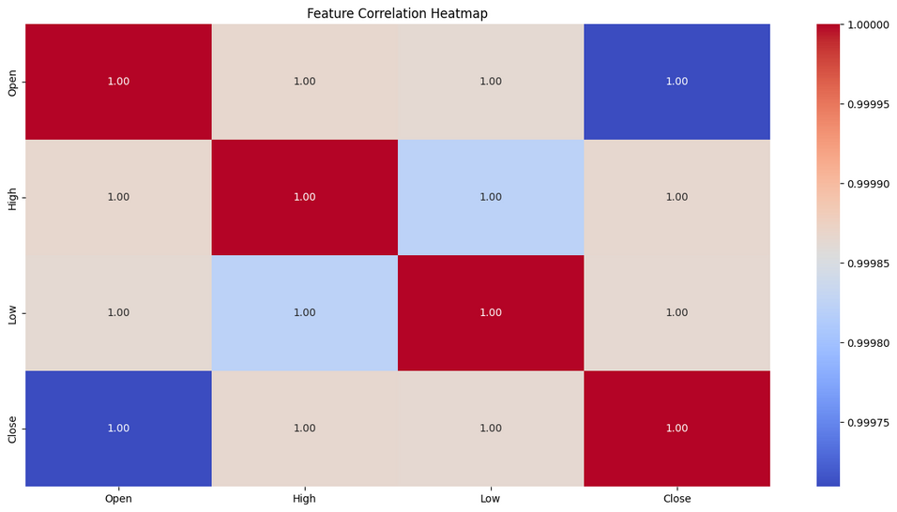
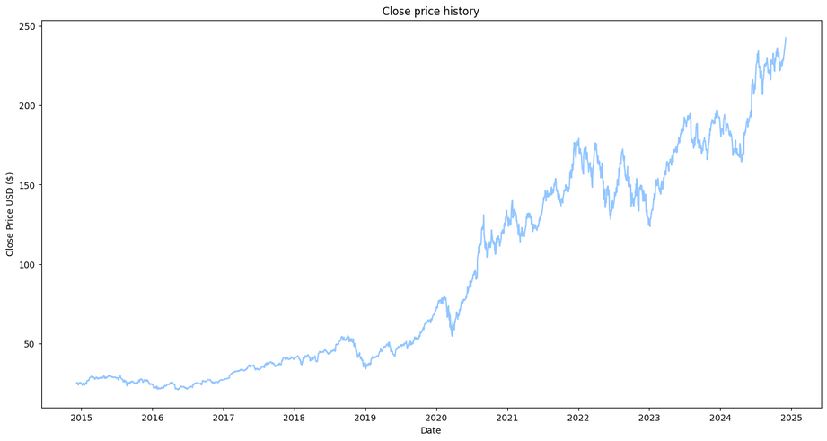
Feature Selection
A heatmap illustrated a strong correlation among features like `Open`, `High`, `Low`, and `Close`, validating the focus on `Close` for predictions
Heatmap for feature correlation.
Historical closing price trends.
Notes:
we had used heatmap for feature selection because it shows the correlation between features in the data set
why not other methods ?
advanced methods like Recursive Feature Elimination (RFE) can be used but the heatmap is particularly useful for understanding relationships in time-series data and for exploratory analysis.
we are focusing on close price because its the key point to check daily performance.

Slide 8
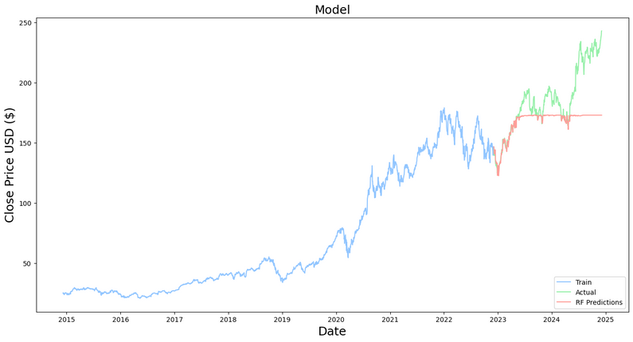
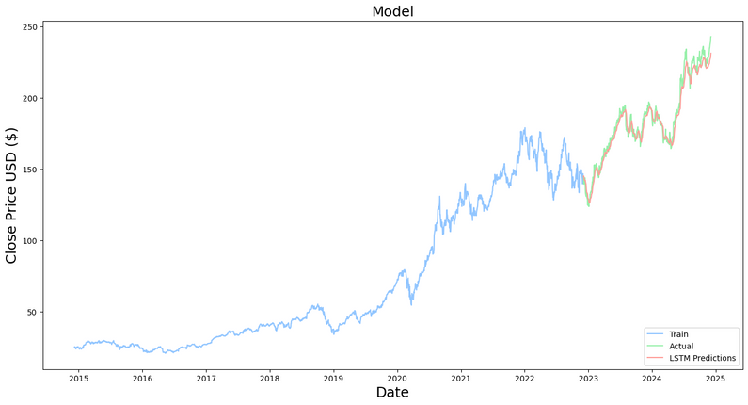
Prediction Models
Random Forest Regressor:
  Ensemble learning to handle non-linear patterns.
  Strength: Handles noise and outliers well.
  Weakness: Limited for sequential dependencies.
Random Forest Prediction
LSTM (Long Short-Term Memory):
  Captures sequential dependencies in time-series data.
  Model architecture: Two LSTM layers + Dense layers.
  Strength: Effective for volatile and sequential data.
LSTM Prediction
Notes:
we had used heatmap for feature selection because it shows the correlation between features in the data set
why not other methods ?
advanced methods like Recursive Feature Elimination (RFE) can be used but the heatmap is particularly useful for understanding relationships in time-series data and for exploratory analysis.
we are focusing on close price because its the key point to check daily performance.

Slide 9
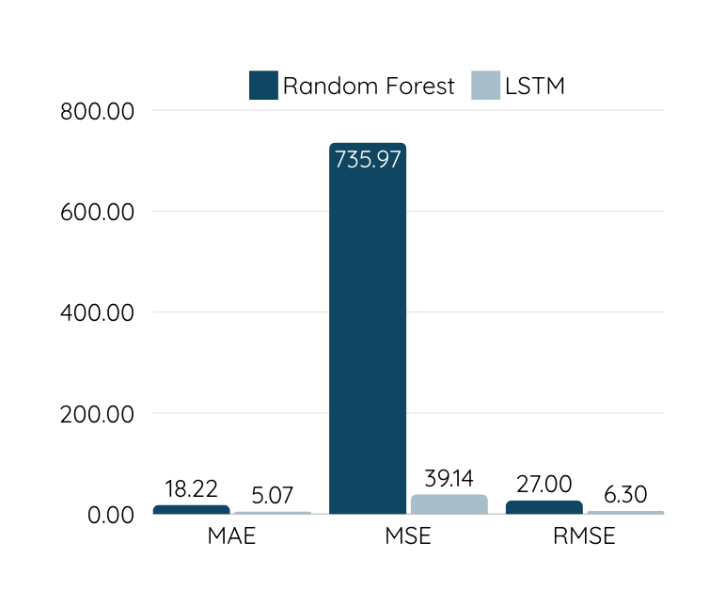
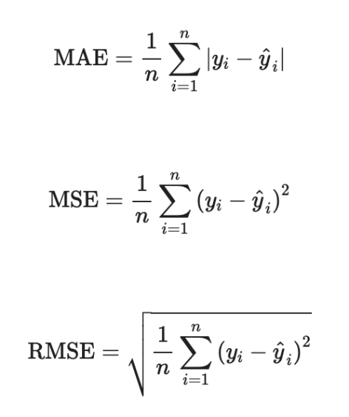
Model Training and Evaluation
The dataset was split into an 80% training set and a 20% testing set. Metrics like Mean Absolute Error (MAE), Mean Squared Error (MSE), and Root Mean Squared Error (RMSE) were used to evaluate the models. These metrics quantify the prediction error in both relative and absolute terms.
Loss Valeus
Metrics
Notes:
To know the accuracy of models
we had used some performance metrics
Mean Absolute Error (MAE):
MAE measures the average absolute difference between predicted and actual values. Lower MAE means fewer large errors.
Mean Squared Error (MSE):
"MSE emphasizes larger errors by squaring the differences
RMSE is the square root of MSE, keeping the units consistent with the original data
We are using Mean Absolute Error (MAE) as the loss function, as it yielded the lowest loss value during model evaluation and is more robust to outliers due to the volatility of the stock market.

Slide 10
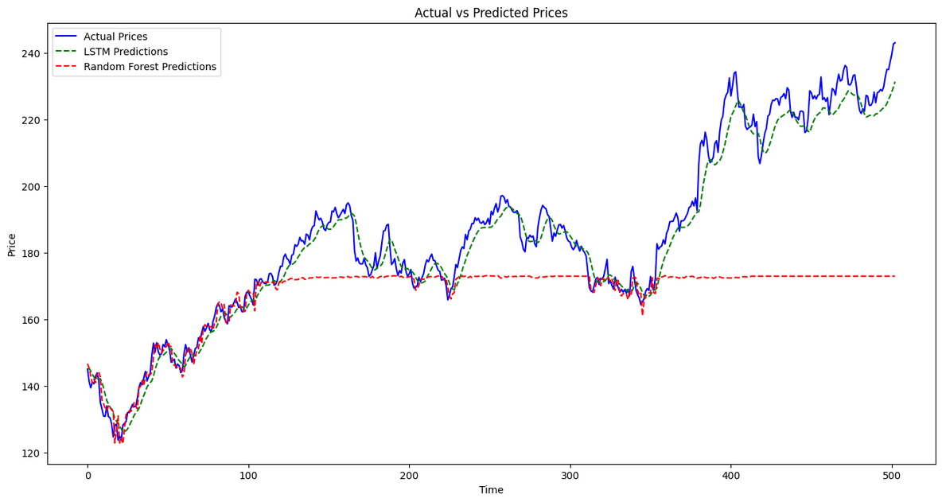
Model Comparison
Graph:
  Showing Actual vs. Predicted prices for Random Forest and LSTM
Highlight:
  LSTM’s superior performance in sequential dependencies
During training, LSTM networks displayed extraordinary effectiveness when compared to Random Forest in capturing the stock data's inherent sequence. Learning from historical price swings and trends.
So, selecting LSTM as the final model.
Notes:
In this slide we are going to talk about camparison between the models
1. random forest
2. LSTM
Random forest is a decision based model that is good at handling complex relationships, outliers etc.
whereas LSTM is model that is used to handle sequential data where the past data effect the future results.
For the comparison, key metrics are use:
MAE
lower the MAE, the more accurate
MSE
smaller MSE means better performace
RSME
smaller means better accuracy
Random foresr will build many decision trees and averages the output to make predictions, It will handle non linear data that have unexpected jumps or fluctuations.
this model does not consider past data and make future predictions
Whereas LSTM handles time series data by remembering important data and forgetting ireevant data.
We will compare both the results and tell which one gives more accurate results.
talk abt comparison table
the line LSTM closely follow the actual shock price line.
random forest deviates
LSTM performs better than random forect in predicting stock price as it has lower MAE, MSE and RMSE.
These graphs like heatmaps, line graphs help easily compare model preformace.

Slide 11
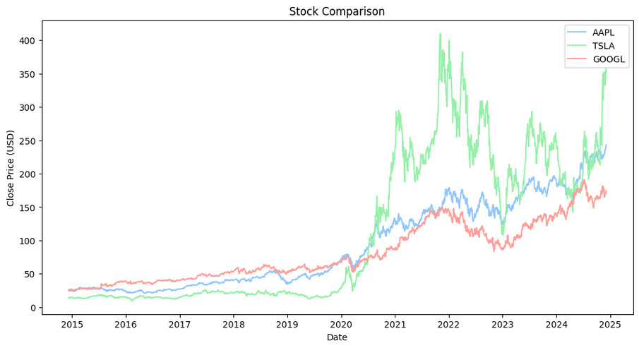
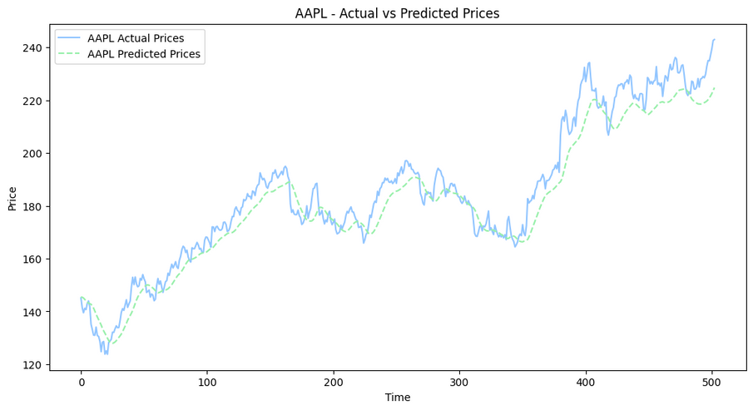
Results and Visualizations

Slide 12
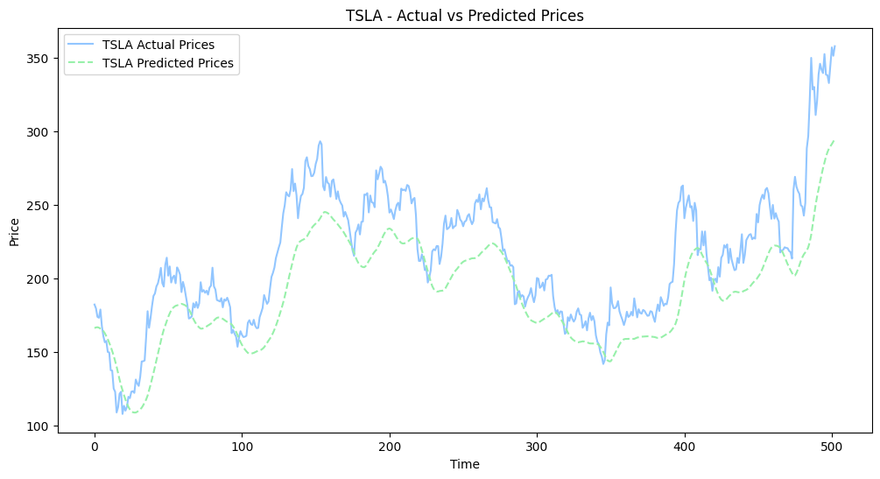
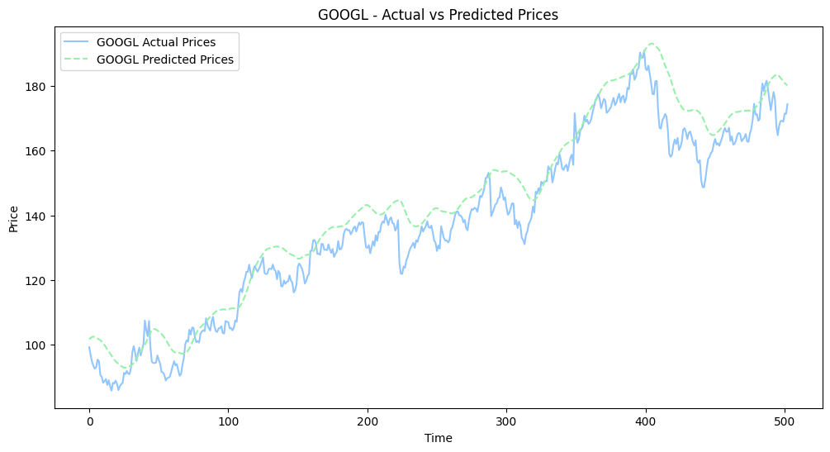
Results and Visualizations

Slide 13
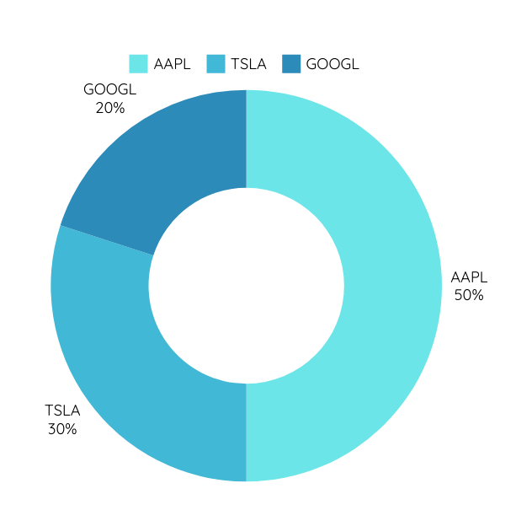
Portfolio Prediction System
Custom Classes:
  StockPredictionModel: Builds, trains, and evaluates LSTM models.
  Stock: Interfaces with stock data and prepares features.
  PortfolioPredictor: Manages multiple stocks, predicts, and calculates profit/loss.
Features:
  Predict next-day prices.
  Calculate profit/loss for the portfolio.
Portfolio Weightages
AAPL: 50%, TSLA: 30%, GOOGL: 20%
Notes:
In our project, we built a portfolio prediction system, which is a fully automated framework designed to simplify stock forecasting and portfolio analysis.
It integrates several custom components to ensure end-to-end efficiency in financial forecasting workflows.
The system is built on three core components:
1. The StockPredictionModel, which constructs and trains LSTM models to handle sequential stock data effectively.
2. The Stock Class, responsible for retrieving stock data, preprocessing it, and creating the features required for predictions.
3. The PortfolioPredictor, which manages predictions for multiple stocks, calculates profit or loss, and visualizes performance trends.

Slide 14
Future Enhancements
Advanced Models:
  Explore Transformer models and hybrid approaches.
  Enhance adaptability for extreme market fluctuations.
Interactive Dashboard:
  Real-time portfolio tracking and decision-making.
  Enable adding/removing stocks based on predictions.
Notes:
“To improve the system further, we have identified several key areas for enhancement:
1. Advanced Models:
We plan to explore Transformer models, which excel at capturing long-range dependencies in data, and hybrid approaches that combine LSTM with attention mechanisms for greater adaptability to market fluctuations.
2. Interactive Dashboard:
Our goal is to build a real-time dashboard for tracking portfolio performance dynamically. This would include features for adding or removing stocks based on predicted trends and current market conditions.
3. Handling Volatility:
We aim to strengthen the system’s resilience to market anomalies by incorporating ensemble methods or probabilistic models.
4. Scalability:
Finally, we want to expand the system to handle larger, more diverse portfolios across multiple sectors.”
Closing Statement
“In summary, our Portfolio Prediction System is a powerful tool for managing portfolios and predicting stock trends. With planned enhancements like advanced models, an interactive dashboard, and improved scalability, we aim to make it even more accurate, robust, and user-friendly.”

Slide 15
References
Advanced Models:
  GeeksforGeeks. (n.d.). Introduction to Long Short-Term Memory (LSTM). https://www.geeksforgeeks.org/deep-learning-introduction-to-long-short-term-memory/
  Keras. (n.d.). Sequential Model. https://keras.io/guides/sequential_model/
  Eurico Paes. (2020, May 20). Extracting Data from Yahoo Finance with yfinance. Medium. https://medium.com/@euricopaes/extracting-data-from-yahoo-finance-with-yfinance-96798253d8ca
  Data Science Tutorials. (2020, May 7). Stock Price Prediction using Python. YouTube. https://youtu.be/QIUxPv5PJOY?si=PKt44abYBiXmbjg1

Slide 16
Conclusion
The portfolio prediction models' outcomes provided a number of significant new insights into how well various machine learning techniques performed. We assessed several models, such as Random Forest Regressor and Long Short-Term Memory (LSTM) networks, and took volatility into account when making predictions. We also investigated the possible advantages of ensemble approaches
Notes:
1. In our project, we tested two main types of models: Random Forest Regressor and Long Short-Term Memory (LSTM) networks.
Each model has its strengths and weaknesses in predicting stock prices. We analyzed how well they could predict stock prices.
2. When making our predictions, We considered the stock market's ups and downs (volatility). This is important because stock prices can change a lot in a short period.
3. We also explored using a combination of different models, known as ensemble approaches. This method can sometimes provide more accurate predictions than using just one model.
Closing Notes:
1. In our project, we placed a strong emphasis on data preprocessing and feature selection.
By handling missing data, removing outliers, and focusing on relevant features, we ensured that our models received high-quality input data.
This step is crucial as it directly impacts the accuracy and reliability of the predictions.
2. We utilized two different models: Long Short-Term Memory (LSTM) networks and Random Forest Regressors.
LSTM networks excel at capturing temporal patterns in stock price movements, making them highly effective for our sequential data.
However, they can be computationally intensive.
On the other hand, Random Forest Regressors are robust to noise and outliers but fall short in capturing sequential dependencies, which is a limitation for time-series forecasting.
3. Looking ahead, we plan to explore advanced models like Transformers and hybrid approaches to further improve our prediction accuracy.
Additionally, developing an interactive dashboard for real-time portfolio tracking will enable portfolio managers to make more informed decisions.
These enhancements have the potential to significantly impact financial forecasting by providing more accurate and actionable insights.

Slide 17
Thank you
Notes:
Closing Notes:
1. In our project, we placed a strong emphasis on data preprocessing and feature selection.
By handling missing data, removing outliers, and focusing on relevant features, we ensured that our models received high-quality input data.
This step is crucial as it directly impacts the accuracy and reliability of the predictions.
2. We utilized two different models: Long Short-Term Memory (LSTM) networks and Random Forest Regressors.
LSTM networks excel at capturing temporal patterns in stock price movements, making them highly effective for our sequential data.
However, they can be computationally intensive.
On the other hand, Random Forest Regressors are robust to noise and outliers but fall short in capturing sequential dependencies, which is a limitation for time-series forecasting.
3. Looking ahead, we plan to explore advanced models like Transformers and hybrid approaches to further improve our prediction accuracy.
Additionally, developing an interactive dashboard for real-time portfolio tracking will enable portfolio managers to make more informed decisions.
These enhancements have the potential to significantly impact financial forecasting by providing more accurate and actionable insights.

