Slide 1
Excelerate Dashboard Presentation
Data Analysis and Insights
By DVA 0302 Team 5A

Slide 2
Introduction
Purpose: To provide insights into user engagement and opportunity sign-ups on Excelerate.
Significance: Helps Excelerate make data-driven decisions for improving user experience.
Team Members: Karunakar Nuvvula, Kiran Hayat, Aniket Mahadik, Atharv Margale.

Slide 3
Dashboard Overview
The dashboard provides insights into user engagement, demographics, opportunities, and scholarships.
Key sections: Overview & User Engagement, Geographic Distribution, Opportunity & Skill Analysis, Scholarship Impact.
Designed for easy navigation and data-driven decision-making.

Slide 4
Key Decisions and Design Choices
Chose Google Data Studio for its interactivity and real-time data integration.
Visualizations: Bar charts, line graphs, and filters for better data exploration.
Used filters to allow user-driven insights (e.g., country-wise breakdowns).

Slide 5
Challenges Faced
Data integration issues while handling large datasets.
Ensuring accuracy and consistency across different data sources.
Optimizing dashboard performance for smooth user interaction.

Slide 6
Solutions Implemented
Cleaned and preprocessed data to ensure consistency.
Used efficient queries and optimized dashboard components for better performance.
Implemented interactive filters to enhance user experience.

Slide 7
Key Insights Derived
27,562 total users; 11,481 have signed up for opportunities.
India, Nigeria, and the U.S. have the highest sign-ups.
Most popular opportunities: Data Visualization, Project Management, and Digital Marketing.
Scholarships awarded across multiple opportunities, benefiting learners.

Slide 8
Addressing Key Questions
How many users are signed up? - 27,562 total, 11,481 for opportunities.
Top 10 countries? - India, Nigeria, U.S., Pakistan, Ghana, etc.
Most popular opportunities? - Data Visualization & Project Management.
Scholarships awarded? - Various opportunities supported with financial aid.

Slide 9
User Interaction & Guidance
Interactive filters for country, opportunity category, and demographics.
Clear visual hierarchy to guide users through insights.
Tooltips and descriptions added for better data understanding.

Slide 10
Visual Highlights
Screenshots of key visualizations of below are followed in next slides.
Breakdown of user engagement trends over time.
Top opportunities and scholarship impact analysis.

Slide 11
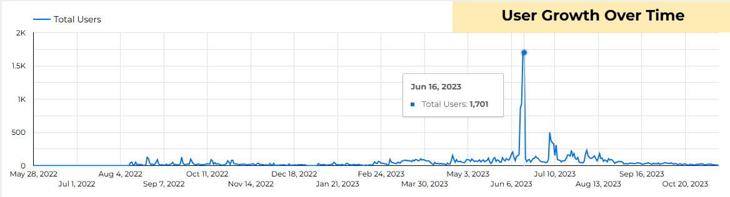

Slide 12
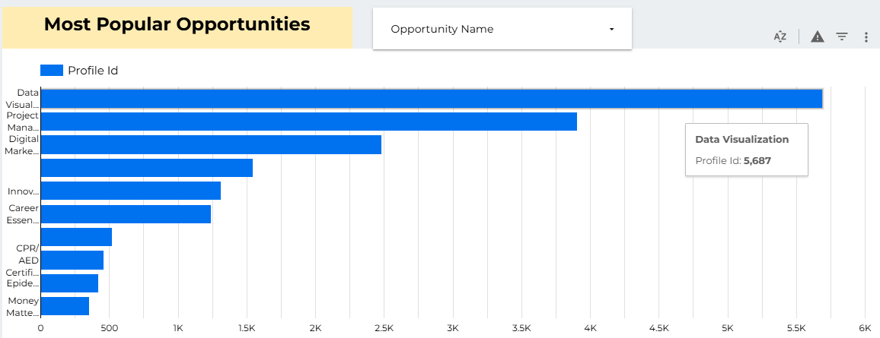

Slide 13
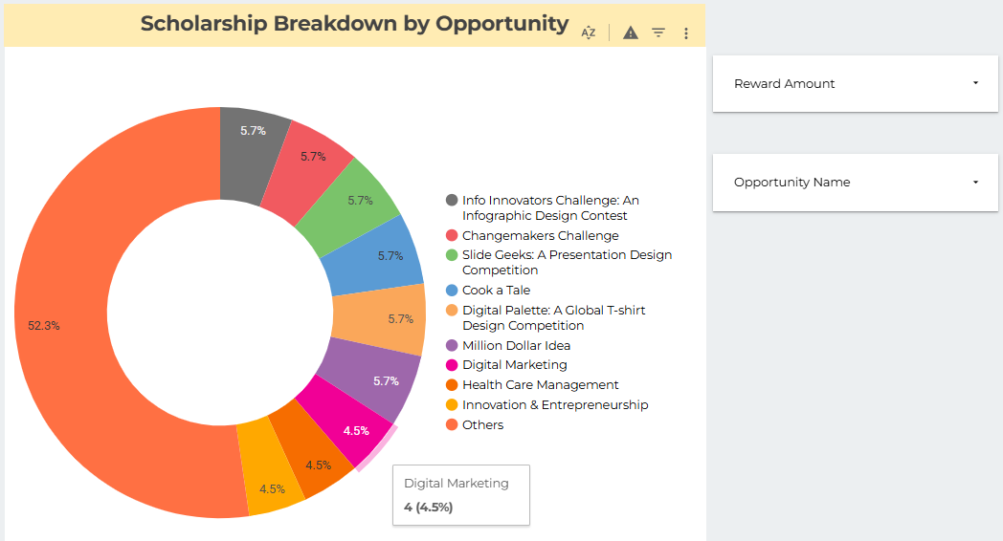

Slide 14
Impact on Decision-Making
Helps Excelerate refine their opportunity offerings.
Data-driven approach to allocating scholarships.
Provides insights for user engagement and growth strategies.

Slide 15
Conclusion
Dashboard enables Excelerate to make informed decisions.
Key insights help in enhancing user engagement and optimizing offerings.
Future scope: Expanding dataset and refining user experience.

