Slide 1
"Feasibility Study: Assessing Market Appetite for a New Newspaper Offering"
K.Karunasagar

Slide 2

Project background and context
In order to investigate the feasibilty of starting edition for a large metropolitan newspaper, information was obtained from a sample of 34 newspapers concerning daily and sunday circulation(in thousands)

Slide 3
Solution
To create a machine learning pipeline to predict the feasiblity of newspaper circulations.
Daily Circulations refers to the number of copies of a newspaper distributed on an average day, typically from Monday to Saturday.
Sunday circulation, on the other hand, specifically refers to the number of copies distributed on Sundays
Newspapers often have different circulation numbers for Sundays because readership patterns can vary significantly between weekdays and weekends.

Slide 4
Goal
To investigate the sunday circulation with accuracy above 80%
To analyze circulation trends, evaluate market demand, and make informed decisions about launching the new edition.
To Identify the trends in daily and Sunday circulation across the sample newspapers over time. Identify any patterns or fluctuations in circulation numbers.

Slide 5
Benefits
Forecasting provides valuable insights for long-term strategic planning. Newspapers can use circulation forecasts to make informed decisions about expansion, investment, and market positioning.
Data-driven insights from the analysis can inform strategic decisions regarding content development, distribution channels, pricing strategies, and marketing efforts for the new edition.
Forecasting helps newspapers allocate resources more efficiently. By anticipating demand, they can adjust staffing levels, printing schedules, and production quantities to meet circulation requirements without overcommitting resources..

Slide 6
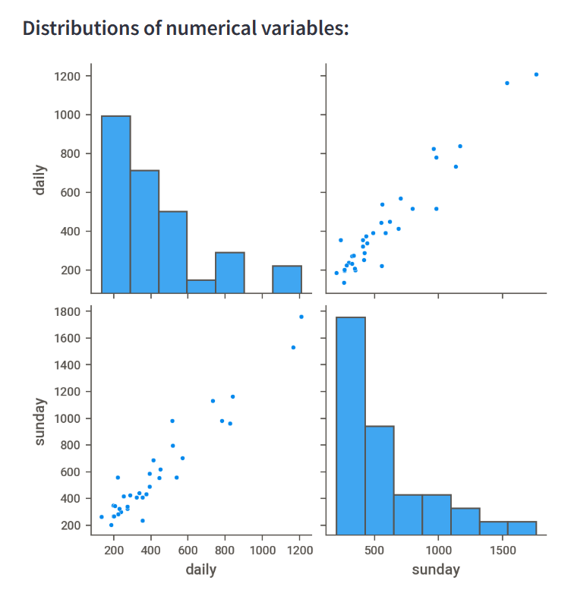
Exploratory data analysis using Visualization
We done exploratory data analysis (EDA) and observed a linear relationship between daily circulations and Sunday circulations.
This finding suggests that there is a positive correlation between these two variables.
A positive correlation implies that as the value of daily circulations increases, the value of the Sunday circulations also tends to increase.

Slide 7
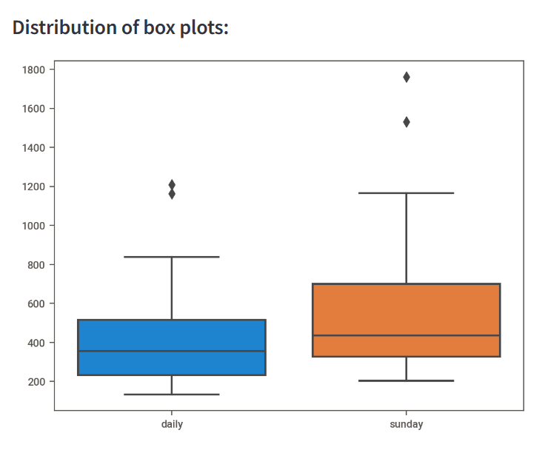
Diagnosis Analysis
In Exploratory data analysis, we observed that there is an outliers through Box plot visualization.
Outliers checked through Interquartile range (IQR) formula & treated with imputation strategies.
After treating outliers, it's essential to assess the impact of the treatment on your analysis

Slide 8
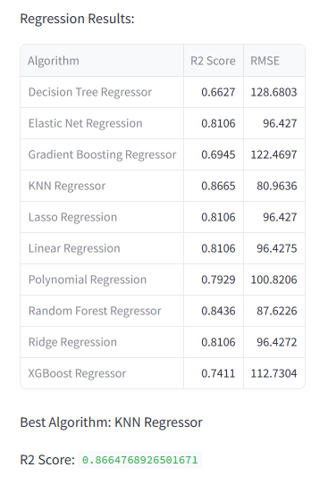
Model Comparision
Using the data after treating the outliers and split the train test datasets.
Build the regression models for train datasets.
Results show that Regression results of various linear regression models
Based on RMSE metrices value, Best model is selected for predictive analysis

Slide 9
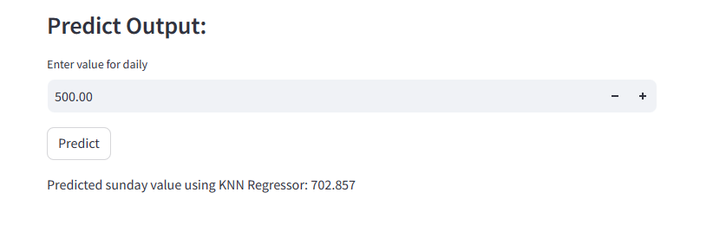

Predictive analysis
KNN Regressor Model is the Model with Lower RMSE values indicate better model performance, as they represent smaller differences between predicted and actual values

Slide 10
Conclusions
We conclude that :
The value of daily circulations increases, the value of the Sunday circulations also tends to increase.
The best Machine Learning algorithm for predicting the sunday circulations is KNN Regressor Model.
A positive correlation implies that as the value of daily circulations increases, the value of the Sunday circulations also tends to increase.

