Slide 1

"Unlocking Tomorrow's Profits: Predictive Insights for Your Business"
K.Karunasagar

Slide 2

Project Background and context
In today's competitive business landscape, organizations are constantly seeking ways to optimize their operations and maximize profitability. One of the key challenges they face is accurately predicting future profits based on various internal and external factors. This predictive capability is crucial for informed decision-making, resource allocation, and strategic planning.

Slide 3

Solution
Our project aims to address the challenge by developing a robust profit prediction model using advanced data analytics techniques.
By leveraging historical financial data, market trends, and other relevant variables, we seek to build a predictive model that can forecast future profits with a high degree of accuracy.

Slide 4

Goal
The primary objective of this project is to develop a profit prediction model that can:
Predict future profitability based on historical financial data and other relevant features.
Identify key drivers and factors that significantly impact profitability.
Provide actionable insights and recommendations for optimizing business strategies and operations to enhance profitability.

Slide 5
Benefits
By accurately predicting future profits, businesses can make more informed decisions regarding resource allocation, investment strategies, pricing policies, and product development. This enables them to prioritize initiatives that are likely to yield the highest returns.
A reliable profit prediction model allows businesses to develop long-term strategic plans with confidence. By forecasting future financial performance, organizations can set realistic goals, allocate resources effectively, and adapt their strategies to changing market conditions.
Reliable profit predictions instill confidence among investors, shareholders, and other stakeholders. By demonstrating a clear understanding of future financial performance, businesses can attract investment, build trust, and foster long-term relationships with stakeholders.
Profit prediction analysis is not a one-time exercise but an ongoing process of refinement and optimization. By continuously monitoring and updating the predictive model with new data and insights, organizations can adapt to changing market dynamics and drive continuous improvement in profitability.

Slide 6
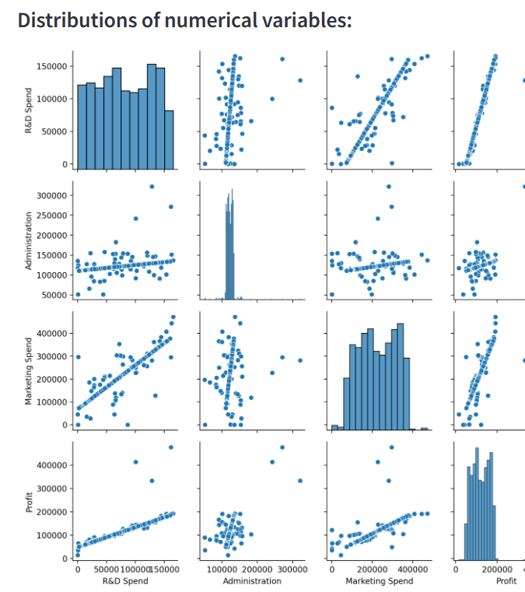
Exploratory Data Analysis
Our exploratory data analysis (EDA) The scatter plot shows the distributions of four numerical variables: R&D Spend, Administration, Marketing Spend, and Profit.
The distribution of a variable refers to how the data points for that variable are spread out. In a normal distribution, the data points are clustered around the center of the distribution, with fewer data points further away from the center.
In a skewed distribution, the data points are not clustered around the center, but are instead bunched up on one side of the distribution.
The scatter plot does not show a clear relationship between any of the four variables. For example, there is no clear trend in the data points that suggests that companies that spend more on R&D also tend to have higher profits.

Slide 7
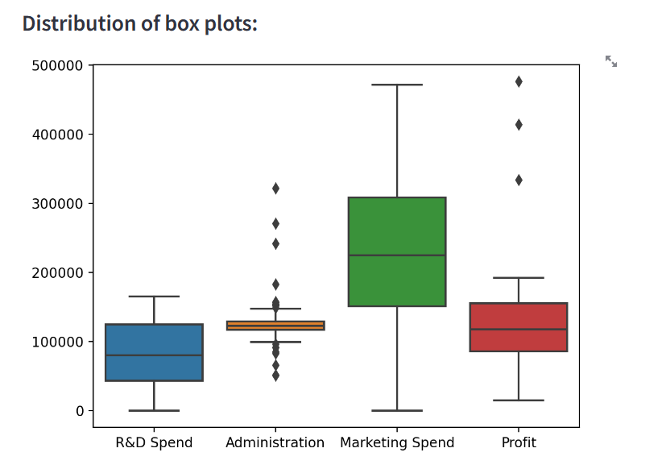
Diagnosis analysis
The spread of data points (represented by the box) is larger for R&D Spend and Marketing Spend compared to Administration and Profit. This means that there is a larger variation in the amount companies spend on R&D and Marketing compared to Administration and Profit.
The medians for R&D Spend, Administration, and Marketing Spend are all very close to each other. Profit has a higher median compared to the other three categories.
The boxplot suggests that there is a larger variation in spending on R&D and Marketing compared to Administration and Profit. The median profit is also higher than the medians for the spending categories.

Slide 8
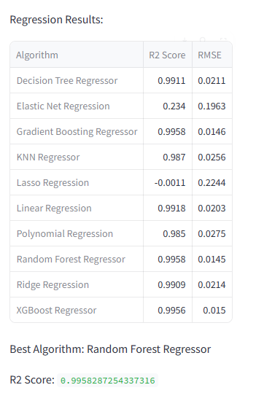
Model Comparision
The result of a comparison of multiple regression algorithms on a specific dataset. R-squared is a statistical measure of how well the regression models fit the data. It represents the proportion of the variance in the dependent variable that the independent variables explain.
In the screenshot, "Random Forest Regressor" has the highest R-squared score (0.9958), which indicates that it performs the best among the listed algorithms in fitting the data for this particular task.
It's important to note that the best algorithm for a specific regression task can vary depending on the data and the problem you're trying to solve. In some cases, simpler models like Linear Regression might perform well, while in other cases more complex models like Random Forest Regression might be necessary

Slide 9

Predictive Analysis
The Random Forest Regressor seems to be the most suitable algorithm for this profit prediction analysis for the startup companies
The chosen model Random Forest Regression achieved a high R-squared value 0.99 , indicating that it effectively captured the relationships between the features and Profit. This reinforces the validity of the conclusions drawn from the analysis.

Slide 10
Conclusion Based on Analysis & Model Performance for Profit Analysis
Model Selection: The Random Forest Regressor is identified as the most suitable algorithm for the profit prediction analysis for startup companies. This conclusion is based on its high R-squared value of 0.9958, indicating that it effectively captures the relationships between the features and profit.
Predictive Capability: The chosen Random Forest Regression model demonstrates strong predictive capability, as evidenced by its high R-squared value. This indicates that the model is able to accurately predict future profitability based on historical financial data and other relevant features.
Key Drivers of Profitability: Through exploratory data analysis (EDA), it was observed that there is no clear relationship between the variables R&D Spend, Administration, Marketing Spend, and Profit. However, the box plot analysis revealed that there is a larger variation in spending on R&D and Marketing compared to Administration and Profit. Additionally, the median profit is higher than the medians for the spending categories, suggesting that spending on R&D and Marketing may be key drivers of profitability.
Actionable Insights: The insights gained from the profit prediction analysis can inform strategic decision-making and resource allocation to optimize business strategies and operations. For example, businesses can prioritize investments in R&D and Marketing to drive profitability, based on the identified key drivers.
Continuous Improvement: Profit prediction analysis is not a one-time exercise but an ongoing process of refinement and optimization. By continuously monitoring and updating the predictive model with new data and insights, organizations can adapt to changing market dynamics and drive continuous improvement in profitability.

