Slide 1
Bayesian/MCMC Workshop
Session 2: Interpreting and Diagnosing MCMC results
Henry Ngo
15 Feb 2019

Slide 2
Review of Session 1
Go over optimal estimation solution
Notes:
On board: Bayes Theorem

Slide 3
MCMC Algorithm review
Compute posterior at current location (p_{current})
Propose a move to a new location
(must be able to access all of the prior space)
Compute posterior at new location (p_{new})
Decide whether or not to move
Always accept if p_{new} > p_{current} (going to better location)
Otherwise, only accept move with some probability (f = p_{new}/p_{current})
Repeat until you reach # of desired steps
Our sample distribution → posterior distribution with infinite steps
But if there is “enough steps” then it is “close enough”
Will compare some MCMC algorithms today
Why? “Detailed Balance” next
“convergence”

Slide 4
Detailed Balance (board)

Slide 5
MCMC Convergence
See Jupyter Notebook

Slide 6
MCMC Algorithms (board)

Slide 7
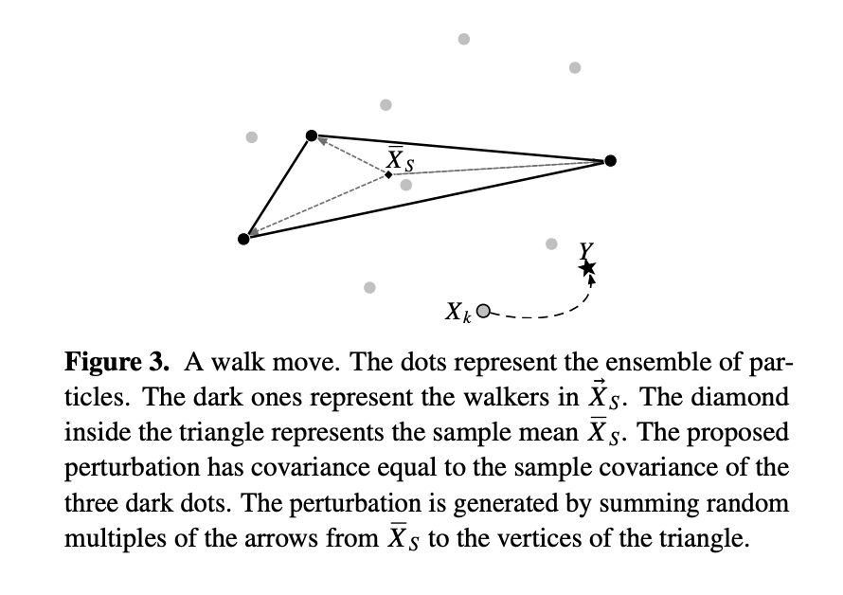
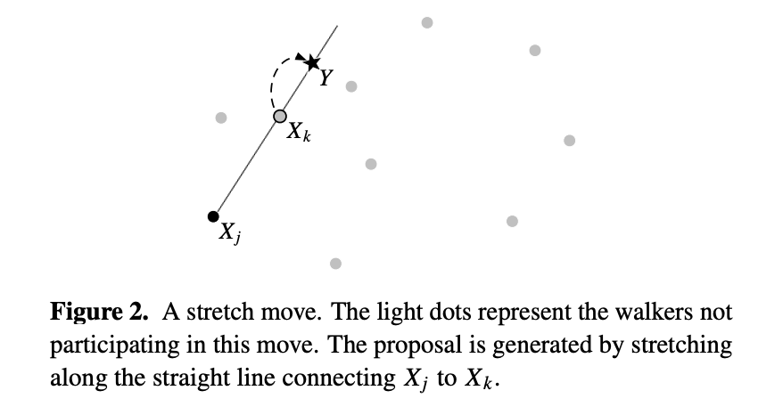
Affine-Invariant Goodman & Weare (2010)

Slide 8
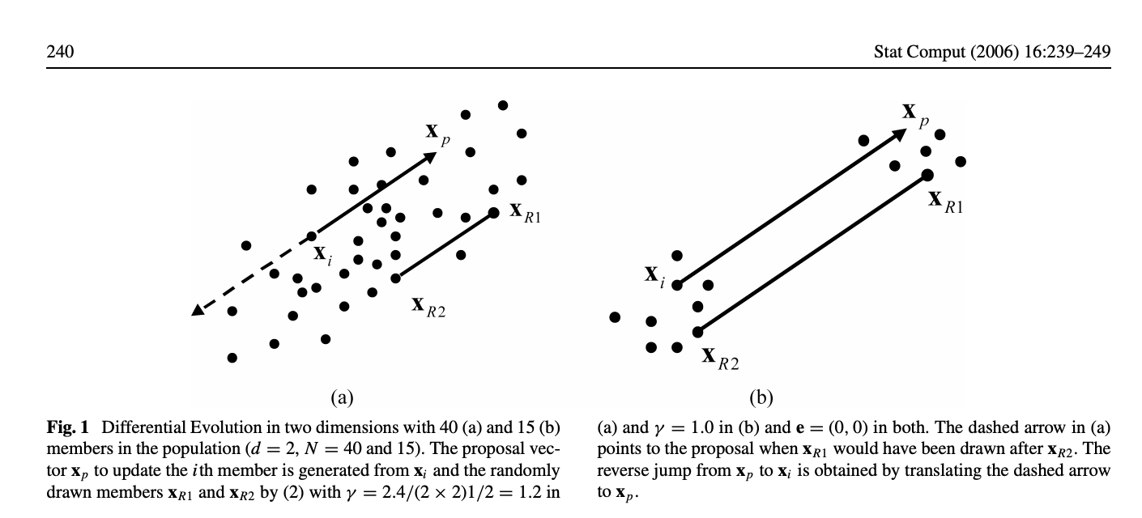
DE MCMC (Cajo J. F. Ter Braak, Stat Comput (2006) 16:239-249)

Slide 9
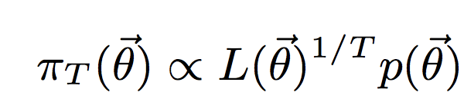
Multi-modal: Parallel Tempering (1)
Run multiple simultaneous versions of your ensemble at different “temperatures”
Takes your normal likelihood function and raises it to the power of 1/T, so that you are sampling from:
Note that for T = 1, this is the same as before
Higher temperatures (T>>1) flattens out the likelihood function, allows sampling across all of prior space
Lower temperatures better at sampling peaks
Vousden et al. 2016, MNRAS

Slide 10
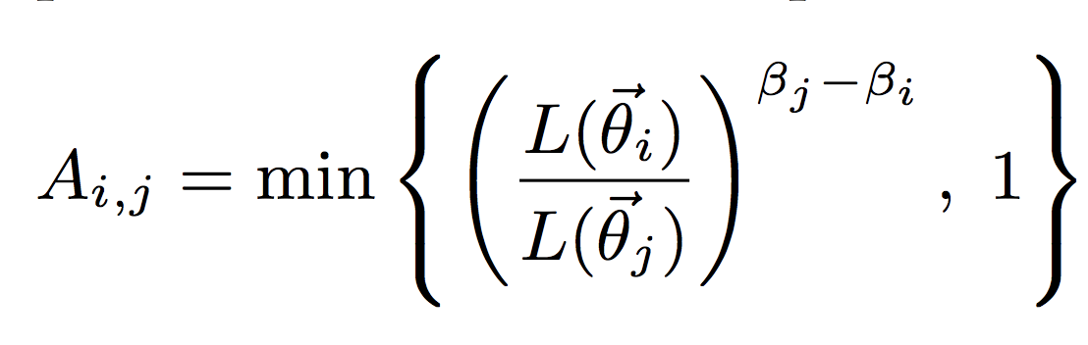
Parallel Tempering (2)
Takes your normal likelihood function and raises it to the power of 1/T, so that you are sampling from:
At predetermined times, the ensembles at different temperatures proposes to swap positions of their walkers which are accepted with probability (to preserve detailed balance)
Note: the lowest temperature chain (base chain) is usually the actual output, the other chains are just auxiliary chains to help sample the entire prior space through these swaps
Vousden et al. 2016, MNRAS

Slide 11
Parallel Tempering (Notebook)

Slide 12
Bayesian and MCMC in papers
Bayesian inference / MCMC removes some arbitrary choices that frequentist analysis requires (e.g. p-value level), but you still have to make some choices (e.g. likelihood function form, priors, initial guesses)
Important part is to be explicit about all of your choices and while different choices will lead to different posteriors, the goal is for the reader to be able to reproduce your analysis if they made the same choices as you.

Slide 13
Best practices for Bayesian analysis in papers
Be explicit about…
Your prior distributions
Your likelihood functional form
What your data are --- make them available to the reader!
What your posteriors are
Publish the distribution and/or the samples, don’t just report median +/- stddev
Plot the 1-D marginalized distributions, show corner plots to check for correlations (provide full N-D posterior for the reader to look in other ways)
What your summary statistics mean
Median? Mean? Confidence Interval: highest mass or centered on median?
How your posteriors compare to your priors
If MCMC, some discussion of convergence
What choices in algorithms used (eg. sampling algorithm, # of walkers)
Code/software version you used (cite the code!)
If using your own code, consider publishing it as well

Slide 14
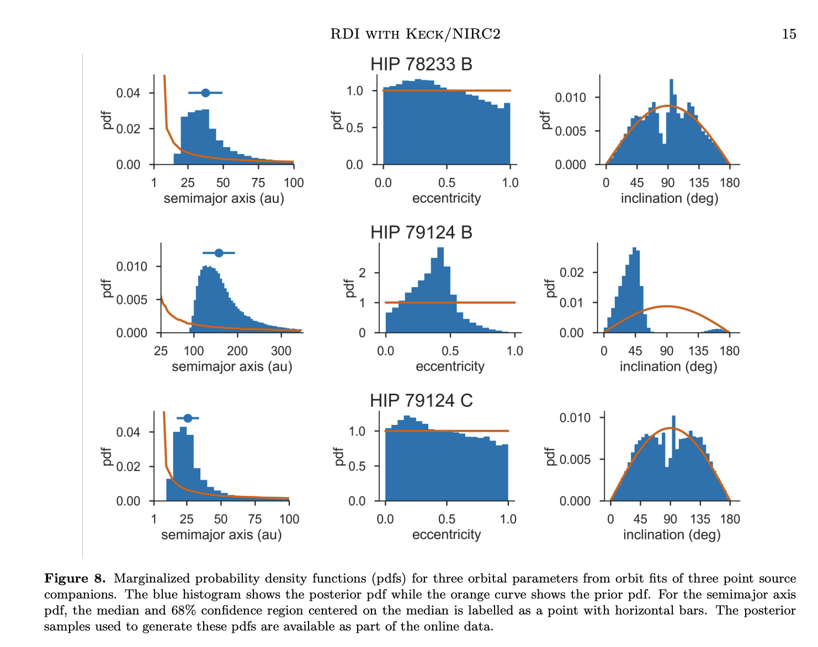
Ruane et al. 2019
https://ui.adsabs.harvard.edu/#abs/2019arXiv190104090R/abstract

Slide 15
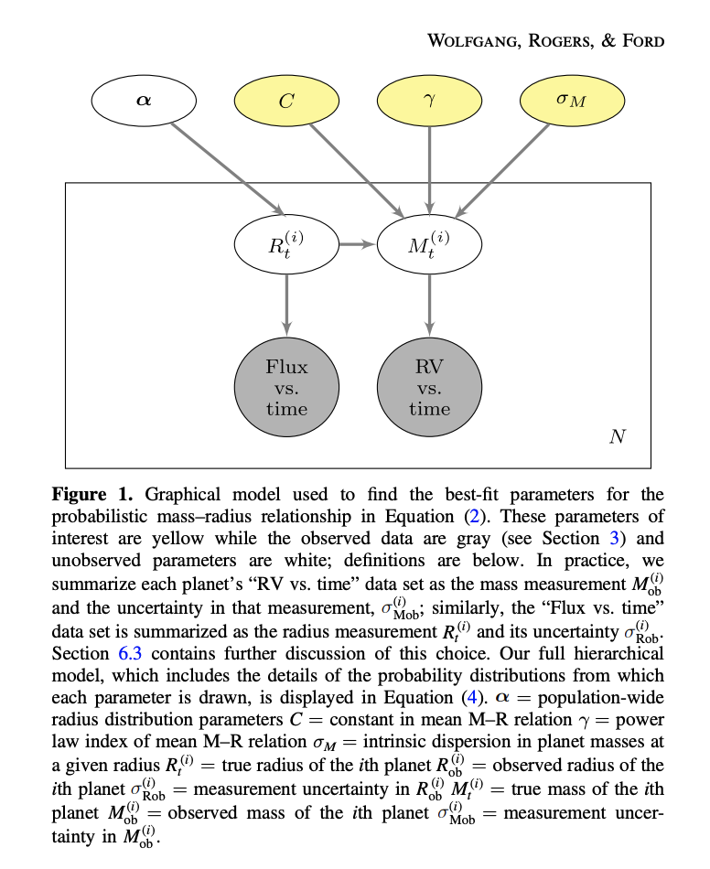

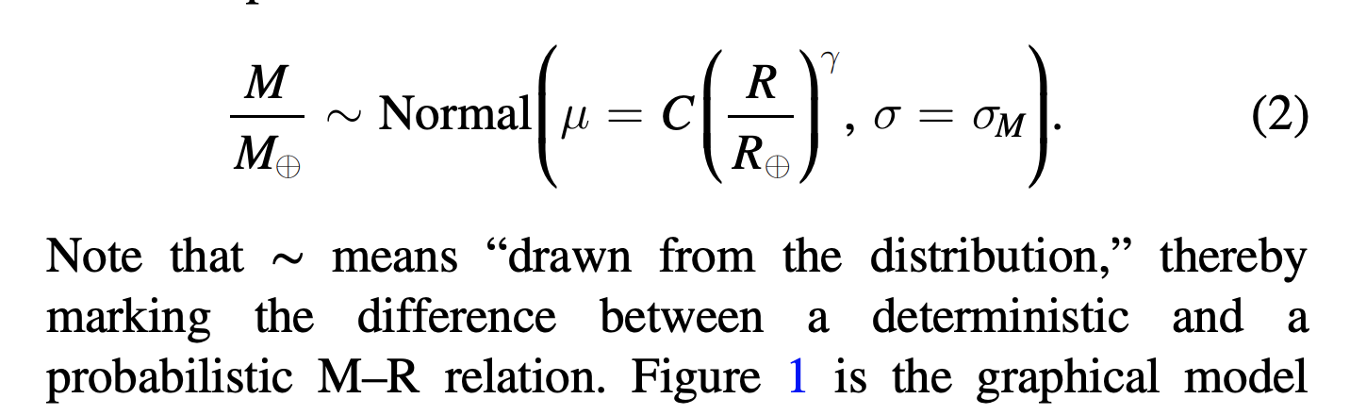
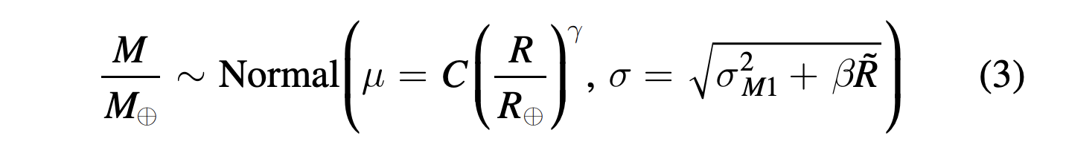
Wolfgang et al. 2016
https://ui.adsabs.harvard.edu/#abs/2016ApJ...825...19W/abstract

Slide 16
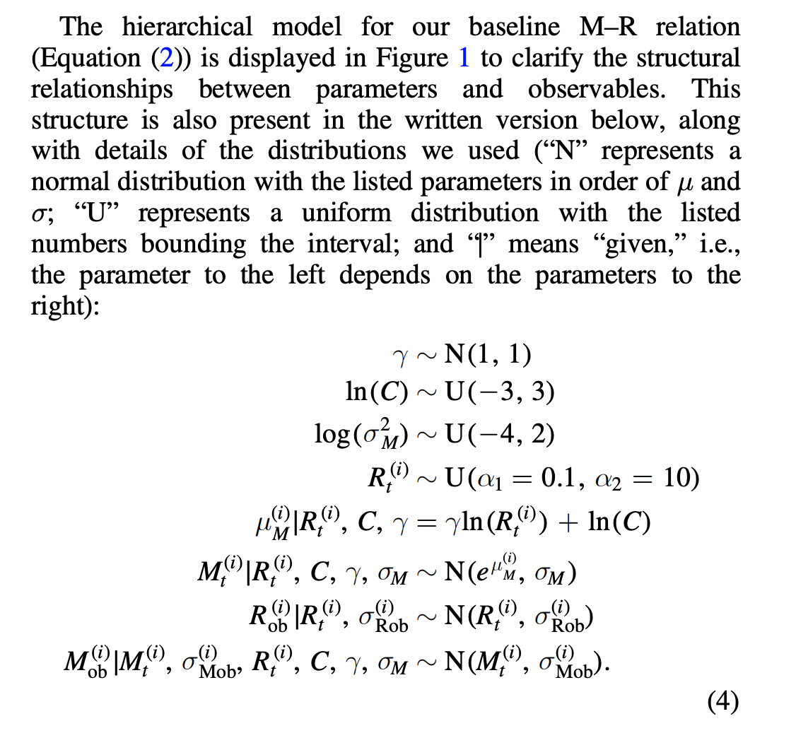
Wolfgang et al. 2016
https://ui.adsabs.harvard.edu/#abs/2016ApJ...825...19W/abstract

Slide 17
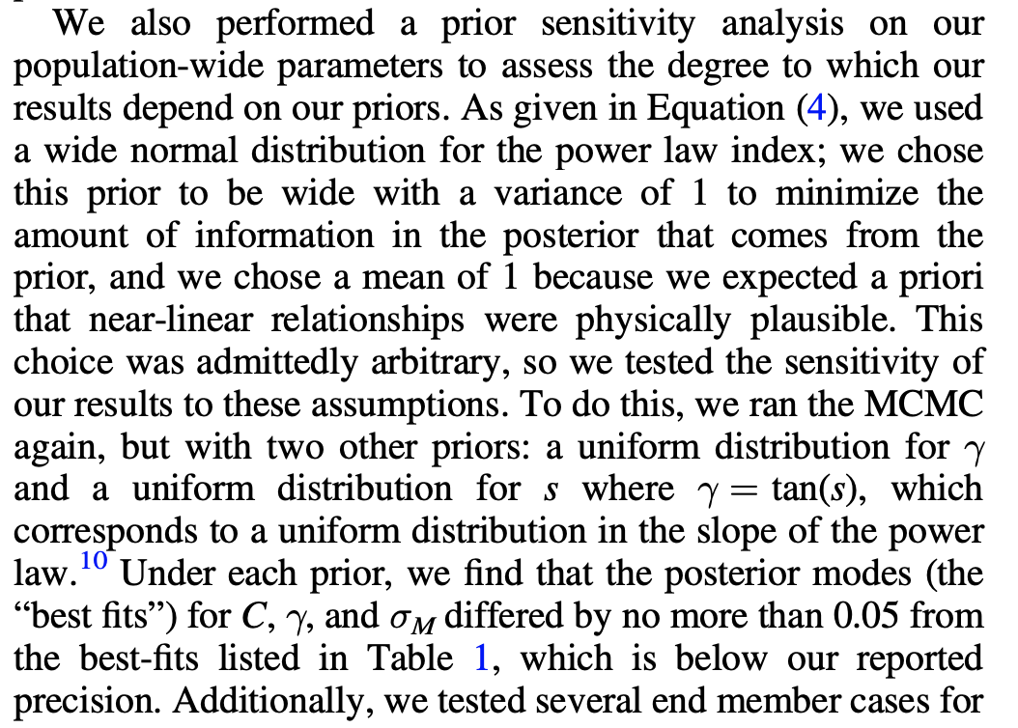
Wolfgang et al. 2016
https://ui.adsabs.harvard.edu/#abs/2016ApJ...825...19W/abstract

Slide 18
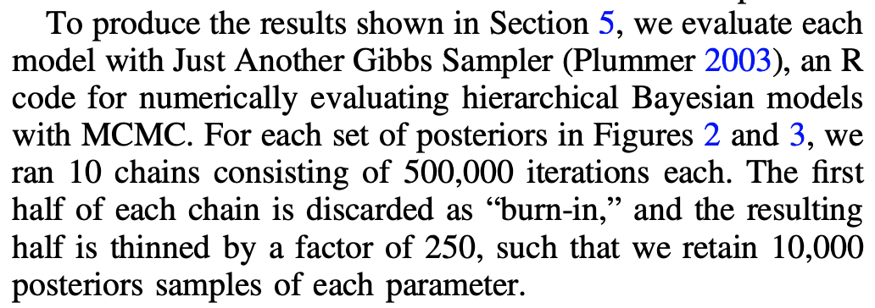
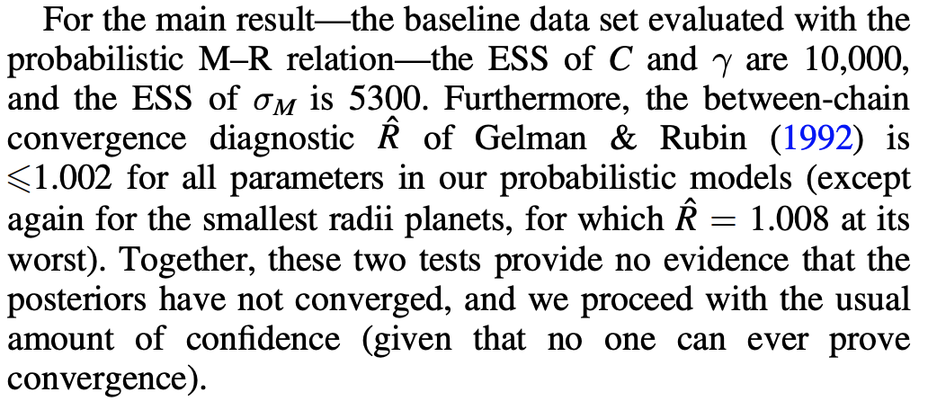
Wolfgang et al. 2016
https://ui.adsabs.harvard.edu/#abs/2016ApJ...825...19W/abstract

Slide 19
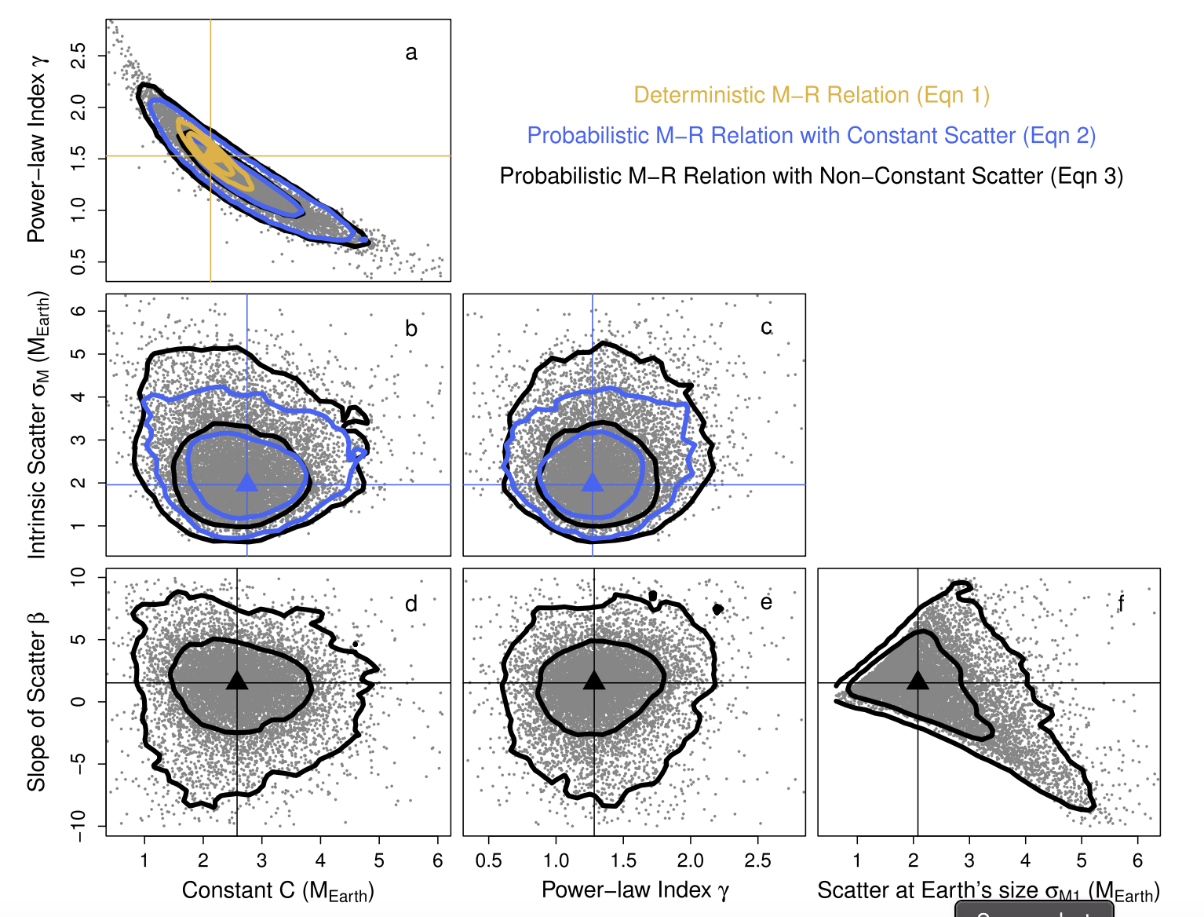
Wolfgang et al. 2016
https://ui.adsabs.harvard.edu/#abs/2016ApJ...825...19W/abstract

Slide 20

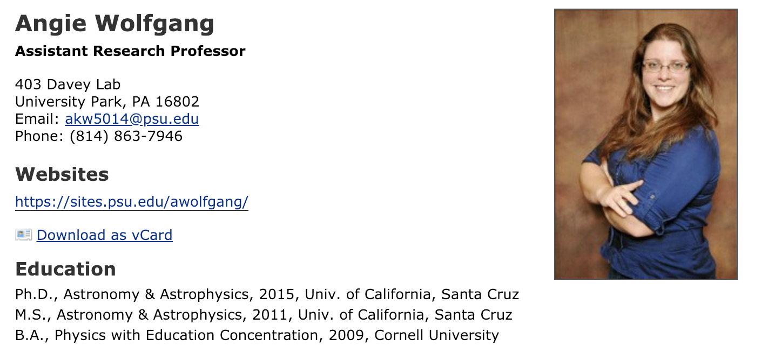
DAO Colloquium Speaker: 12 March 2019

