Slide 1
Sales Dataset Analysis – Excel Project
KARUNYA L
DADS
OCTOBER BATCH

Slide 2
OVERVIEW
OBJECTIVES
Analyze sales trends over time.
Identify high-performing products and sales channels.
Determine the impact of returns and discounts.
Create a dynamic dashboard with key metrics.

Slide 3
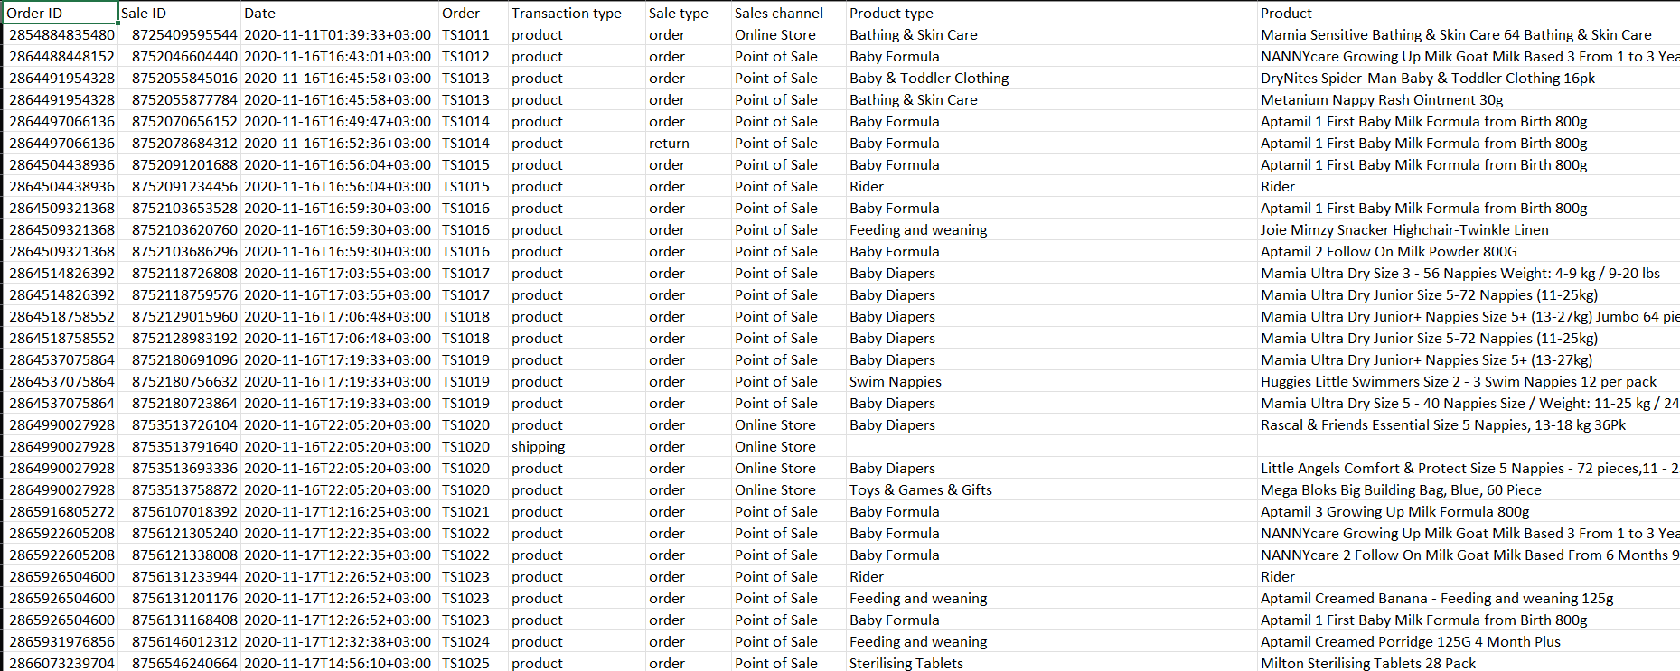
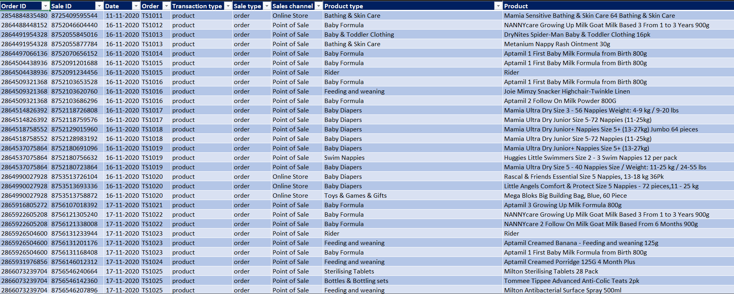
DATA CLEANING
Removed Blank Rows.
Removed Duplicate Rows
Split the columns.
Cleaned Using Power Query

Slide 4
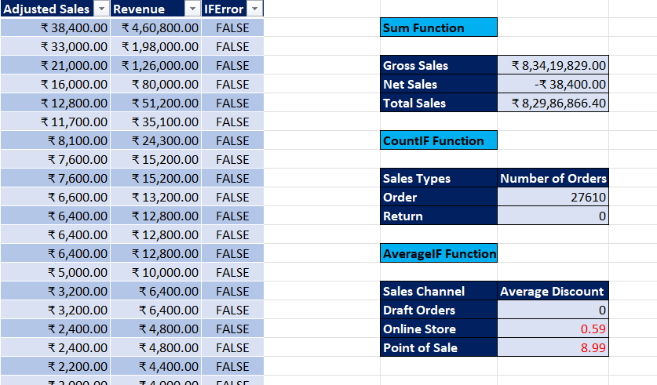
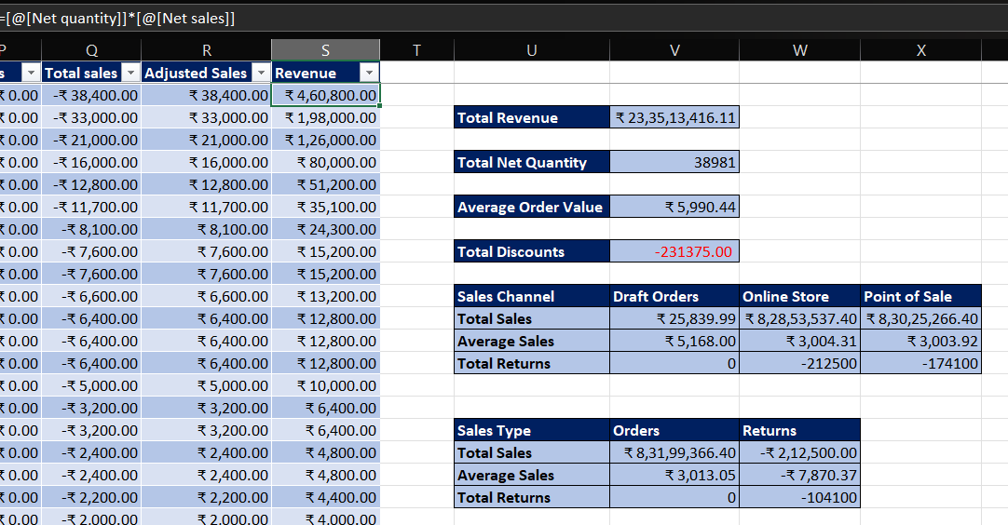
CALCULATIONS

Slide 5
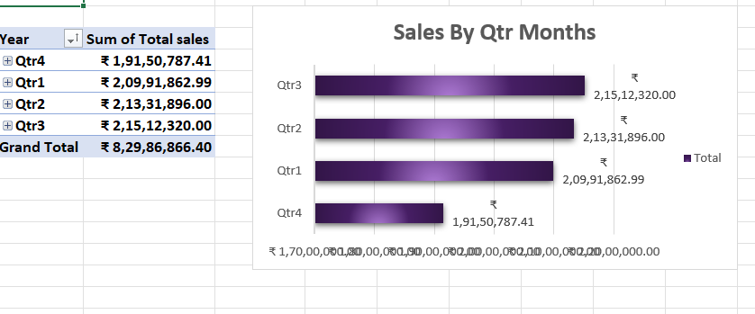
SALES TREND
Monsoon Season has the Highest Sales
Winter Season has the Lowest Sales

Slide 6
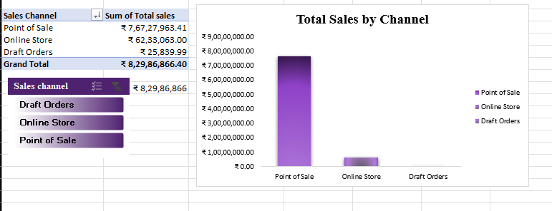
SALES BY CHANNEL
Point of sales has the highest sales
Draft orders are also maximum

Slide 7
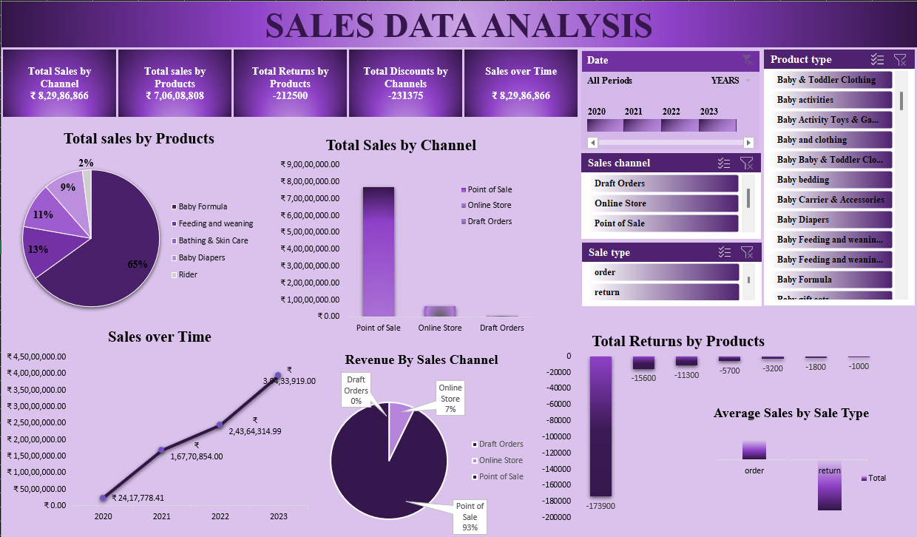
DASHBOARD

Slide 8
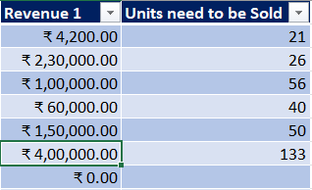
WHAT IF ANALYSIS AND GOAL SEEK
Using Goal-seek calculate the Units Sold
By increasing the Revenue the unit sold is calculated.

Slide 9
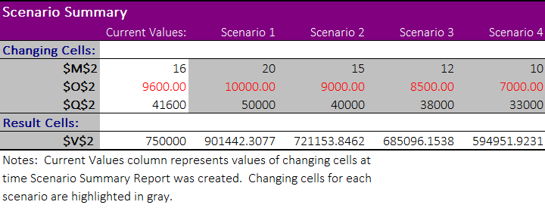
SCENARIO MANAGER

Slide 10
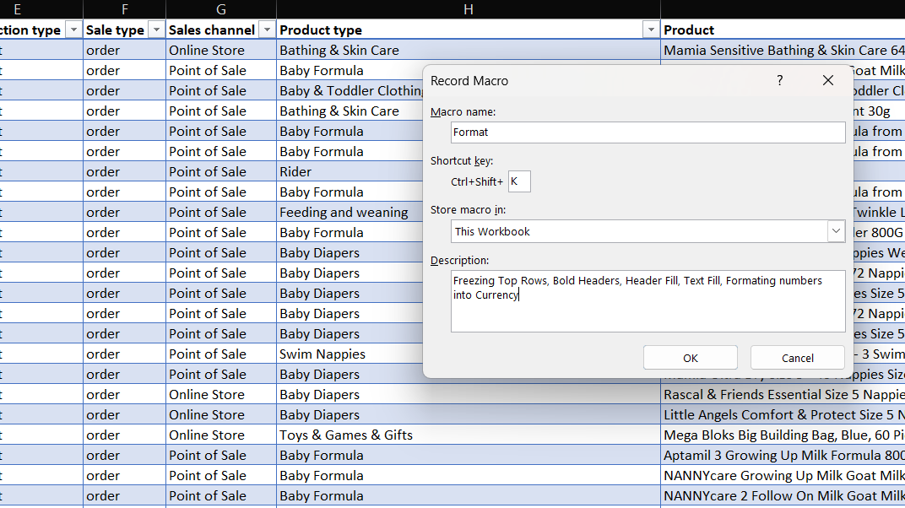
MACROS

Slide 11
INSIGHTS
Top selling Product is Baby Formula
Seasonal Peak is in September
Gradually sales increased year by year.
Comparing Online and Offline sales, Sales increased Offline.

Slide 12
CONCLUSION
Focus on Winter Seasons
Change Products
Increase the sales
Focus on the Online and Draft orders

Slide 13
THANK YOU

