Slide 1
Secure Data Hiding in Image Using Steganography
CAPSTONE PROJECT
Presented By :
Student Name : Karunya Chavan.
College Name : Progressive Education Society’s Modern College of Engineering, Pune : 05
Department : Computer Engineering

Slide 2
OUTLINE
Problem Statement
Technology used
Wow factor
End users
Result
Conclusion
Git-hub Link
Future scope

Slide 3
Problem Statement
With the exponential growth of digital data exchange, securing confidential information has become a major challenge. Conventional encryption techniques, while effective, make encrypted messages easily identifiable and prone to attacks. Steganography provides an alternative by concealing secret messages within digital images, ensuring covert and secure communication. This project implements an image-based steganographic technique using pixel manipulation, preserving image integrity while embedding textual information. A passcode mechanism adds an additional security layer, restricting unauthorized access to hidden data.

Slide 4
Technology used
Programming Language: Python.
Libraries: OpenCV (image processing), Tkinter (GUI development), NumPy (matrix manipulation).
Encryption Method: Pixel-value encoding using RGB channel modifications,
Platform Compatibility: Windows, Linux.
Image Format Support: PNG, JPG, JPEG.
Error Handling & Validation: Input validation and exception handling to prevent data corruption and unauthorized access.

Slide 5
Wow factors
Stealth & Security: Unlike encryption, hidden data remains undetectable unless decrypted/
GUI-Based Implementation: User-friendly interface for embedding and retrieving messages.
Multi-Layered Security: Passcode-based access control prevents unauthorized decryption.
Minimal Image Distortion: Message is embedded efficiently to maintain visual integrity.
Scalability: Can be extended to support multiple image formats and different encoding schemes.

Slide 6
End users
Cybersecurity Experts: Secure data transmission for forensic investigations.
Journalists & Activists: Covert communication in high-risk environments.
Military & Intelligence Agencies: Secure exchange of classified information.
Privacy-Conscious Individuals: Protecting personal data from unauthorized access.

Slide 7
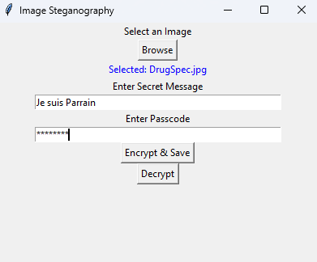
Results
Fig 1 : Graphical User Interface
Using this GUI we’re allowing user friendly encryption for image. Here we’re allowing user to select image , enter message , passcode and encrypt/decrypt.

Slide 8
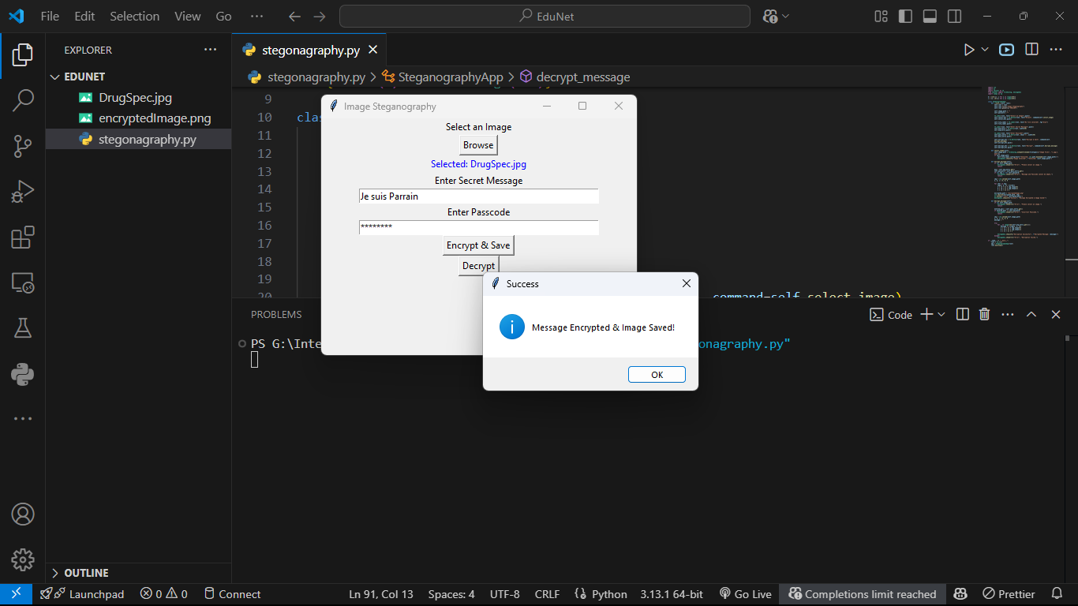
Results
Fig 2 : Encrypting Image
As visible in the image, original image is encrypted with the message and a new encrypted image is generated.

Slide 9
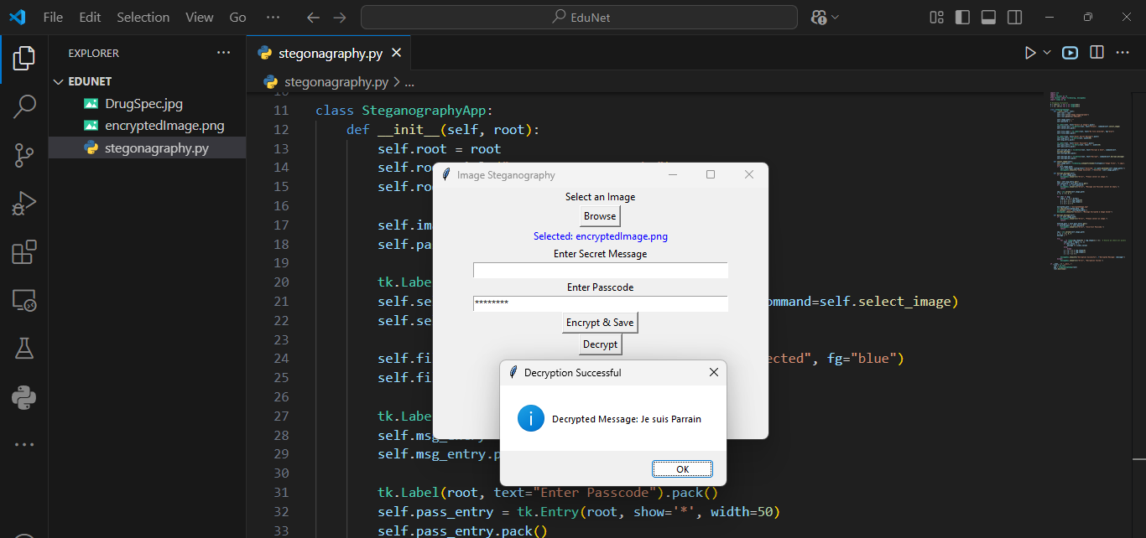
Results
Fig 3 : Decrypting Image
As visible in the image, we need to select the encrypted image using browse button and decrypt the message included in the image.

Slide 10
Conclusion
This project demonstrates an effective method of securely hiding and retrieving data within digital images. By leveraging pixel-level manipulation, it ensures the confidentiality of embedded messages while maintaining the image’s appearance. The integration of a GUI enhances usability, making steganography accessible even to non-technical users. Future advancements can further optimize security, efficiency, and adaptability.

Slide 11
GitHub Link
https://github.com/KarunyaChavan/Steganography-Edunet_Cybersecurity-Internship-2025/tree/main

Slide 12
Future scope(optional)
AI-Based Steganography: Use deep learning for adaptive hiding mechanisms.
Support for Video & Audio Steganography: Expanding beyond static images.
Enhanced Encryption Mechanisms: Hybrid cryptographic and steganographic approaches.
Cloud & Mobile Integration: Secure messaging for mobile applications.
Automated Detection Prevention: Advanced techniques to resist steganalysis attacks.

Slide 13
THANK YOU merci | Gracias | Danke

