Slide 1
Employee Data Analysis using Excel
STUDENT NAME: DIVYADHARSHINI
REGISTER NO: 312206492
ROOL NO: 2221062
DEPARTMENT: COMMERCE
COLLEGE: ARURCHAND MANMULL JAIN COLLEGE.

Slide 2
PROJECT TITLE
Employee
Performance
Analysis using
Excel

Slide 3


AGENDA
Problem Statement
Project Overview
End Users
Our Solution and Proposition
Dataset Description
Modelling Approach
Results and Discussion
Conclusion
3/21/2024 Annual Review

Slide 4

PROBLEM STATEMENT This analysis is created to track the performance of the employees, in order to provide promotions, incentives to the respective employees. This analysis helps the organisation to grow by the growth of the employees of the organisation.

Slide 6

PROJECT OVERVIEW
.
Employee Performance Analysis is created to analyse all the data like attendance, gender, age, high, medium, low, very high skilled employees of the organisation.

Slide 7

WHO ARE THE END USERS? Employees Managers Employers Managerial organisations Industrial organisations

Slide 8

OUR SOLUTION AND ITS VALUE PROPOSITION Conditional formatting - missing Pivot tables - summary Charts – trend Filtering and Formula - performance Graph – data visualization

Slide 9
Dataset Description Employee = Kaggle 26 – Features 9 - Features Employee id – numerical values Name – text Employee type Performance level Employee rating – numerical values

Slide 10

THE "WOW" IN OUR SOLUTION
Performance level =IFS(Z8>=5,”VERY HIGH”,Z8>=4,”HIGH”,Z8>=3,”MED”,TRUE,”LOW”)
3/21/2024 Annual Review
9

Slide 11
MODELLING
Data collection
Downloaded from Edunet dashboard
Data cleaning
Identified the missing values
Filter out missing values
Performance level
Created a formula
Summary
Pivot table
Graph
10

Slide 12
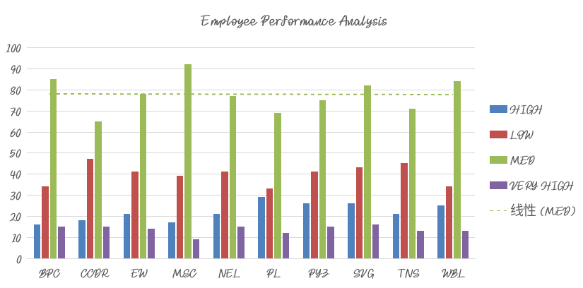
Results
11

Slide 13
Conclusion While we comparing the performance of the employees, the number of employees are highly performed PL sector of the organization. We should motivate the employees of the other sectors by giving different kinds of tasks based on their strength, in order to improve the standard of the organization.

