Slide 1

SMART TRAVEL : ML POWERED PREDICTIVE TRAVEL EXPENSE WITH REAL TIME ASSISTANCE AND DATA PROCESSING
Project Team Members
1.Kathiravan K. 412721104018
2.Tom Roger Tarun B. 412721104054
3.Vasantharaja V. 412721104057
4.Karuppusamy P. 412721104301
Project Guide
Ms. S.Mercy Hennah M.E,(Ph.D)
Designation: Assistant Professor

Slide 2
ABSTRACT
The project helps travelers find suitable accommodation, dining, and attractions in unfamiliar places by offering personalized recommendations based on user behavior and preferences.
It ensures secure user access through authentication options like email and social media, allowing users to register, log in, and manage their profiles easily.
A machine learning-based system is used to dynamically predict travel costs in real time, helping users plan their budgets effectively.
The app supports interactive navigation with integrated maps, chatbot assistance for real-time queries, and voice assistant functionality for hands-free usage.
Users can access detailed location data, weather forecasts, and contribute reviews and ratings to assist others in making informed choices.
Additional features like user preference storage, filtering and sorting options, bookmarking favorite spots, and a feedback form enhance customization and continuous improvement.

Slide 3
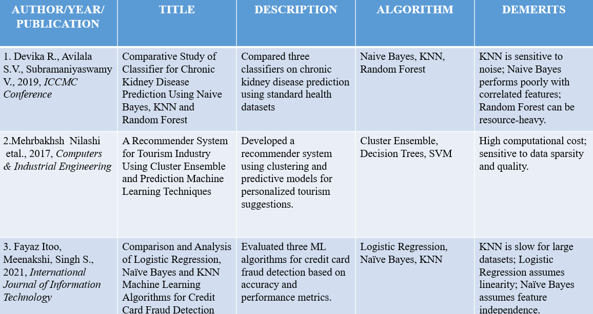
LITERATURE REVIEW

Slide 4
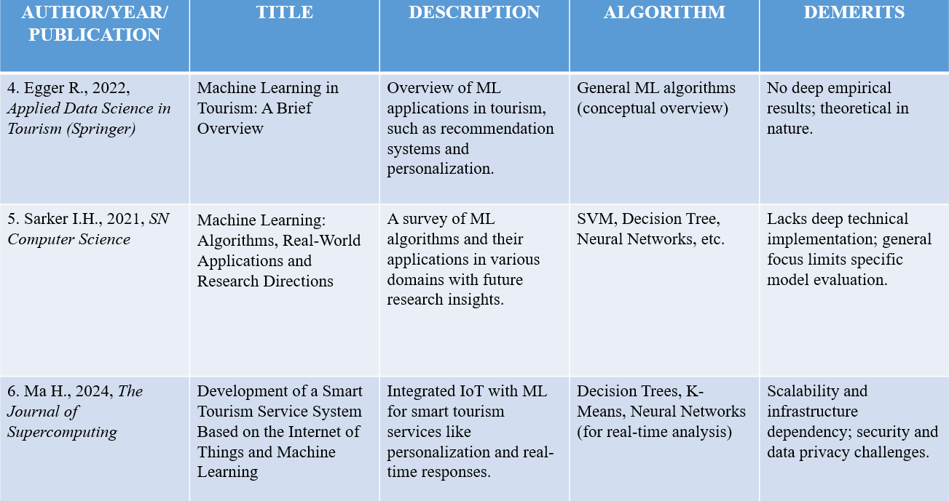

Slide 5
EXISTING SYSTEM
Most existing travel applications lack personalized recommendations based on user preferences and behavior. They do not offer real-time assistance features such as live chat support, weather updates, or location tracking.
Additionally, many platforms rely heavily on unfiltered user reviews, which may not be reliable or relevant. Overall, these systems focus on isolated services like booking or navigation, rather than providing an all-in-one, intelligent travel companion experience.
KNN, Naive Bayes, and Logistic Regression all have some common problems. KNN can be slow when making predictions and doesn’t work well if there are irrelevant features or too much data.
Naive Bayes assumes all features are independent, which is usually not true, and it can struggle with new or complex data.
Logistic Regression expects a straight-line relationship between features and results, so it can’t handle complicated patterns well. It’s also affected by outliers and when features are too similar to each other.

Slide 6
PROPOSED SYSTEM
The proposed solution offers a comprehensive travel app featuring secure user authentication through multiple methods, interactive maps for easy location discovery, and AI-driven personalized recommendations. It includes real-time navigation, an AI-powered chatbot for instant assistance, and up-to-date weather forecasts.
Users can customize their experience by saving preferences, applying filters, and bookmarking favorites. Additional features like voice assistant support and social media sharing enhance accessibility and engagement. A built-in feedback system ensures continuous improvement based on user insights.
Gradient Boosting builds strong models by combining many simple ones, which helps make very accurate predictions. Random Forest uses lots of decision trees to handle big and complex data well, and it helps avoid overfitting. SVM works well for both simple and complex problems by finding the best boundary to separate different groups, even when data is in many dimensions.

Slide 7
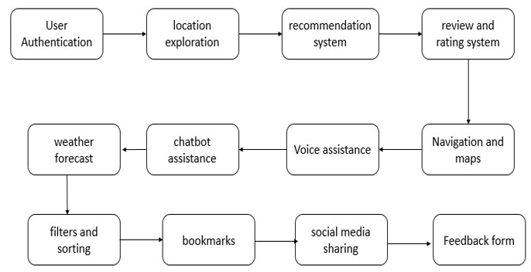
OVERALL SYSTEM ARCHITECTURE
Figure 1.1 Overall System Design

Slide 8
MODULES
Module 1 : Data Collection and Data Preprocessing
Module 2 : Algorithm Implementation and Data Visualization
Module 3 : Deploy the Model in Web Application

Slide 9
Module 1: Data Collection and Preprocessing
Description
Data collection and preprocessing are critical initial steps in any machine learning pipeline. The quality of your data directly influences the performance of your model. This module focuses on gathering the right data, cleaning it, and transforming it into a format suitable for machine learning tasks.
Implementation steps
1.Data Collection: Gather relevant data from available sources.
2.Data Cleaning: Handle missing data, duplicates, and other inconsistencies.
3.Data Transformation: Normalize, encode categorical variables, and scale numerical data.
4.Feature Engineering: Create or select important features for model input.
5.Data Splitting: Split the dataset into training and testing sets.

Slide 10
Module 2: Algorithm implementation and Data Visualization
Algorithm Description
Algorithm 2.1 – Gradient Boosting Classifier
An ensemble technique that builds models sequentially, where each new model corrects the errors of the previous ones. It combines many weak learners (typically decision trees) to create a strong predictive model. Known for high accuracy but can be slower to train.
Algorithm 2.2 - Support Vector Machine (SVM)
A powerful classification algorithm that finds the best boundary (hyperplane) to separate classes in a high-dimensional space. Effective for both linear and non-linear data using kernel functions.
Algorithm 2.3 - Random Forest
An ensemble method that builds multiple decision trees and merges their results to improve accuracy and reduce overfitting. It is robust, handles large datasets well, and works for both classification and regression tasks.

Slide 11
Implementation steps
1.Choose the Model: Select an appropriate machine learning model based on the problem (e.g., regression or classification).
2.Split the Data: Divide the dataset into training and testing sets.
3.Train the Model: Train the model on the training data.
4.Evaluate the Model: Use the testing data to evaluate model performance.
5.Data Visualization: Visualize the results to understand the model’s performance and the data distribution.

Slide 12
Module 3 Deploy the model
Description
Deploying a machine learning model refers to the process of making the trained model available for use in a production environment. The model can be deployed as an API, embedded into an application, or used as part of a larger system. This module will guide you through the steps required to deploy your machine learning model, ensuring it can make real-time predictions or batch predictions in a practical environment.
Implementation steps
1.Save the Trained Model : After training your model, the first step in deployment is saving the model to a file. This allows you to reuse the model without retraining.
2.Create an API for the Model : To allow your model to be accessed via a web service, you can create an API using Flask. Use Flask to create an API endpoint for predictions.
3.Deploy the API to a Server : To make the API accessible over the internet, you can deploy it on a server.
4.Integrate and Test : Connect the deployed model to an application and ensure it works as expected.

Slide 13
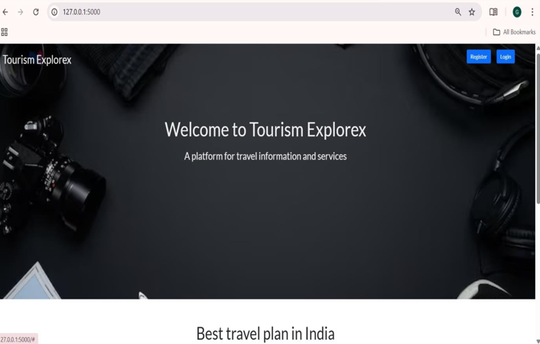
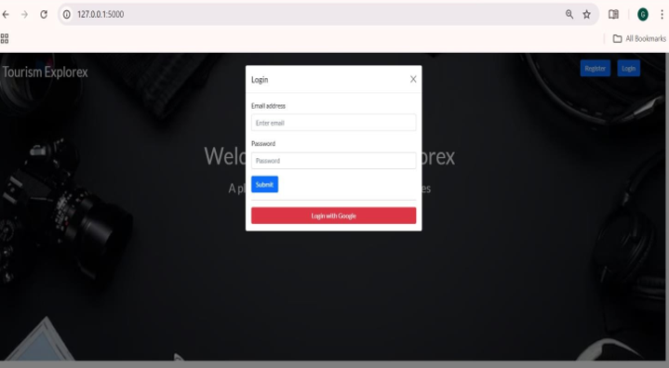
Figure 1.2 Home Page
Figure 1.3 Login page

Slide 14
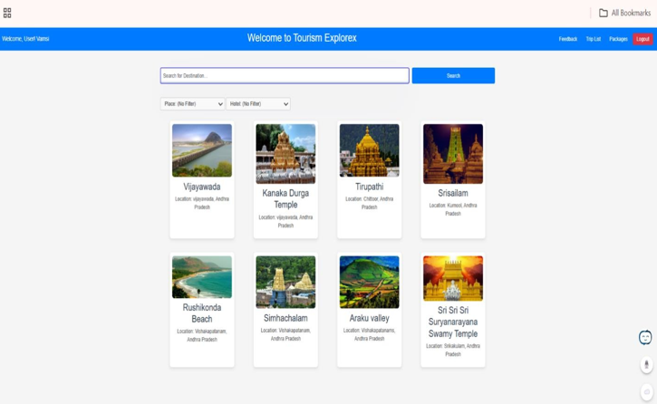
Figure 1.4 Dashboard

Slide 15
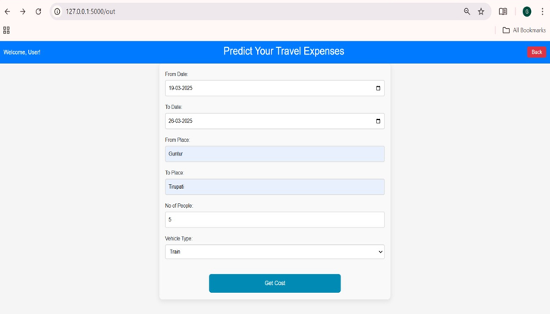
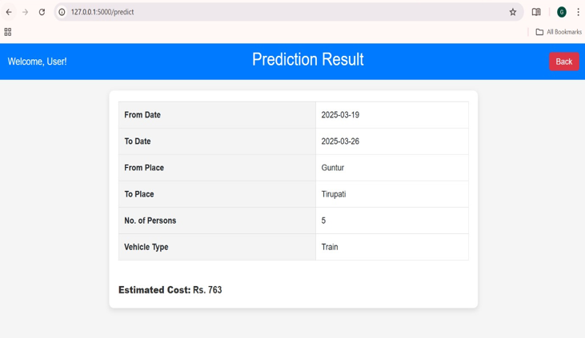
Figure 1.5 Prediction page
Figure 1.6 Result Page

Slide 16
Conclusion
The Location-Based Travel Companion project offers a personalized, user-friendly platform that enhances travel planning through features like AI-driven recommendations, real-time navigation, and weather updates.
It has been thoroughly tested for reliability and scalability. Future enhancements include improving recommendation accuracy, expanding geographic and language support, integrating local services, and exploring technologies like augmented reality and social media integration, all guided by user feedback
and evolving trends.

Slide 17
Future Enhancement
The future scope of the Location-Based Travel Companion includes integrating augmented reality for enhanced navigation, improving AI recommendations through advanced machine learning and real-time analytics, and expanding global accessibility with multilingual and localized content.
Additional plans involve voice and natural language processing for hands-free use, deeper incorporation of user-generated content for a more social and interactive experience, and ongoing performance, security, and user experience improvements to maintain innovation and scalability.

Slide 18
REFERENCES
[1.]Mehrbakhsh Nilashi, Karamollah Bagherifard, Mohsen Rahmani, Vahid Rafe. “A Recommender System for Tourism Industry Using Cluster Ensemble and Prediction Machine Learning Techniques.” Computers & Industrial Engineering, vol. 109, 2017, pp. 357–368. Elsevier,
https://doi.org/10.1016/j.cie.2017.05.016.
[2.]Itoo, F., Meenakshi, and Singh, S. “Comparison and Analysis of Logistic Regression, Naïve Bayes and KNN Machine Learning Algorithms for Credit Card Fraud Detection.” International Journal of Information Technology, vol. 13, 2021, pp. 1503–1511, https://doi.org/10.1007/s41870-020-00430-y.
[3.]Devika, R., S. V. Avilala, and V. Subramaniyaswamy. “Comparative Study of Classifier for Chronic Kidney Disease Prediction Using Naive Bayes, KNN and Random Forest.” 2019 3rd International Conference on Computing Methodologies and Communication (ICCMC), Erode, India, 2019, pp. 679–684,
https://doi.org/10.1109/ICCMC.2019.8819654.

Slide 19
[4.]Egger, R. “Machine Learning in Tourism: A Brief Overview.” Applied Data Science in Tourism. Tourism on the Verge, edited by R. Egger, Springer, Cham, 2022, https://doi.org/10.1007/978-3-030-88389-8_6.
[5.]Sarker, I. H.
“Machine Learning: Algorithms, Real-World Applications and Research Directions.” SN Computer Science, vol. 2, 2021, article no. 160, https://doi.org/10.1007/s42979-021-00592-x.
[6.]Ma, H. “Development of a Smart Tourism Service System Based on the Internet of Things and Machine Learning.” The Journal of Supercomputing, vol. 80, 2024, pp. 6725–6745,
https://doi.org/10.1007/s11227-023-05719-w.

Slide 20
THANK YOU

