Slide 1
SECURE DATA HIDING IN IMAGES USING STEGANOGRAPHY
CAPSTONE PROJECT
Presented By:
Student Name : S.Karunyashri
College Name & Department : VV College of Engineering - ECE

Slide 2
OUTLINE
Problem Statement
Technology used
Wow factor
End users
Result
Conclusion
Git-hub Link
Future scope

Slide 3
Problem Statement
In the digital age, data security is a critical challenge due to cyber threats and unauthorized access.
Traditional encryption methods attract attention, making secure communication vulnerable. This project implements image-based steganography using OpenStego and Python, embedding confidential datawithin images discreetly.By leveraging os,string and cv2 libraries, it ensures covert, secure, and untraceable data transmission.

Slide 4
Technology used
Steganography: Hiding data inside an image without visible distortion.
OpenStego: A free steganography tool used for watermarking and data hiding.
Python Libraries:
os: File handling & system operations
String : Data processing
Cv2(OpenCV) : Image processing

Slide 5
Wow factors
Invisible Communication – Data is hidden in plain sight within images.
No Suspicion – Unlike encryption, it doesn’t attract hackers' attention.
Easy to Implement – Uses OpenStego & Python with minimal complexity.
Customizable & Secure – Can enhance security using encryption before hiding data.

Slide 6
End users
Government & Defense – Secure communication without interception.
Journalists & Whistleblowers – Safe data sharing under surveillance.
Cybersecurity Experts – Enhancing confidential data transmission.
General Users – Protecting personal information from hackers.

Slide 7
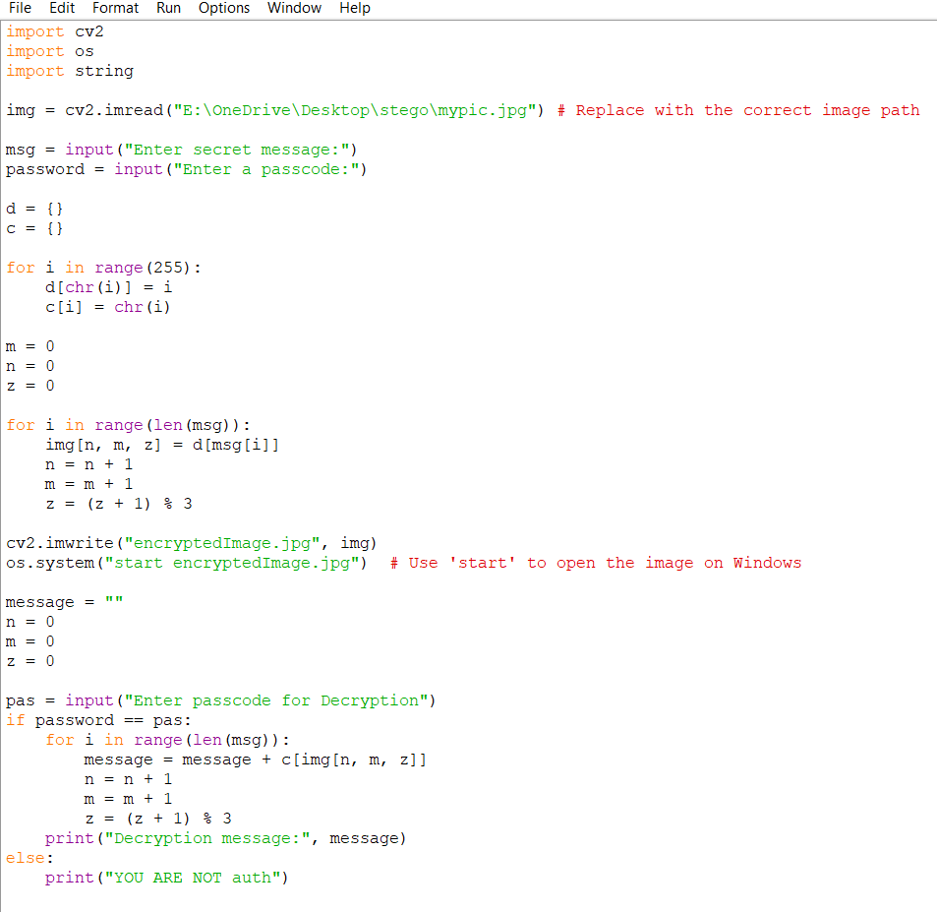
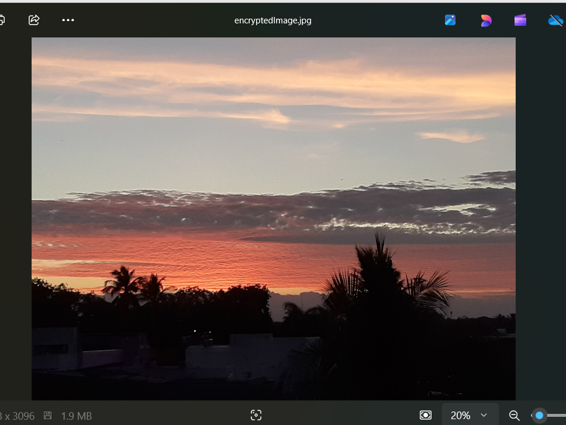
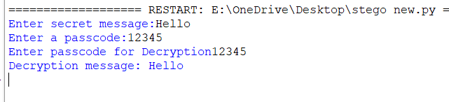
Results
Encrypted Image
Source code
Decrypted message

Slide 8
Conclusion
Steganography is an effective method for secure data transmission.
OpenStego simplifies the process of embedding and extracting data.
Python provides additional flexibility for automation and enhancement.

Slide 9
GitHub Link
run python 3
Lib
pip install cv2
https://github.com/Karush123/aicte-project.git

Slide 10
Future scope
Encryption Before Hiding – Enhance security by encrypting data before embedding.
AI-Based Steganalysis – Detect and counteract steganographic attacks.
Audio & Video Steganography – Expand the technique to other media types.
Cloud Integration – Secure cloud data transfer using steganographic techniques.

Slide 11
THANK YOU

