Slide 1



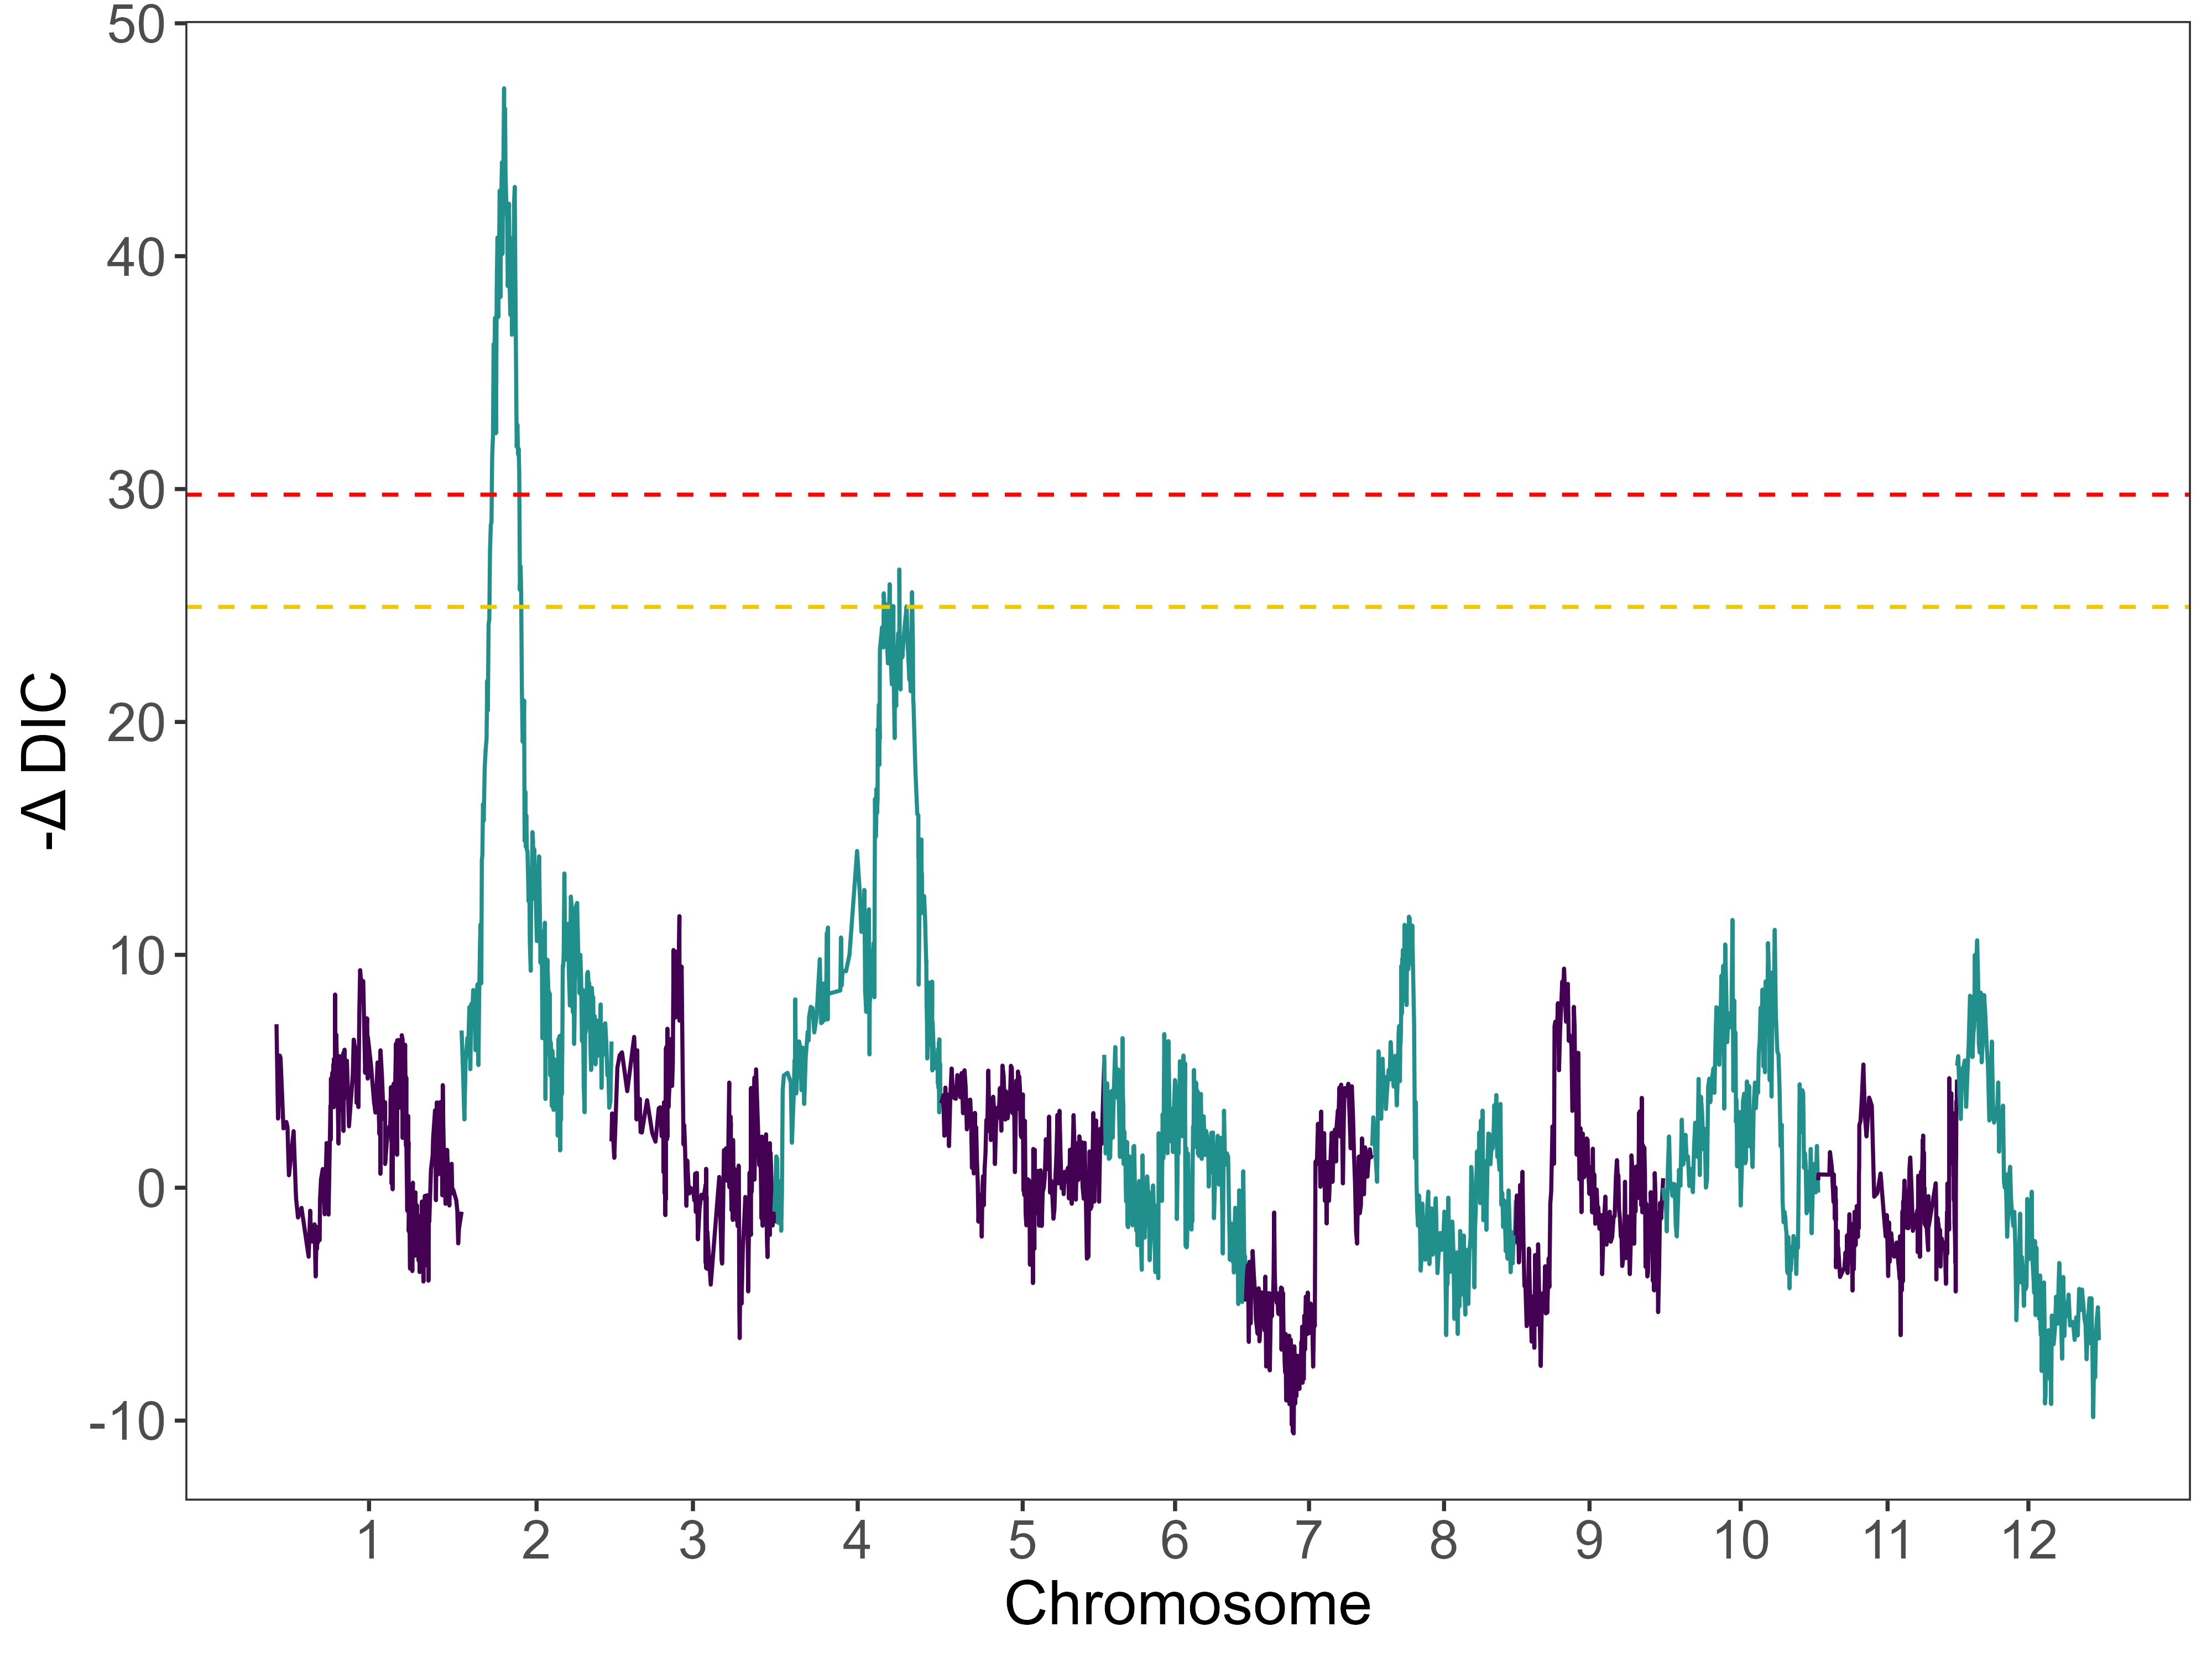
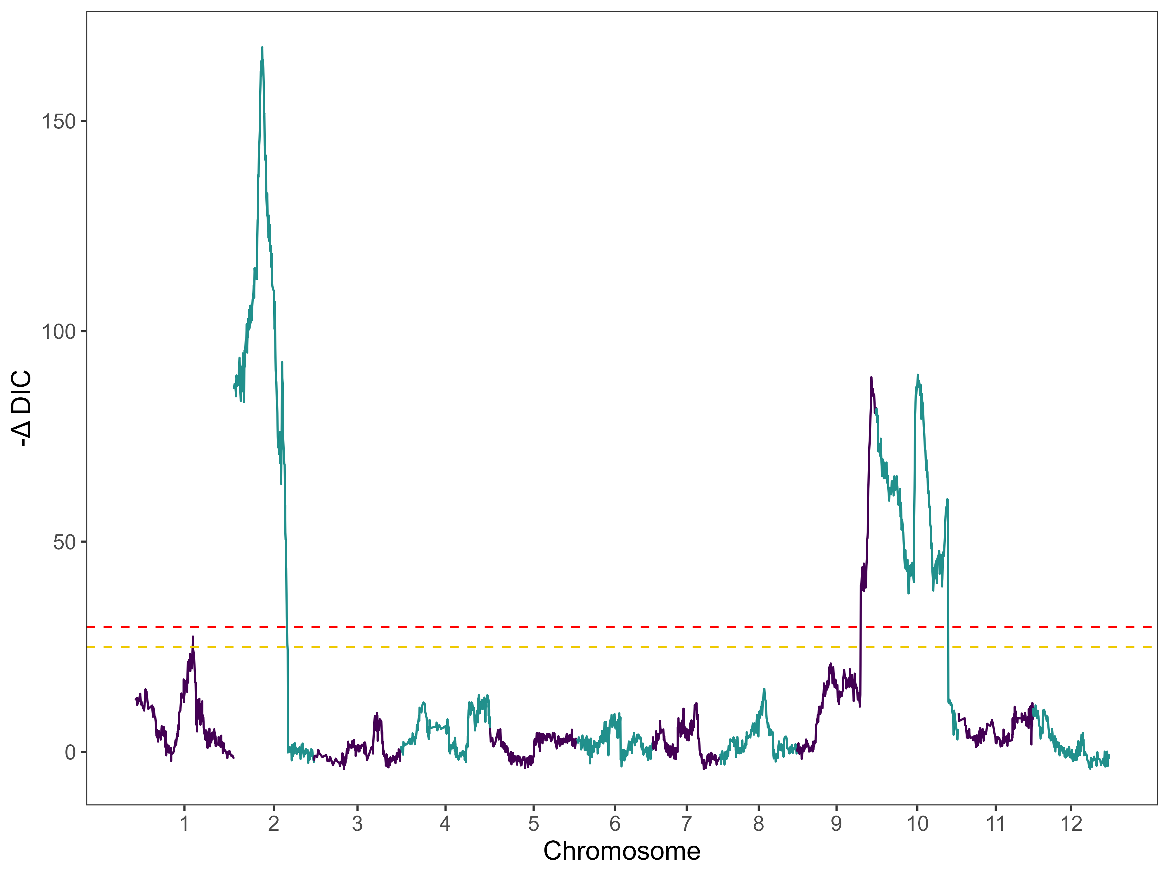
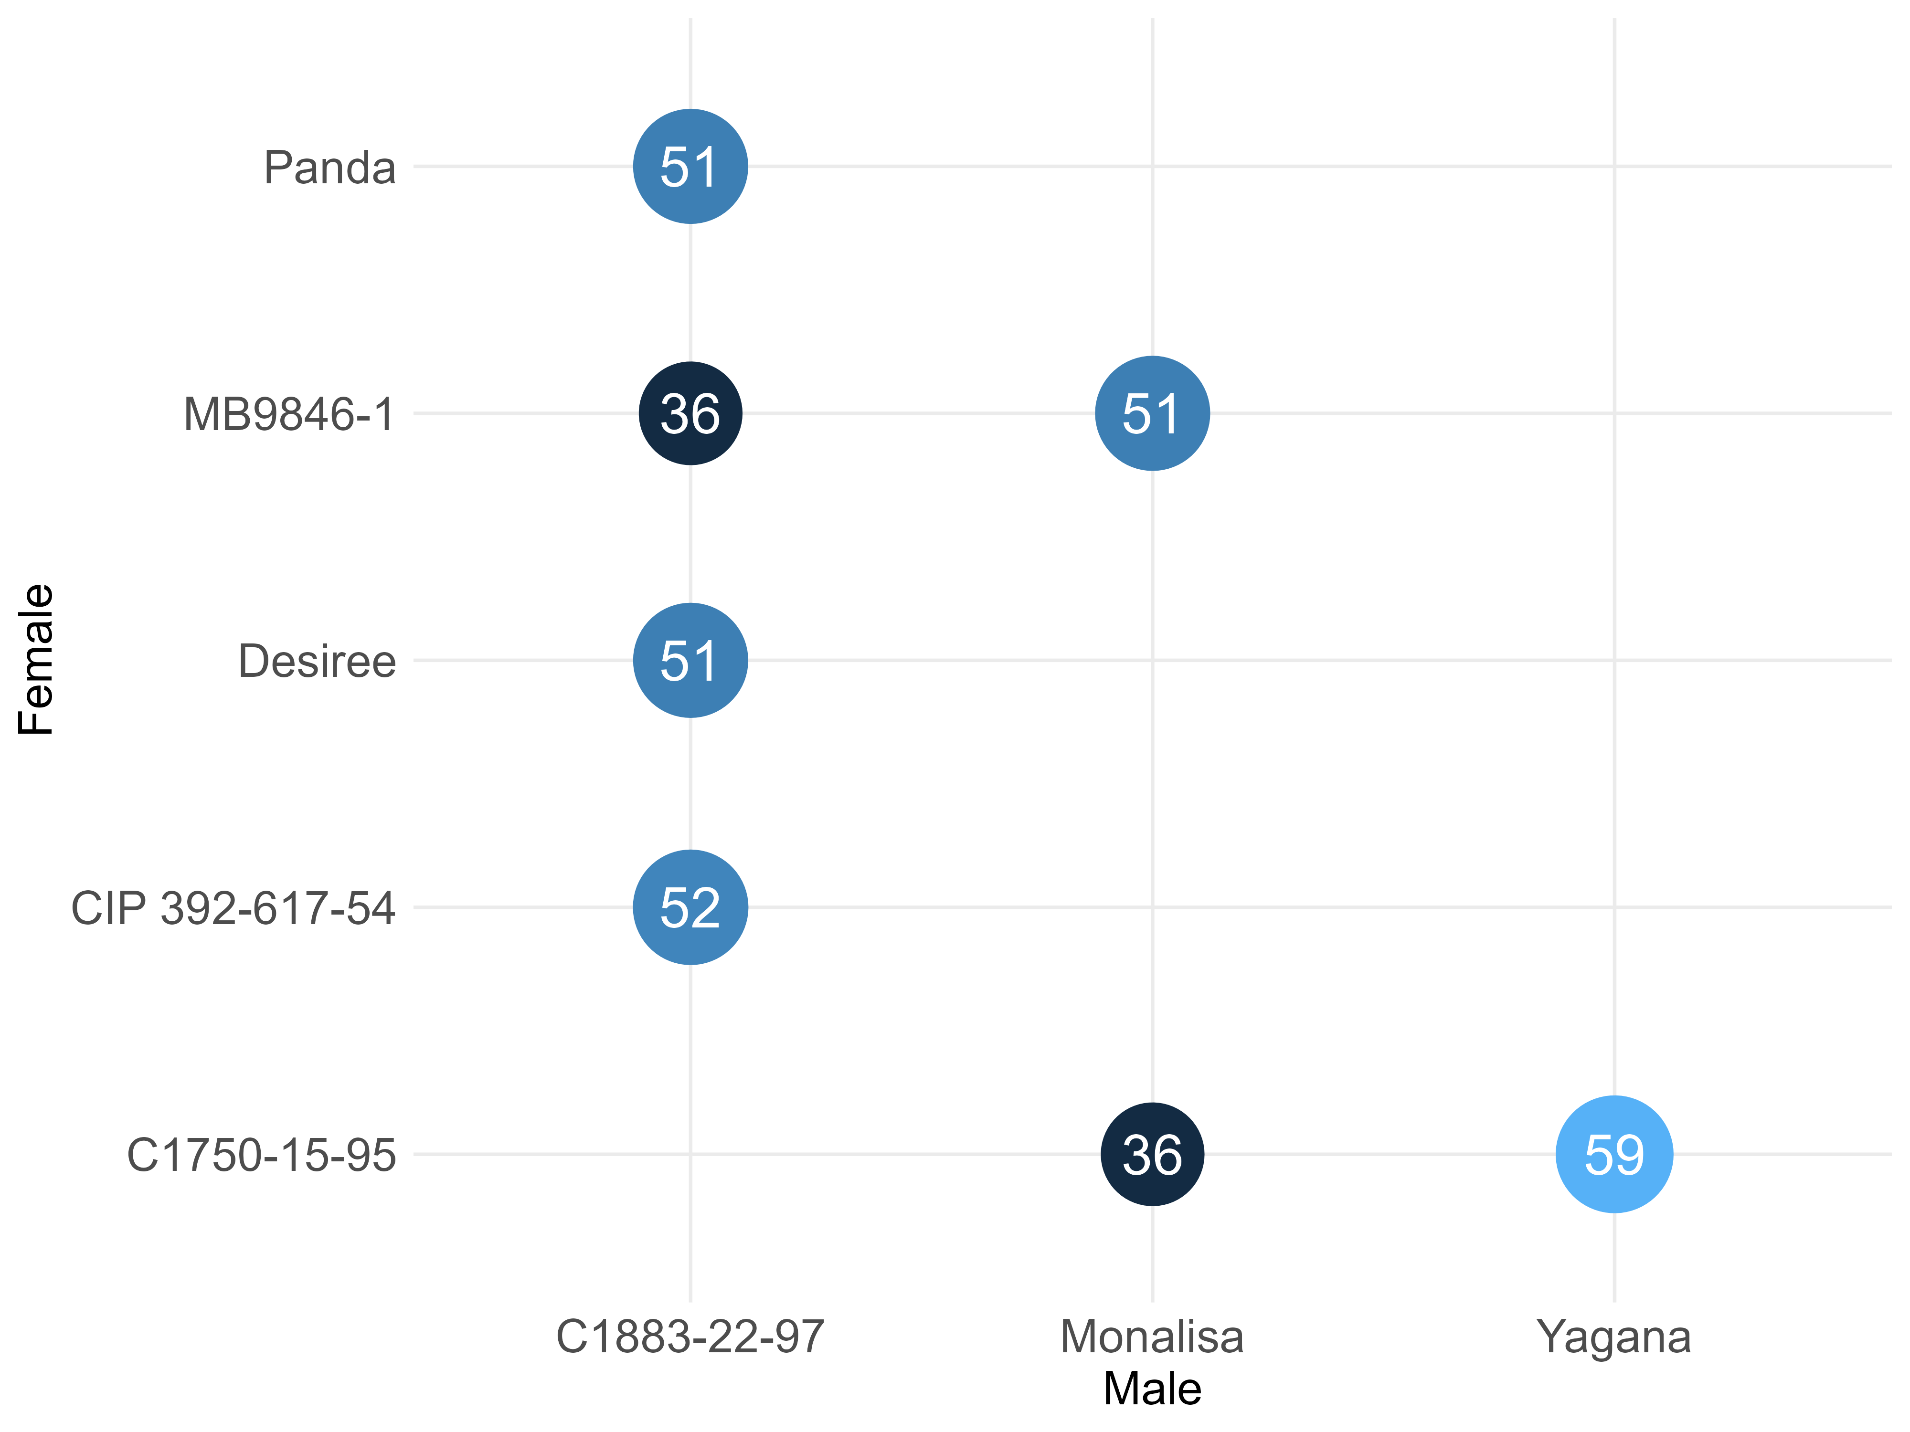
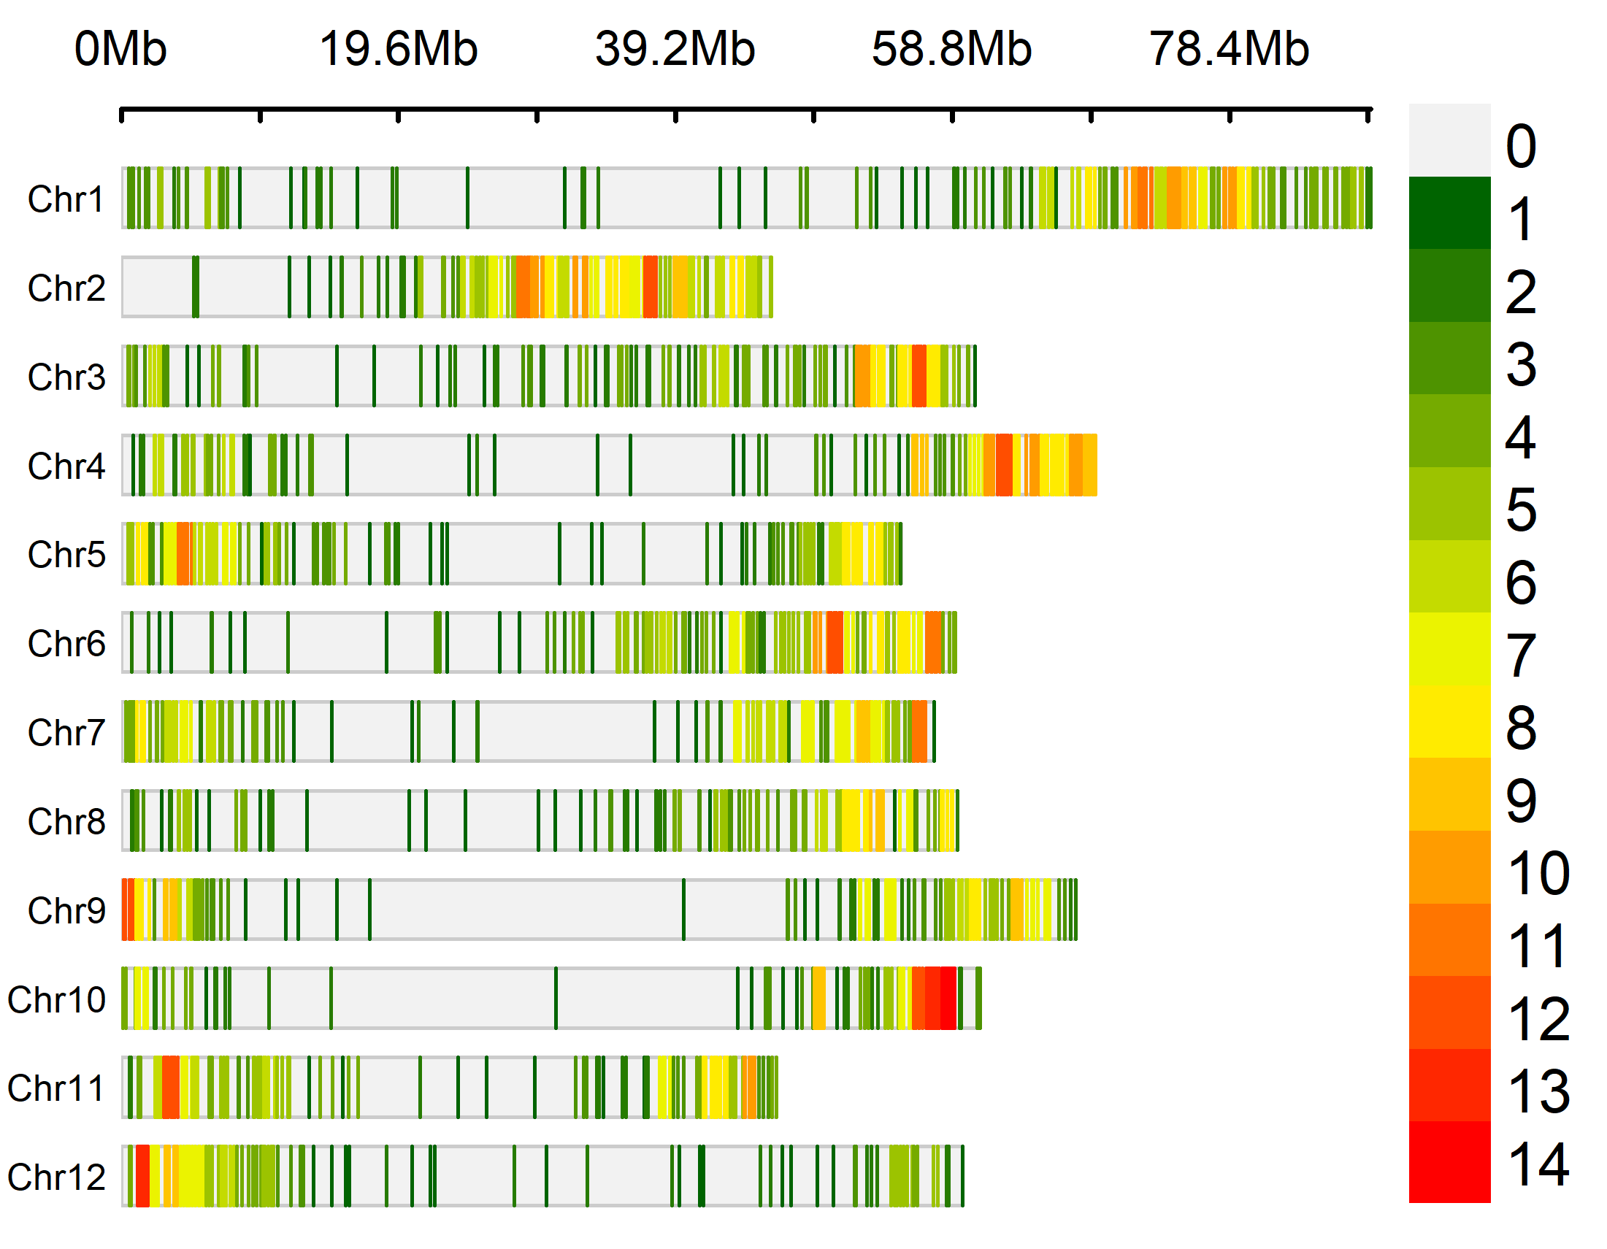
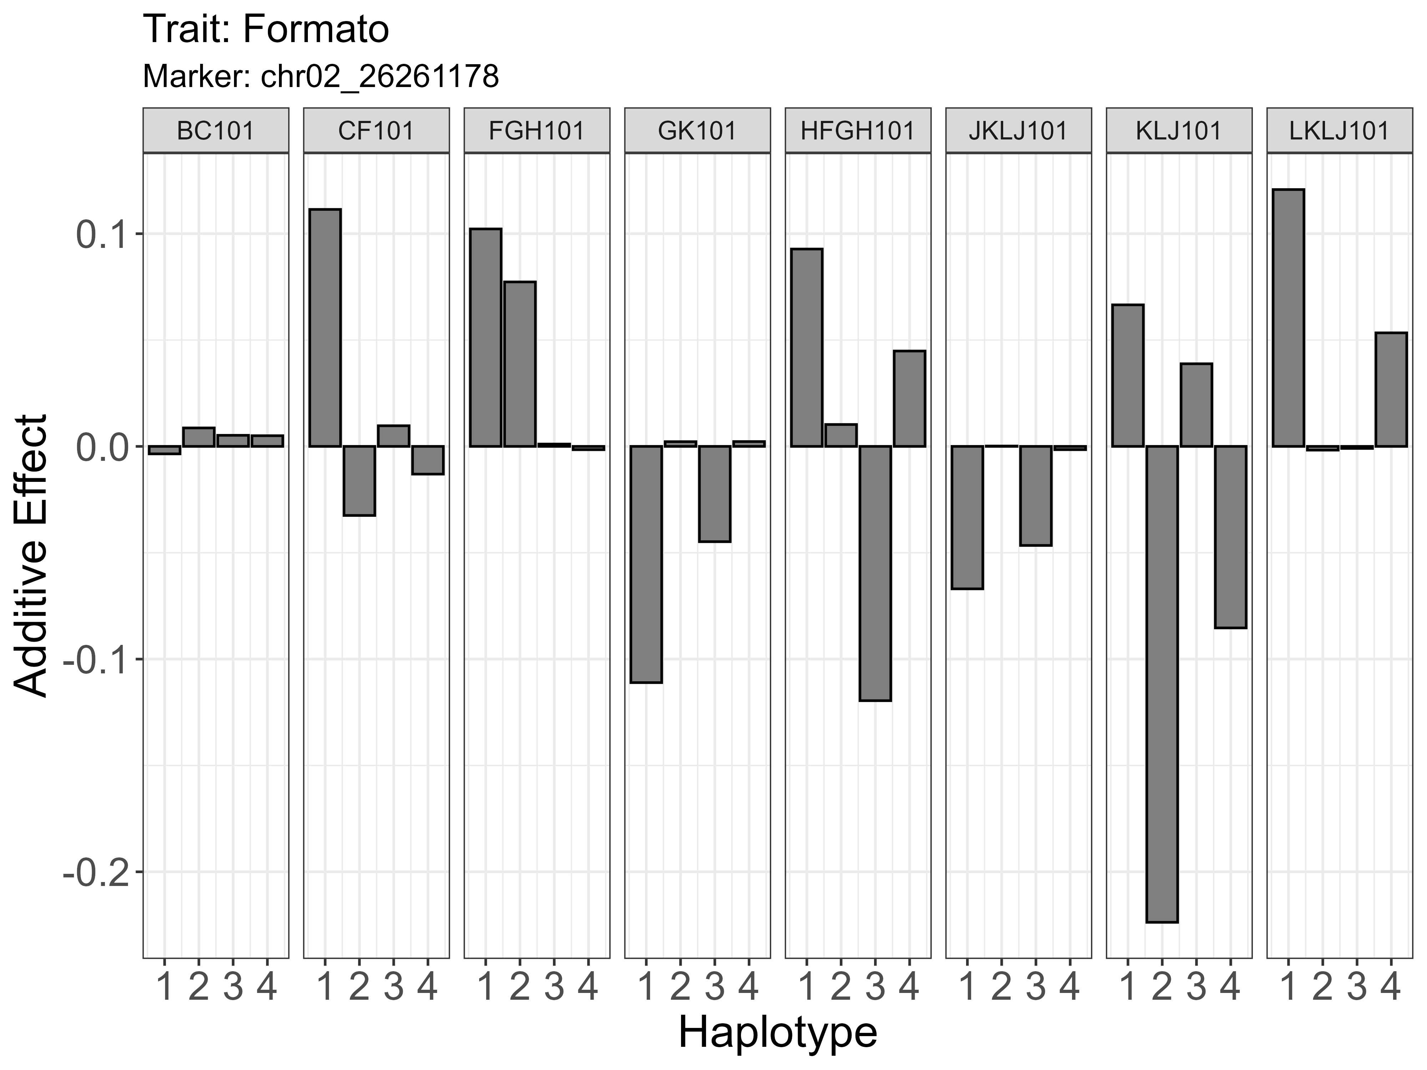
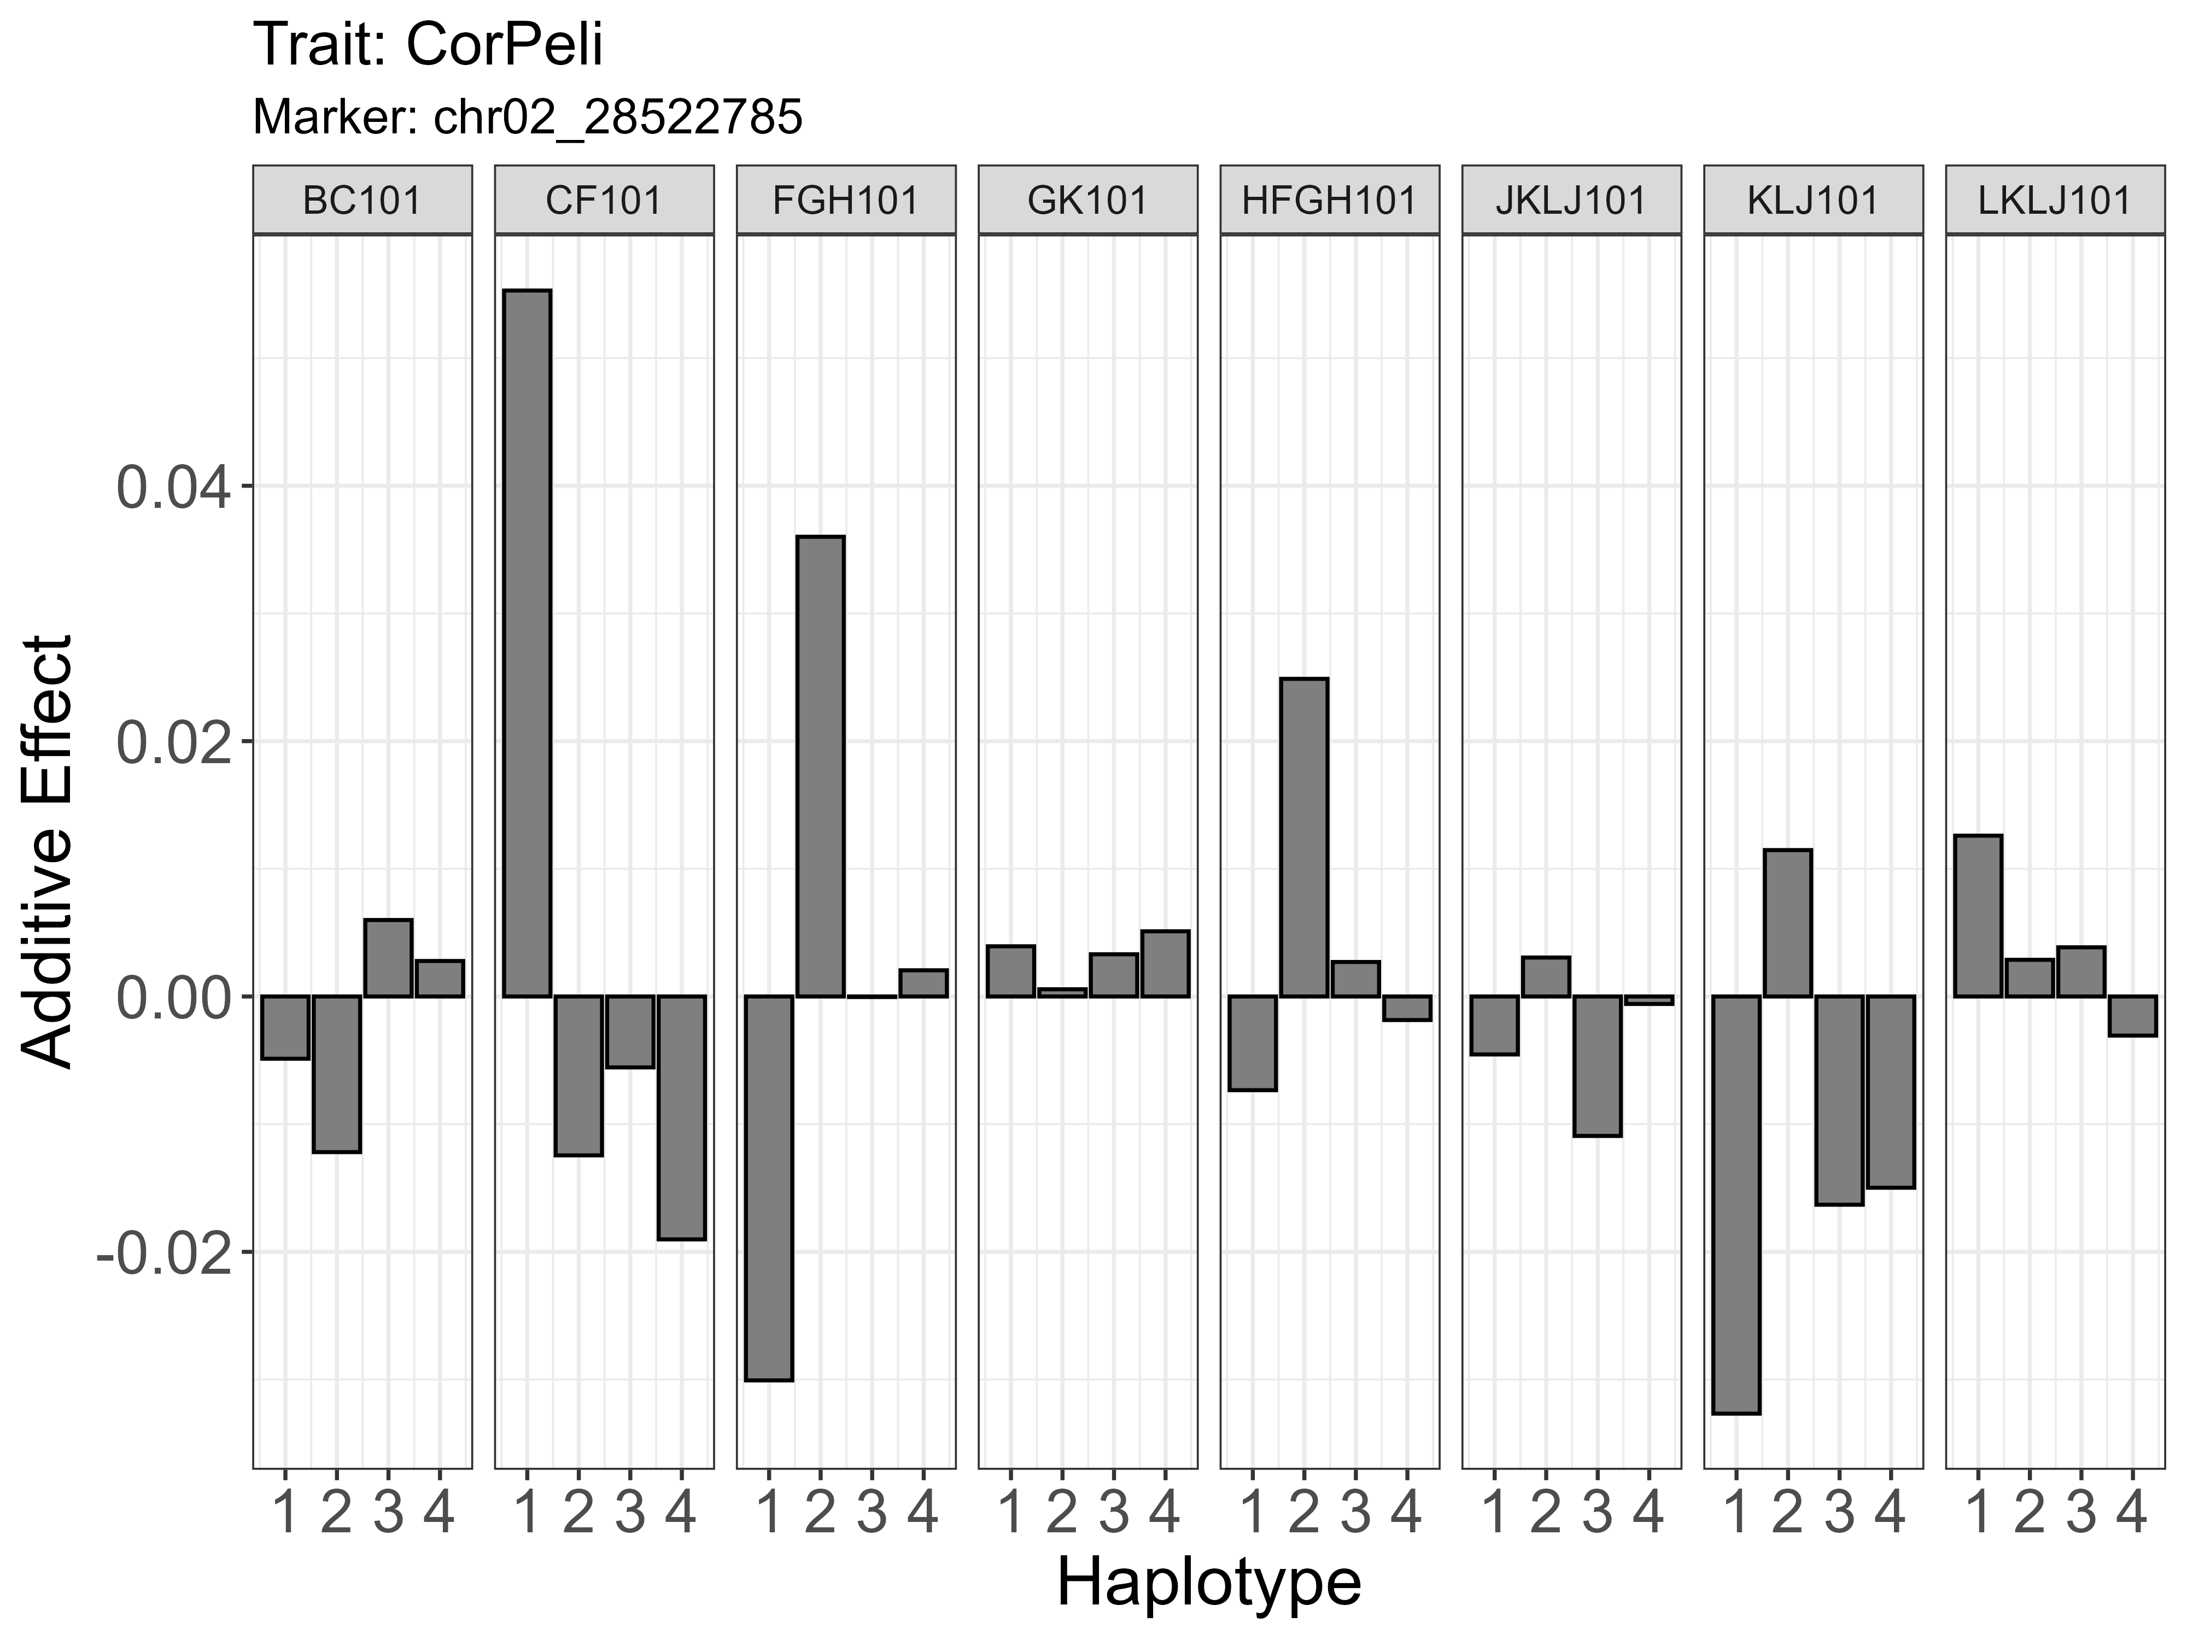
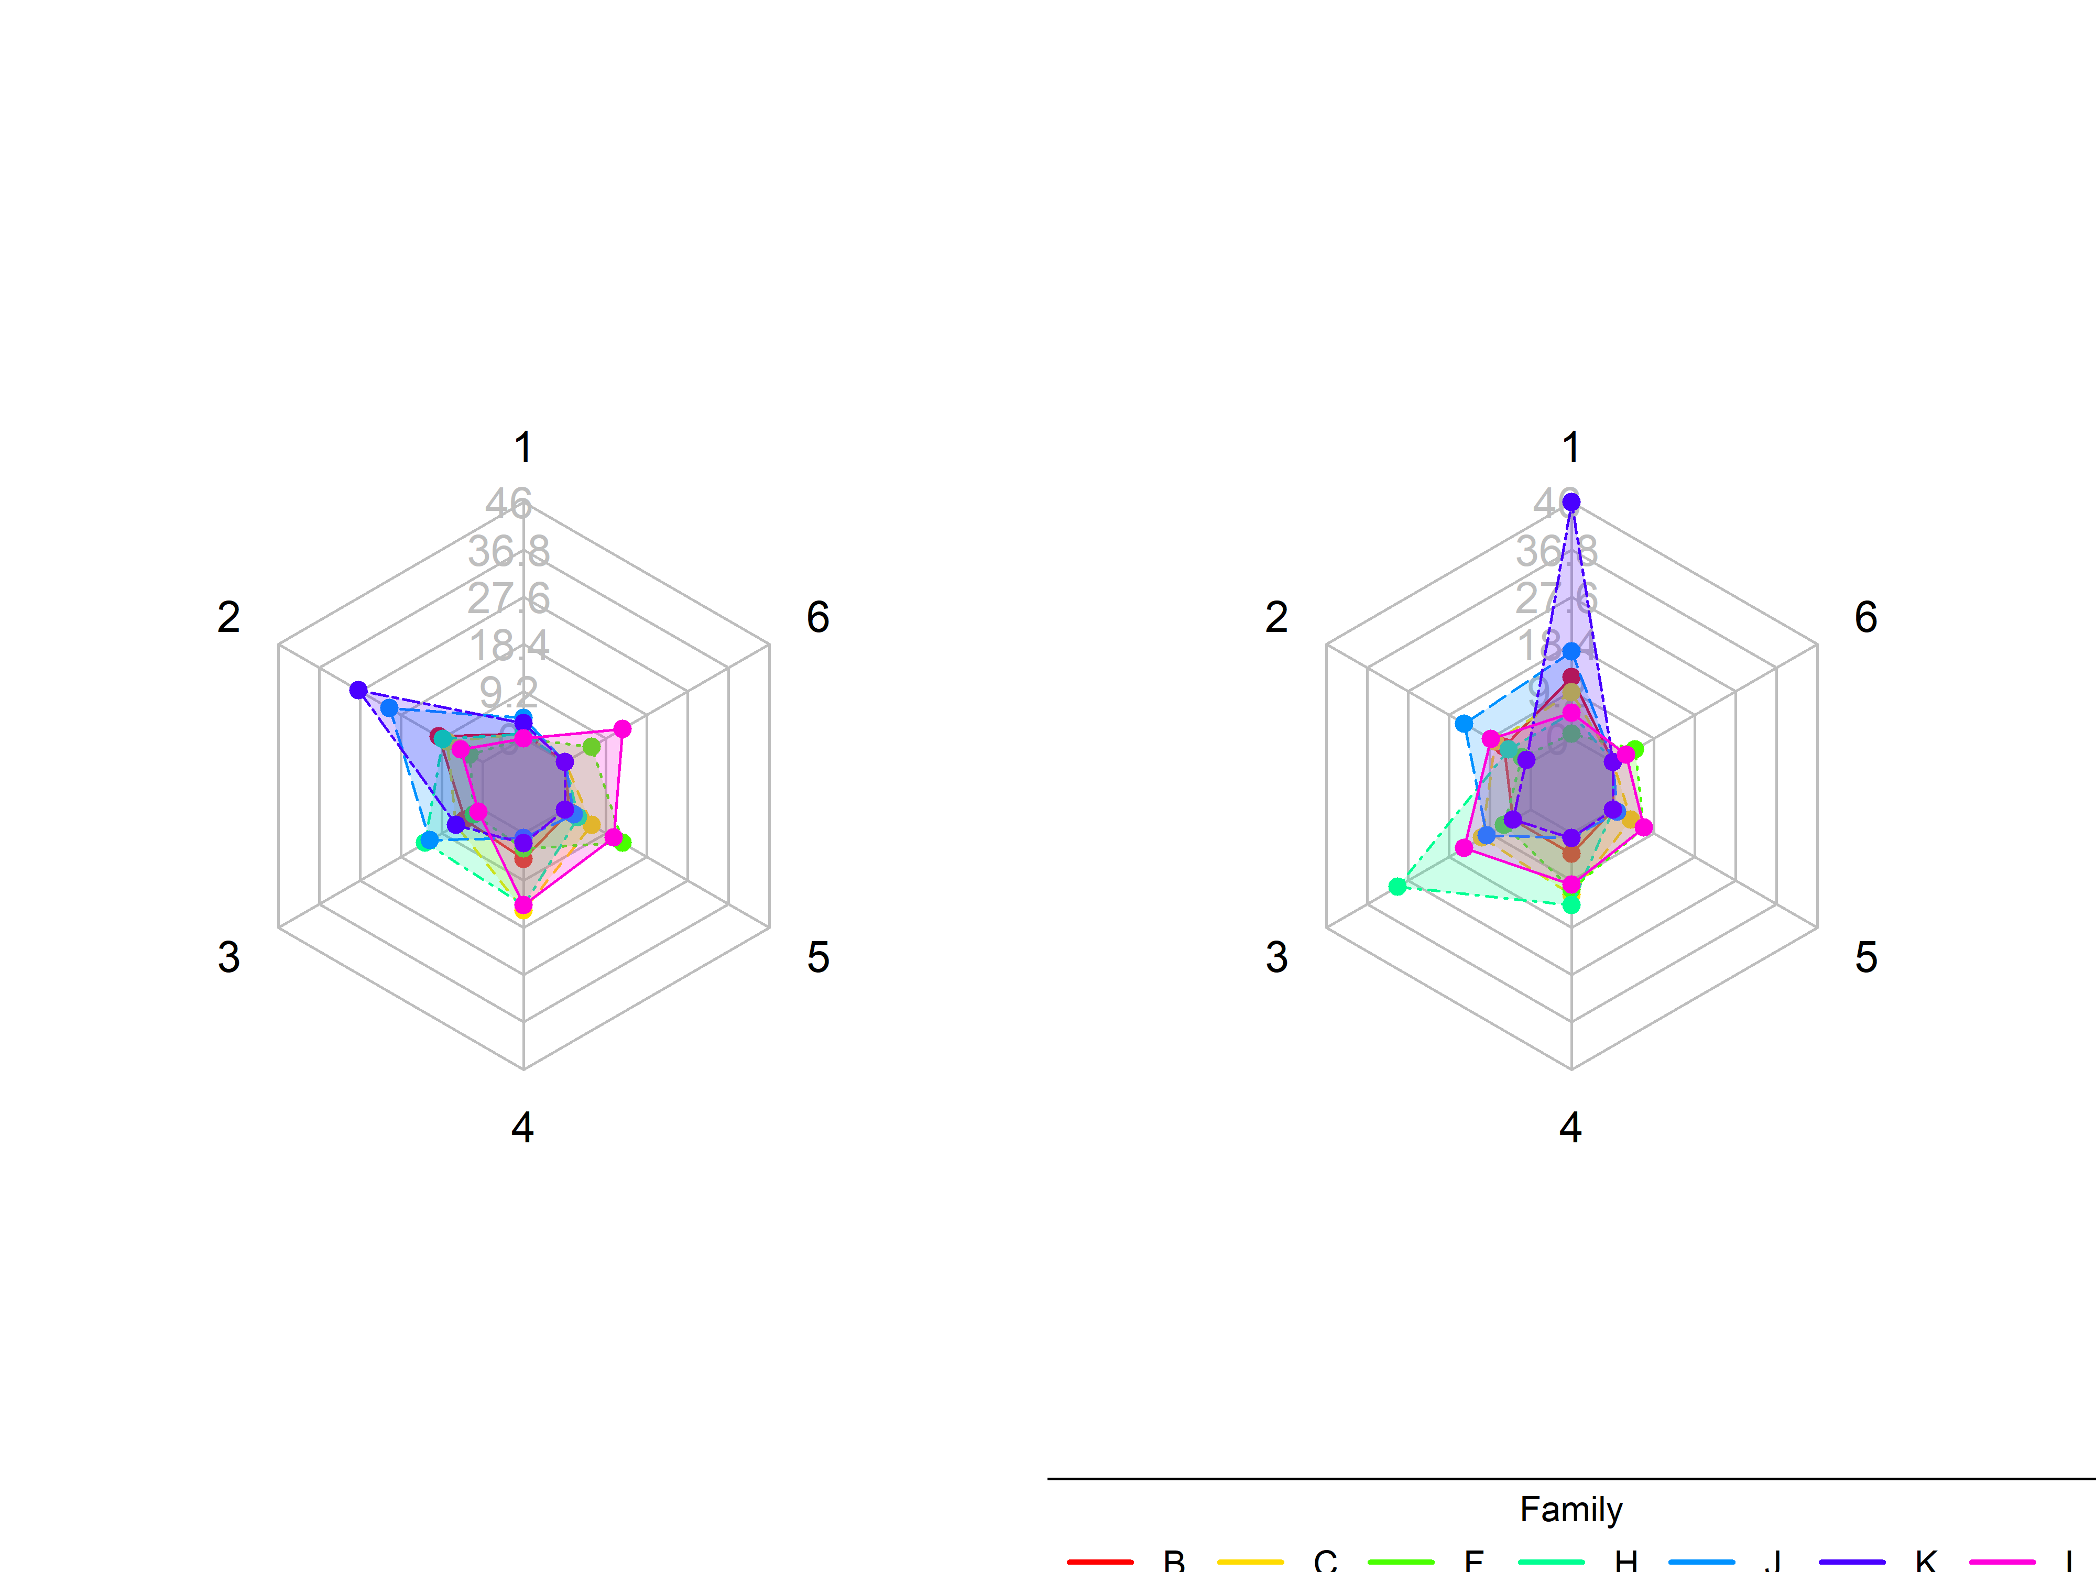
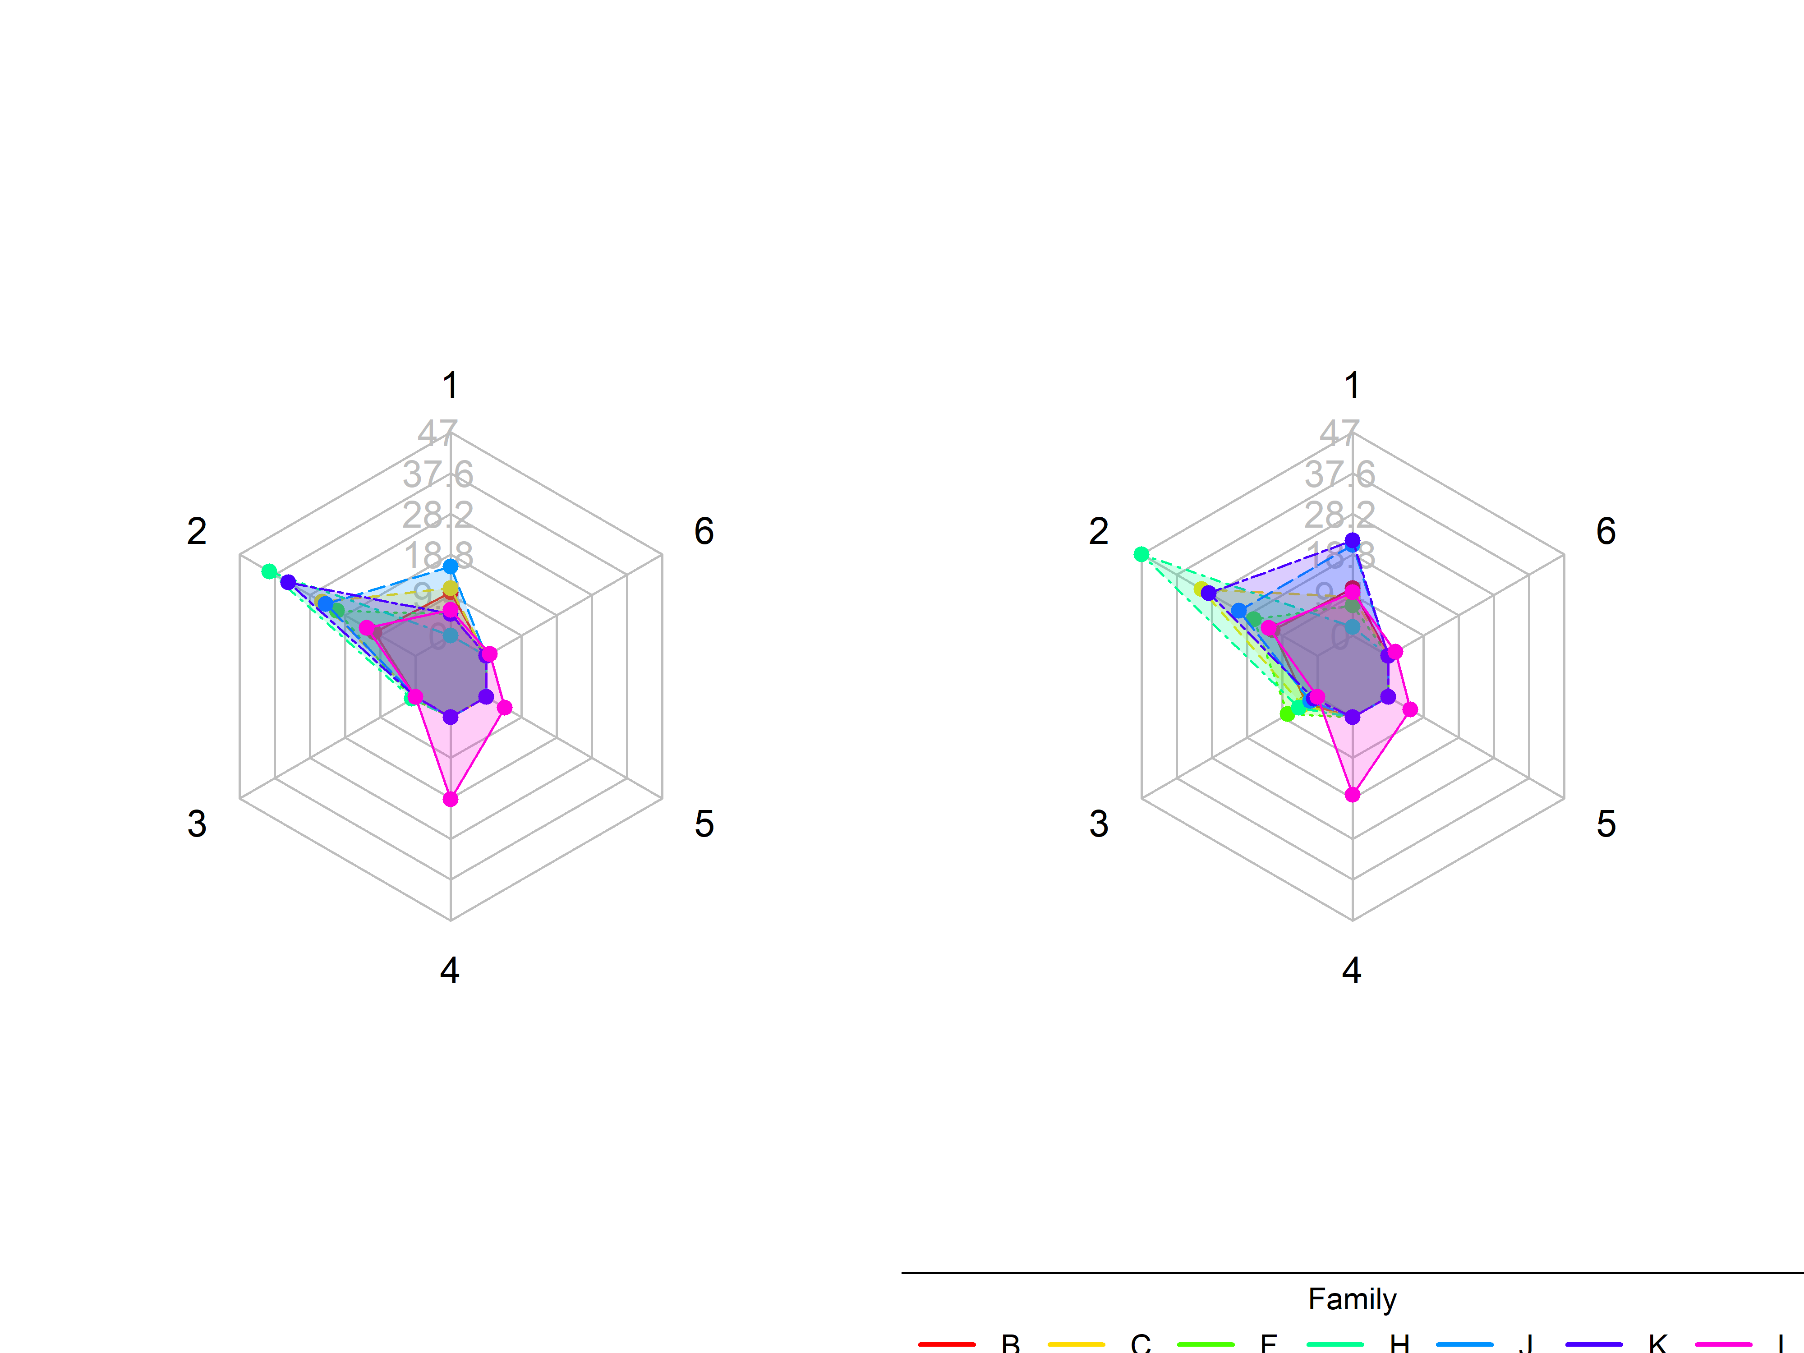
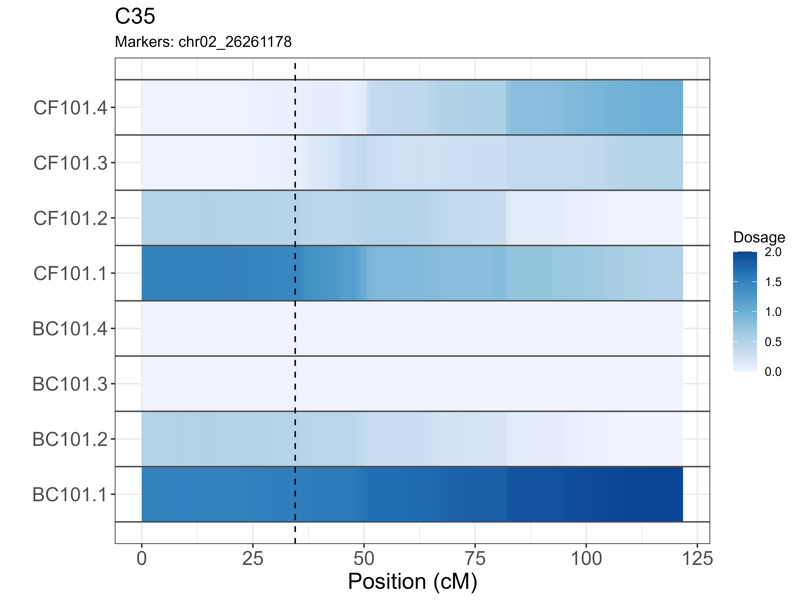
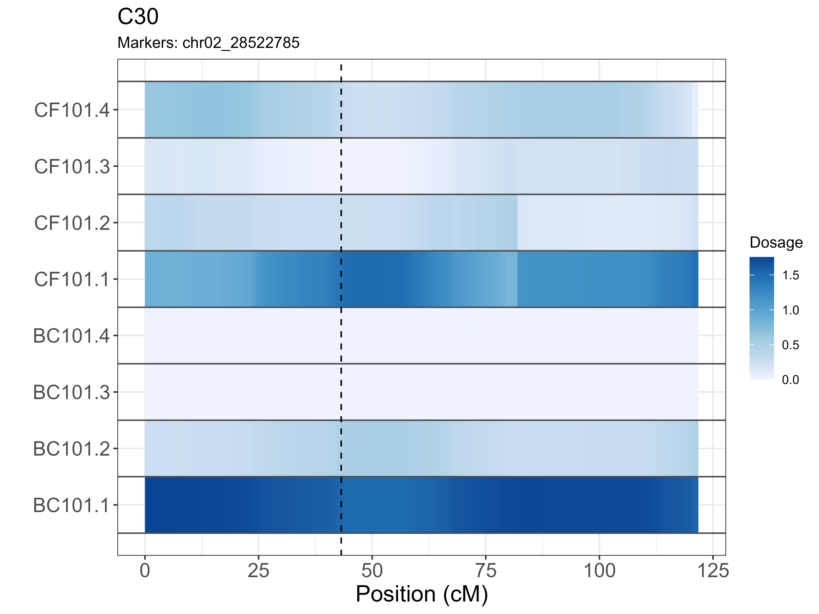



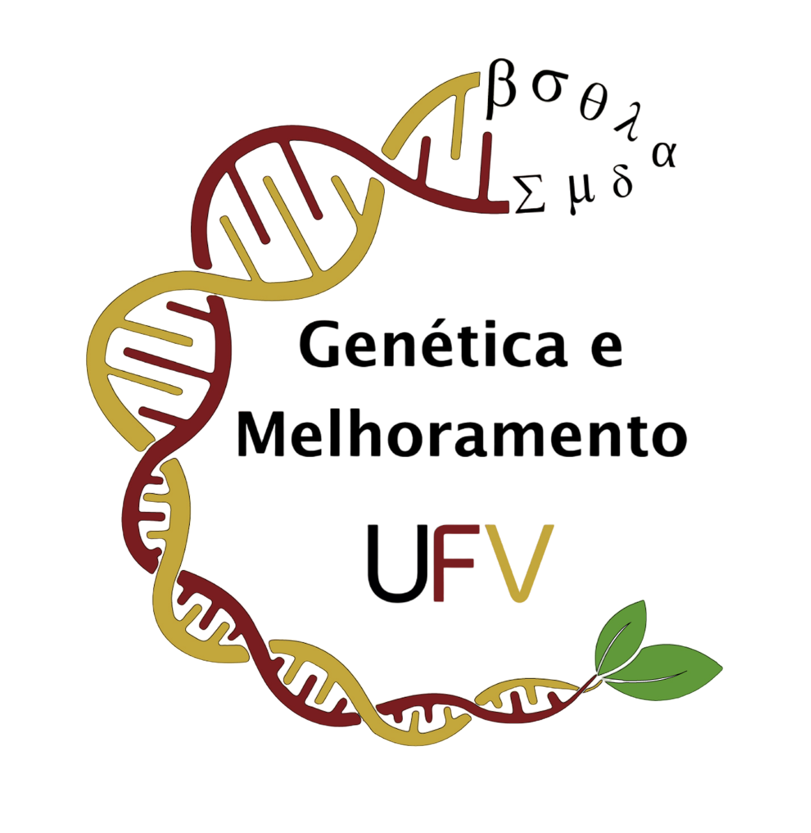


Integrated map construction and QTL mapping in a tetraploid potato multi-parental population
Karya Kate Nanbol^{1*}, Saulo Chaves¹, Adriano Udich Bester^{2,3}, Caroline Marques Castro², Guilherme da Silva Pereira¹
¹ Department of Agronomy, Universidade Federal de Viçosa – UFV
² Brazilian Agricultural Research Corporation - EMBRAPA
³ Department of Crop Science, Universidade Federal de Pelotas – UFPEL
* Corresponding Author: karya.nanbol@ufv.br
1. INTRODUCTION
4. RESULTS
Unraveling the genetic architecture of potato tuber traits can guide selection and enhance breeding effectiveness.
The development of high-throughput and cost-effective single nucleotide polymorphism (SNP) marker panels, coupled with polyploid-specialized software, have provided efficient ways for discovering quantitative trait loci (QTL) on genetic linkage-based studies .
Using an integrated genetic linkage map in QTL analysis greatly boosts accuracy, narrows confidence intervals, and reliably identifies common and stable QTLs across populations.
4.1. QTL discovery
This study revealed a significant QTL on chromosomes 2 and 4, explaining 9% and 14% of the phenotypic variance in tuber shape, respectively(Fig. 4A).
In addition, we detected several QTLs for skin color on chromosomes 1, 2, 9, and 10, with the proportion of explained variation ranging from 3 to 5% (Fig. 4B).
2. GOAL
A
B
To construct an integrated genetic linkage map of a multi-parent population and identify QTL associated with tuber shape and skin color of potato (Solanum tuberosom L.).
3. MATERIAL AND METHODS
3.1. Breeding population and genotyping
A multi-parental population (5 females and 3 males) was created at Embrapa composed of 7 families (36 to 59 individuals per family, total = 335 individuals) (Fig 1A).
The population was genotyped with ∼2.3k single nucleotide polymorphism (SNP) panel from DArTag platform (Fig. 1B).
A
B
Fig. 4. QTL discovery. A) QTLs located on 2 chromosomes for tuber shape, and B) QTLs located on 4 chromosomes for tuber skin color
4.2. Additive effects of parental haplotypes
A
B
Fig. 1. Breeding population A) seven families and progenies count, and B) marker density across potato genome (SNPs within 1 Mb window)
3.2. Phenotyping
Seven full-sib families generated were grown in the nursery during the first two semesters of 2023 at Embrapa, and some tuber traits were rated on a scale of 1 to 6 after harvest
Fig. 5 Additive effect estimates for tuber traits; A) additive effects on chromosomes 2 for tuber shape B) additive effects on chromosome 2 for tuber skin colour.
A
B
4.3. Haplotype-based selection
A
B
Fig.3. Frequency distribution of tuber traits for two semesters; A) tuber shape, and B) tuber skin color
3.3. Integrated linkage map and QTL analysis
Seven individual maps constructed were integrated into a consensus map with 2,264 SNPs spanning 1,480.82cM and haplotype probabilities were estimated and converted into the diaQTL R package expected input format for QTL analysis (Fig. 4).
Fig 7. Haplotype visualization of selected individuals for tuber shape and skin colour; A) Offspring C35 selected for tuber shape B) Offspring C30 selected for tuber skin colour.
5. CONCLUSIONS
These discoveries improve our understanding of the genetic basis of potato tuber traits, identify significant SNPs for marker-assisted selection, and facilitate the early selection of offspring with increased frequencies of alleles associated with the desired tuber traits.
The integrated genetic map derived from the multi-parental population encompasses a large genetic background and enhances the ability to detect QTLs across different genomic regions.
Fig. 4. An integrated linkage map.
6. REFERENCE
7. ACKNOLEDGMENT
Amadeu RR, Muñoz PR, Zheng C, Endelman JB(2021). QTL mapping in outbred tetraploid (and diploid) diallel populations. Genetics, 219(3), iyab124
We appreciate CAPES for sponsoring my study, Embrapa for providing us with the data essential to this project, and UFV for providing us the facilities needed to run our analyses.

