Slide 1




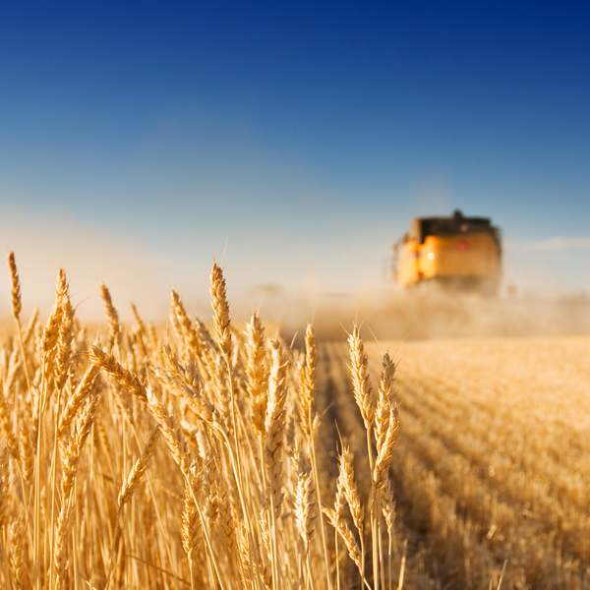
Algorithms in bioinformatics
K-means clustering
Maria

Slide 2
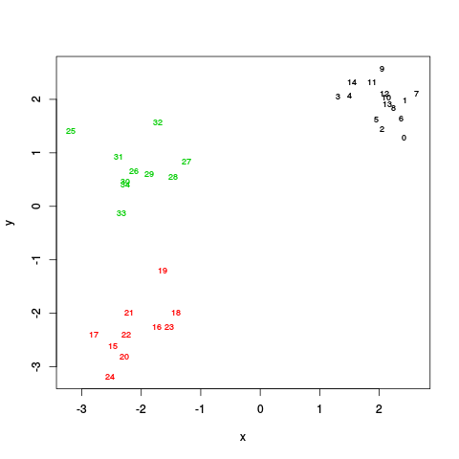
K-means Clustering
Clustering: arranging objects into groups: Objects are characterized by values of sets of variables.
The output is a set of assignments/labels/groups. Multiple format options
List of elements in each cluster Cluster 0: {0,1,2,3,4}; Cluster 1: {5,6,7,8,9}
Labels= [0,0,0,0,0,1,1,1,1,1]
You will implement K-means. K refers to the number of clusters
Notes:
Definition of clustering.
Definition of possible outputs: in each case the first 5 elements are in one cluster and the following 5 are in another cluster.
This has been studied in a lot of previous courses (statistics and Molecular Systems Biology)

Slide 3
Using the algorithm…
Use ratio between WGSS and BGSS to find the optimal number of cluster
WGSS: within-group sum of squares. Measures how similar the elements in the same cluster are to each other.
BGSS: Between-group sum of squares sums. Measures how different elements in different clusters are.
WARNING: you will need to repeat the clustering many times to make sure that you have the “best” possible answer.
Notes:
In this assignment, using the algorithm and understanding the output will be as demanding as writing the algorithm

Slide 4
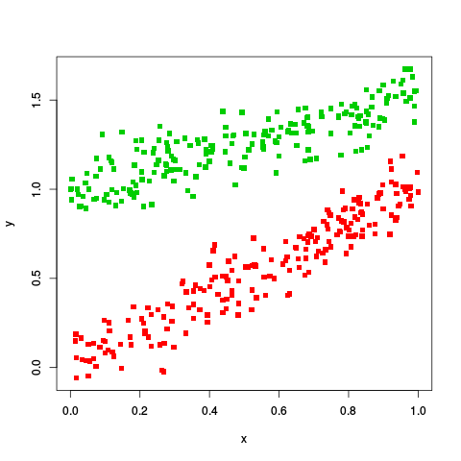
Three data sets
2dtest (35 points in 2 dimensions)
Large set 1 ( 100 points in 24 dimensions)
Large set 2 (400 points in 2 dimensions)
GOOD LUCK!

