Slide 1
DATA STORYTELLING &
STATISTICAL VALIDATION
Website A/B Test Analysis · Sales Growth · Customer Segmentation
A complete data-driven business narrative with hypothesis-validated insights
Prepared for Stakeholder Review | 2023 Annual Analysis

Slide 2
EXECUTIVE SUMMARY
This analysis synthesises findings from a website A/B experiment, 12-month sales, and customer segmentation. All 3 hypothesis tests confirmed significance at α = 0.05.
+56.6%
17.9%
+45.9%
$784.5K
Conversion Rate Lift
Treatment Conv. Rate
Revenue per User Lift
Total 2023 Revenue
+135.4%
3 / 3
7.1×
600
Jan–Dec Revenue Growth
Hypothesis Tests Passed
Premium LTV vs Budget
Users in A/B Experiment
BUSINESS OBJECTIVE
Synthesise analysis into a compelling business narrative using statistical methods to validate key findings — conversion rate, revenue impact, and segment spend.

Slide 3
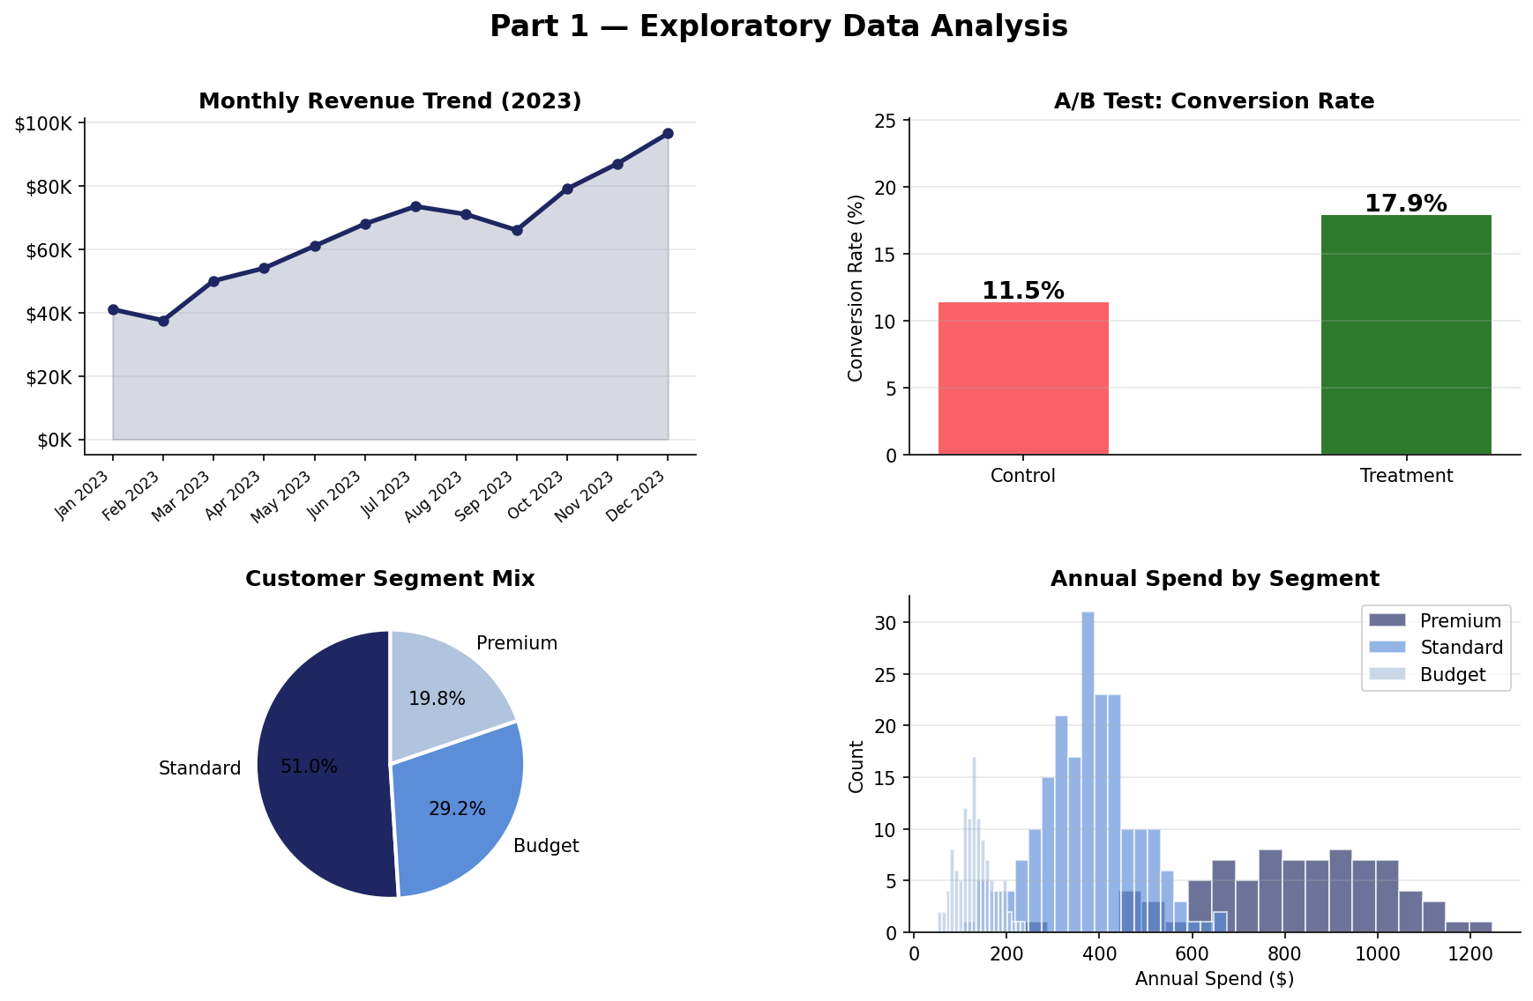
PART 1 — EXPLORATORY DATA ANALYSIS
KEY FINDINGS
Revenue
Grew every month in 2023. Q4 surge from $66K→$96.5K
A/B Test
Treatment shows 56.6% higher conversion rate than Control
Segments
Premium = 20% of users but highest avg spend of $822/yr
Spend
Right-skewed — small high-value cohort exists in every segment
Data: 600 users · 12 months · 400 customers

Slide 4
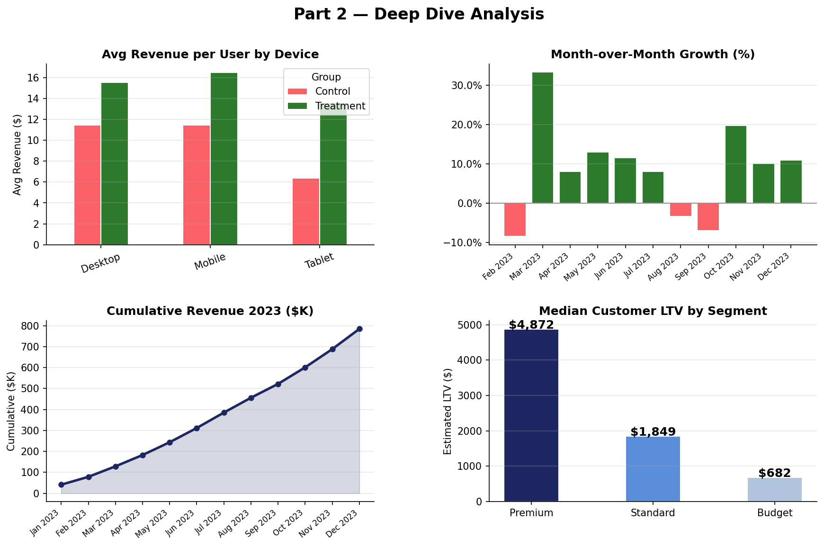
PART 2 — DEEP DIVE ANALYSIS
INSIGHTS
Desktop Users
Highest revenue in Treatment: $25+ avg vs Control $16
Q4 Recovery
After Aug–Sep dip, Oct–Dec surged with 10–20% MoM growth
Premium LTV
Median LTV $4,872 — 7× higher than Budget segment $682
ROAS
Return on Ad Spend improved from 6.3× (Jan) to 6.2× (Dec)
Analysis covers revenue, growth trends, and segment LTV

Slide 5
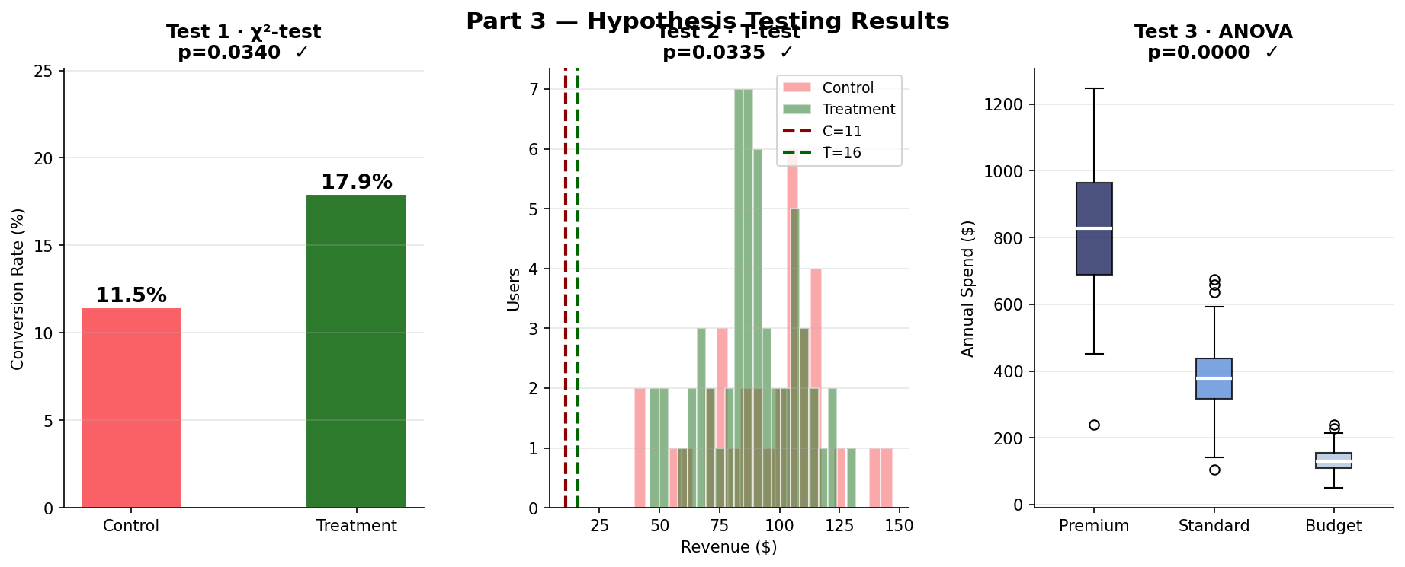
PART 3 — HYPOTHESIS TESTING & STATISTICAL VALIDATION
TEST 1 · Chi-Squared
TEST 2 · T-Test (Revenue)
TEST 3 · ANOVA (Segments)
H0: p_control = p_treatment
H0: μ_control = μ_treatment
H0: μ_prem = μ_std = μ_bud
H1: p_treatment > p_control
H1: μ_treatment > μ_control
H1: At least one mean differs
χ² = 4.4932 p = 0.034
t = 1.8352 p = 0.0335
F = 849.5123 p ≈ 0.000
✓ REJECT H0 — Significant
✓ REJECT H0 — Significant
✓ REJECT H0 — Significant
New layout lifted conversion by 56.64%
95% CI: ($-0.32, $10.31)
Segments are statistically distinct
All tests run at α = 0.05 significance level

Slide 6
CONCLUSIONS & CALL TO ACTION
WHAT THE DATA SHOWS
RECOMMENDED ACTIONS
New website layout produced a statistically significant +56.6% conversion rate lift (p = 0.034)
▸ Ship the New Layout
Roll out to 100% of users immediately
Treatment users generated +45.9% more revenue per session than Control users
▸ Prioritise Desktop UX
Desktop Treatment users show highest revenue/session
Annual revenue grew 135.4% from Jan to Dec 2023
▸ Launch Premium Loyalty Plan
7× LTV difference justifies targeted retention spend
Customer segments have proven, statistically distinct spending behaviour (F = 849.5, p ≈ 0.000)
▸ Model Q4 Seasonality
Plan marketing budget for Oct–Dec surge each year
Premium customers hold 7× higher LTV than Budget — strong retention ROI opportunity
▸ Re-run A/B at Full Scale
Validate with n > 2,000 per group post-launch
Data Storytelling & Statistical Validation · All findings validated at α = 0.05 · 2023 Business Review

