Slide 1

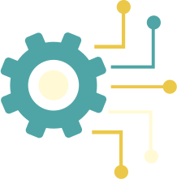
CIRCUIT-SENSE AI
Autonomous Multimodal Agent for Hardware Debugging & Safety.
Theme 3: Productivity Platforms

Slide 2
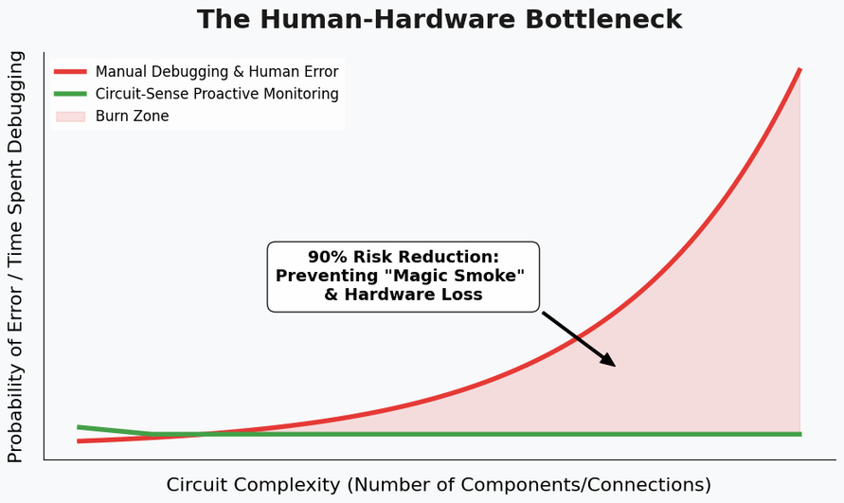
THE $100 BILLION "FRIED CHIP" PROBLEM
Manual Overhead: Engineers spend 60% of time cross-referencing physical breadboards with 500+ page PDF datasheets.
Human Error: One swapped VCC/GND wire leads to instant hardware failure and project delays.
Cognitive Load: No current AI "sees" the physical circuit and "reads" the technical constraints simultaneously.
The real void in the Market is lack of real-time, proactive intervention in hardware prototyping increasing the debugging time and hardware costs.
Building the future of hardware, without the smoke.

Slide 3
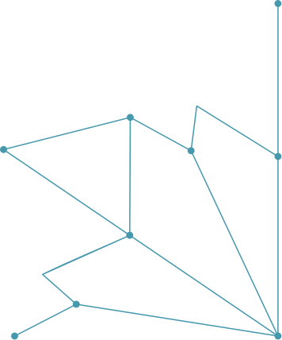
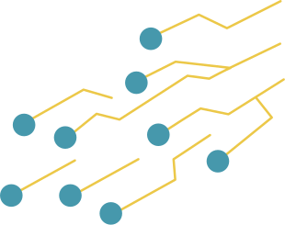
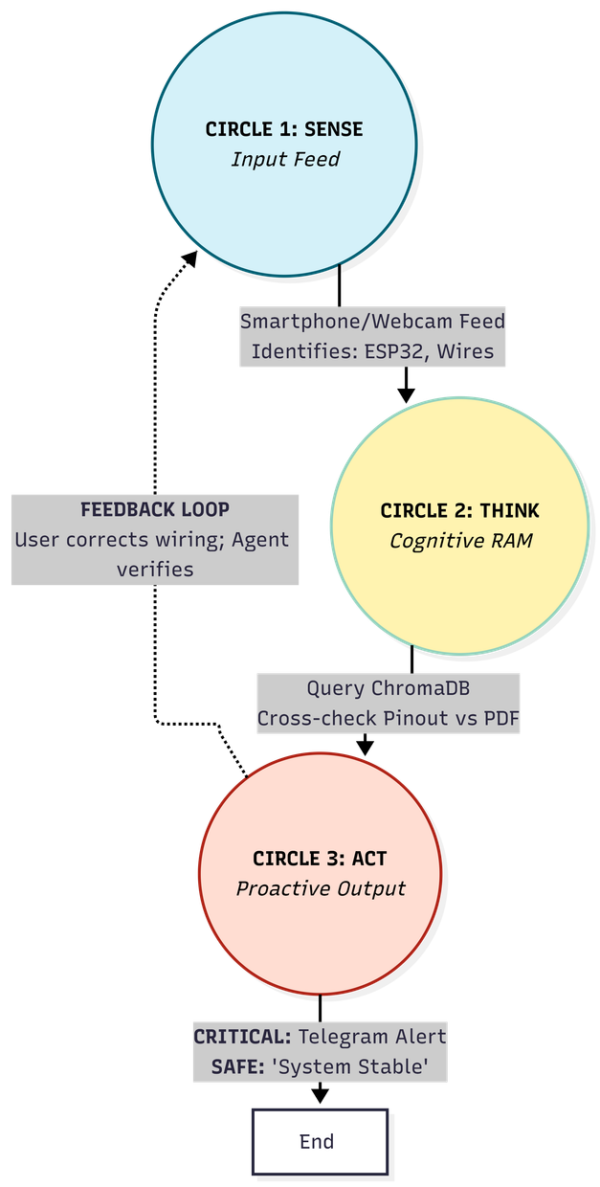
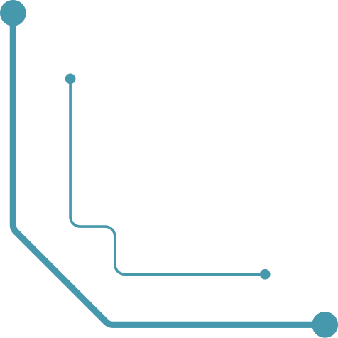
A LACK OF REAL-TIME, PROACTIVE INTERVENTION IN HARDWARE PROTOTYPING
How it Works:
See: Multimodal Vision identifies components & wiring.
Verify: RAG-based Research queries the datasheet for pinouts & voltage limits.
Act: Proactive alerts via WhatsApp/Telegram if a safety violation is detected.
Value Prop: Reduces hardware "burn" rate by 90% and speeds up prototyping by automating pinout validation.
Building the future of hardware, without the smoke.

Slide 4
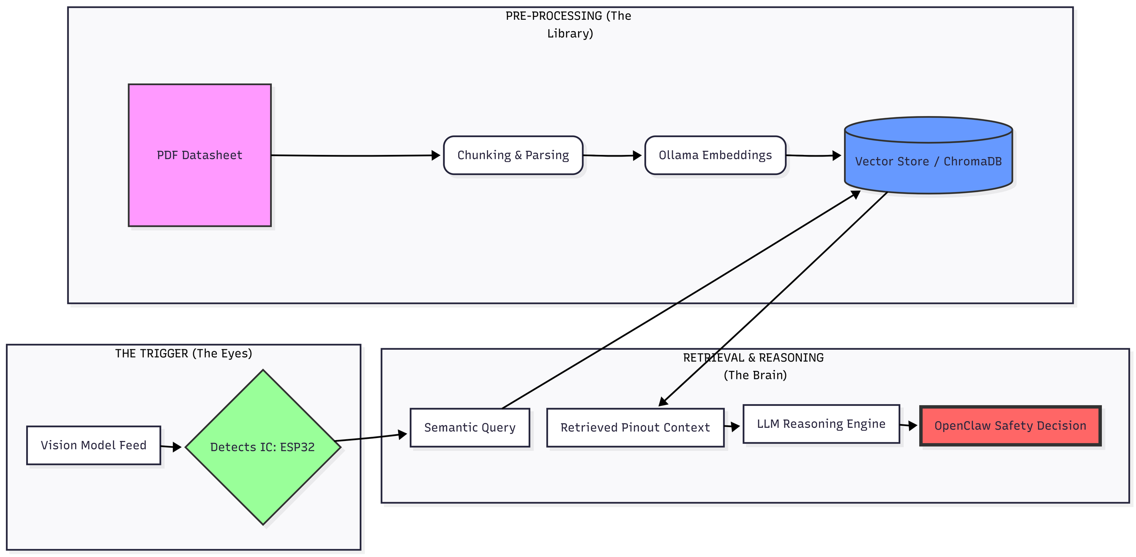
DETAILED PIPELINE
Building the future of hardware, without the smoke.

Slide 5

The Tank : Local Python environment running FastAPI.
Vision Engine: Moondream2 or LLaVA-v1.5 (Local VLM) for object/wire detection.
Cognitive RAM: ChromaDB vector store containing indexed PDF datasheets.
OpenClaw Integration: * SOUL.md: Meticulous, safety-first engineering personality.
HEARTBEAT.md: Proactive loop checking the "Camera Feed" against "Safe State."
BUILT ON
THE OPENCLAW "LOBSTER WAY."
Building the future of hardware, without the smoke.

Slide 6

BASIC USER EXPERIENCE
Step 1: User uploads the datasheet of a new sensor/MCU.
Step 2: User points their smartphone/webcam at the breadboard.
Step 3: The Agent identifies the chip and says: "I see you're using an ESP32. I've mapped the pins."
Step 4 : User moves a wire to a 5V rail. Agent sends a Telegram alert: "STOP! Pin 12 is 3.3V tolerant only. Connection at 5V detected."
Building the future of hardware, without the smoke.

Slide 7
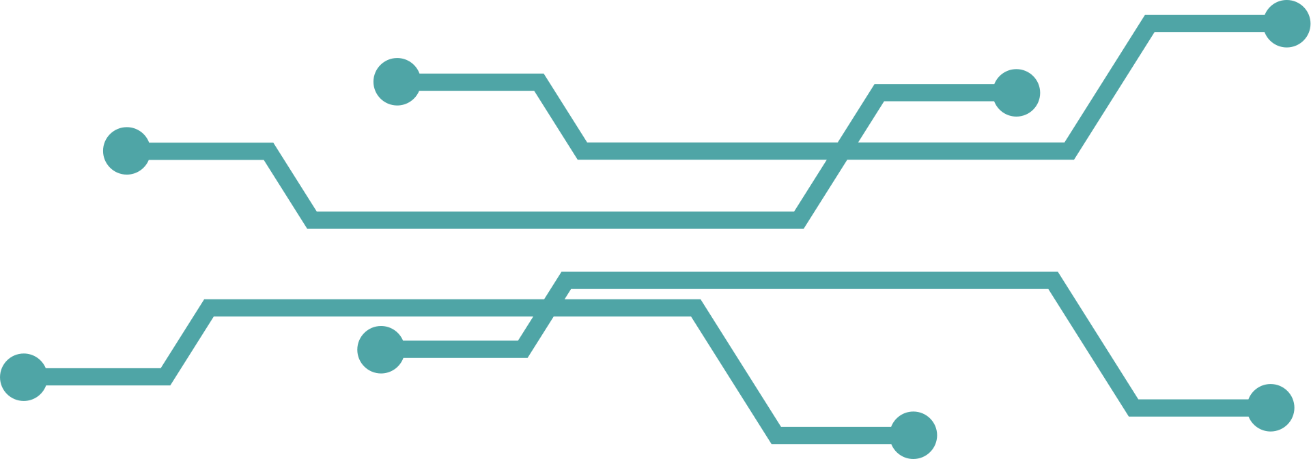
DEVELOPMENT ROADMAP
Week 1 (Current - May 1): PDF Parsing engine + basic Component Recognition (ESP32/Arduino).
Week 2 (May 2 - May 5): Integrating RAG with Vision outputs; establishing the OpenClaw logic loop.
Week 3 (May 6 - May 8): Edge-case testing, UI polish, and recording the 10-minute demo video.
Building the future of hardware, without the smoke.

Slide 8
Impact: Democratizes embedded engineering for beginners and prevents expensive hardware loss for pros.
Future Scope: * Auto-generation of Schematics from breadboard photos.
Integration with Oscilloscopes for real-time signal debugging.
IMPACT
& FUTURE SCOPE
Building the future of hardware, without the smoke.

