Slide 1


| Tech Management, SRI-B
CLAWS
CLASH OF THE
RV College of Engineering_CircuitPulse
See the circuit
Stop the damage
Kaseem Khan Pathan

Slide 2
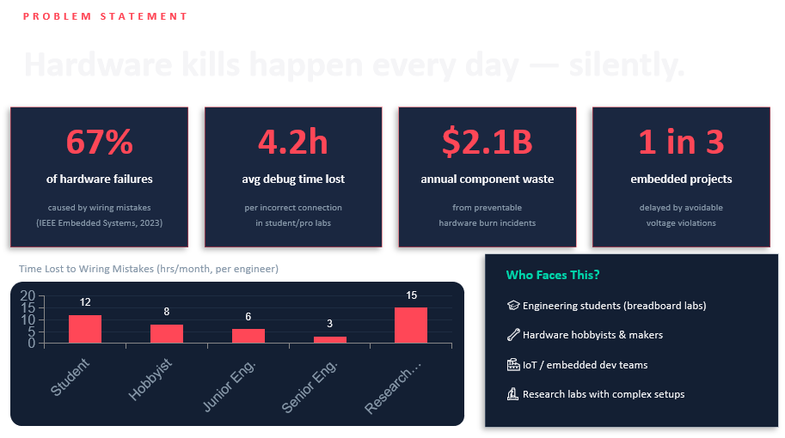
Idea

Slide 3
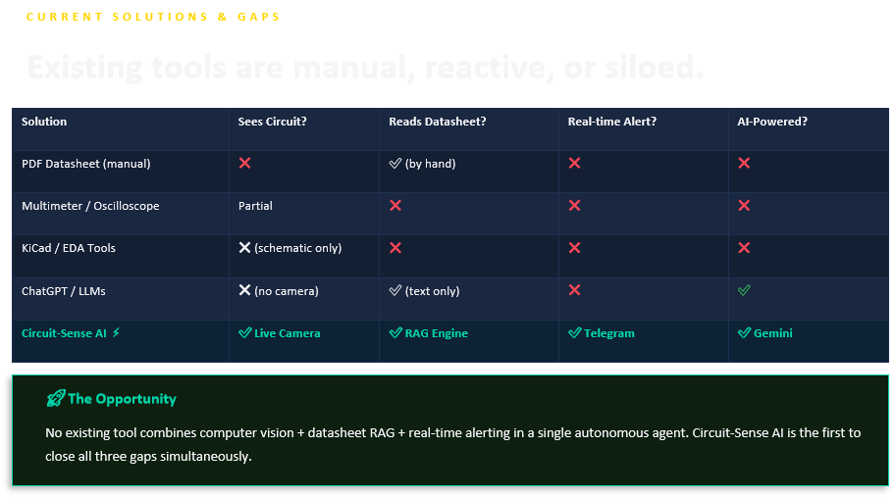

Slide 4
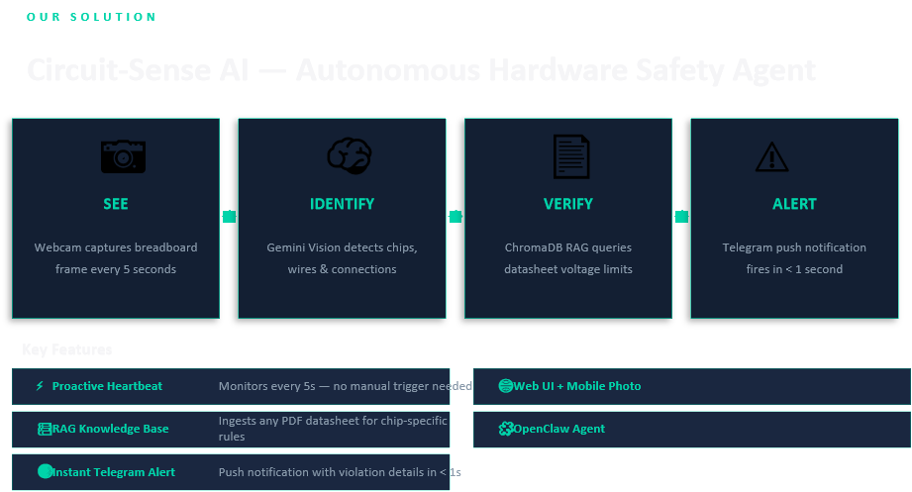

Slide 5
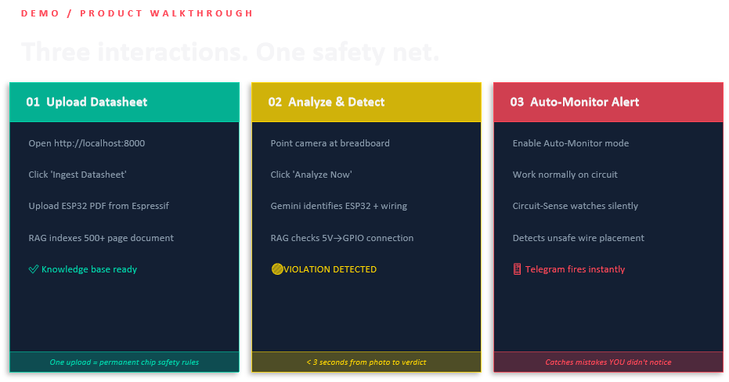

Slide 6
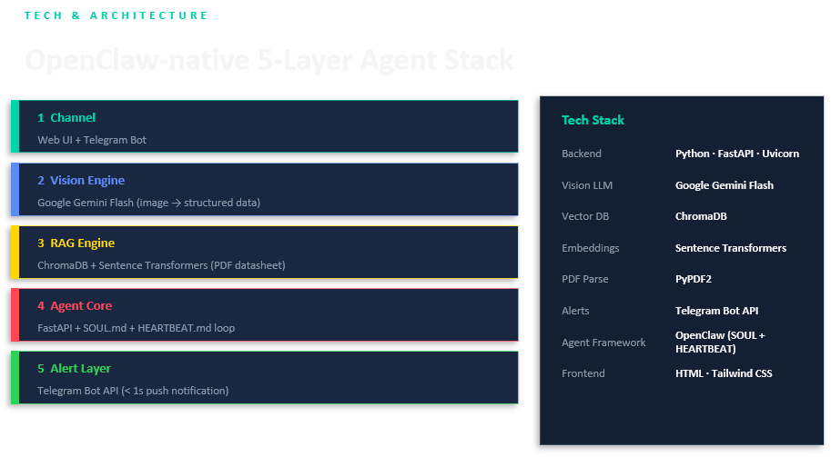
Tech Stack
AI usage( model, APIs, Framework) System Flow( simple)
Keep it real, not generic

Slide 7
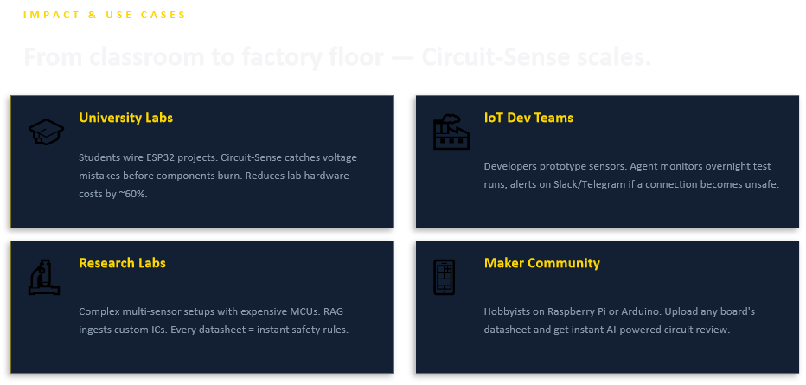

Slide 8
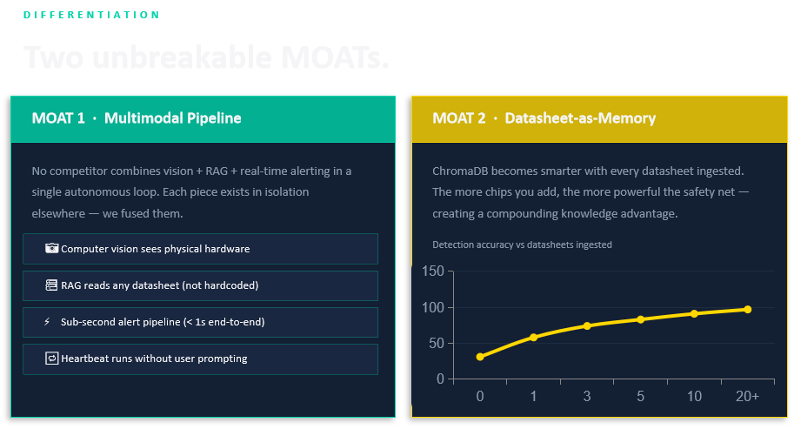

Slide 9
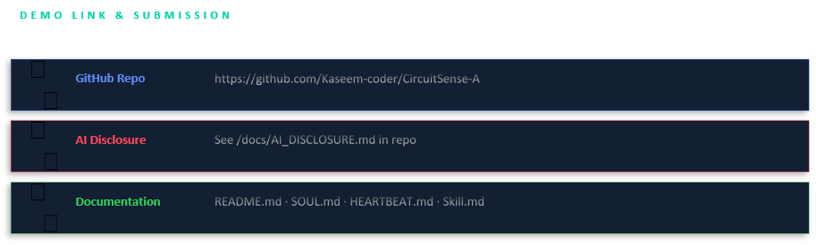

Slide 10
