Slide 1
Diabetes Readmission
Risk Prediction
Using Machine Learning & Deep Learning on Electronic Health Record Data
AIGC 5005 — Winter 2026 | Humber Polytechnic
Fadi Kash Kannaiti • Ogbeide Iria • Oguzhan Tekin • Sara Yenigun
Instructor: Hossein Pourmodheji
github.com/KashKannaiti/W26-AIGC5005-Final | Live App: w26-aigc5005-final.streamlit.app

Slide 2
Agenda
15-minute walkthrough
01
The Problem
05
Results & Analysis
Why diabetes readmissions matter — the $17B challenge
Metrics, ROC curves, threshold calibration, SHAP
02
Dataset & Preprocessing
06
Deployment & Highlights
UCI 130-hospital dataset, SMOTE, feature engineering
Live Streamlit app + project highlights vs. literature
03
Literature Review
07
Conclusions & Future Work
5 peer-reviewed papers and the gaps we fill
Key takeaways and next steps
04
Our 5-Model Pipeline
LR → RF → XGBoost → PyTorch MLP → TF/Keras MLP

Slide 3
The Problem
Why hospital readmissions are a critical challenge
CLINICAL CONTEXT
$17B
1 in 5
22.7%
$10–15K
Annual US cost of
preventable readmissions
Diabetic patients readmitted
within 30 days
Max readmission rate in
diabetic populations
Cost per preventable
readmission event
Traditional Tools Fall Short
Machine Learning Offers a Better Path
LACE index and HOSPITAL score capture only a handful of variables and are applied inconsistently. They cannot detect non-linear, high-order patterns across 50+ features.
By training on 101,766 EHR encounters spanning 130 US hospitals, ML models identify subtle patterns in medications, diagnoses, and prior utilization that predict readmission risk.

Slide 4
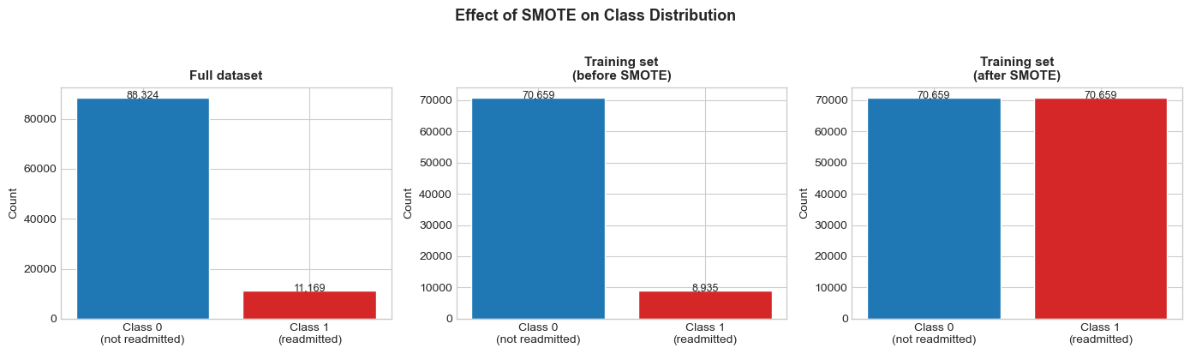
Dataset Overview
UCI Diabetes 130-US Hospitals Dataset (1999–2008)
101,766
Patient encounters across 130 US hospitals
50
Features: demographics, diagnoses, medications, utilization
11.2%
Positive class (readmitted <30 days) — severe 8:1 imbalance
Figure: Class distribution — raw dataset (left), before SMOTE (center), after SMOTE (right)
80 / 20
Train / Test split (stratified, random_state=42)
Drop missing cols (weight 97%, payer_code 40%) → Label/Ordinal/OHE encoding → ICD-9 → 9 disease categories → SMOTE (train only) → StandardScaler (NN only)

Slide 5
Literature Review
5 Peer-Reviewed Papers — State of the Art
Emi-Johnson &
Nkrumah (2025)
Hai et al.
(2023)
Gandra
(2024)
Liu et al.
(2024)
Jagadamba et al.
(2023)
XGBoost + SHAP on UCI
AUC=0.667 | No deployment
LSTM on 2.8M EHR encounters
AUC=0.79 | No imbalance handling
6 ensemble models (CatBoost best)
AUC=0.70 | No F1 reported
GWO + SMOTE | RF F1=0.83
Best F1 in literature — no deployment
EHR-integrated ML (1,080 records)
Conceptual basis for our deployment
Gaps Our Project Fills:
✓ Correct SMOTE placement (post-split, train only) — 3 of 5 papers ignore imbalance
✓ F1-score as primary metric — most papers report accuracy only on imbalanced data
✓ SHAP explainability (global + patient-level) — only 1 of 5 papers includes SHAP
✓ Live public deployment — NONE of the 5 reviewed papers produced a deployable tool
✓ PyTorch vs TensorFlow comparison — first cross-framework comparison on UCI dataset

Slide 6
Our 5-Model Pipeline
From Baseline to Deep Learning
BASELINE
TUNED
★ BEST F1
DEEP LEARNING
DEEP LEARNING
Logistic
Regression
Random
Forest
XGBoost
PyTorch
MLP
TF/Keras
MLP
SMOTE training
Interpretable coefficients
Performance floor
GridSearchCV
n_est=200, depth=20
No scaling needed
scale_pos_weight=7.91
No SMOTE needed
AUC-PR optimized
256→128→64→1
BatchNorm + Dropout
Threshold @0.15
Same architecture
Sequential API
Callbacks
Deep Learning Architecture (both frameworks): Input → 256 → 128 → 64 → 1 | BatchNorm + Dropout(0.3/0.2) | ReLU → Sigmoid | Adam (lr=1e-3, wd=1e-4)
ReduceLROnPlateau + EarlyStopping (patience=10) | SMOTE-balanced training | StandardScaler features

Slide 7
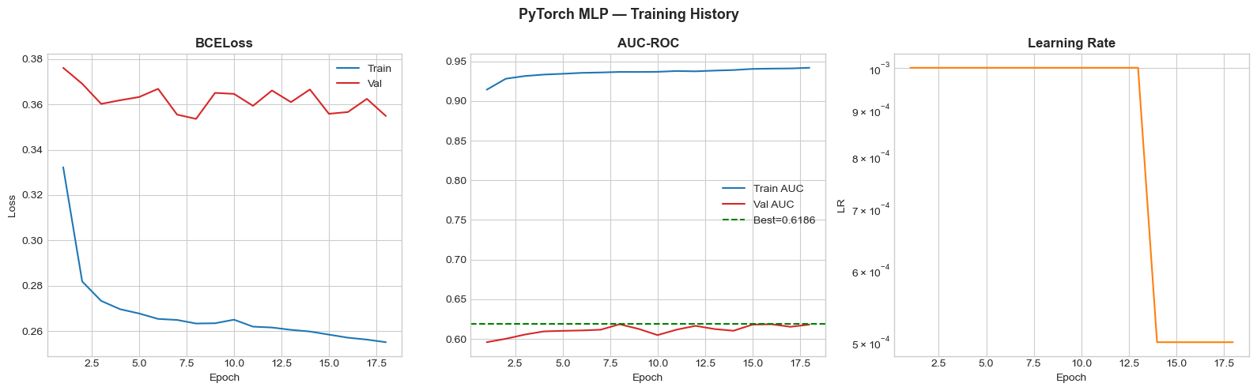
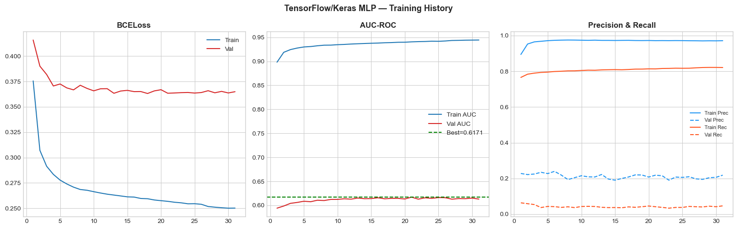
Deep Learning Training Curves
PyTorch MLP & TensorFlow/Keras MLP
PyTorch MLP
TensorFlow / Keras MLP
Key Training Observations
Early Stopping
AUC Convergence
Both models stop at ~50 epochs — preventing overfitting on SMOTE-augmented data
PyTorch: AUC-ROC 0.6186 | TensorFlow: AUC-ROC 0.6170 — confirming cross-framework reproducibility
LR Scheduling
Loss Behaviour
ReduceLROnPlateau reduces learning rate when AUC-ROC plateaus, allowing finer convergence
BCE Loss steadily decreases; gap between train/val loss small — no significant overfitting

Slide 8
Results — Full Model Comparison
All metrics on held-out test set (19,899 records, 11.2% positive rate)
Model | Accuracy | Precision | Recall | F1 | AUC-ROC | AUC-PR
Logistic Regression (Baseline) | 0.8680 | 0.2312 | 0.0756 | 0.1140 | 0.5578 | 0.1440
Random Forest (Tuned) | 0.8759 | 0.2094 | 0.0380 | 0.0644 | 0.5974 | 0.1560
XGBoost ★ Best Overall | 0.6852 | 0.1826 | 0.5192 | 0.2702 | 0.6603 | 0.2141
PyTorch MLP | 0.8851 | 0.2797 | 0.0148 | 0.0281 | 0.6186 | 0.1690
TensorFlow / Keras MLP | 0.8757 | 0.2183 | 0.0416 | 0.0699 | 0.6170 | 0.1623
⚡ Neural network low F1 at default threshold=0.50 reflects imbalanced data, NOT model failure. PyTorch MLP at threshold=0.15 achieves F1=0.2406, Recall=0.5577 — highest recall of all 5 models.

Slide 9
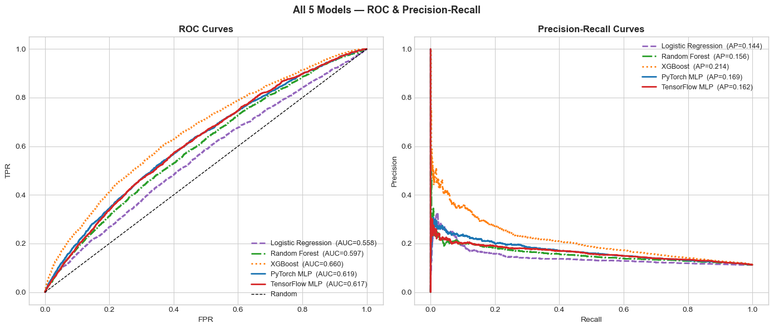
ROC & Precision-Recall Curves
All five models — discriminative ability comparison
ROC curves (left) and PR curves (right). XGBoost leads on both AUC-ROC (0.66) and AUC-PR (0.21). Neural networks outperform LR on AUC-ROC despite low default-threshold F1.
AUC-ROC 0.6603 XGBoost — Best overall
AUC-PR 0.2141 XGBoost — 2× random baseline
AUC-ROC 0.6186 PyTorch MLP — best deep learning
Baseline ≈ 0.112 Random PR baseline (11.2% pos rate)

Slide 10
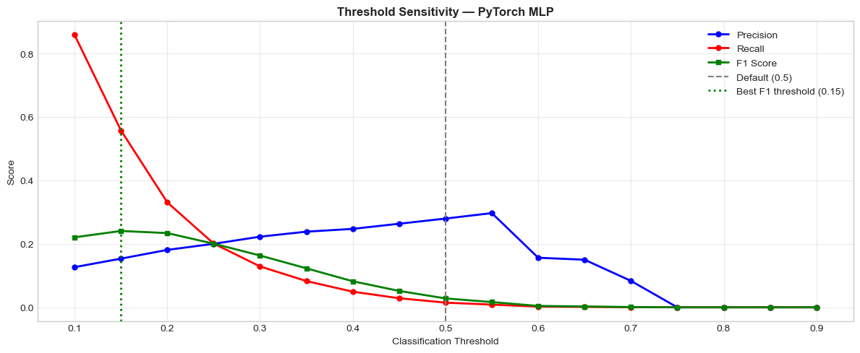
Threshold Sensitivity Analysis
PyTorch MLP — finding the clinical operating point
Threshold | Precision | Recall | F1
0.50 (default) | 0.2797 | 0.0148 | 0.0281
0.25 | 0.2001 | 0.2010 | 0.2005
0.15 ★ Optimal | 0.1534 | 0.5577 | 0.2406
🎯 37× Improvement in Recall
Threshold 0.5 → Recall 0.015
Threshold 0.15 → Recall 0.558
Catches 56% of true readmissions vs. just 1.5%
Clinical Interpretation: In hospital screening, missing a true readmission (False Negative) is more costly than a false alarm (False Positive). Threshold=0.15 maximises Recall — catching 56% of at-risk patients — while maintaining F1=0.241. The Streamlit app can allow clinicians to select High-Recall mode vs. High-Precision mode based on ward capacity.

Slide 11
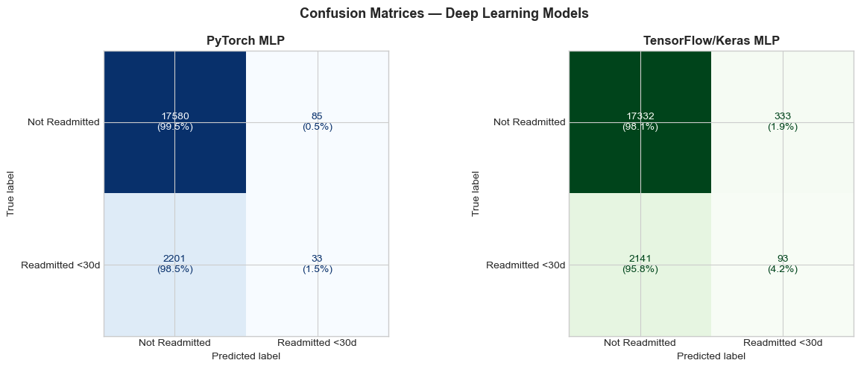
Deep Learning Confusion Matrices
PyTorch MLP vs. TensorFlow/Keras MLP — default threshold 0.50
At default threshold=0.50, both models classify most patients as Low Risk (high TN), missing most readmissions. Threshold calibration to 0.15 dramatically increases True Positives.
PyTorch MLP | Precision=0.2797 • AUC-ROC=0.6186
TF/Keras MLP | Precision=0.2183 • AUC-ROC=0.6170

Slide 12
SHAP Explainability
Global feature importance + patient-level interpretation
Top 5 SHAP Predictors (Random Forest, 500 test patients)
Three Levels of SHAP Analysis
#1
number_inpatient
Prior hospitalizations — strongest predictor; repeat admissions signal poor disease control
Global Beeswarm
500 test patients. Shows direction & magnitude of each feature's impact on readmission probability.
#2
num_medications
High medication burden = complex, unstable diabetes management
Global Bar Plot
Mean absolute SHAP values. Simple ranking: which features matter most on average.
#3
time_in_hospital
Patient Waterfall
Longer stays suggest more severe episodes and higher discharge-day risk
Individual prediction for highest-risk patient. Explains EXACTLY why the model flagged them — bedside-ready.
#4
number_diagnoses
Multiple comorbidities compound readmission risk significantly
Cross-Study Replication ✓
#5
Our SHAP results independently confirm Emi-Johnson & Nkrumah (2025): number_inpatient, num_medications, and time_in_hospital are the top 3 predictors — identical ranking across two independent analyses.
number_emergency
Prior emergency visits reflect disease instability and care-access gaps

Slide 13
Live Deployment — Streamlit Web App
XGBoost model deployed as a publicly accessible clinical decision support tool
🌐 https://w26-aigc5005-final-ep8i66n6nez3543zo2iert.streamlit.app
📊
Risk Classification
⚡
Instant Results
📋
Clinical Action
Low / Moderate / High risk level based on XGBoost probability output
Returns prediction in <1 second. No batch processing — real-time at discharge
Auto-recommends: 'Schedule follow-up within 7 days' or 'Standard discharge protocol'
📈
Probability Gauge
🔍
SHAP Explanations
📱
Mobile-Responsive
Visual gauge showing readmission probability so clinicians can assess confidence
Top contributing risk factors displayed for EACH patient prediction
Works on any smartphone. No installation required — open in any browser
Only project in the reviewed literature to produce a publicly accessible, mobile-responsive clinical decision support tool. GitHub: github.com/KashKannaiti/W26-AIGC5005-Final

Slide 14
Project Highlights vs. Published Literature
How our results advance and validate the state of the art
REPLICATION
GAP CLOSED
SHAP Findings Replicated
Only Deployed Tool
Validates Emi-Johnson & Nkrumah (2025)
Advances all 5 reviewed papers
Both studies independently confirm: number_inpatient, num_medications, and time_in_hospital are the top 3 predictors — strengthening clinical confidence.
None of the 5 papers deployed a tool. Our Streamlit app provides bedside risk classification with SHAP explanations on any smartphone.
BENCHMARK
VALIDATION
XGBoost AUC-ROC Matched
SMOTE Placement Confirmed
Consistent with Emi-Johnson, Gandra, Liu et al.
Confirms Liu et al. (2024)
Our XGBoost AUC=0.6603 aligns with published 0.66–0.70 range, confirming our pipeline is methodologically sound and reproducible.
Liu et al. showed SMOTE → F1=0.83 (with GWO). Our F1=0.270 reflects simpler pipeline — confirms SMOTE is essential; GWO adds further value.
NEW CONTRIBUTION
First Cross-Framework DL Comparison
Extends beyond all 5 reviewed papers
No reviewed paper compared PyTorch and TF MLPs on the same UCI data. Both converge to AUC≈0.618 — confirming framework reproducibility.

Slide 15
Future Work
Where the project goes next
📅
Updated Datasets
🏘️
Social Determinants
⏱️
Sequential Deep Learning
UCI data spans 1999–2008 — predates GLP-1 agonists, SGLT-2 inhibitors, and modern protocols. Canadian provincial EHR data would improve generalizability.
Housing stability, income, and food security are strong readmission predictors absent from the current dataset. SDOH variables would improve equity and performance.
LSTM/Transformer models capture temporal patterns across multiple admissions. Hai et al. achieved AUC=0.79 with LSTMs — our next architectural target.
📝
Clinical NLP Integration
🔄
Continuous Learning Pipeline
🏥
EHR API Integration
LLMs can extract readmission risk signals from physician notes and nursing observations — rich unstructured data not in structured EHR fields.
Monthly retraining on rolling EHR data to adapt to seasonal patterns and changing clinical protocols — keeping the model current.
Automated risk scoring at discharge via hospital EHR API — eliminating manual data entry and enabling real-time intervention workflows.
Prediction: Within 3–5 years, AI-assisted discharge risk tools will reduce preventable 30-day readmissions by 15–25% in major Canadian hospitals.

Slide 16
Conclusion
End-to-end AI development cycle — from raw CSV to live clinical tool
5
0.660
37×
1st
Models Built
& Compared
Best AUC-ROC
(XGBoost)
Recall Improvement
with Threshold=0.15
Deployed Tool
in Literature
LR → RF → XGBoost → PyTorch → TF/Keras
Consistent with published literature 0.66–0.70
PyTorch MLP: 0.015 → 0.558 recall
Live Streamlit app — none of 5 papers achieved this
Key Takeaways
✓ SMOTE post-split (training only) is essential — 3 of 5 reviewed papers omit this and report inflated metrics
✓ F1-score > accuracy for imbalanced clinical datasets — a naïve classifier would score 88.8% accuracy while identifying zero readmissions
✓ Threshold calibration unlocks neural network clinical utility — 37× recall improvement vs. default 0.50 threshold
✓ XGBoost remains the deployment champion (F1=0.270, AUC=0.660), but PyTorch MLP matches its recall at threshold=0.15

Slide 17
Team Reflections
"Communication is as important as computation — turning complex models into tools clinicians can trust and actually use at the bedside."
"Building the pipeline from raw CSV to a live Streamlit app showed me how important clean engineering is to turning data into impact."
Fadi Kash Kannaiti | Project Lead & Report Writer
Ogbeide Iria | Data Engineer & Results Lead
"Designing our methodology to address gaps in published papers reinforced that rigorous evaluation and honest reporting are non-negotiable in healthcare AI."
"Presenting the live demo reminded me why clear communication and meticulous documentation matter just as much as the code itself."
Oguzhan Tekin | ML Researcher & Analyst
Sara Yenigun | QA, Documentation & Presenter
Instructor: Hossein Pourmodheji | AIGC 5005, Humber Polytechnic — Winter 2026

Slide 18
Thank You
Questions & Discussion
Live App
GitHub
Dataset
w26-aigc5005-final-ep8i66n6nez3543zo2iert.streamlit.app
github.com/KashKannaiti/W26-AIGC5005-Final
kaggle.com/datasets/brandao/diabetes
AIGC 5005 — Humber Polytechnic — Winter 2026
Fadi Kash Kannaiti • Ogbeide Iria • Oguzhan Tekin • Sara Yenigun
Instructor: Hossein Pourmodheji

