Slide 1
ONE WORLD, MANY ENCODERS
Representation Convergence
Do independently trained models learn the same geometry — and can one matrix move knowledge between them?
Final project defense · 8 encoders · 9 findings · 11 falsified explanations · 20 minutes
Notes:
Title. One breath: eight encoders, one shared geometry, one matrix between any two worlds. The picture is Plato's cave with seven projections - the project's own metaphor.

Slide 2
MOTIVATION
Why this project
What fascinates me is what happens behind the scenes of a model — not the demo, the mechanism.
My background is hybrid — databases and vision, engineering and ‘spirit and matter’. In databases, correlations between features are explicit: a schema, a join, a key. In vision they are implicit — similar in kind, different in form.
Training itself pulled me in: weights, hyper-parameters, attention, NLP — a world of algorithmics, networks and prediction whose real product is discovered regularity in data.
The question that stuck: when two systems each discover regularity separately — do they discover the same one?
Two worlds, one habit
Database features: price ↔ demand, age ↔ churn — correlation you can name.
Vision features: edge ↔ texture ↔ ‘cat-ness’ — correlation nobody wrote down, learned from pixels alone.
Similar, but different — and both are ultimately geometry over data.
Notes:
Personal motivation, ~1 min. Databases make correlation explicit; vision learns it implicitly. Same habit of mind, two worlds.

Slide 3
MOTIVATION
Patterns in nature, alchemy in training
I started from recurring patterns that invite a scientific explanation: fractal-like branching in coastlines, ferns and lungs (approximate self-similarity, not identical fractals); Fibonacci-related spirals and the golden ANGLE in plant growth; and even popular but scientifically questionable claims about historical cycles — empires falling on a fixed clock, leaders arriving on schedule.
Deep learning felt like the same mystery, engineered: start from RANDOM weights, show examples, and arrive at weights that recognise a face or predict the next word. Correlation appears between variables with no apparent link.
The disciplined question underneath all of them: when we perceive a recurring structure, how do we tell whether it is real, measurable and explanatory rather than coincidence or folklore? That is alchemy only until you measure it — and a learned representation is a geometric object, so it CAN be measured and compared.
random weights
↓ training on examples ↓
weights that
recognise a cat
The question is not whether this works.
It is whether two separate runs of it
arrive at the SAME place.
Notes:
From nature's unexplained patterns to training as measurable alchemy. Land on: two runs, same place?

Slide 4
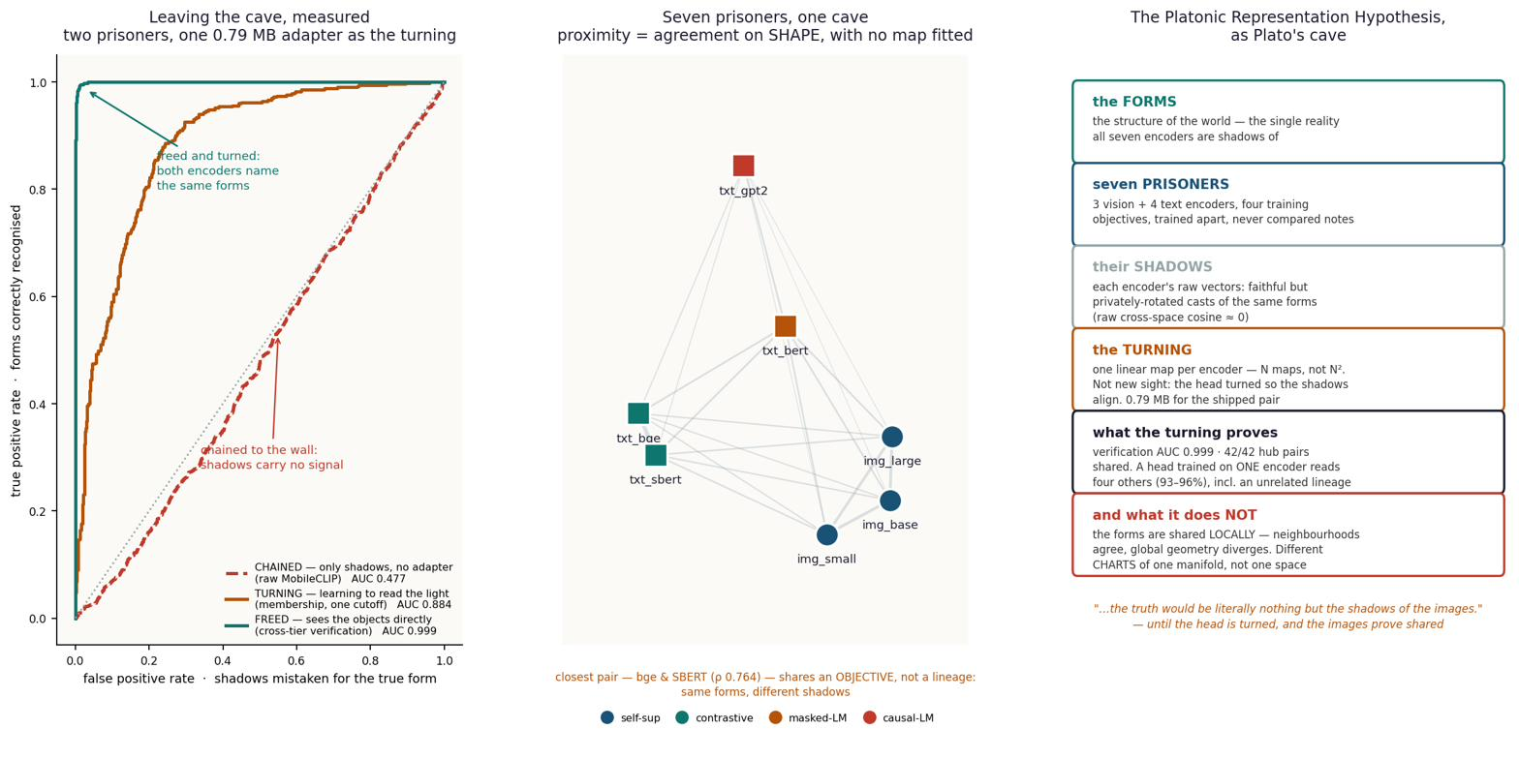
THE HYPOTHESIS
The question: universal patterns across models?
A model trained on PHOTOS of cats and a model trained on SENTENCES about cats — do they converge to a similar internal world?
If they do, can the structure of one serve the other — text-world coordinates for an image model, and the reverse?
The field's answer-in-progress: the Platonic Representation Hypothesis — as models grow, their representations converge toward a shared statistical model of reality, like shadows of one world cast on different cave walls.
Known results I built on: similar layers found across large models of different architecture and training data; model stitching and merging work when the worlds are close (same modality, similar data, similar architecture).
Seven encoders, one scene: each cache is a projection of the same world onto a different wall.
Testable form: representations agree UP TO A LINEAR MAP — one matrix, no training of either model.
Notes:
Cat-photos model vs cat-sentences model. PRH as the frame; my testable form: one linear map, both models frozen.

Slide 5

THE HYPOTHESIS
First evidence — two architectures, one layer structure
Before any hub, any adapter: do two DIFFERENT architectures, trained on DIFFERENT data, even carry similar information layer by layer?
GPT-2 vs Pythia-160M, CKA over 10,000 samples — the raw matrix from the cache, not an illustration (this run: max 0.742; the report quotes 0.744 from its final run — ‘essentially unchanged’).
Trained-vs-trained mean 0.359 against trained-vs-random 0.067 — a 4–5× learning effect. Early layers match early, late match late; the final layer stands apart.
One correction was needed before believing it: a rank-one ‘hubness’ component carried 97% of the matrix energy; dividing the marginals out sharpened the diagonal to 1.16 vs 0.98.
This is what licensed everything after it: the convergence is real — the rest of the project asks what exactly is shared, and how cheaply it moves.
Notes:
The real CKA matrix, ~1 min. First evidence that convergence exists; the hubness correction is the honest footnote. Bridge: 'so WHAT is shared, and how cheaply does it move?'

Slide 6
METHOD
Scientific questions, engineering discipline
Three falsifiable questions
IS structure shared? — if no linear map beats chance, the claim dies.
WHAT is shared — global geometry, or local neighbourhoods?
WHAT decides how much — modality, lineage, or training objective?
The data
COCO image–caption pairs. 9,533 images, five human captions each — e.g.
“A cat sitting on a chair.” · “Cat on chair.” · “A cat is seated on a chair.”
Captions are embedded and AVERAGED into one target — ‘what this image is about’, not ‘what one annotator wrote’.
Retrieval test: the caption ‘cat sit on a chair’ queries 1,000 images — the cat on the chair must beat every sofa cat and every dog. Chance = 0.001.
Rules the project never broke
No training, no fine-tuning — closed-form ridge only; both models frozen.
Every number held-out (1,000 of 9,533 rows), quoted against a control.
Predictions pre-registered before measuring; failures recorded, never deleted — the ledger now holds 11 falsified explanations, two of them our own.
Notes:
Three questions, three rules. The cat/dog example: query must rank the right cat above a dog scoring 0.31.

Slide 7
PART I · TWO ENCODERS
Experiment B — MobileCLIP → SigLIP 2, the adapter
Two frozen image–text encoders that never met: MobileCLIP-S1 (phone-tier, 512-d) and SigLIP 2 (server-tier, 768-d).
One ridge matrix W maps MobileCLIP vectors into SigLIP space — fitted on REPRESENTATION matching, so it never sees the retrieval task it is later scored on.
Then SigLIP’s own machinery — text tower, cosine ranking — is reused, unchanged, on the mapped vectors.
MobileCLIP-S1
W · the adapter
SigLIP 2 space
SigLIP’s own retrieval
frozen · image vector
512-d
ridge, 512×768
closed-form · 0.79 MB
fitted to match representations
mapped vector, 768-d
now speaks SigLIP
text tower + cosine
UNCHANGED, never refit
verification AUC 0.999 · held-out throughout · remove W and everything above collapses to chance (AUC 0.477)
Classic output-layer stitching — with a connector that cannot cheat, because it was never trained on the task it is scored on.
Notes:
Experiment B flow, ~1.5 min. Emphasise: task-free connector - fitted to match representations, never the objective.

Slide 8
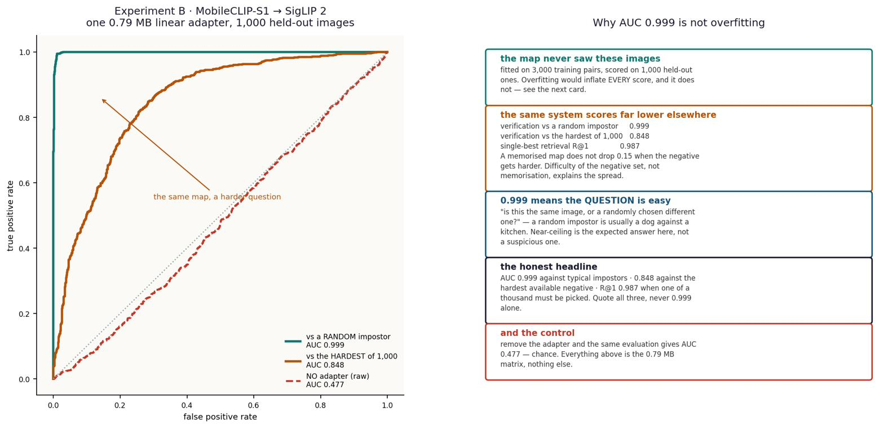
PART I · TWO ENCODERS
Experiment B — what one matrix buys
0.592
0.900
held-out R² of the map
mean cosine to the true twin
88.4%
0.79 MB
of the jointly-trained retrieval ceiling
shipped adapter, Core ML fp16
The surprise that set up Part II: the task-free connector transfers 88.4% STRONGER than a connector trained on the task itself. The shared structure is in the representations — not manufactured by the connector.
Notes:
Four numbers. Then the pivot: task-free beats task-trained by 88.4% - evidence about representations, and the motivation for the hub.

Slide 9
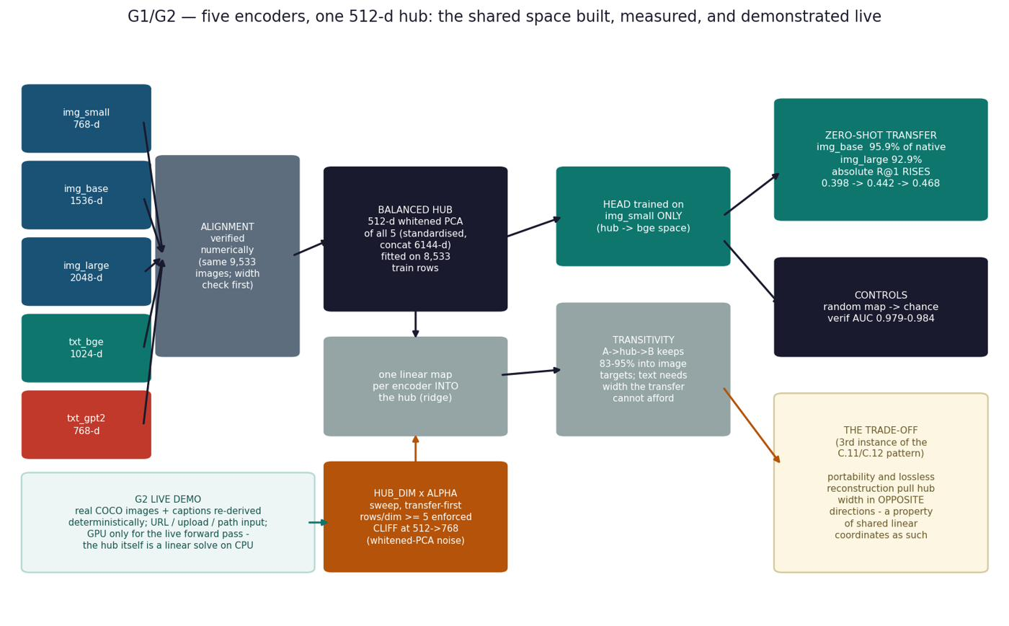
PART II · N ENCODERS
The Hub — one shared coordinate system
Pairwise maps do not scale: 7 encoders ⇒ 42 directed connectors. A PIVOT does: N entry maps into one space.
Build once: z-score each space, concatenate per item, PCA, keep 512 directions, whiten. That basis IS the hub — then it is frozen.
One closed-form ridge map per encoder INTO the hub. One caption head OUT of it, trained on DINOv2-small’s hub coordinates only, into bge-m3 text space.
Three configurations documented: 4 spaces (published 94.2%), 5 (C.13), 7 (with BERT + SBERT).
CORRECTED (E.8)
No trade-off. The cliff is a NUMERICAL ARTIFACT — least squares divides by a near-null singular value at width = source rank. Rule: hub width < 768.
Diagram predates the cliff’s resolution — the red card replaces its ‘trade-off’ box; ‘whitened-PCA noise’ in the sweep box is likewise superseded.
Notes:
Hub construction, ~1.5 min. 42 pairwise maps vs 7 entry maps + one head. Point at the red card - the diagram is older than the cliff resolution, and we correct in place rather than hide.

Slide 10
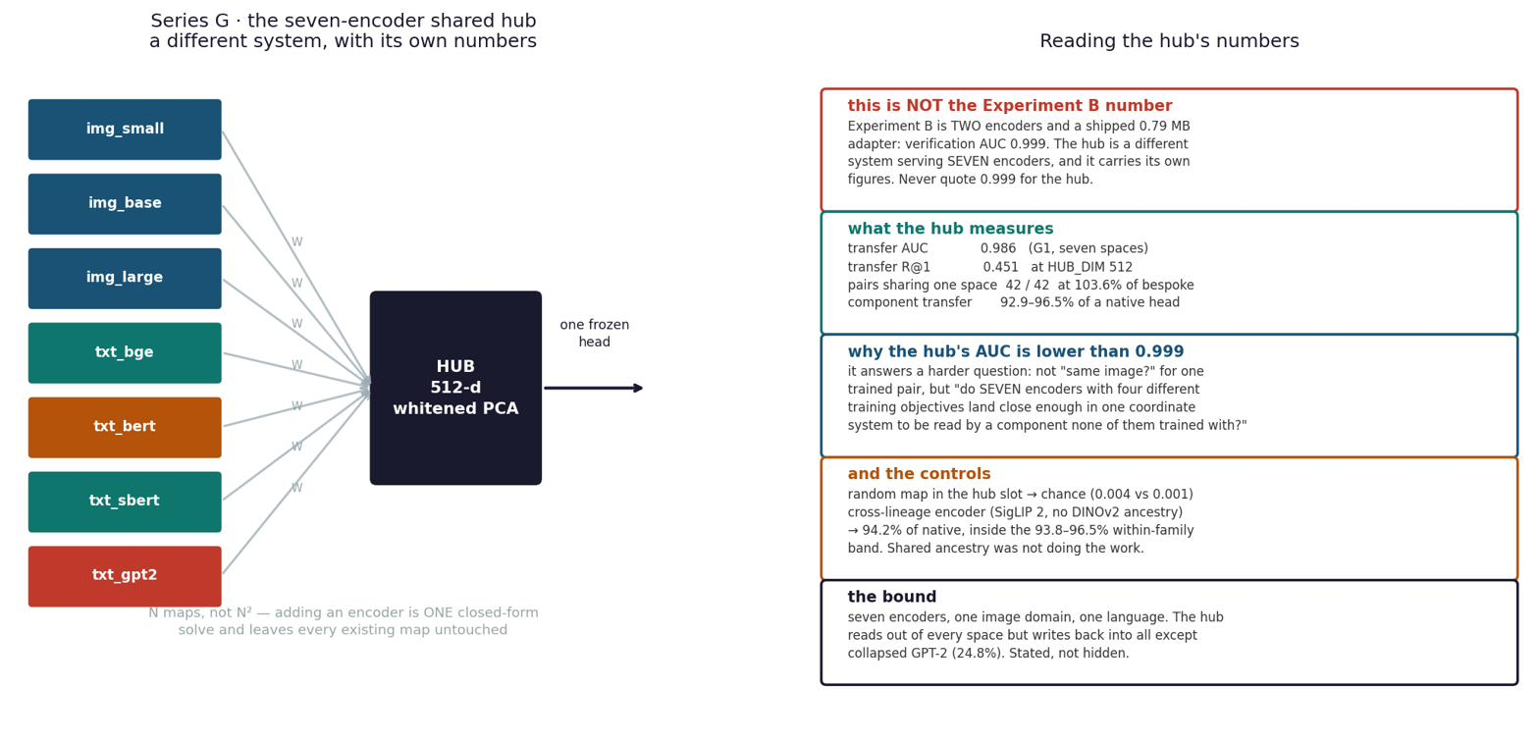
PART II · N ENCODERS
The demo — zero-shot transfer to encoders the head never saw
recipient encoder | relation to the head | R@1 | % of a natively-fitted head
DINOv2-base | sibling — never seen | 0.445 | 96.5%
DINOv2-large | sibling — never seen | 0.473 | 92.9%
SigLIP 2 | independent lineage — never seen | 0.557 | 94.2%
ConvNeXt-base | convnet + fully supervised — never seen | — | 96.7% (above the family band)
random-map control | the number that makes it mean anything | 0.003 | chance = 0.001
One head, trained ONCE on one encoder’s hub coordinates, applied unchanged to encoders absent from its fitting.
Adding a model = fitting ONE entry map. Hub untouched, head untouched, every other map untouched.
Zero-shot means the HEAD — the entry map is one closed-form solve on cached vectors.
All 42 directed pairs through the shared hub: 103.6% of hubs built per-pair. Sharing costs nothing.
Notes:
The demo table. Punchline: ConvNeXt - different architecture AND supervision - lands ABOVE the family band. Control at chance.

Slide 11
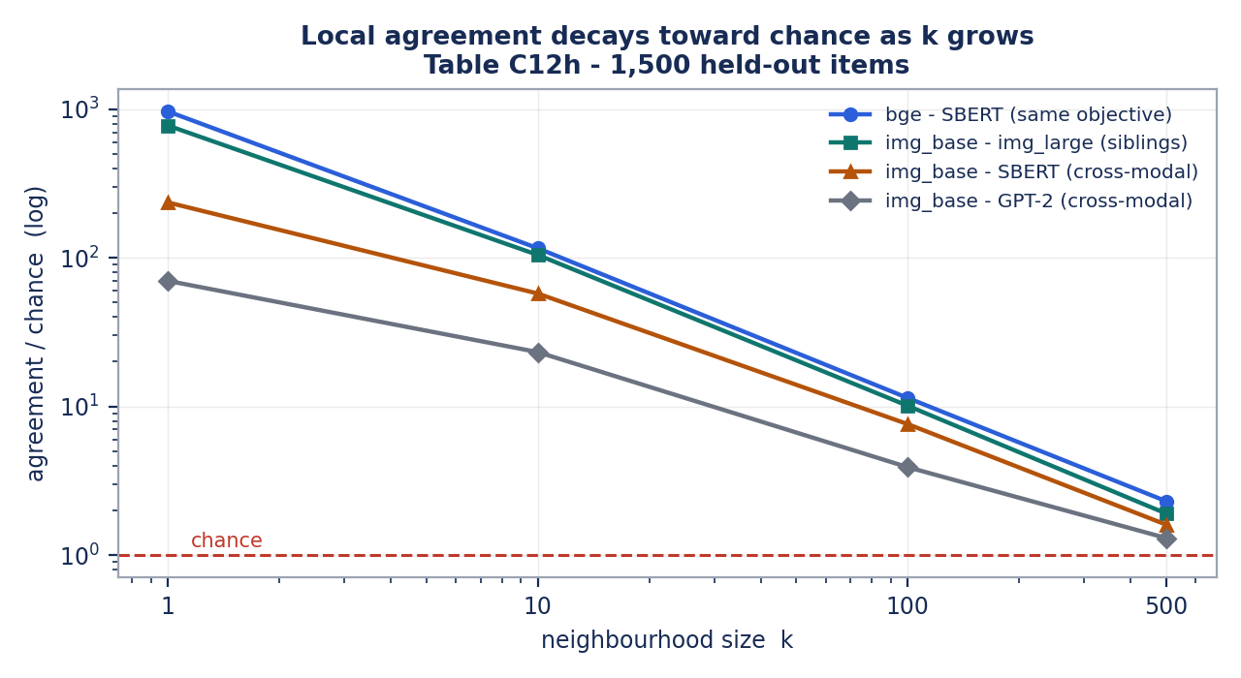
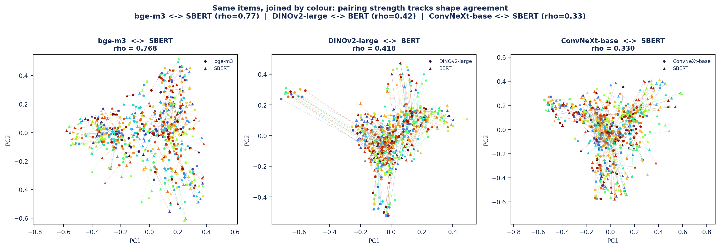
FINDINGS · SIMILARITY
What is actually shared: local structure, not global
Raw cross-space cosine ≈ 0.00 — coordinates never agree.
But SHAPES do: distance ranks correlate at +0.681 Spearman, and 67.1% of an item’s 10 nearest neighbours are the same items in both spaces (27× chance).
Agreement is strongest at small k and decays toward chance by k = 500 — in every pair, on three independent metrics (kNN, CKNNA, rank correlation).
Neighbourhoods agree; global geometry diverges. ‘Same world’ means the same LOCAL arrangement of meaning.
Notes:
The core scientific finding. Coordinates never match; neighbourhoods do. Figure is measured Table C12h data.

Slide 12
FINDINGS · GEOMETRY
Isotropy, anisotropy, modality, objective — what decides agreement
Objective beats lineage beats modality. Sharing a TRAINING OBJECTIVE lifts pairwise agreement +53× over chance; shared lineage +44×; shared modality +29×. The top pair — bge–SBERT at +0.738 — shares an objective and no ancestry at all.
Anisotropy, live: the GPT-2 collapse
GPT-2’s caption space has effective rank 6.6 of 768 — every caption sits at cosine +0.999 to every other. A cone, not a cloud.
Consequence: the hub READS OUT of it at 95.1% — but WRITES INTO it at 24.8%. A collapsed space can be consulted, not addressed.
The rescue: whitening (an isotropy transform) lifts its retrieval R@1 from 0.130 to 0.478 — 102.6% of an encoder trained contrastively on 1.2 BILLION pairs. The information was there; the geometry hid it.
Isotropy cuts both ways — measured twice. An isotropic (evenly spread) space HELPS reading a known correspondence, and HURTS finding an unknown one. One geometric property, opposite prescriptions — there is no single ‘good geometry’, only geometry good for a stated task.
Notes:
G5's +53/+44/+29; isotropy two-instance meta-finding; GPT-2 as the anisotropy case study with the whitening rescue.

Slide 13
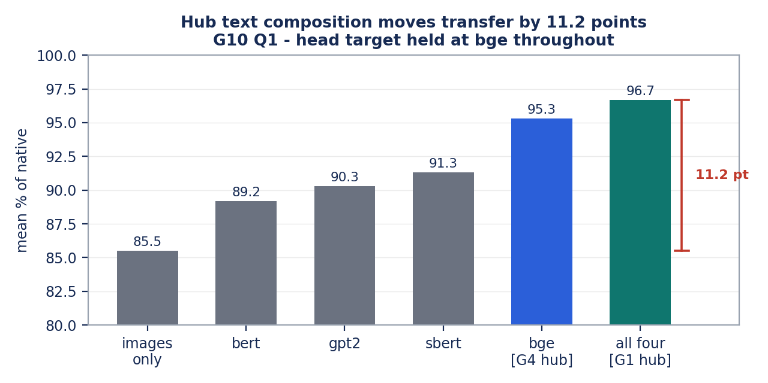
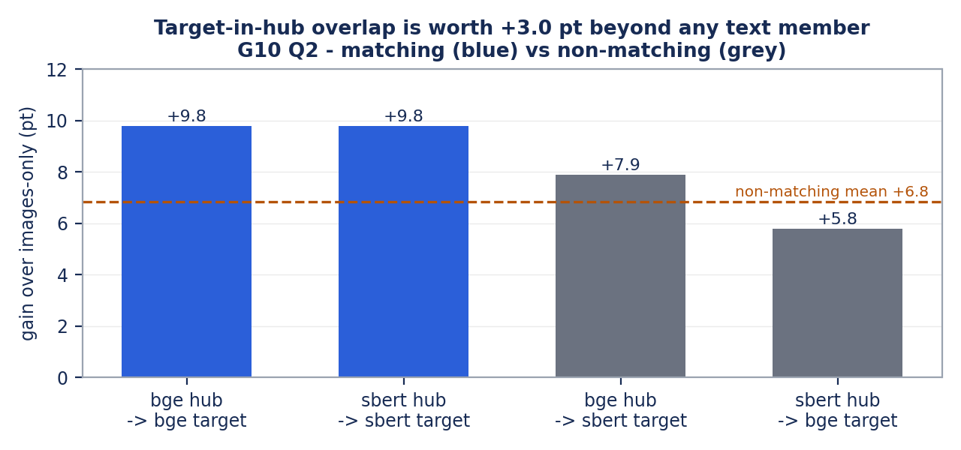
FINDINGS · HONESTY
G10 — what the hub is made of matters, and we declared it
Which text space sits IN the hub moves transfer by 6.1 points at fixed count — and 11.2 points presence-vs-absence — even though every text space can linearly reach only 2–5% of the hub. Reachability does not predict influence.
And the head’s own target sitting inside the hub is worth +3.0 points beyond what ANY text member contributes. Not leakage — everything is held-out — but a real dependency, now measured and declared in the report before anyone else finds it.
Notes:
G10 in one slide: composition sensitivity (left), target-in-hub overlap +3.0pt isolated (right). Declared, not hidden.

Slide 14
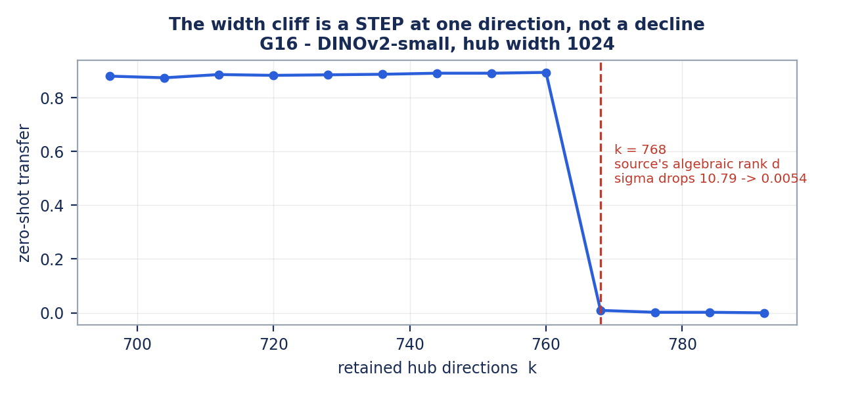
FINDINGS · METHOD
The width cliff — falsification as a first-class result
Transfer collapses when hub width reaches 768 — discovered by accident, chased for six experiments.
TEN explanations tested and killed on pre-registered criteria — local-structure loss, spectral amplification, four cliff statistics, conditioning — including one of our own tests that was itself wrong, and is recorded as such.
The survivor, confirmed to single-direction resolution: 768 is the source encoder’s algebraic rank. The last singular value falls 10.79 → 0.0054 and least squares divides by it.
Verdict: a NUMERICAL artifact of the fit — not a property of shared representations. Rule: hub width < source rank. Ridge or truncation lifts it entirely.
A step of −0.885 at one direction — held 0.894 at k=760, fell to 0.009 at k=768.
Notes:
The falsification story - the project's proudest method result. Eleven-entry ledger, two our own errors, mechanism confirmed at single-direction resolution.

Slide 15
IMPLEMENTATION
Engineering and innovation
0.79 MB
the entire deployable artifact — one fp16 matrix as Core ML; no GPU, no server, no retraining
0 gradients
everything is closed-form ridge on cached vectors — the whole hub rebuilds in seconds on a laptop
to the decimal
the published protocol was reconstructed exactly — SigLIP’s 94.2% reproduces digit-for-digit (G0-exact)
1 solve
adding an encoder = one entry map; hub, head and all other maps untouched — demonstrated live with ConvNeXt
11 entries
a falsification ledger kept as a deliverable — wrong explanations recorded with their mechanism of death, two of them our own
pre-registered
cliff location, discontinuity criteria, SESOI for the null — predictions written down before measuring
Notes:
Six engineering claims, each with a number. The innovation is the discipline as much as the artifact.

Slide 16
RECORD
The experiments, numbered
# | goal | models | outcome
B | transfer via one task-free matrix | MobileCLIP-S1 → SigLIP 2 | 88.4% of ceiling; 0.79 MB shipped — achieved
E1–E13 | cross-modal maps, capacity ladder, pooling | DINOv2 s/b/l → bge-m3 | 40.9 / 53.5 / 58.3% of ceiling; +15.3 pts per decade of parameters
C.11–C.12 | isotropy rescue; pair-free recovery | GPT-2, SBERT, MobileCLIP, SigLIP | whitening 0.130→0.478; Gromov–Wasserstein 39.7% with NO pairs
G0–G4 | rebuild hub exactly; cross-lineage; cross-architecture | + SigLIP 2, ConvNeXt (held out) | 94.2% to the decimal; ConvNeXt 96.7% — above the band
G5–G7 | what predicts agreement; hub vs local structure | all seven | objective +53× > lineage +44× > modality +29×; hub neutral on healthy spaces
G8–G16 | hunt the width cliff | DINOv2 s/b as sources | located at source rank, mechanism confirmed; 8 accounts falsified first
G10 | hub composition; target-in-hub overlap | hub variants × {bge, SBERT} | identity 6.1 pt; presence 11.2 pt; overlap +3.0 pt — declared
K1–K3 | no-PCA replication; stratified re-run; bound the null | all pairs | ordering reproduces raw; null bounded: 95% CI −0.038…+0.024 vs SESOI 0.050
Failures kept on the record: the MLP could not beat the matrix — 0.9183 vs 0.9183, gain +0.0000, twice. Adding encoders to the hub: unchanged, CI includes zero.
Notes:
The record in one table - including the honest failures at the bottom.

Slide 17
RECORD
The encoders — who they are and how they were trained
encoder / dim | objective — what supervises it | role and result
DINOv2 s/b/l 768/1536/2048 | self-distillation: an EMA teacher’s outputs on other crops of the SAME image. No labels, no text — self-supervised on automatically curated data | hub members; capacity ladder 40.9/53.5/58.3%; img_small sets hub width < 768
bge-m3 · 1024 | contrastive on query–passage pairs — pair-supervised, text only | hub member and the head’s target; top pair with SBERT +0.738
GPT-2 · 768 | next-token prediction — self-supervised; same hold-out-and-predict trick as DINOv2, on tokens | the collapse case: rank 6.6; read 95.1% / write 24.8%; whitening rescues to 102.6%
BERT / SBERT · 768 | masked LM (self-sup.) / BERT fine-tuned on human-labelled NLI — SBERT is the one strictly supervised text space | hub members from C.13.3; SBERT best head target at 101.0% of native
SigLIP 2 · 768 | image–text contrastive on web alt-text — pair-supervised | HELD OUT: cross-lineage 94.2%, inside the family band
ConvNeXt · 1024 | ImageNet-22k classification — FULLY supervised, and a convnet | HELD OUT: 96.7%, above the band — neither architecture nor supervision bounds the claim
MobileCLIP-S1 · 512 | image–text contrastive, distilled — pair-supervised | Experiment B source; adapter R² 0.592, shipped 0.79 MB
One COCO row, behind every number here — five human captions: “A cat sitting on a chair.” · “Cat on chair.” · “A cat is seated on a chair.” · “Cat sitting on the chair.” · “A cat perched on a wooden chair.” — embedded and averaged into one target. At query time, ‘cat sit on a chair’ must rank the right cat above 999 impostors — including a sofa cat at 0.52 and a dog at 0.31. Chance is 0.001.
Three supervision regimes, four objectives — and all of them join one hub at 93–97% of native. Convergence does not require a shared training signal.
Notes:
E.10 in one slide. The takeaway line at the bottom is the anti-circularity argument.

Slide 18
RECORD
Sources
Huh, Cheung, Wang & Isola (2024). The Platonic Representation Hypothesis. ICML — the framing, and the CKNNA metric.
Lenc & Vedaldi (2015). Understanding image representations by measuring equivariance and equivalence. CVPR — stitching.
Bansal, Nakkiran & Barak (2021). Revisiting model stitching. NeurIPS — the trained-connector baseline B departs from.
Moschella et al. (2023). Relative representations enable zero-shot latent communication. ICLR — the pivot idea the hub extends.
Gröger et al. (2026), ICML — the Aristotelian reading of convergence; assessed against these results.
Oquab et al. (2023). DINOv2 — the image family and LVD-142M curation.
Tschannen et al. (2025). SigLIP 2 · Vasu et al. (2024). MobileCLIP.
Chen et al. (2024). BGE-M3 · Reimers & Gurevych (2019). Sentence-BERT.
Radford et al. (2019). GPT-2 · Devlin et al. (2019). BERT · Liu et al. (2022). ConvNeXt.
Lin et al. (2014). Microsoft COCO — the 9,533 image–caption rows under every number here.
Full method, all tables and the falsification ledger: Final_Project_Report.pdf (68 pp), with generator notebooks per figure.
Notes:
Sources - one column literature, one column models and data.

Slide 19
NEXT
What remains — in order of value
next test | the question | why it matters
Reverse-direction transfer | does the hub carry information TOWARD an image space, not just from one? ConvNeXt as TARGET is the cleanest case — it was never a hub member | source and target roles are independent (G10 proved it on text); untested for images
Experts vs one large model | do K small experts in a shared hub match one big encoder at matched parameters? | turns the engineering argument into a benchmark outsiders care about (pre-registered as B1, not yet run)
More encoders per group | objective predicts agreement better than lineage — on as few as one pair per cell | the most interesting causal hint, currently the least powered
Other languages & domains | does any of this survive outside COCO captions in English? | the broadest stated limit
Non-linear hubs | could a neighbourhood-preserving embedding carry local structure where whitened PCA does not? | ruled out here by the no-training rule — the natural sequel
Notes:
The Atlas next-test table, led by the new reverse-direction row. B1 is the one pre-registered item not yet run - said out loud.

Slide 20
THE PROJECT IN ONE PARAGRAPH
Two models never share coordinates — raw agreement is exactly chance. But they describe the same world, and the translation between them is a single matrix small enough to fit on a phone. What they share most strongly is LOCAL: they agree about what is near what, and diverge about the shape of the whole. The coordinate frame that makes structure readable is cheap; the arrangement of meaning across directions is what training actually buys.
0.79 MB
96.7%
27×
11
the whole translation
an unseen convnet, zero-shot
chance, at 10 neighbours
explanations falsified on the way
Thank you — questions welcome.
Notes:
Close on the one-paragraph summary and four numbers. Stop at 19-20 minutes; leave the last beat for silence.

