Slide 1
ONE WORLD, MANY ENCODERS
Representation Convergence
Do independently trained models learn the same geometry — and can one matrix move knowledge between them?
Final project defense · 8 encoders · 9 findings · 11 falsified explanations · 20 minutes
Notes:
Title. One breath: eight encoders, one shared geometry, one matrix between any two worlds. The picture is Plato's cave with seven projections - the project's own metaphor.

Slide 2
MOTIVATION
Why this project
What fascinates me is what happens behind the scenes of a model — not the demo, the mechanism.
My background is hybrid — databases and vision, engineering and ‘spirit and matter’. In databases, correlations between features are explicit: a schema, a join, a key. In vision they are implicit — similar in kind, different in form.
Training itself pulled me in: weights, hyper-parameters, attention, NLP — a world of algorithmics, networks and prediction whose real product is discovered regularity in data.
The question that stuck: when two systems each discover regularity separately — do they discover the same one?
Two worlds, one habit
Database features: price ↔ demand, age ↔ churn — correlation you can name.
Vision features: edge ↔ texture ↔ ‘cat-ness’ — correlation nobody wrote down, learned from pixels alone.
Similar, but different — and both are ultimately geometry over data.
Notes:
Personal motivation, ~1 min. Databases make correlation explicit; vision learns it implicitly. Same habit of mind, two worlds.

Slide 3
MOTIVATION
Patterns in nature, alchemy in training
I started from recurring patterns that invite a scientific explanation: fractal-like branching in coastlines, ferns and lungs (approximate self-similarity, not identical fractals); Fibonacci-related spirals and the golden ANGLE in plant growth; and even popular but scientifically questionable claims about historical cycles — empires falling on a fixed clock, leaders arriving on schedule.
Deep learning felt like the same mystery, engineered: start from RANDOM weights, show examples, and arrive at weights that recognise a face or predict the next word. Correlation appears between variables with no apparent link.
The disciplined question underneath all of them: when we perceive a recurring structure, how do we tell whether it is real, measurable and explanatory rather than coincidence or folklore? That is alchemy only until you measure it — and a learned representation is a geometric object, so it CAN be measured and compared.
random weights
↓ training on examples ↓
weights that
recognise a cat
The question is not whether this works.
It is whether two separate runs of it
arrive at the SAME place.
Notes:
From nature's unexplained patterns to training as measurable alchemy. Land on: two runs, same place?

Slide 4
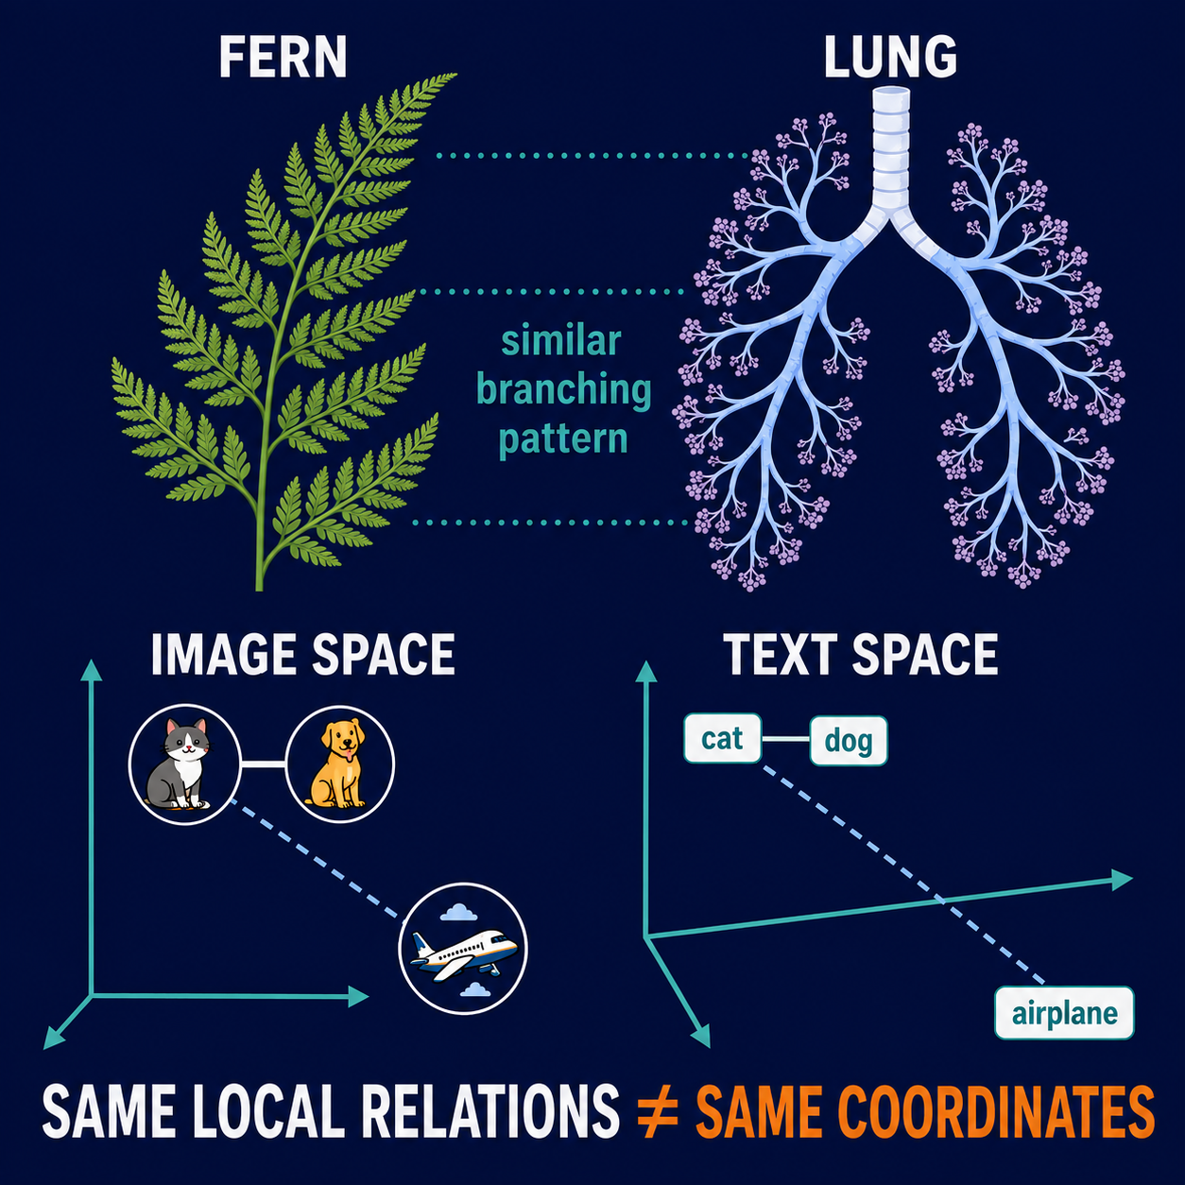
STRUCTURAL SIMILARITY
Different systems can share structure without sharing coordinates
A fern and a lung are made of different material and serve different purposes. Yet both use repeated, fractal-like branching to distribute resources efficiently.
The same idea applies to models. Image and text encoders can place cat, dog and airplane at completely different coordinates while preserving an ordering: cat is nearer to dog than to airplane.
In this project, similarity means agreement in relationships—near/far order and local neighbours—not identical vectors and not perfect global geometry.
Notes:
The natural analogy is structural, not biological: a fern and a lung have different material and function, but both exhibit repeated branching. The model analogy is equally limited and precise. Image and text encoders may use unrelated coordinates while preserving local relational statements such as cat being nearer to dog than to airplane. This motivates the project's measurements of distance ranks and neighbourhood overlap. It does not claim identical vectors, identical global geometry, or a fitted map.
[Sources]
- Embedding_Spaces_Corrections_and_Figures(1).pdf
- Essey et al. (2020), Fractal analysis of concurrently prepared casts of the human lung, PMCID: PMC7574555
- Generated educational illustration based on the project's cat-dog-airplane analogy

Slide 5
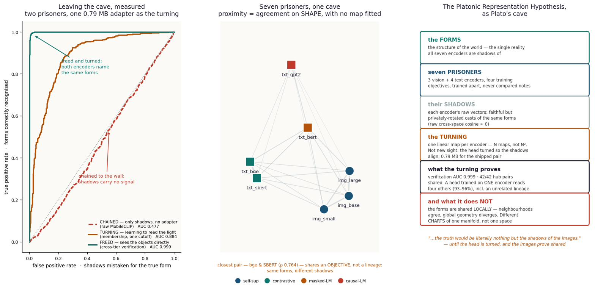
THE HYPOTHESIS
The question: universal patterns across models?
A model trained on PHOTOS of cats and a model trained on SENTENCES about cats — do they converge to a similar internal world?
If they do, can the structure of one serve the other — text-world coordinates for an image model, and the reverse?
The field's answer-in-progress: the Platonic Representation Hypothesis — as models grow, their representations converge toward a shared statistical model of reality, like shadows of one world cast on different cave walls.
Known results I built on: similar layers found across large models of different architecture and training data; model stitching and merging work when the worlds are close (same modality, similar data, similar architecture).
Seven encoders, one scene: each cache is a projection of the same world onto a different wall.
Testable form: representations agree UP TO A LINEAR MAP — one matrix, no training of either model.
Notes:
Cat-photos model vs cat-sentences model. PRH as the frame; my testable form: one linear map, both models frozen.

Slide 6

THE HYPOTHESIS
First evidence — two architectures, one layer structure
Before any hub, any adapter: do two DIFFERENT architectures, trained on DIFFERENT data, even carry similar information layer by layer?
GPT-2 vs Pythia-160M, CKA over 10,000 samples — the raw matrix from the cache, not an illustration (this run: max 0.742; the report quotes 0.744 from its final run — ‘essentially unchanged’).
Trained-vs-trained mean 0.359 against trained-vs-random 0.067 — a 4–5× learning effect. Early layers match early, late match late; the final layer stands apart.
One correction was needed before believing it: a rank-one ‘hubness’ component carried 97% of the matrix energy; dividing the marginals out sharpened the diagonal to 1.16 vs 0.98.
This is what licensed everything after it: the convergence is real — the rest of the project asks what exactly is shared, and how cheaply it moves.
Notes:
The real CKA matrix, ~1 min. First evidence that convergence exists; the hubness correction is the honest footnote. Bridge: 'so WHAT is shared, and how cheaply does it move?'

Slide 7
METHOD
Scientific questions, engineering discipline
Three falsifiable questions
IS structure shared? — if no linear map beats chance, the claim dies.
WHAT is shared — global geometry, or local neighbourhoods?
WHAT decides how much — modality, lineage, or training objective?
The data
COCO image–caption pairs. 9,533 images, five human captions each — e.g.
“A cat sitting on a chair.” · “Cat on chair.” · “A cat is seated on a chair.”
Captions are embedded and AVERAGED into one target — ‘what this image is about’, not ‘what one annotator wrote’.
Retrieval test: the caption ‘cat sit on a chair’ queries 1,000 images — the cat on the chair must beat every sofa cat and every dog. Chance = 0.001.
Rules the project never broke
No training, no fine-tuning — closed-form ridge only; both models frozen.
Every number held-out (1,000 of 9,533 rows), quoted against a control.
Predictions pre-registered before measuring; failures recorded, never deleted — the ledger now holds 11 falsified explanations, two of them our own.
Notes:
Three questions, three rules. The cat/dog example: query must rank the right cat above a dog scoring 0.31.

Slide 8
PART I · TWO ENCODERS
Experiment B — MobileCLIP → SigLIP 2, the adapter
Two frozen image–text encoders that never met: MobileCLIP-S1 (phone-tier, 512-d) and SigLIP 2 (server-tier, 768-d).
One ridge matrix W maps MobileCLIP vectors into SigLIP space — fitted on REPRESENTATION matching, so it never sees the retrieval task it is later scored on.
Then SigLIP’s own machinery — text tower, cosine ranking — is reused, unchanged, on the mapped vectors.
MobileCLIP-S1
W · the adapter
SigLIP 2 space
SigLIP’s own retrieval
frozen · image vector
512-d
ridge, 512×768
closed-form · 0.79 MB
fitted to match representations
mapped vector, 768-d
now speaks SigLIP
text tower + cosine
UNCHANGED, never refit
verification AUC 0.999 · held-out throughout · remove W and everything above collapses to chance (AUC 0.477)
Classic output-layer stitching — with a connector that cannot cheat, because it was never trained on the task it is scored on.
Notes:
Experiment B flow, ~1.5 min. Emphasise: task-free connector - fitted to match representations, never the objective.

Slide 9
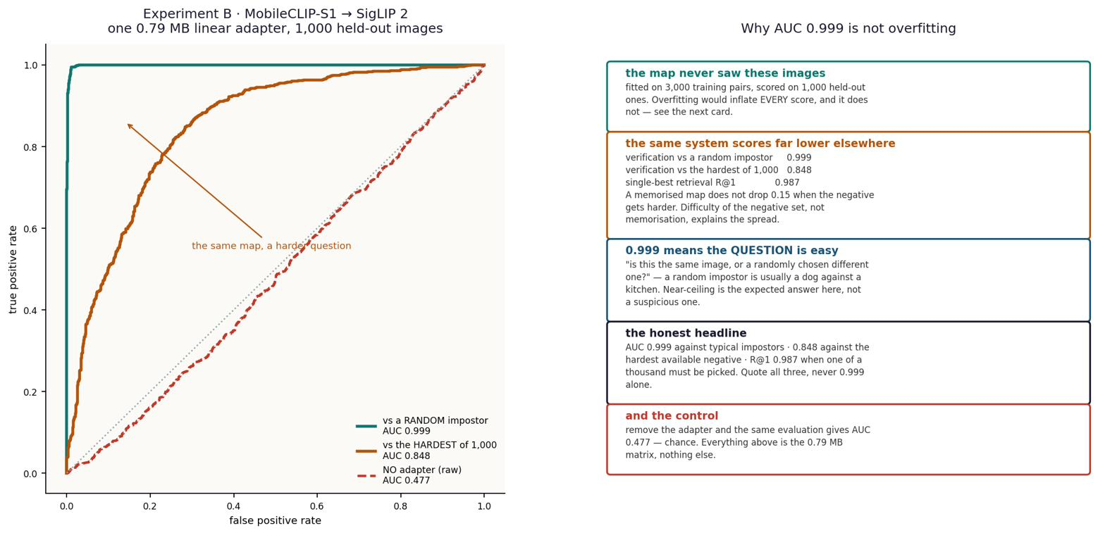
PART I · TWO ENCODERS
Experiment B — what one matrix buys
0.592
0.900
held-out R² of the map
mean cosine to the true twin
88.4%
0.79 MB
of the jointly-trained retrieval ceiling
shipped adapter, Core ML fp16
The surprise that set up Part II: the task-free connector transfers 88.4% STRONGER than a connector trained on the task itself. The shared structure is in the representations — not manufactured by the connector.
Notes:
Four numbers. Then the pivot: task-free beats task-trained by 88.4% - evidence about representations, and the motivation for the hub.

Slide 10
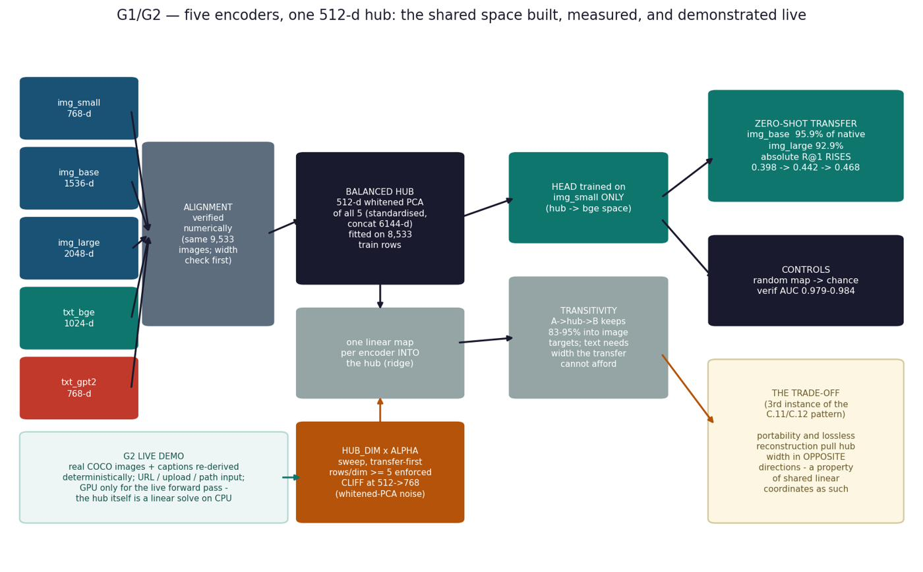
PART II · N ENCODERS
The Hub — one shared coordinate system
Pairwise maps do not scale: 7 encoders ⇒ 42 directed connectors. A PIVOT does: N entry maps into one space.
Build once: z-score each space, concatenate per item, PCA, keep 512 directions, whiten. That basis IS the hub — then it is frozen.
One closed-form ridge map per encoder INTO the hub. One caption head OUT of it, trained on DINOv2-small’s hub coordinates only, into bge-m3 text space.
Three configurations documented: 4 spaces (published 94.2%), 5 (C.13), 7 (with BERT + SBERT).
CORRECTED (E.8)
No trade-off. The cliff is a NUMERICAL ARTIFACT — least squares divides by a near-null singular value at width = source rank. Rule: hub width < 768.
Diagram predates the cliff’s resolution — the red card replaces its ‘trade-off’ box; ‘whitened-PCA noise’ in the sweep box is likewise superseded.
Notes:
Hub construction, ~1.5 min. 42 pairwise maps vs 7 entry maps + one head. Point at the red card - the diagram is older than the cliff resolution, and we correct in place rather than hide.

Slide 11
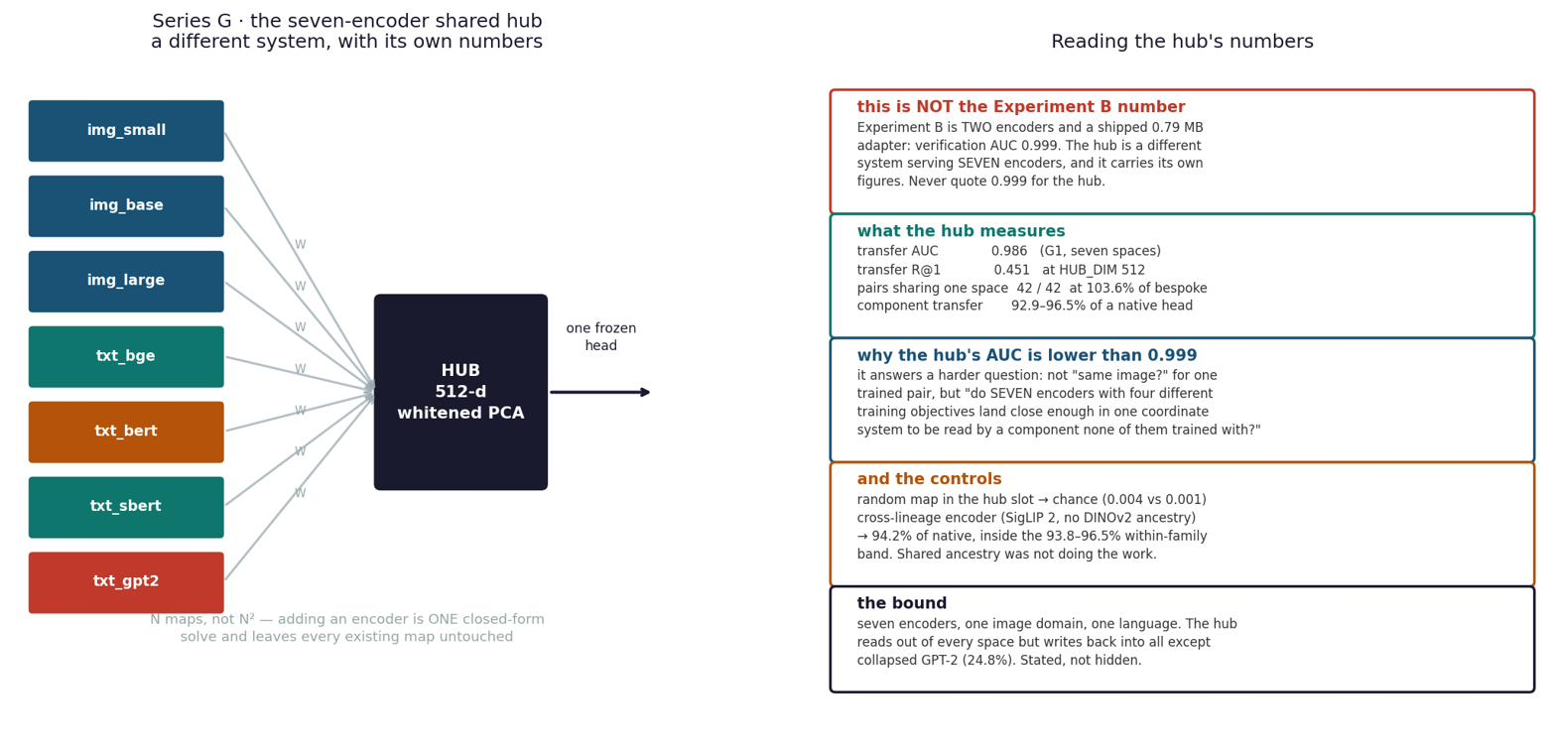
PART II · N ENCODERS
The demo — zero-shot transfer to encoders the head never saw
recipient encoder | relation to the head | R@1 | % of a natively-fitted head
DINOv2-base | sibling — never seen | 0.445 | 96.5%
DINOv2-large | sibling — never seen | 0.473 | 92.9%
SigLIP 2 | independent lineage — never seen | 0.557 | 94.2%
ConvNeXt-base | convnet + fully supervised — never seen | — | 96.7% (above the family band)
random-map control | the number that makes it mean anything | 0.003 | chance = 0.001
One head, trained ONCE on one encoder’s hub coordinates, applied unchanged to encoders absent from its fitting.
Adding a model = fitting ONE entry map. Hub untouched, head untouched, every other map untouched.
Zero-shot means the HEAD — the entry map is one closed-form solve on cached vectors.
All 42 directed pairs through the shared hub: 103.6% of hubs built per-pair. Sharing costs nothing.
Notes:
The demo table. Punchline: ConvNeXt - different architecture AND supervision - lands ABOVE the family band. Control at chance.

Slide 12
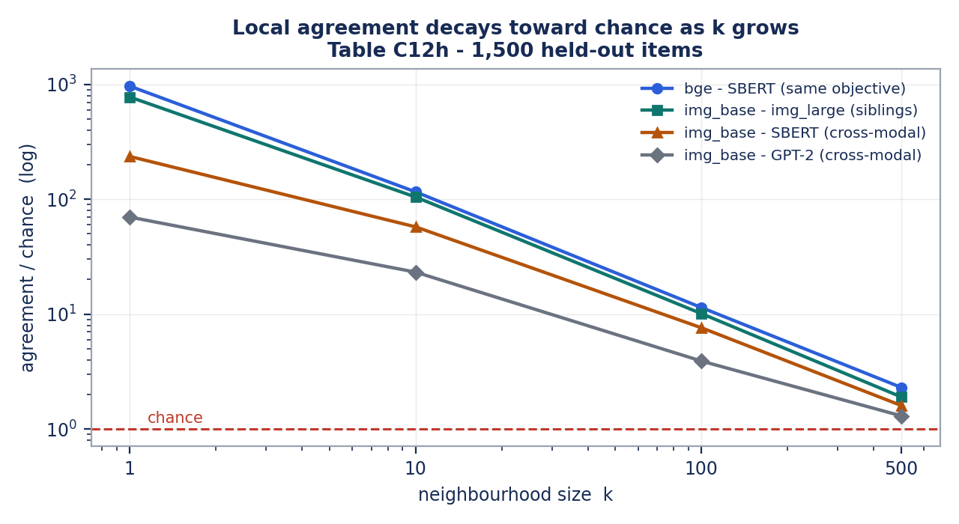
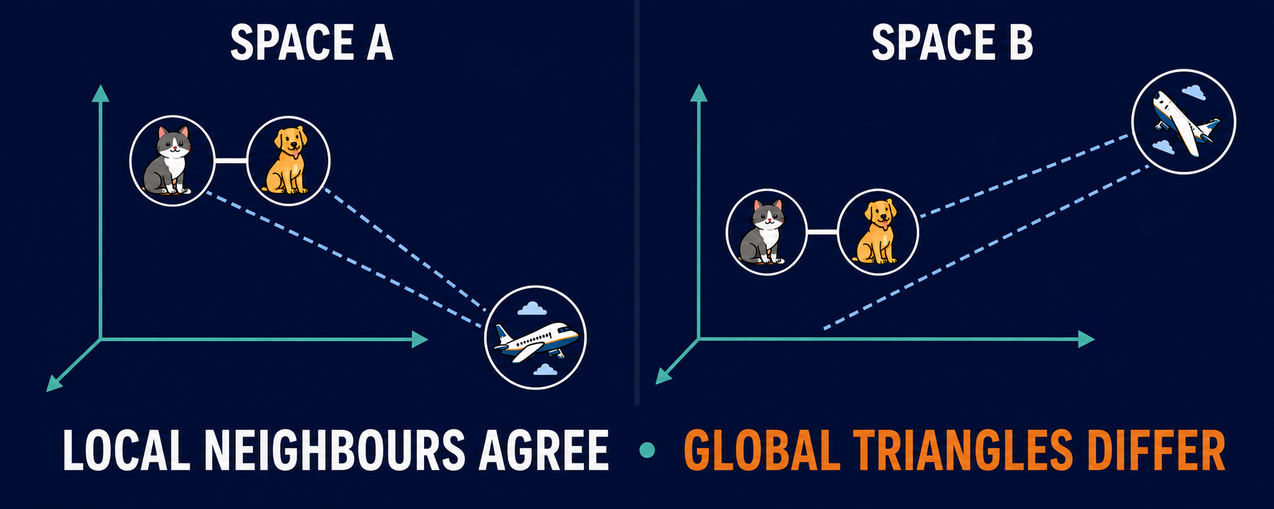
FINDINGS · SIMILARITY
What is actually shared: local structure, not global
Raw cross-space cosine ≈ 0.00 — coordinates never agree.
But SHAPES do: distance ranks correlate at +0.681 Spearman, and 67.1% of an item’s 10 nearest neighbours are the same items in both spaces (27× chance).
Agreement is strongest at small k and decays toward chance by k = 500 — in every pair, on three independent metrics (kNN, CKNNA, rank correlation).
Neighbourhoods agree; global geometry diverges. ‘Same world’ means the same LOCAL arrangement of meaning.
Notes:
The core scientific finding. Coordinates never match; neighbourhoods do. Figure is measured Table C12h data.
The cat-dog-airplane diagram is qualitative: cat and dog remain local neighbours in both spaces, while the changed airplane direction and distance show that global geometry is not preserved.
The illustration does not use a fitted map and does not claim identical coordinates.
[Sources]
- Project measurements and interpretation already documented on this slide.
- Original educational illustration generated for this presentation.

Slide 13
FINDINGS · GEOMETRY
Isotropy, anisotropy, modality, objective — what decides agreement
Objective beats lineage beats modality. Sharing a TRAINING OBJECTIVE lifts pairwise agreement +53× over chance; shared lineage +44×; shared modality +29×. The top pair — bge–SBERT at +0.738 — shares an objective and no ancestry at all.
Anisotropy, live: the GPT-2 collapse
GPT-2’s caption space has effective rank 6.6 of 768 — every caption sits at cosine +0.999 to every other. A cone, not a cloud.
Consequence: the hub READS OUT of it at 95.1% — but WRITES INTO it at 24.8%. A collapsed space can be consulted, not addressed.
The rescue: whitening (an isotropy transform) lifts its retrieval R@1 from 0.130 to 0.478 — 102.6% of an encoder trained contrastively on 1.2 BILLION pairs. The information was there; the geometry hid it.
Isotropy cuts both ways — measured twice. An isotropic (evenly spread) space HELPS reading a known correspondence, and HURTS finding an unknown one. One geometric property, opposite prescriptions — there is no single ‘good geometry’, only geometry good for a stated task.
Notes:
G5's +53/+44/+29; isotropy two-instance meta-finding; GPT-2 as the anisotropy case study with the whitening rescue.

Slide 14
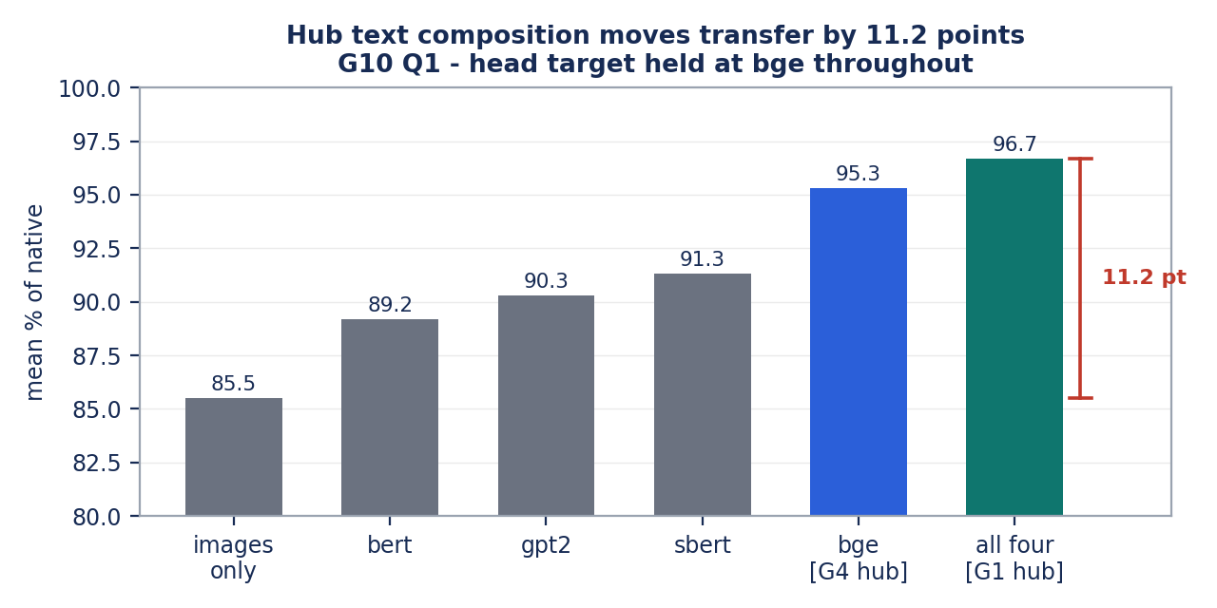
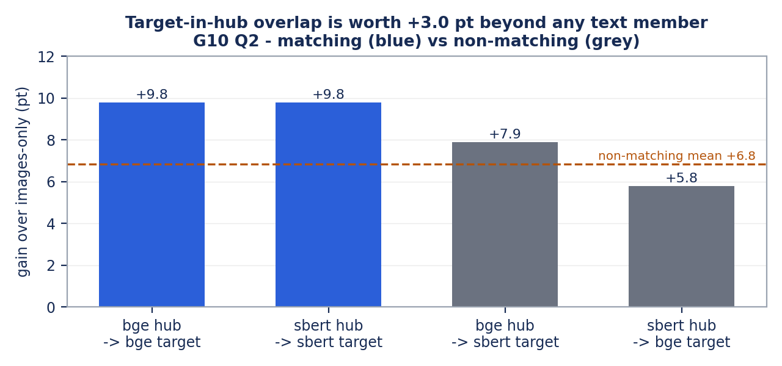
FINDINGS · HONESTY
G10 — what the hub is made of matters, and we declared it
Which text space sits IN the hub moves transfer by 6.1 points at fixed count — and 11.2 points presence-vs-absence — even though every text space can linearly reach only 2–5% of the hub. Reachability does not predict influence.
And the head’s own target sitting inside the hub is worth +3.0 points beyond what ANY text member contributes. Not leakage — everything is held-out — but a real dependency, now measured and declared in the report before anyone else finds it.
Notes:
G10 in one slide: composition sensitivity (left), target-in-hub overlap +3.0pt isolated (right). Declared, not hidden.

Slide 15
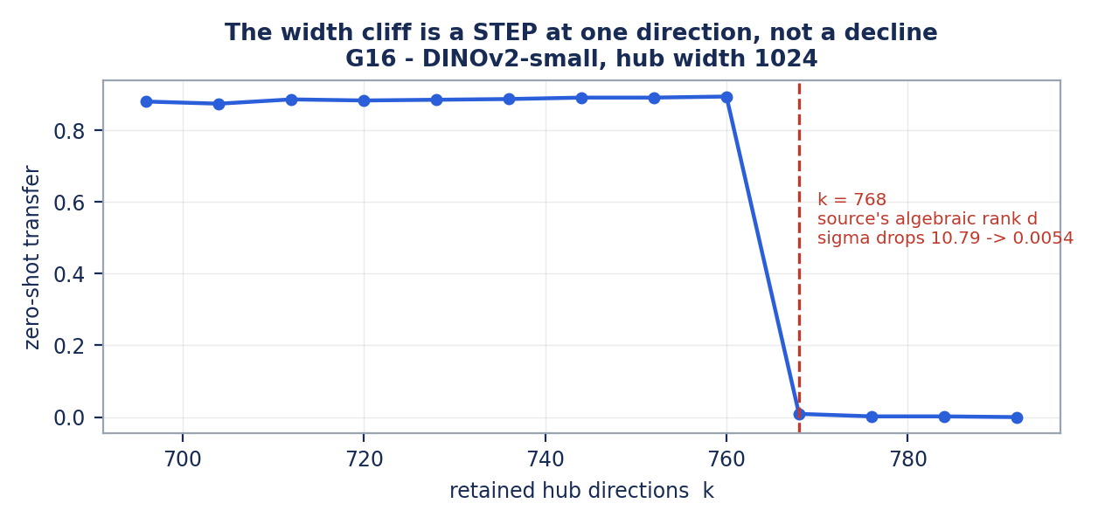
FINDINGS · METHOD
The width cliff — falsification as a first-class result
Transfer collapses when hub width reaches 768 — discovered by accident, chased for six experiments.
TEN explanations tested and killed on pre-registered criteria — local-structure loss, spectral amplification, four cliff statistics, conditioning — including one of our own tests that was itself wrong, and is recorded as such.
The survivor, confirmed to single-direction resolution: 768 is the source encoder’s algebraic rank. The last singular value falls 10.79 → 0.0054 and least squares divides by it.
Verdict: a NUMERICAL artifact of the fit — not a property of shared representations. Rule: hub width < source rank. Ridge or truncation lifts it entirely.
A step of −0.885 at one direction — held 0.894 at k=760, fell to 0.009 at k=768.
Notes:
The falsification story - the project's proudest method result. Eleven-entry ledger, two our own errors, mechanism confirmed at single-direction resolution.

Slide 16
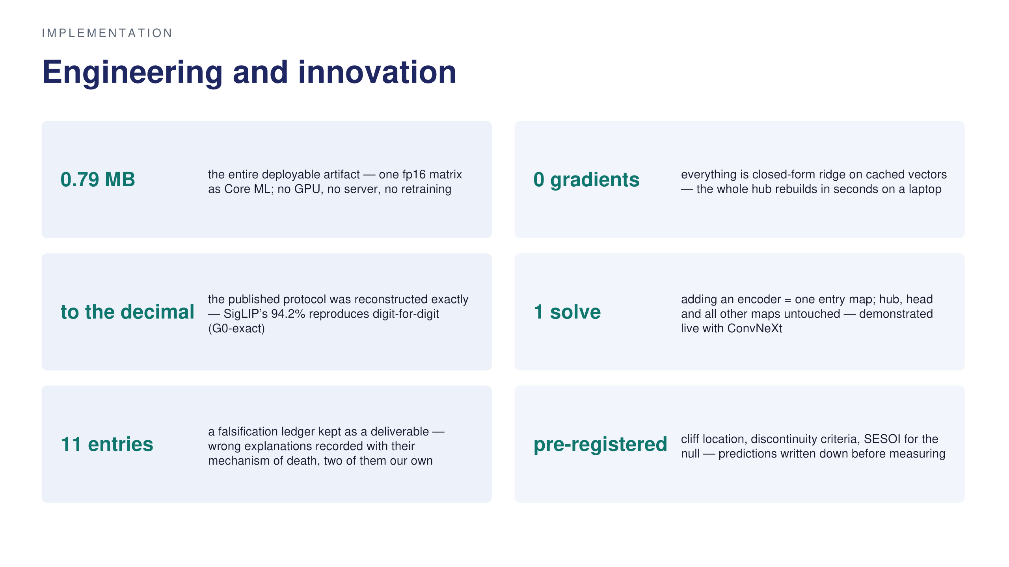
Notes:
Six engineering claims, each with a number. The innovation is the discipline as much as the artifact.

Slide 17
RECORD
The experiments, numbered
# | goal | models | outcome
B | transfer via one task-free matrix | MobileCLIP-S1 → SigLIP 2 | 88.4% of ceiling; 0.79 MB shipped — achieved
E1–E13 | cross-modal maps, capacity ladder, pooling | DINOv2 s/b/l → bge-m3 | 40.9 / 53.5 / 58.3% of ceiling; +15.3 pts per decade of parameters
C.11–C.12 | isotropy rescue; pair-free recovery | GPT-2, SBERT, MobileCLIP, SigLIP | whitening 0.130→0.478; Gromov–Wasserstein 39.7% with NO pairs
G0–G4 | rebuild hub exactly; cross-lineage; cross-architecture | + SigLIP 2, ConvNeXt (held out) | 94.2% to the decimal; ConvNeXt 96.7% — above the band
G5–G7 | what predicts agreement; hub vs local structure | all seven | objective +53× > lineage +44× > modality +29×; hub neutral on healthy spaces
G8–G16 | hunt the width cliff | DINOv2 s/b as sources | located at source rank, mechanism confirmed; 8 accounts falsified first
G10 | hub composition; target-in-hub overlap | hub variants × {bge, SBERT} | identity 6.1 pt; presence 11.2 pt; overlap +3.0 pt — declared
K1–K3 | no-PCA replication; stratified re-run; bound the null | all pairs | ordering reproduces raw; null bounded: 95% CI −0.038…+0.024 vs SESOI 0.050
Failures kept on the record: the MLP could not beat the matrix — 0.9183 vs 0.9183, gain +0.0000, twice. Adding encoders to the hub: unchanged, CI includes zero.
Notes:
The record in one table - including the honest failures at the bottom.

Slide 18
RECORD
The encoders — who they are and how they were trained
encoder / dim | objective — what supervises it | role and result
DINOv2 s/b/l 768/1536/2048 | self-distillation: an EMA teacher’s outputs on other crops of the SAME image. No labels, no text — self-supervised on automatically curated data | hub members; capacity ladder 40.9/53.5/58.3%; img_small sets hub width < 768
bge-m3 · 1024 | contrastive on query–passage pairs — pair-supervised, text only | hub member and the head’s target; top pair with SBERT +0.738
GPT-2 · 768 | next-token prediction — self-supervised; same hold-out-and-predict trick as DINOv2, on tokens | the collapse case: rank 6.6; read 95.1% / write 24.8%; whitening rescues to 102.6%
BERT / SBERT · 768 | masked LM (self-sup.) / BERT fine-tuned on human-labelled NLI — SBERT is the one strictly supervised text space | hub members from C.13.3; SBERT best head target at 101.0% of native
SigLIP 2 · 768 | image–text contrastive on web alt-text — pair-supervised | HELD OUT: cross-lineage 94.2%, inside the family band
ConvNeXt · 1024 | ImageNet-22k classification — FULLY supervised, and a convnet | HELD OUT: 96.7%, above the band — neither architecture nor supervision bounds the claim
MobileCLIP-S1 · 512 | image–text contrastive, distilled — pair-supervised | Experiment B source; adapter R² 0.592, shipped 0.79 MB
One COCO row, behind every number here — five human captions: “A cat sitting on a chair.” · “Cat on chair.” · “A cat is seated on a chair.” · “Cat sitting on the chair.” · “A cat perched on a wooden chair.” — embedded and averaged into one target. At query time, ‘cat sit on a chair’ must rank the right cat above 999 impostors — including a sofa cat at 0.52 and a dog at 0.31. Chance is 0.001.
Three supervision regimes, four objectives — and all of them join one hub at 93–97% of native. Convergence does not require a shared training signal.
Notes:
E.10 in one slide. The takeaway line at the bottom is the anti-circularity argument.

Slide 19
RECORD
Sources
Huh, Cheung, Wang & Isola (2024). The Platonic Representation Hypothesis. ICML — the framing, and the CKNNA metric.
Lenc & Vedaldi (2015). Understanding image representations by measuring equivariance and equivalence. CVPR — stitching.
Bansal, Nakkiran & Barak (2021). Revisiting model stitching. NeurIPS — the trained-connector baseline B departs from.
Moschella et al. (2023). Relative representations enable zero-shot latent communication. ICLR — the pivot idea the hub extends.
Gröger et al. (2026), ICML — the Aristotelian reading of convergence; assessed against these results.
Oquab et al. (2023). DINOv2 — the image family and LVD-142M curation.
Tschannen et al. (2025). SigLIP 2 · Vasu et al. (2024). MobileCLIP.
Chen et al. (2024). BGE-M3 · Reimers & Gurevych (2019). Sentence-BERT.
Radford et al. (2019). GPT-2 · Devlin et al. (2019). BERT · Liu et al. (2022). ConvNeXt.
Lin et al. (2014). Microsoft COCO — the 9,533 image–caption rows under every number here.
Full method, all tables and the falsification ledger: Final_Project_Report.pdf (68 pp), with generator notebooks per figure.
Notes:
Sources - one column literature, one column models and data.

Slide 20
NEXT
What remains — in order of value
next test | the question | why it matters
Reverse-direction transfer | does the hub carry information TOWARD an image space, not just from one? ConvNeXt as TARGET is the cleanest case — it was never a hub member | source and target roles are independent (G10 proved it on text); untested for images
Experts vs one large model | do K small experts in a shared hub match one big encoder at matched parameters? | turns the engineering argument into a benchmark outsiders care about (pre-registered as B1, not yet run)
More encoders per group | objective predicts agreement better than lineage — on as few as one pair per cell | the most interesting causal hint, currently the least powered
Other languages & domains | does any of this survive outside COCO captions in English? | the broadest stated limit
Non-linear hubs | could a neighbourhood-preserving embedding carry local structure where whitened PCA does not? | ruled out here by the no-training rule — the natural sequel
Notes:
The Atlas next-test table, led by the new reverse-direction row. B1 is the one pre-registered item not yet run - said out loud.

Slide 21
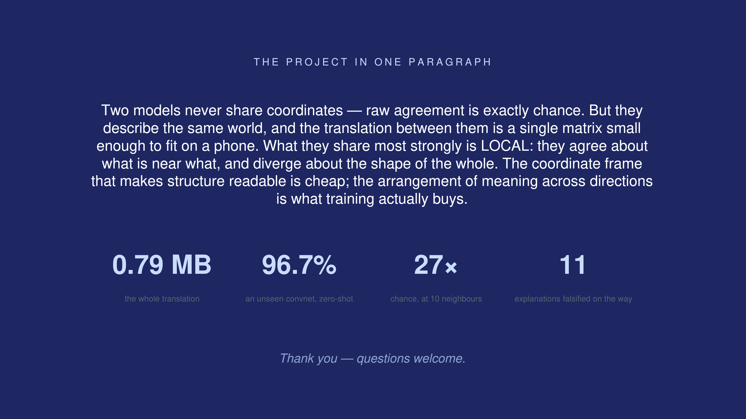
Notes:
Close on the one-paragraph summary and four numbers. Stop at 19-20 minutes; leave the last beat for silence.

Slide 22
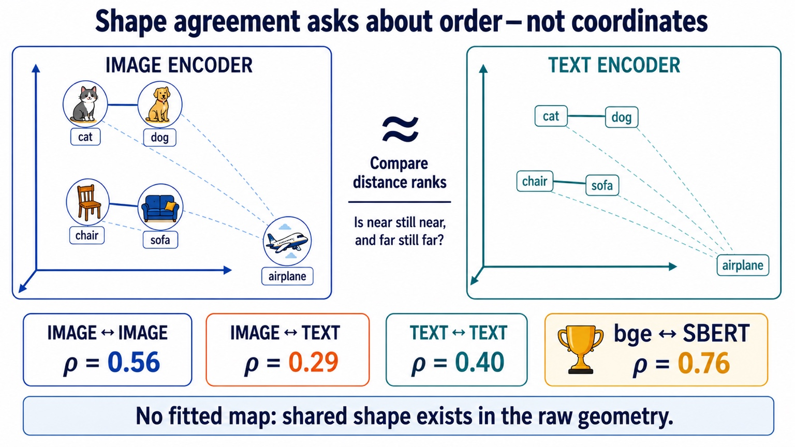
Notes:
Visual appendix: shape agreement asks whether near remains near and far remains far without fitting a map. Project values shown: image-image 0.56, image-text 0.29, text-text 0.40, bge-SBERT 0.76.
[Sources]
- Project measurements and corrected educational diagram supplied by the project author.

Slide 23
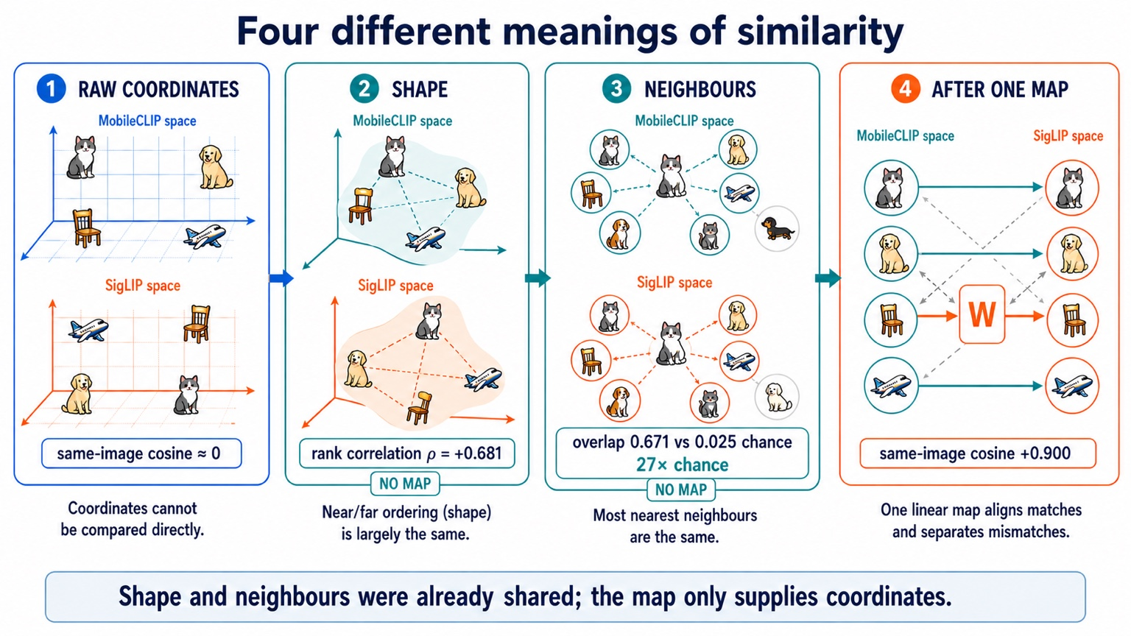
Notes:
Visual appendix: corrected MobileCLIP-SigLIP summary. Raw same-image cosine is approximately zero; distance-rank correlation is +0.681; neighbour overlap is 0.671 versus 0.025 chance, or 27 times chance; after one linear map, same-image cosine is +0.900.
[Sources]
- Project measurements and corrected educational diagram supplied by the project author.

Slide 24
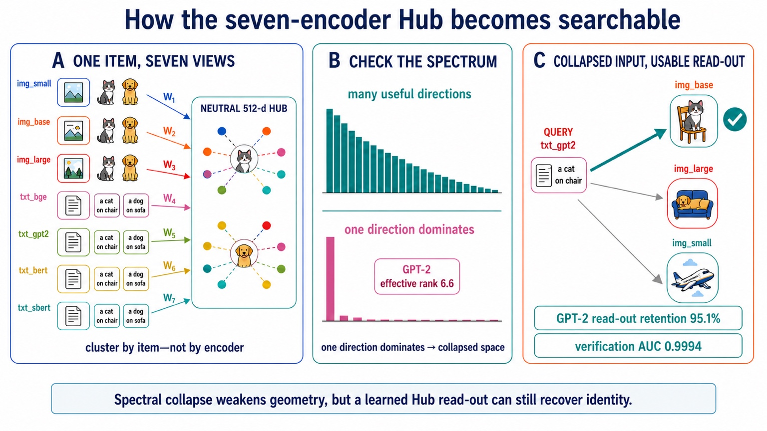
Notes:
Visual appendix: seven independent entry maps into the neutral 512-dimensional Hub. One dominant GPT-2 direction indicates a collapsed space with effective rank 6.6, while learned Hub read-out retains 95.1% and verification AUC is 0.9994.
[Sources]
- Project measurements and corrected educational diagram supplied by the project author.

Slide 25
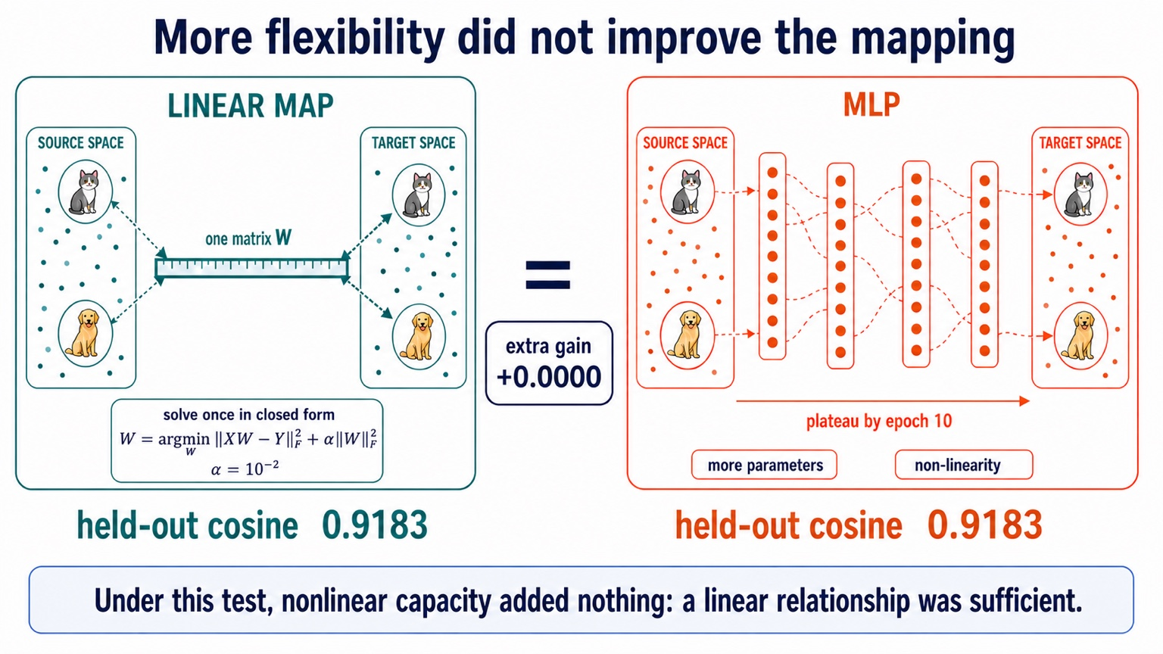
Notes:
Visual appendix: ridge objective includes alpha times the squared Frobenius norm of W, with alpha 1e-2. The MLP plateaus by epoch 10 and reaches the same held-out cosine, 0.9183; measured extra gain is +0.0000.
[Sources]
- Project measurements and corrected educational diagram supplied by the project author.

Slide 26
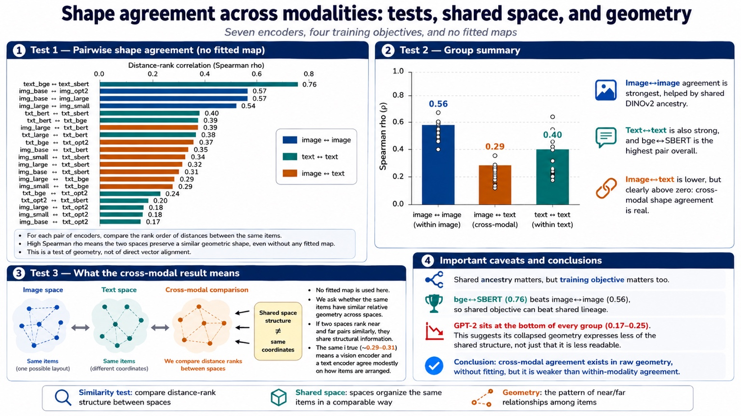
Notes:
Visual appendix: all 21 pairs of the seven-space Hub are compared without a fitted map. Mean shape agreement is 0.56 image-image, 0.29 image-text, and 0.40 text-text; bge-SBERT is the highest pair at 0.76.
[Sources]
- Project measurements and corrected educational diagram supplied by the project author.

