Slide 1
SHARED REPRESENTATIONS, PRACTICAL ADAPTERS
A bounded test of the Platonic Representation Hypothesis —
and two engineering implementations
Do independently trained models discover the same world, and can one matrix move knowledge between them?
Experiment A
Experiment B
Shared hub
Layer-by-layer convergence: GPT-2 → Pythia
Phone→server adapter: 0.79 MB, 95.3% of native
Seven encoders, one space, one frozen head
Liad Kashanovsky · AI Expert final project · 20-minute defense · 17 September 2026
8 encoders · 9 findings · 11 falsified explanations · 2 shipped systems
Notes:
[0:00] Talk structure: hypothesis → measurements (spend time here) → data & controls → three experiments → two discoveries → demo → achievements → close.

Slide 2
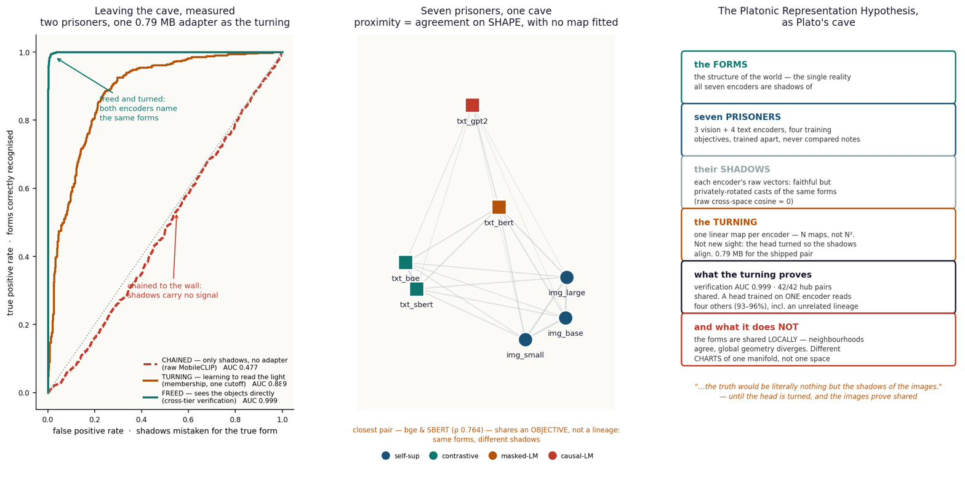
THE HYPOTHESIS
From Plato's cave to a falsifiable linear-map claim
Models trained separately — different data, different objectives, sometimes different senses entirely — are said to be converging on the same underlying picture of the world. The name comes from Plato: there is one reality, and each model sees a shadow of it.
THE CLAIM UNDER TEST independently trained models agree UP TO ONE LINEAR MAP — there exists one matrix W, solved in closed form (no training), with x_A · W ≈ x_B
FALSIFIABLE
BOUNDED — the key point
THREE QUESTIONS
If no linear map beats a random-map control, convergence is rejected. It happened: a pure rotation scored R² 0.038 against ridge 0.592 — 'just rotated' was killed.
A linear map is the WEAKEST useful transform. A matrix has no room to learn a task, so success cannot be explained away by 'a network secretly learned it.' The MLP control proves it: extra capacity gained +0.0000.
(1) IS structure shared?
(2) is it GLOBAL or LOCAL?
(3) what DECIDES how much — modality, lineage, or objective?
2
Notes:
[1:00] Two minutes. Spend time on BOUNDED — if a matrix is too weak to fake a task, then the sharing must be real. The three questions structure the whole talk.

Slide 3
HOW I MEASURE — IN PLAIN WORDS
Five metrics, each as a question about cats and dogs — with its blind spot
metric | the question in the cat/dog sentence | how to read it (chance) | blind spot
cosine similarity | do the cat PHOTO and its CAPTION point the same way? | +1 = same direction; 0 = unrelated; chance ≈ 0 in a healthy space | in a COLLAPSED space every pair reads +0.999 — check mean pair-cosine first
dist (distance) | how far apart is cat-on-chair from cat-on-sofa INSIDE one space? | smaller = nearer; used to rank and to compute ρ and k-NN overlap | scale differs across spaces — compare RANKS, not raw values
R@1 / R@5 (recall) | does the RIGHT cat rank FIRST (or top-5) out of N = 1,000? | chance = 1/N = 0.001; 'R@1 0.36' means right 36% of the time | meaningless without N; always quote chance alongside
R² (held-out) | do the predicted NUMBERS match the caption vector's numbers? | 1 = perfect; can go NEGATIVE when target variance is tiny | a negative R² doesn’t mean retrieval fails — retrieval only needs direction
% of ceiling | how much of a JOINTLY-TRAINED system does my untrained matrix reach? | 88% means 'almost as good as training both together' | ceiling must use the SAME rows, captions and direction as the method
Spearman ρ (rho) | is near still near, far still far? (order of distances, no map fitted) | shape agreement; +1 = perfect order; survives rotation and rescaling | not retrieval accuracy; a high ρ does not guarantee good R@1
the formulas
⚠ the one rule
cos(u,t) = (u·t)/(|u||t|)
dist(i,j) = 1 - cos(i,j) (in one space)
R@K = P(true item in top-K of N) chance = 1/N
R² = 1 - |T-XW|² / |T-μ|²
% ceiling = my R@K / jointly-trained R@K
ρ = Spearman(dist_A(i,j), dist_B(i,j))
A metric only means something RELATIVE to the geometry it is computed in. The same system once read cosine 1.000 and R@1 0.160 on the same data — not a contradiction; two different questions.
3
Notes:
[3:00] Spend TWO minutes here. If the examiner understands R@1, % of ceiling and the rule, every later number lands cleanly. Emphasise that dist is distance inside ONE space.

Slide 4
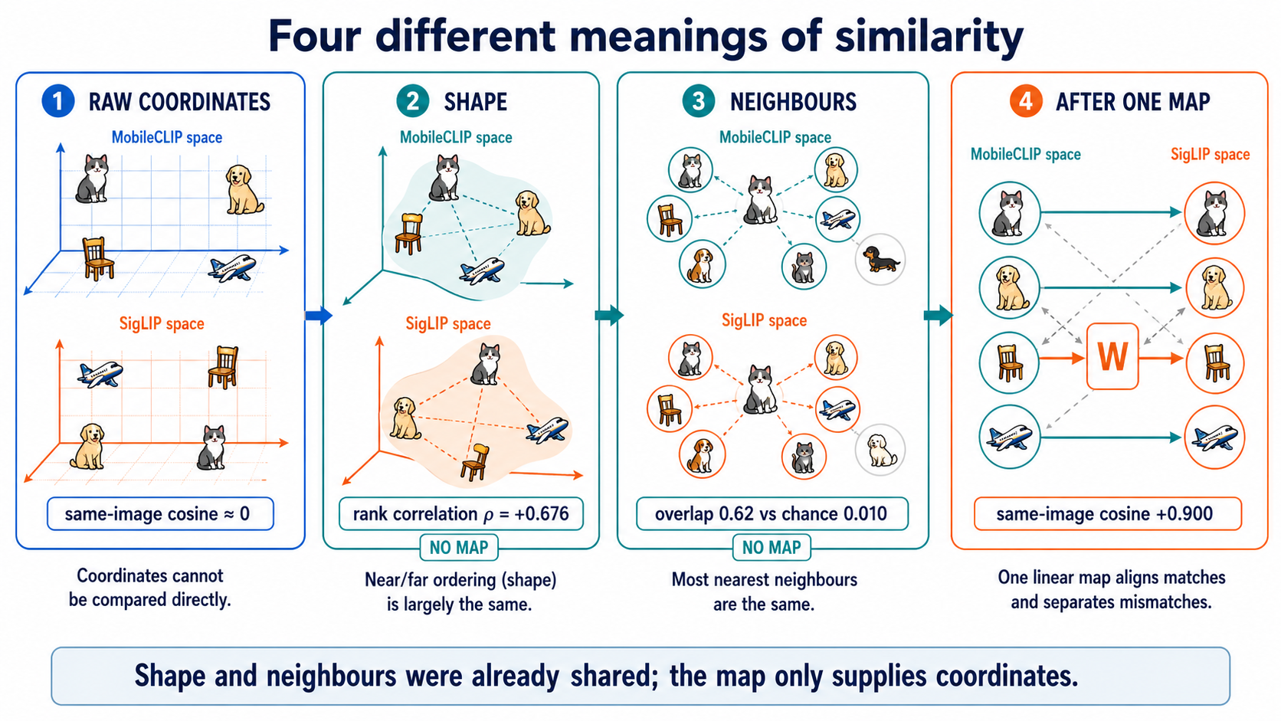
THE WHOLE IDEA IN ONE EXAMPLE
The cat on a chair: unrelated coordinates, identical relationships
the short math
DINOv2 sees pixels -> x_img ∈ R^768
bge-m3 reads text -> x_txt ∈ R^1024
cosine(x_img, x_txt) ≈ 0.00
(the coordinates share NOTHING)
yet dist(cat-chair, cat-sofa)
< dist(cat-chair, airplane)
in BOTH spaces (shape = relations preserved)
claim: ∃ one matrix W with x_img·W ≈ x_txt
cosine ≈ 0: coordinates share nothing
Spearman ρ = +0.676: shape already agrees (no map)
k-NN overlap 62%: same 10 neighbours (chance 1%)
cosine +0.900 after ONE linear map
'dist' = distance between two items inside ONE space (small = near). The numbers are unrelated; the relations are not — that gap is the whole project.
4
Notes:
[5:00] The anchor example. Say 'dist' aloud and define it. The audience needs to see that cosine ≈0 and shape-agreement +0.68 are compatible — two different questions.

Slide 5
DATA, SPLITS AND CONTROLS
What was fitted, what was held out, and what would have killed each number
DATA AND SPLITS
study | data source | fit / eval rows | learned
A | WikiText-103 (Wikipedia) | 7,500 / 2,500 passages | Layer-wise ridge maps GPT-2 → Pythia
B | COCO val2017 | 3,000 / 1,000 images | 512 × 768 adapter W
E1 | COCO train2017 | 7,000 / 1,000 image-caption pairs | 768 × 1024 cross-modal map
Hub | COCO train2017 caches | 8,533 / 1,000 items | PCA basis, entry maps, caption head
F follow-up | Teacher image embeddings | 37,999 / 2,000 rows | Ridge refit; separate MLP control
SIX CONTROLS — every result is a pair: the number and the one that could have killed it
control | fitted result | control / chance | what it checks
Random map / no adapter | AUC 0.999 · hub R@1 0.451 | AUC 0.477 · R@1 0.003 (chance 0.001) | The learned bridge supplies real information
Random model weights | CKA 0.359 · R² 0.737 | CKA 0.067 · R² 0.173 | Alignment is learned, not architectural
Shuffle item pairing | E1 R² 0.511 | Shuffled R² −0.130 · gap 0.641 | The true correspondence matters to the map
Matched native ceiling | B R@5 0.843 | Native R@5 0.885 → 95.3% retention | Task, rows, caption treatment must match
Held-out ConvNeXt | 96.7% retention | ViT band 93.8–96.5% | Supervised convnet; never a hub member
Held-out SigLIP 2 | 94.2% retention | Encoder-specific head (its own) | Unrelated lineage; caption head frozen
5
Notes:
[6:00] Brief. Point out that the table also encodes the scientific design: every claim pre-paired with the number that would kill it.

Slide 6
THE EIGHT ENCODERS — ALL FROZEN
Different modalities, objectives, supervision regimes, sizes
encoder · dim | objective | regime · size | role
DINOv2 s/b/l · 768/1536/2048 | self-distillation on image crops | SELF-SUP · 22–304M | hub members; E capacity ladder
bge-m3 · 1024 | multilingual query–passage contrastive | PAIR-SUP · 568M | hub member + caption head target
GPT-2 · 768 | next-token prediction (WebText) | SELF-SUP · 124M | exp A source; collapse case (whitening rescue)
Pythia-160M · 768 | next-token prediction (The Pile) | SELF-SUP · 160M | exp A target; random-weights CONTROL
BERT / SBERT · 768 | masked-LM / NLI fine-tune | SELF-SUP + SUP · 110M | text ladder; SBERT best head target (101.0%)
SigLIP 2 base · 768 | sigmoid image–text contrastive | PAIR-SUP · HELD OUT | B server target; hub cross-lineage CONTROL → 94.2%
MobileCLIP-S1 · 512 | image–text contrastive, distilled (phone tier) | PAIR-SUP · 21.5M | B phone source; Demo 1
ConvNeXt-base · 1024 | ImageNet-22k class supervision | FULLY-SUP · 89M · HELD OUT | hub architecture CONTROL → 96.7%, above ViT band
Three regimes, four objectives — all join one hub at 93–97 % of native
Scale rungs
Self-supervised (DINOv2, GPT-2, BERT) · pair-supervised contrastive (bge, SigLIP, MobileCLIP) · fully supervised (SBERT, ConvNeXt). One vector per COCO item: tokens → hidden states → pooled row. Row i is the SAME item in every cache — the shared index is the only 'pairing' any fit ever sees.
DINOv2-giant ~1.14B · 3,072-d (held out scale test)
Qwen3-Emb 0.6B / 4B (text scale ladder)
Both ladders rise then FALL past 304M.
6
Notes:
[7:00] Keep brisk — 30 seconds. Flag HELD OUT encoders (SigLIP, ConvNeXt) as the main controls from the previous slide.

Slide 7

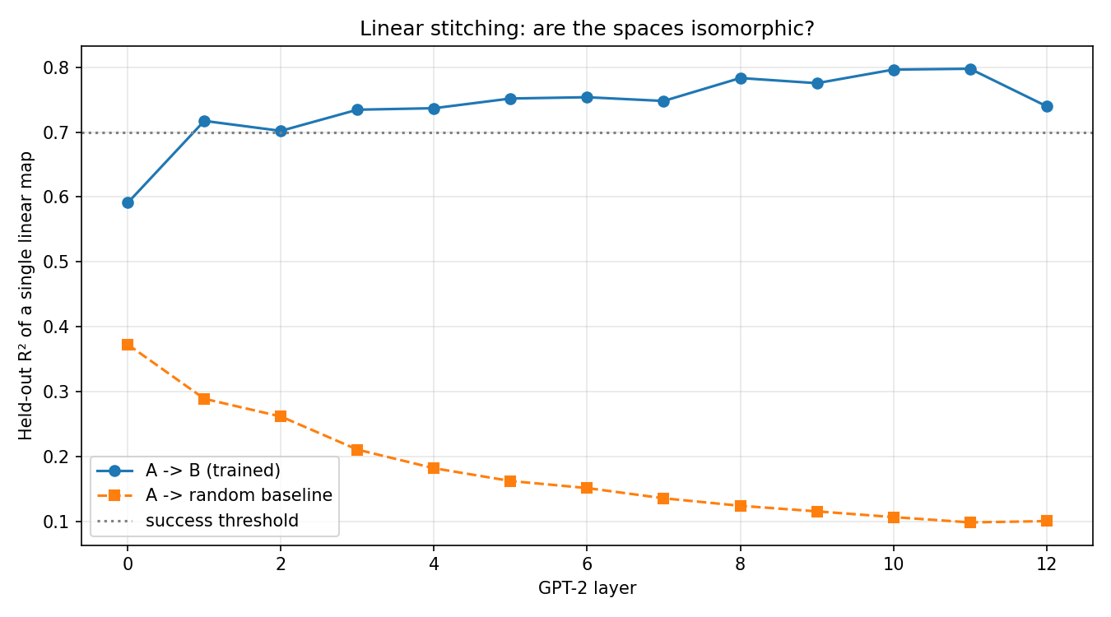
EXPERIMENT A · TWO LANGUAGE MODELS
GPT-2 vs Pythia-160M, layer by layer — with a random-weights control
Setup
10,000 WikiText passages through both frozen models, masked-mean-pooled per layer. Per layer: CKA (structure) and one ridge map GPT-2→Pythia. CONTROL: seeded random-weights Pythia. Nothing trained. 7,500 train / 768 = 9.8 rows/dim.
Measured — CKA: trained mean 0.359 vs random 0.067 = 5.3×; diagonal mean 0.424 = 6.3×. Stitching R²: 0.797 at layer 11 vs random 0.173.
The control makes the case: trained curve RISES with depth (0.59→0.80); random curve DECAYS (0.38→0.09). Opposite slopes = learning, not architecture.
Failure caught: run 1 (1,646 rows) failed on starvation; run 2 (10,000) passed. Same pipeline, more rows.
Proved: convergence is real across architectures and data — the licence for everything after.
7
Notes:
[7:30] Exp A. The key visual is the two curves crossing in slope. The random-weights control (opposite slope) is the whole argument.

Slide 8
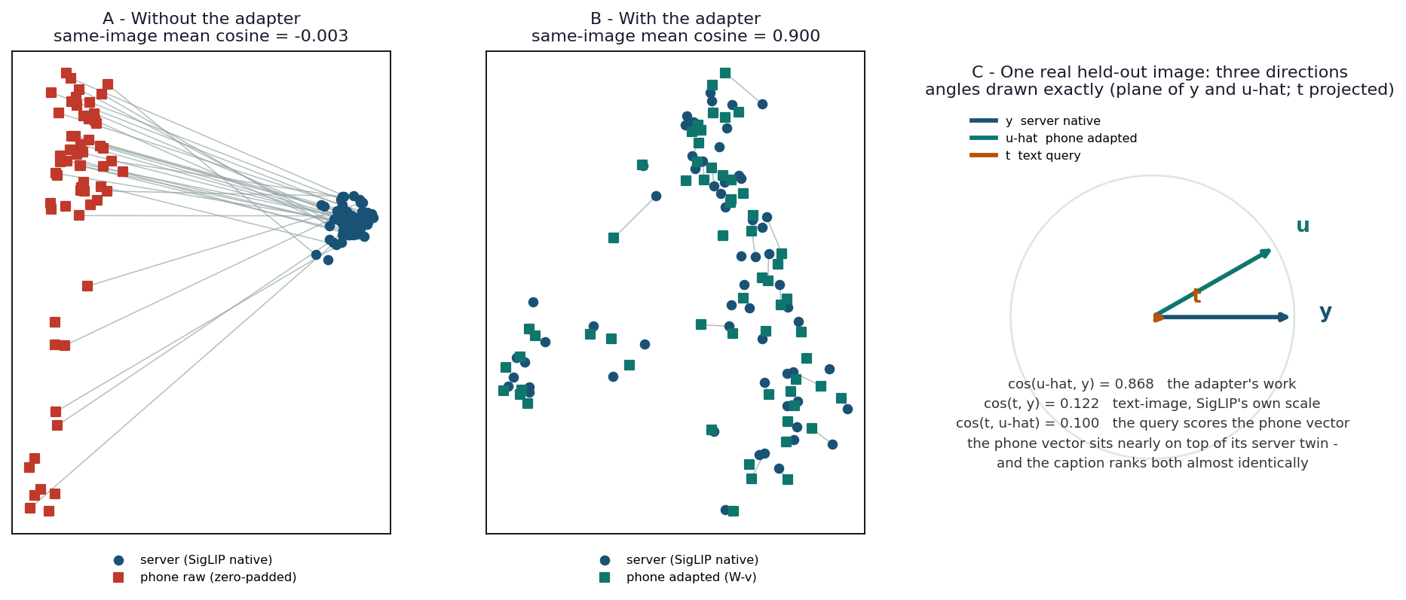
EXPERIMENT B · PHONE → SERVER ADAPTER
▶ LIVE DEMO
One 0.79 MB matrix lets a mobile encoder search a server index
Setup & control
MobileCLIP-S1 (phone, 512-d) and SigLIP 2 (server, 768-d) — never met. Data: 4,000 COCO val2017 pairs, 3,000 train / 1,000 held out. Ridge W (512×768) fitted to match REPRESENTATIONS — never sees the retrieval task. CONTROL: remove W → AUC collapses to 0.477 (chance). Shipped as Core ML fp16, bit-exact.
0.592
0.900
95.3%
88.4%
0.79 MB
held-out R²
mean cosine to true twin
of native R@5
of ceiling R@1 (gate 90%, missed)
fp16 Core ML
Verification AUC 0.999 vs 0.477 no-adapter; R@1 0.987 (same-photo ranking); membership AUC 0.889.
The 90% R@1 gate was recorded as MISSED — reported, not hidden.
8
▶ Demo notebooks B1–B5 — Drive: convergence_experiment
Notes:
[9:00] Demo 1. Run live query if available. Call out the 0.477 control vs 0.999 — that gap is the whole adapter. Mention the missed 90% gate proactively.

Slide 9
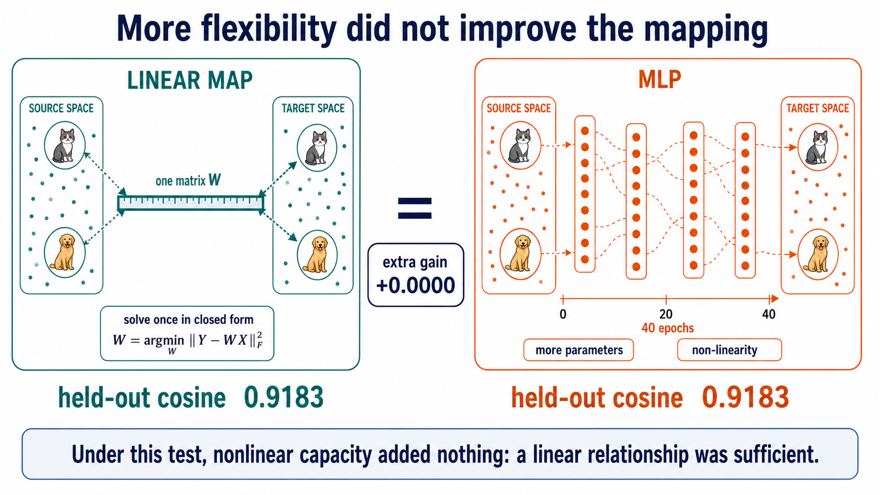
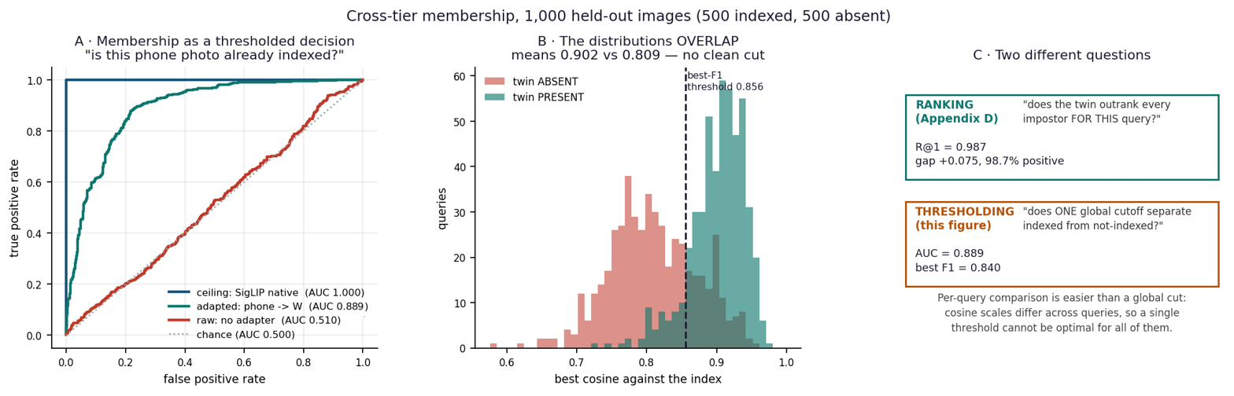
EXPERIMENT B · WHAT THE MATRIX PROVES
A bigger, non-linear model could not beat the one matrix
MLP control (F2): more parameters, non-linearity, 74 rows/dim, 40 epochs — held-out cosine 0.9183 vs ridge 0.9183, gain +0.0000, on two runs. Linearity is not an approximation; it IS the relationship.
One adapter, three decisions ranked by difficulty: verification (same photo?) AUC 0.999 · ranking (twin first?) R@1 0.987 · membership (indexed at all, one global cutoff?) AUC 0.889. Harder as the decision becomes more global.
The MLP is the control for 'a network secretly learned the task' — it gains nothing.
9
Notes:
[10:30] The MLP control is conceptual dynamite: capacity adds zero, so the linear structure is exact, not approximate.

Slide 10
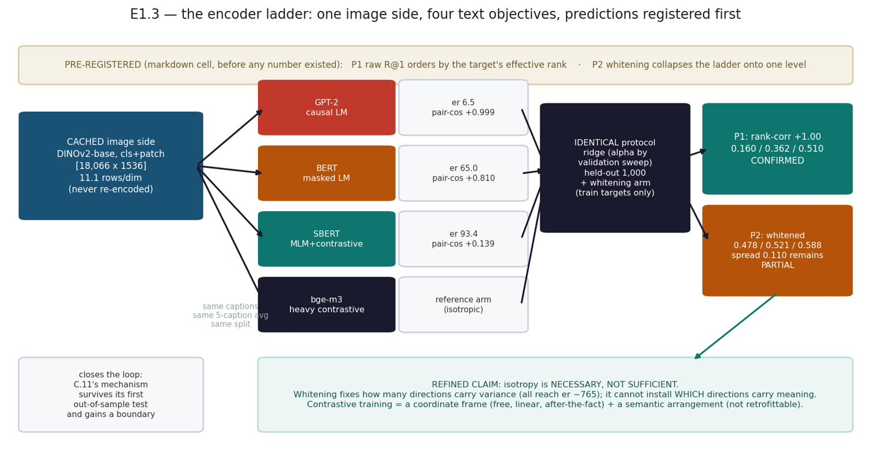
EXPERIMENT E · CROSSING MODALITIES
DINOv2 never saw a word; bge-m3 never saw a pixel — one matrix, image → text
Setup & control
8,000 COCO train2017 pairs — 7,000 fit W (768→1024), 1,000 held out. Target = five bge captions averaged. CONTROL: shuffle the pairing — the map should fail. Ceiling = jointly-trained system on the same rows.
Measured — R@1 0.358 = 40.9% of the matched ceiling (358× chance); R² 0.511; shuffle-gap 0.641 (true R² 0.511 minus shuffled −0.130).
Failure caught: a borrowed ceiling read 55.2% — wrong direction, wrong protocol. Re-measured on matched rows: 40.9%. New rule: ceiling is never borrowed.
Proved: PRH's cross-modal claim holds WITHOUT joint training. Crossing modality costs ~half the R@1 of a same-modality pair.
Data: COCO train2017 · DINOv2-small images + bge-m3 captions · shuffle gap confirms pairing is real
10
Notes:
[11:30] The shuffle control makes this credible: the pairing matters (gap 0.641). The ceiling correction story shows scientific honesty.

Slide 11
EXPERIMENT E · CAPACITY — DOES IT SCALE?
Alignment grows with size to 304M — then both ladders fall
40.9%
53.5%
58.3%
small 22M
base 87M
large 304M
Ladder (same encoder, data, pooling at every rung): +15.3 pts of ceiling per decade of parameters — exactly PRH's prediction, up to 304M.
Then the falsification: image ladder falls 0.418 → 0.339 at giant (1.1B); text ladder 0.352 → 0.307 at Qwen-4B. Rise then FALL — P2/P3 FALSIFIED.
Honest scope: this is a 0.02–4B regime; PRH's evidence runs to 70B. The big-model tests are the to-do list.
ρ = Spearman of pairwise distances, no map fitted — shape agreement before any fitting. Report E.16.
11
Notes:
[12:30] Concede the scale falsification proactively. It demonstrates the science is real — falsifiable predictions were actually tested.

Slide 12
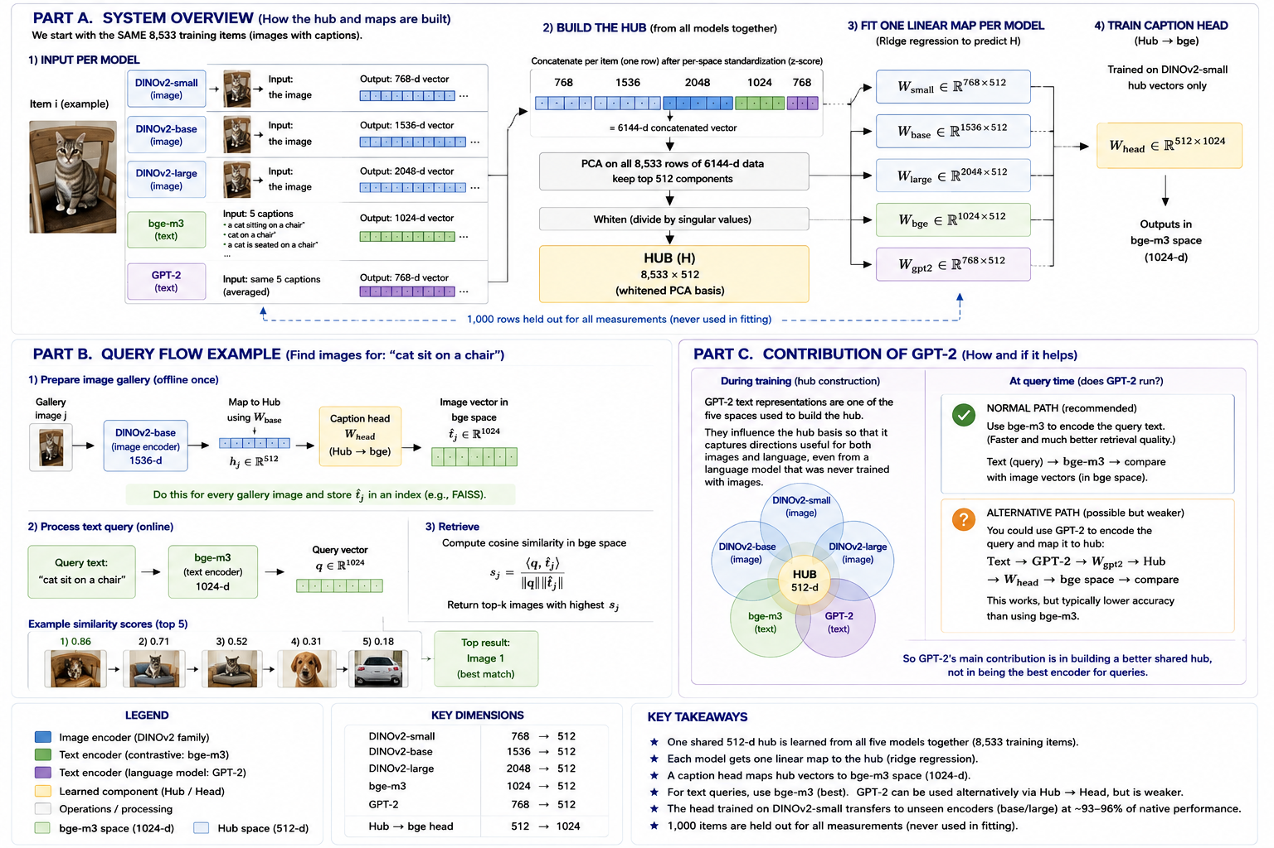
DISCOVERY · ISOTROPY, NOT SIMILARITY-TRAINING
A collapsed language space, rescued to 102.6 % of a contrastive encoder by a free linear transform
What happened
GPT-2 captions: eff.rank 6.6 of 768. Every caption sits at cosine +0.999 to every other — a cone, not a cloud. Cosine reads 1.000 while retrieval R@1 is 0.130.
Whitening (divide each direction by its spread, label-free, linear) lifts R@1 to 0.478 = 102.6% of an encoder trained on 1.2 BILLION pairs.
CONTROL: centering alone (no whitening) leaves eff.rank at 6.5 and fails — it is the isotropy, not the shift.
Measured — eff.rank vs R@1 correlates at ρ +0.94 across encoders: isotropy is a dial, not a switch.
Proved: isotropy is NECESSARY, not sufficient. A linear transform supplies the coordinate frame; contrastive training adds the semantic arrangement that survives whitening.
Cuts both ways: isotropy HELPS reading a known correspondence (retrieval ↑) and HURTS finding an unknown one (Gromov–Wasserstein 39.7% → 0.1%).
12
Notes:
[13:30] A discovery, not a planned result. The centering-only control isolates what makes whitening work. The 102.6% number is the memorable beat.

Slide 13
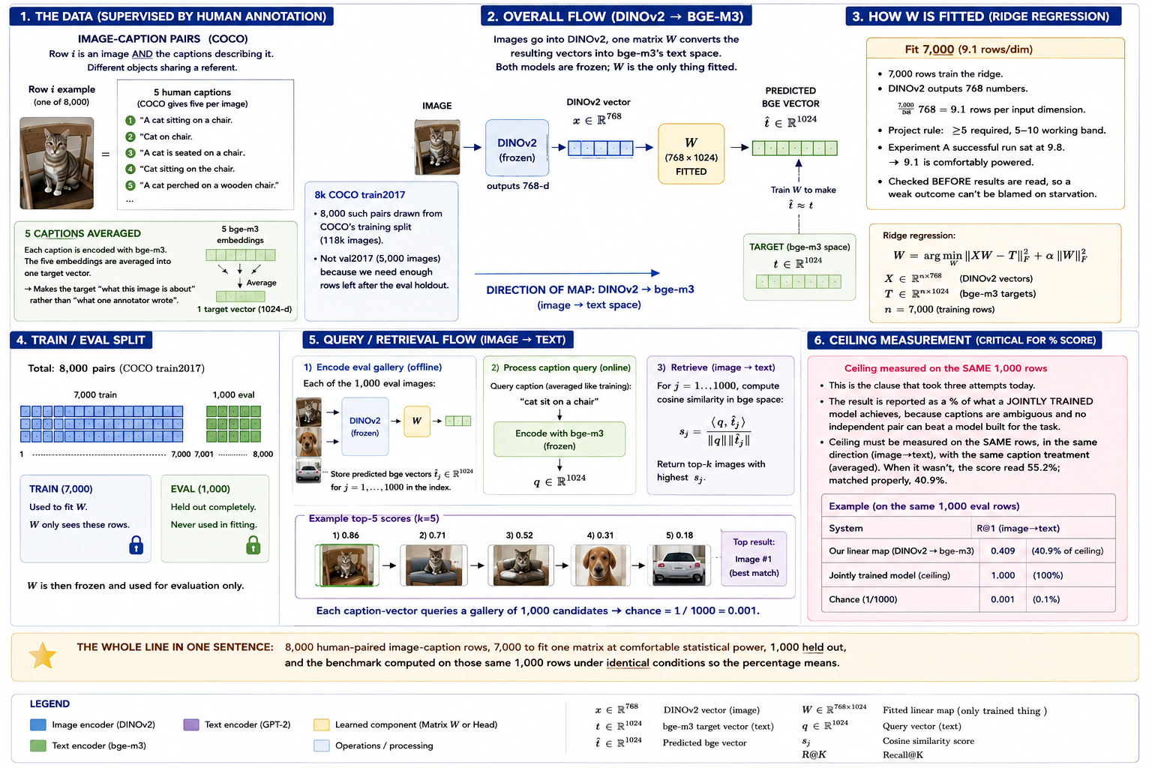
ENGINEERING SYSTEM 2 · THE SHARED HUB
Seven encoders, one 512-d coordinate system — one frozen head, many recipients
configuration | members | concat width
Published 4-space | DINO s/b/l + bge | 5,376
Intermediate 5-space | Four-space + GPT-2 | 6,144
Extended 7-space | Five-space + BERT + SBERT | 7,680
the short math
Z = [X̃_1 | … | X̃_K] (8,533 × 7,680)
H = whiten(PCA₅₁₂(Z))
W_k = ridge(X_k → H) per encoder
W_head = ridge(H_small → T_bge) once
query: x_k W_k W_head → rank captions
add a model = one solve of W_new;
hub, head & all other maps untouched
13
Notes:
[14:30] Hub build. The key engineering point: adding a model is ONE solve. Pairwise would need N-1 new maps; the hub needs 1.

Slide 14
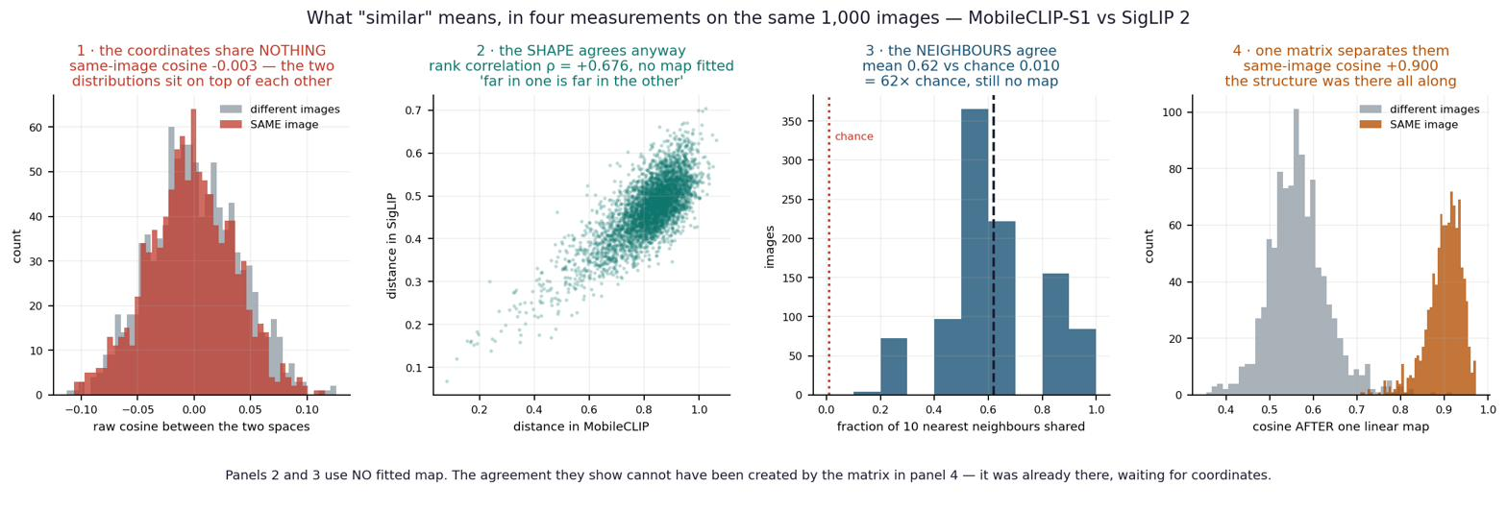
THE HUB · TRANSFER TO ENCODERS IT NEVER SAW
▶ LIVE DEMO
One frozen head trains on one encoder and serves all others
recipient (never seen) | R@1 | retention | control?
DINOv2-base (sibling) | 0.445 | 96.5%
DINOv2-large (sibling) | 0.473 | 92.9%
SigLIP 2 (new lineage) | 0.557 | 94.2% | held-out
ConvNeXt (convnet+supervised) | — | 96.7% | held-out
random-map control | 0.003 | — | chance 0.001
All 42 directed pairs through the shared hub reach 103.6% of bespoke per-pair hubs — sharing is FREE.
CONTROLS: random entry map scores 0.003 (chance 0.001). ConvNeXt — convnet, supervised, never a member — 96.7%, ABOVE the ViT band. Neither architecture nor supervision bounds the claim.
Seven-space R@1 0.451 vs five-space 0.445 — adding encoders does not hurt.
14
▶ Demo notebook G2 (live) — Drive: convergence_experiment
Notes:
[15:30] Demo 2. Show G2. Call out random-map control (0.003) and ConvNeXt (96.7%) — those two numbers together prove the claim is real and broad.

Slide 15

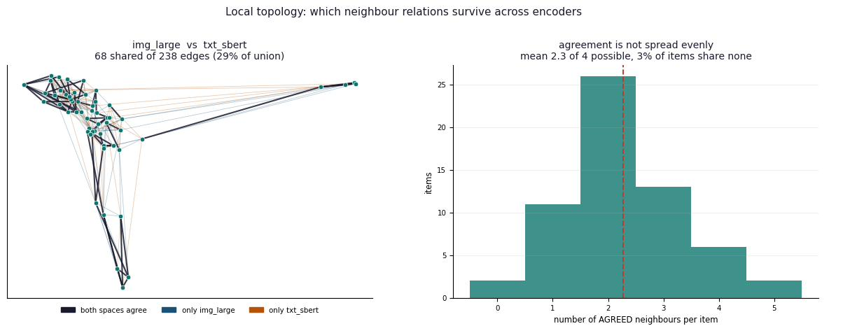
THE CENTRAL DISCOVERY
What is shared is LOCAL structure — not global geometry
The finding
Raw cosine ≈ 0 — coordinates never agree. Shape does: ρ +0.681; 67% of 10 nearest neighbours shared (27× chance). Agreement strongest at small k, decays to chance by k = 500 — 21/21 pairs, three metrics including PRH's own. Different CHARTS of one structure, not one space.
15
Notes:
[16:45] The headline scientific result. 'Same world' means same LOCAL arrangement of meaning. The map-projection metaphor is the takeaway.

Slide 16
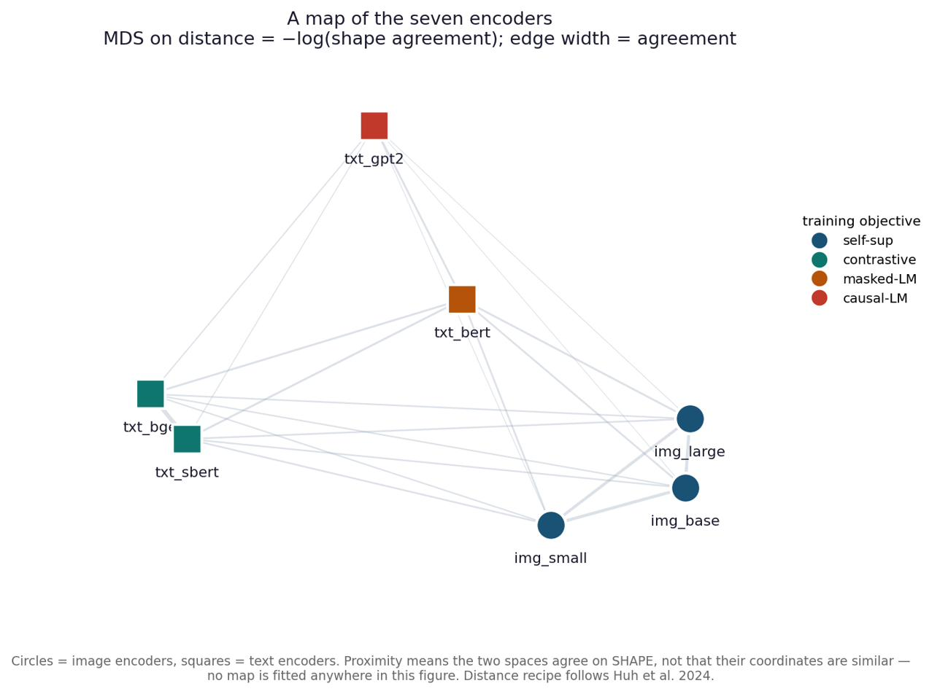
AND WHAT DECIDES HOW MUCH
Objective beats lineage beats modality
+53×
+44×
+29×
Top pair: bge–SBERT ρ +0.76 — shares an objective and NO ancestry; beats the sibling image pair.
ConvNeXt: LOWEST raw shape agreement (0.33–0.40), HIGHEST transfer (96.7%) — raw shape does not predict transfer.
MDS map (right): encoders cluster by training OBJECTIVE. No map fitted anywhere.
shared OBJECTIVE
shared LINEAGE
shared MODALITY
16
Notes:
[17:30] What you train FOR matters more than what you train ON or which sense you use. bge-SBERT is the cleanest evidence.

Slide 17
ACHIEVEMENTS — AND THE HONESTY THAT BACKS THEM
Nine findings, two shipped systems, eleven falsified explanations
PROVED & BUILT
FALSIFIED — kept on the record (11, two of them mine)
Convergence is real but LOCAL; linear, not rigid (Procrustes 0.038 vs ridge 0.592).
It crosses modality with no joint training: 40.9–58.3% of ceiling, 358× chance.
Isotropy rescue: collapsed space → 102.6% of a billion-pair encoder.
Self-identifying from shape alone: 39.7% exact, ZERO pairs (595× chance).
Objective > lineage > modality (+53 / +44 / +29×).
Shipped: a 0.79 MB phone adapter (95.3% of native R@5).
Shipped: a hub where adding a model is one closed-form solve.
'Same space' — refuted: raw cosine ≈ 0, global agreement ≈ chance. It is LOCAL.
'A rotation aligns them' — refuted: Procrustes R² 0.038.
'An MLP beats the matrix' — refuted: +0.0000 gain, twice.
'Scaling keeps helping' — refuted: both ladders fall past 304M.
The width cliff: seven mechanisms falsified; the eighth (algebraic rank wall) confirmed. One of my own tests was wrong and is on record.
Initial fit underpowered (run 1) — rows-per-dim rule added.
The method IS the result: a claim that survived a test which could have killed it is worth more than one never exposed to one.
17
Notes:
[18:30] Science: the local finding. Engineering: 0.79 MB + hub. Method: falsification ledger. Close with the italic line.

Slide 18
NEXT TESTS — IN PRIORITY ORDER
Bigger models come first; the boundary is named, not hidden
priority | test | success evidence
1 | Expand paired corpus; repeat giant / Qwen transfer | Stable absolute R@K, non-degenerate references, 10+ rows/dim for giant
2 | Extend model scale with matched pooling and controls | Raw geometry and transfer reported separately; architecture confound isolated
3 | Small experts vs one large encoder (pre-registered B1) | Matched task quality, device latency, RAM and energy
4 | Domains, languages, image-target heads and mobile tests | Transfer beyond COCO English; actual device benchmarks
Why the boundary is scientific, not just honest
PRH's own evidence runs to 70B-parameter language models, a regime this project never entered. The two falsifications (P2/P3) are at 0.3–4B — a confound (model family and architecture change together) means they are a signal to investigate, not a definitive rejection of PRH at scale. Naming the boundary and costing the next test (35,133 items brings gamma to 0.22; ~10 rows/dim for giant) is the work.
18
Notes:
[19:15] Forty-five seconds. The examiner's first question is 'what about big models?' — this slide pre-empts it. 35,133 items is the specific next step.

Slide 19
APPENDIX · METRIC DEFINITIONS AND BLIND SPOTS
Full reference for any examiner question on measurement
metric | formula / meaning | what it misses or when it misleads
cosine | x·y / (||x|| ||y||): direction agreement | Near-one scores uninformative in anisotropic (collapsed) spaces
dist | 1 − cosine(i,j) within one space | Scale differs across spaces — compare ranks, not raw values
R² | 1 − SSE/SST: target variance explained | Includes magnitude; can go negative; healthy R@1 with negative R² is possible
R@K | Fraction of queries where true item is in top-K of N | Requires N (chance = K/N); meaningless without it
% of ceiling | My R@K divided by jointly-trained R@K | Ceiling must match rows, caption protocol and direction
Spearman ρ | Correlation of ranked within-space pairwise distances | Not retrieval accuracy; survives rotation, not magnitude
CKA | HSIC(K,L)/sqrt(HSIC(K,K)·HSIC(L,L)): centred similarity structure | Calibrate against controls; sensitive to width differences
CKNNA | Centred alignment on mutual k-nearest neighbours | Specify k; local (small k) vs global (large k) differ substantially
k-NN overlap | Shared neighbours / k | Null ≈ k/(N−1); report ratio to chance
verification AUC | P(score(same) > score(random)) | Negatives are easy; near-1 AUC means the question was easy
Reference: Similarity_Methods_Master_Table.pdf · Math_and_Terms.pdf · Final_Project_Report.pdf Appendix C.13
19
Notes:
Backup slide. Use if examiner questions any measurement definition. Not part of the 20-minute flow.

Slide 20
IN ONE PARAGRAPH
Two models never share coordinates — raw agreement is exactly chance. But they describe the same world, and the translation between them is a single matrix small enough to fit on a phone. What they share most strongly is LOCAL: they agree about what is near what, and diverge about the shape of the whole. The coordinate frame that makes structure readable is cheap; the arrangement of meaning across directions is what training actually buys.
Science
Engineering
Method
a subset of PRH proved, narrowed to its defensible form
two small-expert systems that run without a GPU
11 falsified explanations kept on the record
Supported scope: selected models, datasets and metrics on COCO / WikiText-103. Universal convergence remains open.
Thank you — questions welcome.
Full method, tables and falsification ledger: Final_Project_Report.pdf (74 pp) · the story with the math: Project_Atlas.pdf
Notes:
[19:45] Land the three pillars. The 'supported scope' caveat is the honest boundary. Close on 'Thank you'.

