Slide 1
REPRESENTATION CONVERGENCE
Do independently trained models discover the same world — and can one matrix move knowledge between them?
A subset of the Platonic Representation Hypothesis, tested on small frozen encoders — and turned into two engineered systems that run on weak devices.
Liad Kashanovsky · AI Expert final project · Viva 17 September 2026 · 8 encoders · 9 findings · 11 falsified explanations · 2 shipped artifacts
Reminder deck: goal → measurement → what was proved or built, with the cat-on-a-chair example on every step.

Slide 2
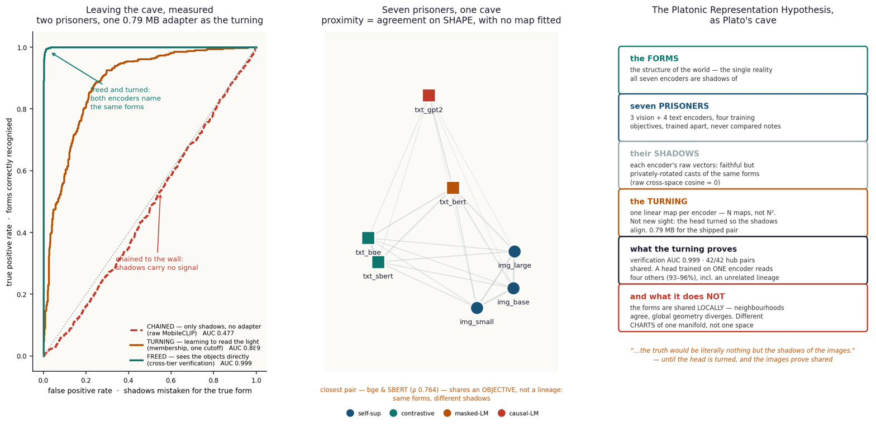
THE HYPOTHESIS
The Platonic Representation Hypothesis, in plain words
Models trained separately — different data, different objectives, sometimes different senses entirely — are said to be converging on the same underlying picture of the world. The name comes from Plato: there is one reality, and each model sees a shadow of it.
What Huh et al. (2024) claim
The gap I had to close
As models grow larger and train on more data, their internal representations converge toward one shared statistical model of reality — shadows of a single world on different cave walls. They measure it with mutual-nearest-neighbour alignment (CKNNA) on models up to 70B parameters, and report it grows stronger with scale.
“Converging on the same picture” has no units — it cannot be tested or failed as written. So I narrowed it to a claim that CAN fail:
independently trained models agree UP TO ONE LINEAR MAP
meaning: there exists one matrix W, solved in closed form (no training), with x_A · W ≈ x_B.
2

Slide 3
WHY THE LINEAR-MAP FORM IS A REAL TEST, NOT A SLOGAN
Three properties the narrowed claim has that the original does not
1 · FALSIFIABLE
2 · BOUNDED (why this matters)
3 · USEFUL
The claim can be proven wrong. If no linear map beats a random-map control, convergence is rejected.
It happened: a pure rotation (Procrustes) scored R² 0.038 against ridge 0.592 — so “same shape, just rotated” was falsified. The map has to STRETCH, not merely turn.
A linear map is the WEAKEST useful transform — no hidden layers, no non-linearity, just multiply by one matrix.
So if it works, you cannot dismiss it as “a powerful network secretly learned the task.” A matrix has no room to learn a task. The MLP control proves it: adding capacity gained +0.0000. Success can only mean the structure was already shared.
If one matrix carries knowledge between models, their components become interchangeable — an engineering result, not only a scientific one.
Two systems follow directly: the 0.79 MB phone→server adapter, and the 512-d hub where adding a model is one solve.
In one line
“Same picture” is untestable. “Agree up to one linear map” is falsifiable (a control can kill it), bounded (a matrix is too weak to fake it), and useful (it makes parts swappable). That is the claim this project actually proved — for a subset of models, and only locally.
3

Slide 4
THE WHOLE RESULT, UP FRONT
What the project proved, what it built, and what it falsified
PROVED — the science
BUILT — the engineering (small-model advantage)
Convergence is real but LOCAL: neighbourhoods agree (up to 62× chance), global geometry does not (raw cosine ≈ 0).
It is linear, not rigid: one matrix works; a rotation alone fails (0.038 vs 0.592).
It crosses modality with no joint training: image→text at 40.9–58.3% of a jointly-trained ceiling, up to 358× chance.
Objective beats lineage beats modality (+53× / +44× / +29× over chance).
The correspondence is self-identifying: recoverable from shape alone with ZERO pairs (39.7%, 595× chance).
A 0.79 MB phone→server adapter (Core ML fp16, no GPU): a mobile encoder searches a server index at 95% of a jointly-trained ceiling.
A 512-d hub for many small experts: adding a model updates ONE map, not the whole system — a closed-form solve in seconds on CPU.
A whitening preprocessor that rescues a collapsed space (GPT-2 R@1 0.130 → 0.478).
One GPU pass builds the caches; everything after runs on a laptop — the same economy that makes it deployable.
FALSIFIED — kept on the record (11 explanations, 2 of them our own)
“Good models converge to the SAME space” — refuted: raw cosine ≈ 0, global agreement ≈ chance. It is local, not global.
“A rotation aligns the spaces” — refuted (Procrustes 0.038). “An MLP beats the matrix” — refuted (+0.0000, twice).
“Alignment keeps rising with scale” — both ladders rise then FALL (giant 0.339, Qwen-4B 0.307). P2/P3 falsified.
The width cliff: seven mechanisms falsified, the eighth (rank wall) confirmed. One of our own tests was wrong and is recorded as such.
4

Slide 5
WHY SMALL, FROZEN ENCODERS — THE CONSTRAINT AND THE THESIS
A short project with no cluster made small models both necessary and the point
The constraint
The decision
Why it was the RIGHT choice
PRH's own evidence uses language models up to 70B parameters. Encoding models that large over a corpus, repeatedly, is weeks of GPU time and money a short, time-boxed project cannot spend — and scale hides the mechanism. Careful research needs MANY cheap, held-out, pre-registered runs, not a few expensive ones.
Eight encoders of 22M–4B parameters, run forward ONCE over 9,533 COCO items on a Colab T4/L4. Everything after is linear algebra on a CPU: the ridge maps, the whitened-PCA hub, all retrieval. No training, no fine-tuning — delete the matrix and only the two downloaded models remain.
It made 30+ falsifiable experiments and 11 falsifications affordable — the science. And it is exactly what an on-device product needs — the engineering. The small-model design is not a compromise; it is the thesis: many small experts, cheaply combined, on weak hardware.
The engineering advantage, concretely
Update one model, not all of them: adding or swapping an encoder re-fits ONE entry map (a closed-form solve, seconds) — the hub, the head and every other map stay untouched. A monolithic large model would need a full retrain.
Runs on weak devices: the shipped adapter is one 0.79 MB fp16 matrix that executes on a phone with no GPU; the hub rebuilds on a CPU in seconds.
Specialisation kept: each small expert stays strong in its own domain instead of being averaged into one generalist — and sharing them costs nothing (103.6% of hubs built per pair).
The scale caveat is conceded, not hidden: PRH's ladder predicts more scale should only strengthen these results — the big-model tests are the to-do list (slide 30), first in line when compute allows.
5

Slide 6
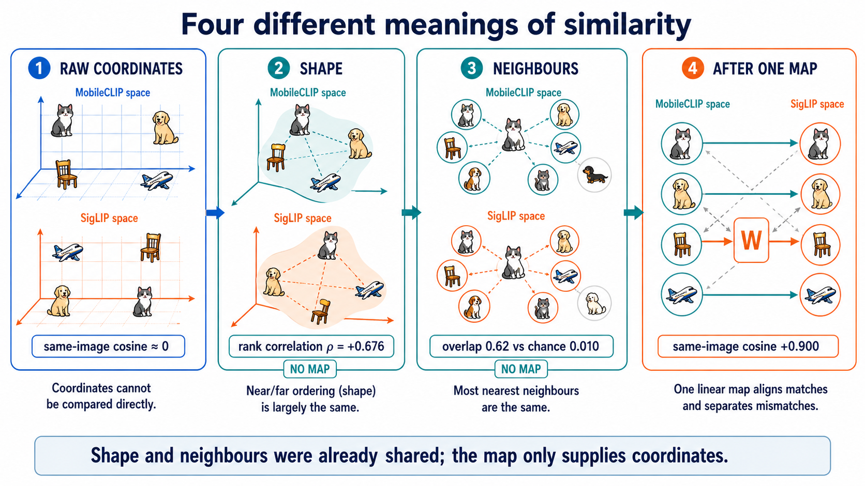
THE WHOLE PROJECT IN ONE EXAMPLE
The cat on a chair: two models place it at unrelated coordinates, yet agree on its relationships
the short math
DINOv2 sees pixels -> x_img in R^768
bge-m3 reads text -> x_txt in R^1024
cosine(x_img, x_txt) ~ 0.00
(the two COORDINATES share nothing)
yet in BOTH spaces the RELATIONS hold:
dist(cat-chair, cat-sofa)
< dist(cat-chair, airplane)
claim: exists ONE matrix W with
x_img . W ~ x_txt (no training)
coordinates share nothing: same-image cosine ≈ 0
shape agrees (no map): distance-rank correlation ρ = +0.676
neighbours agree (no map): 62% of 10 nearest shared vs 1% chance
after ONE linear map: same-image cosine +0.900
Fig: four meanings of similarity on the same 1,000 images. 'dist' = distance between two items inside one space (small = near). Shape and neighbours were already shared; the map only supplies coordinates.
6

Slide 7
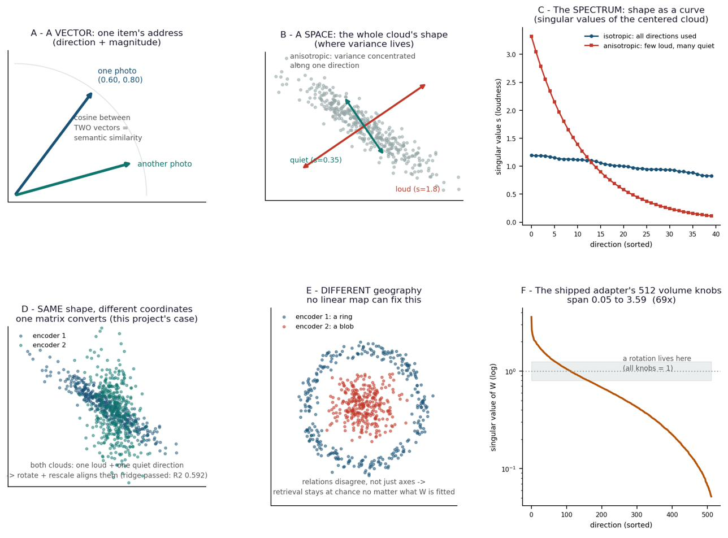
THE WORDS USED ON EVERY SLIDE
Vector, space, structure — and the four things that can make two spaces alike
term | meaning | cat / dog reading
VECTOR | one item's address: direction + length | one cat photo = one arrow
SPACE | the whole cloud's shape: where variance lives | all cats and dogs together; round or a cigar?
STRUCTURE | the pattern of relations between items | cat near cat, dog near dog, airplane far
MODALITY | the input channel | DINOv2 saw the photo; bge read the caption
OBJECTIVE | the learning signal that shaped the space | contrastive · next-token · masked-LM · classification
LINEAGE | shared ancestry / weights | DINOv2 small, base, large are siblings
ISOTROPY | variance spread evenly across directions | cosine reads the full shape; healthy
ANISOTROPY | variance concentrated in few directions | GPT-2: every caption at cosine +0.999 — a cone
Fig shape_vs_vector.png: A vector vs B space, C spectrum, D same shape / different coordinates, E different geography (no linear map fixes it), F the adapter's 512 singular values (69× spread).
Result to hold onto: sharing an OBJECTIVE aligns spaces more than sharing LINEAGE, and both more than sharing MODALITY (+53× / +44× / +29× over chance).
7

Slide 8
HOW 'SIMILAR' IS GRADED
Five kinds of similarity, weakest to strongest — the answer changes as you climb
level | the question | for the cat on a chair | measured by | result here
1 · shared NEIGHBOURS | do the same things sit nearby? | is cat-on-sofa among its nearest items in both spaces? | k-NN overlap (no map) | YES, strongly — 27–62× chance at k=10
2 · shared ORDER | do they agree on nearer vs farther? | cat-chair nearer to cat-sofa than to airplane, in both? | Spearman ρ of pairwise distances (no map) | YES, moderately — ρ 0.29 cross-modal, up to 0.76
3 · shared STRUCTURE | does the whole similarity pattern match? | does every item relate to every other the same way? | CKA / RSA vs a random control | PARTLY — 4–6× a random control, weak absolutely
4 · shared SUBSPACE | can one be turned into the other by a linear map? | map the image vector onto its caption's direction | ridge regression, then retrieval | YES — 88–95% of a jointly-trained ceiling
5 · same GEOMETRY | same shape, just rotated? | does a pure rotation align the clouds? | orthogonal Procrustes | NO — 0.038 vs ridge 0.592. Related, not rigid
Reading the ladder
The metaphor that fits
Strong at level 1, weak at level 3 → models agree about NEIGHBOURHOODS, not global arrangement. Level 4 works but 5 fails → the spaces are related by a STRETCH, not merely a turn (the adapter's singular values span 69×).
Two map projections of the Earth disagree about distance and area, yet both keep Spain next to France. Different charts of one shared structure — not one space.
8

Slide 9
THE MEASUREMENTS
Every metric is a question with a blind spot — what each asks, in the cat/dog sentence
metric | the question it asks (cat / dog) | when it misleads | read it as
cosine similarity | do two vectors point the same way? (cat photo vs its caption) | in a collapsed space every pair reads +0.999 | check the space's mean pair-cosine first
distance (dist) | how far apart are two items in ONE space? (cat-chair to cat-sofa) | scale differs between spaces — compare RANKS, not raw values | small = near; the raw material for ρ and k-NN
R² (held-out) | do the predicted numbers match the caption vector's? (reconstruction) | tiny target variance → hugely negative even when retrieval is fine | reconstruction quality WITH magnitude
R@1 / R@5 | does the right cat rank first / in the top 5 of N=1,000? | meaningless without N — always quote chance 1/N | the deployed question; chance 0.001
% of ceiling | how much of a jointly-trained system survives? | if the ceiling used a different protocol (55.2% → 40.9%) | the honest cross-experiment yardstick
k-NN overlap | are my 10 nearest cats your 10 nearest cats? | raw fraction rises with k because chance does | the RATIO to chance k/N
Spearman ρ | is near still near, far still far? (order of distances) | — | shape agreement, no map, rotation-invariant
verification AUC | same cat, or a random impostor? | negatives are easy → scores sit near 1 | 0.999 means the question was easy
effective rank | how many directions carry information? | — | < ~10% of width = collapsed
the short math
cos(u,t) = (u.t)/(|u||t|)
dist(i,j) = 1 - cos(i,j) (in one space)
R@K = P(true item in top-K of N)
kNN overlap = |NN_k^A(i) & NN_k^B(i)| / k
chance = k/N ; report overlap / (k/N)
rho = Spearman over all pairwise dists
AUC = P(score(same) > score(impostor))
worked cat row (toy 3 -> 2):
a=[0.9,0.1,0.4]; W fitted on 7,000 rows
u = a.W = [0.61,0.88]; t=[0.60,0.80]
cos(u,t)=0.999 -> the right row is found
Lesson: a metric is only interpretable relative to the geometry it is computed in — the same system read cosine 1.000 and retrieval 0.160 on the same data. Full reference: Similarity_Methods_Master_Table.pdf, Math_and_Terms.pdf.
9

Slide 10
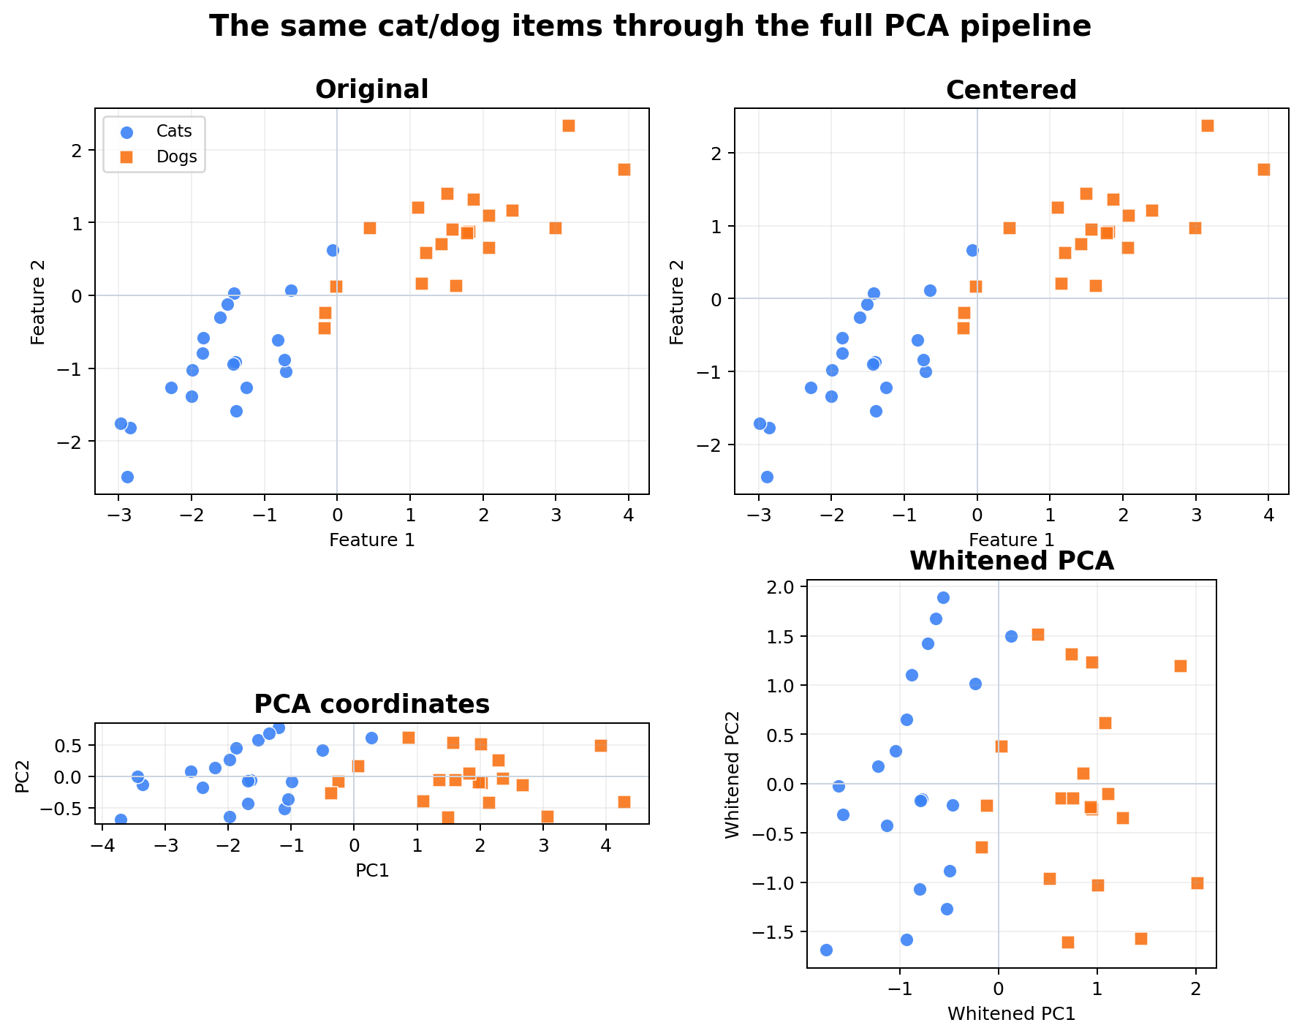
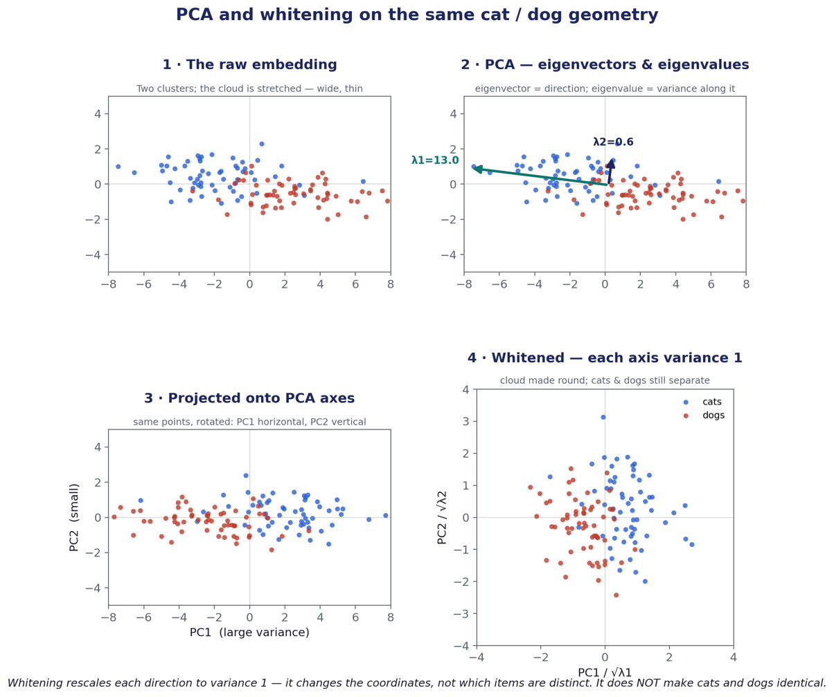
THE FRAME BEHIND EVERY METRIC
PCA and whitening on cats and dogs: the separation was there all along
the short math
center: Xc = X - mu
PCA: Xc = U S V^T
V = directions, S^2/(n-1) = variance
whiten: H = Xc V S^-1
-> every direction has variance 1
cat/dog toy: PC1 holds 96.4% of variance
GPT-2 real: eff.rank 6.6 -> 490.8;
R@1 0.130 -> 0.478 (102.6% of bge)
Experiment: PCA finds the loud direction; whitening divides each direction by its spread so the stretched cloud becomes round.
Measurement: retrieval R@1 and mean pair-cosine, before vs after. In a stretched cloud the loud axis dominates every angle; whitening lets all directions count.
Result: cats and dogs stay separate — whitening changes coordinates, never which items are distinct. This IS the GPT-2 rescue (C.11).
Caveat, cuts both ways: uneven variance is NOISE when reading a known correspondence (retrieval ↑) and SIGNAL when finding an unknown one (Gromov–Wasserstein 39.7% → 0.1%, C.12).
Step-by-step: PCA_Cat_Dog_All_Graph_States.pdf · Experiment_Summary.pdf §4
10

Slide 11
THE EIGHT ENCODERS
Modality, objective, supervision regime, size — and what each did here
encoder · dim | objective — what supervises it | regime · params | role and result
DINOv2 s/b/l · 768/1536/2048 | self-distillation: an EMA teacher's output on other crops of the SAME image; no labels, no text | SELF-SUP · 22–304M | hub members; capacity ladder 40.9 / 53.5 / 58.3% of ceiling; img_small sets hub width < 768
bge-m3 · 1024 | contrastive on query–passage pairs (the pairing is the label) | PAIR-SUP (text) · 568M | hub member + head TARGET; top pair with SBERT (ρ 0.76)
GPT-2 · 768 | next-token prediction | SELF-SUP · 124M | the collapse case: eff.rank 6.6; read 95.1% / write 24.8%; whitening rescues to 102.6%
BERT · 768 | masked language modelling | SELF-SUP · 110M | ladder rung between GPT-2 and contrastive spaces (eff.rank 65)
SBERT (all-mpnet) · 768 | BERT fine-tuned on human-labelled NLI pairs | SUPERVISED · 110M | healthiest text space; best head target 101.0% of native
SigLIP 2 base · 768 | image–text contrastive on web alt-text | PAIR-SUP · HELD OUT | Exp B target & ceiling; cross-lineage hub transfer 94.2%
MobileCLIP-S1 · 512 | image–text contrastive, distilled (phone tier) | PAIR-SUP · phone tier | Exp B source: adapter R² 0.592, cos 0.900, 0.79 MB shipped
ConvNeXt-base · 1024 | ImageNet-22k classification (22k human labels) | FULLY SUP · HELD OUT | 96.7% of native — ABOVE the ViT family band
Scale rungs: DINOv2-giant 3072 · Qwen3-Emb 0.6B/4B | self-distillation / contrastive fine-tune | 1.1B · 0.6B · 4B | both ladders rise then FALL (P2, P3 falsified)
Three supervision regimes, four objectives — all join one hub at 93–97% of native. Convergence does not require a shared training signal. Provenance: Report §E.10; Experiment_Summary.pdf p.1.
11

Slide 12
THE MODELS · THEIR WORLDS
How each encoder builds its world — and why that predicts how it aligns
Self-supervised image (DINOv2)
Contrastive image–text (SigLIP 2, MobileCLIP)
Contrastive text (bge-m3, SBERT, Qwen)
A ViT sees two crops of the SAME photo; a slow “teacher” copy of itself labels one, the student predicts it. No text, no labels — the world is “what stays the same across views.” One 768–2048-d vector per image.
Two towers. Photos and their alt-text are pulled together, everything else pushed apart. The world is “what text says about pictures.” MobileCLIP is the same idea distilled to phone size (512-d).
Trained so a query and its matching passage (or NLI-entailed sentences) point the same way. Isotropic, cosine-friendly spaces — the “coordinate frame” that similarity training buys.
Language models (GPT-2 causal, BERT masked)
Supervised convnet (ConvNeXt)
Vector embeddings, in general
Predict the next / masked token. Never asked to make sentences comparable, so the pooled space collapses toward one direction (GPT-2 pair-cosine +0.999). The information is there — the frame hides it.
No attention at all; 22k ImageNet class labels. The control that says architecture and supervision do not bound the claim: 96.7% hub transfer, above the ViT band.
Every model ends as one vector per item: tokens → hidden states → masked-mean over tokens (text) or CLS/patch pooling (image). Row i of every cache is the SAME COCO item — the only “pairing” any fit sees.
See tokens_layers_pooling.png (Status_Report.pdf p.3) for the token→layer→pooled-row pipeline; Report §E.10 for provenance.
12

Slide 13
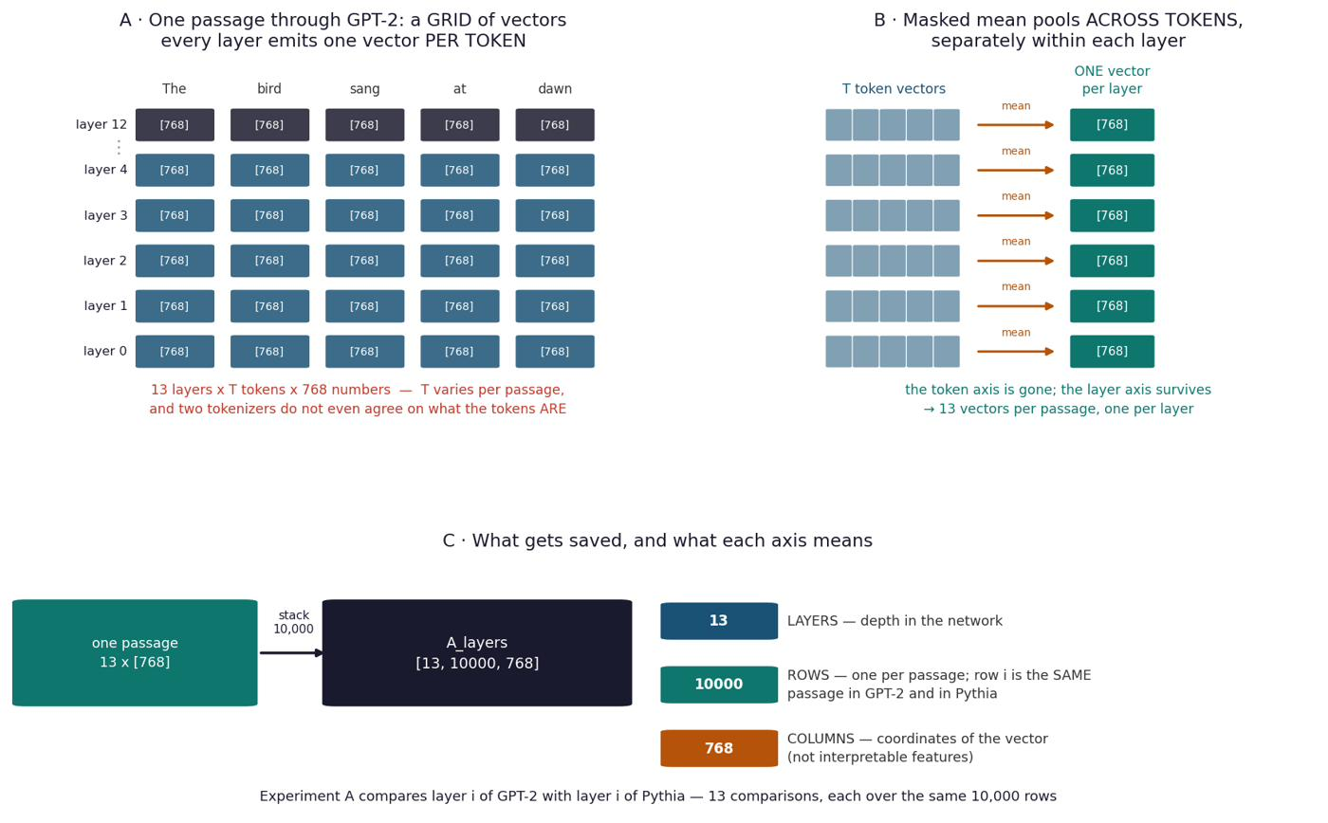
METHOD
Scientific questions, engineering discipline — and the one COCO row behind every number
Rules the project never broke
No training, no fine-tuning — closed-form ridge only; both models frozen (delete W and nothing remains). Every number held-out (1,000 of 9,533 rows) and quoted against a control. Predictions pre-registered before measuring; failures recorded, never deleted. Rows per input dimension ≥ 5, checked BEFORE reading results.
The data
COCO image–caption pairs, 9,533 images (8,533 train / 1,000 eval). Five human captions each — ‘A cat sitting on a chair.’ · ‘Cat on chair.’ · ‘A cat is seated on a chair.’ — embedded and AVERAGED into one target. Averaging raised R² 0.278 → 0.511, so the ceiling is averaged too.
the short math
the only fitted object is one ridge matrix:
W = argmin_W |XW - T|^2 + alpha|W|^2 = (X^T X + alpha I)^-1 X^T T
alpha chosen on a validation slice of TRAIN rows only
retrieval: s_j = cos(q, t_j), ranked over N=1,000; chance 0.001
13

Slide 14
THE RECORD
How the project evolved — Part I: pairwise experiments, then Part II: the hub
PART I · TWO ENCODERS AT A TIME (A, B, E, C) — is structure shared, and can one matrix carry it?
A
Do two LLMs converge?
B / F
Phone→server adapter
GPT-2 vs Pythia-160M · 10,000 WikiText passages
MobileCLIP→SigLIP · 4,000 COCO val2017
R² 0.74–0.80; CKA 5.3× random
88.4% of ceiling; 0.79 MB; MLP +0.0000
E1–E13
Cross-modal & capacity ladder
C.11–C.12
Isotropy rescue; pair-free recovery
DINOv2 s/b/l → bge-m3 · 8,000 COCO train2017
GPT-2 whitening; Gromov–Wasserstein
40.9 / 53.5 / 58.3% of ceiling
0.130→0.478; 39.7% with NO pairs
PART II · MANY ENCODERS IN ONE SPACE (G, K) — can a component trained on one serve the rest?
G0–G4
The hub; held-out lineages
G5–G16
What predicts agreement; the width cliff
94.2% to the decimal; ConvNeXt 96.7%
objective +53×; rank wall confirmed, 7 falsified
G10 · K1–K3
Honesty & statistical power
Scale P1–P4
Does capacity keep helping?
11.2 pt declared; CI −0.038–0.024 vs SESOI 0.05
both ladders rise then FALL
14

Slide 15
PART I
Two encoders at a time
Experiments A, B, E, C — is structure shared between two independently trained models, and can a single matrix carry it? Each slide: how it was fitted, what was measured, what it proved, what failed.

Slide 16

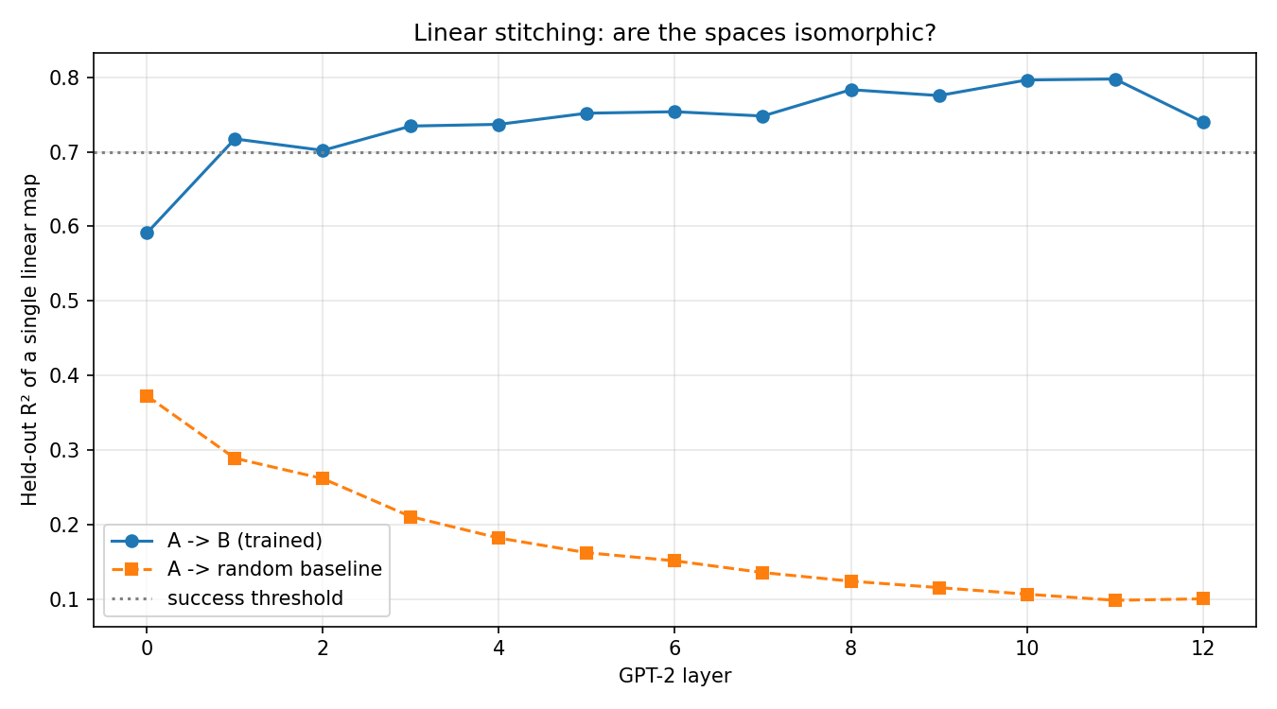
EXPERIMENT A · TWO LANGUAGE MODELS
Do GPT-2 and Pythia-160M carry the same information, layer by layer?
Data & setup
Data: 10,000 WikiText passages through both frozen models. Hidden states masked-mean-pooled per layer → A_layers [13, 10000, 768]. Per layer: CKA (structure) and one ridge map GPT-2→Pythia (stitching), with a seeded random-weights Pythia as control. 7,500 train / 768 = 9.8 rows/dim. Nothing was trained.
Measured — CKA (structure agreement): trained 0.359 vs random 0.067 = 5.3× (diagonal mean 0.424 = 6.3×). Stitching R² (linear map GPT-2→Pythia): 0.797 at layer 11 vs 0.173 random.
Proved: convergence exists at all, across architectures and data — the licence for everything after. The trained curve RISES with depth (0.59→0.80) while the random control DECAYS (0.38→0.09): opposite slopes, an 8× gap at layer 11.
Failure caught → converted: a rank-one ‘hubness’ component carried 97% of the CKA matrix; dividing marginals out lifted the diagonal 0.98→1.16. Run 1 (1,646 rows) FAILED on starvation; run 2 (10,000) passed — same pipeline, more rows.
the short math
CKA(K,L) = HSIC(K,L) /
sqrt(HSIC(K,K) HSIC(L,L))
pool_i = sum_t h_t / T (pads out)
W_l = ridge(X_l -> Y_l) per layer
16

Slide 17
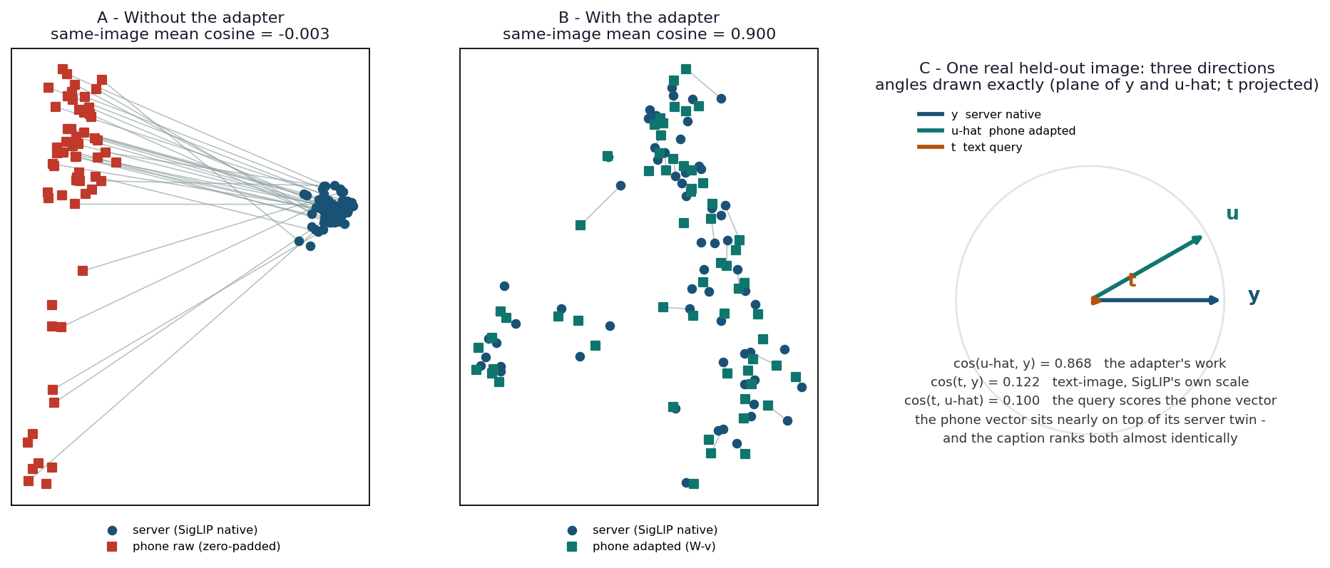
EXPERIMENT B · ENGINEERED SOLUTION #1
MobileCLIP → SigLIP 2: one 0.79 MB matrix lets a phone encoder search a server index
Data & how it was fitted
Two frozen image–text encoders that never met: MobileCLIP-S1 (phone tier, 512-d) and SigLIP 2 (server, 768-d). Data: 4,000 COCO val2017 image–caption pairs — 3,000 train / 1,000 held out. One ridge matrix W (512×768) fitted to match REPRESENTATIONS — it never sees the retrieval task it is later scored on. SigLIP's own text tower and cosine ranking are reused unchanged. Exported as Core ML fp16, bit-exact.
Measured — held-out R² 0.592 (reconstruction); mean cosine to the true twin 0.900 (raw was −0.003); verification AUC 0.999 (no-adapter control 0.477); R@1 88.4% and R@5 95.1% of the jointly-trained ceiling; 39 ms upload-to-index.
Failure → finding: orthogonal Procrustes (rotation only) scores R² 0.038 — the spaces differ by a STRETCH (W's singular values span 69×). Related, not rigid.
Proved: the shared structure lives in the representations, not the connector — a task-free matrix transfers BETTER than a task-trained one.
Cat reading (panel C): the phone cat vector sits nearly on top of its server twin (cos 0.868), and the caption ‘a cat’ ranks both almost identically.
17

Slide 18
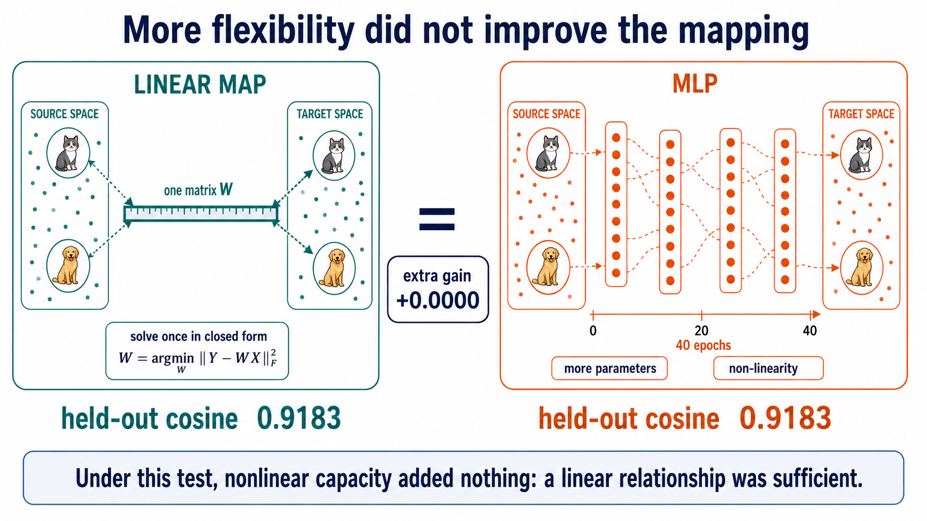
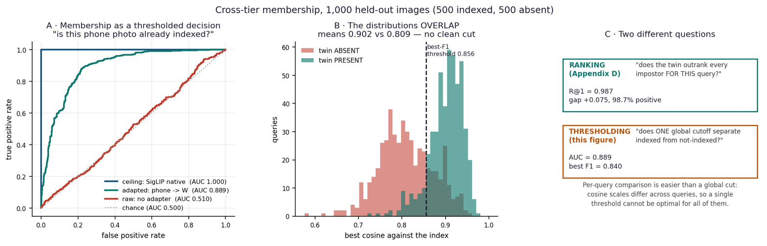
EXPERIMENT B · WHAT ONE MATRIX BUYS
The failure that proved linearity — and the same adapter as three different decisions
0.592
0.900
88.4%
0.79 MB
held-out R² (reconstruction)
mean cosine to the true twin
of the jointly-trained ceiling (R@1)
shipped adapter, Core ML fp16, no GPU
MLP control (F2): more parameters, non-linearity, 74 rows/dim, 40 epochs — held-out cosine 0.9183 vs 0.9183, gain +0.0000, on two runs. Linear is not an approximation of the relationship; it IS the relationship.
One adapter, three questions (D.2): verification — same photo? AUC 0.999. ranking — does the twin outrank impostors? R@1 0.987. membership — indexed at all, under ONE global cutoff? AUC 0.889, F1 0.840. Difficulty rises as the decision gets more global.
mlp_vs_linear (corrections pack); membership_roc.png (report D.2). B5 sandbox: 11 free-text queries on real photos, 7/9 rank-1, negative query flat — pass.
18

Slide 19
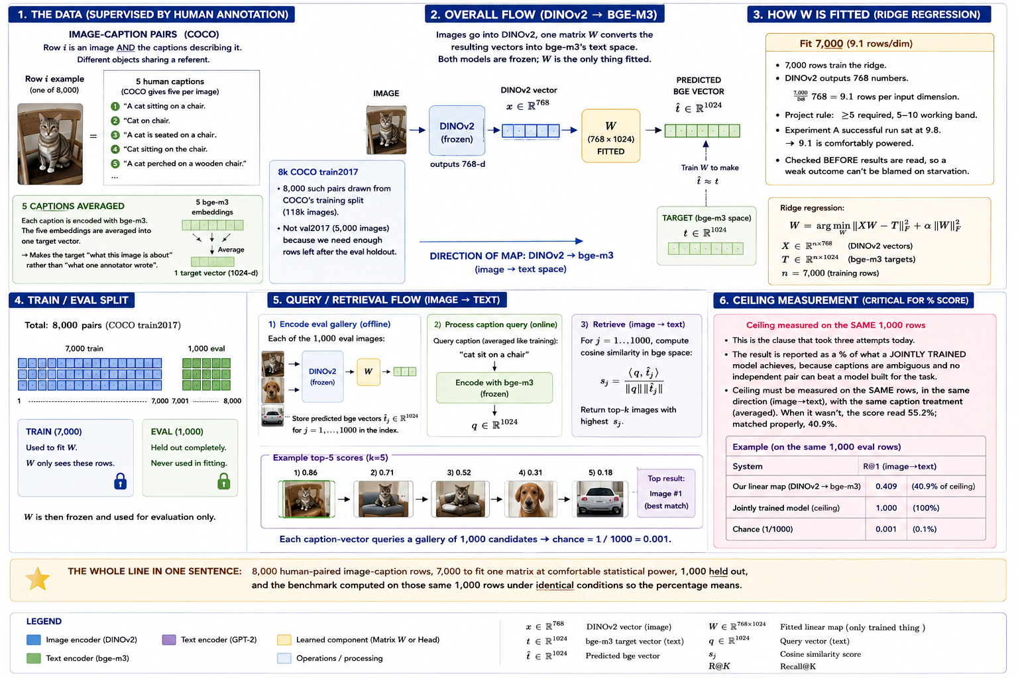
EXPERIMENT E1 · CROSSING MODALITIES
DINOv2 never saw a word; bge-m3 never saw a pixel. One matrix, image → text space
Data & how it was fitted
Data: 8,000 COCO train2017 image–caption pairs — 7,000 fit W (768→1024), 1,000 held out. Target = the five captions embedded by bge-m3 and AVERAGED. Ridge; alpha on a train-internal validation slice. 9.1 rows/dim (floor 5). Ceiling = SigLIP measured on the SAME rows, same direction, same averaging.
Measured — R² 0.511 (reconstruction); R@1 0.358 = 40.9% of the matched ceiling (358× chance); shuffle-control gap 0.641. Verdict: MEASURABLE BUT WEAK, robust to caption protocol (24.7% single / 40.9% averaged, both in the pre-registered band).
Failure caught: a borrowed ceiling read 55.2% — wrong direction and protocol. Re-measured properly: 40.9%. Now a standing rule — the ceiling is never a borrowed number.
Proved: PRH's actual cross-modal claim holds WITHOUT joint training — crossing modality costs about half of R@1 versus a same-modality pair.
19

Slide 20
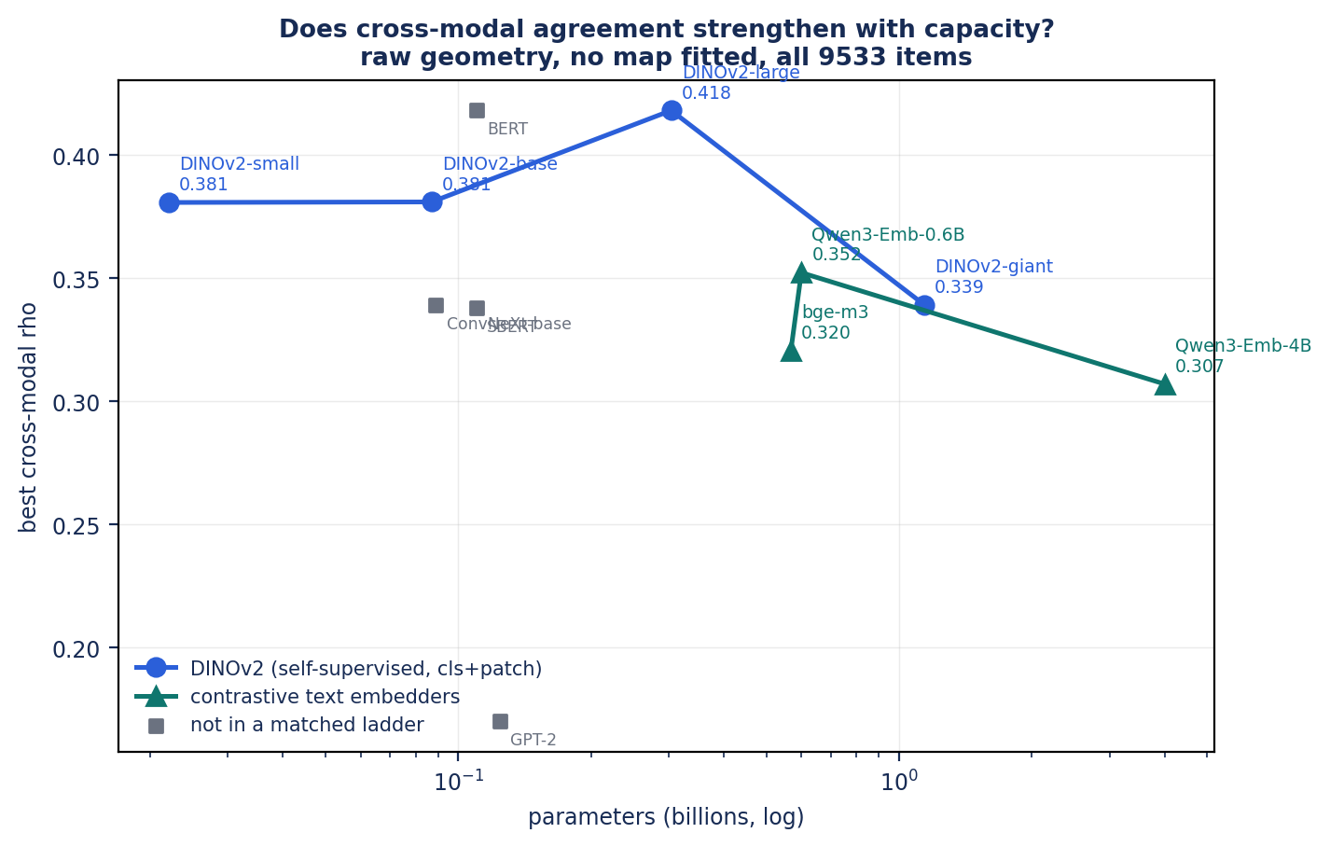
EXPERIMENT E · CAPACITY
Does alignment grow with model size? Yes to 304M — then both ladders fall
40.9%
53.5%
58.3%
small 22M
base 87M
large 304M
Ladder (E1 sweep): same text encoder, data, pooling, 11.1 rows/dim at every point. Every measure rises: R² 0.516/0.580/0.609; shuffle gap 0.616/0.682/0.709. +15.3 points of ceiling per decade of parameters (fit R² 0.949). Returns compress: 4.0× params buys 12.6 pts, the next 3.5× buys 4.8.
Scale extension (raw shape ρ, no map, 11 encoders): image ladder 0.381→0.381→0.418 then 0.339 at giant; text ladder 0.320→0.352→0.307 at Qwen-4B. Rise then FALL at 7× the parameters. P2 and P3 FALSIFIED.
Proved: alignment is not monotonic in capacity in this regime (0.02–4B). Within-modality contrastive text pairs agree at 0.76–0.86; cross-modal sits at 0.19–0.35 and does not improve with scale.
capacity chart from Viva_Presentation_2; Report C.10 and E.16. ρ = distance-rank (shape) agreement, no map fitted.
20

Slide 21
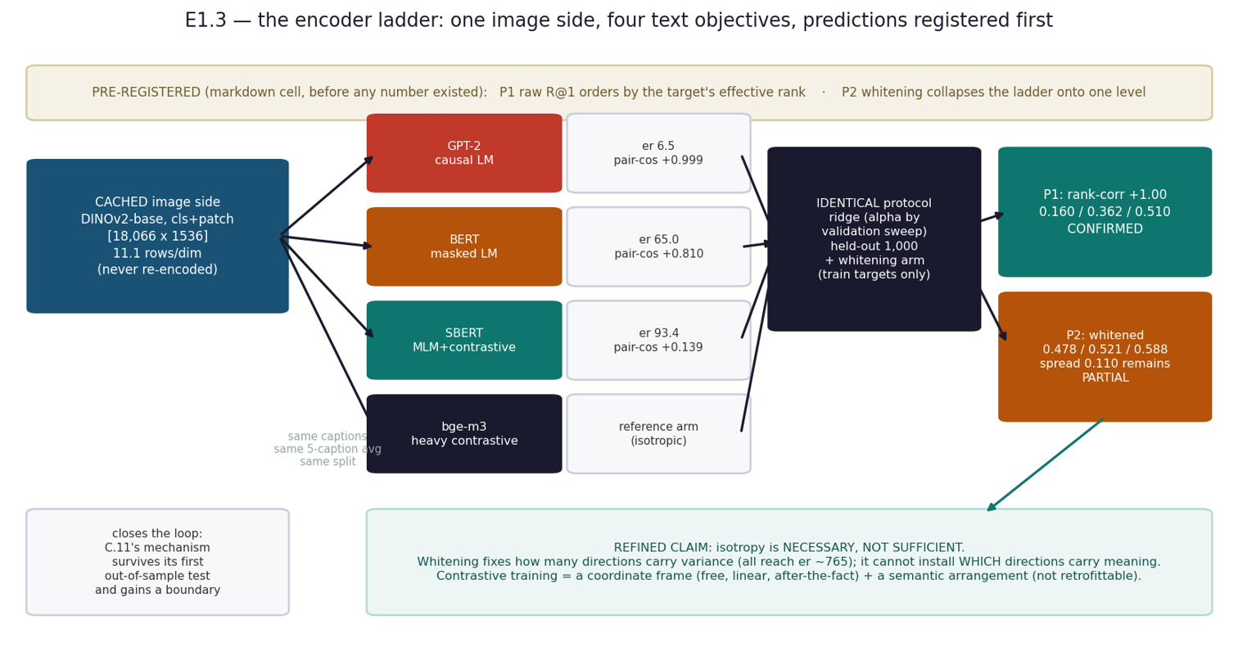
EXPERIMENTS E1.1–E1.3 · ISOTROPY, NOT SIMILARITY TRAINING
GPT-2's collapsed space: unreadable by cosine, rescued to 102.6% of bge by a free linear transform
How it was tested
E1.1: replace bge-m3 with GPT-2 mean-pooled captions as the target, all else identical (9.1 rows/dim). E1.2: six label-free arms — raw, centered, all-but-top-k (k=1,3,10), whitened — fitted on train rows only, validated on a synthetic control. E1.3: two encoders C.11 never saw (BERT masked-LM, SBERT contrastive) run under the identical protocol, with predictions written in the notebook BEFORE the numbers existed.
Measured — GPT-2 eff.rank 6.5 of 768, pair-cosine +0.999 → cosine reads 1.000 while R@1 is 0.130. Whitening (x → S^−1/2(x−μ)) lifts R@1 to 0.478 = 102.6% of an encoder trained contrastively on 1.2B pairs. Isotropy is a dial: eff.rank vs R@1 correlate at ρ +0.94.
Failure → sharper finding: prediction 1 (raw R@1 orders by target eff.rank) confirmed at rank-corr +1.00 (6.5/65/93 → 0.160/0.362/0.510). Prediction 2 (whitening collapses the ladder) only PARTIAL — whitening lifts every arm but a 0.110 spread remains.
Proved: isotropy is NECESSARY, not sufficient. A label-free linear map supplies the coordinate frame; contrastive training adds the semantic arrangement that survives whitening.
21

Slide 22
EXPERIMENT C.12 · REMOVING THE LAST SUPERVISION
Can the correspondence be found with NO paired examples — from shape alone?
39.7%
595×
0.1%
exact matches recovered with zero pairs
chance (1/1,500 = 0.067%)
after whitening — the sharpest negative
How it was done
Measured · proved · the two negatives
Two sets of 1,500 vectors of the same images (MobileCLIP, SigLIP), one side shuffled and the true permutation sealed until scoring. Entropic Gromov–Wasserstein matches distance-structure to distance-structure using only each space's own internal distance matrix; then CSLS self-learning. ε swept per run (optimum moves with N).
Measured: 39.7% exact matches; a map fitted from that assignment reaches R@1 0.252 (40% of ceiling), verification AUC 0.906. Proved: the correspondence is partially SELF-IDENTIFYING from geometry. Kept negatives: iterative refinement degraded monotonically (converging on its own errors); whitening — which RESCUES cosine in E1.2 — collapses matching to chance here.
the short math
GW(C_A,C_B) = min_T sum |C_A(i,k) - C_B(j,l)|^2 T_ij T_kl
C_A,C_B = intra-space distance matrices; T = soft matching
cat reading: 'the cat far from every airplane, near every sofa-cat'
is identifiable in BOTH spaces by that pattern alone -> matched, no pairing
22

Slide 23
PART II
Many encoders in one space
Series G and K — build one 512-d hub so a component trained on ONE encoder serves encoders it never saw. The constructive form of the thesis, and engineered solution #2.

Slide 24
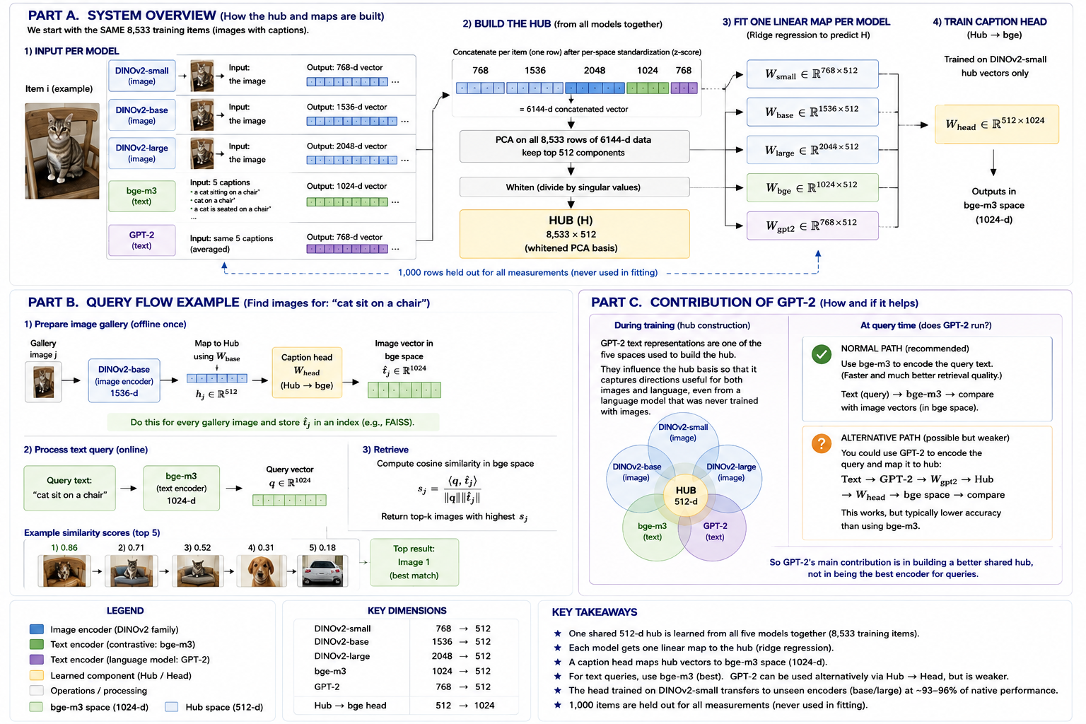
THE HUB (SERIES G) · ENGINEERED SOLUTION #2
Seven encoders, one 512-d coordinate system: N maps instead of N(N−1)
How it is built (no training)
1 · z-score each cached space. 2 · concatenate per item (8,533 rows × 6,144 dims for five spaces). 3 · PCA, keep 512 directions. 4 · whiten → H, unit variance per direction. That basis IS the hub, then frozen. One closed-form ridge map per encoder INTO the hub; one caption head OUT of it (hub → bge-m3), trained on DINOv2-small's hub coordinates only.
the short math
Z = [X~_1 | ... | X~_k]; Z = U S V^T
H = Z V_512 S_512^-1 (8533 x 512)
W_k = (X_k^T X_k + aI)^-1 X_k^T H
add a model = one solve of W_new;
hub & head untouched
rule: hub_width < dim(source) (E.8)
24

Slide 25
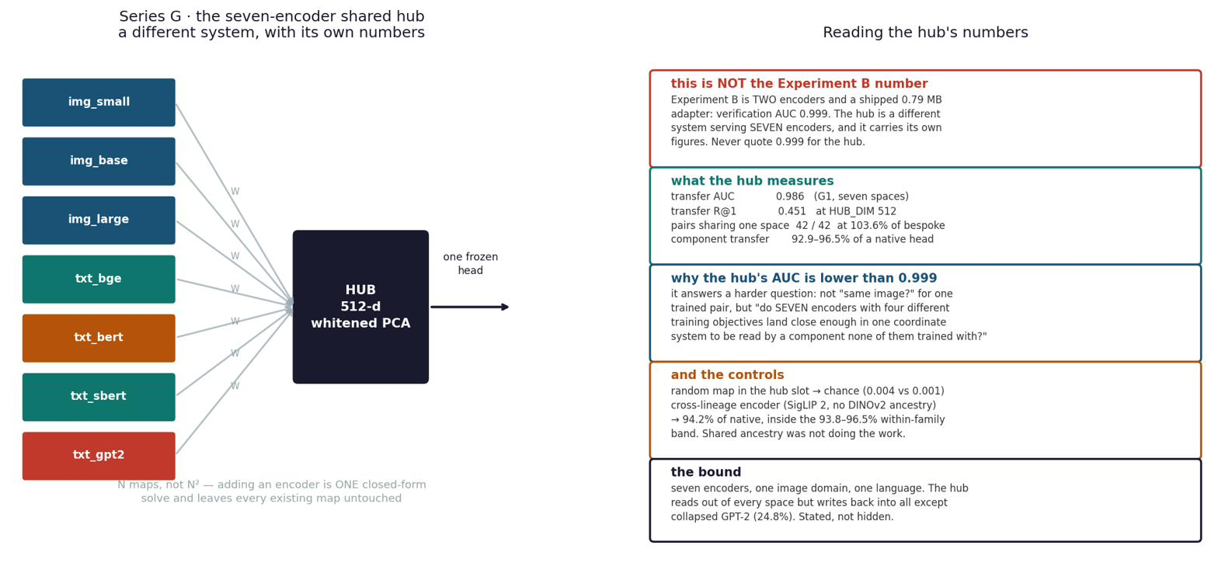
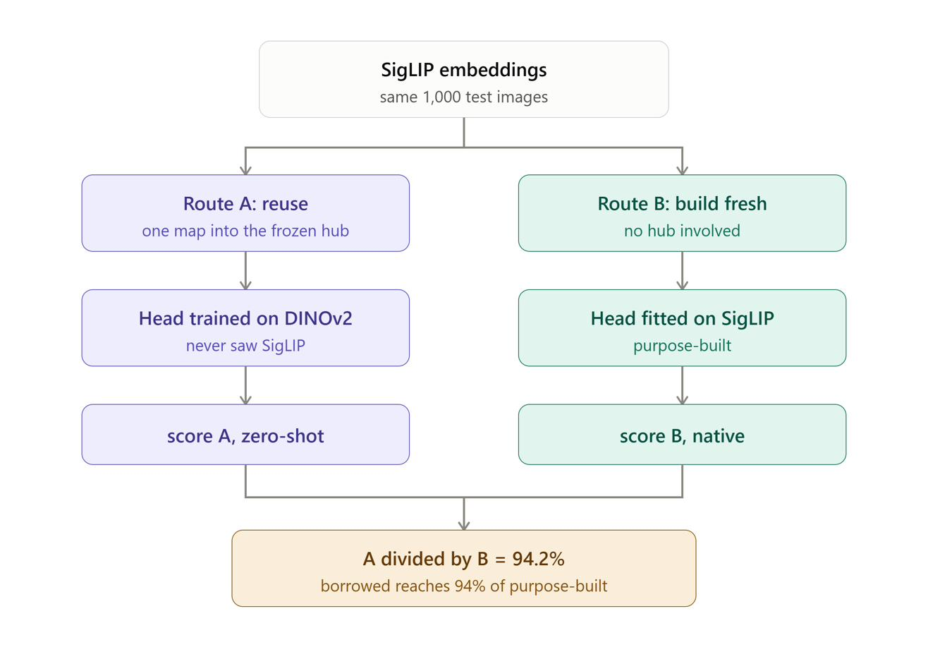
THE HUB · THE DEMO
One head trained once on one encoder, applied unchanged to encoders it never saw
recipient encoder | relation to the head | R@1 | % of native head
DINOv2-base | sibling — never seen | 0.445 | 96.5%
DINOv2-large | sibling — never seen | 0.473 | 92.9% (entry map at 4.2 rows/dim — conservative)
SigLIP 2 | independent lineage — never seen | 0.557 | 94.2% (reproduced to the decimal)
ConvNeXt-base | convnet + fully supervised — never seen | — | 96.7% — ABOVE the family band
random-map control | the number that makes it mean anything | 0.003 | chance = 0.001
Zero-shot means the HEAD — the entry map is one closed-form solve on cached vectors. Adding a model = fitting ONE entry map; hub, head and every other map untouched.
All 42 directed pairs through the shared hub reach 103.6% of hubs built per pair. Sharing costs nothing. Seven-encoder hub: R@1 0.451, verification AUC 0.986 — unchanged from five (CI includes zero).
Cat reading: query ‘a cat on chair’ encoded by GPT-2 → hub → head lands on the img_base cat at +0.45 and on the dog-sofa at +0.00.
▶ Demo notebooks G1 / G2 — Drive: convergence_experiment
25

Slide 26
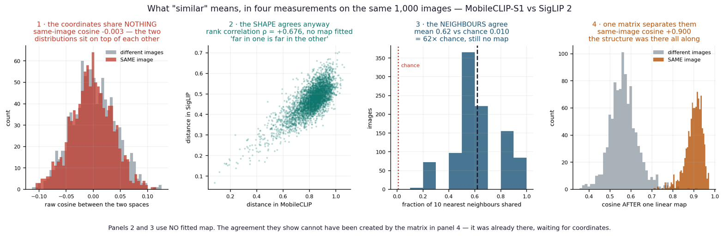
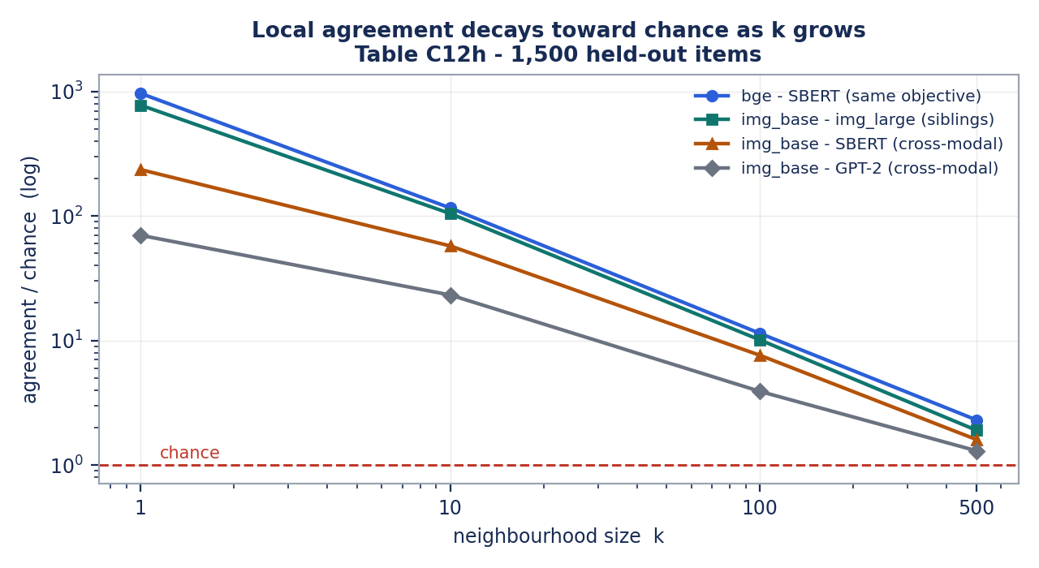
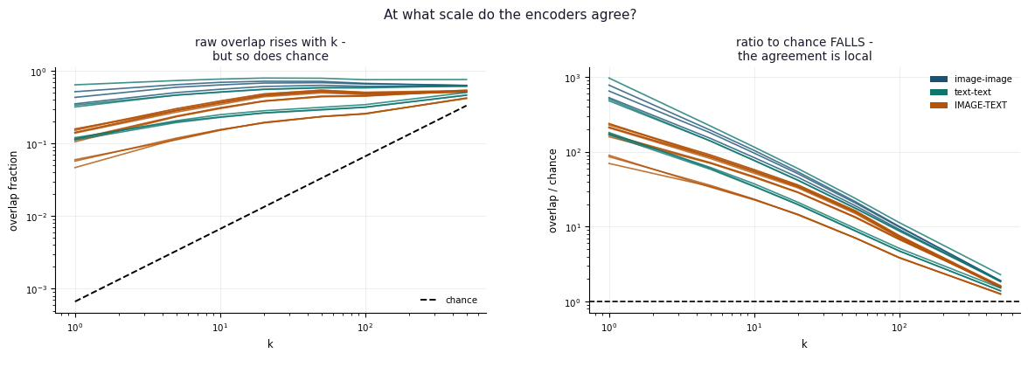
FINDING · SIMILARITY
What is actually shared: local structure, not global — on three independent metrics
raw cosine ≈ 0 — coordinates never agree.
shape agrees: ρ +0.681; 67% of 10-NN shared (27× chance).
strongest at small k, decays to chance by k=500 — every pair, on k-NN, CKNNA and ρ.
‘Same world’ = the same LOCAL arrangement of meaning.
26

Slide 27

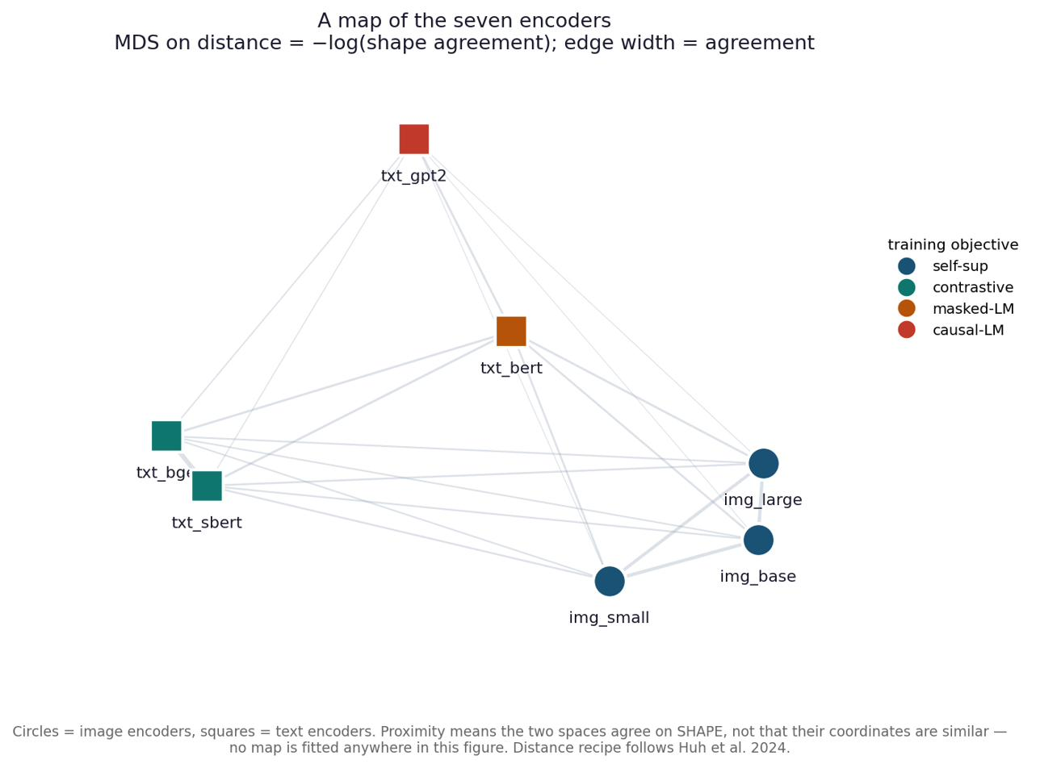
FINDING · GEOMETRY
Objective beats lineage beats modality — what decides how much two spaces agree
Top pair: bge–SBERT ρ +0.76 — shares an objective and NO ancestry; beats img–img (0.56) with shared ViT lineage.
Cross-modal ≈ +0.29 on every pair. ConvNeXt has the LOWEST raw shape agreement (0.33–0.40) yet the HIGHEST transfer (96.7%) — raw shape does not predict transfer.
MDS map (right): distance = −log(shape agreement), no map fitted. Encoders cluster by training OBJECTIVE, not modality.
+53×
+44×
+29×
shared OBJECTIVE
shared LINEAGE
shared MODALITY
27

Slide 28
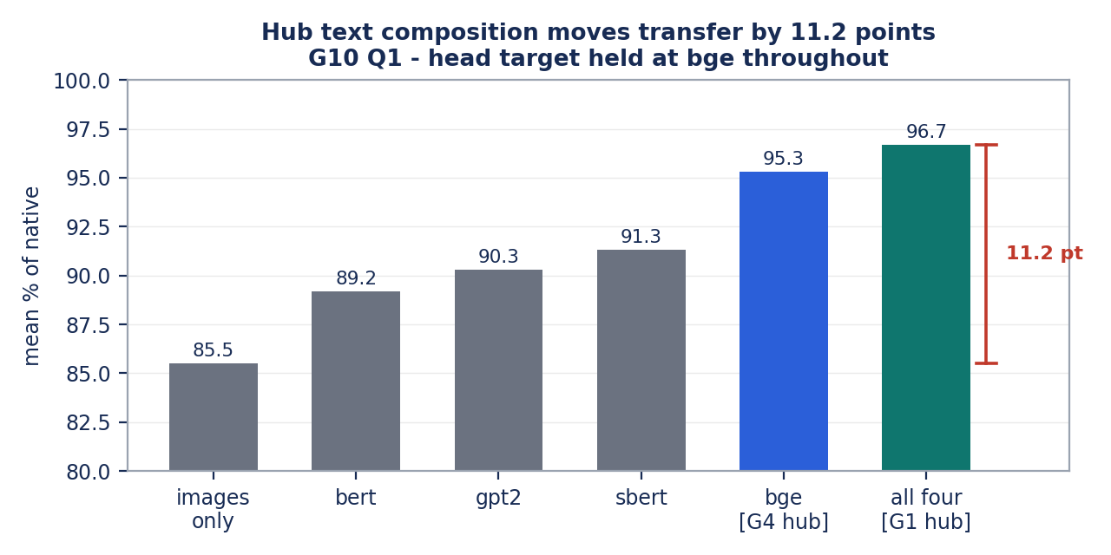
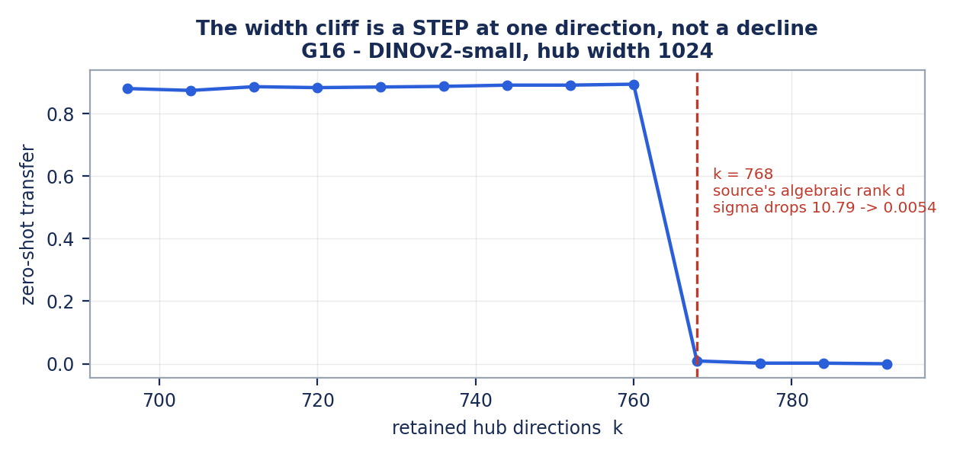
FINDINGS · HONESTY AND METHOD
G10: what the hub is made of matters — and the width cliff, falsification as a first-class result
G10 — declared before anyone else finds it
The width cliff — G8–G16
Which text space sits IN the hub moves transfer by 6.1 pts at fixed count and 11.2 pts presence-vs-absence — even though every text space can linearly reach only 2–5% of the hub. Reachability does not predict influence. The head's own target inside the hub is worth +3.0 pts beyond any text member. Not leakage (all held-out) — a real dependency, measured and reported.
Transfer collapses when hub width reaches 768. Seven mechanisms falsified on pre-registered criteria (one of our own tests was wrong — recorded). The eighth predicted the location out of sample: 768 is the source encoder's ALGEBRAIC rank; the last singular value falls 10.79 → 0.0054 and least squares divides by it. A step (0.894 at k=760 → 0.009 at 768), not a decline. Verdict: numerical artifact. Rule: hub_width < dim(source); truncation or head α=1e3 repairs it.
28

Slide 29
ROBUSTNESS · THE LEDGER
K1–K3 reproduce and bound; 11 explanations tested and recorded false — two of them our own
notebook | question | how | result
K1 | does raw Procrustes reproduce C.13.7 after the VM died? | similarity Procrustes, all 21 pairs, no hub | ordering reproduces; rotation 0.281 vs ridge 0.667 — rotation not enough
K2 | does the hub damage any single space's neighbourhoods? | G7 re-run; stratify degenerate GPT-2 BEFORE averaging | healthy spaces neutral (SBERT 0.135); GPT-2 reproduces; Spearman +0.891
K3 | is ‘no effect’ a real null or low power? | cluster bootstrap over ENCODERS; SESOI 0.050 | 95% CI −0.038–0.024 — a bounded, demonstrated null
D.5 | have the artifacts themselves been checked? | 47 automated checks: power, row alignment, geometry, cache keys | no hard failures; every fit 5.9–9.8 rows/dim
Self-corrections reached by measurement
Why the negatives are load-bearing
Run-1 starvation (5.9 rows/dim) → the ≥5 rule and power gate · synthetic hot-diagonal figure → replaced with the real matrix · mismatched E1 ceiling 55.2% → 40.9% · wrong teacher checkpoint (SigLIP 1 vs 2), now an automated check · premature ‘gate passed’ refuted by F5 · G13 entropy-vs-algebraic rank.
ICP converging on its own errors, whitening destroying discovery, the width cliff — each measured, each explaining the boundary it marks. A claim that survived a test which could have killed it is worth more than one never exposed to one. Full ledger: Final_Project_Report.pdf (11 entries).
29

Slide 30
TO DO · THE BIG-MODEL TESTS COME FIRST
What remains, in order of value — the tests that need more compute than this project had
next test | the question | cost | why it matters / status
1 · Scale the text side (7B+) | does a large text encoder push transfer and shape agreement higher, as PRH's ladder predicts? | medium — one solve + one encoding pass | the caveat an examiner raises first; Qwen-4B already FELL (0.307) — first run when a GPU is free
2 · Experts vs one large model (B1) | do K small experts in a shared hub match one big encoder at matched parameters? | medium | turns the engineering argument into a benchmark outsiders care about; pre-registered, not run
3 · Re-estimate the hub on a larger corpus | hub PCA sits at γ = d/n = 0.63; does transfer hold at γ 0.22 (35,133 items)? | high — every number re-measured | the only change that improves the FOUNDATION; lifts img_large from 4.2 to 16.7 rows/dim
4 · Rebuild the hub WITH DINOv2-giant as a member | does a hub built around a wider image encoder transfer better? | blocked until #3 (γ = 1.26 now, rank-deficient) | giant stops being a held-out test; depends on the corpus row
5 · Reverse-direction transfer | does the hub carry information TOWARD an image space? ConvNeXt as TARGET | medium | source/target roles independent on text (G10); untested for images
6 · Other languages & domains · non-linear hubs | does any of this survive outside COCO English? can a neighbourhood-preserving embedding beat whitened PCA? | high / medium | the broadest stated limit; the natural sequel, ruled out here by the no-training rule
Atlas §9; Defense_Brief.pdf §8 (scale caveat, prepared answer); Viva_Presentation_2 slide 20.
30

Slide 31
RESOURCES AND LINKS
Where every number lives — documents, notebooks, demos, data
Final_Project_Report.pdf (74 pp)
Notebooks and demos (Google Colab, 25 notebooks A1–K3)
source of truth: all tables, appendices C–E, falsification ledger, generator notebook per figure
Project_Atlas.pdf
A1–A3 layer convergence · B1–B10 adapter, retrieval, membership, quantization; B5 sandbox · C1.1 Gromov–Wasserstein · E1–E3 cross-modal, capacity sweep, E2 interactive demo (image → captions, text → images) · F1–F5 MLP control and refit · G0 rebuild-exact, G1 hub build, G2 LIVE DEMO, G3–G16 · K1–K3 · V1 diagnostic battery. Colab T4/L4 for the one-time encoding pass; everything else CPU.
the story with the math: five levels of similarity, metrics reference, hub rationale, next steps
Experiment_Summary.pdf · Results_Summary.pdf
encoders · experiments · measurements; every outcome in one place with controls
Similarity_Methods_Master_Table.pdf
one row per instrument: math, where run, obstacles, result, implication
Math_and_Terms.pdf · Linear_Maps_Ridge_and_SVD_Study_Guide.pdf
ridge, SVD, whitening — the math behind entry maps and the hub
PCA_Cat_Dog_All_Graph_States.pdf
▶ Drive: convergence_experiment (notebooks + caches pairs.npz, adapter.npz, hub_rebuilt.npz)
PCA, eigenvectors, whitening step by step on cats and dogs
Shared_Hub_Chat_Summary.pdf · Hub_Scores_Summary.pdf
▶ Drive: figs_for_claude (all figures)
hub training, transfer and retrieval walked through with paired cat/dog items
Defense_Brief.pdf · Mock_Viva.pdf · Technical_Cheat_Sheet.pdf
Data and artifacts
hard questions with answers; scale caveat; target-choice objection
B5_Sandbox_Practical_Report.pdf
COCO train2017 / val2017 rows: 9,533 hub items; 8,000 for the E-series (train2017); 4,000 for Experiment B (val2017); 10,000 WikiText passages for Experiment A. Caches: pairs.npz, adapter.npz (W 512×768, fp16 Core ML 0.79 MB), hub_rebuilt.npz, a ConvNeXt cache. Shared Qdrant index for the phone→server demo. Sources: Huh et al. 2024 (PRH, CKNNA), Lenc & Vedaldi 2015, Bansal et al. 2021, Moschella et al. 2023.
the phone pipeline on real photos, eleven free-text queries
Vector_Similarity_Handbook.pdf · Status_Report.pdf
the concepts end to end; status by experiment
31

Slide 32
THE PROJECT IN ONE PARAGRAPH
Two models never share coordinates — raw agreement is exactly chance. But they describe the same world, and the translation between them is a single matrix small enough to fit on a phone. What they share most strongly is LOCAL: they agree about what is near what, and diverge about the shape of the whole. The coordinate frame that makes structure readable is cheap; the arrangement of meaning across directions is what training actually buys.
Huh et al. showed alignment rises with scale and correlates with capability. I took the hypothesis as given and asked what is actually shared, whether one matrix can carry it, and where it fails — and the answers are local structure, yes at 96.7 percent, and at the source encoder's rank.
Science: a subset of PRH proved, narrowed to its defensible form. Engineering: two small-expert systems that run without a GPU. Method: 11 falsified explanations kept on the record.

