Slide 1
REPRESENTATION CONVERGENCE
Do independently trained models discover the same world — and can one matrix move knowledge between them?
From a deployable MobileCLIP→SigLIP adapter to a seven-encoder shared hub — a subset of the Platonic Representation Hypothesis, tested on small frozen models.
Liad Kashanovsky · AI Expert final project · 20-minute defense · 17 September 2026
8 encoders · 9 findings · 11 falsified explanations · 2 shipped systems
Notes:
[0:00] Opening. This is a 20-minute defense. Roadmap: the ambition and the testable claim, how I measure it, the controls, then the experiments and two live demos, then discovery and achievements.

Slide 2
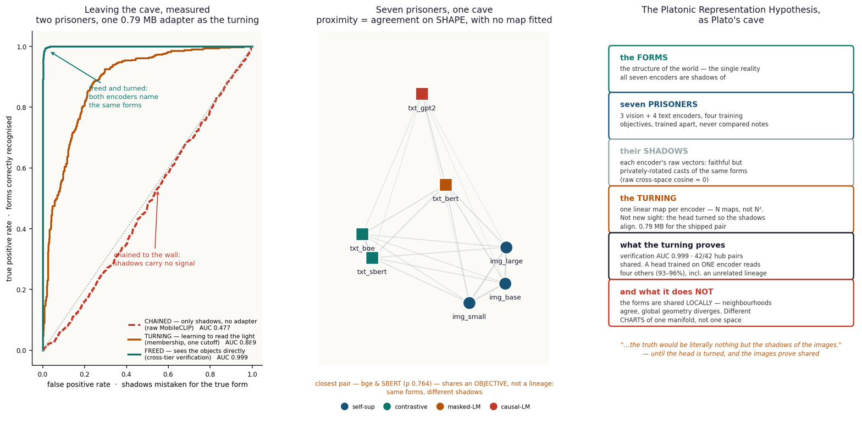
THE AMBITION
The question: do two systems that learn regularity separately find the SAME one?
Models trained separately — different data, different objectives, sometimes different senses entirely — are said to be converging on the same underlying picture of the world. The name comes from Plato: there is one reality, and each model sees a shadow of it.
Why it fascinated me
Huh et al. (2024) — the field's answer
My background is hybrid — databases and vision, engineering and ideas. In a database, correlations are explicit: a schema, a join, a key. In vision they are implicit — edge → texture → ‘cat-ness’, learned from pixels, written down nowhere.
Training is the same mystery, engineered: start from random weights, show examples, and arrive at weights that recognise a cat. The question that stuck: when two runs of that each discover regularity on their own — do they discover the SAME regularity? A learned representation is a geometric object, so it CAN be measured and compared.
As models grow, their representations converge toward one shared statistical model of reality — shadows of one world on different cave walls. Measured on models up to 70B, and reported to strengthen with scale.
I take this as my starting point and ask three sharper questions.
2
Notes:
[1:00] The ambition. Personal motivation kept short. Land on: convergence is measurable because a representation is geometry. Huh et al. is the field's claim; I sharpen it.

Slide 3
FROM SLOGAN TO EXPERIMENT
‘Same picture’ has no units — I narrowed it to a claim that can fail
THE CLAIM UNDER TEST: independently trained models agree UP TO ONE LINEAR MAP — there exists one matrix W, solved in closed form (no training), with x_A · W ≈ x_B
FALSIFIABLE
BOUNDED (the key point)
USEFUL
It can be proven wrong: if no linear map beats a random-map control, convergence is rejected. It happened — a pure rotation scored 0.038 against 0.592, so ‘just rotated’ was killed.
A linear map is the WEAKEST useful transform — just one matrix, no hidden layers. A matrix has no room to learn a task by itself, so if it works, the structure must ALREADY be shared. The MLP control proves it: extra capacity gained +0.0000.
If one matrix carries knowledge between models, their components become interchangeable — an engineering result. Two systems follow: the 0.79 MB adapter and the shared hub.
Three falsifiable questions the project answers: (1) IS structure shared? (2) is it GLOBAL or LOCAL? (3) what DECIDES how much — modality, lineage, or objective?
3
Notes:
[2:30] This is the pivot from philosophy to science. Emphasise BOUNDED: a matrix is too weak to fake a task, so success cannot be explained away. State the three questions — they structure the whole talk.

Slide 4
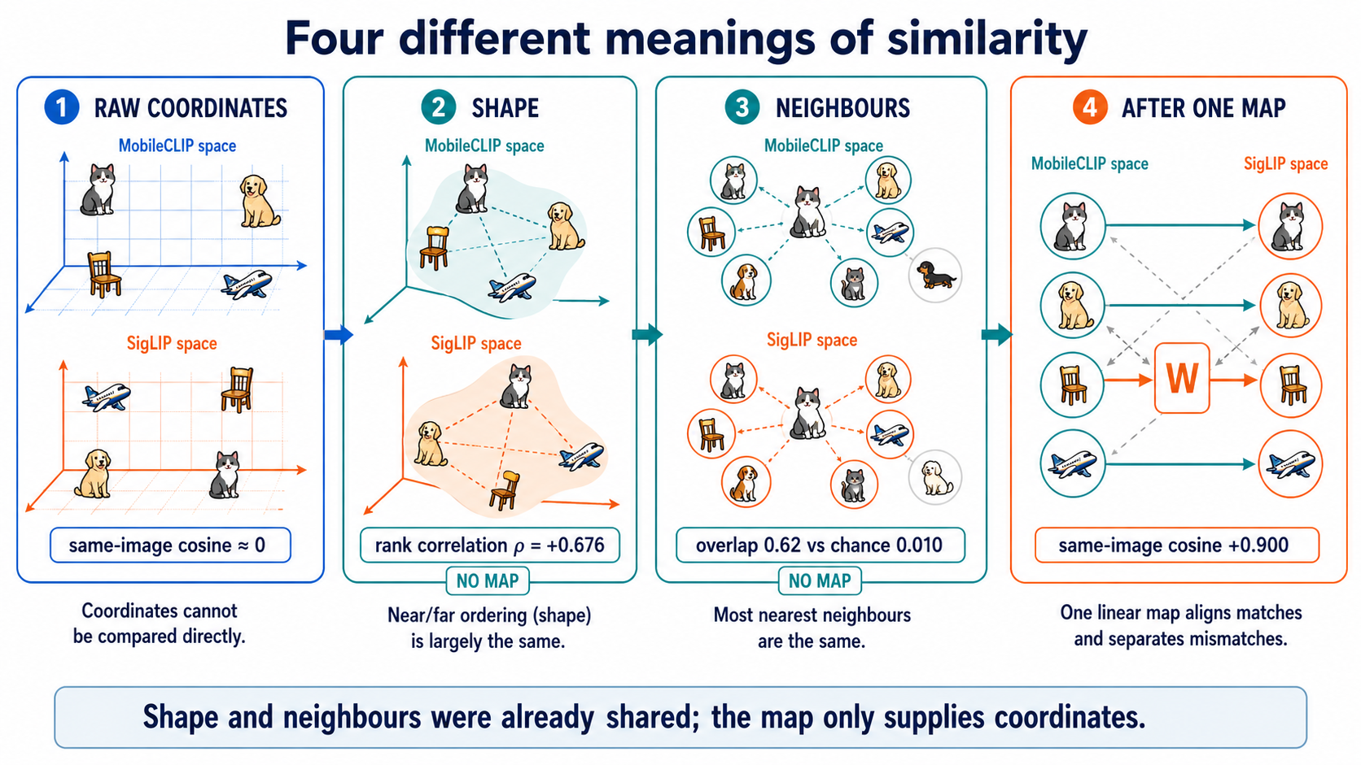
THE WHOLE IDEA IN ONE EXAMPLE
The cat on a chair: unrelated coordinates, identical relationships
the short math
DINOv2 sees pixels -> x_img in R^768
bge-m3 reads text -> x_txt in R^1024
cosine(x_img, x_txt) ~ 0.00
coordinates share NOTHING
yet in BOTH spaces:
dist(cat-chair, cat-sofa)
< dist(cat-chair, airplane)
one matrix W: x_img.W ~ x_txt
coordinates share nothing: same-image cosine ≈ 0
shape agrees, no map: distance-rank ρ = +0.676
neighbours agree, no map: 62% of 10 nearest shared (1% chance)
after ONE linear map: same-image cosine +0.900
'dist' = distance between two items inside ONE space (small = near). The numbers are unrelated; the relations are not — that gap is the whole project.
4
Notes:
[4:00] The anchor example the whole audience carries. cosine ~0 but the near/far ORDER matches, and one matrix supplies the missing coordinates. Define 'dist' out loud.

Slide 5
HOW I MEASURE — IN PLAIN WORDS
Four numbers do most of the work; each is a question with a blind spot
metric | the question, in the cat / dog sentence | how to read it (chance)
cosine similarity | do the cat photo and its caption point the same way? | +1 = same direction; but a collapsed space reads +0.999 for everything — check the space first
R@1 / R@5 | does the RIGHT cat rank first (or top-5) out of N = 1,000 images? | the deployed question; chance = 1/N = 0.001. 'R@1 0.36' = right 36% of the time
R² (held-out) | do the predicted caption-vector numbers match the real ones? | 1 = perfect reconstruction; can go negative on a low-variance target
% of ceiling | how much of a jointly-TRAINED system does my untrained matrix reach? | the honest yardstick — 88% means 'almost as good as training both together'
Spearman ρ | is near still near, far still far? (order of distances, no map) | shape agreement; survives rotation and rescaling
the short math
cos(u,t) = (u.t)/(|u||t|)
dist(i,j) = 1 - cos(i,j)
R@1 = P(true item ranks first of N)
chance = 1/N
R^2 = 1 - |T-XW|^2 / |T-mean|^2
% ceiling = my R@1 / joint R@1
one rule the project lives by:
a metric only means something
RELATIVE to the geometry it
is computed in.
Same system, same data, once read cosine 1.000 and retrieval 0.160 — not a contradiction, two different questions. Full reference: Similarity_Methods_Master_Table.pdf.
5
Notes:
[5:15] Spend real time here — if the examiner understands R@1 and % of ceiling, every later number lands. The punchline: a metric is only meaningful relative to its geometry.

Slide 6
THE CONTROLS — WHAT MAKES EVERY NUMBER MEAN SOMETHING
No result is quoted without the number that could have killed it
control | what it asks | where used | result vs the real number
RANDOM-MAP / no-adapter | would a random or absent matrix score as well? | Exp B, the hub | adapter AUC 0.999 vs 0.477 no-adapter; hub R@1 0.451 vs 0.003 random (chance 0.001)
RANDOM-WEIGHTS model | is it LEARNING, or just the architecture's shape? | Exp A (untrained Pythia) | CKA 0.359 trained vs 0.067 random; stitching R² 0.797 vs 0.173
SHUFFLE (break the pairing) | does the map need the TRUE image–caption alignment? | E1, the D.5 battery | shuffle-control gap 0.641; every fit checked by row-shuffle before it is believed
BASELINE / CEILING | how good is 'as good as possible' here? | every % of ceiling | ceiling = a jointly-TRAINED retrieval system on the same rows; I report the fraction I reach
ConvNeXt (held-out convnet) | does the claim need attention or self-supervision? | the hub | a convnet, fully supervised, NEVER a hub member → 96.7% transfer, ABOVE the ViT band
SigLIP 2 (held-out lineage) | does it work on a model of unrelated ancestry? | the hub | independent lineage, never seen → 94.2%, reproduced to the decimal
Every headline in this talk is a PAIR: the number, and the control beside it. A claim that survived a test which could have killed it is worth more than one never exposed to one.
6
Notes:
[6:30] They asked for this explicitly. Walk each control: random/no-adapter, random-weights, shuffle, baseline/ceiling, ConvNeXt held-out, SigLIP held-out. This is the credibility slide — slow down.

Slide 7
THE EIGHT ENCODERS
Different modalities, objectives, supervision regimes, sizes — all frozen
encoder | objective · regime | size | role
DINOv2 s/b/l | self-distillation on image crops · self-sup | 22–304M | hub members; capacity ladder
bge-m3 | query–passage contrastive · pair-sup (text) | 568M | hub member; head target
GPT-2 | next-token · self-sup | 124M | the collapse case (whitening rescue)
BERT / SBERT | masked-LM / NLI fine-tune · self-sup / supervised | 110M | text ladder; SBERT healthiest
SigLIP 2 | image–text contrastive · pair-sup | HELD OUT | cross-lineage control → 94.2%
MobileCLIP-S1 | image–text contrastive, distilled · phone tier | 512-d | adapter source (Demo 1)
ConvNeXt-base | ImageNet-22k classification · fully supervised | HELD OUT | convnet control → 96.7%
Three regimes, four objectives
self-supervised (DINOv2, GPT-2, BERT) · pair-supervised contrastive (bge, SigLIP, MobileCLIP) · fully supervised (SBERT, ConvNeXt).
All of them join one hub at 93–97% of native — convergence does NOT require a shared training signal.
One vector per item
Every model ends as one vector per COCO item: tokens → hidden states → pooled row. Row i is the SAME item in every cache — that shared index is the only 'pairing' any fit ever sees. Data: 9,533 COCO images, five human captions each, averaged into one target.
7
Notes:
[8:00] Keep brisk. The point: maximum diversity of modality/objective/supervision, all frozen, and they still converge. Flag ConvNeXt and SigLIP as the held-out controls from the previous slide.

Slide 8

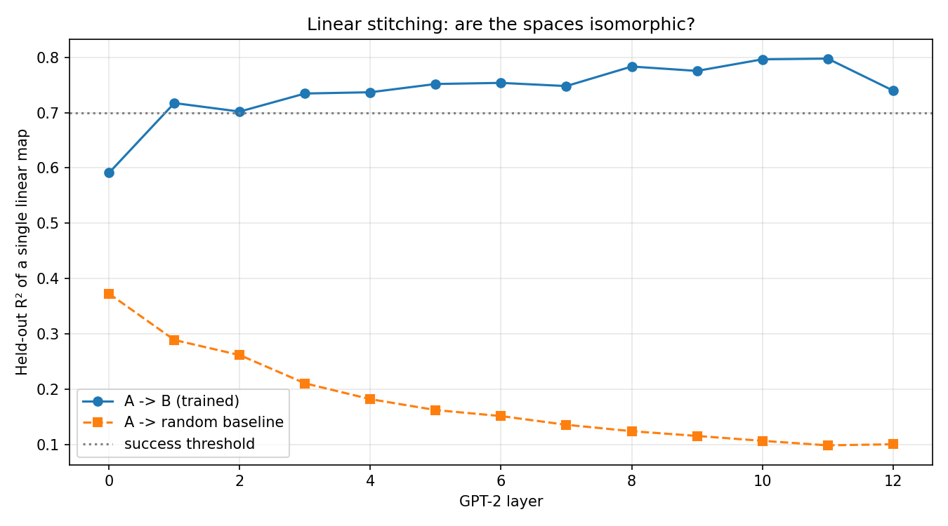
EXPERIMENT A · DO TWO LANGUAGE MODELS CONVERGE?
GPT-2 vs Pythia-160M, layer by layer — with a random-weights control
Setup
10,000 WikiText passages through both frozen models, masked-mean-pooled per layer. Per layer: CKA (structure) and one ridge map GPT-2→Pythia. CONTROL: a seeded random-weights Pythia. Nothing trained.
Measured — CKA (structure): trained 0.359 vs RANDOM-WEIGHTS 0.067 = 5.3× (diagonal mean 0.424 vs 0.067 = 6.3×). Stitching R² (linear map): 0.797 vs random 0.173 at layer 11.
The control makes the case: the trained curve RISES with depth (0.59→0.80); the random control DECAYS (0.38→0.09). Opposite slopes = learning, not architecture.
Proved: convergence is real across architectures and data. Failure caught: run 1 (1,646 rows) failed on starvation; run 2 (10,000) passed — same pipeline.
8
Notes:
[9:30] First experiment. The random-weights control is the star: opposite depth-slopes prove it's learning. This licences everything after.

Slide 9
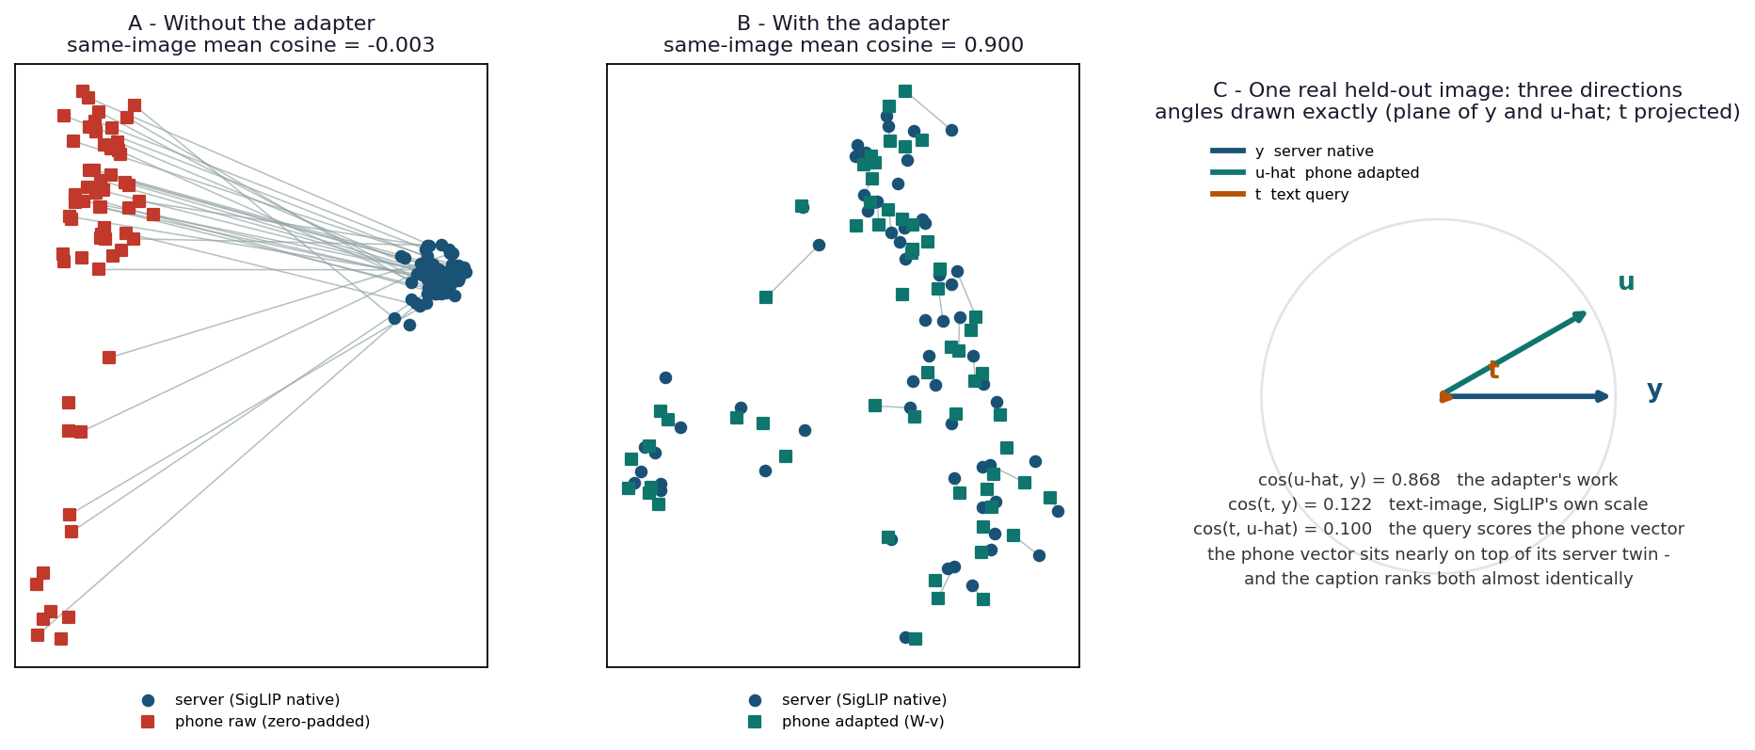
EXPERIMENT B · THE PHONE→SERVER ADAPTER
▶ LIVE DEMO
One 0.79 MB matrix lets a mobile encoder search a server index
Setup & control
MobileCLIP-S1 (phone, 512-d) and SigLIP 2 (server, 768-d) — never met. Data: 4,000 COCO val2017 pairs, 3,000 train / 1,000 held out. One ridge W (512×768) fitted to match REPRESENTATIONS — never sees the retrieval task. CONTROL: remove W (no-adapter) and everything collapses to AUC 0.477 (≈ chance). Shipped as Core ML fp16, bit-exact.
Measured — held-out R² 0.592; mean cosine to the true twin 0.900 (raw −0.003); verification AUC 0.999 vs 0.477 no-adapter; R@1 88.4% and R@5 95.1% of the jointly-trained ceiling; 39 ms upload-to-index.
Proved: the shared structure lives in the REPRESENTATIONS, not the connector — a task-free matrix beats a task-trained one.
▶ Demo 1
Free-text query → SigLIP text tower searches the mapped phone vectors. B5 sandbox: 11 queries on real photos, 7/9 rank-1, a negative query ('a dog' with no dogs) stays flat — the honest pass.
▶ Demo notebooks B1–B5 — Drive: convergence_experiment
9
Notes:
[11:00] DEMO 1. Run a live query if possible. Emphasise the no-adapter control (0.477) — without W it's chance. This is the deployable engineering result.

Slide 10
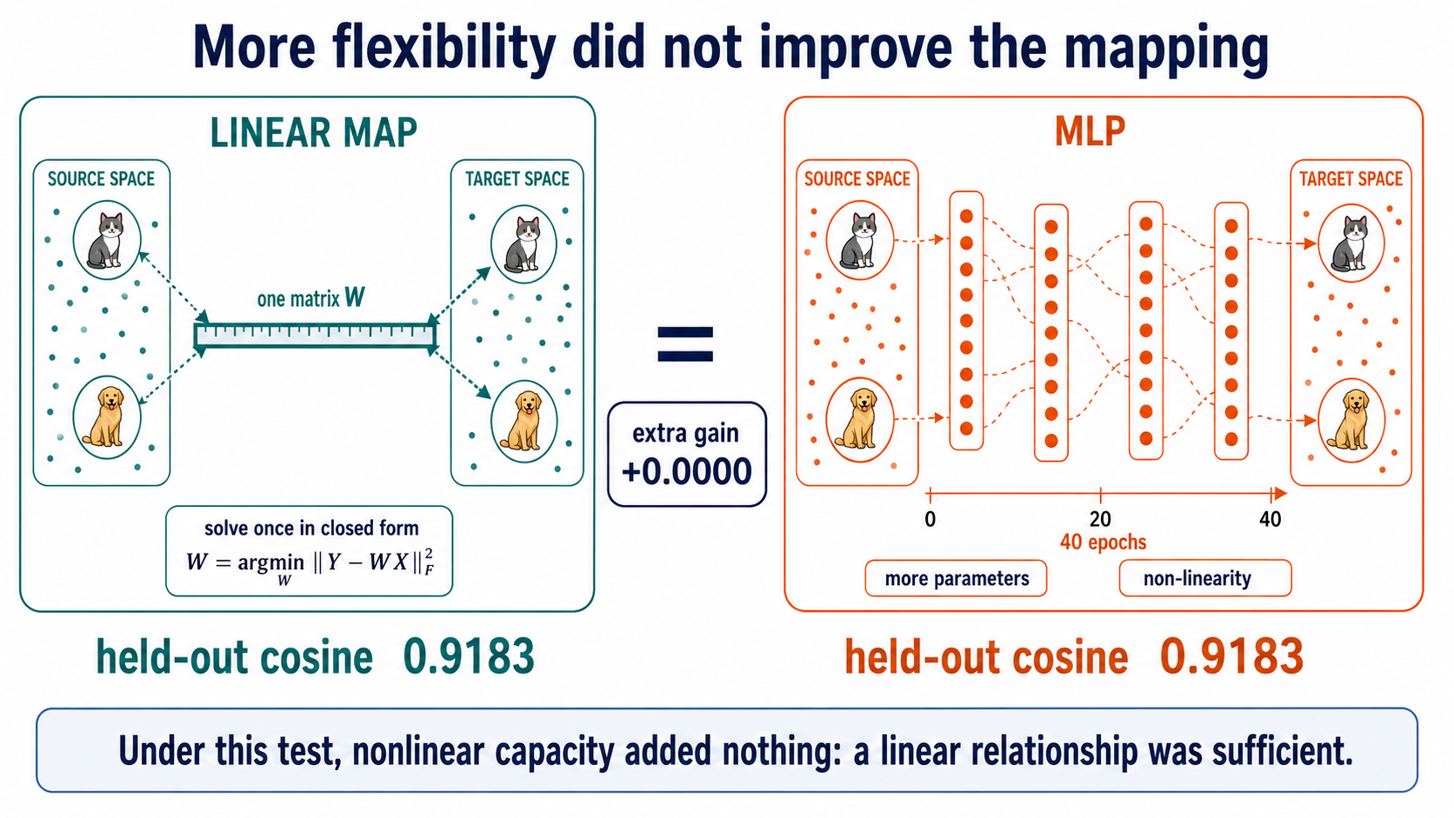
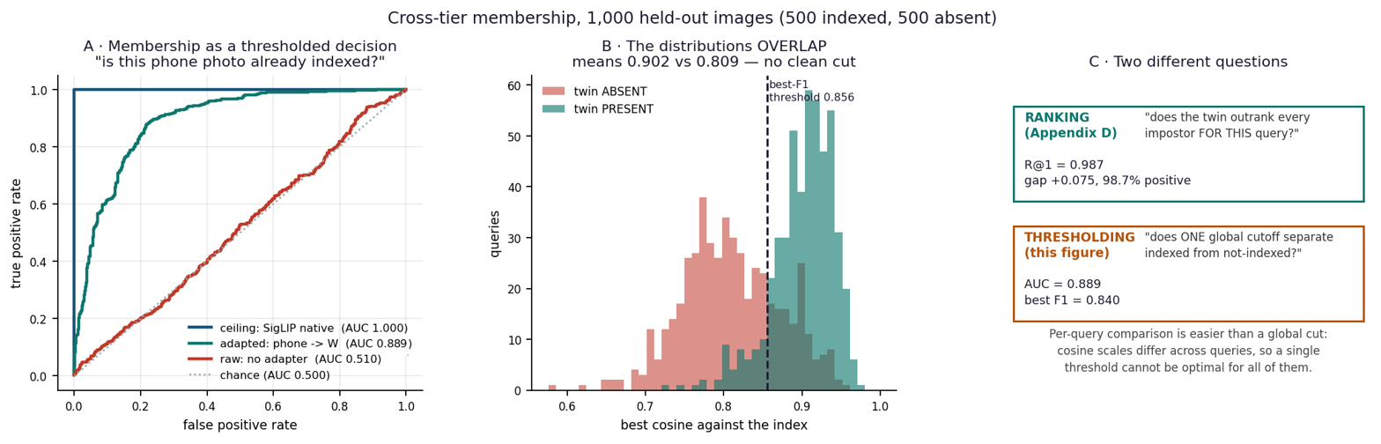
EXPERIMENT B · THE FAILURE THAT PROVED LINEARITY
A bigger, non-linear model could not beat the one matrix
0.592
0.900
88.4%
0.79 MB
held-out R² (reconstruction)
cosine to the true twin
of the jointly-trained ceiling
shipped, runs on a phone
MLP CONTROL (F2): more parameters, non-linearity, 74 rows/dim, 40 epochs — held-out cosine 0.9183 vs the matrix's 0.9183, gain +0.0000, on two runs. Linearity is not an approximation; it IS the relationship.
One adapter, three decisions: verification (same photo?) AUC 0.999 · ranking (twin first?) R@1 0.987 · membership (indexed at all, one global cutoff?) AUC 0.889. Harder as the decision gets more global.
The MLP is the control for 'maybe a network is secretly learning the task' — it gains nothing, so the matrix is the whole story.
10
Notes:
[12:30] The MLP control is conceptual dynamite: capacity buys +0.0000, so linearity is exact. Membership curve shows the same adapter graded three ways.

Slide 11
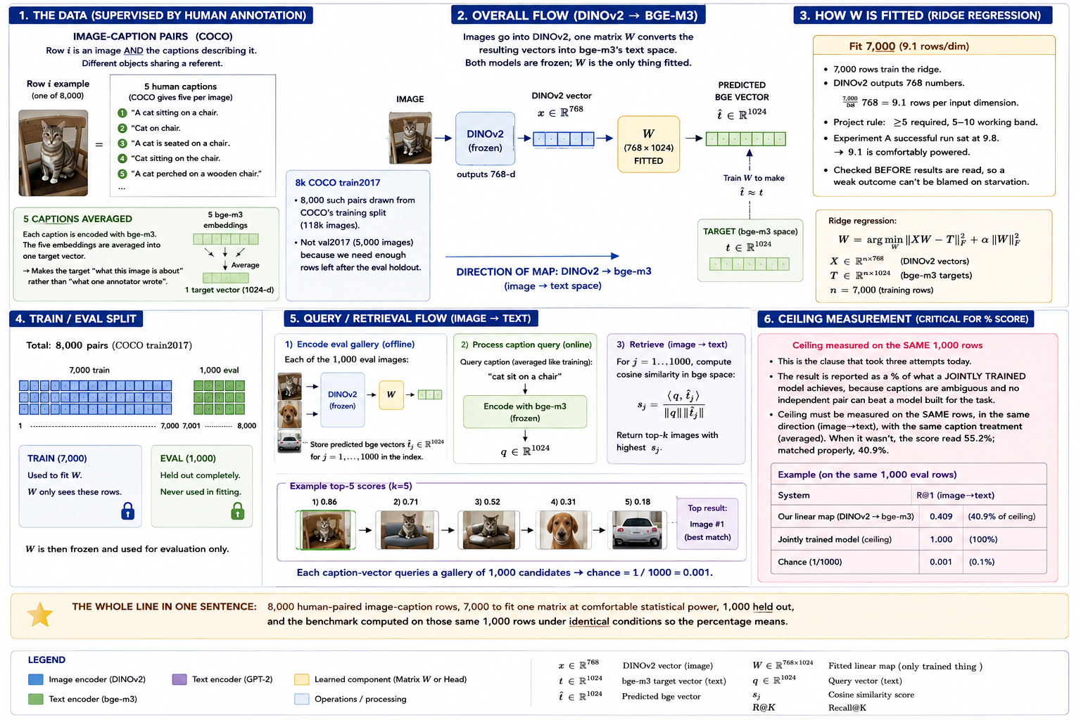
EXPERIMENT E · CROSSING MODALITIES
DINOv2 never saw a word; bge-m3 never saw a pixel — one matrix, image → text
Setup & control
8,000 COCO train2017 pairs — 7,000 fit W (768→1024), 1,000 held out. Target = five captions embedded by bge-m3, averaged. CONTROL: shuffle the pairing — the map should then fail. Ceiling = a same-modality jointly-trained system on the same rows.
Measured — R@1 0.358 = 40.9% of the matched ceiling (358× chance); R² 0.511; SHUFFLE-control gap 0.641 (true minus shuffled).
Failure caught: a borrowed ceiling read 55.2% — wrong protocol. Re-measured on matched rows: 40.9%. New rule: the ceiling is never borrowed.
Proved: PRH's actual cross-modal claim holds WITHOUT joint training — crossing modality costs about half the R@1 of a same-modality pair.
11
Notes:
[13:45] The boldest scientific claim: image and text, no shared training, still linearly mappable. The shuffle control is what proves the map needs the true alignment.

Slide 12
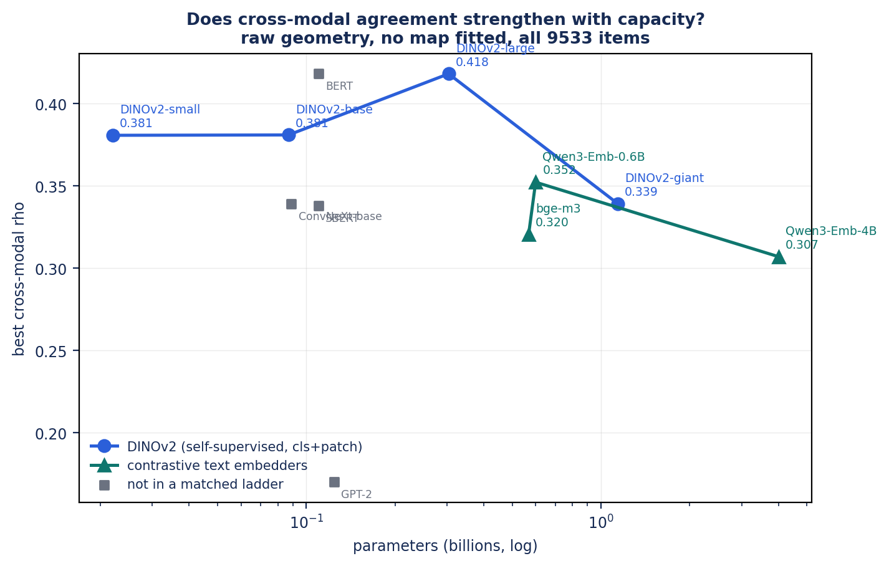
EXPERIMENT E · DOES IT SCALE?
Alignment grows with size to 304M — then both ladders fall (pre-registered, falsified)
40.9%
53.5%
58.3%
small 22M
base 87M
large 304M
Ladder: same text encoder, data, pooling at every rung. +15.3 points of ceiling per decade of parameters (six monotone measures) — exactly PRH's prediction, up to 304M.
Then the falsification: extend to DINOv2-giant (1.1B) and Qwen-4B — image shape agreement 0.418 → 0.339; text 0.352 → 0.307. Rise then FALL at 7× the parameters. Predictions P2/P3 FALSIFIED.
Honest scope: this is a 0.02–4B regime; PRH's own evidence runs to 70B. Naming the boundary is the point — the big-model tests are the to-do list.
ρ = distance-rank (shape) agreement, no map fitted. Report C.10, E.16.
12
Notes:
[14:45] The honesty beat: my own prediction that scaling keeps helping was FALSIFIED beyond 304M. Concede the scale boundary before the examiner raises it.

Slide 13
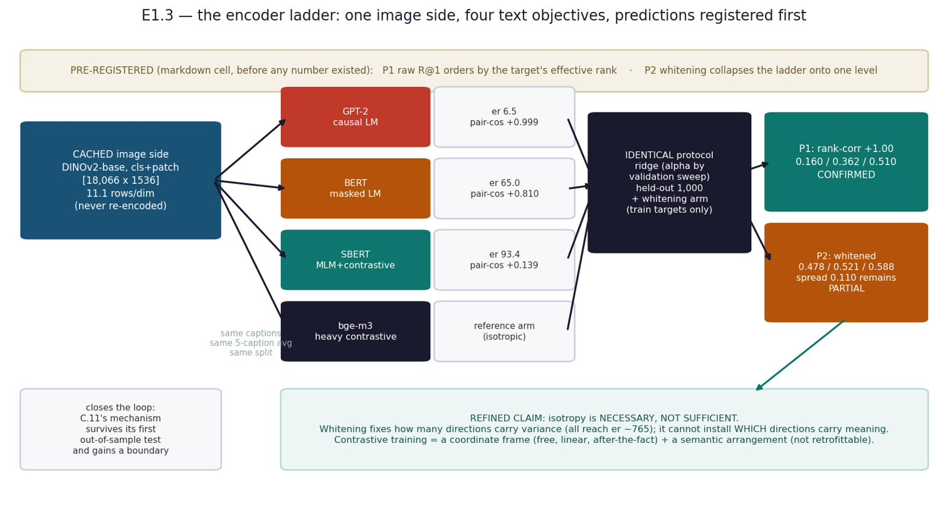
DISCOVERY · ISOTROPY, NOT SIMILARITY-TRAINING
A collapsed language space, rescued to 102.6% of a contrastive encoder by a free linear transform
What happened
GPT-2's caption space has effective rank 6.6 of 768 — every caption sits at cosine +0.999 to every other. A cone, not a cloud. Cosine reads 1.000 while retrieval R@1 is 0.130.
Whitening (divide each direction by its spread — label-free, linear) lifts R@1 to 0.478 = 102.6% of an encoder trained contrastively on 1.2 BILLION pairs. The information was there; the geometry hid it.
CONTROL: centering alone (no whitening) leaves rank at 6.5 and fails — so it is the isotropy, not the shift.
Measured — effective rank vs R@1 correlate at ρ +0.94 across encoders: isotropy is a dial, not a switch.
Proved: isotropy is NECESSARY, not sufficient — a linear transform supplies the coordinate frame; contrastive training adds the arrangement that survives whitening.
13
Notes:
[15:45] A discovery, not a planned result. The rescue number (102.6% of a billion-pair model, for free) is the memorable one. Centering-alone is the control that isolates isotropy.

Slide 14
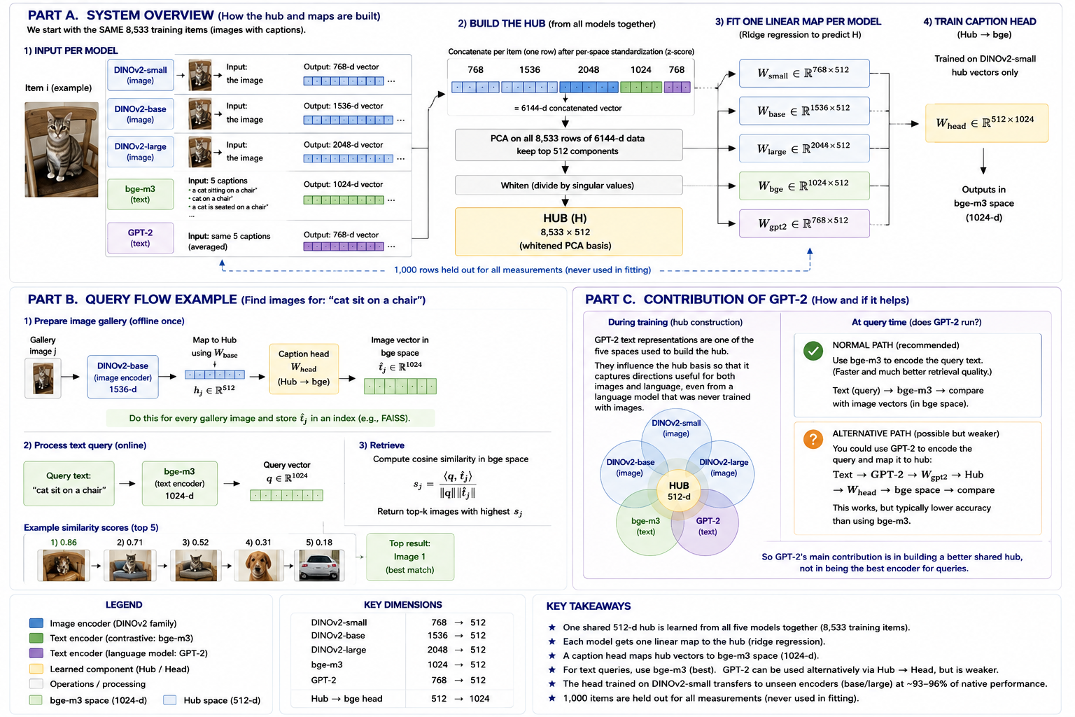
THE HUB · MANY ENCODERS, ONE SPACE
▶ LIVE DEMO
A component trained on ONE encoder transfers to encoders it never saw
recipient (never seen) | R@1 | % native | control
DINOv2-base (sibling) | 0.445 | 96.5%
SigLIP 2 (new lineage) | 0.557 | 94.2% | held-out
ConvNeXt (convnet, supervised) | — | 96.7% | held-out
random-map control | 0.003 | — | chance 0.001
Build once (no training): z-score → concatenate → PCA to 512 → whiten. One ridge map per encoder INTO the hub; one caption head OUT. Adding a model = ONE solve; hub, head, every other map untouched.
CONTROLS: a random entry map scores 0.003 (chance 0.001). ConvNeXt — a convnet, fully supervised, never a member — hits 96.7%, ABOVE the ViT band: neither architecture nor supervision bounds the claim.
All 42 directed pairs share one hub at 103.6% of per-pair hubs — sharing is free.
▶ Demo notebook G2 (live) — Drive: convergence_experiment
14
Notes:
[17:00] DEMO 2. Show G2: image or caption in, ranked results out, through the shared hub. The random-map control (0.003) and ConvNeXt held-out (96.7%) are the two numbers to say aloud.

Slide 15
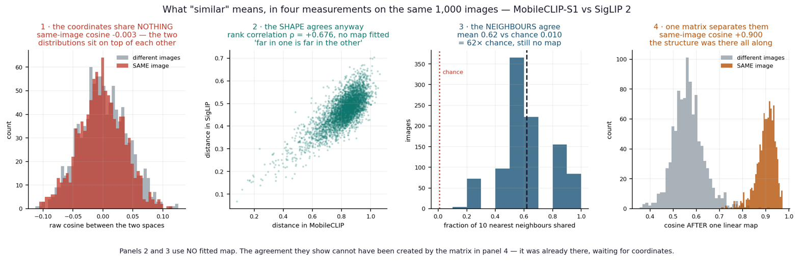
THE CENTRAL DISCOVERY
What is shared is LOCAL structure, not global geometry
The finding, on three metrics
Why it matters
Raw cosine ≈ 0 — coordinates never agree. But shapes do: distance-rank ρ +0.681, and 67% of an item's 10 nearest neighbours are shared (27× chance). Agreement is strongest for near neighbours and decays to chance by k = 500 — confirmed on k-NN, CKNNA, and rank correlation, including the metric PRH's own authors designed.
It narrows the Platonic claim to its DEFENSIBLE form. Models do not build the same space — they build different CHARTS of one shared structure, like two map projections of the Earth that disagree on area but both keep Spain next to France. It also explains why one linear map reaches most, but not all, of the ceiling.
15
Notes:
[18:15] The headline discovery. 'Same world' means same LOCAL arrangement of meaning. The map-projection metaphor is the takeaway line.

Slide 16

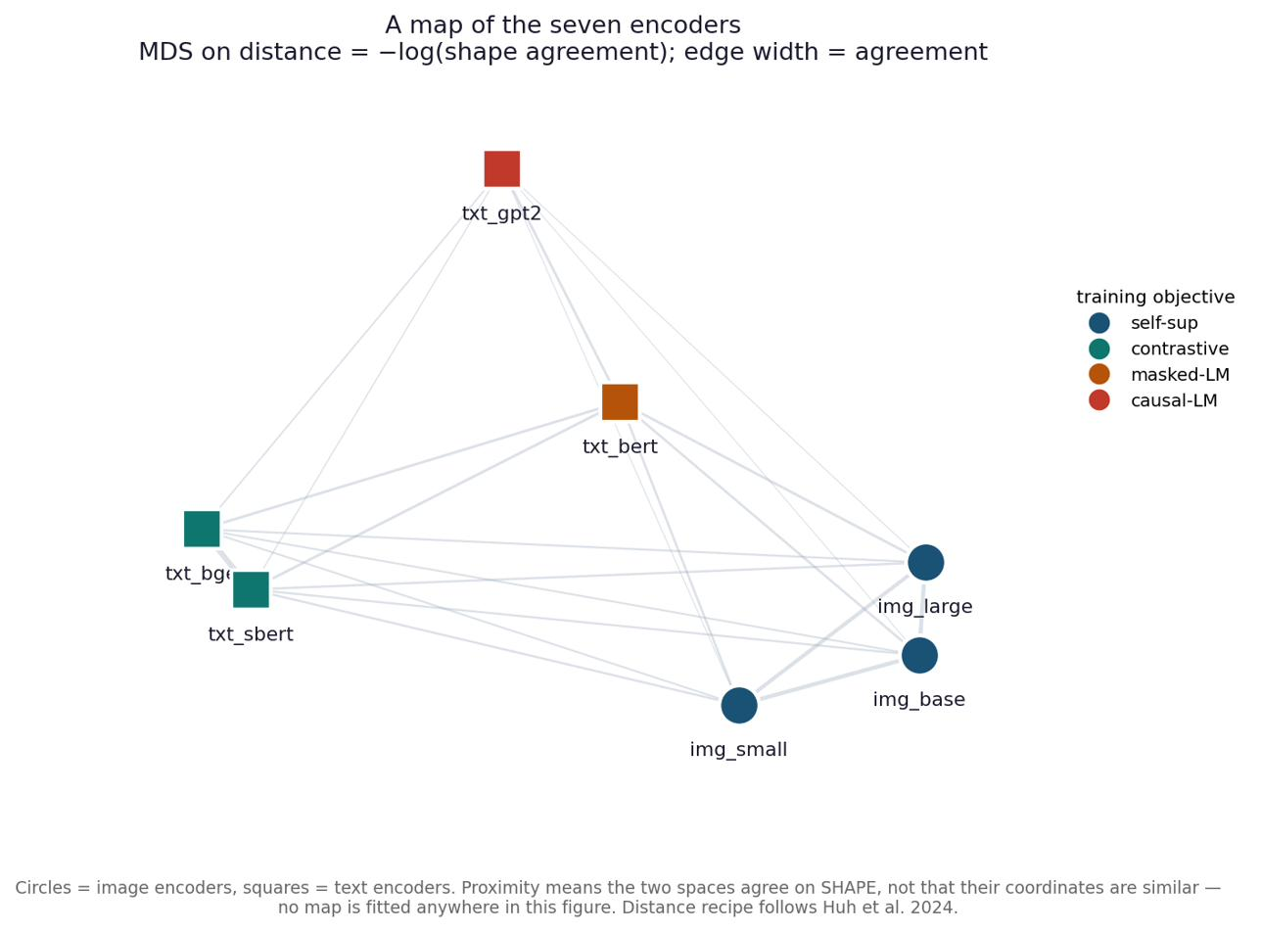
AND WHAT DECIDES HOW MUCH
Objective beats lineage beats modality
Top pair: bge–SBERT ρ +0.76 — shares an objective and NO ancestry; beats the sibling image pair.
ConvNeXt: LOWEST raw shape agreement (0.33–0.40), HIGHEST transfer (96.7%) — raw shape does not predict transfer.
MDS map (right): no map fitted — encoders cluster by training OBJECTIVE, not by modality.
+53×
+44×
+29×
shared OBJECTIVE
shared LINEAGE
shared MODALITY
16
Notes:
[19:00] The causal hint: what you train FOR matters more than what you train ON or which sense you use. bge-SBERT (shared objective, no ancestry) is the cleanest evidence.

Slide 17
ACHIEVEMENTS — AND THE HONESTY THAT BACKS THEM
Nine findings, two shipped systems, eleven falsified explanations
PROVED & BUILT
FALSIFIED, KEPT ON THE RECORD (11 — two of them mine)
Convergence is real but LOCAL; linear, not rigid (0.038 vs 0.592).
Cross-modal with no joint training: 40.9–58.3% of ceiling, 358× chance.
Isotropy rescue: a collapsed space → 102.6% of a billion-pair encoder.
Self-identifying from shape alone: 39.7% exact with ZERO pairs (595× chance).
Objective > lineage > modality (+53 / +44 / +29×).
Shipped: a 0.79 MB phone adapter, and a hub where adding a model is one solve.
'Same space' — refuted (raw cosine ≈ 0). It is local, not global.
'A rotation aligns them' — refuted (0.038). 'An MLP beats the matrix' — refuted (+0.0000).
'Scaling keeps helping' — refuted (both ladders fall past 304M).
The width cliff: transfer collapses at hub width = 768. Seven mechanisms falsified; the eighth confirmed — 768 is the source encoder's algebraic rank, a NUMERICAL artifact, not a property of sharing. One of my own tests was wrong and is recorded as such.
The method IS the result: a claim that survived a test which could have killed it is worth more than one never exposed to one.
Full method, all tables and the falsification ledger: Final_Project_Report.pdf (74 pp) · the story with the math: Project_Atlas.pdf
17
Notes:
[19:30] Land the achievements and the honesty in one breath. The falsification ledger, including my own errors, is the scientific-integrity signature of the project.

Slide 18
IN ONE PARAGRAPH
Two models never share coordinates — raw agreement is exactly chance. But they describe the same world, and the translation between them is a single matrix small enough to fit on a phone. What they share most strongly is LOCAL: they agree about what is near what, and diverge about the shape of the whole. The frame that makes structure readable is cheap; the arrangement of meaning across directions is what training actually buys.
NEXT, IN ORDER OF VALUE
1 · Scale the text side to 7B+ — the examiner's first question, and Qwen-4B already fell.
2 · K small experts vs one large model, at matched parameters (pre-registered B1).
3 · Re-estimate the hub on a 35k-item corpus; then rebuild it WITH DINOv2-giant as a member.
4 · Reverse-direction transfer (ConvNeXt as target) · other languages · non-linear hubs.
Science: a subset of PRH proved, narrowed to its defensible form. Engineering: two small-expert systems that run without a GPU. Method: 11 falsified explanations kept on the record.
Thank you — questions welcome.
Notes:
[20:00] Close. The one-paragraph summary is the sentence to leave them with. To-do slide doubles as the answer to 'what about big models?' — conceded and prioritised.

