Slide 1
AI EXPERT COURSE · FINAL PROJECT
Do independently trained models
learn the same representations?
A scientific test, and a 0.79 MB artifact shipped from its answer
Experiment A · GPT-2 vs Pythia-160M Experiment B · MobileCLIP -> SigLIP 2 adapter
Notes:
Two halves: a scientific claim tested with controls, and an engineering artifact that only exists because the claim held. Total compute under one GPU-hour.

Slide 2
MOTIVATION
The question, and why the obvious answer fails
Can layers from different models be assembled without training?
But representations may still converge
Weight merging works only within one lineage (SLERP, TIES, DARE).
Cross-architecture transplants fail — permutation symmetry.
Same content, different coordinate systems.
Git Re-Basin · CKA studies · Platonic Representation Hypothesis · vec2vec
HYPOTHESIS
Well-trained independent models share representations up to a linear transformation.
Every word load-bearing: well-trained → needs a random-weights control · independent → no shared lineage · up to linear → strong enough to undo rotations, too weak to invent information
Notes:
The hypothesis is deliberately falsifiable: a linear map can rotate, scale and shear — it cannot compute new features or memorize exceptions. If it works, the structure was already there.

Slide 3
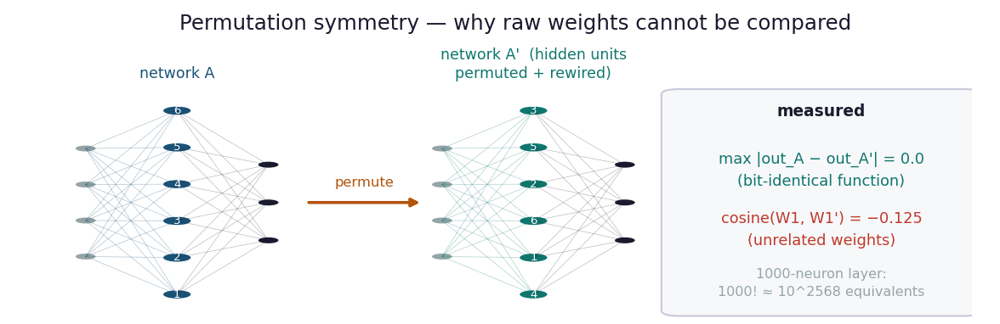
ASSUMPTION 1
Why weights cannot be compared — the obstacle
Measured on real matrices
output difference: 0.0
identical function
cosine(W, W'): −0.125
unrelated weights
One 1000-neuron layer has 1000! ≈ 10²⁵⁶⁸ equivalent arrangements — so the comparison must happen on ACTIVATIONS (what the model computes), not WEIGHTS (how it computes).
Consequence for the design: feed both models the SAME inputs, read their internal states, and compare the geometry those states form.
Notes:
This is why the project measures activations. Weight-space comparison is not merely hard, it is meaningless without solving the permutation alignment problem first.

Slide 4
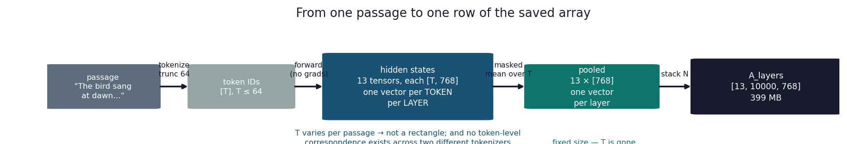
METHOD
Experiment A — the pipeline
A1
Extract
A2
CKA
A3
Stitch
10,000 WikiText passages through both models
+ a seeded random-weights control
All 13×13 layer pairs, twice
(trained vs trained, trained vs random)
One ridge matrix per layer pair
held-out R² = the strong test
Models chosen adversarially: different labs, tokenizers, architectures, training corpora — both trained from scratch, no shared ancestry.
Notes:
Mean pooling is what makes the comparison possible: different tokenizers mean no token-level correspondence exists, but passage-level does.

Slide 5
MATHEMATICS
The map is a formula, not a training run
W = ( XᵀX + αI )⁻¹ XᵀY
closed form · one np.linalg.solve · seconds · byte-identical every run · no epochs, no learning rate, no convergence question
Why the inverse decomposes the problem
The number that decided the project
The inverted matrix contains only X — the outputs never enter it. So the 768×768 fit is 768 INDEPENDENT regressions sharing one inverse.
The requirement is rows per INPUT dimension, not rows per 590,000 parameters.
1.6
9.8
run 1 · 1,234 rows
STARVED
run 2 · 7,500 rows
ADEQUATE
rule of thumb: 5–10 rows per input dimension
Consequence, checked later: output width is nearly free — the 512→768 adapter needs rows relative to 512, which is why 3,000 image pairs sufficed in Experiment B.
Notes:
If asked why not divide by 590K: the fit is 768 tractable problems, not one intractable one. Dividing by total parameters gives 0.002 and 0.013 — a meaningless ratio.

Slide 6
HONEST FAILURE
Run 1 failed — and the failure was the lesson
What the first run reported
What changed — and what did not
stitching mean R² 0.434
peak (L11) 0.552
random control −0.773
verdict vs criteria: BELOW TARGET
samples: 1,646 → 10,000
split: validation → train
(validation holds only ~1,646 long passages)
everything else: UNCHANGED
A negative R² on the control is impossible for a healthy fit — it means the map generalizes WORSE than predicting the mean. That is the signature of memorize-then-shrink, not of absent structure.
No leakage: both models are FROZEN, nothing is trained, the text is only probe stimuli. Held-out discipline lives one level down — A3 holds out its own 25%.
Diagnosis, not fitting the result: the arithmetic was checkable in advance · CKA barely moved (0.365 → 0.359) while regression moved a lot · the control shifted exactly as theory predicts
Notes:
Key defensive point: this was a diagnosed confound with a prediction attached, not a lucky reroll. Run 1 numbers are reported in full, never discarded.

Slide 7
RESULT
Experiment A — the hypothesis holds
0.737
0.797
0.173
6.3×
stitching mean R²
held-out, 13 layers
peak at layer 11
middle-layer maximum
random-weights control
same pipeline
CKA trained / random
0.424 vs 0.067
The shape is the evidence
Trained curve RISES with depth (0.59 → 0.80): both models build shared abstraction layer by layer.
Control curve DECAYS (0.38 → 0.09): random layers grind input structure away.
Opposite slopes cannot be produced by architecture or shared inputs alone.
Notes:
If asked about the missed threshold: the pre-registered CKA diagonal target was >0.5 and we measured 0.424. Reported as missed in Appendix C. The ratio criteria and stitching passed decisively.
CKA panel wording (measured, A2-bis / report C.7): do NOT say 'hot diagonal' about the raw panel. DO say: the diagonal is elevated (ratio 1.20, permutation p < 0.001) and rises strictly monotonically from layer 3 to layer 11, 0.125 to 0.742, Spearman rho = 1.000, p < 1e-5 - which mirrors the stitching curve on this slide. Two independent measures agree on depth ordering.
If asked why the panel looks blocky: hubness. Row means span 0.19 to 0.57 and 97% of the matrix energy is rank-1, so most cells reflect 'how similar is this layer to everything' rather than a specific pairing. Divide out the marginals and 77% of layers match within two, diagonal enriched at p = 0.006. Same anisotropy that defeated Procrustes in Experiment B.

Slide 8
VALIDATION
A robustness check that became a finding
Fitting the REVERSE direction (Pythia → GPT-2) appeared asymmetric. Two follow-up tests explained it completely.
Layer 0 — a REAL information difference
Middle layers — a METRIC artifact
Sequence length recoverable from pooled layer-0 vector:
GPT-2 R² = 1.000 Pythia R² = 0.126
GPT-2 adds absolute positional embeddings at layer 0; Pythia's rotary encoding is applied inside attention.
Mean |gap| under variance weighting: 0.097
Recomputed with uniform averaging: 0.006
16× reduction — the two directions become indistinguishable (L4: 0.722 vs 0.723).
Why it matters twice
GPT-2's variance collapses into 2–11 effective directions — the rogue-dimension phenomenon, measured here.
The same property (unequal variance spread) is what defeats rotation-only alignment in Experiment B.
Notes:
This slide shows the project's method: an anomaly is not hand-waved, it is diagnosed with a test that could have failed.

Slide 9
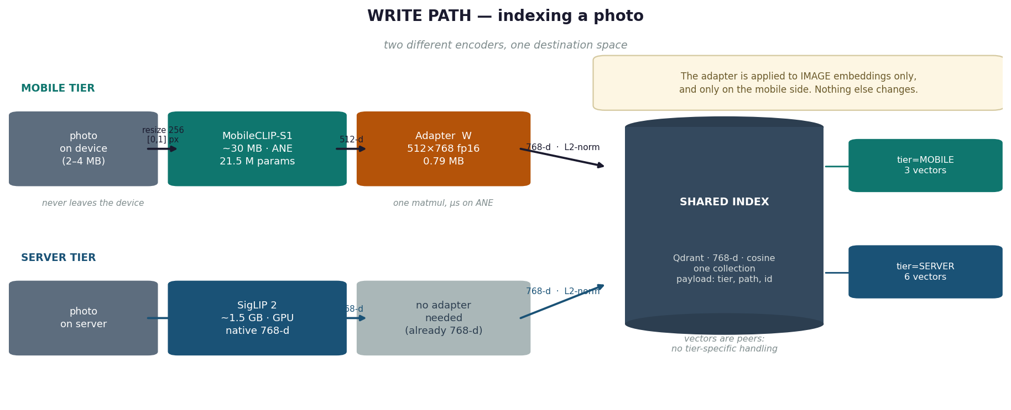
EXPERIMENT B
From finding to product
If two spaces are linearly related, a phone-tier encoder and a server-tier encoder can share ONE vector index.
512 → 768
0.79 MB
1 index
one matrix W
fitted in seconds
Core ML fp16
runs on the ANE
instead of two
photos never uploaded
Notes:
The adapter is applied to image embeddings only, and only on the mobile side. The server and all queries stay native.

Slide 10
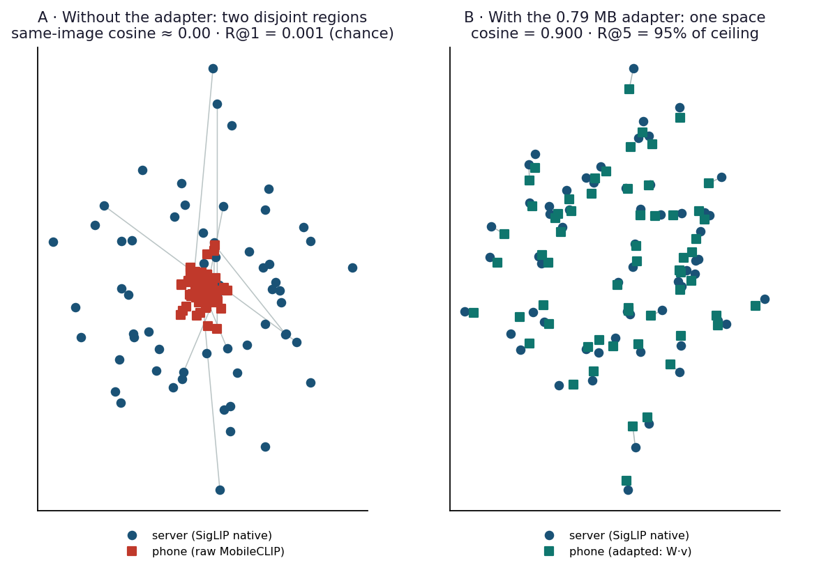
EXPERIMENT B · RESULT
What the adapter does to the geometry
Before
Same-image pairs sit far apart.
cosine ≈ 0.00 · R@1 = 0.001 (exact chance)
After one 512×768 matrix
Each phone vector lands on its server twin.
cosine = 0.900
R@5 = 95.3% of ceiling
R@10 = 97.2% of ceiling
The clouds interleave — there is no region you could circle and call "the mobile part".
Controlled comparison: an MLP (512→1024→768, 300 epochs) gained +0.003 cosine — the relationship is linear, and the residual gap is missing information, not translation error.
Notes:
The MLP is the only gradient training in the entire project, run deliberately as a control to prove it was unnecessary.

Slide 11
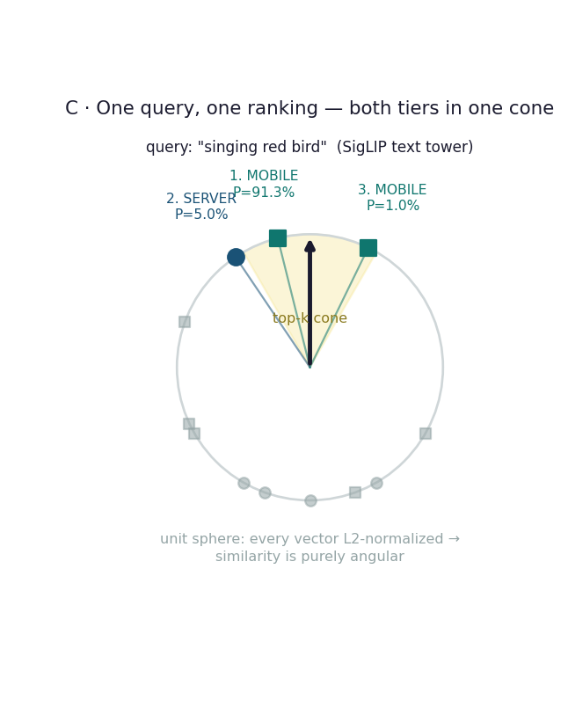
DEMONSTRATED
It runs — one query, both tiers, one ranking
Live demo, measured
1. MOBILE P = 91.3% the uploaded photo, indexed via the phone path
2. SERVER P = 5.0% goldfinches, indexed natively
3. MOBILE P = 1.0%
39 ms
0.08 ms
photo indexed on the
phone path, end to end
local search vs 150 ms
simulated network RTT
auto-captioned by BLIP
on upload
same math either way —
the network is the difference
Notes:
Honest scope: this is a qualitative demo on 9 vectors. The quantitative claim is B3's Recall@K on 1,000 held-out images.

Slide 12
SCIENTIFIC HONESTY
Three negative results, kept
Procrustes
The MLP
Pair-free translation
R² = 0.038
+0.003
R@1 = chance
vs ridge 0.592
cosine gain
cosine 0.395 vs 0.017 floor
A rotation preserves variance spread, so it cannot reconcile spaces that differ in anisotropy. Confound disclosed: the 512-vs-768 gap forced zero-padding, which handicaps rotation mechanically.
Ten times the parameters, direct optimization of the retrieval objective — no improvement. This is what PROVED linearity; the failed stronger method is the measurement.
Distribution-level alignment recovered with zero pairs (23× random); instance-level not. Diagnostics refuted one hypothesis, supported another — full vec2vec machinery is necessary, not decorative.
Notes:
Each negative is trusted only because a positive control succeeded on the same data — that is what makes it a finding rather than a failure to measure.

Slide 13
METHODOLOGICAL TAKEAWAY
Before accepting a negative result, verify the experiment could have said yes.
1
Rows per input dimension
arithmetic
starvation biases DOWNWARD, systematically — it does not merely add noise
2
Alignment of the two matrices
seconds
one off-by-one and every pair is wrong, with no error raised — test by shuffling
3
Pooling and preprocessing
review
the transforms that produced the matrices can destroy signal before fitting begins
A false positive announces itself under scrutiny. A false negative just sits there looking like a clean answer.
Notes:
This is the transferable lesson. Run 1 would have closed the investigation with a plausible wrong conclusion, and Experiment B would never have existed.

Slide 14
SUMMARY
What was delivered
Scientific
Engineering
Documentation
Hypothesis confirmed: R² 0.737 mean, 0.797 peak
CKA ratio 6.3× against a seeded control
Direction-symmetric once the metric artifact is removed
Anisotropy measured directly (eff. dim 2.2–92.7)
Adapter.mlpackage — 0.79 MB, fp16, iOS 16+
R@5 / R@10 at 95.3% / 97.2% of ceiling
One shared Qdrant index, photos never uploaded
Live end-to-end demo with mixed-tier ranking
21-page report with 3 appendices
Technical companion + concepts & corrections
14 notebooks, every stage reproducible
Hebrew editions of the main documents
Total compute for the scientific core: under one GPU-hour on a free Colab T4.
Notes:
Every headline number is measured on held-out data the fit never saw.

Slide 15
CONCLUSION
Two models that never shared a datapoint
built the same map of the world.
One matrix translates between them — and the same matrix, fitted between a phone encoder and a server encoder, lets both write into a single index.
0.737
0.900
0.79 MB
held-out R²
Experiment A
cosine to target
Experiment B
shipped artifact
iOS 16+
Limitations stated plainly: two small models are a two-point sample of the Platonic Representation Hypothesis, not proof of its trend.
Notes:
Close on scope: the experiments confirm the measured points and are consistent with the predicted trend; the trend itself remains an extrapolation this replication makes credible but cannot prove.

