Slide 1
FINAL YEAR PROJECT 2026 · CHECKPOINT 2
GuardianAI
Real-Time Automated Fall Detection and Alert System
Group FYP-2026-G6 · BS Computer Science
Kashan M. Ashraf BSCS-01007 Umer Ahmed BSCS-01011 Imran BSCS-01014
kashan84-guardianai.static.hf.space

Slide 2
THE NEED
Why We Chose This Problem
Falling is one of the most common accidents for older people living at home.
The bigger danger is often not the fall itself. It is lying on the floor for a long time before anyone notices.
Most families here cannot afford a full time caretaker, and children are usually out at work or school.
Emergency buttons and smart bands already exist, but the person has to remember to wear them and has to be conscious enough to press them.
Almost every home or clinic can afford a simple camera, and many already have one.
Our goal: make the room itself notice the fall, so nobody has to wear or press anything.
GuardianAI · FYP-2026-G6
2

Slide 3
THE IDEA IN ONE LINE
What GuardianAI Does
A normal camera watches the room. The software checks how the person is moving and standing. If it looks like a fall, it raises an alert straight away.
📷
👤
⏱
🔔
Any ordinary camera
Nothing to wear
Always watching
Alert in seconds
A laptop webcam or a CCTV camera is enough. No special sensor or new hardware.
The person does not carry a band, a button or a phone. Nothing to charge or forget.
The system does not get tired, distracted or fall asleep at night.
The family or the caretaker is told immediately, even if they are in another room.
GuardianAI · FYP-2026-G6
3

Slide 4
STEP BY STEP
How It Works
1
2
3
4
5
Take a frame
Find the body
Measure
Decide
Alert
One picture is taken from the live camera video.
The system marks points on the head, shoulders, hips, knees and feet.
It works out the body angle, how fast the head is dropping and how low the person is.
The status becomes Normal, Warning or Fall.
Buzzer, screen popup, Windows notification and email.
This whole cycle repeats about 25 to 30 times every second, so an alert appears in well under a second.
The measurements are printed on the screen, so we can always show why the system gave that answer.
GuardianAI · FYP-2026-G6
4

Slide 5
THE CORE OF OUR METHOD
Two Checks Before We Say Fall
Check 1 · The Rules
Check 2 · The Trained Model
Plain measurements that anyone can follow.
A model that learned from movement examples.
Is the body upright or flat?
Did the head drop suddenly?
Is the person low down, near the floor?
It reads the last one second of movement.
It looks at the pattern, not a single picture.
It can catch shapes of movement that fixed rules miss.
The two answers are then combined into one final status.
The model has the bigger say and the rules act as a safety check. Because we look at a full second instead of one picture, bending down or sitting quickly is not reported as a fall.
GuardianAI · FYP-2026-G6
5

Slide 6
THE ALERT
When a Fall Is Detected
🔊
Buzzer
Mute button
A sound plays on the computer in the room.
One click turns the sound and the popups off, which is useful while testing or at night. The events are still recorded in the background.
🖥
Screen alert
A red banner appears on the dashboard.
💬
Windows notification
Pops up in the corner even when another program is open.
No alarm storms
✉
Email
After one alert the system waits 30 seconds before it can alert again, so a single fall does not set off a long chain of alarms.
Sent to the caretaker or family contact that was saved.
📄
Saved record
Every event is written to a log file with the date and time.
GuardianAI · FYP-2026-G6
6

Slide 7
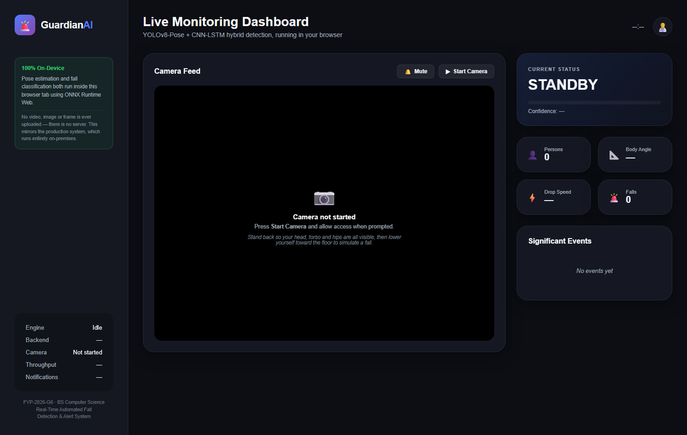
WHAT THE CARETAKER SEES
The Dashboard
The live camera picture with the body points drawn on the person.
The current status and how confident the system is.
Body angle and drop speed, so the decision can be checked by a human.
A running list of the events that happened.
Buttons to start the camera and to mute the sound.
GuardianAI · FYP-2026-G6
7

Slide 8
WHY IT FITS A NORMAL HOME
Privacy and Cost
The video stays inside the house
Only the alert travels
Runs on an ordinary laptop
All the processing happens on the same computer that the camera is plugged into. The video is never uploaded to any company or cloud service.
When a fall happens we send a short message, not the recording. There is no library of family video sitting on someone else's server.
No graphics card, no server and no monthly subscription. A camera and a normal computer are enough.
We also put a version online that anyone can open from a link.
Even on that public page the camera video never leaves the visitor's own browser, so the same privacy promise holds. The link is on the last slide.
GuardianAI · FYP-2026-G6
8

Slide 9
PROGRESS
Where We Are and What Is Next
Finished in FYP 1
Planned for FYP 2
Requirement document, now at version 3
Software Design Document with full diagrams
Updated architecture document
Working prototype with a live dashboard
Alerts through sound, popup, notification and email
A public demo link that runs in a browser
Train and test on a public fall dataset and measure the accuracy properly
Tighten the fall rule so posture and speed must agree
Follow more than one person in the same room
Send alerts to a phone through SMS or WhatsApp
Try it on a small low cost computer next to the camera
GuardianAI · FYP-2026-G6
9

Slide 10
NOW LET US SHOW YOU
Live Demo
Try it yourself
kashan84-guardianai.static.hf.space
Source code
github.com/KashanAshraf84/FYP-2026-G6-RealTimeAutomatedFallDetectionAndAlertSystem
Thank you. We are happy to take your questions.

