Slide 1
INTRODUCTION TO INFORMATION AND COMMUNICATION TECHNOLOGIES
CS 117
ICT – LAB
Introduction to computer peter Norton pdf (Course Book)

Slide 2
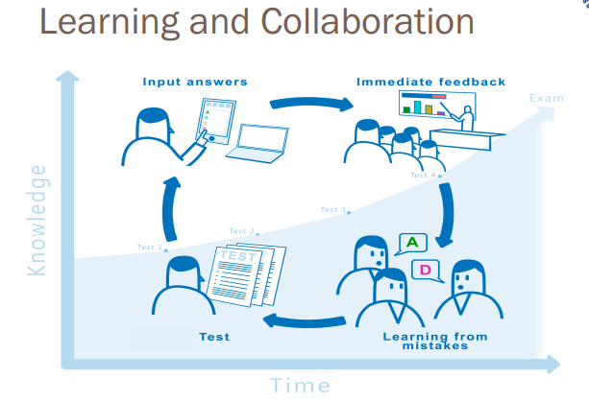
Learning and collaboration

Slide 3

History
A person who never made a mistake never tried anything new [Albert Einstein]

Slide 4
DATA
facts and statistics collected together for reference or analysis.
An individual unit that contains raw materials which do not carry any specific meaning

Slide 5
Information
Information: facts provided or learned about something or someone
Information is a group of data that collectively carries a logical meaning. Data doesn't depend on information.

Slide 6
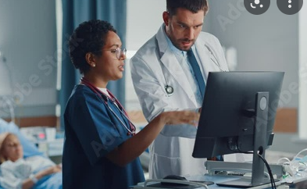
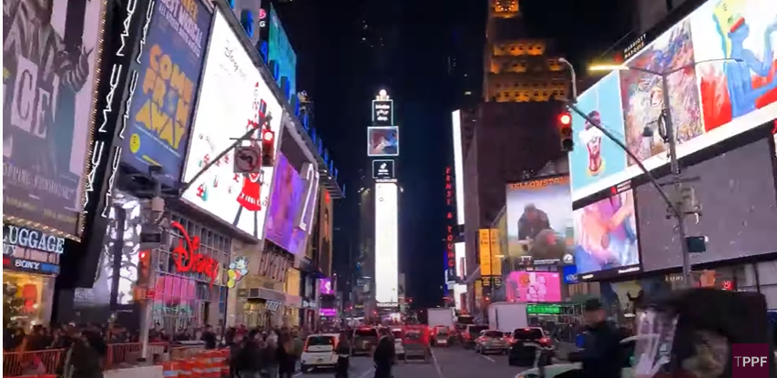
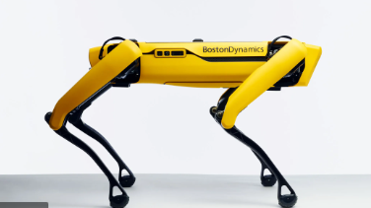
Introduction to Computer
A computer is an electronic device that processes data, converting it into information that is useful to people
“Computers are everywhere” overstatement?

Slide 7
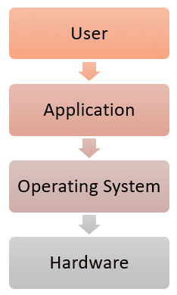
An operating system (OS) is:
an intermediary between the user of a computer and the computer hardware”
“manages the computer hardware”

Slide 8
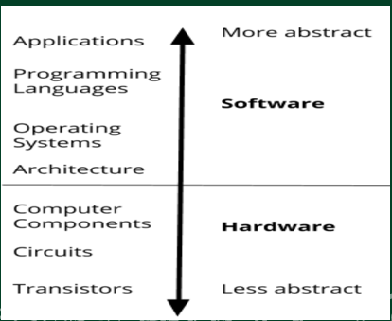

Slide 9
APPLICATIONS
Any program you run on your computer
Microsoft Word
Google Chrome
Note application
.exe (Windows) or .app (Mac) file
Can use without knowing how it works behind the scenes (abstraction)
Programs are written in code, the next layer of abstraction

Slide 10
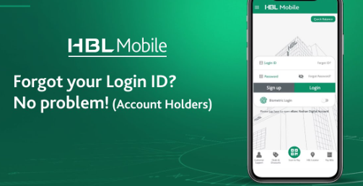


Uses of Computer (Daily Life)
Online banking
Education
Online shopping

Slide 11
WELCOME YOU ALL
Wishing you all the best for your future

