Slide 1
William Stallings
Data and Computer Communications
7th Edition
Chapter 1
Data Communications and Networks Overview

Slide 2
A Communications Model
Source
  generates data to be transmitted
Transmitter
  Converts data into transmittable signals
Transmission System
  Carries data
Receiver
  Converts received signal into data
Destination
  Takes incoming data

Slide 3
Communications Tasks
Transmission system utilization | Addressing
Interfacing | Routing
Signal generation | Recovery
Synchronization | Message formatting
Exchange management | Security
Error detection and correction | Network management
Flow control

Slide 4
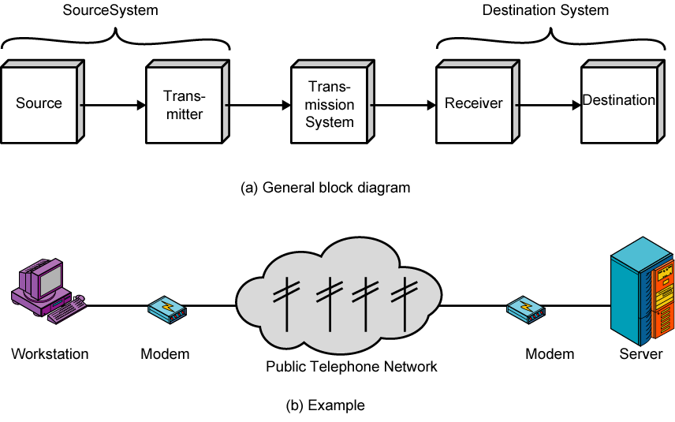
Simplified Communications Model - Diagram

Slide 5
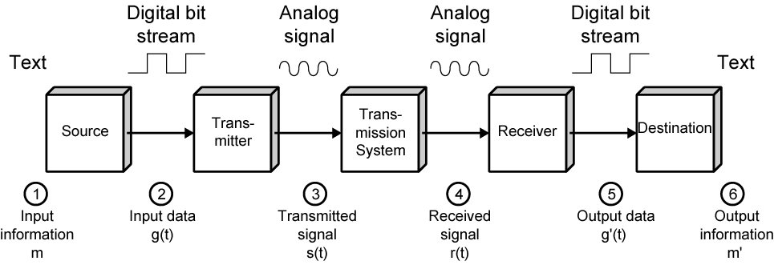
Simplified Data Communications Model

Slide 6
Networking
Point to point communication not usually practical
  Devices are too far apart
  Large set of devices would need impractical number of connections
Solution is a communications network
  Wide Area Network (WAN)
  Local Area Network (LAN)

Slide 7
Wide Area Networks
Large geographical area
Crossing public rights of way
Rely in part on common carrier circuits
Alternative technologies
  Circuit switching
  Packet switching
  Frame relay
  Asynchronous Transfer Mode (ATM)

Slide 8
Circuit Switching
Dedicated communications path established for the duration of the conversation
e.g. telephone network

Slide 9
Packet Switching
Data sent out of sequence
Small chunks (packets) of data at a time
Packets passed from node to node between source and destination
Used for terminal to computer and computer to computer communications

Slide 10
Frame Relay
Packet switching systems have large overheads to compensate for errors
Modern systems are more reliable
Errors can be caught in end system
Most overhead for error control is stripped out

Slide 11
Asynchronous Transfer Mode
ATM
Evolution of frame relay
Little overhead for error control
Fixed packet (called cell) length
Anything from 10Mbps to Gbps
Constant data rate using packet switching technique

Slide 12
Local Area Networks
Smaller scope
  Building or small campus
Usually owned by same organization as attached devices
Data rates much higher
Usually broadcast systems
Now some switched systems and ATM are being introduced

Slide 13
LAN Configurations
Switched
  Switched Ethernet
    May be single or multiple switches
  ATM LAN
  Fibre Channel
Wireless
  Mobility
  Ease of installation

Slide 14
Metropolitan Area Networks
MAN
Middle ground between LAN and WAN
Private or public network
High speed
Large area

Slide 15
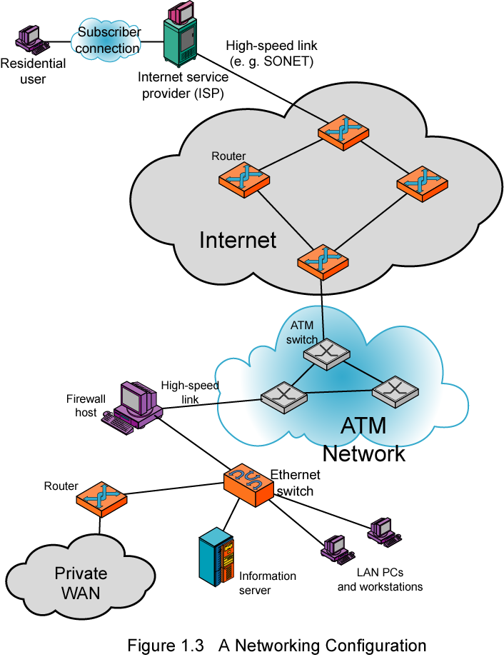
Networking
Configuration

Slide 16
Further Reading
Stallings, W. [2003] Data and Computer Communications (7th edition), Prentice Hall, Upper Saddle River NJ, chapter 1
Web site for Stallings book
  http://williamstallings.com/DCC7e.html

