Slide 1

Introduction to Illustrator:
Basics including: Toolbox, Basic tools, and creating a shape.

Slide 2
Overview
Illustrator concepts
Creating new documents
Illustrator interface
Illustrator toolbox
Creating a shape
Arrow tools & shapes

Slide 3
Illustrator Concepts
Used to create vector graphics.
Can be resized without losing quality.
Created through dots (Anchor points) connected with paths.
This is a shape, which can ave a stroke or fill included.

Slide 4
Bitmap & vector
Bitmap:
Made up of pixels
Will pixelate when made bigger or smaller
Take up more memory
Vector:
Made up of lines and curves
Can be resized without losing quality
Takes up less memory

Slide 5
Illustrator Concepts
Through various tools, the designer can create shapes that have a base of anchor points and paths using fills and strokes.

Slide 6
Creating a new document
Open adobe illustrator.
Can either:
Hit the new button.
Do the keyboard shortcut ctrl + N.
File>New from the main menu bar.

Slide 7
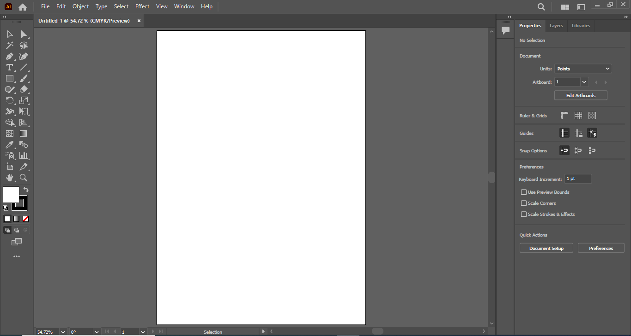
Control Panel
Tools panel
Artboard
Panel sets

Slide 8

Illustrator Workspace
What if I can not see/find my workspace?
Solution:
View > Fit Artboard in Window
Can also use the Zoom tool

Slide 9
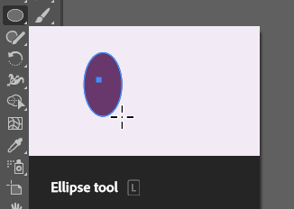
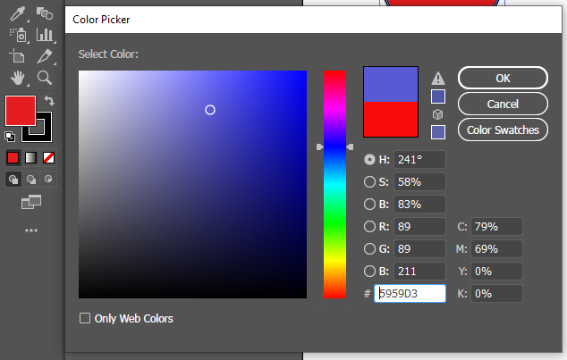
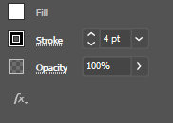
Creating a shape
Draw a red ellipse (circle) with a black, 4 pt. stroke
Use the color picker to select the fill color (any)
To access the color picker, double-click on the fill icon at the bottom of the tool box

Slide 10
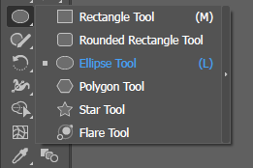

Creating a shape
Navigate the Tool box, locate the rectangle tool.
NOTE: Many tools in the Adobe products have a small arrow in the lower right corner denoting a collapsed set of tools. This means there is more than one similar tool in the group.
Click and hold the Rectangle Tool to access the collapsed tool group, and select the Ellipse tool.
Position the cursor on the artboard and click, hold and drag to draw a circle.

Slide 11
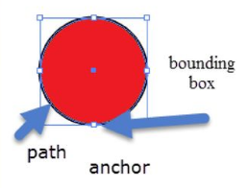
Creating a shape
The box in the image is called the Bounding box of the shape.
Can be used to size the shape.
Position the cursor over one of the corners/anchor points to drag and resize.

Slide 12

Arrow tools & shapes
The black arrow (called Selection) selects an entire shape by clicking on it.
Can be used to move and resize via the bounding box of the shape.
The white arrow (called Direct Selection) can be used to select part of a shape.
It enables a designer to work with the anchor points by selecting and manipulating them

Slide 13
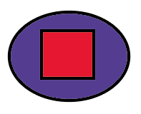
Layers
Draw another small blue rounded rectangle, 2 pixel stroke.
With the use arrow keys to nudge the blue rectangle.

Slide 14
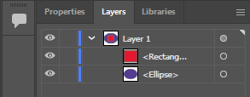
Layers
Find the layers pane (probably collapsed, bottom of screen at right side in older versions)
Try dragging a layer up or down, see how it changes stacking order of elements (your blue rectangle was automatically added to another layer)
Try trashing a layer (drag to trash icon)
The eye icon toggles the visibility of the layers
Empty block next to eye lets you lock a layer to prevent changes
Little blue button lets you select the artwork on a layers

