Slide 1
Data Processing

Slide 2
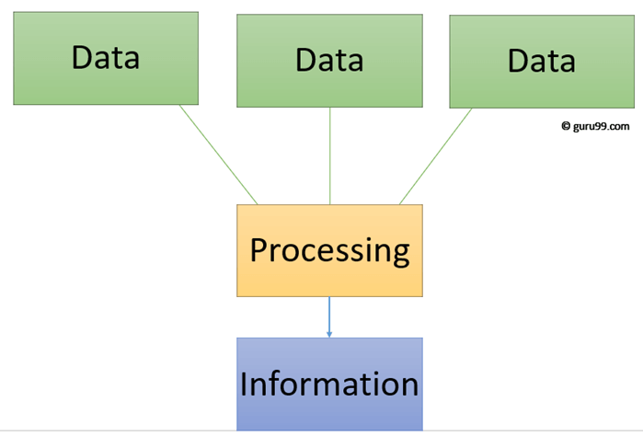
Difference between Data & Information
Data are simply facts or figures, bits of information, but not information itself. When data are processed, interpreted, organized, structured or presented so as to make them meaningful or useful, they are called information.
Example:
The history of temperature readings all over the world for the past 100 years is data. If this data is organized and analyzed to find that global temperature is rising, then that is information.

Slide 3
Data Representation
Computers have their own number system, called Binary Number System.
Computers use binary - the digits 0 and 1 - to store data.
A binary digit, or bit, is the smallest unit of data in computing.
It is represented by a 0 or a 1.
Binary numbers are made up of binary digits (bits), e.g. the binary number 1001

Slide 4
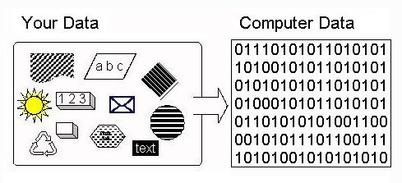
Data Representation
Binary and Switches. Binary is a mathematical number system: a way of counting. We have all learned to count using ten digits: 0-9. One probable reason is that we have ten fingers to represent numbers. The computer has switches to represent data and switches have only two states: ON and OFF. Binary has two digits to do the counting: 0 and 1 - a natural fit to the two states of a switch (0 = OFF, 1 = ON).

Slide 5
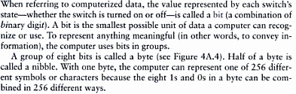
Bits and Bytes
e:
0 | 1 bit
1 | 1 bit
0110 | 4 bits
01101011 | 8 bits
01000011
Bits Representation
8 bits = 1 Byte

Slide 6

Text Codes
EBCDIC: Extended Binary Coded Decimal Interchange Code
ASCII: American Standard Code for Information Interchange
Extended ASCII
Unicode: Unicode Worldwide Character Standard

Slide 7
Data Processing
Components that handle the data processing are:
Central Processing Unit
Memory
Buses

Slide 8
Central Process Unit (CPU)
Central Processing Unit (CPU) consists of the following features −
CPU is considered as the brain of the computer.
CPU performs all types of data processing operations.
It stores data, intermediate results, and instructions (program).
It controls the operation of all parts of the computer.

Slide 9
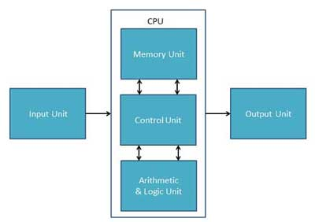
Central Process Unit (CPU)
CPU itself has following three components.
Memory or Storage Unit
Control Unit
ALU(Arithmetic Logic Unit)
CPU Architecture

Slide 10
Central Process Unit (CPU)
Memory or Storage Unit
This unit can store instructions, data, and intermediate results. This unit supplies information to other units of the computer when needed. It is also known as internal storage unit or the main memory or the primary storage or Random Access Memory (RAM).
Its size affects speed, power, and capability. Primary memory and secondary memory are two types of memories in the computer. Functions of the memory unit are −
It stores all the data and the instructions required for processing.
It stores intermediate results of processing.
It stores the final results of processing before these results are released to an output device.
All inputs and outputs are transmitted through the main memory.

Slide 11
Central Process Unit (CPU)
Control Unit
This unit controls the operations of all parts of the computer but does not carry out any actual data processing operations.
Functions of this unit are −
It is responsible for controlling the transfer of data and instructions among other units of a computer.
It manages and coordinates all the units of the computer.
It obtains the instructions from the memory, interprets them, and directs the operation of the computer.
It communicates with Input/Output devices for transfer of data or results from storage.
It does not process or store data.

Slide 12
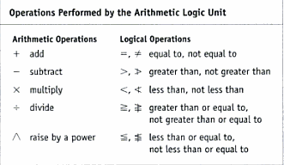
Central Process Unit (CPU)
Arithmetic and Logic Unit
This unit consists of two subsections:
Arithmetic Section:
Function of arithmetic section is to perform arithmetic operations like addition, subtraction, multiplication, and division. All complex operations are done by making repetitive use of the above operations.
Logic Section:
Function of logic section is to perform logic operations such as comparing, selecting, matching, and merging of data.

Slide 13
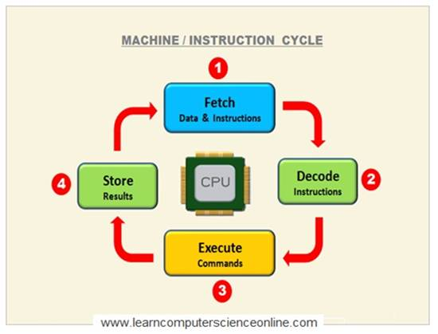
Central Process Unit (CPU)
Machine Cycle
The steps performed by the computer processor to execute each instruction.
Machine cycle is further divided into four parts
Fetch: Control Unit retrieve the instruction from memory
Decode: Before execution instruction is being break down into opcode(operation code)
Execute: Instructions are being executed.
Store: CPU requires to store the result in memory.

Slide 14
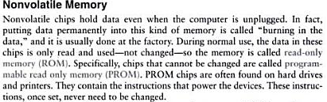
Memory

Slide 15
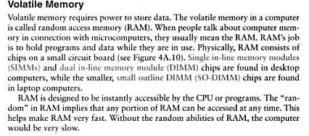
Memory

Slide 16
System Bus
The system bus is a pathway composed of cables and connectors used to carry data between a computer microprocessor and the main memory. The bus provides a communication path for the data and control signals moving between the major components of the computer system.
The system bus works by combining the functions of the three main buses, each of the three buses has its separate characteristics and responsibilities.
Data Buses: which is a bidirectional path, carries the actual data between the processor, the memory and the peripherals.
Address Buses: used to specify memory locations for the data being transferred.
Control Buses: carries the control, timing and coordination signals to manage the various functions across the system.

Slide 17
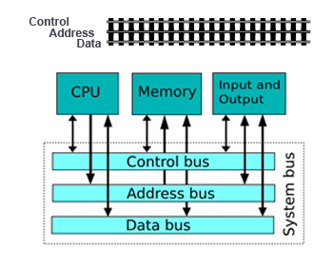
System Bus

Slide 18
Factors Affecting Processing Speed
Registers
The CPU contains of small memory areas: called registers, which store data and instructions while the CPU processes them.
The size of the registers determines the amount of data with which the computer can work at a one time.
Today most PC`s have 32-bit registers, mean the CPU can process four bytes data at one time. Register sizes are rapidly growing to 64 bits.
RAM
The amount of RAM in a PC has a direct affect on the system`s speed.
The more RAM a PC has, the more program instructions and data can be held in memory, which is faster than storage on disk.

Slide 19
Factors Affecting Processing Speed
The System Clock
The computer`s system clock sets the pace the CPU by using a vibrating quartz crystal.
A single "tick" of the clock is the time required to turn a transistor off and back on. This is called a clock cycle.
Clock cycles are measured in Hertz(Hz),a measure of cycles per second. If a computer has a clock speed of 300 MHz, then its system clock "ticks" 300 million times every seconds.
The faster a PCs clock runs, the more instructions the PC can execute each second.
Cache Memory
Cache memory is high-speed memory that holds the most recent data and instructions that have been loaded by the CPU.
Cache is located directly on the CPU or between the CPU and RAM, making it faster than normal RAM.
The amount of cache memory has a tremendous impact on the computer`s speed.

Slide 20
THE END

