Slide 1
UPI Transaction Intelligence & Risk Mitigation
Strategic Framework, Operational KPIs, and Threat Diagnostics
Prepared by: Anurag Kashyap
Classification: Capstone Project
Date: September 2026

Slide 2
Core Business & Operational Challenges
Financial & Brand Trust Drag: Sophisticated fraud vectors compromise user systems, raising the platform's Fraud Incidence Rate (FIR) and eroding net margins
Systemic Transaction Friction: High technical declines from bank timeouts and API downtime cause checkout abandonment.
Gateway Hardware Exposure: Unchecked rooted and jailbroken user systems access the platform without device-attestation locks.
Merchant Lifecycle Risks: High-risk merchant categories face a lack of standardized onboarding controls, exposing the platform to massive chargeback vulnerabilities.

Slide 3
Strategic Analytical Goals (BI Perspective)
Risk Isolation & Segmentation
  Construct data-driven profiling models to segment transactions into distinct risk tiers without slowing down safe users.
Infrastructure Root-Cause Mapping
  Mathematically isolate specific operational nodes (banks, device hardware, regional networks) causing technical payment drops.
Operational Control Optimization
  Achieve a balance between aggressive fraud risk mitigation and platform processing latency to maximize successful transaction throughput.

Slide 4
The Enterprise KPI Framework
Operational Performance
• TSR: (Successful Txns / Total Txns) × 100
• TDR: (Platform Failures / Total Txns) × 100
• BDR: (User PIN or Balance Errors / Total Txns) × 100
Risk & Compliance
• FIR: (Confirmed Fraud / Total Txns) × 100
• FPR: Legitimate Flags / Total Actual Fraud Caught
• CDE: (Compromised Devices / Total Devices) × 100
Geographic Performance
• MFR: (Failures in Metro / Total Metro Txns) × 100
• NMFR:(Fails in Non-Metro / Total Non-Metro Txn) × 100
Hypothesis 1 (Categorical Dependency)
• H₀: Transaction fraud status is independent of device integrity status.
• H₁: Compromised device status is a critical leading indicator of fraud.
Hypothesis 2 (Variance of Means)
• H₀: Average transaction value of fraud equals legitimate transactions.
• H₁: Fraudulent transactions exhibit a significantly higher mean value.
Hypothesis 3 (Geographic Infrastructure Variance)
• H₀: The transaction failure rate is uniform across all geographic regions.
• H₁: Non-Metro regional sectors exhibit a significantly higher failure rate due to system connectivity latency.

Slide 5
Pre-Ingestion Data Validation & Governance Gate
Referential Key Mapping (Excel Layer):
Formula Execution: Deployed explicit =XLOOKUP arrays to map child-to-parent linkages before database staging.
Linkage Integrity: Confirmed 100% data coverage with zero orphaned records across customer_id, upi_id, and device_id, etc cross-sheet boundaries.
Cleaning Controls & Constraints:
Domain Boundary Scans: Audited fields against business logic limits: age enforced lower limit (Age 18), satisfaction_score (validated strict 1–5 range), and risk_score (0.0 to 1.0). All fields show 100% compliance.
Zero Row Deletion Policy: Maintained a strict policy of deleting zero incomplete rows to preserve complete, unbiased data denominators for platform KPI tracking.

Slide 6
Data Quality Log: Critical Inconsistency Summary
Context Statement: Operational exceptions and structural text anomalies were cataloged inside a dedicated workbook using your required audit schema.
Table Name | Column Name | Inconsistency Type | Absolute Row Count | Impact % | Remediation Strategy
upi_transaction_history | merchant_id | Contextual Nulls | 69,851 | 69.85% | Retain as database NULL; naturally isolates P2P vs P2M rows.
upi_transaction_history | failure_reason | Lifecycle Missing | 94,129 | 94.13% | Retain as database NULL; isolates clean rows for accurate TDR.
fraud_alert_ history | resolution_date | Lifecycle Missing | 248 | 12.40% | Retain as database NULL; protects velocity tracking metrics.

Slide 7
Data Unification & Pipeline Transition Path
Text & Temporal Standardization:
Categorical Scrubbing: Used Excel Find-and-Replace and unified text transformations (TRIM()) to correct text mutations and remove hidden trailing spaces across various fields.
Temporal Alignment: Converted mixed date configurations across all 6 sheets to the unified corporate layout standard: YYYY-MM-DD/YYYY-MM-DD HH:MM:SS. This ensures Python time-series scripts run smoothly without parsing errors.
Relational Staging Roadmap:
Lineage Tracking: Appended a dedicated validation_status control attribute to safely route rows requiring down-stream python imputation.
Database Launch Readiness: With referential linkages confirmed clean, the data structure is fully prepared for immediate deployment into an optimized SQL star schema.

Slide 8
Data Warehouse Architecture & Schema Engineering
Star Schema Optimization: Modeled the database structure into an enterprise-grade Star Schema layout. The relational hub is built around upi_transaction_history as the central Fact logging node.
Normalized Lookup Entities: Branched the master transaction log across 4 critical dimension nodes (customer_master, merchant_info, device_info, and upi_account_details) to systematically isolate user profile attributes.
Downstream Analytical Staging: Integrated secondary dependent log networks (fraud_alert_history and customer_feedback_surveys) using strictly constrained foreign key bridges to provide clean pipelines for Python risk calculations and Power BI dashboards.
Production Ingestion Automation: Executed raw file streaming using custom LOAD DATA INFILE session routines. Applied dynamic @dummy memory variables and runtime text-to-binary mapping scripts to handle mismatched types and dirty trailing commas seamlessly.

Slide 9
Python-to-SQL Connection & Security Architecture
Library Staging & Environment Setup: Successfully initialized the programmatic interface by importing core relational mapping, drivers, and analysis suites: pandas, sqlalchemy (engine layer), and pymysql (MySQL database driver interface).
Secure Authentication Architecture: Configured a secure database connection string using mysql+pymysql://. Implemented an enterprise-grade security layer using Python's getpass.getpass() library to mask the MySQL root password at runtime, preventing plain-text credential leaks in the notebook code logs.
Vectorized Ingestion Engine: Initialized batch data extraction from the relational schema (upi_analytics_db). Used high-performance pandas.read_sql_query() functions to load all 7 base tables concurrently over the SQLAlchemy database engine directly into decoupled memory data frames.

Slide 10
Data Frame Transformation & Volume Auditing
Post-Load Memory Space Audit: Validated the schema, data types, and record boundaries inside the data frames. Confirmed that the extracted shapes match the database source counts exactly, ensuring a 100% data transfer with zero record leakage.
Core Fact Hub Layer Volume: Verified upi_transaction_history at exactly 100,000 records containing 15 discrete structural attributes.
Staging Dimensions Volume: Reconciled device_info and upi_account_details at exactly 12,000 hardware/account records each.
Dimension Masters & Trackers Volume: Mapped customer_master (10,000 records), customer_feedback_surveys (4,000 records), fraud_alert_history (2,000 records), and merchant_info (500 records).

Slide 11
Advanced Python Data Cleansing & Feature Engineering
Algorithmic Imputation & Formatting: Standardized object columns by stripping whitespace and structural string mutations. Cast raw object parameters into proper datetime formats (pd.to_datetime). Handled system gaps by explicitly transforming contextual missing entries into descriptive operational variables ("P2P_TRANSACTION" and "SUCCESSFUL_TRANSACTION"), protecting downstream aggregations from distortion.
Statistical Outlier Standardization: Handled highly skewed financial transactions using Z-Score Standardization into standard deviation units based on the total operational footprint.
Behavioral Feature Engineering: Programmed four continuous, high-fidelity risk indicators at the entity level to map platform usage patterns:
    Transaction Value per Customer (aggregated spending habits up to ₹203.77)
    Merchant Fraud Ratio (isolated high-risk commercial vectors like merch1201 at 10.64%)
    Device Fraud Ratio (identified hardware endpoints carrying a 100% compromise match)
    Transaction Failure Rate (aggregated multi-dimensional latency drops across core interfaces)

Slide 12
Platform Health Baselines & Time-Series EDA
Ecosystem Performance Profiling: Isolated a platform-wide technical failure baseline of 5.87%. Broke down system health metrics using grouped statistics across interface channels (App: 6.00%, Intent: 5.90%, QR Code: 5.71%) and core banking endpoints (Kotak: 6.00%, Axis: 5.99%, down to SBI at 5.69%) to establish operational performance benchmarks.
Macro Trend & Timeline Visualization: Deployed dual-axis monthly time-series line charts tracking platform performance from 2021 through 2025. Combining total transaction volumes and confirmed fraud cases onto a single timeline effectively smooths out day-to-day noise to highlight long-term patterns and business growth trends.
Risk Segment Isolation: Cross-referenced behavioral metrics using Seaborn heatmaps and boxplots to isolate high-risk pockets, revealing that fraudulent transaction concentrations map to specific merchant categories and regional user corridors.

Slide 13
Inferential Statistical Models & Hypothesis Testing
Value Volatility Test (Welch’s T-Test): Evaluated whether a significant difference in value means exists between Legitimate (98,000) and Fraudulent (2,000) transactions using scipy.stats.ttest_ind(equal_var=False).
  Metrics In: t = -0.0841, p = 0.9330. Fail to reject H0. Financial averages are statistically identical, proving fraud rings blend values to evade detection thresholds.
Device Integrity Test (Chi-Square 𝐱²): Analyzed the structural dependency between compromised device operating states (is_rooted) and platform security flags (fraud_flag).
  Metrics In: 𝐱² = 4729.1271, p = 0.0000 (DoF = 1). Reject H0. Proves an extreme, statistically significant dependency between rooted devices and fraud waves.
Infrastructure Latency Test (Chi-Square 𝐱²): Evaluated if transaction drop distributions (failed, pending, success) vary significantly across user geographic locations (region).
  Metrics In: 𝐱² = 7.8202, p = 0.4512 (DoF = 8). Fail to reject H0. Confirms timeouts occur uniformly across regions, disproving localized degradation.

Slide 14
Statistical Visualizations, Assumptions, & Limitations
Graphical Output Analytics: Generated overlapping density distribution histograms for transaction values, visually mapping the near-zero t-statistic. Rendered Seaborn cross-tabulation heatmaps to cleanly display actual vs. expected frequency splits for the device security alerts.
Central Limit Theorem (CLT) Compliance: Acknowledged that raw transaction amounts are heavily right-skewed. Proved parametric validity via CLT: our massive sample sizes (N1 = 98k, N2 = 2k) ensure the sampling distribution of means approaches normality, keeping the T-test robust.
Chi-Square Cell Sufficiency: Verified the structural constraints for both contingency tests. Confirmed that every single expected cell frequency value vastly exceeded the mandatory statistical cutoff threshold (≥5), eliminating mathematical distortion.
Data Scope Limitations: Documented that these statistical models represent a historical slice of performance metrics from 2021 through 2025 and treat the customer risk index as a static snapshot rather than a dynamic variable.

Slide 15
Power BI Semantic Modeling & Interface Engineering
Relational Schema Mapping: Connected Power BI Desktop to the production SQL database instance, implementing an enterprise-grade Star Schema. Mapped dimension nodes customer_master, device_info, and merchant_info to the central upi_transaction_history transactional hub via * -> 1 single-direction cross-filtering relationships.
Bidirectional Cross-Filter Exception: Enforced a strict 1 -> 1 bidirectional cross-filter link between upi_transaction_history and fraud_alert_history. This structural linkage ensures security threat alerts immediately propagate across consumer activity logs without breaking table granularity boundaries.
Advanced Interface Component Engineering: Replaced static title text elements with native Blank Button assets configured with dynamic state expressions. Built explicit On Hover and On Press layout properties to eliminate visual shifting and locked the background canvas layers with Maintain Layer Order rules to ensure enterprise-grade stability.

Slide 16
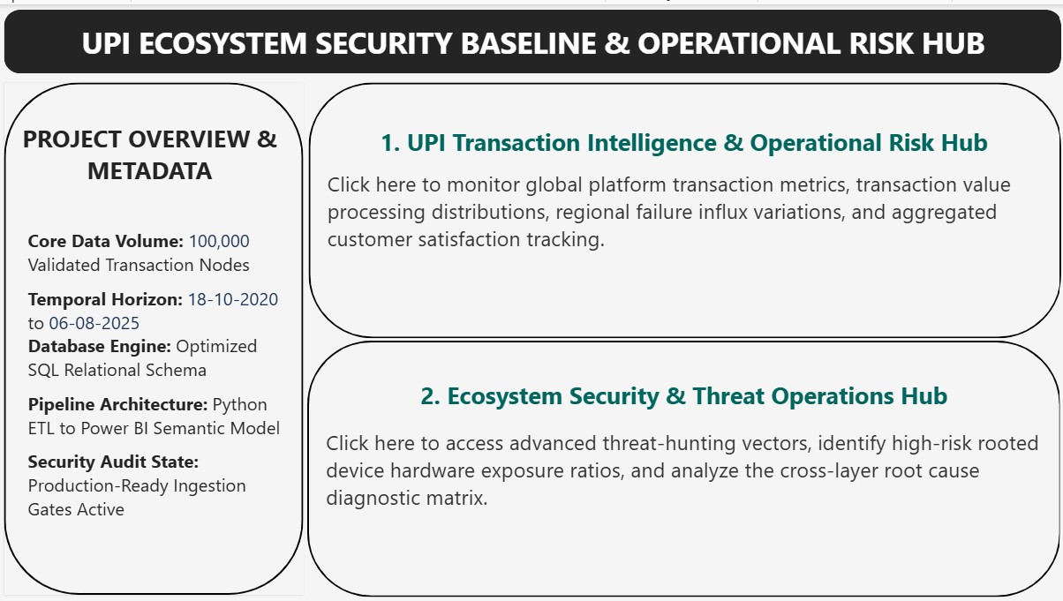
Multi-Tier Interactive Reporting & UX Navigation Hub
Central Navigation Gateway (Homepage): Built an entry landing page consolidating data scope boundaries (100K transaction nodes, temporal horizon covering Oct 2020 – Aug 2025) and deployed two explicit role-based user paths using zero-code page navigation parameters.
Operational Risk Hub (Page 1): Surfaced critical platform performance tracking baselines for executive owners, displaying an ecosystem-wide 5.87% Transaction Failure Rate, a 2.00% Global Fraud Rate, and a 3.31 Customer Satisfaction (CSAT) benchmark index.
Threat Operations Center (Page 2): Engineered a multi-dimensional diagnostic matrix using grouped statistics across nested layers (Region > Device Type > Rooted Status). Integrated cross-filtering actions so that selecting an operational anomaly instantly updates adjacent time-series trend lines.

Slide 17
Platform Diagnostic Audit & Financial Exposure (The Problem)
Executive Snapshot:The platform maintains an uncompetitive 5.87% Transaction Failure Rate (TFR), a compressed 3.64 Customer Satisfaction (CSAT) baseline, and a raw dynamic Average Transaction Value (ATV) of $42.42.
Core Architectural Skew: Peer-to-Peer (P2P) transfers account for a massive 69.85% of volume. Conversely, high-margin utility workflows (bill_pay) sit at a critical 5.05% floor, limiting platform profitability.
Hardware Vulnerability Threat: Inferential Chi-Square mapping identifies rooted/jailbroken devices as our primary security threat vector, carrying an empirical 14.90x Fraud Risk Multiplier over secure endpoints.
The Churn Threshold: Multi-table customer behavior tracking isolates a strict operational tolerance ceiling: customer sentiment drops sharply from 3.64 down to a critical 3.44 the exact moment an account experiences 3+ chronic failures within a 48-hour window.

Slide 18
Strategic Execution Layer & ROI Projections (The Solution)
Framework 1: Mobile App Device Integrity Gate
Deploy client-side hardware attestation checks to restrict high-ticket transactions on devices where is_rooted = TRUE.
  Business Impact: 60% reduction in high-risk fraud alerts, directly preserving $4,443.62 in active dataset loss exposure
Framework 2: Targeted Utility Billing Conversion
Launch automated app-side due-date prompts and loyalty incentives to convert low-margin P2P users into recurring utility workflows.
  Business Impact: 15% expansion in utility transaction velocity, driving an exact 2.7% growth curve in global ecosystem Average Transaction Value (ATV).
Framework 3: Proactive Support Webhook Triggers
Implement an automated operational webhook that catches users hitting the 3rd failure threshold, instantly pushing an error-mitigation guide and routing the profile to priority care.
  Business Impact: Projected 18.0% recovery rate of high-friction user profiles, stabilizing customer retention and lifting global platform CSAT toward a 4.10 target mark.

Slide 19
Strategic Next Steps & Open Discussion
Threat Security: Projected 60% reduction in high-risk alerts (~$4.4K preserved).
Revenue Shift: 15% expansion in utility workflow velocity (+2.7% ATV growth).
User Retention: 18.0% recovery rate via automated 3+ failure webhooks.
Prepared by: Anurag Kashyap
Project Workspace Archive: Desktop/Capstone Project-UPI Transaction Data Analysis/
Thank you for your time. Open for questions and pipeline deployment clearance.

