Slide 1
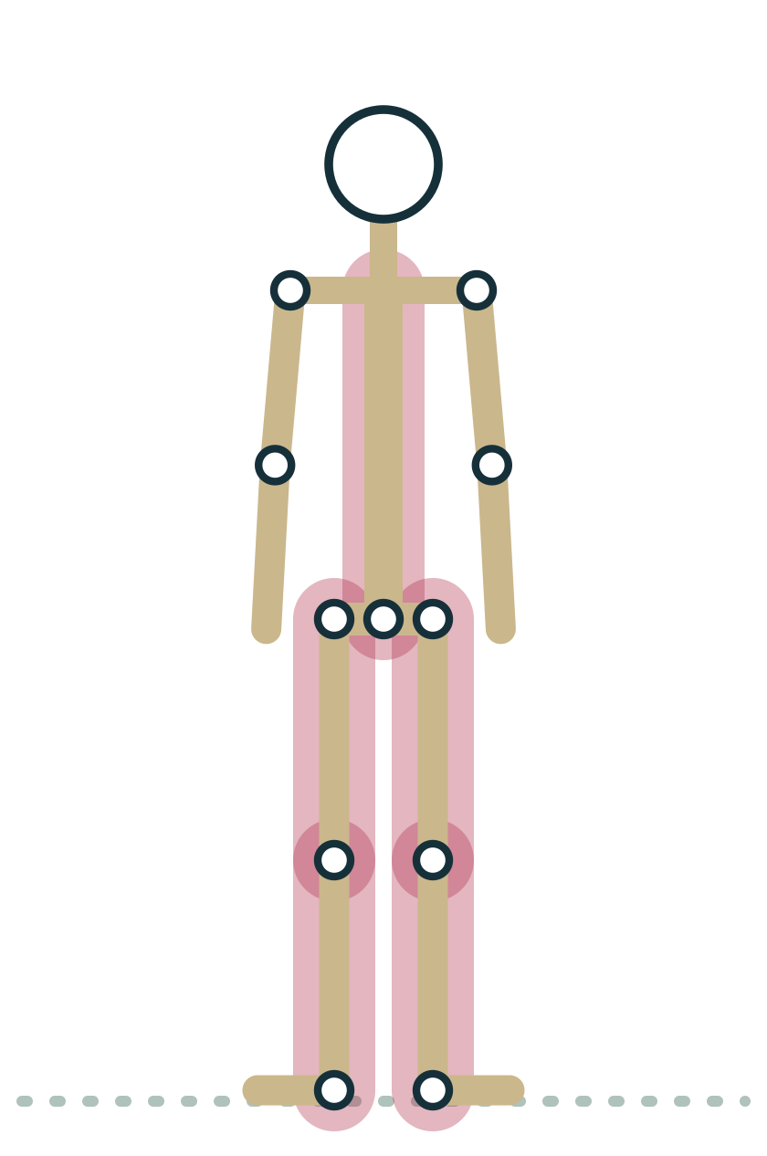
MODULE 2
The Skeleton for Yoga Teachers
Bones are the frame every pose is built on, and the landmarks you can see are how a teacher reads that frame in a room.
2 hours · 5 lessons · Anatomy & Physiology for Vinyasa Teachers
Anatomy on the Mat · Dr. Akash Garg, D.C.

Slide 2
MODULE 2 OBJECTIVES
By the end of this module you can
1
By the end of this module you can classify the major bones as axial or appendicular and describe five functions of bone.
LESSONS
2.1 Axial and appendicular skeleton: what bones do
2.2 Skull, spine, ribs and sternum
2.3 Shoulder girdle and upper limb, down to the weight bearing hand
2.4 Pelvis and lower limb, down to the foot as foundation
2.5 Landmarks you can see and cue: ASIS, iliac crest, greater trochanter, acromion, C7, malleoli
2
By the end of this module you can name the regions of the spine, their vertebra counts and their curves, and explain why twists come mainly from the thoracic spine.
3
By the end of this module you can identify the bones of the shoulder girdle, arm and hand, and give options for students with wrist discomfort in weight-bearing poses.
4
By the end of this module you can describe the pelvis, femur, lower leg and foot, including the foot tripod, and explain why hip range varies between people.
5
By the end of this module you can locate the ASIS, iliac crest, greater trochanter, acromion, C7 and malleoli on yourself and use them in clear, non-forcing cues.
Anatomy on the Mat · Dr. Akash Garg, D.C.
2

Slide 3
2.1
LESSON 2.1 · 20 MIN
Axial and appendicular skeleton: what bones do
See it
Feel it
Cue it
Check it
Anatomy on the Mat · Dr. Akash Garg, D.C.
3

Slide 4
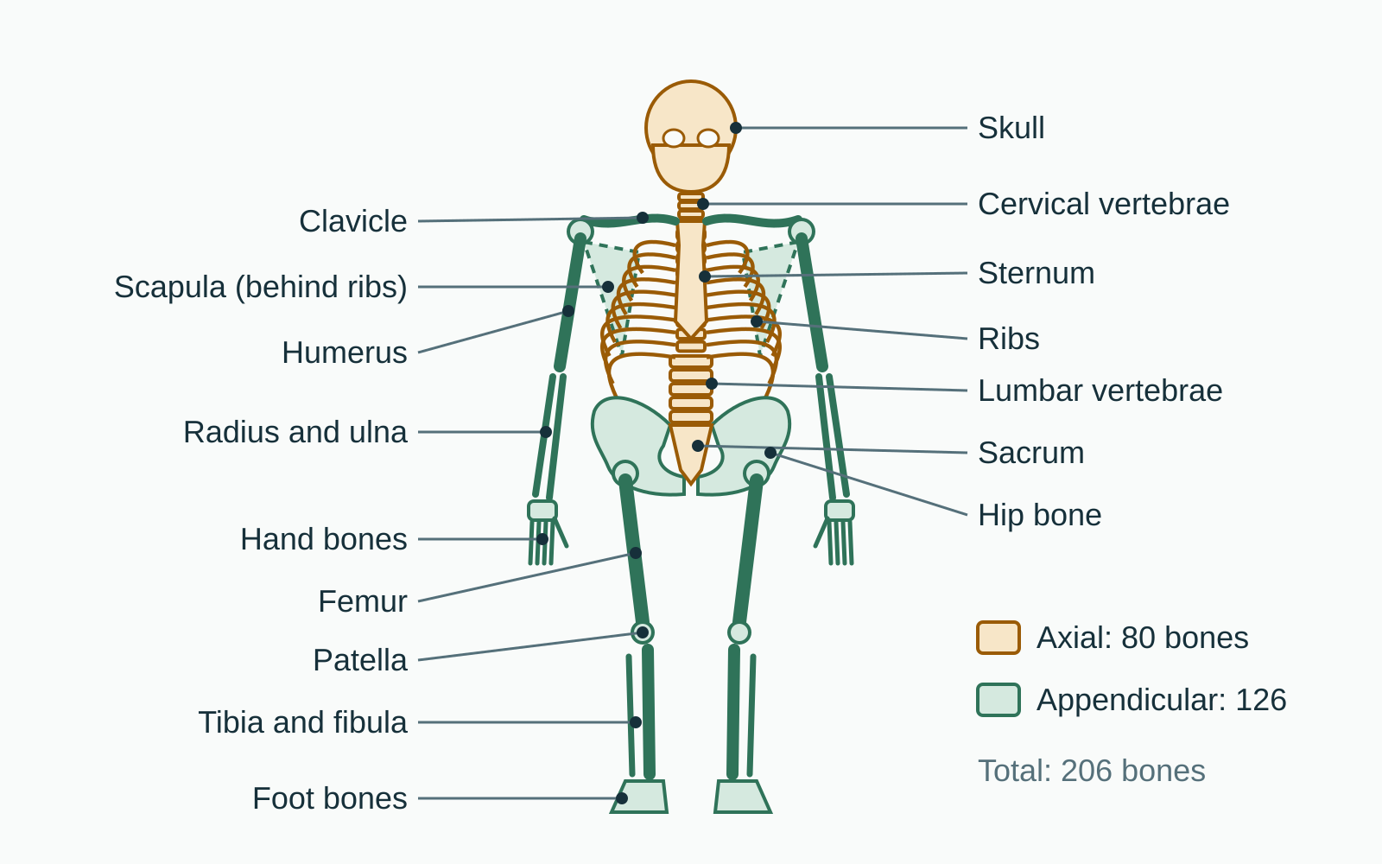
LESSON 2.1
Bones in the adult skeleton
206
About 80 form the axial skeleton down the midline. The other 126 form the appendicular skeleton: the limbs and the girdles that attach them.
Plate 1 Axial skeleton in amber, appendicular in green
Anatomy on the Mat · Dr. Akash Garg, D.C.
4

Slide 5
LESSON 2.1
Two halves of one skeleton
Axial (about 80)
Appendicular (about 126)
Skull, spine, ribs, sternum
Protects brain, cord, heart, lungs
Built mainly for stability
Home of breath and posture
Shoulder and pelvic girdles
Arms, hands, legs, feet
Built mainly for movement
Reaches, grips, steps, balances
Anatomy on the Mat · Dr. Akash Garg, D.C.
5

Slide 6
LESSON 2.1
What bones actually do
Support: a frame to stand and hold poses
Protect: skull, spine and ribs guard vital organs
Move: bones are levers that muscles pull on
Store and make: minerals, fat and blood cells
Plate 2 Mountain: bones stacked to carry load with little effort
Anatomy on the Mat · Dr. Akash Garg, D.C.
6

Slide 7
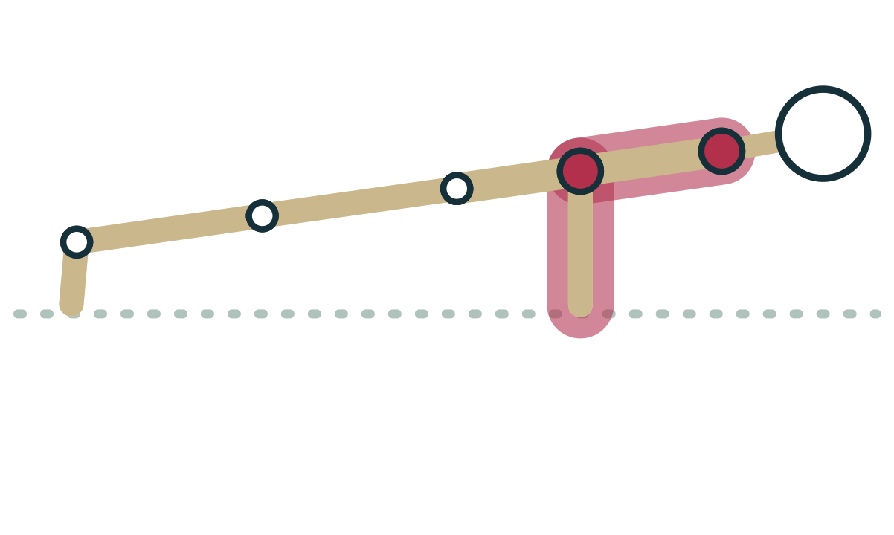
LESSON 2.1
Bone is living tissue that answers to load
Bone cells constantly break down and rebuild bone
Regular load tends to keep bone stronger
Yoga's effect on bone density is still uncertain
Osteoporosis: adapt poses, avoid forceful loaded flexion
Plate 3 Weight-bearing on the arms loads the arm bones
Anatomy on the Mat · Dr. Akash Garg, D.C.
7

Slide 8
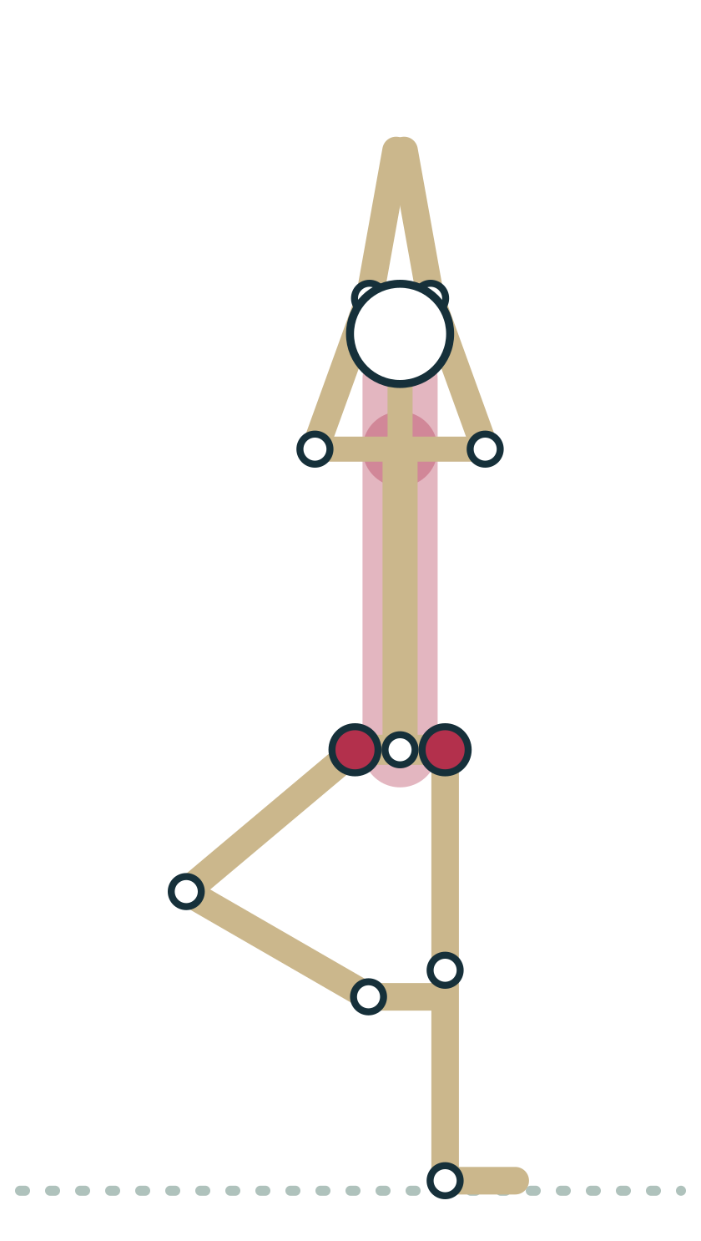
LESSON 2.1 · FEEL IT
Feel it: axial and appendicular in Tree
1
Stand in Mountain. Tap your skull, breastbone and ribs: that is your axial core.
2
Shift into Tree. Notice the standing leg, a stack of appendicular bones, carrying you.
3
Raise your arms. Feel the shoulder blades glide on the ribs as the girdle moves.
4
Breathe in. Feel the axial ribcage widen while the limbs stay steady.
Plate 4 Tree: an axial column balanced on one leg
Anatomy on the Mat · Dr. Akash Garg, D.C.
8

Slide 9
LESSON 2.1 · CHECK IT
Which bone belongs to the appendicular skeleton?
Sternum
Pause the video and choose before you move on.
A
Scapula
B
Sacrum
C
Anatomy on the Mat · Dr. Akash Garg, D.C.
9

Slide 10
LESSON 2.1 · CHECK IT
Answer
Scapula
B
The scapula is part of the shoulder girdle, which connects the arm to the axial skeleton.
Question: Which bone belongs to the appendicular skeleton?
Anatomy on the Mat · Dr. Akash Garg, D.C.
10

Slide 11
2.2
LESSON 2.2 · 25 MIN
Skull, spine, ribs and sternum
See it
Feel it
Cue it
Check it
Anatomy on the Mat · Dr. Akash Garg, D.C.
11

Slide 12
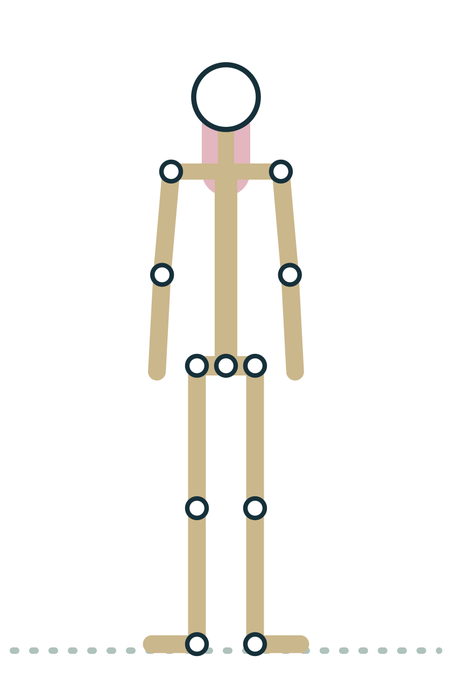
LESSON 2.2
The skull balances on the top of the spine
Cranium protects the brain; facial bones frame the face
Occipital bone rests on C1, the atlas
The head weighs roughly 4.5 to 5 kg
C1 and C2 allow much of head turning
Plate 5 Mountain: the head balanced over the spine
Anatomy on the Mat · Dr. Akash Garg, D.C.
12

Slide 13
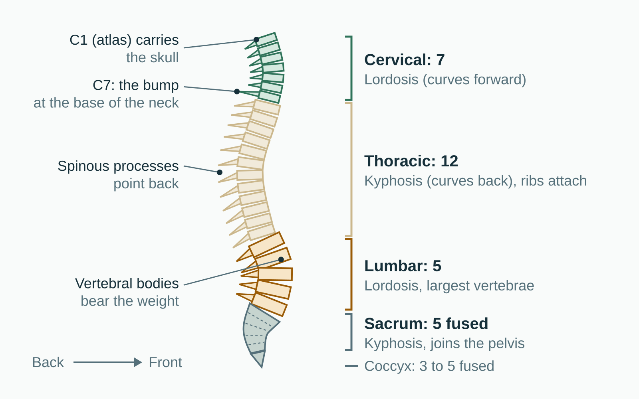
LESSON 2.2
Cervical, thoracic and lumbar vertebrae
7 / 12 / 5
Below the lumbar spine sit the sacrum, five fused vertebrae, and the coccyx, three to five small fused bones. Seen from the side, the column makes four gentle curves.
Plate 6 Side view of the vertebral column: regions and curves
Anatomy on the Mat · Dr. Akash Garg, D.C.
13

Slide 14
LESSON 2.2
Each region moves in its own way
Cervical
Thoracic
Lumbar
Small, very mobile vertebrae
Nods, turns and tilts the head
Keep heavy load off it
Ribs attach here
Rotates well, extends less
Most of a twist lives here
Largest, strongest vertebrae
Bends forward and back easily
Little rotation per segment
Anatomy on the Mat · Dr. Akash Garg, D.C.
14

Slide 15
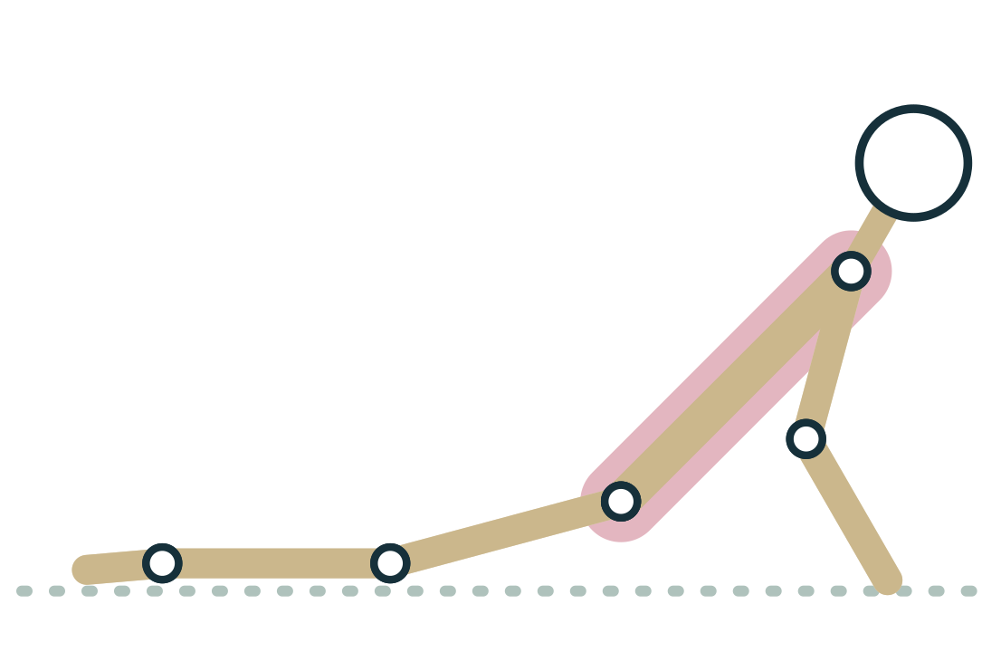
LESSON 2.2
Ribs and sternum: a cage that moves
12 pairs of ribs join the thoracic vertebrae
Pairs 1 to 7 attach directly to the sternum
Pairs 8 to 10 join by shared cartilage; 11 and 12 float
Cartilage lets the cage expand with each breath
Plate 7 Cobra: the chest opens as the thoracic spine extends
Anatomy on the Mat · Dr. Akash Garg, D.C.
15

Slide 16
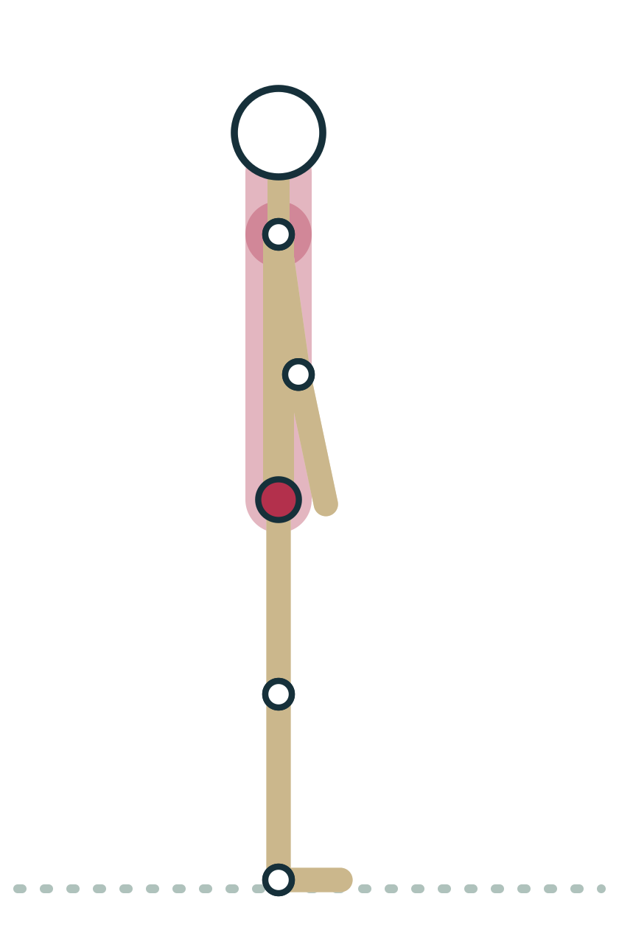
LESSON 2.2 · FEEL IT
Feel it: find your curves and your ribs
1
Stand side on to a wall, heels, sacrum and upper back touching it.
2
Slide a hand behind your low back and neck: feel the two forward curves.
3
Place hands on your side ribs and breathe in slowly: feel them widen.
4
Find the notch at the top of your sternum, then the xiphoid at the bottom.
Plate 8 Mountain from the side: the spine's natural curves
Anatomy on the Mat · Dr. Akash Garg, D.C.
16

Slide 17
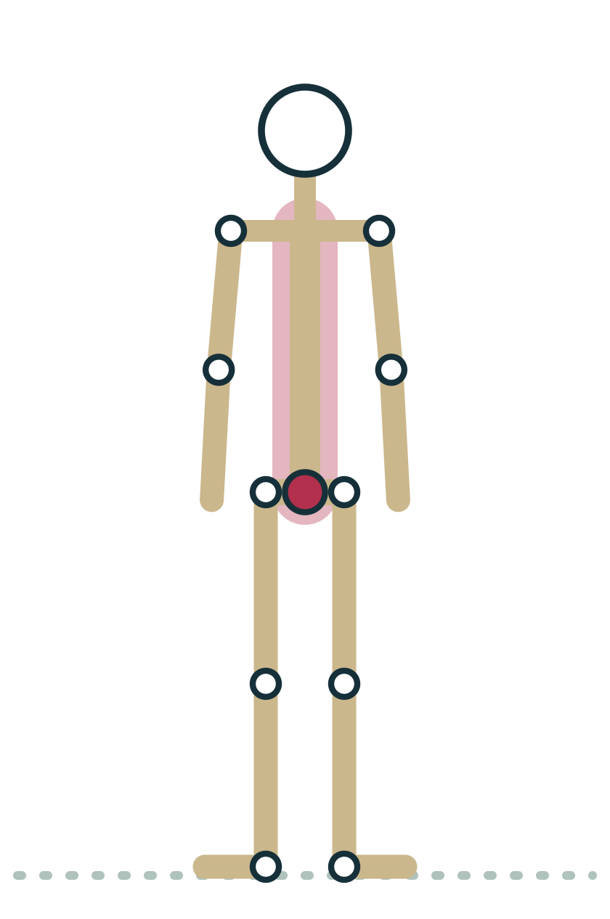
LESSON 2.2 · CUE IT
Twist from the ribcage
“Lengthen up through the crown as you breathe in. As you breathe out, turn from the ribs and let the belly follow.”
Why it works The thoracic spine is built to rotate while the lumbar spine allows only a few degrees per segment, so the turn should begin higher up.
Plate 9 Rotation comes mainly from the thoracic spine
Anatomy on the Mat · Dr. Akash Garg, D.C.
17

Slide 18
LESSON 2.2 · CHECK IT
A student forces a deep seated twist by levering with the arms. Which region is least built for rotation?
Cervical spine
Pause the video and choose before you move on.
A
Thoracic spine
B
Lumbar spine
C
Anatomy on the Mat · Dr. Akash Garg, D.C.
18

Slide 19
LESSON 2.2 · CHECK IT
Answer
Lumbar spine
C
Lumbar vertebrae allow only a few degrees of rotation each, so forced twisting tends to load the low back.
Question: A student forces a deep seated twist by levering with the arms. Which region is least built for rotation?
Anatomy on the Mat · Dr. Akash Garg, D.C.
19

Slide 20
2.3
LESSON 2.3 · 25 MIN
Shoulder girdle and upper limb, down to the weight bearing hand
See it
Feel it
Cue it
Check it
Anatomy on the Mat · Dr. Akash Garg, D.C.
20

Slide 21
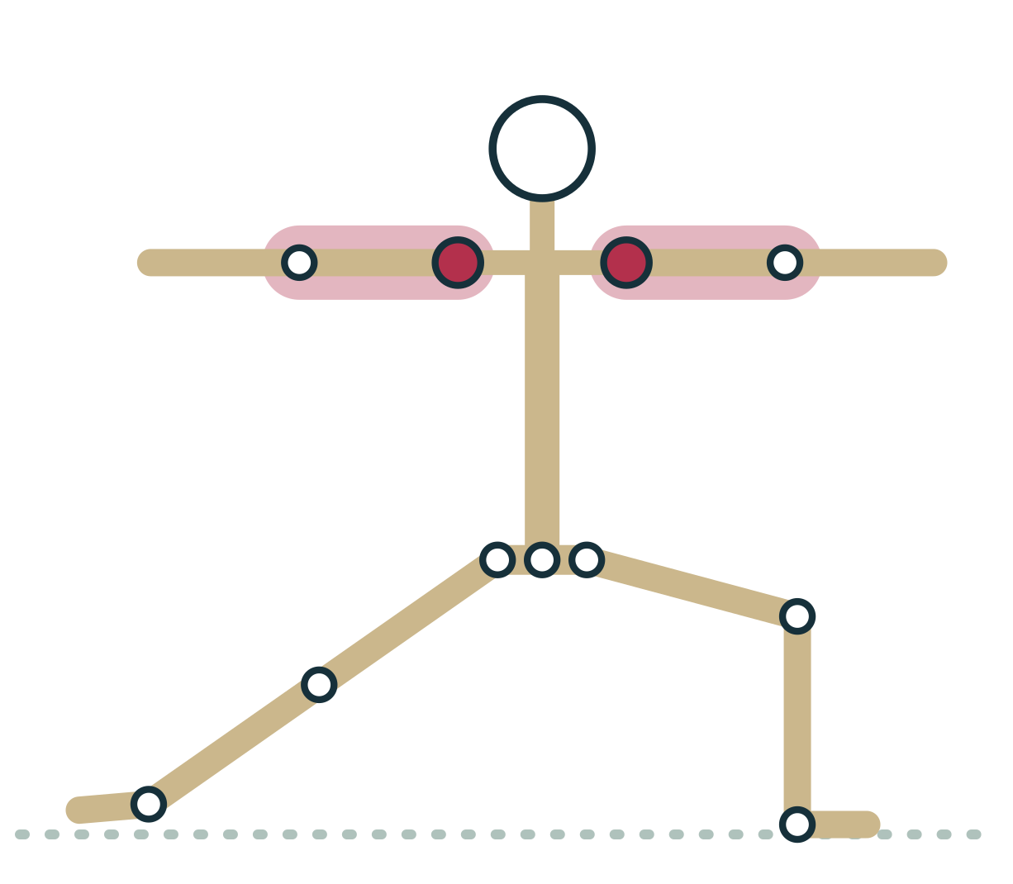
LESSON 2.3
The shoulder girdle floats on the ribcage
Two bones per side: clavicle and scapula
Only bony link to the trunk: the sternoclavicular joint
Scapula glides on the back of the ribs
Shallow socket: mobile, but depends on muscle
Plate 10 Warrior II: arms carried by the shoulder girdle
Anatomy on the Mat · Dr. Akash Garg, D.C.
21

Slide 22
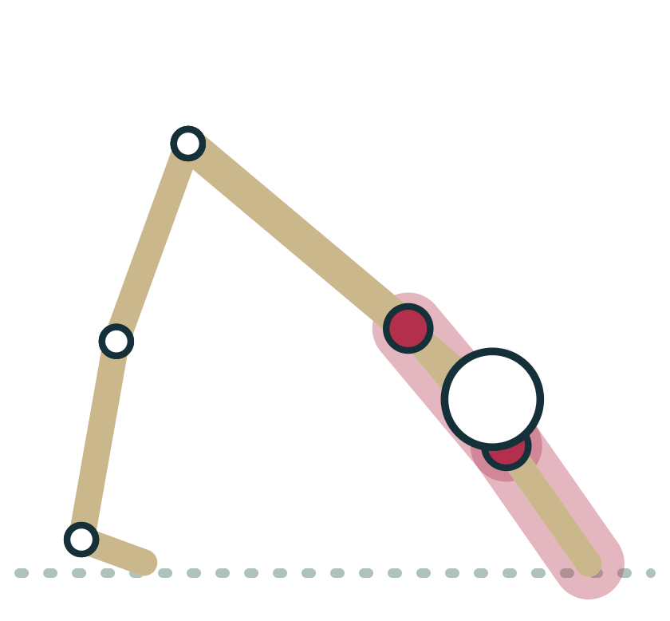
LESSON 2.3
From shoulder to wrist
Humerus: the single upper arm bone
Radius on the thumb side, ulna on the little finger side
Radius turns around the ulna to rotate the palm
Olecranon of the ulna is the point of the elbow
Plate 11 Down Dog: humerus, radius and ulna in a line of load
Anatomy on the Mat · Dr. Akash Garg, D.C.
22

Slide 23
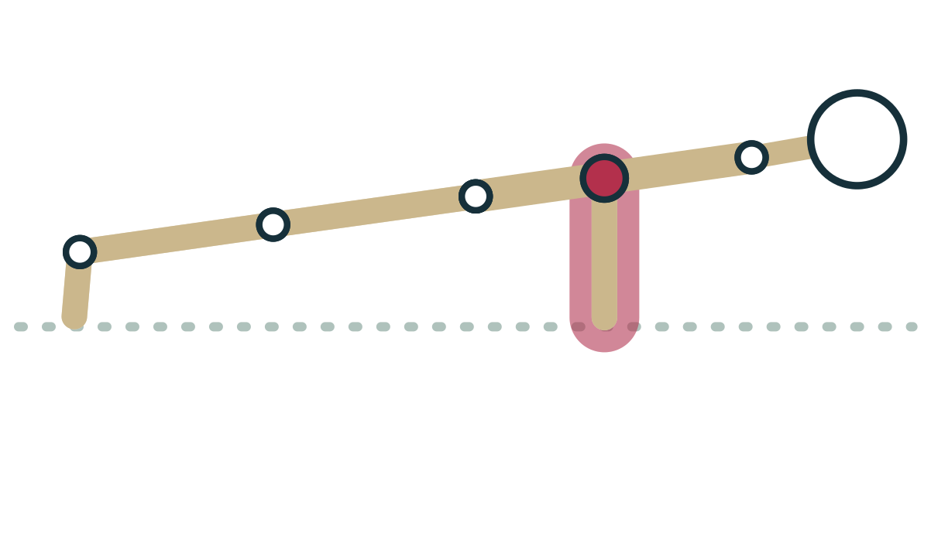
LESSON 2.3
Bones in each wrist and hand
27
8 carpals in two rows, 5 metacarpals in the palm and 14 phalanges in the fingers. The hand was built for grip and fine skill, not for carrying body weight.
Plate 12 Chaturanga: the hands carry a large share of body weight
Anatomy on the Mat · Dr. Akash Garg, D.C.
23

Slide 24
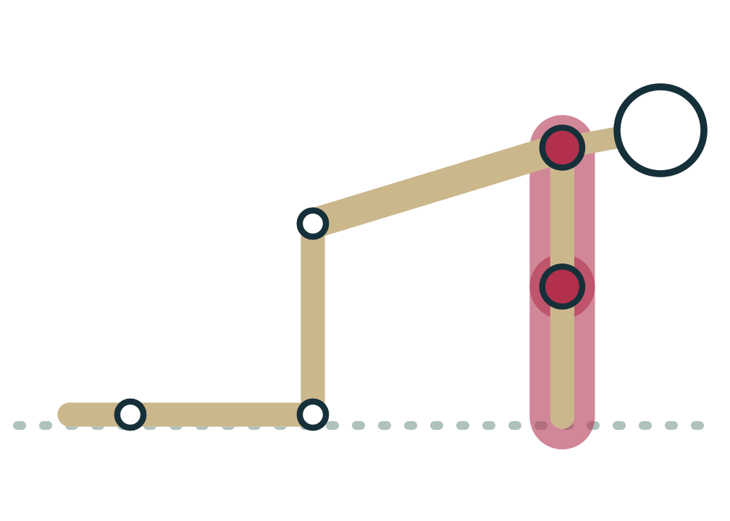
LESSON 2.3 · FEEL IT
Feel it: map the weight-bearing hand
1
Come to tabletop, wrists under shoulders, fingers spread comfortably wide.
2
Rock onto the heels of your hands, then onto your fingertips. Notice the difference.
3
Press evenly through the knuckle at the base of each finger, especially index and thumb.
4
Feel the centre of the palm lift slightly, like a gentle dome.
Plate 13 Tabletop: learning to share weight across the hand
Anatomy on the Mat · Dr. Akash Garg, D.C.
24

Slide 25
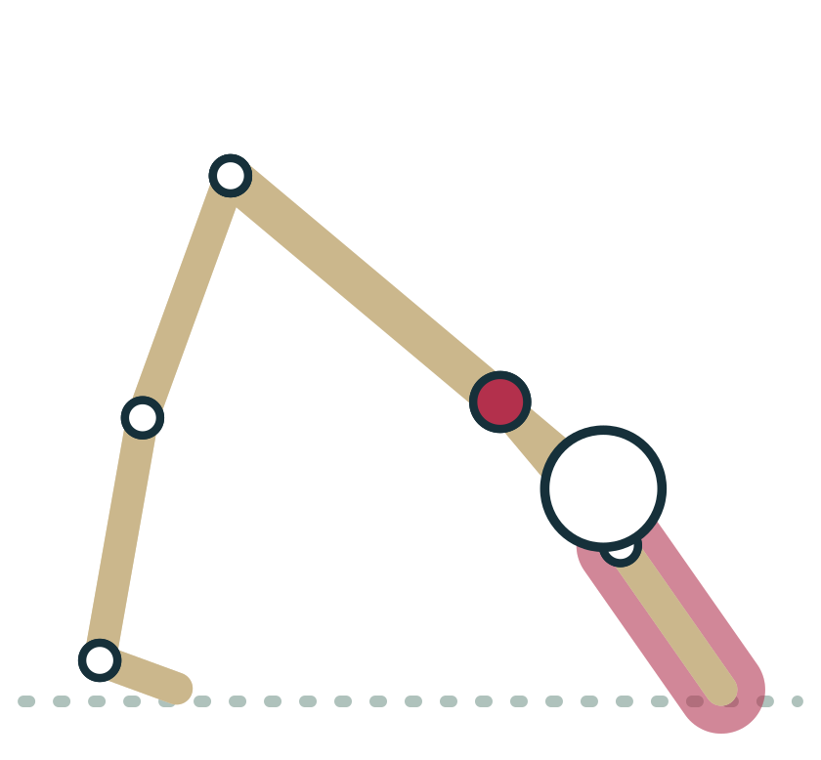
LESSON 2.3 · CUE IT
Share the load through the hand
“Spread your fingers and press through the base of your index finger and thumb, so the wrist is not carrying you alone.”
Why it works The wrist is extended near its end range in Plank and Down Dog; spreading load toward the knuckles and fingers reduces pressure on the heel of the hand.
Plate 14 Down Dog: rooting the hands
Anatomy on the Mat · Dr. Akash Garg, D.C.
25

Slide 26
LESSON 2.3 · CHECK IT
Which is the only joint that connects the upper limb bones to the axial skeleton?
Glenohumeral joint
Pause the video and choose before you move on.
A
Sternoclavicular joint
B
Acromioclavicular joint
C
Anatomy on the Mat · Dr. Akash Garg, D.C.
26

Slide 27
LESSON 2.3 · CHECK IT
Answer
Sternoclavicular joint
B
The clavicle meets the sternum at the sternoclavicular joint; everything else attaching the arm to the trunk is muscle.
Question: Which is the only joint that connects the upper limb bones to the axial skeleton?
Anatomy on the Mat · Dr. Akash Garg, D.C.
27

Slide 28
2.4
LESSON 2.4 · 25 MIN
Pelvis and lower limb, down to the foot as foundation
See it
Feel it
Cue it
Check it
Anatomy on the Mat · Dr. Akash Garg, D.C.
28

Slide 29
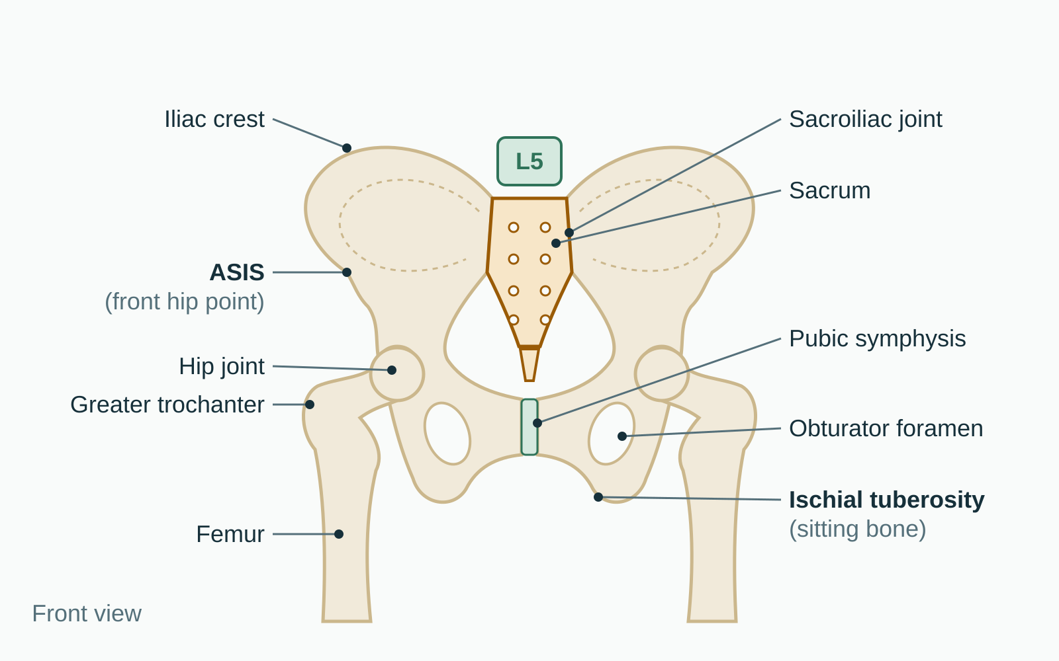
LESSON 2.4
The pelvis: two hip bones and the sacrum
Each hip bone is ilium, ischium and pubis fused
They meet the sacrum at the sacroiliac joints
In front they meet at the pubic symphysis
The acetabulum is the deep hip socket
Plate 15 Pelvis from the front, with the key landmarks
Anatomy on the Mat · Dr. Akash Garg, D.C.
29

Slide 30
LESSON 2.4
Shoulder girdle and pelvic girdle
Shoulder girdle
Pelvic girdle
Light, open, floats on ribs
Shallow socket for the humerus
Built for reach and range
Heavy ring joined to the sacrum
Deep socket for the femur
Built for carrying weight
Anatomy on the Mat · Dr. Akash Garg, D.C.
30

Slide 31
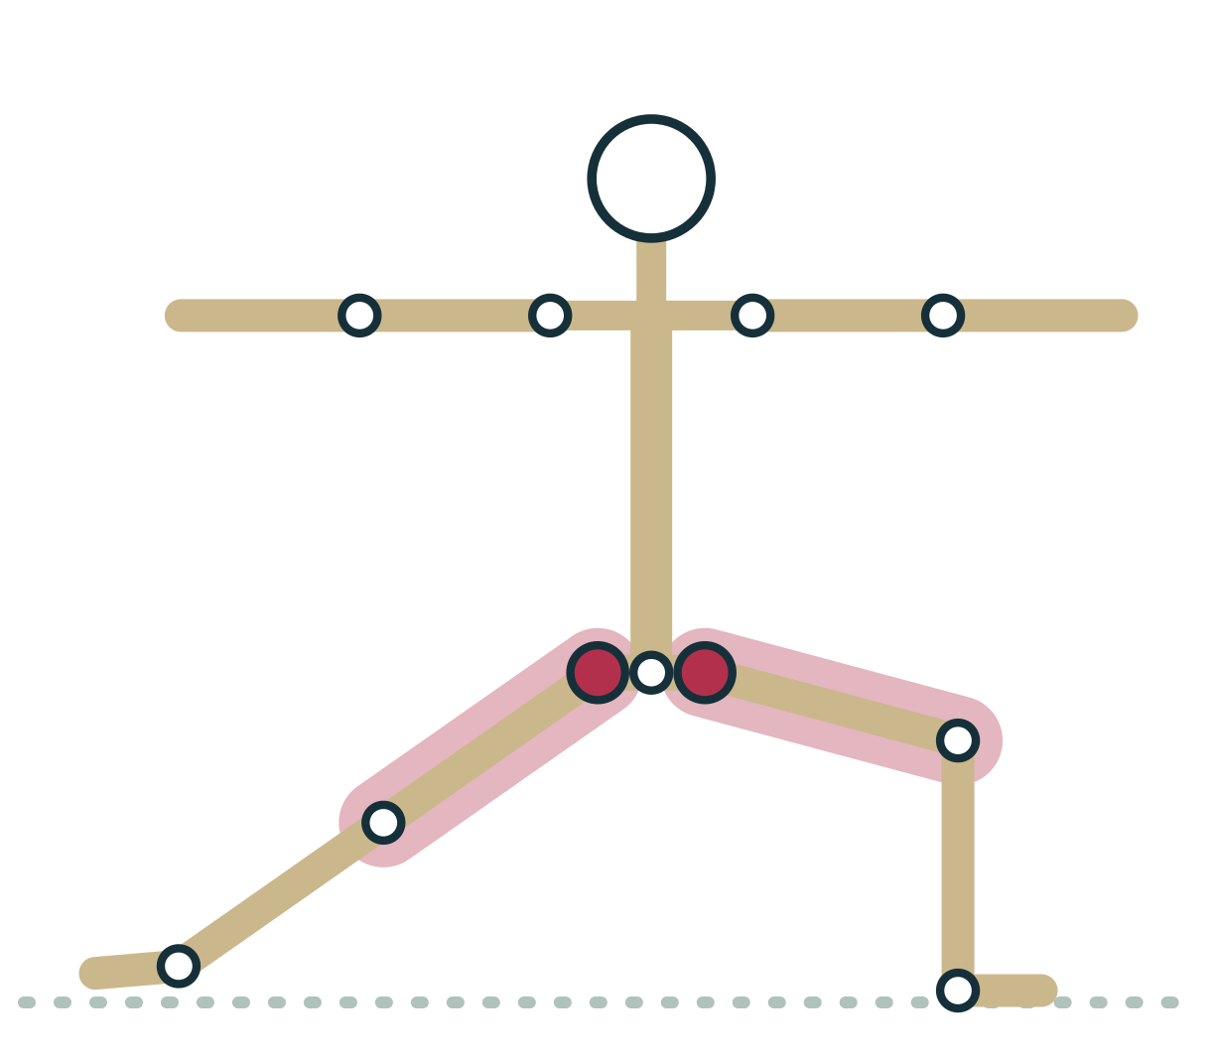
LESSON 2.4
The femur: longest bone, angled neck
Femoral head sits deep in the acetabulum
Neck angles out to the greater trochanter
Shaft slopes inward toward the knee
Bone shapes vary, so hip range varies
Plate 16 Warrior II: the femurs rotate outward in the hip sockets
Anatomy on the Mat · Dr. Akash Garg, D.C.
31

Slide 32
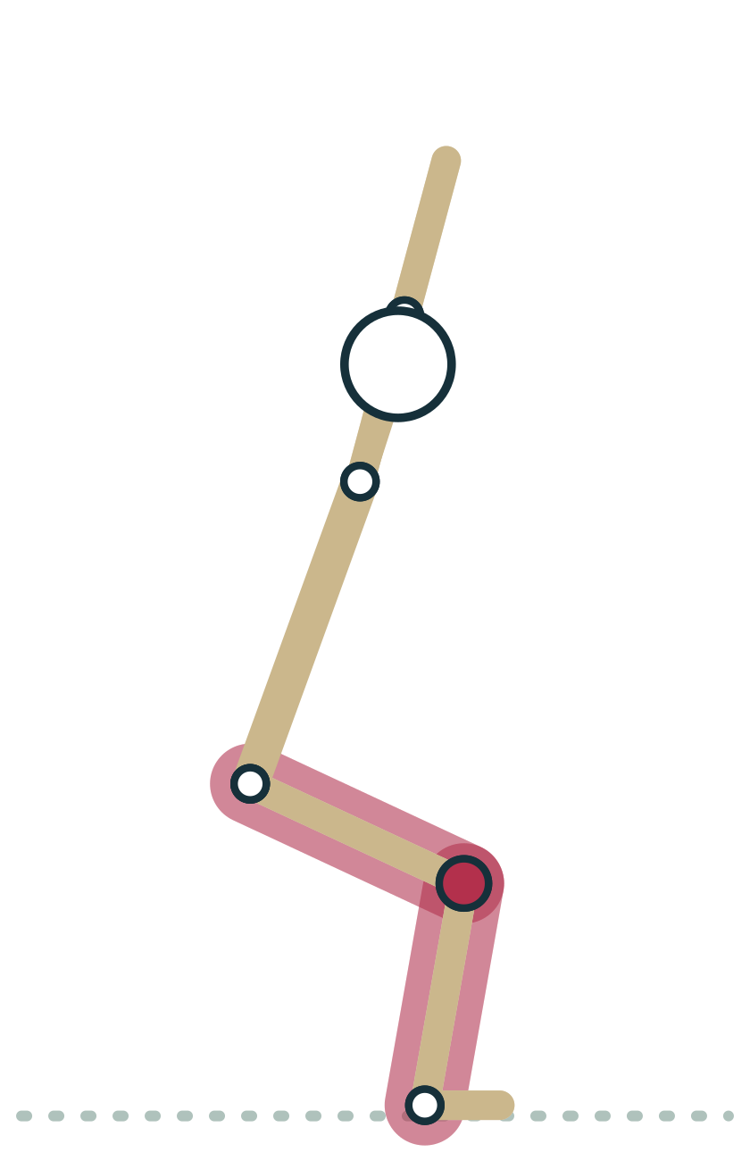
LESSON 2.4
Knee and lower leg: tibia carries, fibula steadies
Femur meets tibia at the knee; patella glides in front
Tibia carries most of the body's weight
Fibula is slender, mainly for muscle attachment
Malleoli: tibia inside, fibula outside the ankle
Plate 17 Chair: knees track over the feet
Anatomy on the Mat · Dr. Akash Garg, D.C.
32

Slide 33
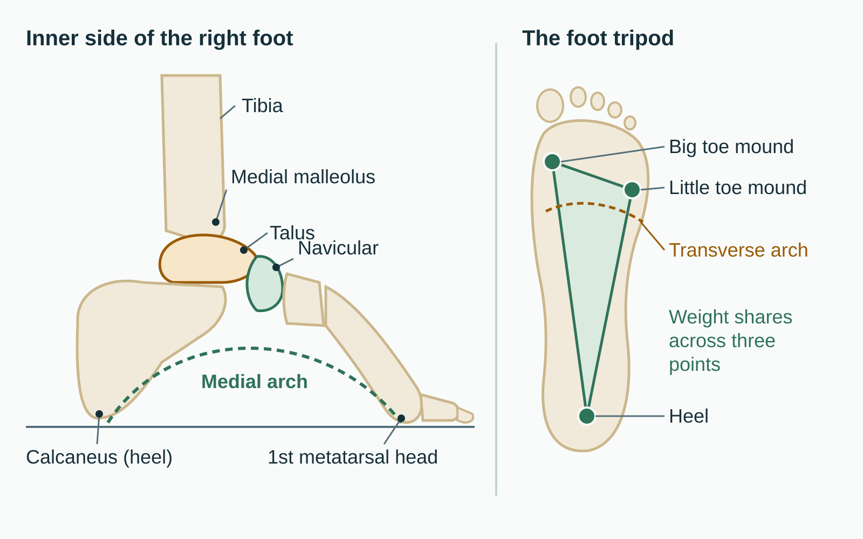
LESSON 2.4 · FEEL IT
Feel it: build the foot tripod
1
Stand in Mountain and lift all ten toes.
2
Feel three points: big toe mound, little toe mound and centre of the heel.
3
Keep those points grounded as you lower the toes softly.
4
Notice the inner arch gently lift without gripping the toes.
Plate 18 Foot bones, the medial arch and the three-point tripod
Anatomy on the Mat · Dr. Akash Garg, D.C.
33

Slide 34
LESSON 2.4 · CHECK IT
Which bone forms the outer ankle bone, the lateral malleolus?
Tibia
Pause the video and choose before you move on.
A
Fibula
B
Talus
C
Anatomy on the Mat · Dr. Akash Garg, D.C.
34

Slide 35
LESSON 2.4 · CHECK IT
Answer
Fibula
B
The lateral malleolus is the lower end of the fibula; the medial malleolus is the lower end of the tibia.
Question: Which bone forms the outer ankle bone, the lateral malleolus?
Anatomy on the Mat · Dr. Akash Garg, D.C.
35

Slide 36
2.5
LESSON 2.5 · 25 MIN
Landmarks you can see and cue: ASIS, iliac crest, greater trochanter, acromion, C7, malleoli
See it
Feel it
Cue it
Check it
Anatomy on the Mat · Dr. Akash Garg, D.C.
36

Slide 37
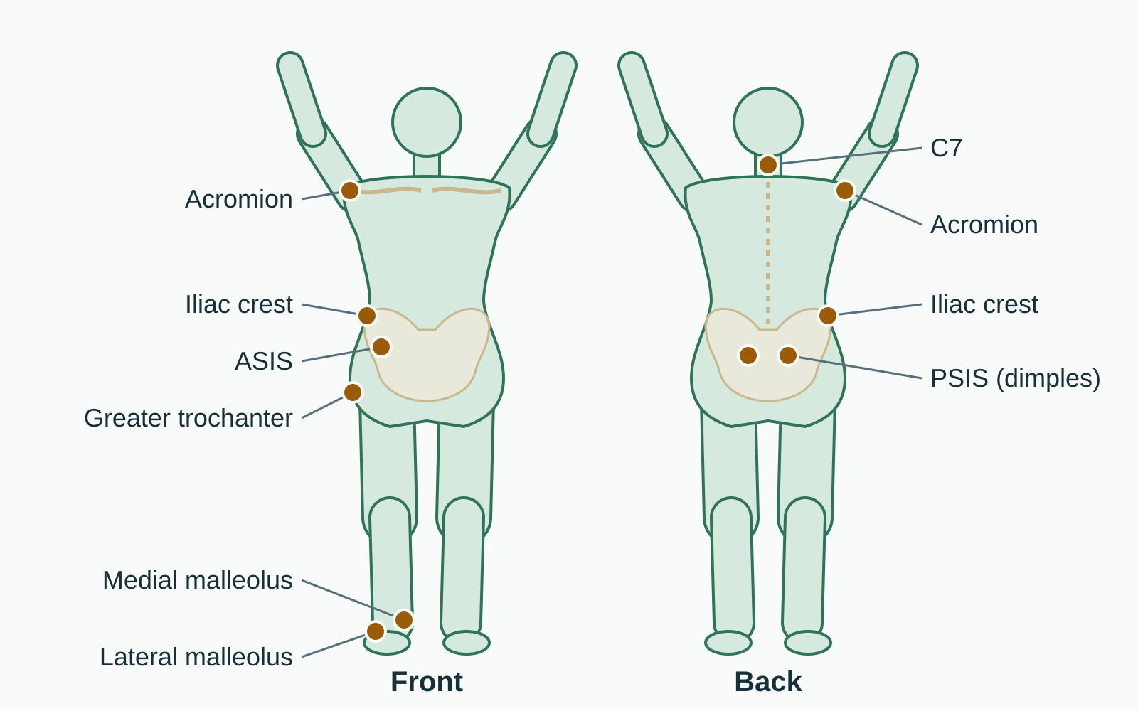
LESSON 2.5
Landmarks are bones you can see and feel
Palpable bony points lie just under the skin
They let you read alignment from across the room
Students can find them on themselves
Use them for reference, not to force symmetry
Plate 19 Six key landmarks from the front and back
Anatomy on the Mat · Dr. Akash Garg, D.C.
37

Slide 38
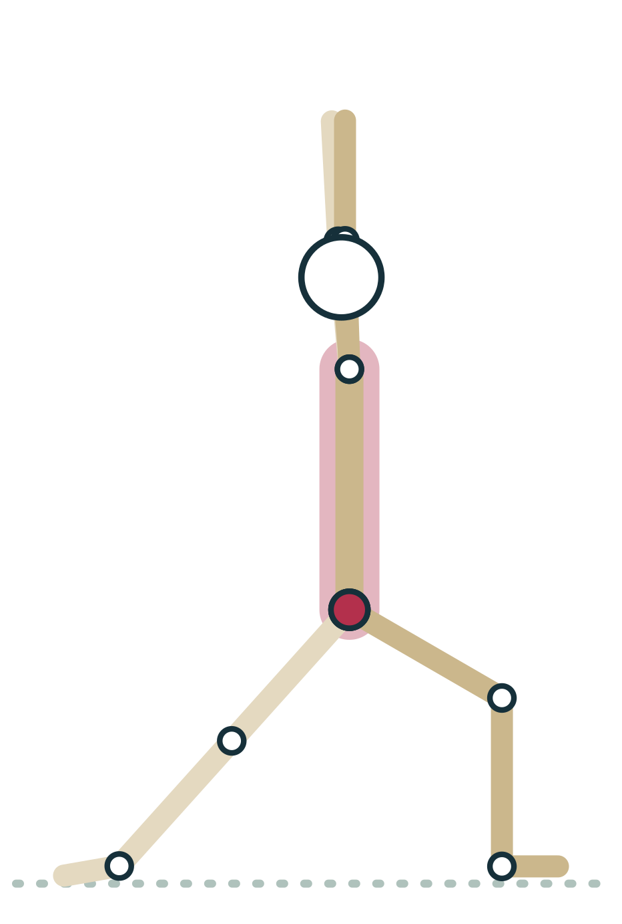
LESSON 2.5 · CUE IT
ASIS: the front hip points
“Place your hands on your front hip points and let them turn toward the front of the mat, as far as your back hip comfortably allows.”
Why it works The ASIS is the forward tip of the iliac crest; watching the two points shows how the pelvis is turned, and many hips cannot square fully in Warrior I.
Plate 20 Warrior I: the ASIS points show where the pelvis faces
Anatomy on the Mat · Dr. Akash Garg, D.C.
38

Slide 39
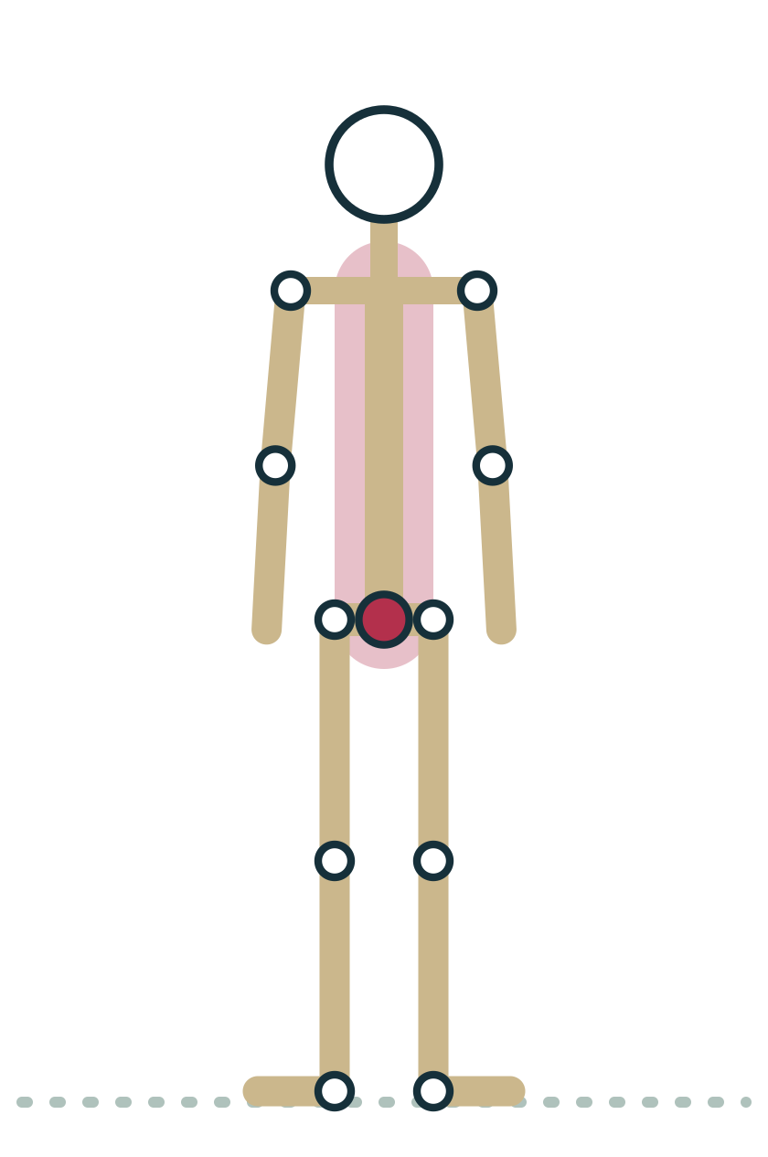
LESSON 2.5
Level of a line across the tops of the iliac crests
L4
Hands on hips rest on the iliac crests. A line joining their highest points crosses the spine at about the fourth lumbar vertebra.
Plate 21 Mountain: iliac crests level at the waist
Anatomy on the Mat · Dr. Akash Garg, D.C.
39

Slide 40
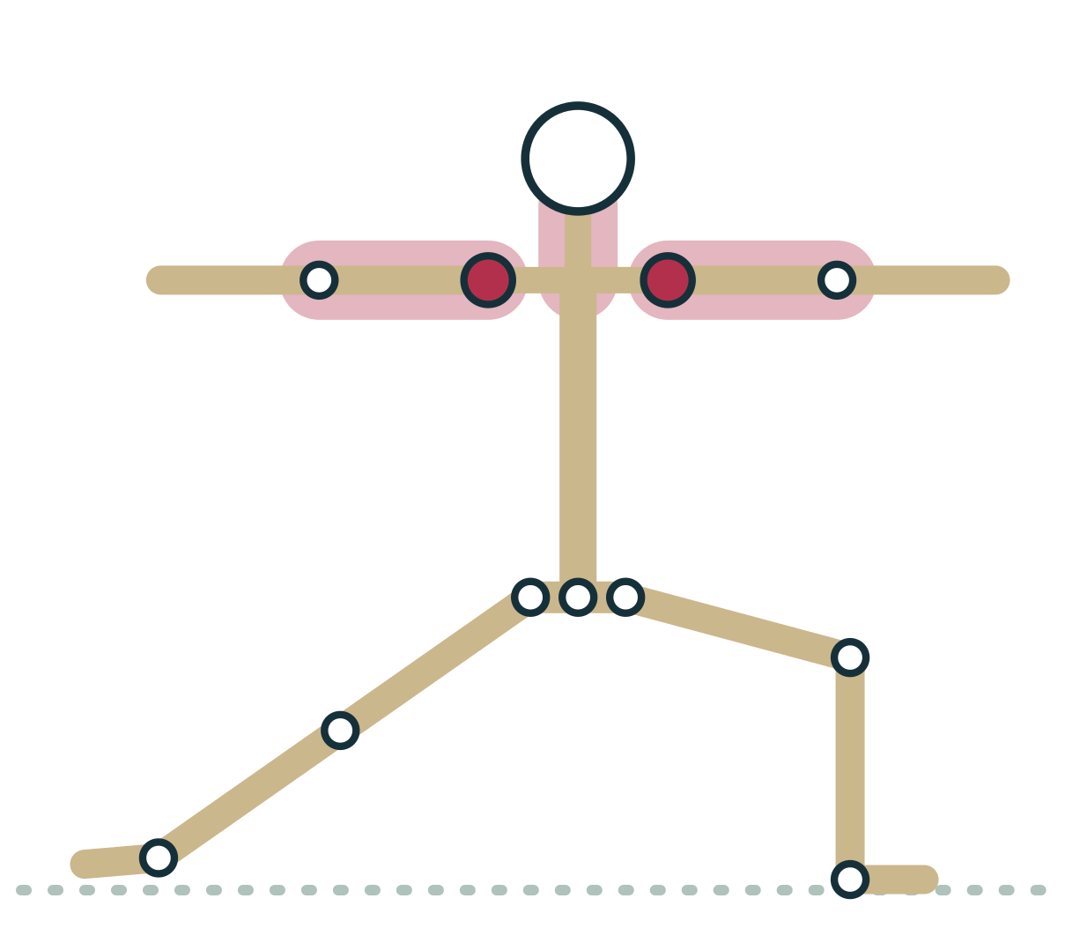
LESSON 2.5 · CUE IT
Acromion and C7: shoulders and neck
“Let the tops of your shoulders widen away from your ears, and keep the bump at the base of your neck soft and long.”
Why it works The acromion is the bony top of the shoulder; C7 has the most prominent spinous process at the base of the neck, so both show how the shoulders and head are carried.
Plate 22 Warrior II: acromions level and away from the ears
Anatomy on the Mat · Dr. Akash Garg, D.C.
40

Slide 41
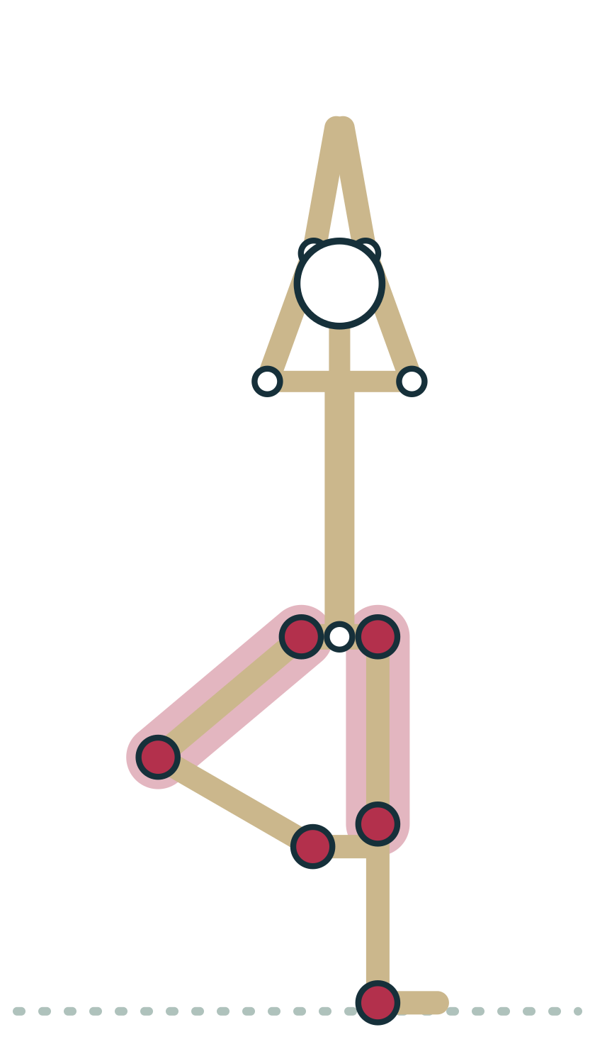
LESSON 2.5
Greater trochanter and malleoli
Greater trochanter: bony bump on the outer hip
It moves when the thigh rotates
Medial malleolus (tibia) sits higher than lateral (fibula)
In Tree, place the foot above or below the knee
Plate 23 Tree: hips, knee and ankle as reference points
Anatomy on the Mat · Dr. Akash Garg, D.C.
41

Slide 42
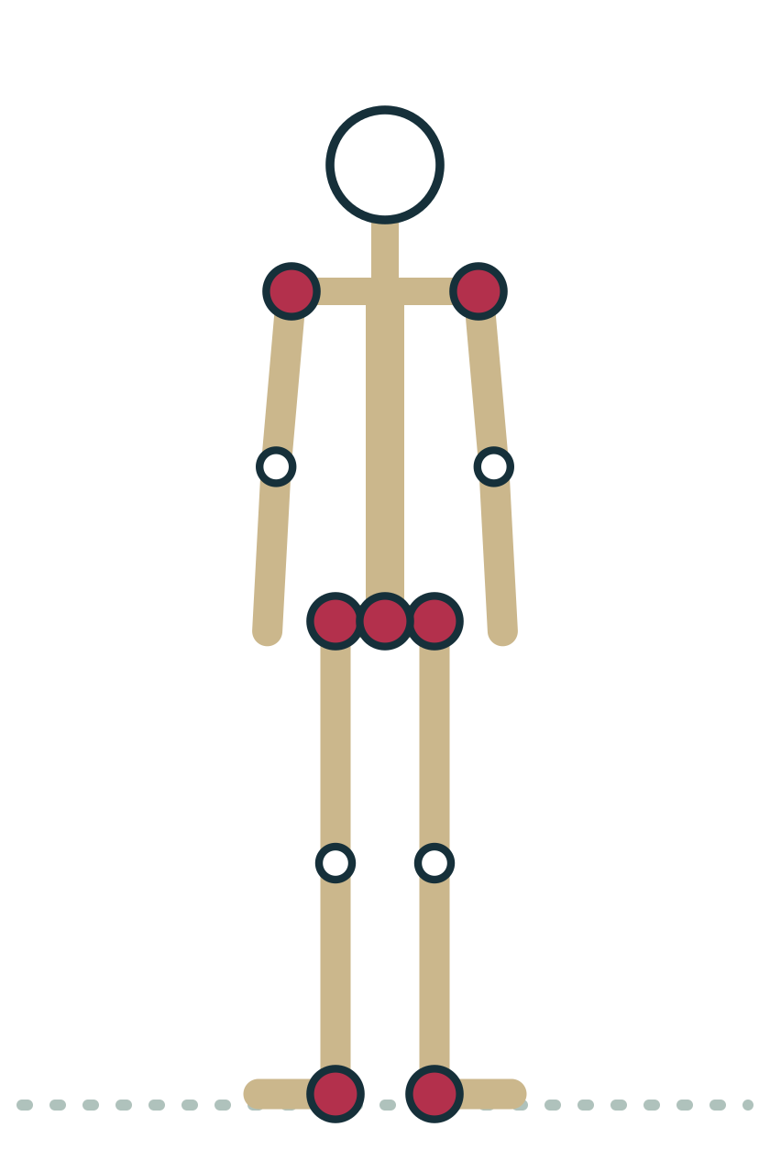
LESSON 2.5 · FEEL IT
Feel it: a landmark tour on yourself
1
Hands on hips: find the iliac crests, then slide forward to the ASIS points.
2
Thumbs back: feel for the PSIS dimples beside the sacrum.
3
Find the greater trochanter and turn the foot in and out to feel it move.
4
Trace the collarbone out to the acromion; find C7, then both malleoli.
Plate 24 Mountain: a full landmark tour
Anatomy on the Mat · Dr. Akash Garg, D.C.
42

Slide 43
LESSON 2.5 · CHECK IT
In Warrior I a student's back hip will not turn to face forward. What is the best response?
Press on the ASIS until the hips square
Pause the video and choose before you move on.
A
Invite the hips toward the front as far as comfortable, and offer a shorter, wider stance
B
Tell them their pelvis is misaligned
C
Anatomy on the Mat · Dr. Akash Garg, D.C.
43

Slide 44
LESSON 2.5 · CHECK IT
Answer
Invite the hips toward the front as far as comfortable, and offer a shorter, wider stance
B
Bone shape and back hip range limit how square the pelvis can get, so invite and offer options rather than force or diagnose.
Question: In Warrior I a student's back hip will not turn to face forward. What is the best response?
Anatomy on the Mat · Dr. Akash Garg, D.C.
44

Slide 45
MODULE 2 REVIEW
Key terms
Axial skeleton | The central column of about 80 bones: skull, spine, ribs and sternum. In Mountain it is the stacked core the limbs hang from.
Appendicular skeleton | The 126 bones of the limbs and the shoulder and pelvic girdles. In Tree the standing leg is appendicular.
Vertebra | One of the bones of the spine, with a weight-bearing body in front and a protective arch behind. You feel their spinous processes as bumps when rolling down.
Lordosis | A forward curve of the spine, found in the neck and low back. It is the hollow you feel behind your low back in Mountain against a wall.
Kyphosis | A backward curve of the spine, found in the thoracic and sacral regions. It is the gentle rounding of the upper back that touches the wall.
Intervertebral disc | A pad of cartilage between two vertebral bodies with a tough outer ring and a gel-like centre. It shares load as you bend in Forward Fold.
Atlas and axis (C1, C2) | The top two cervical vertebrae. The skull nods on the atlas and turns as the atlas pivots on the axis, as when you look over your shoulder in Warrior II.
Sternum | The breastbone, made of the manubrium, body and xiphoid process. It lifts gently as the chest opens in Cobra.
Clavicle | The collarbone, joining the sternum to the scapula. It lifts slightly when you reach the arms overhead in Warrior I.
Scapula | The shoulder blade, which glides over the back of the ribs. It slides wide across the back in Plank.
Radius and ulna | The two forearm bones: radius on the thumb side, ulna on the little finger side. The radius crosses the ulna when the palms press flat in Down Dog.
Anatomy on the Mat · Dr. Akash Garg, D.C.
45

Slide 46
MODULE 2 REVIEW
Key terms (continued)
Carpals | The eight small bones of the wrist in two rows. They carry weight through the heel of the hand in Plank.
Ilium, ischium and pubis | The three bones that fuse to form each hip bone. You sit on the ischium's sitting bones in Easy Pose.
Acetabulum | The deep cup-shaped hip socket that holds the head of the femur. The femur rotates within it in Warrior II.
Femur | The thighbone, the longest and strongest bone. Its angled neck and head shape help set how far a student can go in Lotus.
Patella | The kneecap, a sesamoid bone inside the quadriceps tendon. It lifts as you engage the thighs in Mountain.
Tibia and fibula | The lower leg bones: the tibia carries most of the weight, the slender fibula mostly anchors muscles. The tibia stacks over the ankle in Chair.
Foot tripod | The three grounding points of the foot: big toe mound, little toe mound and heel. Rooting all three steadies Tree.
ASIS | Anterior superior iliac spine: the front hip point at the end of the iliac crest. Its direction shows where the pelvis faces in Warrior I.
Greater trochanter | The bony bump on the outer upper thigh, part of the femur. It rolls back as the thigh turns out in Warrior II.
Acromion | The flat bony shelf at the top of the shoulder, part of the scapula. Cue it away from the ears in Warrior II.
Malleoli | The ankle bones: medial (inner, from the tibia) and lateral (outer, from the fibula). In Tree the foot rests above or below the knee, not on the knee joint.
Anatomy on the Mat · Dr. Akash Garg, D.C.
46

Slide 47
MODULE 2 REVIEW
Myths to retire
Bones are dead, fixed structures.
Bone is living tissue that is constantly broken down and rebuilt and responds to the loads placed on it.
Yoga reverses osteoporosis.
Weight-bearing helps bone in general, but evidence that yoga improves bone density is limited and mixed. Adapt poses and follow the student's medical advice.
Everyone can square the hips in Warrior I with enough effort.
Hip range depends partly on bone shape and back hip extension. Invite the hips toward the front as far as comfortable instead of forcing.
Twists wring out toxins from the organs.
There is no good evidence for detox by twisting. Twists move the spine, mostly at the thoracic level, and can simply feel good.
Flat feet or an uneven pelvis mean something is wrong.
Arch height and minor asymmetry vary widely in healthy people. Teachers observe and adapt; they do not diagnose.
Anatomy on the Mat · Dr. Akash Garg, D.C.
47

Slide 48
End of Module 2
Before the next module: work through the study guide, the flashcards and the interactive exercises, then run the module in the Anatomy Chase.
kashee12345.github.io/anatomy-on-the-mat
Anatomy on the Mat · Dr. Akash Garg, D.C.

