Slide 1
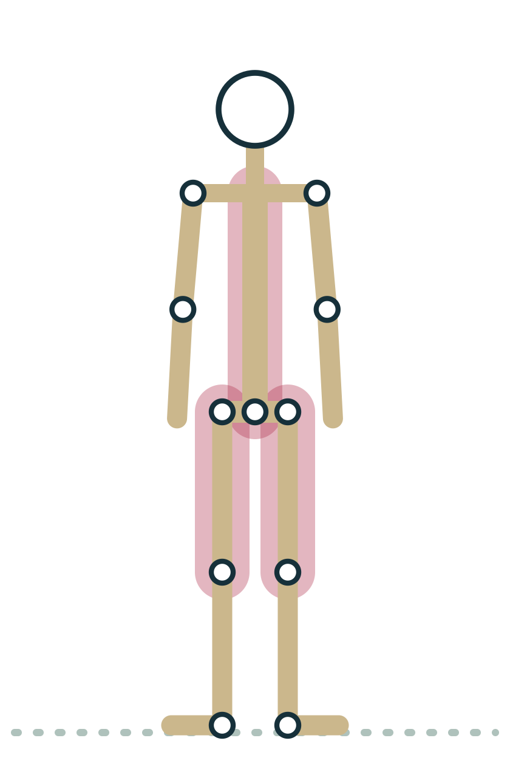
MODULE 4
Muscles and How They Contract
Knowing how muscles shorten, lengthen, share roles and respond to stretch lets you cue strength and flexibility honestly and safely.
3 hours · 7 lessons · Anatomy & Physiology for Vinyasa Teachers
Anatomy on the Mat · Dr. Akash Garg, D.C.

Slide 2
MODULE 4 OBJECTIVES
By the end of this module you can
1
Describe the structure of skeletal muscle from whole muscle to sarcomere and explain the sliding filament model in plain words
LESSONS
4.1 Muscle structure and how a muscle shortens
4.2 Concentric, eccentric and isometric: lowering through Chaturanga, holding Chair
4.3 Agonist, antagonist, synergist and stabilizer
4.4 Reciprocal inhibition, the stretch reflex and the Golgi tendon organ
4.5 What flexibility is: nervous system tolerance and tissue length
4.6 Fascia without the hype
4.7 Pose lab: muscle roles in Warrior III and Bridge
2
Identify concentric, eccentric and isometric contractions in Chaturanga, Chair and other common poses
3
Assign agonist, antagonist, synergist and stabilizer roles for a given joint action in a pose
4
Explain the stretch reflex, reciprocal inhibition and the Golgi tendon organ, and state what current evidence says about how PNF works
5
Distinguish the nervous system and tissue contributions to flexibility and cue end-range strength for flexible students
6
Separate supported from unsupported claims about fascia and choose accurate cueing language
Anatomy on the Mat · Dr. Akash Garg, D.C.
2

Slide 3
4.1
LESSON 4.1 · 25 MIN
Muscle structure and how a muscle shortens
See it
Feel it
Cue it
Check it
Anatomy on the Mat · Dr. Akash Garg, D.C.
3

Slide 4
LESSON 4.1
Skeletal muscle: the tissue you cue
Three muscle types: skeletal, cardiac and smooth
Only skeletal muscle is under voluntary control
Skeletal muscle attaches to bone through tendons
It moves joints, holds postures and makes heat
Plate 1 Even standing still in Mountain, skeletal muscles are quietly working
Anatomy on the Mat · Dr. Akash Garg, D.C.
4

Slide 5
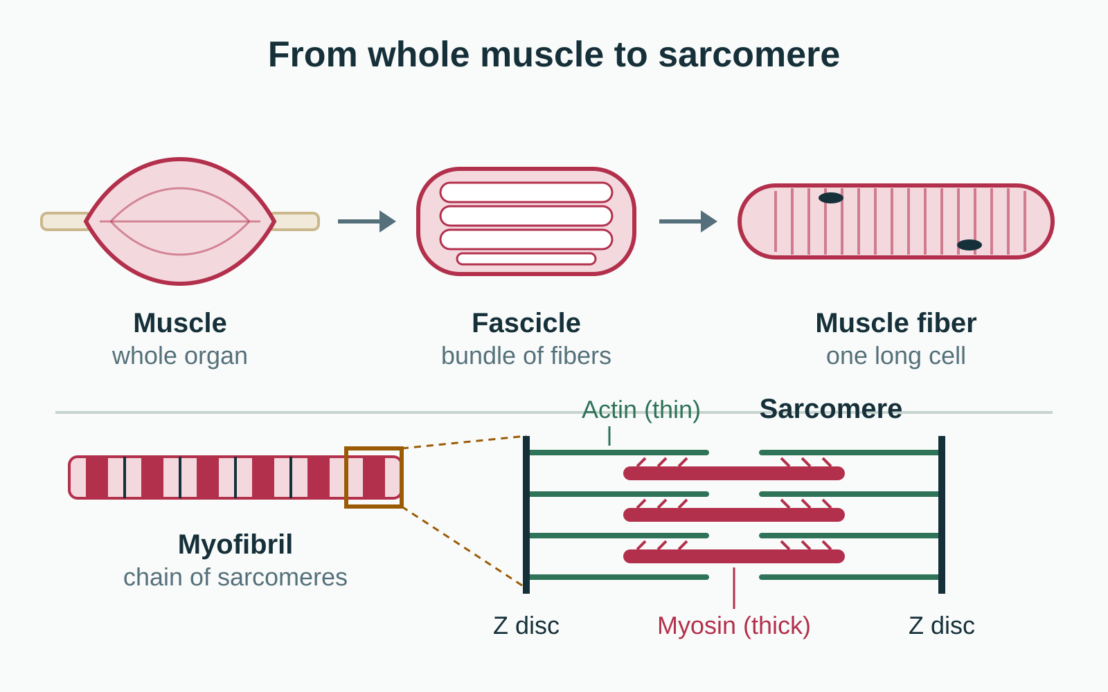
LESSON 4.1
Muscle to sarcomere: boxes inside boxes
Muscle is built of bundles called fascicles
Each fascicle holds many muscle fibers (cells)
Each fiber is packed with myofibrils
Each myofibril is a chain of sarcomeres
Plate 2 Muscle, fascicle, fiber, myofibril, sarcomere
Anatomy on the Mat · Dr. Akash Garg, D.C.
5

Slide 6
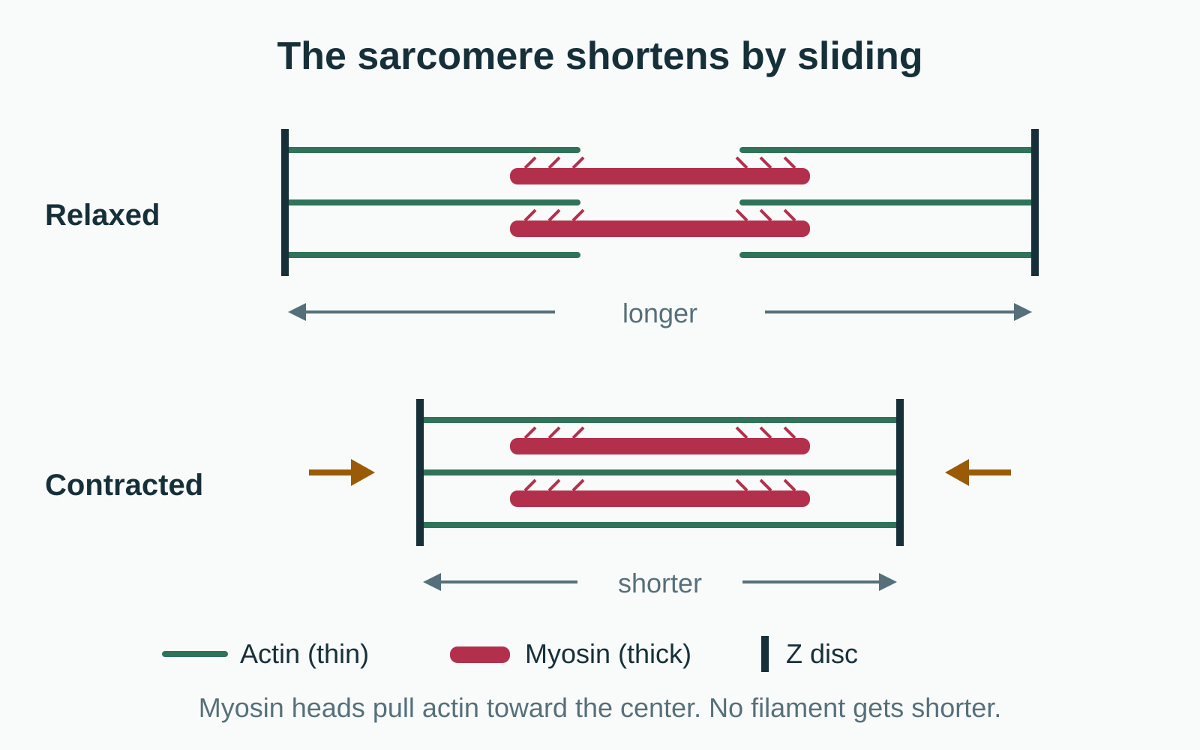
LESSON 4.1
The sliding filament model
Thin filaments: actin. Thick filaments: myosin
Myosin heads grab actin and pull it toward the center
Filaments slide past each other; none of them shrinks
Needs calcium to switch on and ATP to release and reset
Plate 3 Relaxed versus contracted sarcomere
Anatomy on the Mat · Dr. Akash Garg, D.C.
6

Slide 7
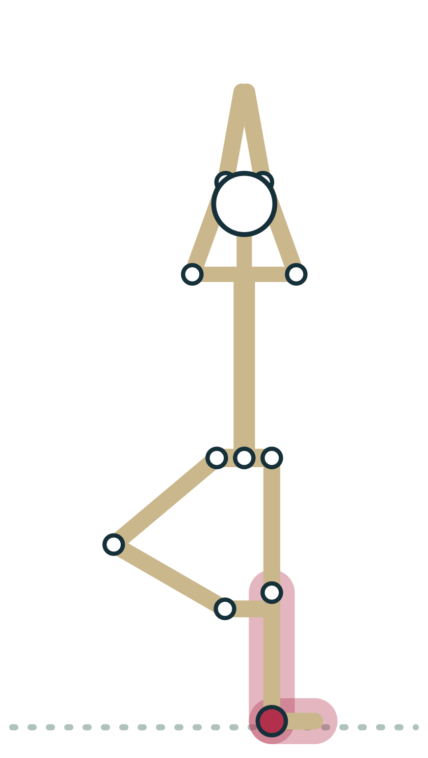
LESSON 4.1
Motor units: how effort is graded
A motor unit is one motor neuron plus its fibers
When a motor unit fires, all its fibers contract
More force: recruit more units and fire them faster
Small units allow the fine corrections of balance
Plate 4 Tree: small motor units in the standing foot and ankle make constant tiny corrections
Anatomy on the Mat · Dr. Akash Garg, D.C.
7

Slide 8
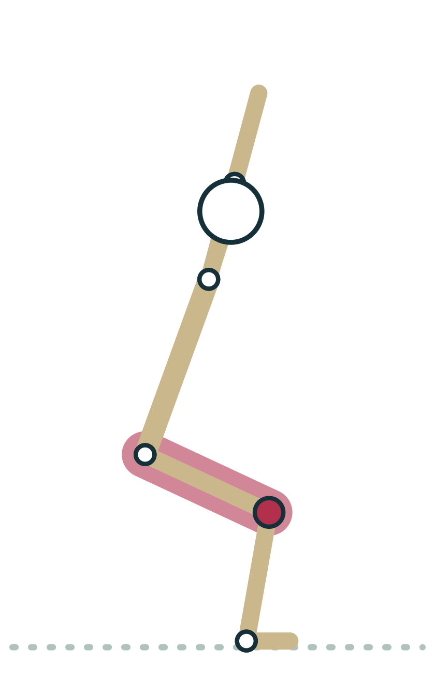
LESSON 4.1
Skeletal muscles in the human body
600+
Every one of them can only pull on its attachments. No muscle can push, so every movement back the other way needs a different muscle or gravity.
Plate 5 In Chair the quadriceps pull on the shin to stop the knees bending further
Anatomy on the Mat · Dr. Akash Garg, D.C.
8

Slide 9

LESSON 4.1 · FEEL IT
Feel it: find a muscle switching on
1
Stand in Mountain and rest one hand on the front of each thigh
2
Feel the thighs soft; now bend the knees slightly into a small Chair
3
Notice the quadriceps firm under your hands as they start to work
4
Sink a little deeper and feel them firm further: more motor units recruited
Plate 6 Feel the quadriceps firm as you sink
Anatomy on the Mat · Dr. Akash Garg, D.C.
9

Slide 10
LESSON 4.1 · CHECK IT
During a contraction, what happens inside the sarcomere?
Actin and myosin filaments shorten
Pause the video and choose before you move on.
A
Myosin pulls actin toward the center so the filaments slide past each other
B
The Z discs move further apart
C
Anatomy on the Mat · Dr. Akash Garg, D.C.
10

Slide 11
LESSON 4.1 · CHECK IT
Answer
Myosin pulls actin toward the center so the filaments slide past each other
B
In the sliding filament model the filaments keep their length and slide past each other, drawing the Z discs closer together.
Question: During a contraction, what happens inside the sarcomere?
Anatomy on the Mat · Dr. Akash Garg, D.C.
11

Slide 12
4.2
LESSON 4.2 · 30 MIN
Concentric, eccentric and isometric: lowering through Chaturanga, holding Chair
See it
Feel it
Cue it
Check it
Anatomy on the Mat · Dr. Akash Garg, D.C.
12

Slide 13
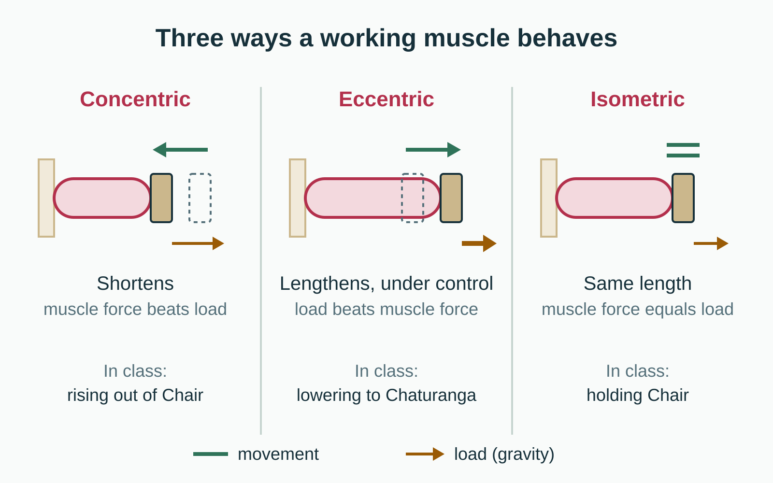
LESSON 4.2
Three ways a working muscle behaves
Concentric: the muscle shortens while working
Eccentric: the muscle lengthens while working, under control
Isometric: the muscle works but its length stays the same
Compare muscle force with the load, usually gravity
Plate 7 Concentric, eccentric and isometric contractions
Anatomy on the Mat · Dr. Akash Garg, D.C.
13

Slide 14
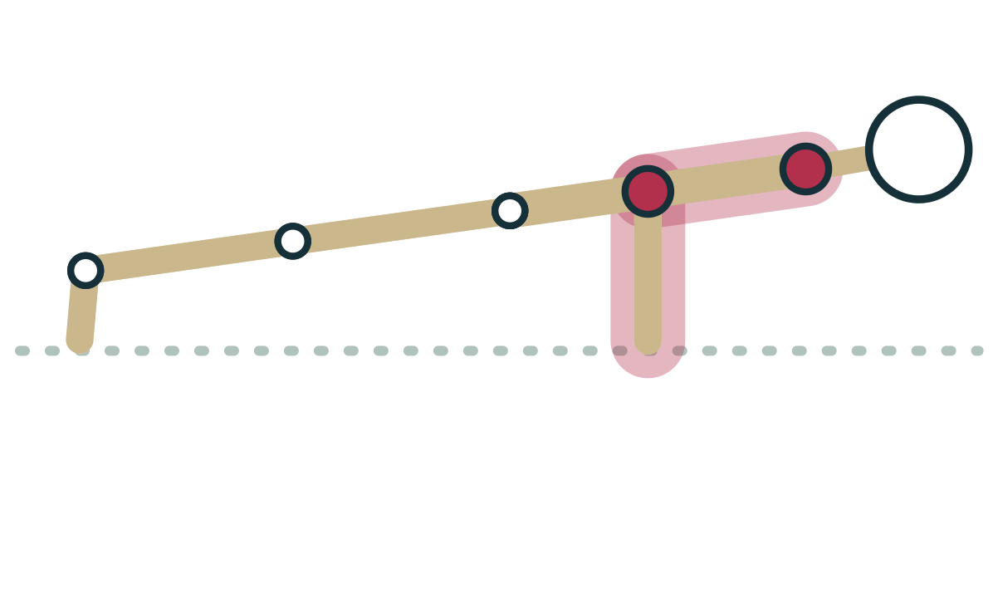
LESSON 4.2
Chaturanga: an eccentric lower
Lowering from plank, the elbows bend under body weight
Triceps, pectorals and front deltoids lengthen as they work
They act as brakes: eccentric contraction
Pressing back up would be concentric work
Plate 8 Lowering to Chaturanga: triceps and chest muscles brake the descent
Anatomy on the Mat · Dr. Akash Garg, D.C.
14

Slide 15

LESSON 4.2 · CUE IT
Holding Chair: isometric work
“Sit back as if onto a chair, then stay: keep the thighs working, keep breathing, and keep the knees tracking toward the second toes.”
Why it works In the hold, the quadriceps and gluteus maximus produce tension without changing length. That is an isometric contraction, and it is why Chair feels hard even though nothing is moving.
Plate 9 Chair hold: quadriceps and gluteals work isometrically
Anatomy on the Mat · Dr. Akash Garg, D.C.
15

Slide 16
LESSON 4.2
The same muscle, three jobs in Chair
Lowering in (eccentric)
Holding (isometric)
Rising (concentric)
Quadriceps lengthen while working
Gravity is winning, slowly
Control the speed of descent
Quadriceps length stays the same
Force matches gravity
Builds strength at that angle
Quadriceps shorten while working
Muscle force beats gravity
Lifts the body upward
Anatomy on the Mat · Dr. Akash Garg, D.C.
16

Slide 17
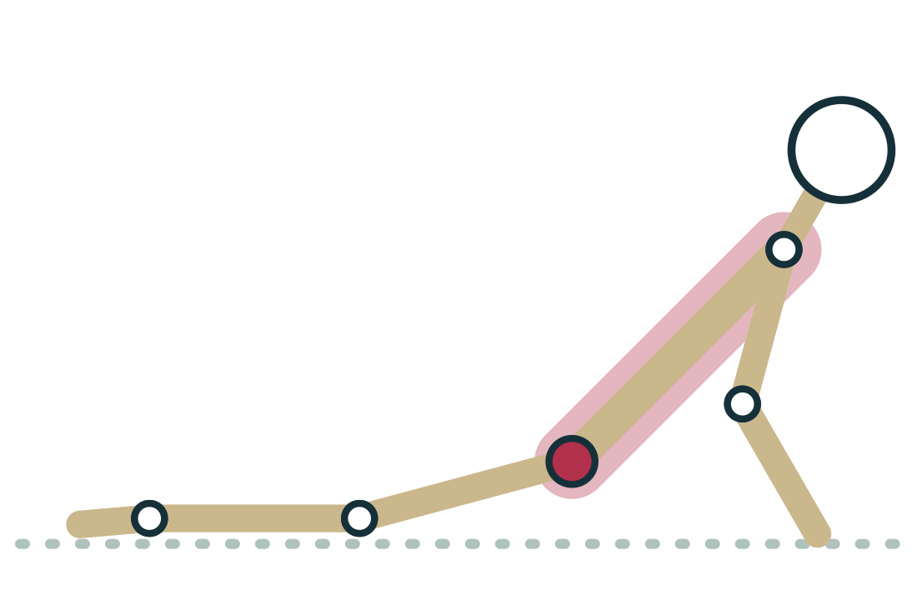
LESSON 4.2
Gravity decides the contraction type
Ask: is this part moving with, against or across gravity?
Lowering the chest from Cobra: back extensors work eccentrically
Lifting into Cobra: the same back extensors work concentrically
Unfamiliar eccentric work causes the most next-day soreness
Plate 10 Cobra: the back extensors lift you and then lower you
Anatomy on the Mat · Dr. Akash Garg, D.C.
17

Slide 18
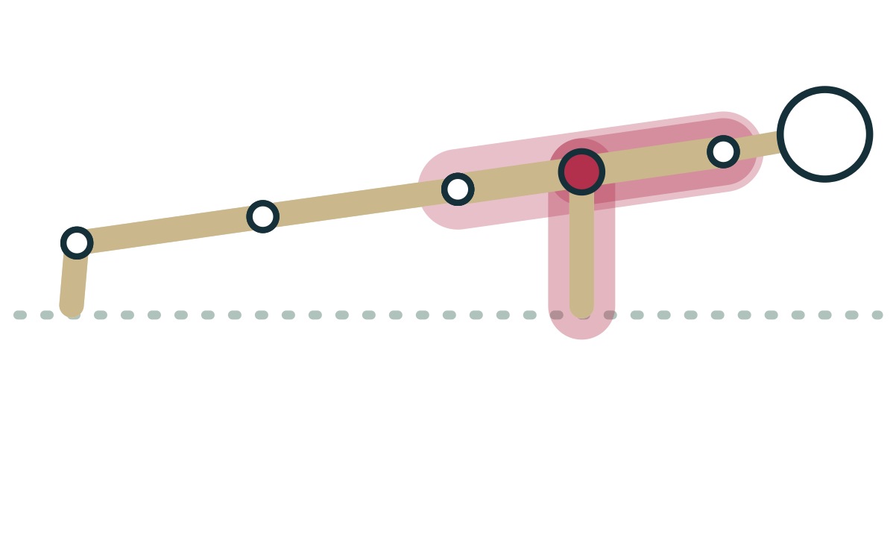
LESSON 4.2 · FEEL IT
Feel it: one Chaturanga, three contractions
1
From plank, shift forward and lower slowly for a count of four: eccentric
2
Pause halfway down and hold for three breaths: isometric
3
Press back up to plank with control: concentric
4
Repeat with knees down and notice the lighter load
Plate 11 Lower, pause, press: three contraction types
Anatomy on the Mat · Dr. Akash Garg, D.C.
18

Slide 19
LESSON 4.2 · CHECK IT
A student lowers slowly from plank into Chaturanga. What are the triceps doing?
Relaxing, because the elbows are bending
Pause the video and choose before you move on.
A
Contracting concentrically
B
Contracting eccentrically, lengthening under control
C
Anatomy on the Mat · Dr. Akash Garg, D.C.
19

Slide 20
LESSON 4.2 · CHECK IT
Answer
Contracting eccentrically, lengthening under control
C
Gravity is bending the elbows and the triceps lengthen while working to control the descent, which is an eccentric contraction.
Question: A student lowers slowly from plank into Chaturanga. What are the triceps doing?
Anatomy on the Mat · Dr. Akash Garg, D.C.
20

Slide 21
4.3
LESSON 4.3 · 25 MIN
Agonist, antagonist, synergist and stabilizer
See it
Feel it
Cue it
Check it
Anatomy on the Mat · Dr. Akash Garg, D.C.
21

Slide 22
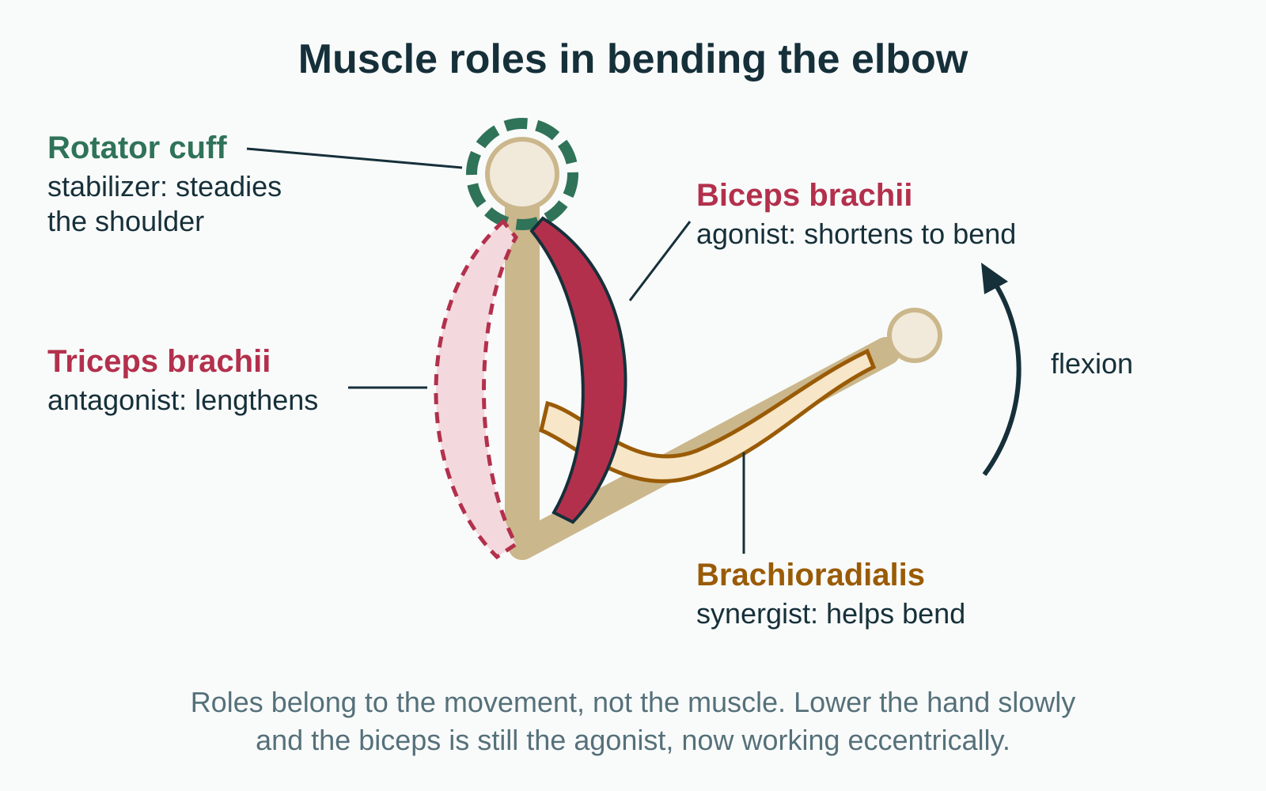
LESSON 4.3
Four roles in every movement
Agonist (prime mover): main muscle producing the movement
Antagonist: produces the opposite movement; usually lengthens
Synergist: assists the agonist or cancels unwanted motion
Stabilizer: holds a nearby joint steady so force transfers
Plate 12 Muscle roles in bending the elbow
Anatomy on the Mat · Dr. Akash Garg, D.C.
22

Slide 23
LESSON 4.3
Roles at the knee in Chair
Agonist
Antagonist
Stabilizers
Quadriceps
Control knee bending and straightening
Work in every phase
Hamstrings
Opposite action at the knee
Mostly quiet, lengthening a little
Gluteus medius and deep hip rotators
Keep knees tracking over toes
Anatomy on the Mat · Dr. Akash Garg, D.C.
23

Slide 24
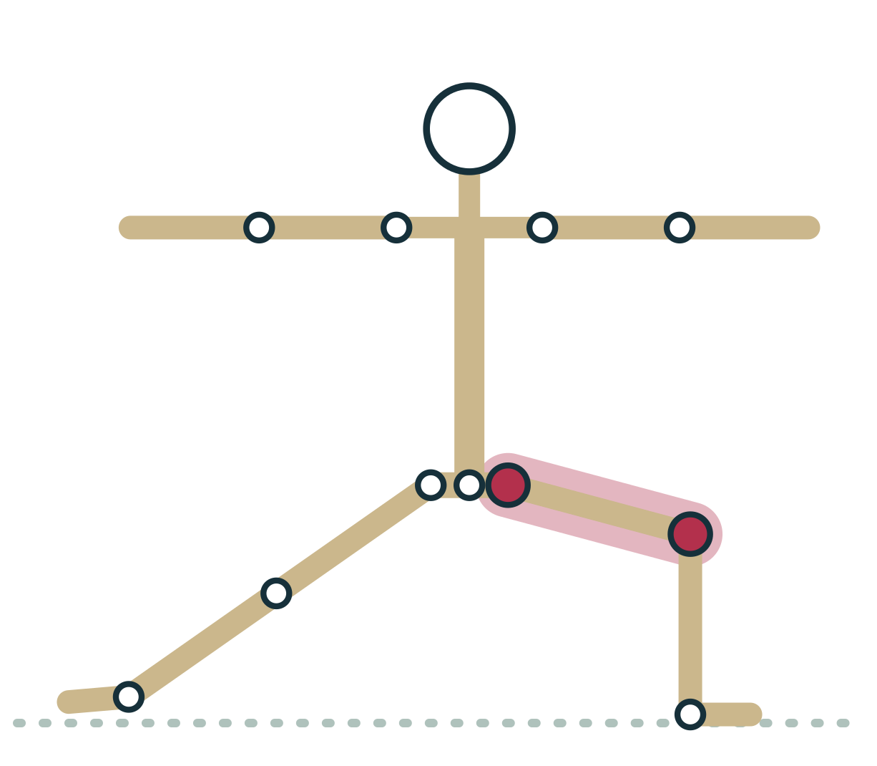
LESSON 4.3
Roles belong to the movement
The same muscle can be agonist in one pose, antagonist in another
Biceps: agonist for elbow bending, antagonist for straightening
Two-joint muscles can play different roles at each joint
Always name the joint and the action first
Plate 13 Warrior II front leg: quadriceps control the bent knee while hip muscles stabilize
Anatomy on the Mat · Dr. Akash Garg, D.C.
24

Slide 25
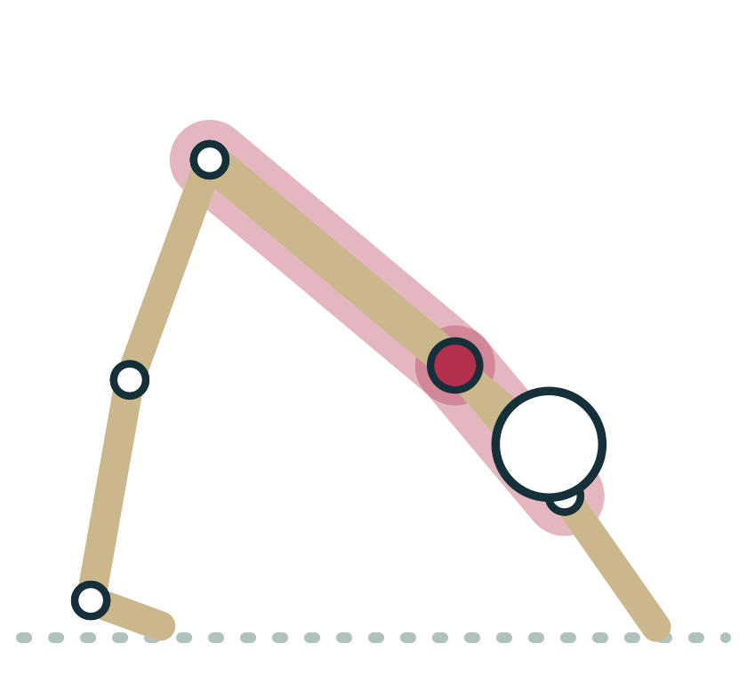
LESSON 4.3
Stabilizers: the quiet workers
In Down Dog, serratus anterior holds the shoulder blades on the ribs
The rotator cuff keeps the ball of the humerus centered
Deep abdominals stiffen the trunk before the limbs move
Weak stabilizers often show up as wobble or collapse
Plate 14 Down Dog: serratus anterior and rotator cuff stabilize the shoulder
Anatomy on the Mat · Dr. Akash Garg, D.C.
25

Slide 26
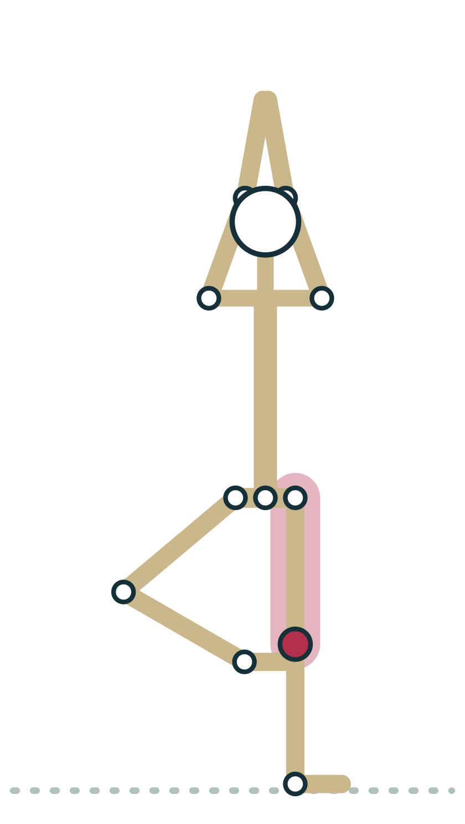
LESSON 4.3 · FEEL IT
Feel it: agonist and antagonist at the knee
1
Stand on one leg near a wall, the other foot just off the floor
2
Straighten the standing knee firmly: feel the front of the thigh harden
3
Reach back and feel the hamstrings: softer, lengthening slightly
4
Now press the standing heel down as if to bend the knee: feel the roles swap
Plate 15 Feel the standing thigh: front and back
Anatomy on the Mat · Dr. Akash Garg, D.C.
26

Slide 27
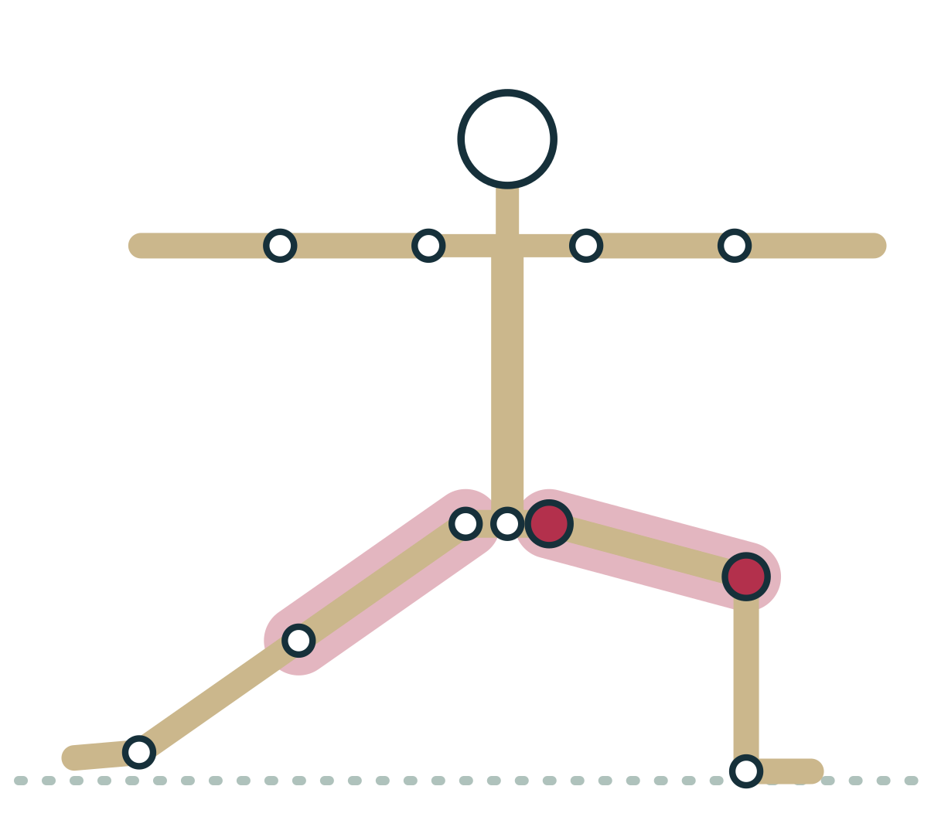
LESSON 4.3 · CUE IT
Cue the job, not just the muscle
“Press the outer edge of the back foot down and draw the front knee toward the little-toe side of the foot.”
Why it works The gluteus medius and deep hip rotators stabilize the front leg in Warrior II, keeping the knee tracking over the ankle while the quadriceps hold the bend.
Plate 16 Warrior II: stabilizers keep the front knee over the ankle
Anatomy on the Mat · Dr. Akash Garg, D.C.
27

Slide 28
LESSON 4.3 · CHECK IT
In Chair, which muscle group is best described as the agonist at the knee?
Quadriceps
Pause the video and choose before you move on.
A
Hamstrings
B
Calf muscles
C
Anatomy on the Mat · Dr. Akash Garg, D.C.
28

Slide 29
LESSON 4.3 · CHECK IT
Answer
Quadriceps
A
The quadriceps control the knee against gravity in every phase of Chair, so they are the agonist; the hamstrings are the antagonist at the knee.
Question: In Chair, which muscle group is best described as the agonist at the knee?
Anatomy on the Mat · Dr. Akash Garg, D.C.
29

Slide 30
4.4
LESSON 4.4 · 35 MIN
Reciprocal inhibition, the stretch reflex and the Golgi tendon organ
See it
Feel it
Cue it
Check it
Anatomy on the Mat · Dr. Akash Garg, D.C.
30

Slide 31
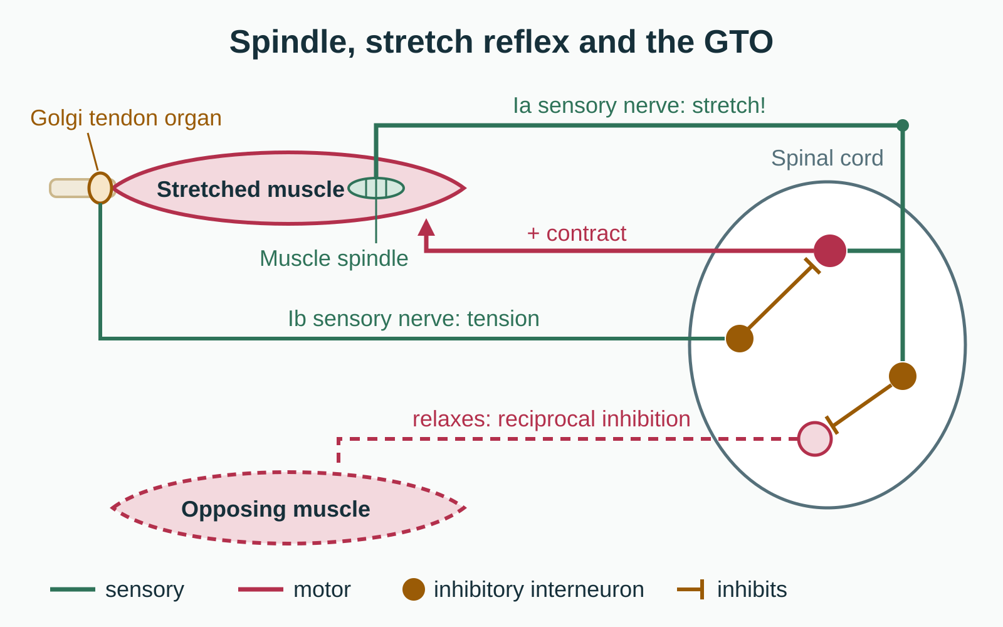
LESSON 4.4
Two sensors inside every muscle
Muscle spindles lie among the fibers and sense length and speed
Golgi tendon organs sit where muscle meets tendon and sense tension
Both send signals to the spinal cord, many below awareness
They underlie reflexes and your sense of body position
Plate 17 Spindle, stretch reflex, reciprocal inhibition and the Golgi tendon organ
Anatomy on the Mat · Dr. Akash Garg, D.C.
31

Slide 32
LESSON 4.4
Muscle spindle versus Golgi tendon organ
Muscle spindle
Golgi tendon organ
In the muscle belly, parallel to fibers
Senses length and speed of stretch
Ia nerve: excites the same muscle
Drives the stretch reflex
At the muscle-tendon junction
Senses tension, mainly from contraction
Ib nerve: inhibits the same muscle
Constant force feedback
Anatomy on the Mat · Dr. Akash Garg, D.C.
32

Slide 33
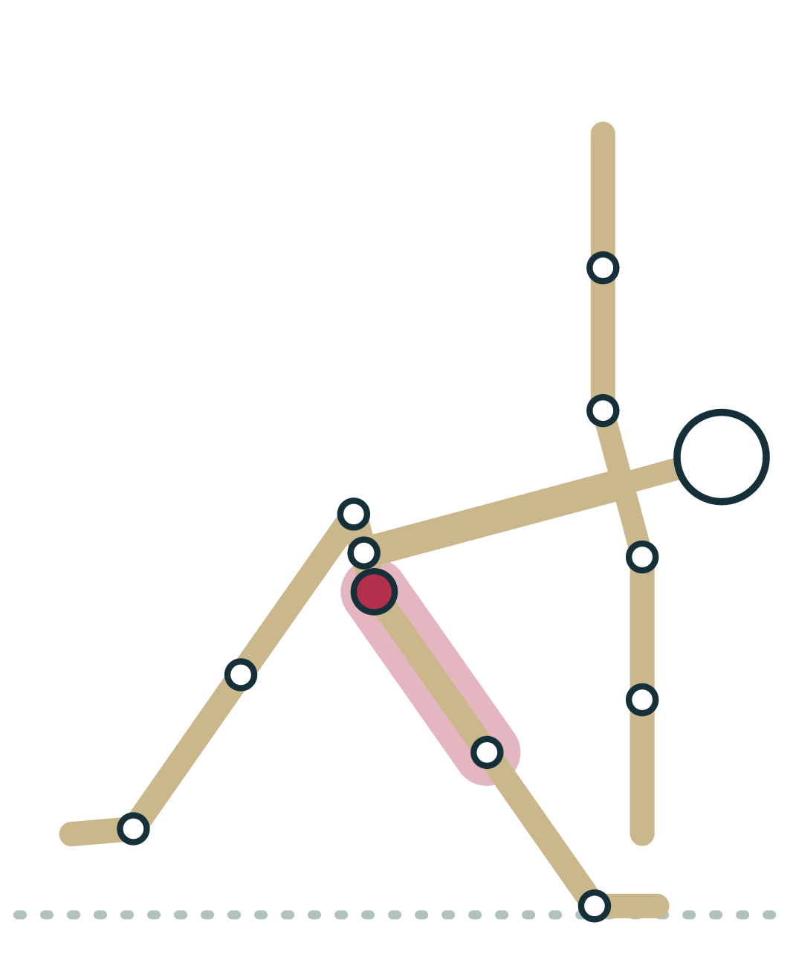
LESSON 4.4 · CUE IT
The stretch reflex: why we do not bounce
“Ease into the fold slowly, stop at the first clear stretch and breathe there. No bouncing.”
Why it works A fast stretch fires muscle spindles, which reflexly contract the same muscle. Slow entry keeps that reflex quiet and gives the nervous system time to settle.
Plate 18 Triangle: enter slowly so the front hamstrings are not triggered to resist
Anatomy on the Mat · Dr. Akash Garg, D.C.
33

Slide 34
LESSON 4.4
Reciprocal inhibition
When a muscle contracts, its antagonist's motor neurons are damped
The same Ia signal excites one muscle and inhibits its opposite
Lets opposing muscles avoid fighting each other
In slow stretches its extra benefit is probably small
Plate 19 The Ia signal excites one muscle and damps its opposite
Anatomy on the Mat · Dr. Akash Garg, D.C.
34

Slide 35
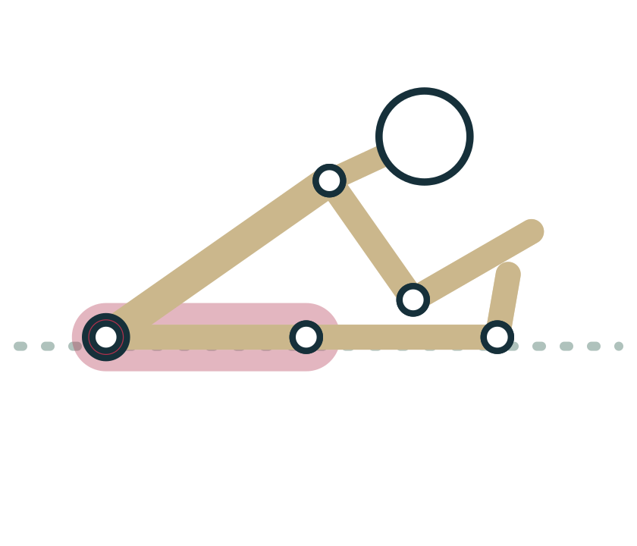
LESSON 4.4
The GTO and PNF: what the research actually says
PNF: contract the stretched muscle, relax, then stretch further
It reliably gives short-term range gains
The classic explanation, GTO autogenic inhibition, is questioned
Most evidence points to increased tolerance of the stretch
Plate 20 Contract-relax in a seated fold: effective, but not for the reason often taught
Anatomy on the Mat · Dr. Akash Garg, D.C.
35

Slide 36
LESSON 4.4 · FEEL IT
Feel it: contract-relax in a seated fold
1
Sit in a forward fold, knees bent as needed, to a mild stretch
2
Press the heels down into the floor for five seconds, about a third effort
3
Relax completely and take one slow exhale
4
Fold a little further on the exhale; notice whether the stretch feels less intense
Plate 21 Heels press down, relax, then fold a little further
Anatomy on the Mat · Dr. Akash Garg, D.C.
36

Slide 37
LESSON 4.4 · CHECK IT
Which statement about PNF contract-relax stretching best fits current evidence?
It works because the Golgi tendon organ switches the muscle off for several minutes
Pause the video and choose before you move on.
A
It improves short-term range mainly by increasing tolerance to the stretch
B
It does not change range of motion at all
C
Anatomy on the Mat · Dr. Akash Garg, D.C.
37

Slide 38
LESSON 4.4 · CHECK IT
Answer
It improves short-term range mainly by increasing tolerance to the stretch
B
PNF reliably improves short-term range, but the GTO inhibition explanation is questioned; increased stretch tolerance is the leading explanation.
Question: Which statement about PNF contract-relax stretching best fits current evidence?
Anatomy on the Mat · Dr. Akash Garg, D.C.
38

Slide 39
4.5
LESSON 4.5 · 25 MIN
What flexibility is: nervous system tolerance and tissue length
See it
Feel it
Cue it
Check it
Anatomy on the Mat · Dr. Akash Garg, D.C.
39

Slide 40
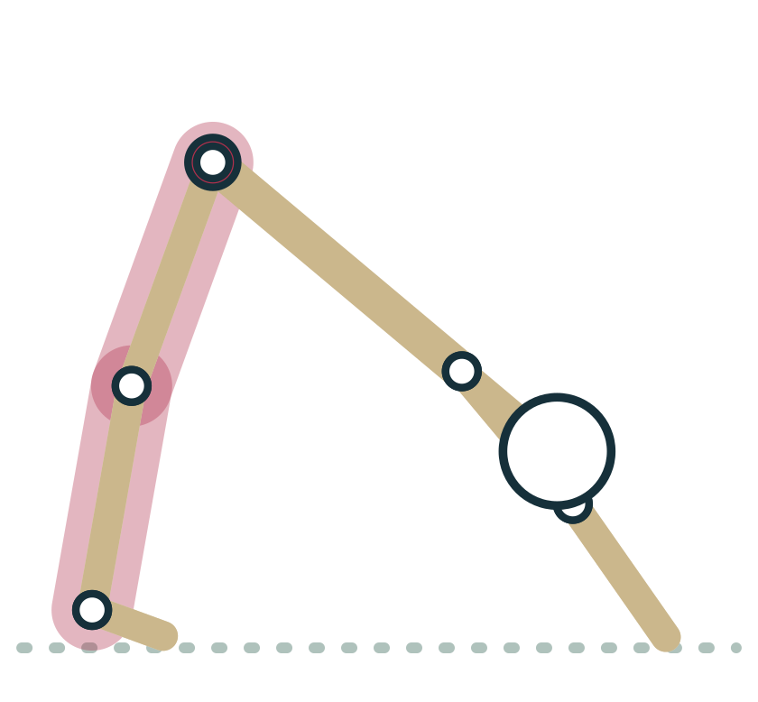
LESSON 4.5
Flexibility has two ingredients
Tissue: how long and stiff the muscle-tendon unit and other tissues are
Nervous system: how much stretch sensation you allow
The end of range is usually set by sensation, not by tissue tearing
Range often increases under general anesthesia
Plate 22 Down Dog range reflects both tissue and tolerance
Anatomy on the Mat · Dr. Akash Garg, D.C.
40

Slide 41
LESSON 4.5
The sensory theory of stretching
After a stretching session, range goes up quickly
Muscle stiffness changes little in the short term
What changes most: tolerance of the stretch sensation
This stretch tolerance model is the mainstream view
Plate 23 Folding further after a few breaths: tolerance, not a longer muscle
Anatomy on the Mat · Dr. Akash Garg, D.C.
41

Slide 42
LESSON 4.5
Short term versus long term
Within one session
Weeks of regular practice
Range increases within minutes
Mainly increased stretch tolerance
Tissue stiffness changes little
Fades within hours
Range increases steadily
Tolerance still a large part
Some tissue changes, evidence mixed
Maintained only with continued practice
Anatomy on the Mat · Dr. Akash Garg, D.C.
42

Slide 43

LESSON 4.5
Not every limit is a tight muscle
Bone shape: hip sockets and thigh bones vary a lot
Compression: tissue meeting tissue, as in Child's pose
Joint capsule, ligaments and nerves can also limit range
A hard stop with a pinching feeling is not a stretch
Plate 24 Hip shape varies between people and sets some limits in Warrior II
Anatomy on the Mat · Dr. Akash Garg, D.C.
43

Slide 44
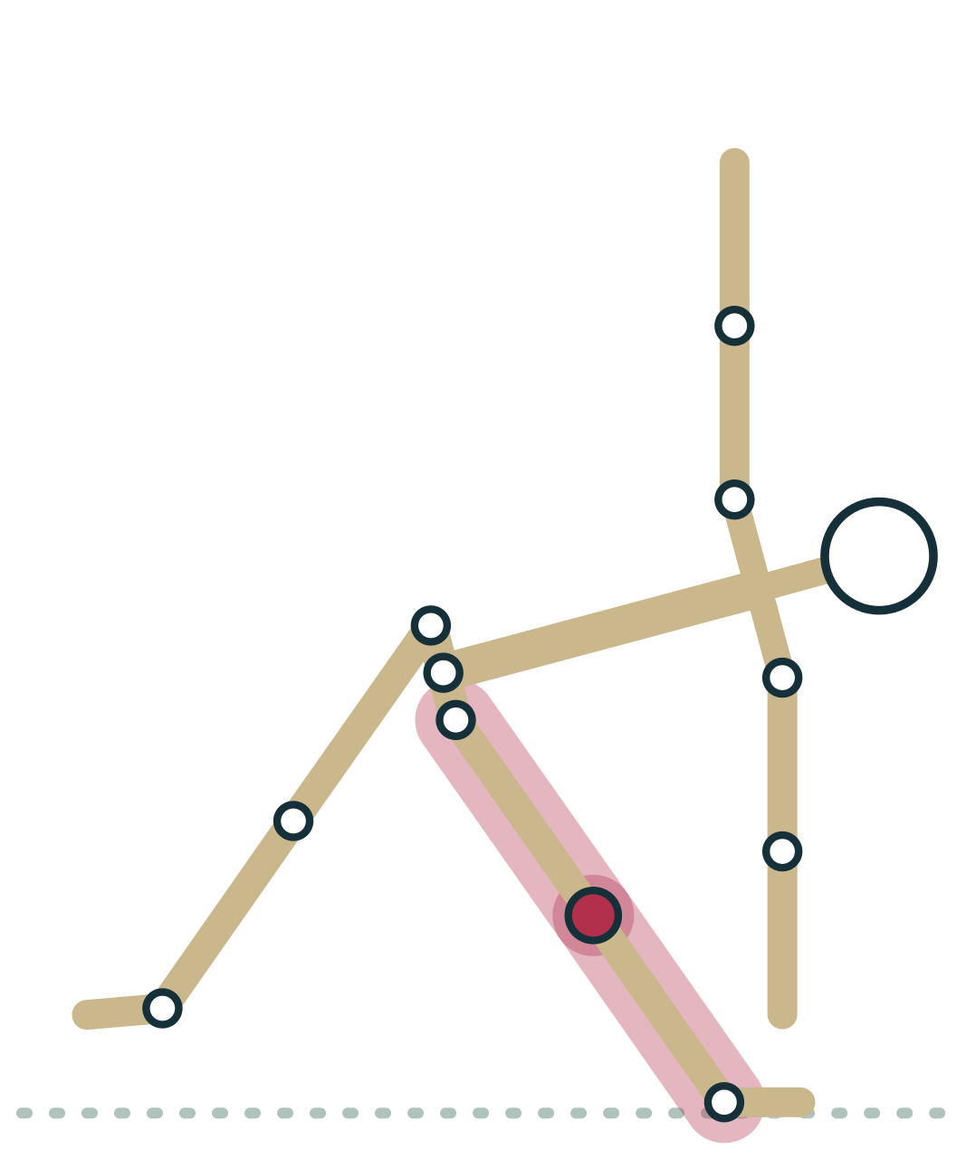
LESSON 4.5 · CUE IT
Strength at the end of range
“Keep a micro-bend in the front knee, press the big-toe mound down and make the pose strong before you make it deep.”
Why it works Flexible and hypermobile students often rest on ligaments at end range. Active muscle control at that range builds usable, stable flexibility.
Plate 25 Triangle: avoid locking the front knee into hyperextension
Anatomy on the Mat · Dr. Akash Garg, D.C.
44

Slide 45
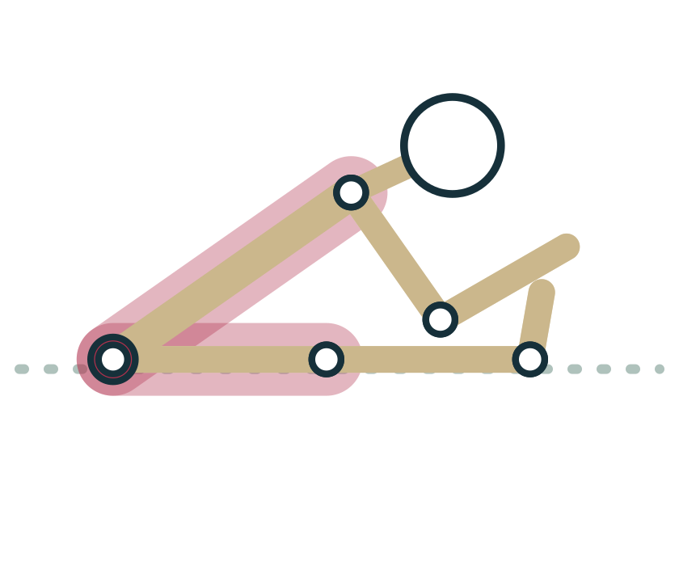
LESSON 4.5 · FEEL IT
Feel it: watch tolerance change
1
Fold forward to the first clear stretch; note where your hands reach
2
Rate the intensity from 0 to 10 and breathe slowly for about a minute
3
At the same depth, rate the intensity again
4
Then fold to a new point that feels like your first rating
Plate 26 Same depth, lower intensity: tolerance changing
Anatomy on the Mat · Dr. Akash Garg, D.C.
45

Slide 46
LESSON 4.5 · CHECK IT
A student reaches further in a forward fold after holding it for a minute. What is the most likely main reason?
The hamstrings have permanently lengthened
Pause the video and choose before you move on.
A
The nervous system now tolerates more stretch sensation
B
The Golgi tendon organ has switched the hamstrings off
C
Anatomy on the Mat · Dr. Akash Garg, D.C.
46

Slide 47
LESSON 4.5 · CHECK IT
Answer
The nervous system now tolerates more stretch sensation
B
Short-term range gains are best explained by increased stretch tolerance; muscle length and stiffness change little in one session.
Question: A student reaches further in a forward fold after holding it for a minute. What is the most likely main reason?
Anatomy on the Mat · Dr. Akash Garg, D.C.
47

Slide 48
4.6
LESSON 4.6 · 20 MIN
Fascia without the hype
See it
Feel it
Cue it
Check it
Anatomy on the Mat · Dr. Akash Garg, D.C.
48

Slide 49
LESSON 4.6
What fascia is
Connective tissue made mostly of collagen, wrapping and linking structures
Wraps every level of muscle: whole muscle, fascicle and fiber
Deep fascia forms sheets such as the thoracolumbar fascia
Superficial fascia lies just under the skin
Plate 27 Connective tissue wraps each level of this hierarchy
Anatomy on the Mat · Dr. Akash Garg, D.C.
49

Slide 50
LESSON 4.6
What fascia really does
Transmits force from muscles to bones and to neighboring muscles
Separates structures and lets them glide past each other
Contains many nerve endings: it contributes to body sense and pain
Adapts slowly to load, like tendon and ligament
Plate 28 Cobra: the thoracolumbar fascia links back muscles, gluteals and latissimus
Anatomy on the Mat · Dr. Akash Garg, D.C.
50

Slide 51
LESSON 4.6
Fascia claims: what the evidence supports
Supported
Not supported
Fascia transmits force and links muscles
It is richly innervated and sensitive
It adapts slowly to regular loading
Hands or rollers release or lengthen dense fascia
Fascia stores emotions or trauma
A pose rehydrates fascia
Anatomy on the Mat · Dr. Akash Garg, D.C.
51

Slide 52
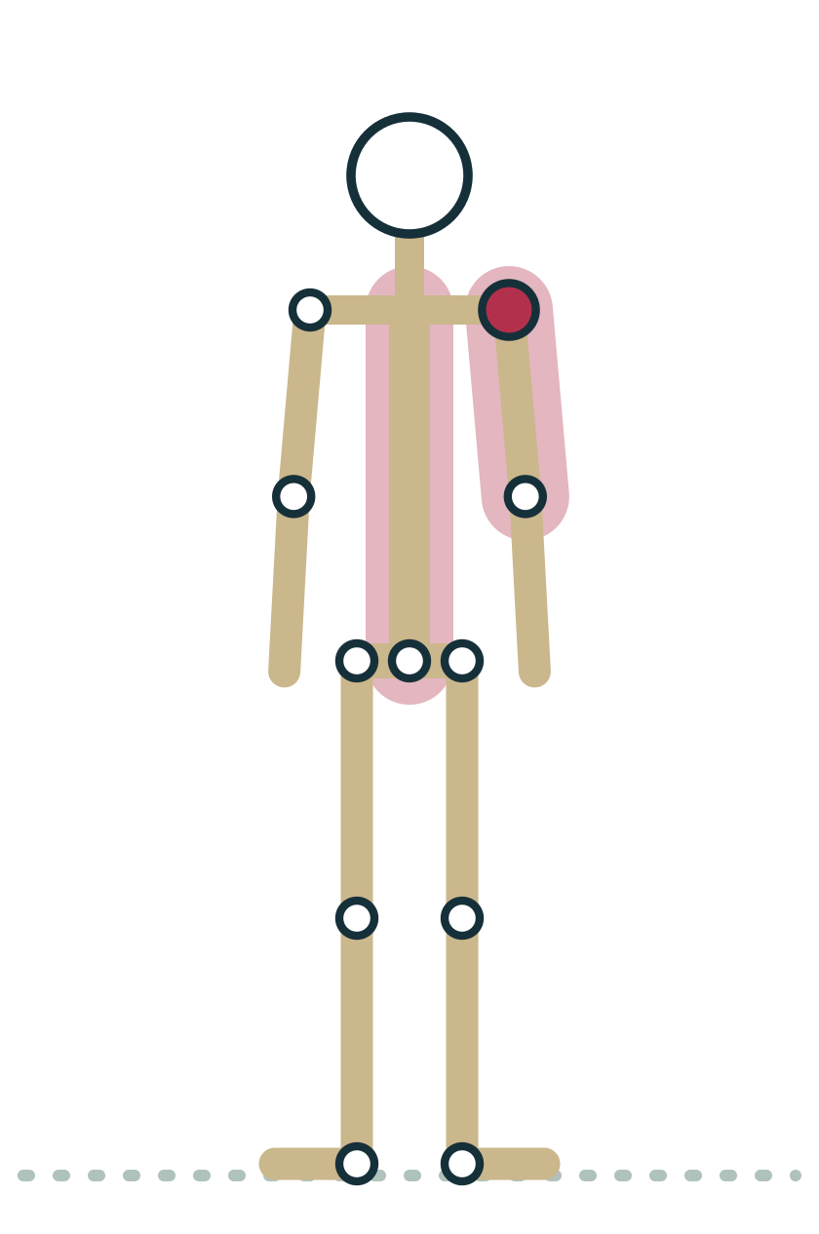
LESSON 4.6 · FEEL IT
Feel it: glide and connection
1
Sit and pinch a fold of skin on the front of the thigh
2
Slowly bend and straighten the knee; feel skin and superficial fascia glide
3
Stand in Mountain and reach one arm long overhead
4
Notice sensation spread from the side waist to the hip: connected tissue, not released tissue
Plate 29 Reach long and notice sensation spread along the side body
Anatomy on the Mat · Dr. Akash Garg, D.C.
52

Slide 53
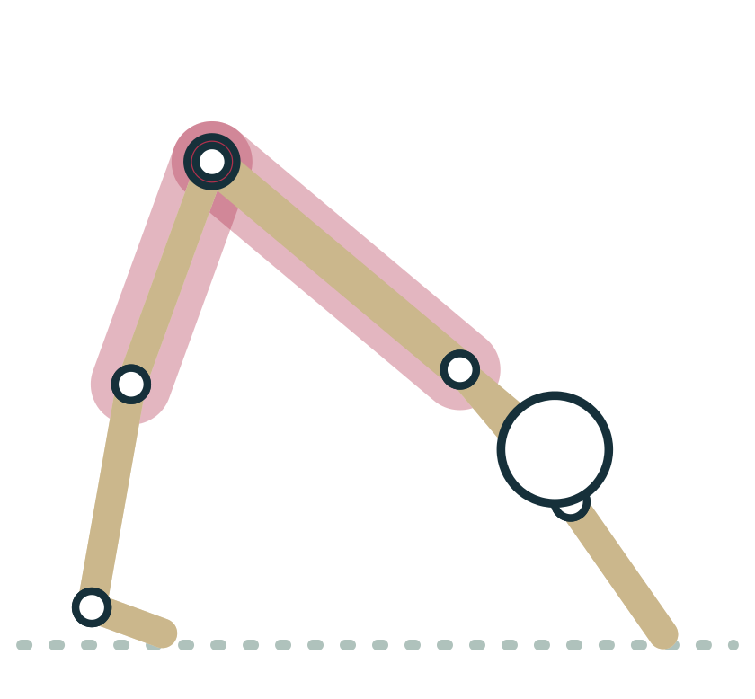
LESSON 4.6 · CUE IT
Honest language for fascia
“Notice the sensation spreading along the whole back of the body as you reach the hips up and back.”
Why it works Muscles and fascia are connected, so stretch sensation often spreads. Describing sensation is accurate; promising to release or melt fascia is not.
Plate 30 Down Dog: describe the sensation, not a promised release
Anatomy on the Mat · Dr. Akash Garg, D.C.
53

Slide 54
LESSON 4.6 · CHECK IT
Which statement about fascia is best supported by current evidence?
Foam rolling permanently lengthens the iliotibial band
Pause the video and choose before you move on.
A
Fascia transmits force and contains many sensory nerve endings
B
Fascia stores unresolved emotions that poses release
C
Anatomy on the Mat · Dr. Akash Garg, D.C.
54

Slide 55
LESSON 4.6 · CHECK IT
Answer
Fascia transmits force and contains many sensory nerve endings
B
Force transmission and rich innervation are well supported; permanent deformation by rolling and emotional storage are not.
Question: Which statement about fascia is best supported by current evidence?
Anatomy on the Mat · Dr. Akash Garg, D.C.
55

Slide 56
4.7
LESSON 4.7 · 20 MIN
Pose lab: muscle roles in Warrior III and Bridge
See it
Feel it
Cue it
Check it
Anatomy on the Mat · Dr. Akash Garg, D.C.
56

Slide 57
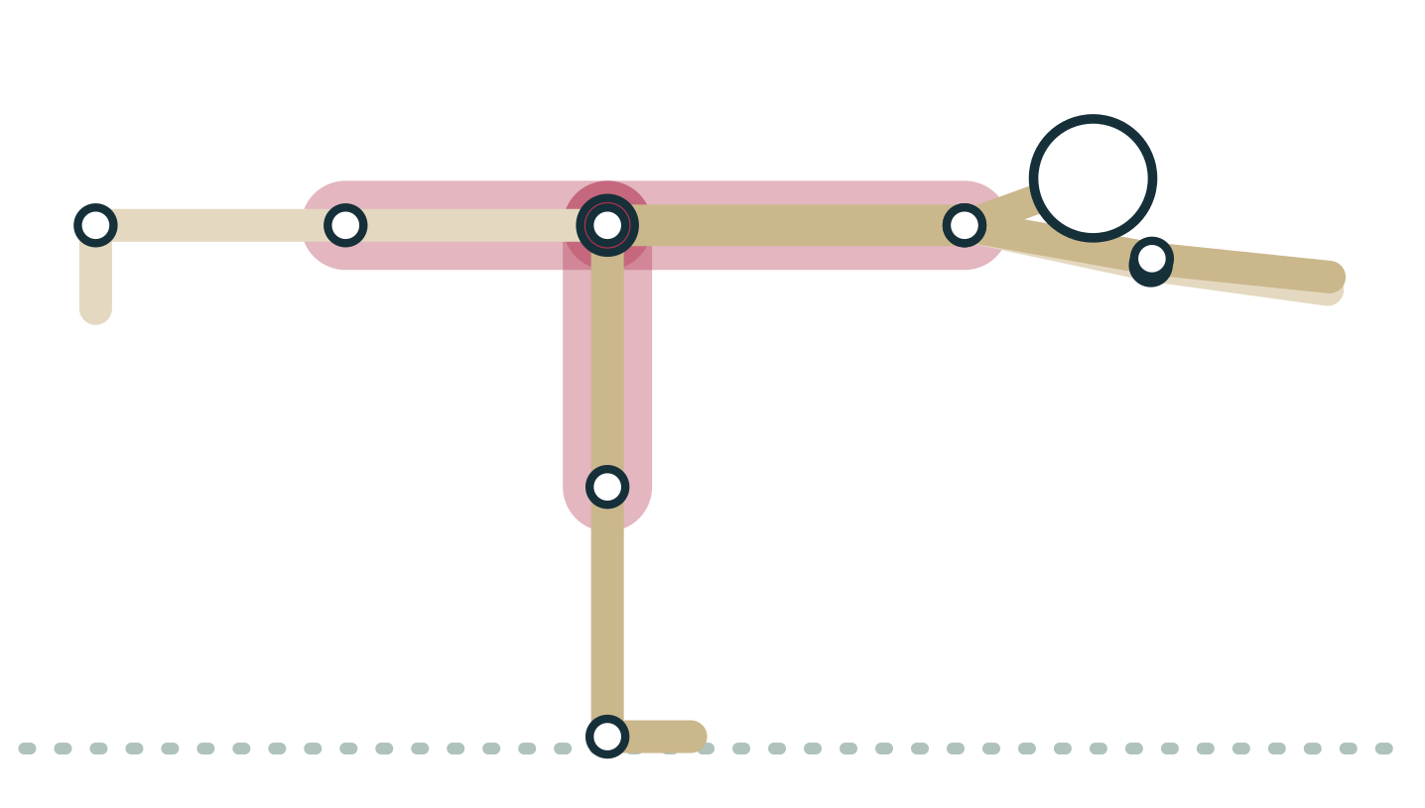
LESSON 4.7
Warrior III: who does what
Standing leg: quadriceps hold the knee; ankle muscles balance
Standing hip: glutes and hamstrings control the forward tilt
Lifted leg: glutes and hamstrings hold it up isometrically
Back extensors hold the trunk level; shoulders hold the arms
Plate 31 Warrior III: standing leg vertical, trunk and back leg level
Anatomy on the Mat · Dr. Akash Garg, D.C.
57

Slide 58
LESSON 4.7
Warrior III: standing side versus lifted side
Standing leg
Lifted leg and trunk
Glutes and hamstrings: control hip flexion
Gluteus medius: keeps pelvis level
Quadriceps: hold the knee
Foot and ankle: balance
Glutes and hamstrings: hold leg up
Erector spinae: hold trunk level
Deep abdominals: stiffen the trunk
Shoulder muscles: hold arms forward
Anatomy on the Mat · Dr. Akash Garg, D.C.
58

Slide 59
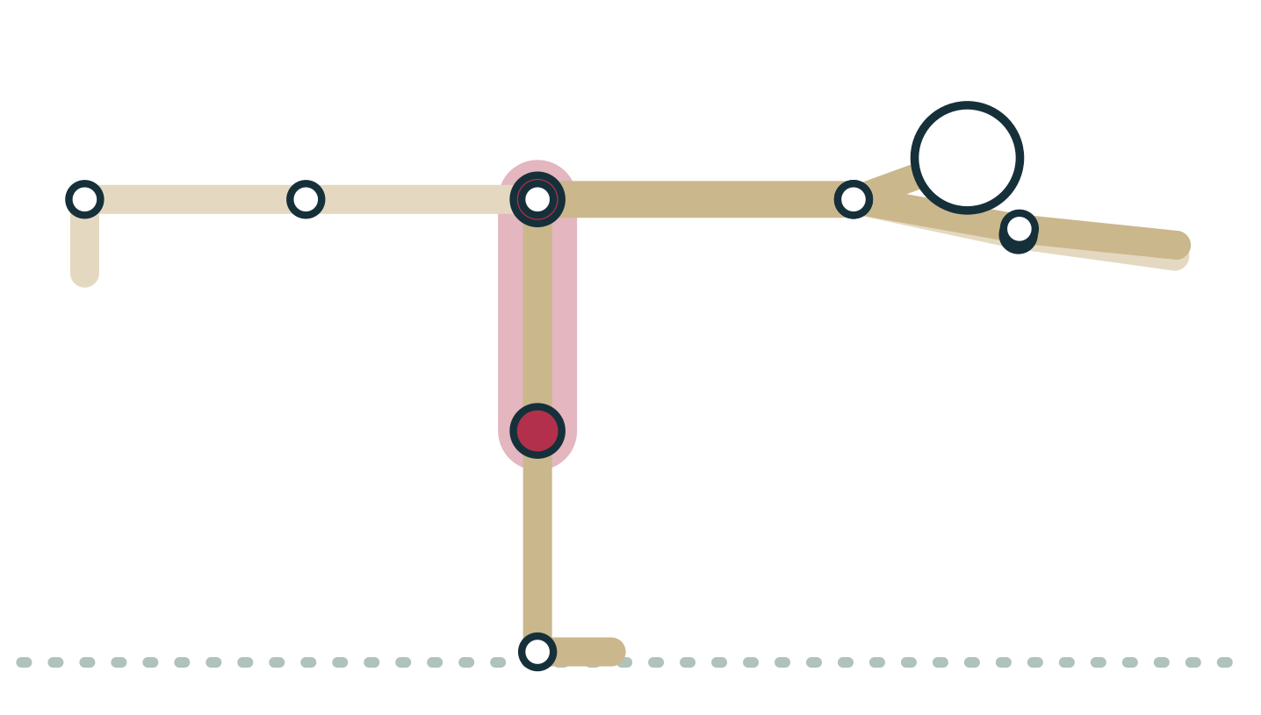
LESSON 4.7 · CUE IT
Cueing Warrior III
“Press down through the standing foot, reach back through the lifted heel, and keep both hip points facing the floor.”
Why it works Pressing down engages the standing leg; reaching back engages the lifted leg's glutes and hamstrings; level hips call on the standing gluteus medius.
Plate 32 Standing hip: gluteus medius keeps the pelvis level
Anatomy on the Mat · Dr. Akash Garg, D.C.
59

Slide 60
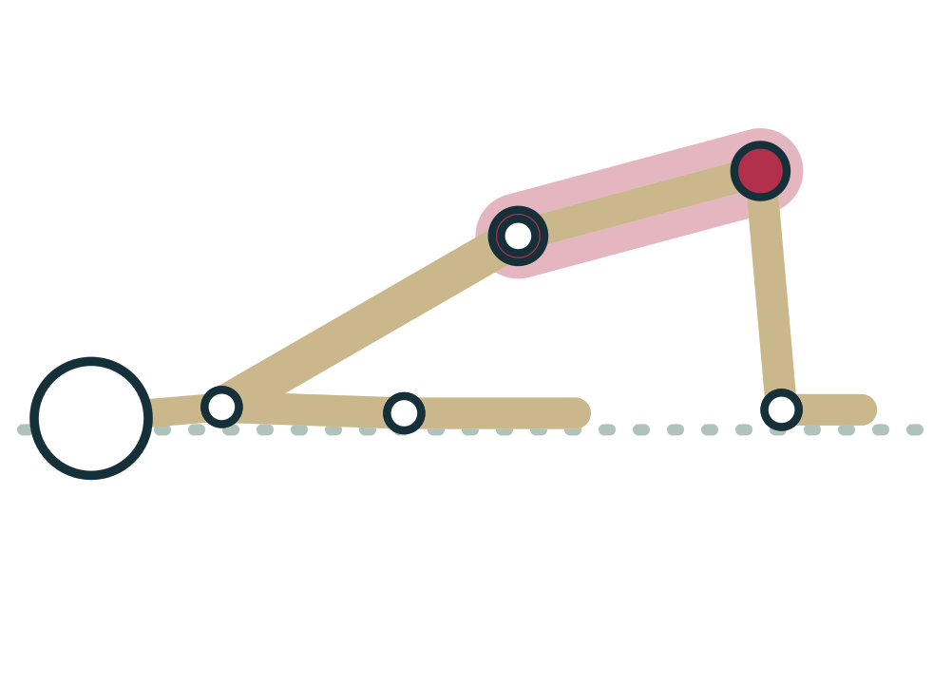
LESSON 4.7
Bridge: who does what
Gluteus maximus and hamstrings: agonists for hip extension
Quadriceps help push the knees forward over the ankles
Adductors stabilize: they stop the knees splaying apart
Hip flexors at the front are the antagonists, lengthened
Plate 33 Bridge: gluteals and hamstrings lift the pelvis
Anatomy on the Mat · Dr. Akash Garg, D.C.
60

Slide 61
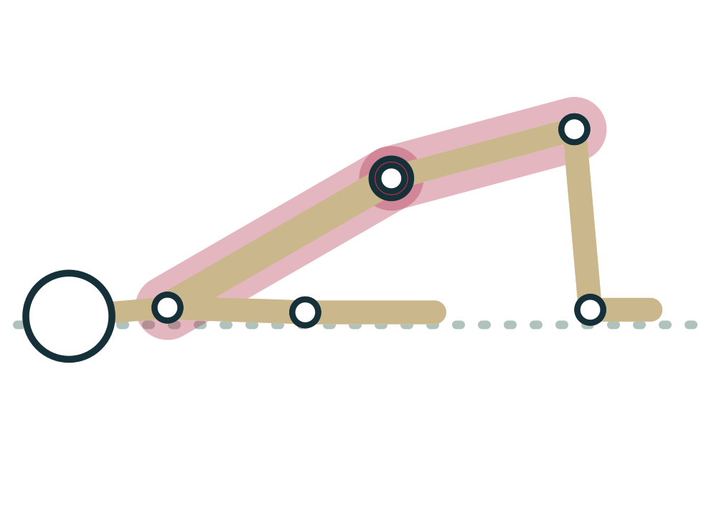
LESSON 4.7 · FEEL IT
Feel it: Bridge in three phases
1
Lie on your back, knees bent, feet hip-width, heels a hand's length from the pelvis
2
Press into the feet and lift the hips over four counts: concentric
3
Hold for three breaths with eyes and chin still: isometric
4
Lower one segment at a time over four counts: eccentric
Plate 34 Lift, hold, lower: three contraction types
Anatomy on the Mat · Dr. Akash Garg, D.C.
61

Slide 62
LESSON 4.7 · CHECK IT
In Warrior III, the lifted-leg hip keeps rolling up toward the ceiling. Which muscle role most needs attention?
The standing leg's gluteus medius as a stabilizer
Pause the video and choose before you move on.
A
The lifted leg's hip flexors as agonists
B
The standing leg's calf muscles as antagonists
C
Anatomy on the Mat · Dr. Akash Garg, D.C.
62

Slide 63
LESSON 4.7 · CHECK IT
Answer
The standing leg's gluteus medius as a stabilizer
A
The standing gluteus medius stabilizes the pelvis; when it is not holding, the pelvis rotates and the lifted hip opens toward the ceiling.
Question: In Warrior III, the lifted-leg hip keeps rolling up toward the ceiling. Which muscle role most needs attention?
Anatomy on the Mat · Dr. Akash Garg, D.C.
63

Slide 64
MODULE 4 REVIEW
Key terms
Skeletal muscle | Voluntary, striated muscle attached to bone by tendons; the quadriceps holding you in Chair are skeletal muscle.
Fascicle | A bundle of muscle fibers wrapped in connective tissue; the visible grain in a muscle such as the hamstrings.
Muscle fiber | A single long muscle cell with many nuclei; thousands of them work together when you press up from Chaturanga.
Myofibril | A thread inside a muscle fiber made of sarcomeres linked end to end.
Sarcomere | The basic contractile unit of muscle, from one Z disc to the next; millions shorten together when you rise out of Chair.
Actin and myosin | The thin (actin) and thick (myosin) protein filaments; myosin heads pull actin to shorten the sarcomere.
Motor unit | One motor neuron and all the fibers it controls; small motor units make the fine ankle corrections in Tree.
Concentric contraction | A muscle shortens while working; the quadriceps as you rise out of Chair.
Eccentric contraction | A muscle lengthens while working, acting as a brake; the triceps as you lower into Chaturanga.
Isometric contraction | A muscle works without changing length; the quadriceps while holding Chair.
Agonist (prime mover) | The main muscle producing a movement; the gluteus maximus lifting the pelvis in Bridge.
Anatomy on the Mat · Dr. Akash Garg, D.C.
64

Slide 65
MODULE 4 REVIEW
Key terms (continued)
Antagonist | The muscle producing the opposite movement, usually lengthening; the hip flexors in Bridge.
Synergist | A muscle that assists the agonist or cancels an unwanted action; the brachioradialis helping bend the elbow.
Stabilizer | A muscle that holds a nearby joint steady; the standing gluteus medius keeping the pelvis level in Warrior III.
Muscle spindle | A stretch sensor in the muscle belly that detects length and speed of stretch; it fires if you drop fast into a fold.
Golgi tendon organ | A tension sensor at the muscle-tendon junction; it reports force as you press the heels down in contract-relax stretching.
Stretch reflex | A fast spinal reflex in which a quick stretch makes the same muscle contract; the reason bouncing in Triangle backfires.
Reciprocal inhibition | Damping of the antagonist's motor neurons when a muscle contracts; engaging the quadriceps in Down Dog damps the hamstrings slightly.
PNF stretching | Proprioceptive neuromuscular facilitation: contract the stretched muscle, relax, then stretch further, as in a seated fold with heels pressing down.
Stretch tolerance | How much stretch sensation a person accepts; the main reason you reach further after a minute in a forward fold.
Fascia | Collagen-rich connective tissue that wraps and links muscles; the thoracolumbar fascia spans the low back in Cobra.
Hypermobility | Joints that move beyond typical range; a front knee locking back in Triangle may be a sign, and calls for control cues.
Anatomy on the Mat · Dr. Akash Garg, D.C.
65

Slide 66
MODULE 4 REVIEW
Myths to retire
Muscles shorten because the filaments inside them shrink
Actin and myosin keep their length and slide past each other, drawing the Z discs closer together.
A muscle that is lengthening must be relaxed
Lengthening muscles are often working hard eccentrically, like the triceps lowering you into Chaturanga.
PNF works because the Golgi tendon organ switches the muscle off
PNF improves short-term range, but the GTO explanation is questioned; increased stretch tolerance is the leading explanation.
Holding a stretch makes the muscle longer within that session
Short-term gains come mainly from greater tolerance of the stretch sensation; muscle length and stiffness change little.
Yoga or foam rolling releases fascia, and fascia stores emotions
Dense fascia cannot be deformed by hands or rollers, the felt release is mostly neural, and there is no evidence fascia stores emotions.
Anatomy on the Mat · Dr. Akash Garg, D.C.
66

Slide 67
End of Module 4
Before the next module: work through the study guide, the flashcards and the interactive exercises, then run the module in the Anatomy Chase.
kashee12345.github.io/anatomy-on-the-mat
Anatomy on the Mat · Dr. Akash Garg, D.C.

