Slide 1
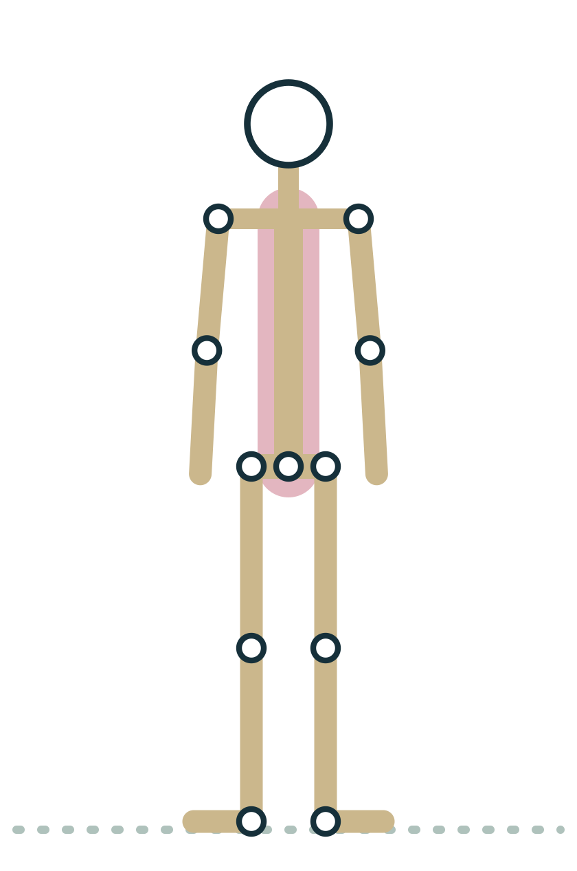
MODULE 1
The Language of Movement
A shared vocabulary of planes, axes and joint movements lets you cue any pose clearly and understand every module that follows.
1.5 hours · 4 lessons · Anatomy & Physiology for Vinyasa Teachers
Anatomy on the Mat · Dr. Akash Garg, D.C.
Notes:
Module 1: The Language of Movement. Before you can explain why a pose works, you need words that mean the same thing to everyone in the room. This module builds that vocabulary: anatomical position, directional terms, the three planes of the body with their axes, and the paired terms for joint movement, from flexion and extension to the special words for the ankle, forearm and shoulder blade. We learn it all through three standing poses you already know: Mountain, Warrior II and Triangle. You will also meet the six tissues that every pose loads, with a clear line between what research supports and what remains yoga lore. Throughout, the rule for teachers is simple: adapt and refer, never diagnose.

Slide 2
MODULE 1 OBJECTIVES
By the end of this module you can
1
Describe anatomical position and explain how it differs from Mountain pose
LESSONS
1.1 Why anatomy makes a better yoga teacher
1.2 Anatomical position, planes and axes, seen through three standing poses
1.3 Movement vocabulary: flexion, extension, abduction, adduction, rotation and special terms
1.4 Tissues in brief: bone, cartilage, ligament, tendon, fascia, muscle
2
Identify the sagittal, frontal and transverse planes and the axis of each in Mountain, Warrior II and Triangle
3
Name the joint movements of a standing pose, joint by joint, using correct paired terms
4
Define the special movement terms for the ankle, foot, forearm and shoulder blade and give a pose example of each
5
Compare bone, cartilage, ligament, tendon, fascia and muscle by function and ability to adapt
6
Distinguish well supported anatomy claims from common yoga myths
Anatomy on the Mat · Dr. Akash Garg, D.C.
2
Notes:
Describe anatomical position and explain how it differs from Mountain pose Identify the sagittal, frontal and transverse planes and the axis of each in Mountain, Warrior II and Triangle Name the joint movements of a standing pose, joint by joint, using correct paired terms Define the special movement terms for the ankle, foot, forearm and shoulder blade and give a pose example of each Compare bone, cartilage, ligament, tendon, fascia and muscle by function and ability to adapt Distinguish well supported anatomy claims from common yoga myths

Slide 3
1.1
LESSON 1.1 · 15 MIN
Why anatomy makes a better yoga teacher
See it
Feel it
Cue it
Check it
Anatomy on the Mat · Dr. Akash Garg, D.C.
3
Notes:
Lesson 1.1: Why anatomy makes a better yoga teacher. Anatomy gives you precise, shared language for cues Bodies vary, so poses should be adapted rather than forced into one shape Every lesson follows See it, Feel it, Cue it, Check it Separate well supported benefits from popular myths Yoga teachers adapt and refer; they never diagnose

Slide 4
LESSON 1.1
Anatomy is a teaching tool, not a trivia contest
Clear anatomy words make your cues precise and repeatable
Knowing structure helps you adapt poses to real bodies
It helps you spot when a student needs a referral
It keeps your claims honest and evidence based
Plate 1 Even Mountain pose is full of anatomy worth naming
Anatomy on the Mat · Dr. Akash Garg, D.C.
4
Notes:
Welcome to Anatomy on the Mat. I have taught anatomy and physiology since 2007, and I am also a chiropractor, so I spend a lot of time with bodies that do not match the textbook picture. That is exactly why this course exists. You do not need to memorise every muscle to teach well. You need a shared vocabulary so your cues mean the same thing every time, enough structure to understand why a pose feels different in different bodies, and the judgement to know when something is outside your lane. Anatomy gives you all three. Think of it as a tool that sits in your teaching kit next to breath, sequencing and voice.

Slide 5
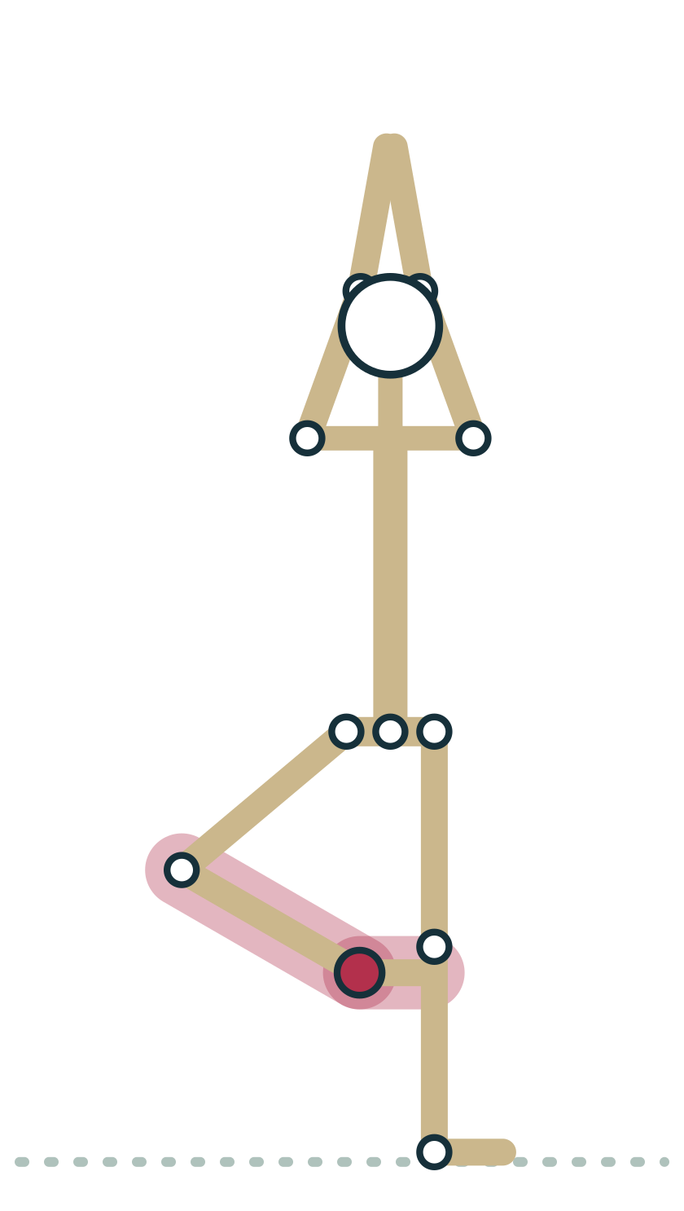
LESSON 1.1
Steps in every lesson
4
See it, Feel it, Cue it, Check it. You learn the structure, find it in your own body, turn it into words for class, then test yourself.
Plate 2 Feel it: your standing ankle is busy in Tree
Anatomy on the Mat · Dr. Akash Garg, D.C.
5
Notes:
Every lesson in this course follows the same four steps. See it means we look at the anatomy, usually with a diagram or a pose figure. Feel it means you find that structure or movement in your own body on the mat, because anatomy you have felt sticks far better than anatomy you have only read. Cue it means we turn the idea into plain words you could say to a room of beginners. Check it means a quick question or two so you know it landed. Take Tree as an example: you can see the ankle joint on a diagram, feel the tiny corrections of your standing ankle, and cue students to let those wobbles happen.

Slide 6
LESSON 1.1
Yoga lore and anatomy: what holds up
Well supported
Not supported
Yoga can improve strength, balance and mobility
Slow breathing can calm many people
Regular loading makes tissues adapt
Twists wring toxins out of organs
Stretching releases stored emotions from fascia
One perfect alignment fits every body
Anatomy on the Mat · Dr. Akash Garg, D.C.
6
Notes:
You will hear many claims in yoga spaces. Some hold up well: regular practice can improve strength, balance and range of motion, and slow breathing reliably helps many people feel calmer. Other claims are not supported. Twists do not squeeze toxins out of your liver; your liver and kidneys handle that job continuously. Emotions are not stored in fascia in any way science has shown. And there is no single perfect alignment that suits every skeleton, because bones vary in shape. Throughout this course I will be plain about what is established and what is not. That honesty protects your students and your credibility.

Slide 7
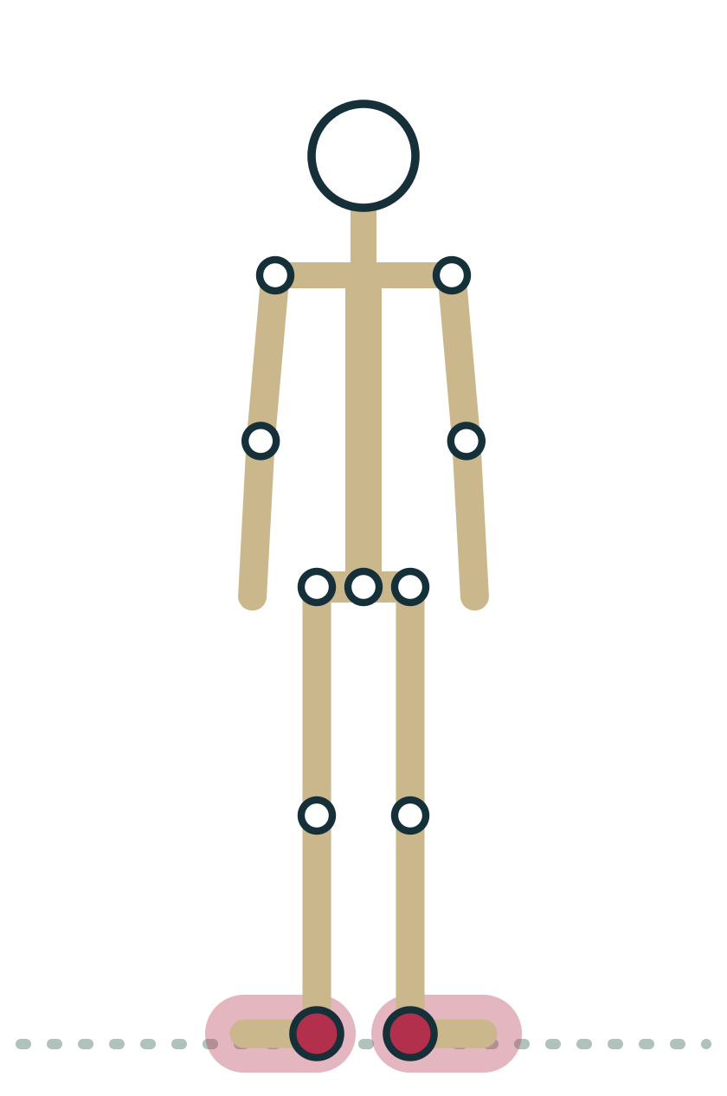
LESSON 1.1 · FEEL IT
Feel it: notice before you name
1
Stand in Mountain with feet hip width and arms relaxed by your sides
2
Sway slowly forward and back; notice where pressure travels under your feet
3
Sway side to side; notice which muscles switch on at hips and ankles
4
Come to stillness and list three things you felt, in plain words
Plate 3 Small sways reveal the ankle and hip strategies of balance
Anatomy on the Mat · Dr. Akash Garg, D.C.
7
Notes:
Before we learn any new words, I want you to notice. Stand in Mountain and let yourself sway very slowly forward and back, like a tree in a light breeze. You will feel pressure move toward your toes and then your heels, and you will probably feel your calves and shins working. Now sway side to side and notice the hips joining in. Come back to stillness and name three things you felt in your own words. Later in this module you will learn the proper terms for these movements. The point is that feeling comes first and vocabulary makes it shareable.

Slide 8
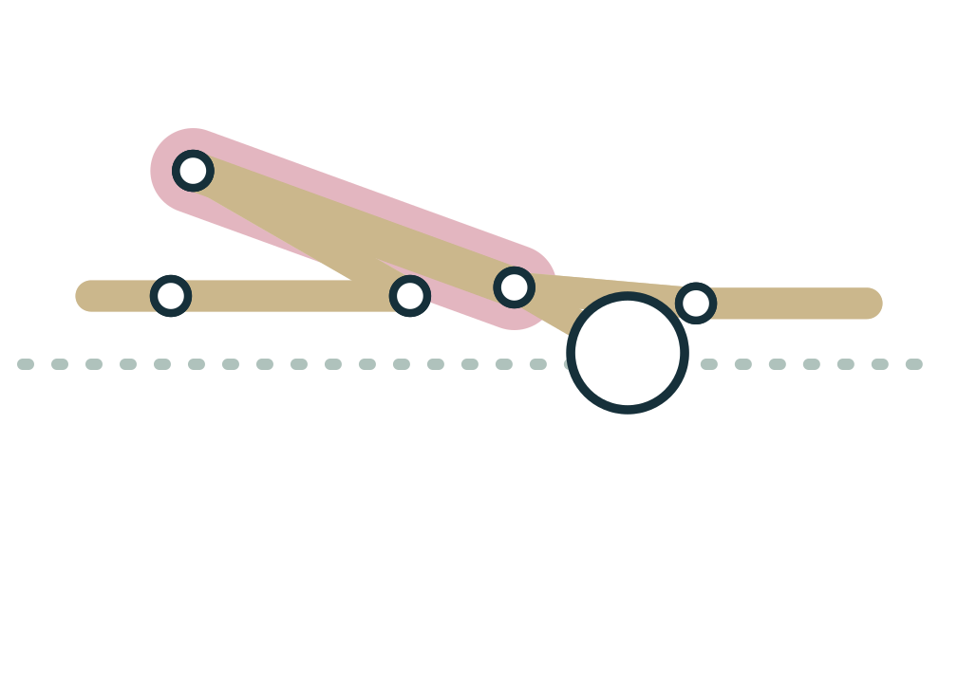
LESSON 1.1 · CUE IT
Adapt and refer, never diagnose
“Let's find a version of this pose that feels steady for you today, and if something hurts, come out and tell me after class.”
Why it works Pain has many causes that a yoga teacher cannot assess. Your job is to offer options and suggest a qualified professional when pain persists.
Plate 4 Child's pose is always a valid option
Anatomy on the Mat · Dr. Akash Garg, D.C.
8
Notes:
This is the most important boundary in the whole course. Anatomy knowledge can tempt teachers to play clinician: you tore your meniscus, your pelvis is out, that is sciatica. Please never do this. Even trained clinicians need a history, an examination and sometimes imaging to make a diagnosis. What you can do is adapt the pose, offer a rest option such as Child's pose, and encourage a student with persistent or sharp pain, numbness or tingling to see a doctor or physical therapist. That is not a weakness in your teaching. It is exactly what a skilled, safe teacher does.

Slide 9
LESSON 1.1 · CHECK IT
A student says her knee hurts in Warrior II. What is the best first response from a yoga teacher?
Offer a modified version or rest, and suggest she see a clinician if pain persists
Pause the video and choose before you move on.
A
Tell her she probably has a torn meniscus
B
Ask her to push through so the knee gets stronger
C
Anatomy on the Mat · Dr. Akash Garg, D.C.
9
Notes:
Take a moment with this one. The first option reflects the scope we just discussed: modify, rest, and refer if the pain persists. Naming a diagnosis is outside a yoga teacher's scope and could be wrong. Pushing through pain is never good advice in a group class.

Slide 10
LESSON 1.1 · CHECK IT
Answer
Offer a modified version or rest, and suggest she see a clinician if pain persists
A
Teachers adapt and refer; they do not diagnose or encourage working through pain.
Question: A student says her knee hurts in Warrior II. What is the best first response from a yoga teacher?
Anatomy on the Mat · Dr. Akash Garg, D.C.
10
Notes:
The answer is A: Offer a modified version or rest, and suggest she see a clinician if pain persists. Teachers adapt and refer; they do not diagnose or encourage working through pain.

Slide 11
1.2
LESSON 1.2 · 25 MIN
Anatomical position, planes and axes, seen through three standing poses
See it
Feel it
Cue it
Check it
Anatomy on the Mat · Dr. Akash Garg, D.C.
11
Notes:
Lesson 1.2: Anatomical position, planes and axes, seen through three standing poses. Anatomical position is Mountain with palms turned forward Directional terms come in opposite pairs Sagittal: forward and back; frontal: side to side; transverse: turning Each plane has an axis at right angles to it, like a hinge Most poses combine movements in more than one plane

Slide 12
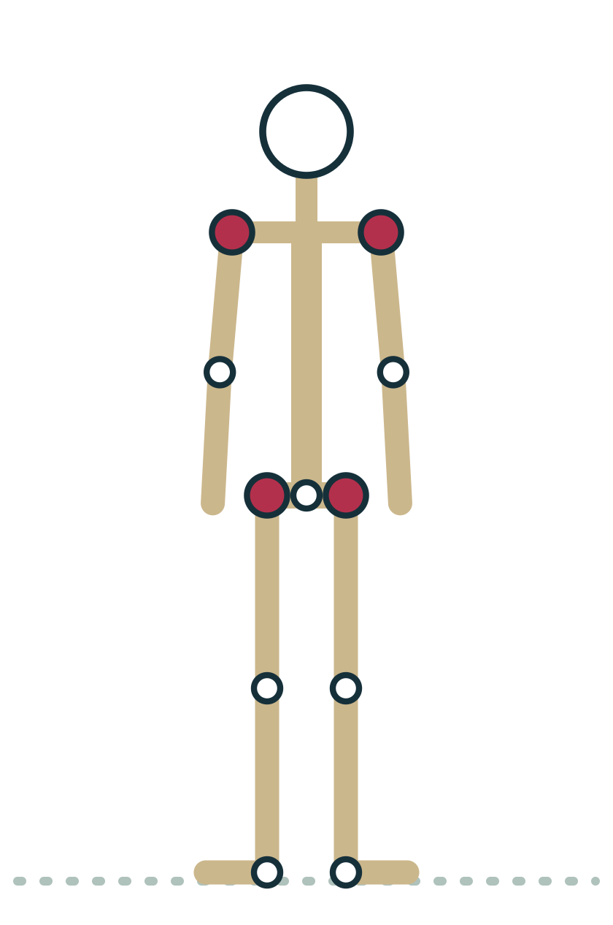
LESSON 1.2
Anatomical position: the starting map
Standing tall, face and feet forward, arms by the sides
Palms turned forward, thumbs pointing away from the body
Every movement term is named from this position
Mountain is anatomical position with palms turned in
Plate 5 Turn the palms forward and Mountain becomes anatomical position
Anatomy on the Mat · Dr. Akash Garg, D.C.
12
Notes:
Anatomists needed one agreed starting posture so that words like up, front and inward mean the same thing no matter how a body is lying or twisting. That posture is called anatomical position: standing upright, head and eyes facing forward, feet together or slightly apart and pointing forward, arms hanging by the sides with the palms facing forward. Look at Mountain pose. It is almost identical. The only difference is that in Mountain most students let their palms face their thighs. Ask them to turn the palms forward and they are standing in anatomical position. From now on, every movement term we use is described relative to this map.

Slide 13
LESSON 1.2
Directional terms in pairs
Up and down, front and back
Middle and limbs
Superior: toward the head
Inferior: toward the feet
Anterior: toward the front
Posterior: toward the back
Medial: toward the midline
Lateral: away from the midline
Proximal: closer to the trunk
Distal: farther from the trunk
Anatomy on the Mat · Dr. Akash Garg, D.C.
13
Notes:
Directional terms come in opposite pairs, which makes them easier to learn. Superior means toward the head and inferior means toward the feet, so the knee is superior to the ankle. Anterior is the front and posterior is the back, so the kneecap is on the anterior knee. Medial means toward the midline of the body and lateral means away from it, so the big toe is on the medial side of the foot. Proximal and distal are used for limbs: proximal is closer to where the limb attaches to the trunk and distal is farther away. The elbow is proximal to the wrist. You will hear these words throughout this course.

Slide 14
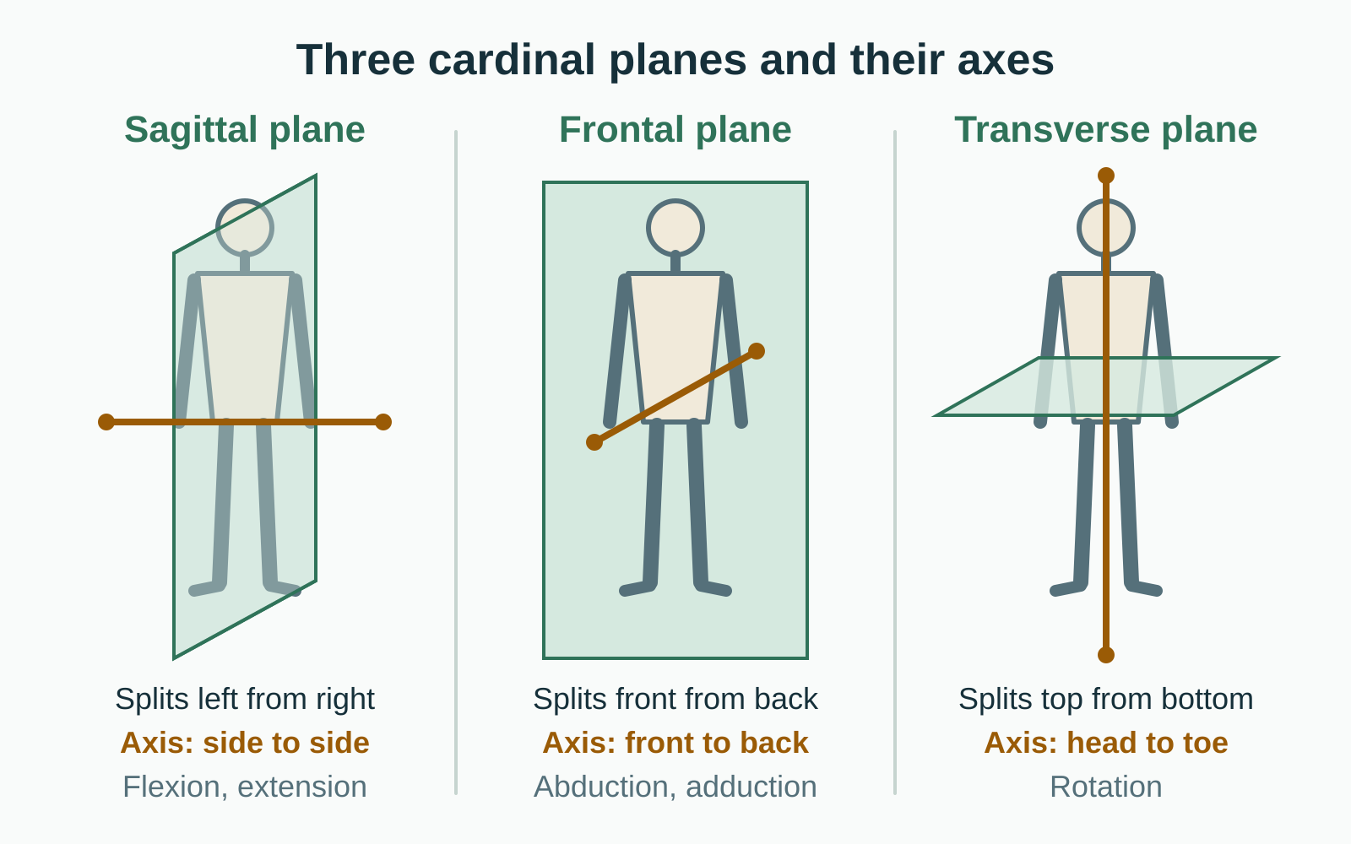
LESSON 1.2
Three planes, three axes
Sagittal plane: splits left and right; forward and back movement
Frontal plane: splits front and back; side to side movement
Transverse plane: splits top and bottom; turning movement
Each plane turns around an axis at right angles to it
Plate 6 Each plane has a matching axis of rotation, shown in amber
Anatomy on the Mat · Dr. Akash Garg, D.C.
14
Notes:
A plane is an imaginary flat sheet of glass through the body. The sagittal plane divides the body into left and right parts, and movements in it go forward and back, like folding forward. The frontal plane, also called the coronal plane, divides front from back, and movements in it go out to the side and back in, like lifting your arms in Warrior II. The transverse plane divides top from bottom, and movements in it are turns, like a seated twist. Each movement happens around an axis, a line like a door hinge. The hinge always sits at right angles to the plane of motion. A forward fold swings around a side to side axis through the hips.

Slide 15
LESSON 1.2
Three standing poses, three planes
Tadasana
Warrior II
Triangle
The neutral reference for all planes
Close to anatomical position
Small sways in sagittal and frontal planes
Arms abducted in the frontal plane
Front hip externally rotated
Front knee flexed over the foot
Trunk tilts sideways, frontal plane
Front hip flexed and externally rotated
Arms open wide, frontal plane
Anatomy on the Mat · Dr. Akash Garg, D.C.
15
Notes:
Here is why this module teaches planes through three standing poses. Tadasana, or Mountain, is our neutral reference: it is nearly anatomical position, and the only movement is small sway in the sagittal and frontal planes. Warrior II shows frontal plane work clearly: the arms are lifted out to the sides, which is abduction, and the front thigh is turned out, which is external rotation in the transverse plane. Triangle again opens the arms in the frontal plane and tilts the trunk sideways. Notice that real poses mix planes. The front hip in Triangle is flexed, abducted and externally rotated all at once. Planes are a naming tool, not a rule that poses must stay flat.

Slide 16
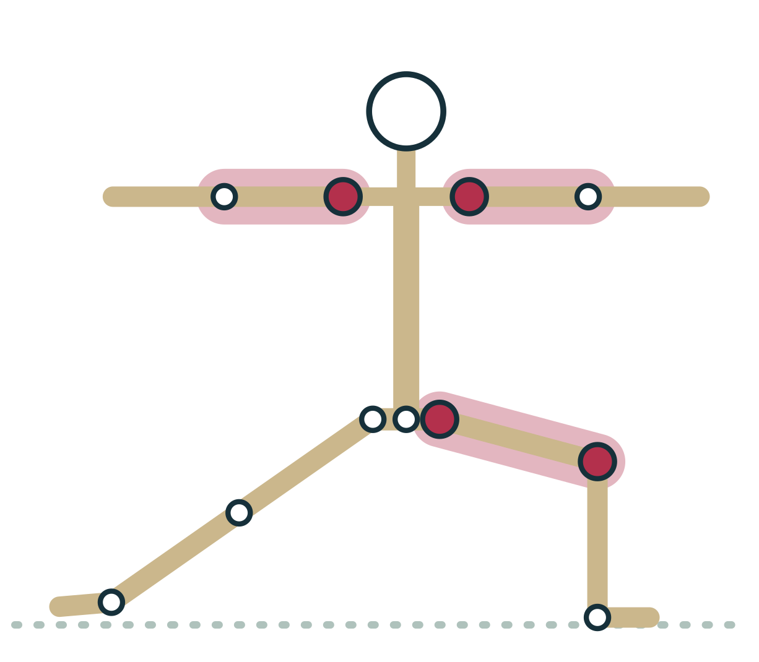
LESSON 1.2 · FEEL IT
Feel it: find the planes in Warrior II
1
From Mountain, lift both arms out to shoulder height: frontal plane
2
Step wide, turn the front foot out: rotation in the transverse plane
3
Bend the front knee: flexion in the sagittal plane of that leg
4
Hold three breaths and name each plane to yourself as you scan
Plate 7 Warrior II uses all three planes at once
Anatomy on the Mat · Dr. Akash Garg, D.C.
16
Notes:
Let's feel the planes rather than just read about them. Start in Mountain and lift both arms out to the sides to shoulder height. That movement happened in the frontal plane. Now step your feet wide and turn your front foot and thigh outward. That turning is rotation in the transverse plane. Now bend the front knee. The knee is bending forward and back relative to that leg, which is sagittal plane motion for the knee. Stay for three breaths and scan: arms, frontal; hip turn, transverse; knee bend, sagittal. You have just found all three planes in one familiar pose. This kind of scan is a habit you will use for every pose.

Slide 17
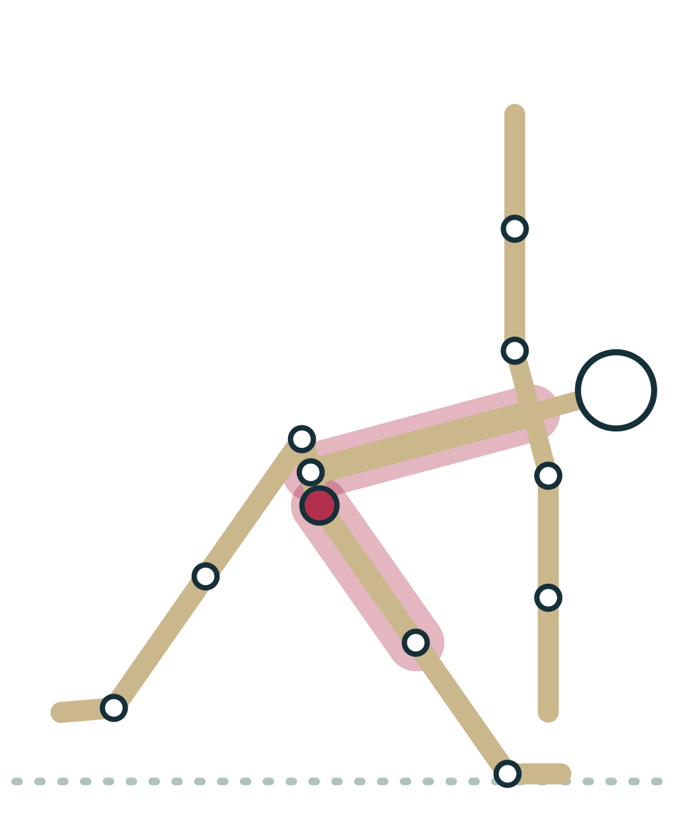
LESSON 1.2 · CUE IT
Cueing Triangle with planes in mind
“Reach long through your front arm, then tilt sideways from the hips and let both sides of your waist stay long.”
Why it works Triangle is mainly hip flexion with trunk tilting in the frontal plane. Keeping both sides of the waist long avoids collapsing into only the lower side.
Plate 8 Triangle tilts the trunk mainly in the frontal plane
Anatomy on the Mat · Dr. Akash Garg, D.C.
17
Notes:
Many teachers cue Triangle as if the body is pressed between two panes of glass. It is a useful image for the frontal plane, but take it lightly. Most people's pelvis will naturally turn a little toward the floor, and that is fine; forcing the pelvis flat can strain the knee or lower back. A better emphasis is to reach first and tilt from the hips, keeping both sides of the waist long. Anatomically, the front hip is flexing as the pelvis tips over the front thigh, and the trunk adds some lateral flexion. Give students permission to use a block so the shape serves them, not the other way round.

Slide 18
LESSON 1.2 · CHECK IT
Lifting the arms out to the sides into Warrior II arms happens mainly in which plane?
Sagittal plane
Pause the video and choose before you move on.
A
Frontal plane
B
Transverse plane
C
Anatomy on the Mat · Dr. Akash Garg, D.C.
18
Notes:
The frontal plane divides front from back, so any movement out to the side and back in happens there. Sagittal would be lifting the arms forward, as in Warrior I, and transverse would be a turning movement.

Slide 19
LESSON 1.2 · CHECK IT
Answer
Frontal plane
B
Moving the arms out to the side and back in is abduction and adduction in the frontal plane.
Question: Lifting the arms out to the sides into Warrior II arms happens mainly in which plane?
Anatomy on the Mat · Dr. Akash Garg, D.C.
19
Notes:
The answer is B: Frontal plane. Moving the arms out to the side and back in is abduction and adduction in the frontal plane.

Slide 20
1.3
LESSON 1.3 · 30 MIN
Movement vocabulary: flexion, extension, abduction, adduction, rotation and special terms
See it
Feel it
Cue it
Check it
Anatomy on the Mat · Dr. Akash Garg, D.C.
20
Notes:
Lesson 1.3: Movement vocabulary: flexion, extension, abduction, adduction, rotation and special terms. Name the joint and the movement together, such as hip flexion Most movement terms come in opposite pairs Sagittal: flexion and extension; frontal: abduction and adduction; transverse: rotation Ankle, foot, forearm and shoulder blade each have special terms Upward rotation of the shoulder blades is needed for arms overhead Describe poses joint by joint, from hips to shoulders

Slide 21
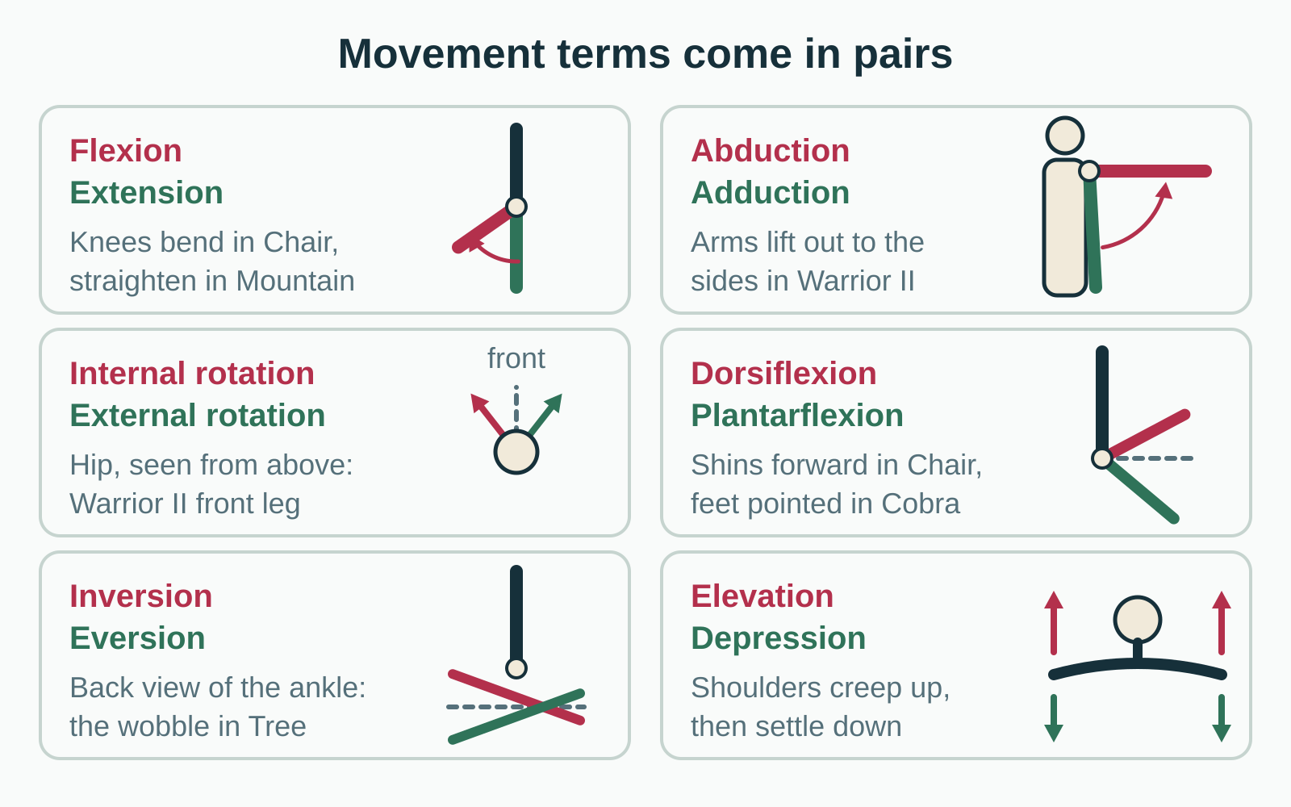
LESSON 1.3
Movement words come in opposite pairs
Flexion bends a joint; extension straightens it
Abduction moves away from the midline; adduction moves toward it
Internal rotation turns inward; external rotation turns outward
Learn one word and you have learned its partner
Plate 9 Paired movement terms, with the first term in red and its partner in green
Anatomy on the Mat · Dr. Akash Garg, D.C.
21
Notes:
Joint movement terms come in pairs of opposites, which halves the work of learning them. Flexion usually decreases the angle between two bones, like bending the knees in Chair, and extension increases it, like straightening back to Mountain. Abduction takes a limb away from the midline, like lifting the arms out into Warrior II, and adduction brings it back. Internal rotation, also called medial rotation, turns the front of a limb toward the midline, and external or lateral rotation turns it away. The front thigh in Warrior II is externally rotated. The diagram also shows some of the special terms we will meet next. Always name the joint and the movement together, such as hip flexion.

Slide 22
LESSON 1.3
Sorting movements by plane
Sagittal
Frontal
Transverse
Flexion and extension
Dorsiflexion and plantarflexion
Example: Forward Fold
Abduction and adduction
Lateral flexion of the spine
Example: Warrior II arms
Internal and external rotation
Horizontal abduction and adduction
Example: seated twist
Anatomy on the Mat · Dr. Akash Garg, D.C.
22
Notes:
Each pair of movements belongs to a plane, and knowing the plane helps you recognise the movement. Flexion and extension happen in the sagittal plane, and so do dorsiflexion and plantarflexion at the ankle. Abduction and adduction, and side bending of the spine, called lateral flexion, happen in the frontal plane. Rotations happen in the transverse plane, and so do horizontal abduction and adduction, where an arm already lifted to shoulder height sweeps back and forth, like opening the arms from in front of you out to Warrior II. One small caution: a few joints, such as the thumb and the shoulder blade, move in ways that do not fit neatly into one plane. The table is a guide, not a rule.

Slide 23
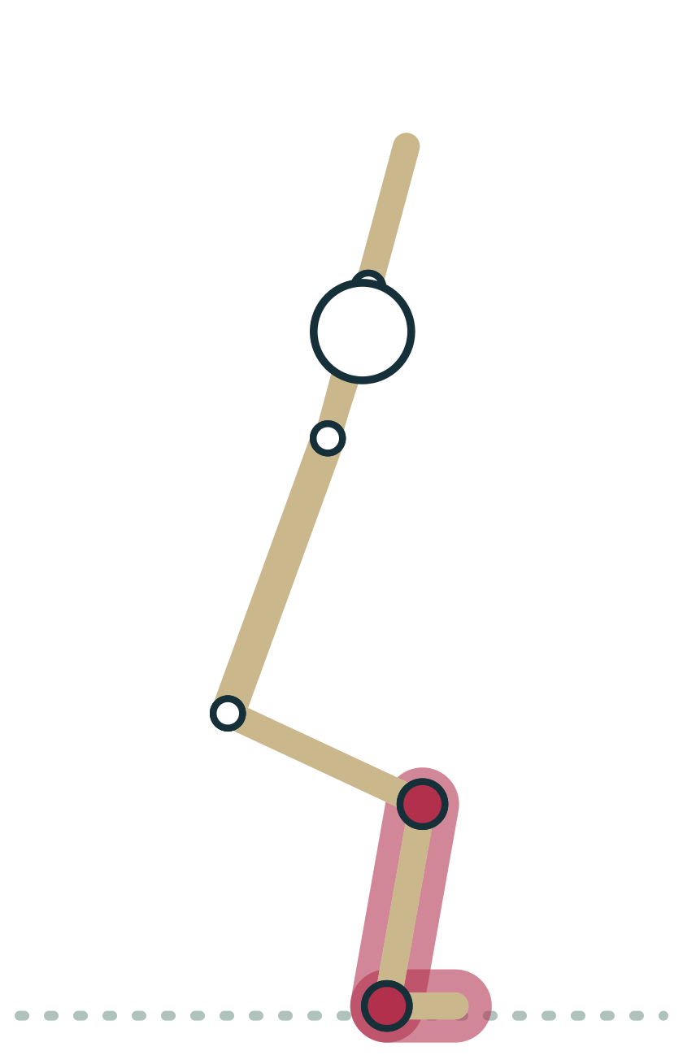
LESSON 1.3
Special terms: ankle, foot and forearm
Dorsiflexion lifts the top of the foot toward the shin
Plantarflexion points the foot, as in tops of feet down
Inversion turns the sole in; eversion turns it out
Supination turns the palm up; pronation turns it down
Plate 10 Chair asks for plenty of ankle dorsiflexion
Anatomy on the Mat · Dr. Akash Garg, D.C.
23
Notes:
Some joints get their own words. At the ankle, dorsiflexion brings the top of the foot toward the shin. Chair pose needs lots of it as the shins lean forward. Plantarflexion points the foot, as when the tops of the feet rest on the mat in Cobra or Child's pose. Inversion tilts the sole of the foot inward and eversion tilts it outward; you feel both as the tiny wobbles of the standing foot in Tree. At the forearm, supination turns the palm up and pronation turns the palm down. Your forearms are pronated in Downward Dog, with palms on the floor. A memory trick: you can hold a bowl of soup in a supinated hand.

Slide 24
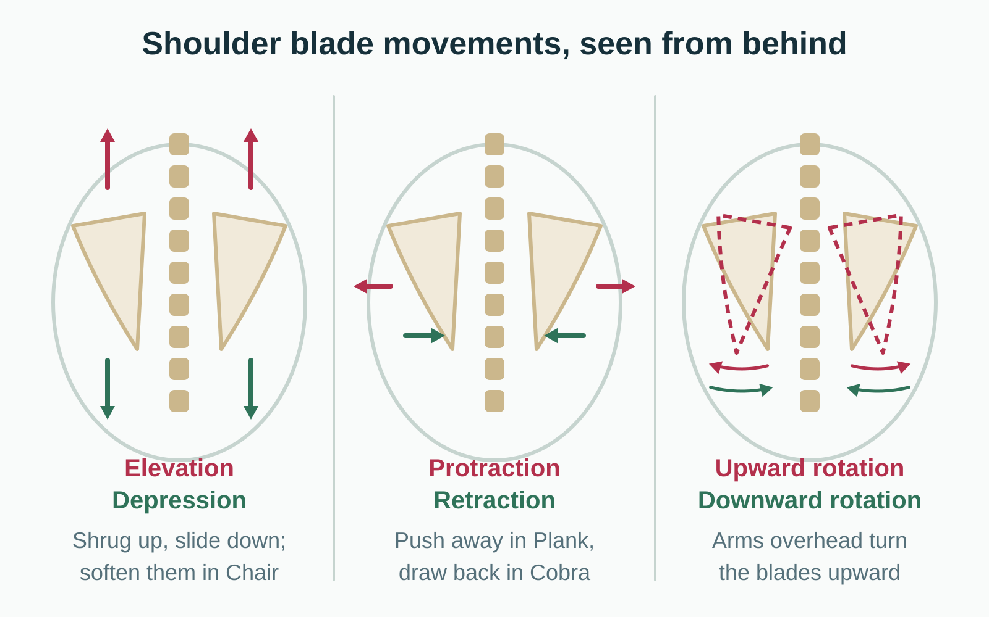
LESSON 1.3
Special terms: the shoulder blade
Elevation lifts the shoulder blades; depression lowers them
Protraction wraps them forward around the ribs; retraction draws them back
Upward rotation turns the socket up as arms go overhead
Downward rotation returns the blades as the arms lower
Plate 11 Scapular movements seen from behind
Anatomy on the Mat · Dr. Akash Garg, D.C.
24
Notes:
The shoulder blade, or scapula, slides over the back of the rib cage, and it has its own vocabulary. Elevation is a shrug and depression lowers the blades. Protraction wraps them forward around the ribs, as when you press the floor away in Plank, and retraction draws them toward the spine, as in Cobra. Upward rotation turns the shoulder socket to face upward; it happens automatically whenever you lift your arms overhead, roughly one degree of blade rotation for every two degrees of arm lift. Downward rotation is the return. This matters for cueing. Telling students to pin the shoulders down and back while their arms are overhead fights the upward rotation that the shoulder needs.

Slide 25
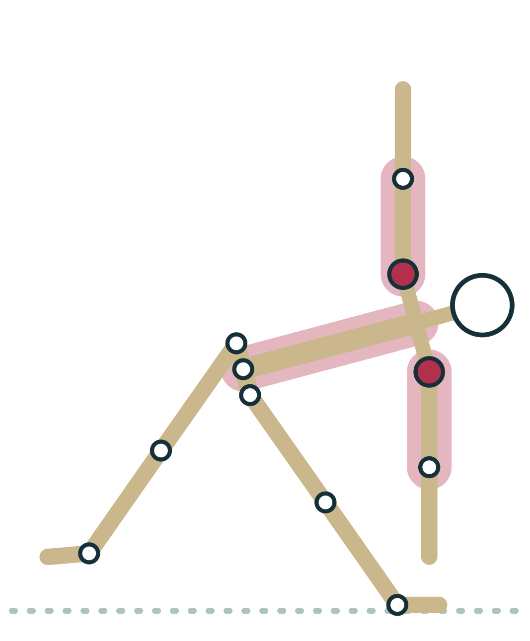
LESSON 1.3
Circles, side bends and horizontal sweeps
Circumduction: a circle combining flexion, abduction, extension and adduction
Lateral flexion: bending the spine sideways, as in Gate
Horizontal abduction: arm at shoulder height sweeps back
Horizontal adduction: arm at shoulder height sweeps across
Plate 12 Triangle adds some lateral flexion of the trunk
Anatomy on the Mat · Dr. Akash Garg, D.C.
25
Notes:
A few more terms round out the vocabulary. Circumduction is a circle drawn by a limb, like arm circles or ankle circles in a warm up. It is not a separate kind of movement but a combination of flexion, abduction, extension and adduction in sequence. Lateral flexion means side bending of the spine or neck, as in Gate pose, a standing side bend, or the side tilt in Triangle. Horizontal abduction and adduction describe an arm already lifted to shoulder height. Sweeping it back and out is horizontal abduction, as when the arms open from in front of you into Warrior II. Sweeping it across the chest is horizontal adduction, as in Eagle arms.

Slide 26
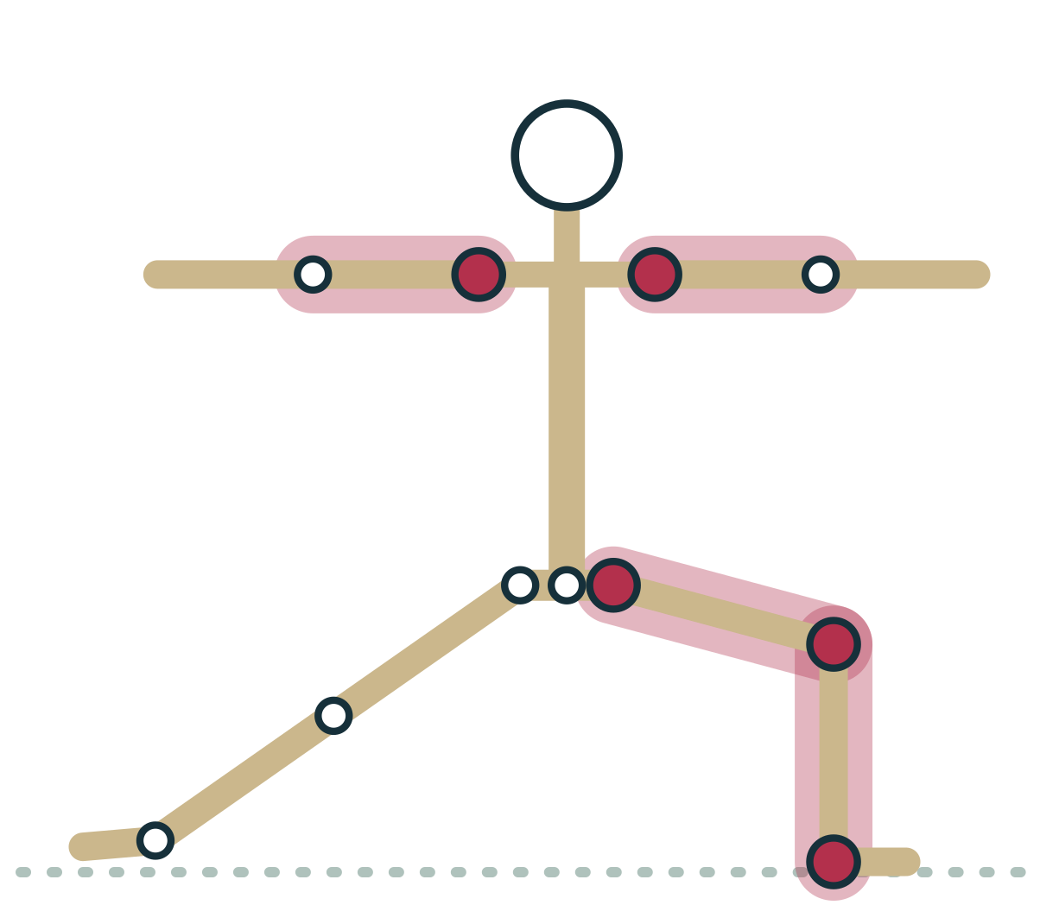
LESSON 1.3 · FEEL IT
Feel it: name the joint actions of Warrior II
1
Front hip: flexed, abducted and externally rotated
2
Front knee: flexed toward ninety degrees; front ankle: dorsiflexed
3
Back leg: hip abducted, knee extended, foot turned slightly in
4
Shoulders: abducted to shoulder height, forearms often pronated
Plate 13 Name each joint, then each movement
Anatomy on the Mat · Dr. Akash Garg, D.C.
26
Notes:
Now we practise the most useful skill in this module: describing a pose joint by joint. Come into Warrior II. Start at the front hip: it is flexed because the thigh has moved forward relative to the pelvis, abducted because the leg is away from the midline, and externally rotated because the knee points out over the toes. The front knee is flexed and the front ankle is dorsiflexed as the shin leans forward. The back hip is abducted and the back knee is extended. The shoulders are abducted to about ninety degrees. The forearms are usually pronated, palms down. Say these out loud once, and the pose will never look the same again.

Slide 27
LESSON 1.3 · CHECK IT
In Chair pose, the shins lean forward over the feet. What is the ankle doing?
Plantarflexion
Pause the video and choose before you move on.
A
Inversion
B
Dorsiflexion
C
Anatomy on the Mat · Dr. Akash Garg, D.C.
27
Notes:
When the shin leans forward over a flat foot, the angle between the top of the foot and the front of the shin gets smaller. That is dorsiflexion. Plantarflexion would be pointing the foot, and inversion would be tilting the sole inward.

Slide 28
LESSON 1.3 · CHECK IT
Answer
Dorsiflexion
C
The top of the foot and the shin come closer together, which is dorsiflexion.
Question: In Chair pose, the shins lean forward over the feet. What is the ankle doing?
Anatomy on the Mat · Dr. Akash Garg, D.C.
28
Notes:
The answer is C: Dorsiflexion. The top of the foot and the shin come closer together, which is dorsiflexion.

Slide 29
1.4
LESSON 1.4 · 20 MIN
Tissues in brief: bone, cartilage, ligament, tendon, fascia, muscle
See it
Feel it
Cue it
Check it
Anatomy on the Mat · Dr. Akash Garg, D.C.
29
Notes:
Lesson 1.4: Tissues in brief: bone, cartilage, ligament, tendon, fascia, muscle. Ligament joins bone to bone; tendon joins muscle to bone The adult skeleton has 206 living, remodelling bones Articular cartilage has no blood vessels and heals very slowly Muscle adapts in weeks; tendon and bone take months Fascia is real and interesting, but many popular claims are unproven

Slide 30
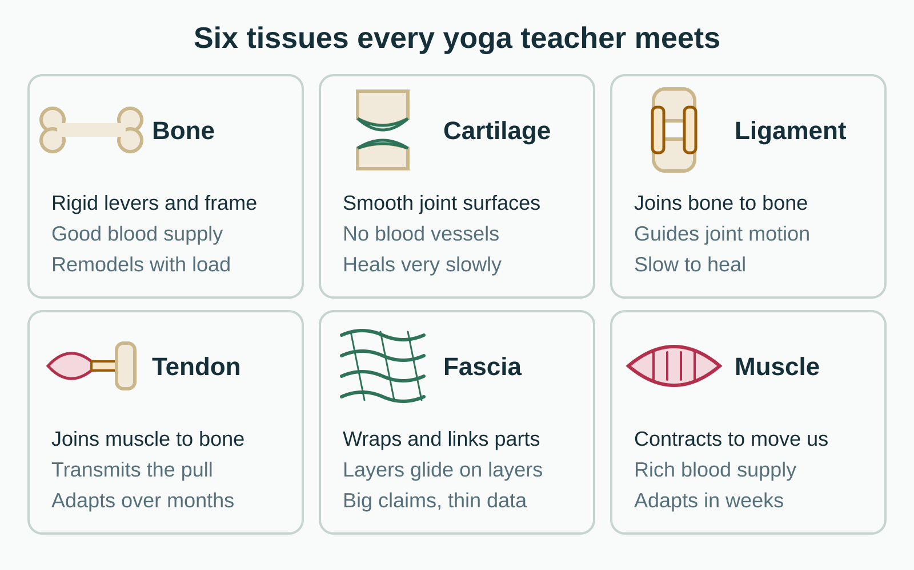
LESSON 1.4
Six tissues you work with in every pose
Bone and cartilage form the frame and joint surfaces
Ligaments join bone to bone; tendons join muscle to bone
Muscle contracts and fascia wraps and connects
Blood supply largely sets how fast each tissue adapts
Plate 14 Six tissues compared by job, blood supply and adaptation
Anatomy on the Mat · Dr. Akash Garg, D.C.
30
Notes:
Every pose loads the same small cast of tissues. Bone forms the rigid frame and the levers that muscles pull on. Cartilage covers the ends of bones inside joints, giving a smooth, low friction surface. Ligaments are tough bands that join bone to bone and help guide joint motion. Tendons join muscle to bone and transmit the pull of the muscle. Muscle is the tissue that contracts. Fascia is the broad name for the connective tissue sheets that wrap and link muscles and organs. One useful pattern: tissues with a rich blood supply, like muscle, adapt and heal fastest, while tissues with a poor supply, like cartilage and ligament, change slowly.

Slide 31
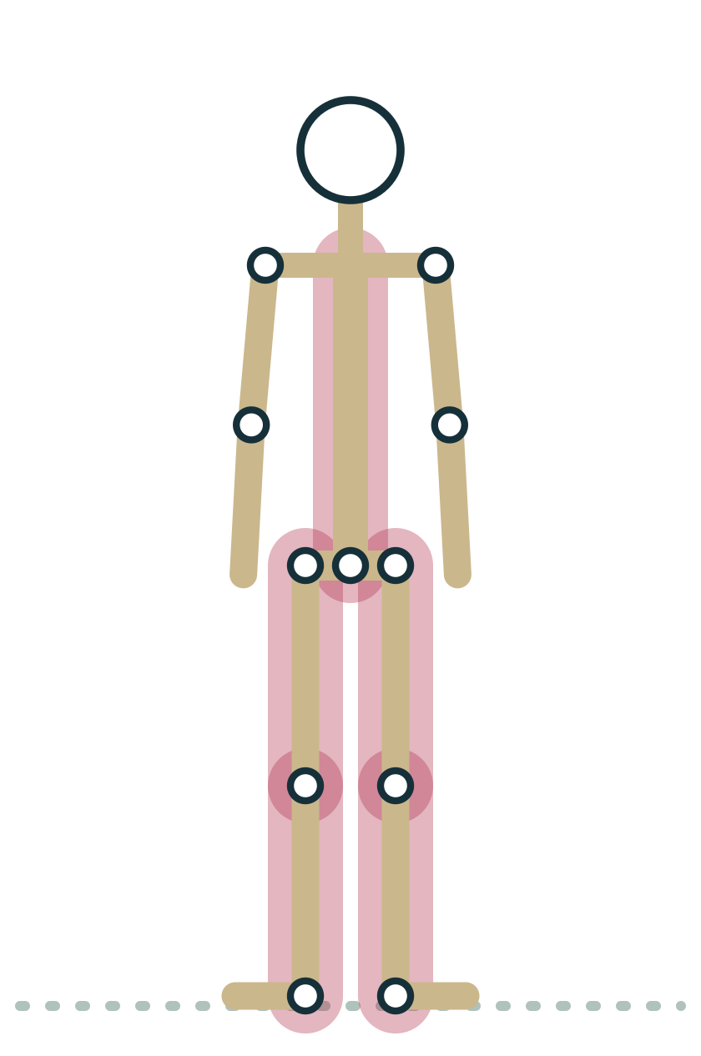
LESSON 1.4
Bones in the adult skeleton
206
Bone is living tissue with nerves and blood vessels. It stores minerals, makes blood cells in marrow and remodels in response to load.
Plate 15 Standing poses load the leg bones and spine
Anatomy on the Mat · Dr. Akash Garg, D.C.
31
Notes:
The adult skeleton has 206 bones. It is easy to think of bone as dry and dead, like a museum skeleton, but living bone has a blood supply and nerves, stores calcium and other minerals, and makes blood cells in its marrow. Bone also remodels throughout life. When it is loaded regularly, as in standing and weight bearing poses, it tends to maintain or gain density; when it is unloaded, as in long bed rest, it loses density. This is one reason weight bearing practice is often recommended for bone health. The effect of yoga alone on bone density is still being studied, so keep claims modest.

Slide 32
LESSON 1.4
Ligament or tendon?
Ligament
Tendon
Connects bone to bone
Guides and limits joint motion
Rich in position sensing nerve endings
Heals slowly once overstretched
Connects muscle to bone
Transmits muscle force to bone
Stiffens and strengthens with loading
Adapts over months, not days
Anatomy on the Mat · Dr. Akash Garg, D.C.
32
Notes:
Ligaments and tendons are both made of dense, tightly packed collagen, and students often mix them up. The simple rule is: ligament, bone to bone; tendon, muscle to bone. Ligaments guide and limit joint movement and contain nerve endings that tell the brain where the joint is. They have a limited blood supply, so once overstretched they heal slowly and may stay looser. That is one reason we do not aim to stretch ligaments by hanging into the end range of joints. Tendons carry the force of a muscle to a bone. They respond well to gradual loading but adapt more slowly than muscle, over months rather than days, so progress intense practices gradually.

Slide 33
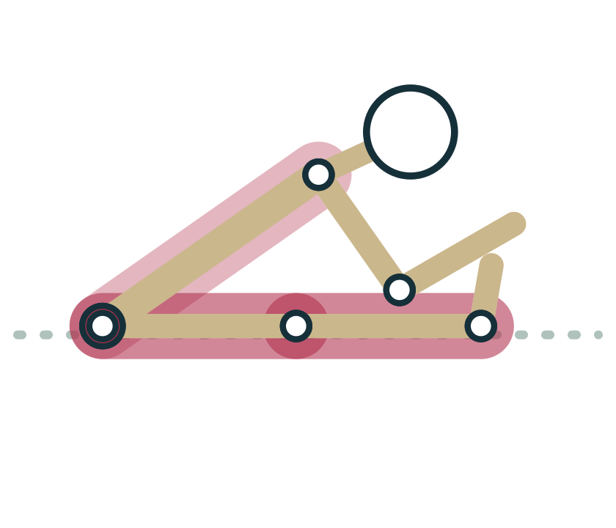
LESSON 1.4
Fascia: what we know and what we don't
Fascia is fibrous connective tissue wrapping muscles and organs
It is continuous and richly supplied with sensory nerves
Hands or stretches probably cannot remodel dense fascia quickly
Claims about releasing stored emotions or toxins lack evidence
Plate 16 Forward Fold stretches muscles and their fascial wrappings together
Anatomy on the Mat · Dr. Akash Garg, D.C.
33
Notes:
Fascia has become a hot topic in yoga. Here is what is established. Fascia is fibrous connective tissue that wraps individual muscles, groups of muscles and organs, and it is continuous from region to region. It contains many sensory nerve endings, so it contributes to how we feel stretch and body position. Here is what is not established. Research suggests that dense fascia needs very large forces to deform permanently, so a stretch or a massage probably changes how the nervous system responds rather than remodelling fascia itself in minutes. Claims that fascia stores emotions or toxins that a pose can release have no good evidence. Fascia is interesting enough without the myths.

Slide 34
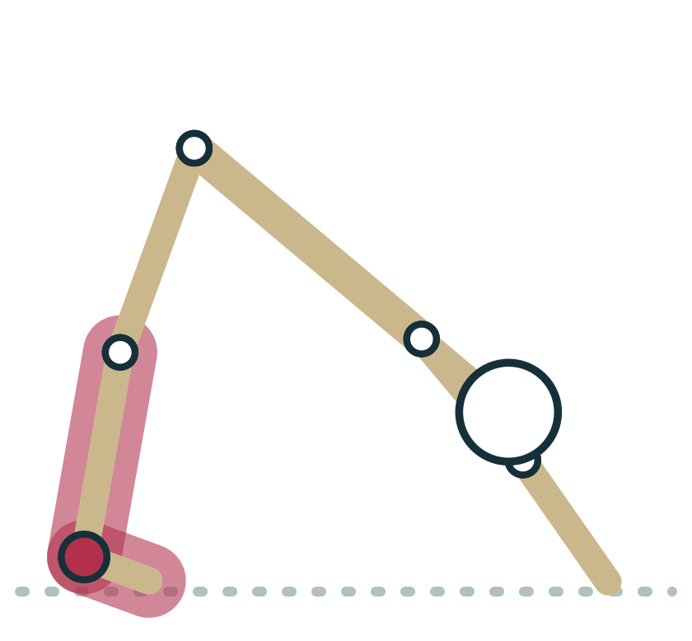
LESSON 1.4 · FEEL IT
Feel it: tendon, muscle and joint
1
Sitting, pinch the cord at the back of your heel: your Achilles tendon
2
Point and flex the foot; feel the calf muscle bunch and the tendon move
3
Come to Downward Dog and pedal the heels slowly
4
Notice stretch in the calf belly, not a sharp pull at the tendon or joint
Plate 17 Downward Dog stretches the calves and loads the Achilles tendon
Anatomy on the Mat · Dr. Akash Garg, D.C.
34
Notes:
Let's find some of these tissues. Sitting down, pinch the thick cord at the back of your heel. That is the Achilles tendon, the strongest tendon in the body, joining the calf muscles to the heel bone. Point and flex your foot and feel the muscle belly of the calf shorten and lengthen above it. Now come into Downward Dog and pedal your heels slowly. You should feel a broad stretch in the belly of the calf muscle. If a student feels a sharp, localised pull at the tendon itself, or at the back of the knee joint, that is a signal to back off and bend the knees. Muscle stretch is welcome; sharp joint or tendon pain is not.

Slide 35
LESSON 1.4 · CHECK IT
Which tissue connects muscle to bone?
Ligament
Pause the video and choose before you move on.
A
Tendon
B
Cartilage
C
Anatomy on the Mat · Dr. Akash Garg, D.C.
35
Notes:
Tendon, muscle to bone; ligament, bone to bone. Cartilage covers the joint surfaces of bones and does not connect muscle to anything. If you remember one fact from this lesson, make it this one.

Slide 36
LESSON 1.4 · CHECK IT
Answer
Tendon
B
Tendons connect muscle to bone; ligaments connect bone to bone.
Question: Which tissue connects muscle to bone?
Anatomy on the Mat · Dr. Akash Garg, D.C.
36
Notes:
The answer is B: Tendon. Tendons connect muscle to bone; ligaments connect bone to bone.

Slide 37
MODULE 1 REVIEW
Key terms
Anatomical position | The reference posture for all movement terms: standing, face and feet forward, palms facing forward. Mountain with palms turned out.
Superior and inferior | Toward the head and toward the feet. In Mountain the knees are superior to the ankles.
Medial and lateral | Toward and away from the midline. The big toe is on the medial side of the foot.
Proximal and distal | Closer to or farther from where a limb joins the trunk. In Downward Dog the wrist is distal to the elbow.
Sagittal plane | The plane dividing left from right; forward and backward movements happen in it, as in a Forward Fold.
Frontal (coronal) plane | The plane dividing front from back; side to side movements happen in it, as when the arms lift into Warrior II.
Transverse plane | The plane dividing top from bottom; rotations happen in it, as in a seated twist.
Axis | The imaginary hinge line a movement turns around, always at right angles to the plane of movement. A forward fold turns around a side to side axis through the hips.
Flexion | A movement that usually decreases the angle between two bones, like bending the knees in Chair.
Extension | A movement that usually increases the angle between two bones, like straightening the knees back to Mountain.
Abduction | Moving a limb away from the midline, like lifting the arms out to the sides in Warrior II.
Anatomy on the Mat · Dr. Akash Garg, D.C.
37
Notes:
Key terms for review. Anatomical position, Superior and inferior, Medial and lateral, Proximal and distal, Sagittal plane, Frontal (coronal) plane, Transverse plane, Axis, Flexion, Extension, Abduction

Slide 38
MODULE 1 REVIEW
Key terms (continued)
Adduction | Moving a limb toward the midline, like bringing the arms back down to the sides after Warrior II.
Internal and external rotation | Turning the front of a limb toward (internal) or away from (external) the midline. The front thigh in Warrior II is externally rotated.
Lateral flexion | Bending the spine or neck sideways, as in Gate pose or the side tilt of Triangle.
Circumduction | A circular movement combining flexion, abduction, extension and adduction, like arm circles in a warm up.
Dorsiflexion and plantarflexion | Lifting the top of the foot toward the shin (Chair) and pointing the foot (tops of feet down in Cobra).
Inversion and eversion | Tilting the sole of the foot inward and outward; you feel both as the standing foot wobbles in Tree.
Pronation and supination | Turning the palm down (hands on the mat in Downward Dog) and turning the palm up (palms up in Savasana).
Protraction and retraction | Wrapping the shoulder blades forward around the ribs (pressing away in Plank) and drawing them toward the spine (Cobra).
Elevation and depression | Lifting the shoulder blades toward the ears and lowering them away, as when softening a shrug in Chair.
Upward and downward rotation | Turning the shoulder blade so the socket faces up as the arms rise overhead, and back again as they lower.
Horizontal abduction and adduction | With the arm at shoulder height, sweeping it back and out (opening into Warrior II) or across the chest (Eagle arms).
Anatomy on the Mat · Dr. Akash Garg, D.C.
38
Notes:
Key terms for review. Adduction, Internal and external rotation, Lateral flexion, Circumduction, Dorsiflexion and plantarflexion, Inversion and eversion, Pronation and supination, Protraction and retraction, Elevation and depression, Upward and downward rotation, Horizontal abduction and adduction

Slide 39
MODULE 1 REVIEW
Myths to retire
Warrior II and Triangle must be performed flat, as if between two panes of glass.
The frontal plane is a useful reference, but most pelvises turn slightly toward the floor. Forcing a flat shape can strain knees and the lower back.
Shoulders should always be pinned down and back.
Lifting the arms overhead requires the shoulder blades to rotate upward and elevate a little. Pinning them down fights normal shoulder mechanics.
Twists wring toxins out of the organs.
The liver and kidneys clear waste continuously. There is no evidence that twisting squeezes out toxins, though twists can feel good and improve spinal mobility.
Stretching releases emotions stored in fascia.
Fascia is richly innervated and stretching can feel emotional, but there is no evidence that fascia stores emotions or that poses release them.
Ligaments should be stretched to gain flexibility.
Ligaments stabilise joints and heal slowly. Flexibility work should target muscle, with a broad stretch rather than sharp joint sensation.
Anatomy on the Mat · Dr. Akash Garg, D.C.
39
Notes:
Common misconceptions and what is actually true.

Slide 40
End of Module 1
Before the next module: work through the study guide, the flashcards and the interactive exercises, then run the module in the Anatomy Chase.
kashee12345.github.io/anatomy-on-the-mat
Anatomy on the Mat · Dr. Akash Garg, D.C.
Notes:
Wrap up and point trainees to the module resources.

