Slide 1
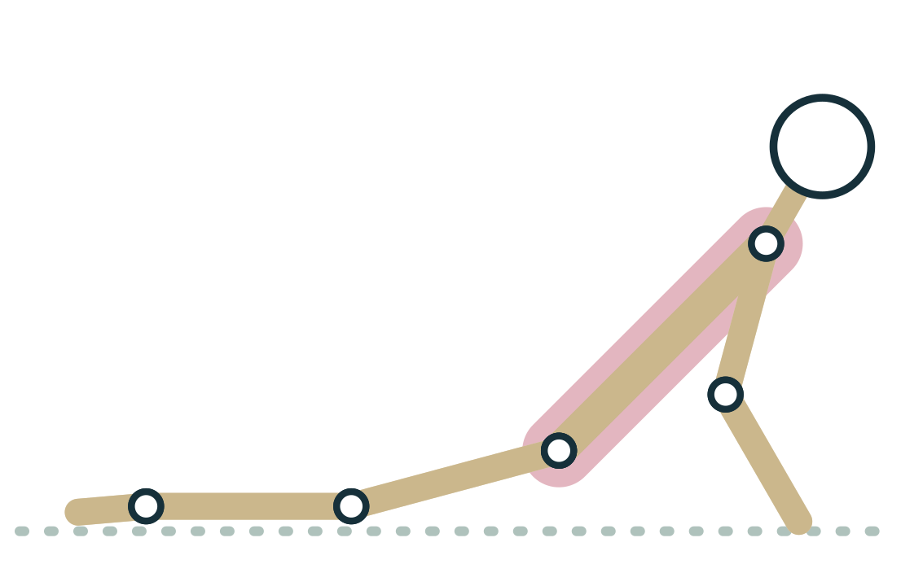
MODULE 3
Joints: Structure, Range and Stability
Every pose is a set of joint actions, and knowing how joints are built, what limits them and what holds them steady is how you teach real bodies instead of ideal shapes.
2.5 hours · 6 lessons · Anatomy & Physiology for Vinyasa Teachers
Anatomy on the Mat · Dr. Akash Garg, D.C.
Notes:
Module 3: Joints: Structure, Range and Stability. A joint (also called an articulation) is any place where two or more bones meet. Some joints barely move at all, like the sutures of the skull, while others, like the hip and shoulder, move in every direction. In this module you will learn the three structural classes of joint, the six types of synovial joint and the movements each one allows, and the vocabulary you need to describe any pose as a list of joint actions. You will also meet two ideas that change how you see a class. First, range of motion ends either by tension (tissue reaching its stretch limit) or by compression (something running into something else), and bone shape differs from person to person, so two students may never reach the same shape. Second, joints are held stable passively by bone fit, capsule and ligaments, and actively by muscle. That is why very flexible students need strength and control, and why stiff students need patience, props and respect rather than force. Teachers adapt and refer; they never diagnose.

Slide 2
MODULE 3 OBJECTIVES
By the end of this module you can
1
Classify a joint as fibrous, cartilaginous or synovial and give a body example of each.
LESSONS
3.1 Fibrous, cartilaginous and synovial joints
3.2 The six synovial joint types and the movements each allows
3.3 Range of motion: tension versus compression and individual bone shape
3.4 Joint stabilization: passive (ligament, capsule, bony fit) and active (muscle)
3.5 Hypermobility and hypomobility in the yoga room
3.6 Pose lab: reading every joint action in Sun Salutation A
2
Name the six synovial joint types, give an example of each, and state the movements each allows.
3
Describe any yoga pose as a list of joint actions using flexion, extension, abduction, adduction, rotation and related terms.
4
Distinguish tension from compression as the end of a range of motion and explain how individual bone shape limits a pose.
5
Explain passive and active joint stability and compare the hip with the shoulder.
6
Recognise hypermobile and hypomobile patterns in class and choose safe cues and props without diagnosing.
Anatomy on the Mat · Dr. Akash Garg, D.C.
2
Notes:
Classify a joint as fibrous, cartilaginous or synovial and give a body example of each. Name the six synovial joint types, give an example of each, and state the movements each allows. Describe any yoga pose as a list of joint actions using flexion, extension, abduction, adduction, rotation and related terms. Distinguish tension from compression as the end of a range of motion and explain how individual bone shape limits a pose. Explain passive and active joint stability and compare the hip with the shoulder. Recognise hypermobile and hypomobile patterns in class and choose safe cues and props without diagnosing.

Slide 3
3.1
LESSON 3.1 · 20 MIN
Fibrous, cartilaginous and synovial joints
See it
Feel it
Cue it
Check it
Anatomy on the Mat · Dr. Akash Garg, D.C.
3
Notes:
Lesson 3.1: Fibrous, cartilaginous and synovial joints. A joint (articulation) is any place where bones meet. Fibrous joints: dense fibrous tissue, little or no movement, e.g. skull sutures. Cartilaginous joints: cartilage link, slight movement, e.g. intervertebral discs and pubic symphysis. Synovial joints: fluid-filled capsule, free movement, e.g. hip, knee, shoulder. The spine's range comes from many small joints each contributing a little. More mobility usually means less built-in stability.

Slide 4
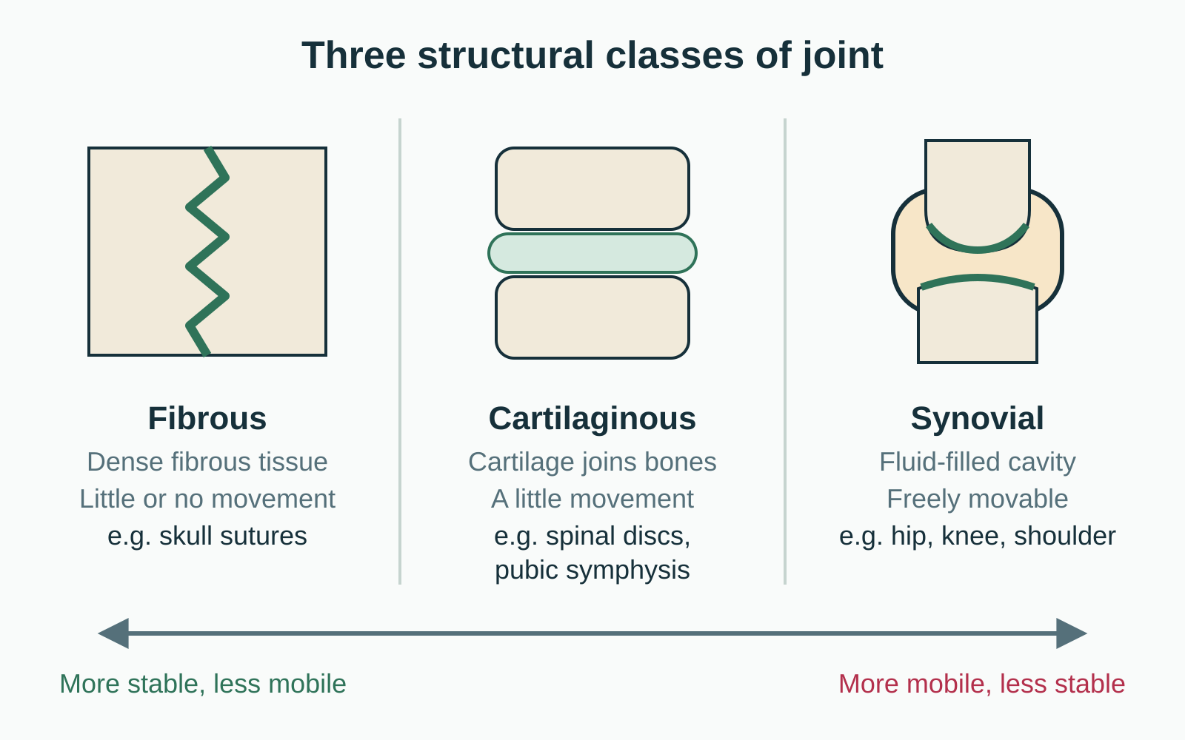
LESSON 3.1
Where two bones meet
A joint, or articulation, is any place bones meet
Structure asks: what tissue holds the bones together?
Function asks: how much movement does the joint allow?
Three structural classes: fibrous, cartilaginous, synovial
Plate 1 The three structural classes, from most stable to most mobile
Anatomy on the Mat · Dr. Akash Garg, D.C.
4
Notes:
Let's start with a simple definition. A joint, which anatomists also call an articulation, is anywhere two or more bones meet. There are two ways to sort joints. The structural way asks what connects the bones: dense fibrous tissue, cartilage, or a fluid-filled capsule. The functional way asks how much the joint moves: not at all, a little, or freely. The two systems line up quite well. Fibrous joints mostly do not move, cartilaginous joints move a little, and synovial joints move freely. Notice the arrow along the bottom of the diagram. As we move from left to right we gain mobility and give up some built-in stability. Keep that trade-off in mind, because it comes back in every lesson of this module, especially when we compare the hip and the shoulder.

Slide 5
LESSON 3.1
The three structural classes
Fibrous
Cartilaginous
Synovial
Bones joined by dense fibrous tissue
No cavity, little or no movement
Skull sutures, tooth in socket
Tibia and fibula held by ligament
Bones joined by cartilage
No cavity, slight movement
Intervertebral discs, pubic symphysis
Growth plates in young bones
Fluid-filled cavity inside a capsule
Freely movable
Hip, knee, shoulder, elbow, wrist
Most joints used in asana
Anatomy on the Mat · Dr. Akash Garg, D.C.
5
Notes:
Here are the three classes side by side. Fibrous joints are stitched together by dense fibrous tissue, the same tough collagen tissue that makes up ligaments. Examples are the sutures between skull bones, the tooth held in its socket, and the lower ends of the tibia and fibula, which are bound by a strong ligament. Cartilaginous joints are joined by cartilage and allow a small amount of give. The discs between your vertebrae and the pubic symphysis at the front of the pelvis are the ones yoga teachers care about most. In children, the growth plates are also cartilaginous joints. Synovial joints have a real space between the bones, filled with fluid and wrapped in a capsule. Nearly every joint you name when you describe a pose, hip, knee, ankle, shoulder, elbow, wrist, is synovial.

Slide 6
LESSON 3.1
Intervertebral discs in the adult spine
23
Each disc is a cartilaginous joint that allows only a little movement. Added together, those small movements give the spine its large range in Cat, Cow and twists.
Plate 2 Spinal extension shared across many small joints
Anatomy on the Mat · Dr. Akash Garg, D.C.
6
Notes:
Here is a number worth remembering: twenty-three. There is no disc between the skull and the first vertebra, and none between the first and second neck vertebrae, and the sacrum and coccyx are fused, so the adult spine has twenty-three discs. Each disc is a cartilaginous joint with a tough fibrocartilage ring around a gel-like centre. On its own, one disc allows only a few degrees of bending. But the spine is a chain. When you add together small movements at many levels, you get the large curve of Cobra or the deep round of Cat. The spine also has small synovial facet joints at the back of each vertebra, which guide the direction of movement. So when a student backbends, you are watching many small joints share the work, not one hinge.

Slide 7
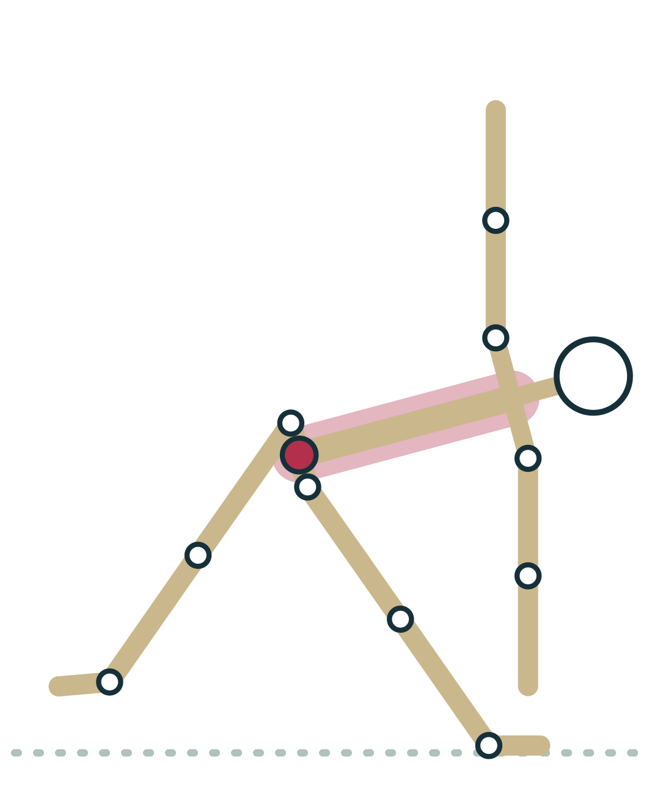
LESSON 3.1
The sacroiliac joint: a special case
Where the sacrum meets each side of the pelvis
Synovial in front, strong fibrous ligaments behind
Movement is very small, a few degrees at most
Built for load transfer, not for big range
Plate 3 The sacroiliac joints carry load between spine and legs
Anatomy on the Mat · Dr. Akash Garg, D.C.
7
Notes:
Yoga teachers hear a lot about the sacroiliac joint, often shortened to SI joint. It sits where the sacrum, the triangular bone at the base of the spine, meets the ilium on each side of the pelvis. It is a mixed joint: the front part is synovial, with a thin capsule, while the back is held by some of the strongest ligaments in the body. Its surfaces are rough and interlocking, and research consistently finds the movement to be very small, only a few degrees. Its main job is to pass the weight of the upper body into the legs. You cannot see SI joint movement in a pose, and you should be careful with claims that a student's SI joint is out. If a student reports pain in this area, adapt the pose and suggest they see a qualified health professional.

Slide 8
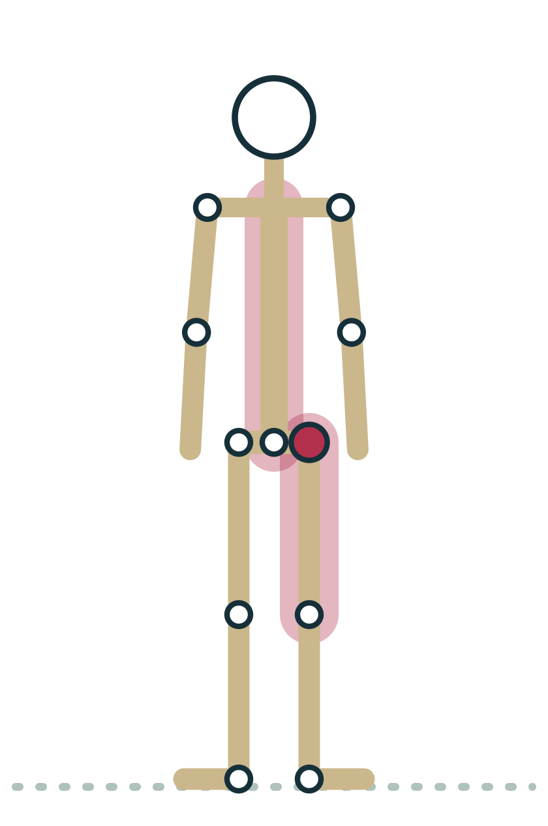
LESSON 3.1 · FEEL IT
Feel it: three classes in your own body
1
Press gently on your skull: the fibrous sutures give no movement at all
2
Slowly round and arch your spine: many discs each allow a little
3
Lift one knee and circle the thigh: the synovial hip moves freely
4
Notice how movement grows as you go from skull to spine to hip
Plate 4 Find each joint class standing in Mountain
Anatomy on the Mat · Dr. Akash Garg, D.C.
8
Notes:
Let's make this real. Stand in Mountain. First, place your fingertips on your head and press gently. Underneath are the sutures, fibrous joints that fused into place in childhood; there is nothing to move. Next, slowly round your spine forward and then lift your chest into a gentle arch. No single joint moves much, but you can feel the whole column change shape because many discs and facet joints each contribute a little. Finally, shift weight into your left foot, lift the right knee and draw slow circles with it. That is a synovial ball-and-socket joint, and the difference is obvious. Take a moment to notice the progression from no movement, to a little shared movement, to free movement. You have just felt the whole spectrum from the diagram.

Slide 9
LESSON 3.1 · CHECK IT
Which joint is cartilaginous?
A skull suture
Pause the video and choose before you move on.
A
The pubic symphysis
B
The hip joint
C
Anatomy on the Mat · Dr. Akash Garg, D.C.
9
Notes:
Take a moment before you answer. A skull suture is fibrous: bones knitted together by dense fibrous tissue with no movement in the adult. The hip joint is synovial: it has a fluid-filled cavity inside a capsule and moves freely. The pubic symphysis is the cartilaginous joint here. It sits at the front of the pelvis, where a pad of fibrocartilage joins the left and right pubic bones. It allows a small amount of movement, which increases in pregnancy when hormones soften the surrounding ligaments. That is one reason wide-legged poses and big asymmetrical steps can feel uncomfortable at the front of the pelvis during pregnancy. If you got this right, you can already sort joints by the tissue that holds them together, which is the whole point of this lesson.

Slide 10
LESSON 3.1 · CHECK IT
Answer
The pubic symphysis
B
The pubic symphysis joins the two pubic bones with a fibrocartilage disc and allows only slight movement.
Question: Which joint is cartilaginous?
Anatomy on the Mat · Dr. Akash Garg, D.C.
10
Notes:
The answer is B: The pubic symphysis. The pubic symphysis joins the two pubic bones with a fibrocartilage disc and allows only slight movement.

Slide 11
3.2
LESSON 3.2 · 30 MIN
The six synovial joint types and the movements each allows
See it
Feel it
Cue it
Check it
Anatomy on the Mat · Dr. Akash Garg, D.C.
11
Notes:
Lesson 3.2: The six synovial joint types and the movements each allows. Synovial joints share cartilage, capsule, synovial membrane, fluid and ligaments. Hinge and pivot: one axis. Condyloid and saddle: two axes. Ball-and-socket: three axes. Plane joints glide a little; the knee is a modified hinge. Flexion closes a joint angle, extension opens it; abduction moves away from the midline. Rotation happens in the transverse plane; the forearm pronates and supinates. Most poses combine several joint actions, and the pelvis links both hips.

Slide 12
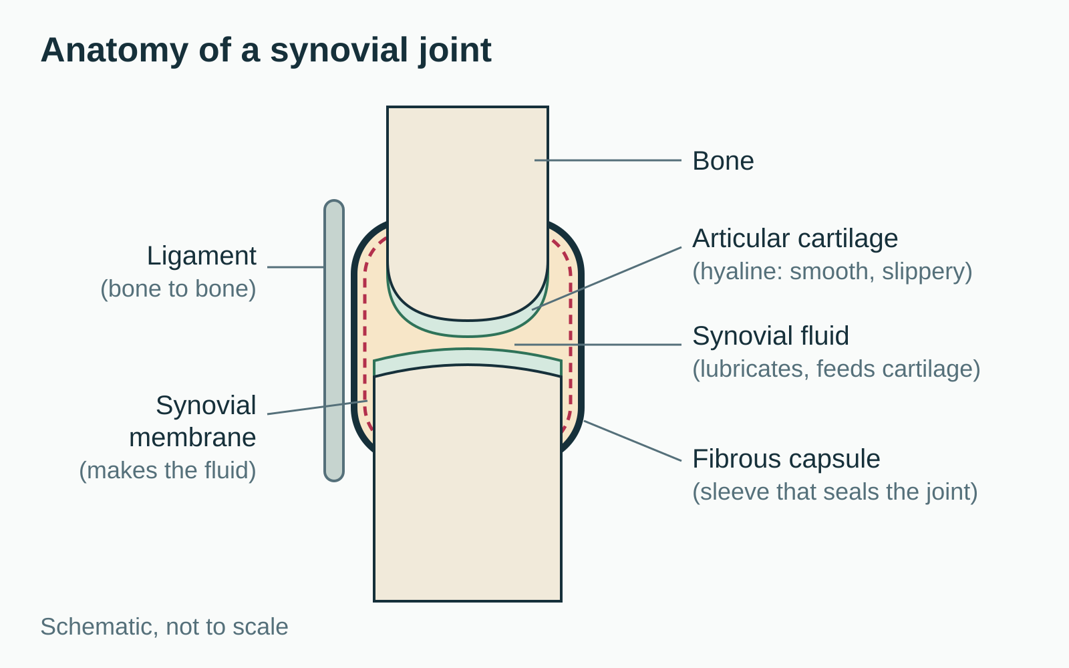
LESSON 3.2
Inside a synovial joint
Articular cartilage caps bone ends: smooth and slippery
Fibrous capsule seals the joint; synovial membrane lines it
Synovial fluid lubricates and feeds the cartilage
Ligaments link bone to bone and limit extremes
Plate 5 Parts shared by every synovial joint
Anatomy on the Mat · Dr. Akash Garg, D.C.
12
Notes:
Every synovial joint shares the same basic parts. The ends of the bones are covered with articular cartilage, a smooth, glassy layer of hyaline cartilage that lets surfaces slide with very little friction. Around the joint is a sleeve called the fibrous capsule, and its inner lining, the synovial membrane, makes synovial fluid. That fluid is thick like egg white. It lubricates the joint and also feeds the cartilage, which has no blood supply of its own. Cartilage gets its nutrients partly through loading and unloading, which is one good reason movement matters for joint health. Outside or within the capsule are ligaments, bands of dense connective tissue joining bone to bone. Some joints add extras, like the menisci in the knee or the labrum around the hip and shoulder sockets. We will meet those when we talk about stability.

Slide 13
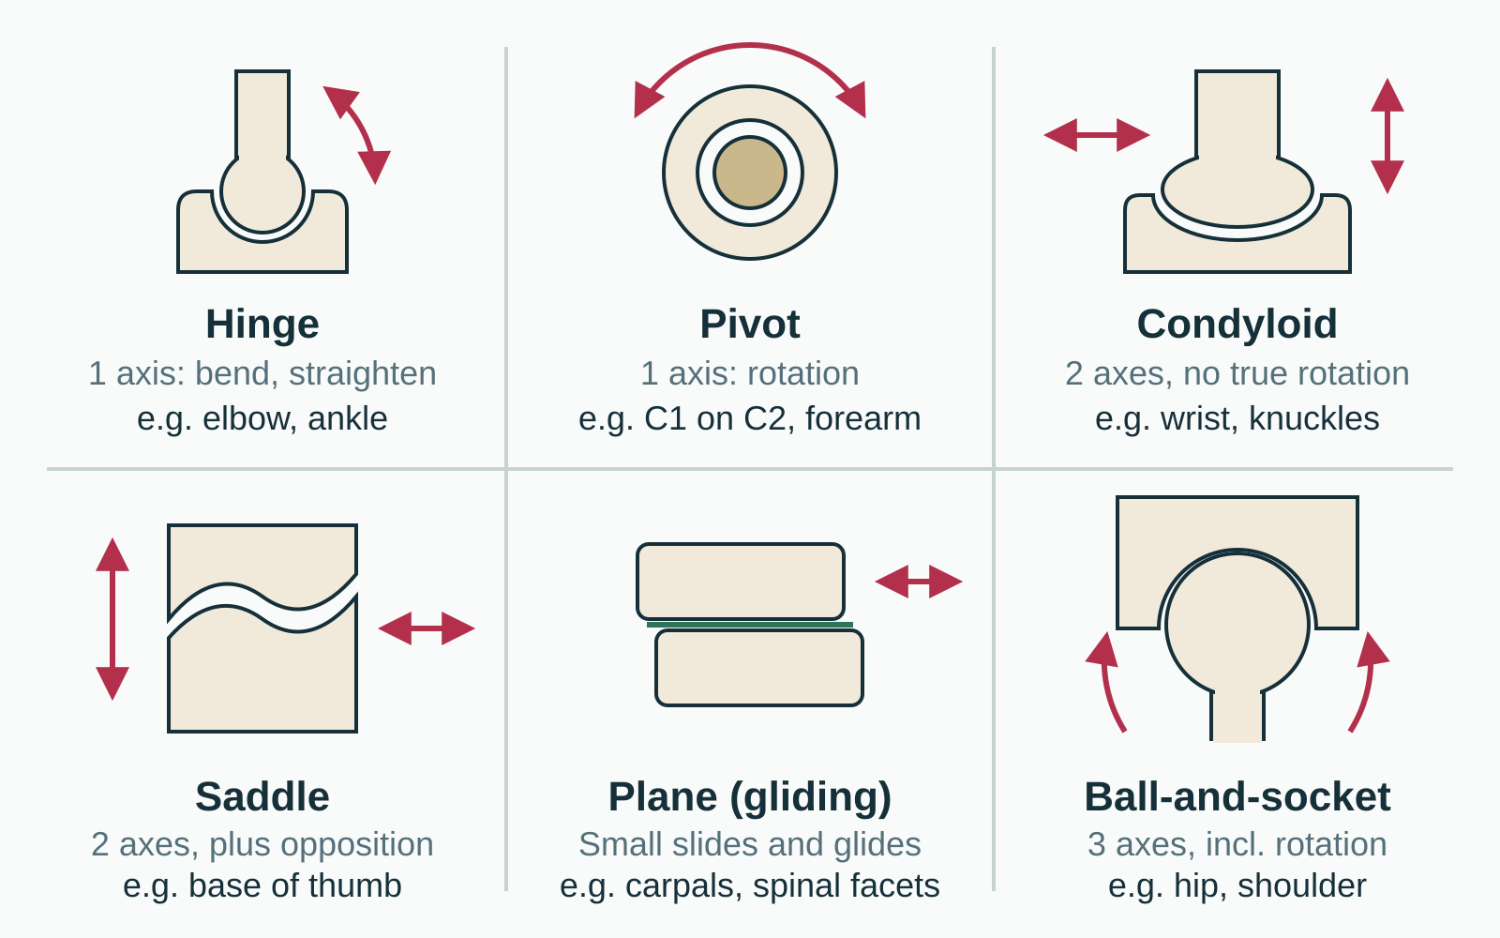
LESSON 3.2
Six shapes, six movement menus
Hinge and pivot: one axis each
Condyloid and saddle: two axes
Ball-and-socket: three axes, including rotation
Plane joints: small glides between flat surfaces
Plate 6 The six synovial joint types with body examples
Anatomy on the Mat · Dr. Akash Garg, D.C.
13
Notes:
Synovial joints are grouped by the shape of their surfaces, because shape decides which movements are possible. A hinge, like the elbow or the ankle, bends and straightens around one axis. A pivot rotates around one axis, like the first neck vertebra turning around the peg of the second, or the radius turning when you flip your palm. Condyloid joints, such as the wrist and the knuckles, move in two directions, forward and back and side to side, but cannot truly rotate. The saddle joint at the base of the thumb also moves in two axes and gives us opposition, touching thumb to fingertips. Plane joints are flat surfaces that glide a little, like the small bones of the wrist and the facet joints of the spine. The ball-and-socket joints, hip and shoulder, move around all three axes, including rotation.

Slide 14
LESSON 3.2
Movement vocabulary by plane
Sagittal plane
Frontal plane
Transverse plane
Flexion: angle closes
Extension: angle opens
Forward folds, backbends
Ankle: dorsiflexion, plantarflexion
Abduction: away from midline
Adduction: toward midline
Side bends: lateral flexion
Star shape, Gate pose
Internal rotation: turns inward
External rotation: turns outward
Spinal rotation in twists
Forearm pronation, supination
Anatomy on the Mat · Dr. Akash Garg, D.C.
14
Notes:
To describe what a joint is doing you need a shared vocabulary. Movements happen in three planes. In the sagittal plane, which divides left from right, we have flexion, where the angle of a joint closes, and extension, where it opens. Forward folds are mostly flexion; backbends are mostly extension. At the ankle, lifting the toes toward the shin is dorsiflexion and pointing the foot is plantarflexion. In the frontal plane, which divides front from back, we have abduction, moving a limb away from the midline, adduction, bringing it back, and lateral flexion of the spine in side bends. In the transverse plane, which divides top from bottom, we have rotation: internal rotation turns a limb inward, external rotation turns it outward. The forearm has its own words: pronation turns the palm down, supination turns it up. Circumduction combines several of these into a circle.

Slide 15
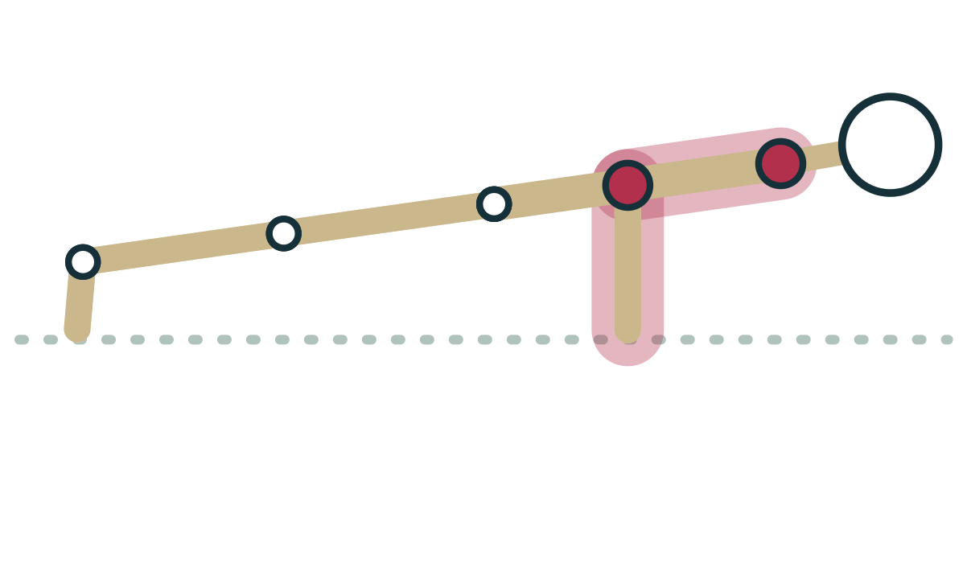
LESSON 3.2
Hinges in practice: elbow, knee and ankle
Elbow hinge bends to about ninety degrees in Chaturanga
The knee is a modified hinge: small rotation when bent
Keep the knee tracking over the foot under load
Ankle hinge: dorsiflexion as the shin travels forward
Plate 7 Chaturanga: elbow flexion held by strong muscles
Anatomy on the Mat · Dr. Akash Garg, D.C.
15
Notes:
Let's look at hinges in real poses. In Chaturanga, the elbows are hinge joints bending to roughly ninety degrees while the triceps and chest work hard to control the lowering. The knee is usually called a modified hinge. Mostly it bends and straightens, but when it is bent it can also rotate a little, and when it straightens fully the tibia rotates slightly to lock the joint. That small rotation is why we ask students to keep the knee tracking in line with the second or third toe in Warrior poses and lunges. Twisting a loaded, bent knee is a common way to strain it. The ankle joint, where the tibia and fibula meet the talus, is also a hinge. It dorsiflexes as the shin moves forward over the foot in Chair and Warrior I, and plantarflexes when you point your feet in Cobra.

Slide 16
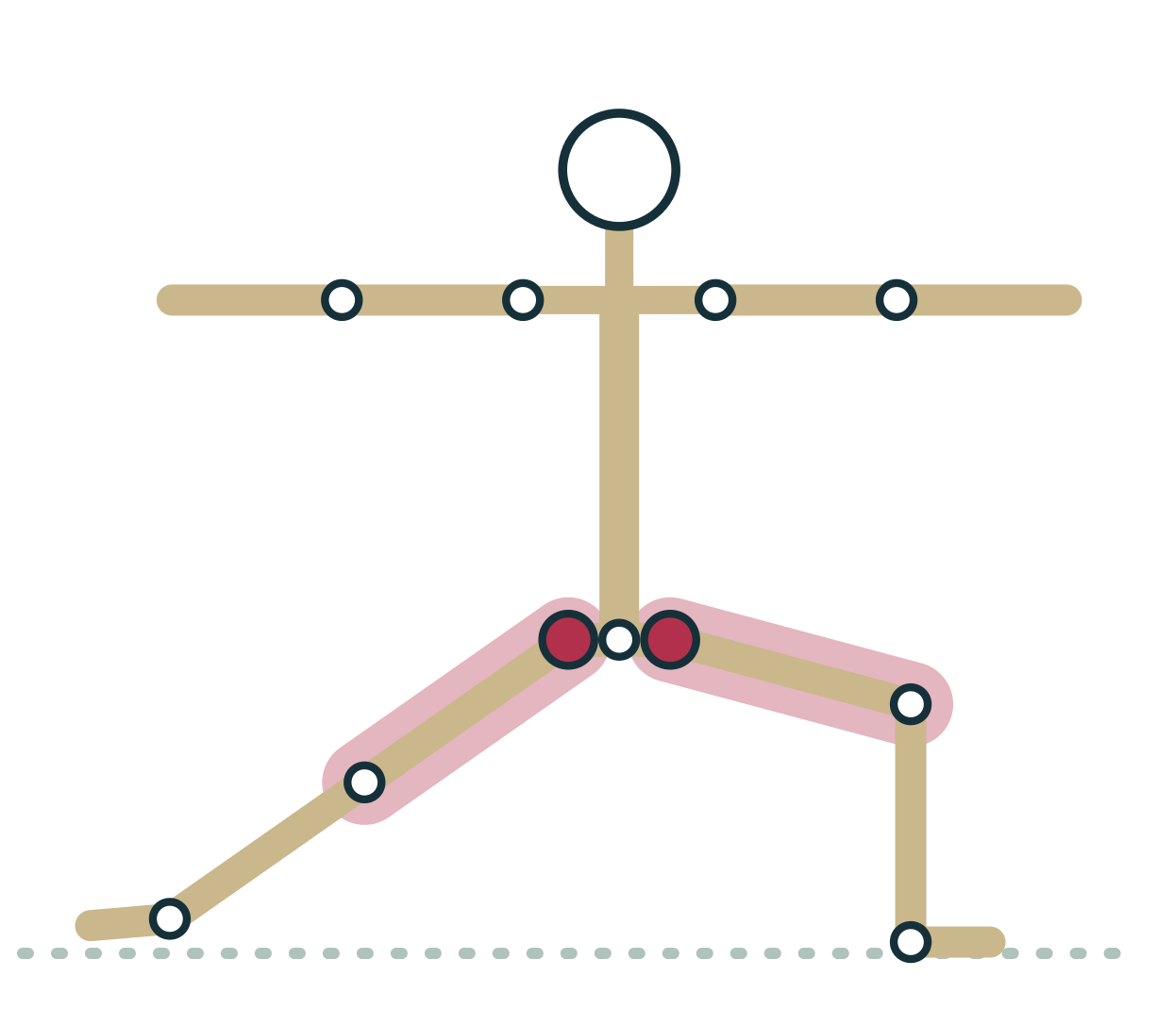
LESSON 3.2
Ball-and-socket: the hip in Warrior II
Front hip: flexion with external rotation and abduction
Back hip: extension with some external rotation
Three axes allow many combinations at once
The pelvis position changes what the hips must do
Plate 8 Warrior II: two hips doing different jobs
Anatomy on the Mat · Dr. Akash Garg, D.C.
16
Notes:
Ball-and-socket joints can combine movements in all three planes at once, and Warrior II is a great example. Look at the front leg. The hip is flexed because the thigh is forward of the pelvis, it is abducted because the leg is away from the midline, and it is externally rotated so the knee points over the toes. The back leg is quite different: that hip is closer to neutral or slightly extended, with some rotation depending on how the back foot is turned. The pelvis links the two hips. If a student turns the pelvis to face the long edge of the mat, the front hip must externally rotate more. If the pelvis turns a little toward the front, the demand drops. So hip comfort in Warrior II depends partly on pelvis position, which is why we let students adjust it rather than forcing a square or open pelvis.

Slide 17
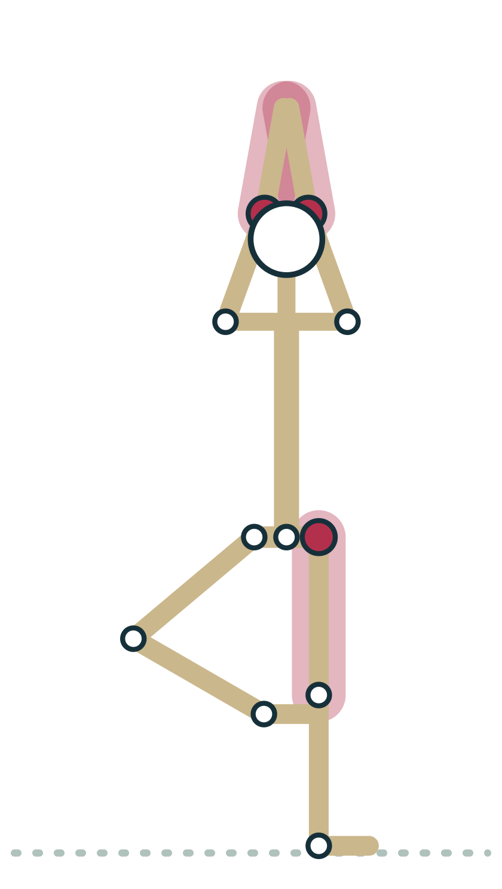
LESSON 3.2 · FEEL IT
Feel it: take each joint through its menu
1
Elbow: bend and straighten. Only one axis, so try to rotate it: nothing
2
Forearm: turn palm up and down; the radius pivots over the ulna
3
Wrist: move up, down and side to side; notice it cannot twist
4
Thumb: touch each fingertip to feel the saddle joint's opposition
5
Hip: standing in Tree, flex, abduct and rotate the lifted leg
Plate 9 Test each joint type standing near Tree
Anatomy on the Mat · Dr. Akash Garg, D.C.
17
Notes:
Now let's feel each type. Start with your elbow: bend and straighten it. Then try to rotate at the elbow alone without moving the shoulder or forearm. You cannot, because a hinge has one axis. Now turn your palm up and down. That movement happens at pivot joints between the radius and ulna, not at the wrist. Next, move your wrist up, down and side to side. It is condyloid, so it moves in two directions but will not twist. Touch your thumb to each fingertip in turn. That is opposition, made possible by the saddle joint at the base of the thumb. Finally, stand near a wall, lift one leg toward Tree and take the thigh forward, out to the side and into outward rotation. The hip has all three axes. Notice how many more options it gives you.

Slide 18
LESSON 3.2 · CHECK IT
A student turns their palms up in Savasana. Which joint type makes this possible?
Hinge joints at the elbow
Pause the video and choose before you move on.
A
Pivot joints between the radius and ulna
B
Condyloid joint at the wrist
C
Anatomy on the Mat · Dr. Akash Garg, D.C.
18
Notes:
This question catches many people. It feels like the wrist is turning, but the wrist is condyloid and cannot rotate. The movement of turning the palm up is supination, and turning it down is pronation. Both happen because the radius, the forearm bone on the thumb side, rotates around the ulna at the radioulnar joints near the elbow and near the wrist. The joint near the elbow is a pivot joint. The elbow hinge between the humerus and ulna only bends and straightens. You will use this in class more than you might expect. In Downward-facing Dog, for example, students with elbows that hyperextend or wrists that ache sometimes benefit from a cue about the forearm, pressing the base of the index finger down, which involves the forearm bones and the muscles around them rather than the wrist alone.

Slide 19
LESSON 3.2 · CHECK IT
Answer
Pivot joints between the radius and ulna
B
Turning the palm up (supination) happens as the radius pivots around the ulna at the radioulnar joints.
Question: A student turns their palms up in Savasana. Which joint type makes this possible?
Anatomy on the Mat · Dr. Akash Garg, D.C.
19
Notes:
The answer is B: Pivot joints between the radius and ulna. Turning the palm up (supination) happens as the radius pivots around the ulna at the radioulnar joints.

Slide 20
3.3
LESSON 3.3 · 30 MIN
Range of motion: tension versus compression and individual bone shape
See it
Feel it
Cue it
Check it
Anatomy on the Mat · Dr. Akash Garg, D.C.
20
Notes:
Lesson 3.3: Range of motion: tension versus compression and individual bone shape. Range of motion ends by tension (stretch limit) or compression (parts meeting). Tension is felt opposite the movement; compression is felt where parts meet. Tension-limited range often improves with practice; bony compression does not. Bone shape, such as femoral neck angle and version, varies widely between people. Judge a pose by its purpose, not by how closely it matches a photo. A pinch or hard stop calls for a new angle or a prop, not more effort.

Slide 21
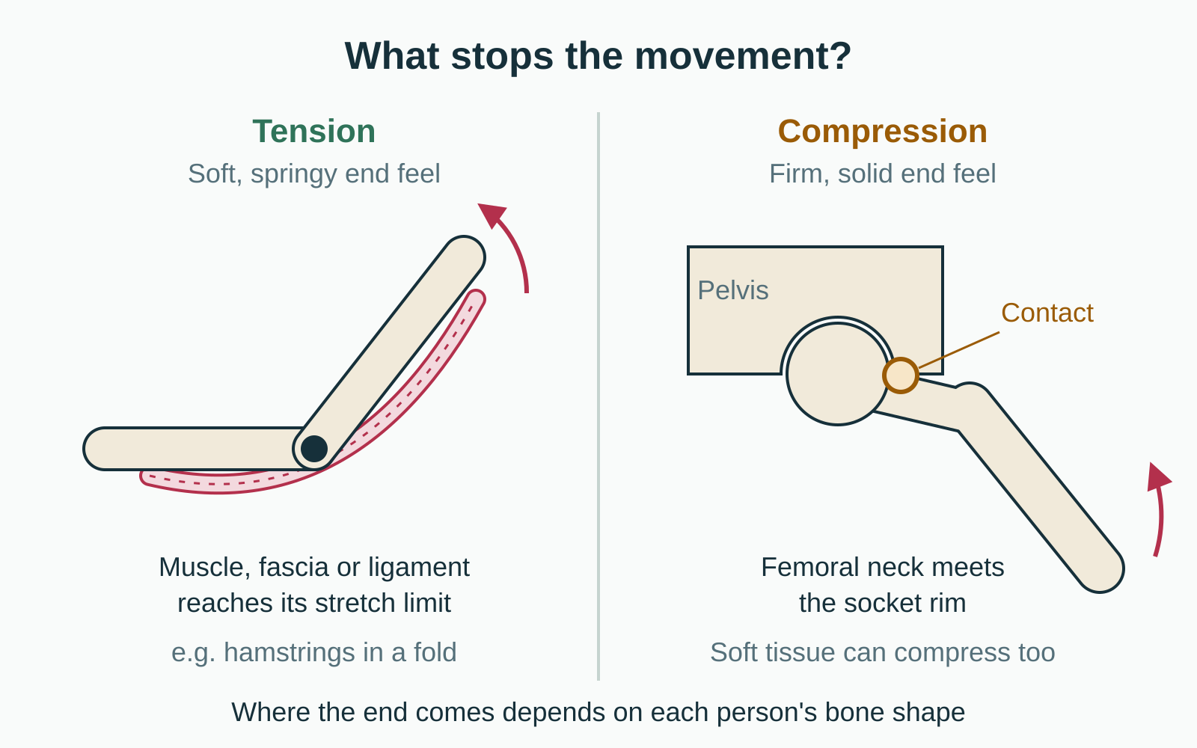
LESSON 3.3
What stops the movement?
Range of motion ends by tension or by compression
Tension: tissue reaches its stretch limit, soft end feel
Compression: something meets something, firm end feel
Compression can be bone on bone or soft tissue
Plate 10 Two ways a range of motion comes to an end
Anatomy on the Mat · Dr. Akash Garg, D.C.
21
Notes:
Range of motion is how far a joint can move in a given direction. Every range has an end, and it helps to ask what is creating that end. There are two broad answers. The first is tension: a tissue on the opposite side of the movement reaches its stretch limit. That could be muscle, fascia, joint capsule or ligament. It usually has a soft, springy feel and is felt as a stretch. The second is compression: something runs into something else. That might be bone meeting bone, like the femoral neck touching the rim of the hip socket, or soft tissue meeting soft tissue, like the thigh pressing into the belly in a deep fold. Compression has a firm, blocking feel and is felt where the parts meet. This framework is simplified, but it is very useful for teaching.

Slide 22
LESSON 3.3
Reading the end of a range
Tension
Compression
Felt opposite the movement
Soft, springy, stretchy sensation
May change with regular practice
e.g. back of thigh in a fold
Felt where parts meet
Firm, blocked or pinching sensation
Bony limits will not change
e.g. front of hip in deep fold
Anatomy on the Mat · Dr. Akash Garg, D.C.
22
Notes:
Here is a quick way to tell the two apart. Tension is felt on the side opposite the movement. In a forward fold, the hip flexes and the stretch is felt at the back of the thighs. It feels springy, and with regular practice many people gain range here, partly from tissue changes and largely from greater tolerance of the stretch sensation. Compression is felt where the parts come together. In a deep fold, a pinch at the front of the hip is a sign of compression. Bony compression will not change with practice, and pushing into it can irritate the joint. Soft tissue compression varies with body size and shape. The teaching point: when a student feels a stretch, they can explore. When they feel a pinch or a hard block, they have found an end, and the answer is a different angle or a prop, not more effort.

Slide 23
LESSON 3.3
Average adult angle between femoral neck and shaft
About 125 degrees
Individual hips spread well either side of this average, and the neck also twists forward by differing amounts. Those differences change how far each hip can rotate and abduct.
Plate 11 Where the femoral neck meets the socket rim depends on bone shape
Anatomy on the Mat · Dr. Akash Garg, D.C.
23
Notes:
Bone shape is one of the least discussed and most important facts in a yoga room. The femur, the thigh bone, has a neck that angles off the shaft toward the socket. In adults this angle averages about one hundred and twenty-five degrees, but real hips vary noticeably either side of that. The neck also twists forward by different amounts in different people, which anatomists call femoral version. The hip socket varies too: how deep it is and which way it faces. These differences change where the femoral neck meets the rim of the socket, and so where compression stops the movement. One student can rotate the thigh outward into Lotus easily while another, just as dedicated, stops early because bone meets bone. No amount of stretching changes the shape of adult bone. This is anatomy, not effort.

Slide 24
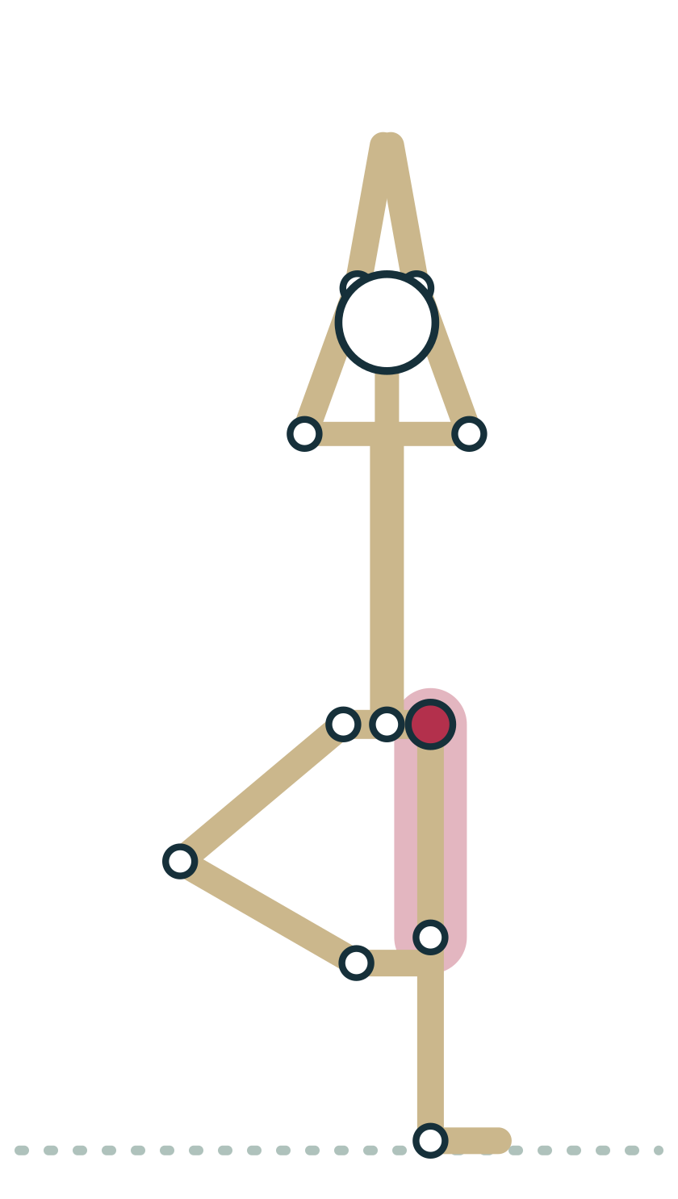
LESSON 3.3
Same pose, different skeletons
Two students cannot always reach the same shape
Hip, shoulder and elbow shapes differ between people
Judge a pose by its function, not its photo
Offer options that suit the skeleton in front of you
Plate 12 Tree: the lifted knee's angle depends partly on hip shape
Anatomy on the Mat · Dr. Akash Garg, D.C.
24
Notes:
Put these ideas together and you reach one of the most freeing ideas in teaching: two students cannot always reach the same shape, however hard they work. In Tree, one student's lifted knee points straight out to the side while another's points forward at an angle. Both may be working at their true end range. Hip shape, the carrying angle of the elbow, the shape of the shoulder socket and many other differences change where each person's range ends. So rather than asking whether a pose looks like the photo, ask what the pose is for. Tree is for balance, attention and a stable standing leg. If the knee angle is different, the pose is still doing its job. Offer choices, such as the foot at the ankle or calf, and let students find their own version.

Slide 25
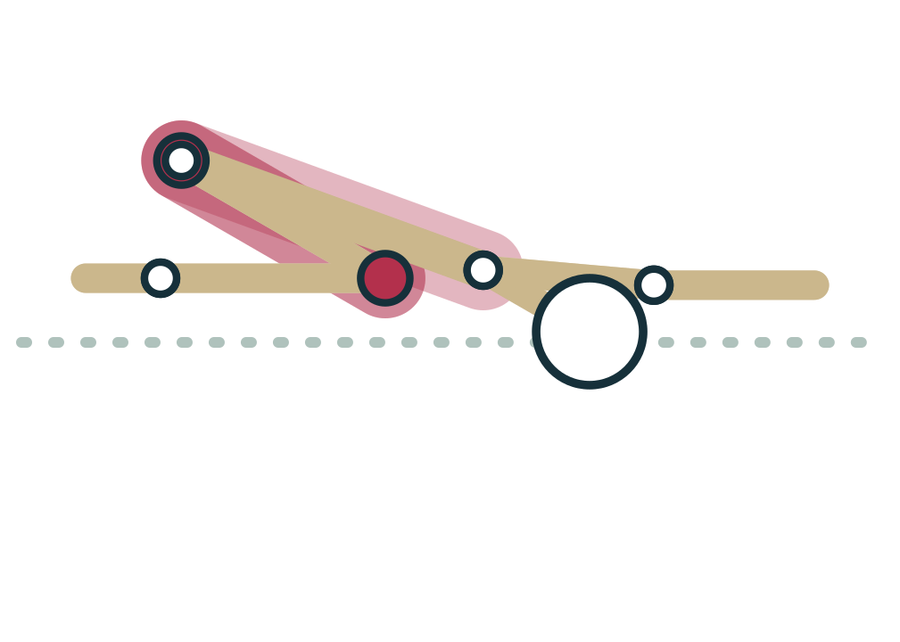
LESSON 3.3 · FEEL IT
Feel it: tension or compression?
1
Lie on your back and hug one knee toward your chest
2
Notice where you feel it: back of hip, or front of hip
3
Take the knee slightly outward and hug again: does it change?
4
Now come into Child's Pose with knees together, then knees wide
5
Name each end as tension or compression
Plate 13 Child's Pose: often a compression end at hips and knees
Anatomy on the Mat · Dr. Akash Garg, D.C.
25
Notes:
Let's find both kinds of end in your own body. Lie on your back and slowly hug one knee toward your chest. Where do you feel the limit? Some people feel a stretch in the buttock or back of the thigh, which is tension. Others feel a pinch or fullness at the front of the hip crease, which is compression. Now take the knee slightly out toward the armpit on the same side and hug again. For many people the pinch eases, because the femoral neck is now angled away from the rim of the socket. Then come into Child's Pose with knees together. Notice whether the thighs press into the belly, a soft tissue compression. Now widen the knees and let the torso sink between them. Changing the angle changed what met what. That is the teaching insight in one small experiment.

Slide 26
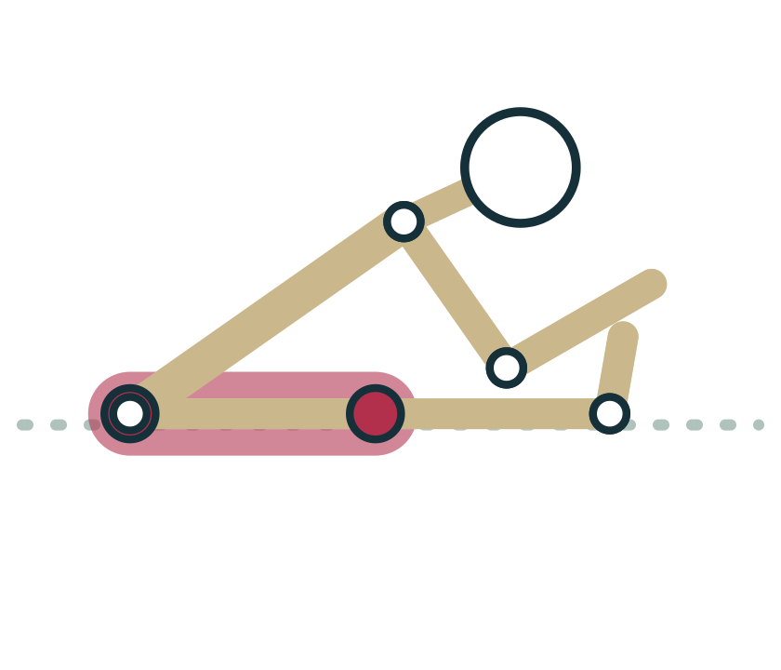
LESSON 3.3 · CUE IT
Cue the sensation, not the shape
“If you feel a stretch, you can stay and breathe. If you feel a pinch or a hard stop, change the angle or add a prop.”
Why it works A stretch usually signals tension, which may be explored gently. A pinch or block usually signals compression, which effort cannot change and may irritate.
Plate 14 Forward Fold: stretch behind, possible pinch in front
Anatomy on the Mat · Dr. Akash Garg, D.C.
26
Notes:
Here is how this becomes a cue. Rather than telling students to fold further, teach them to read what they feel. A stretch sensation usually means tension, and they can stay, breathe and explore gently. A pinch, a sense of jamming, or a hard stop usually means compression. Pushing into that will not change the bone and may irritate the joint. So the cue gives a clear action for each: change the angle or add a prop. In Forward Fold, bending the knees or widening the feet often clears a pinch at the front of the hips. In Child's Pose, widening the knees or placing a blanket between thighs and belly does the same. This language also protects you as a teacher, because you are not guessing at a student's anatomy. You are helping them notice and respond to their own signals.

Slide 27
LESSON 3.3 · CHECK IT
In a deep squat, a student feels a hard pinch at the front of the hip. What is the most likely limit?
Tension in the hamstrings
Pause the video and choose before you move on.
A
Compression at the front of the hip
B
A weak core
C
Anatomy on the Mat · Dr. Akash Garg, D.C.
27
Notes:
Remember the rule of thumb: tension is felt opposite the movement, compression is felt where things meet. In a deep squat the hip is strongly flexed. The front of the hip is where the thigh and pelvis come together, so a pinch there suggests compression, either the femoral neck approaching the rim of the socket or soft tissues pressing together. Hamstring tension would be felt at the back of the thigh, and in a squat the knees are bent, which actually slackens the hamstrings. A weak core has nothing to do with this sensation. The teaching response is to change the angle. Widen the feet, turn the toes out a little more, or place a block under the seat so the hips do not have to flex as deeply. And if a pinch persists outside of class, suggest the student has it checked by a health professional.

Slide 28
LESSON 3.3 · CHECK IT
Answer
Compression at the front of the hip
B
A pinch felt where parts meet, at the front of the hip in deep flexion, points to compression, which stretching will not change.
Question: In a deep squat, a student feels a hard pinch at the front of the hip. What is the most likely limit?
Anatomy on the Mat · Dr. Akash Garg, D.C.
28
Notes:
The answer is B: Compression at the front of the hip. A pinch felt where parts meet, at the front of the hip in deep flexion, points to compression, which stretching will not change.

Slide 29
3.4
LESSON 3.4 · 30 MIN
Joint stabilization: passive (ligament, capsule, bony fit) and active (muscle)
See it
Feel it
Cue it
Check it
Anatomy on the Mat · Dr. Akash Garg, D.C.
29
Notes:
Lesson 3.4: Joint stabilization: passive (ligament, capsule, bony fit) and active (muscle). Passive stability: bony fit, capsule, ligaments, labrum, menisci. Active stability: muscles, coordinated by the nervous system. The hip is mostly passively stable; the shoulder is mostly actively stable. The rotator cuff keeps the humeral head centred on the shallow glenoid. The knee combines ligaments, menisci and muscle; avoid loaded twisting of a bent knee. Active stability is trainable; overstretched ligaments do not readily recover.

Slide 30
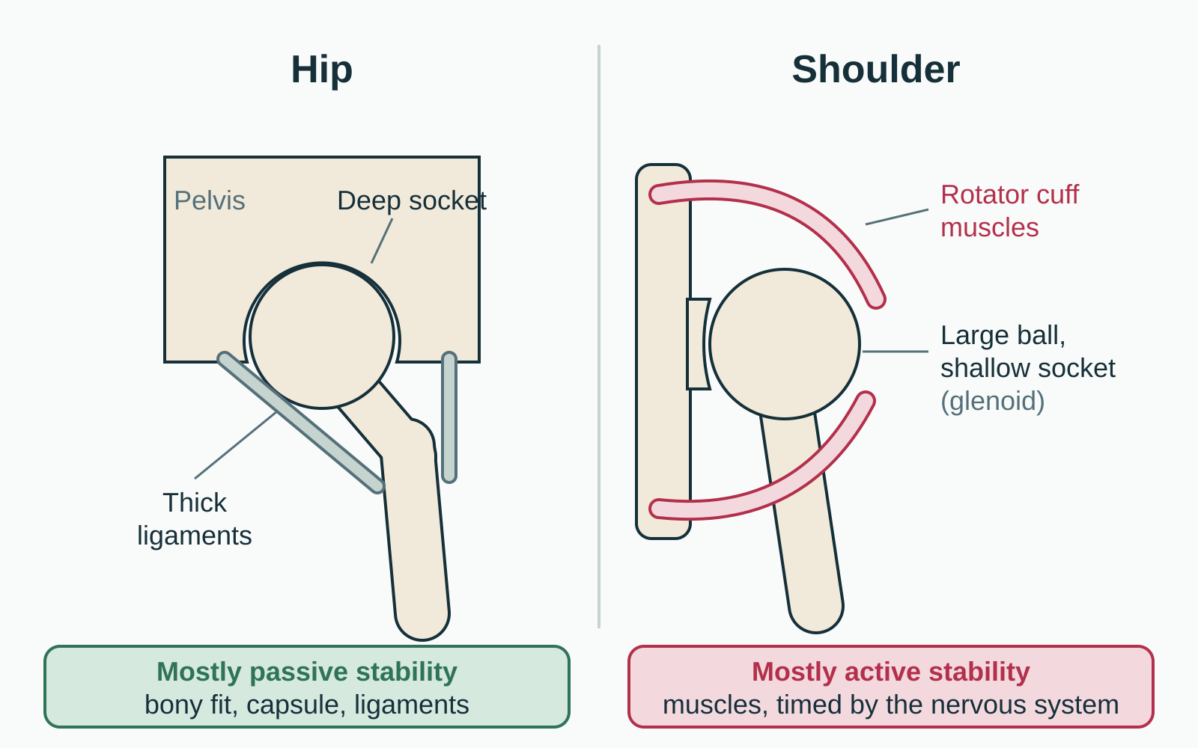
LESSON 3.4
Two ways to hold a joint steady
Stability keeps joint surfaces centred under load
Passive: bony fit, capsule, ligaments, labrum, menisci
Active: muscles, switched on and timed by nerves
Every joint uses both, in different proportions
Plate 15 Hip relies more on passive stability, shoulder more on active
Anatomy on the Mat · Dr. Akash Garg, D.C.
30
Notes:
Stability is a joint's ability to keep its surfaces well centred and to resist unwanted movement when load is applied. There are two kinds of support. Passive stabilizers work without any effort from you: the fit of the bones, the joint capsule, ligaments, and extras like the labrum, a rim of fibrocartilage that deepens the hip and shoulder sockets, and the menisci, C-shaped cartilage pads in the knee. Active stabilizers are muscles. They only help when they are switched on, and the nervous system decides when and how strongly, based on information from sensors in muscles, tendons and joints. Every joint uses both kinds, but in different proportions. Compare the hip and the shoulder in the diagram. The hip has a deep socket and thick ligaments. The shoulder trades that for range and depends much more on its muscles.

Slide 31
LESSON 3.4
Passive and active stabilizers
Passive
Active
Bony fit: shape of the socket
Capsule and ligaments: bone to bone
Labrum and menisci deepen surfaces
Always present, cannot be switched on
Muscles crossing the joint
Tendons pull bones into position
Nervous system controls timing
Trainable through strength and control
Anatomy on the Mat · Dr. Akash Garg, D.C.
31
Notes:
Let's compare them in detail. Passive stability comes from structure. A deep socket holds a ball well. The capsule and ligaments act like straps that become taut near the end of a range. The labrum and menisci deepen or cushion joint surfaces. These structures are always present, but you cannot switch them on, and ligaments adapt slowly and do not spring back well once overstretched. Active stability comes from muscle. Muscles pull tendons, which pull bones into position, and the nervous system coordinates this in fractions of a second. The big difference for teachers is that active stability is trainable. Practice that builds strength, balance and control improves it. That is why so much of our cueing is about engagement, not to hold rigidly, but to have muscles share the load that would otherwise fall on passive structures at end range.

Slide 32
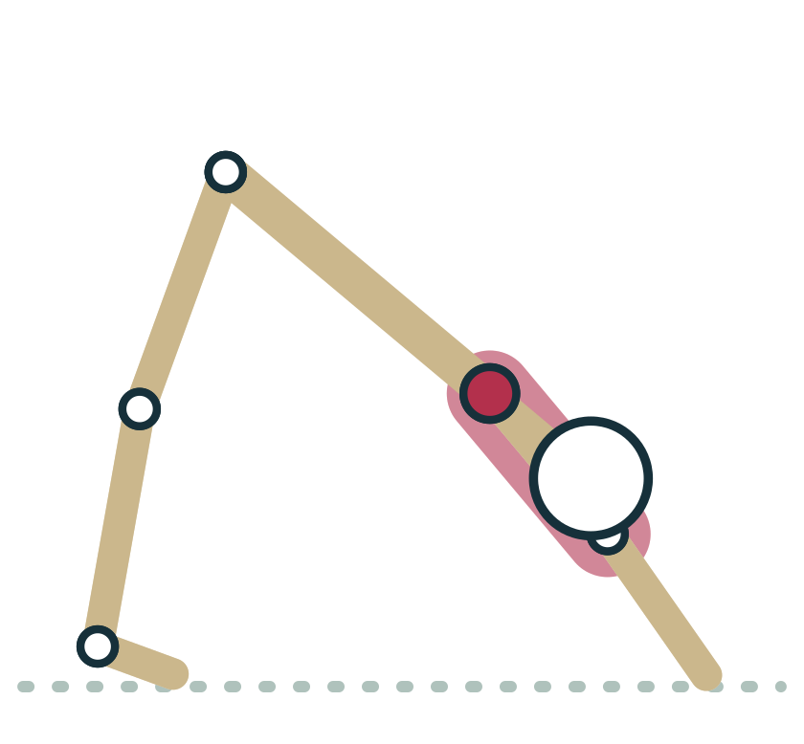
LESSON 3.4
Hip versus shoulder: the mobility trade-off
Hip: deep socket, strong ligaments, built to bear weight
Shoulder: large head on a shallow socket, huge range
Rotator cuff muscles keep the humeral head centred
Arm balances ask the shoulder for strength and control
Plate 16 Downward Dog: shoulders flexed and loaded, cuff working
Anatomy on the Mat · Dr. Akash Garg, D.C.
32
Notes:
The hip and shoulder are both ball-and-socket joints, but they are built for different jobs. The hip carries body weight every time we stand or walk, so it has a deep socket, a labrum that deepens it further, and some of the strongest ligaments in the body. The shoulder is built for reach. The head of the humerus is large and the glenoid, its socket, is small and shallow; many anatomists compare it to a golf ball on a tee. That gives the shoulder the largest range of any joint, but it depends heavily on four rotator cuff muscles to keep the ball centred on the socket. In Downward Dog, Plank and arm balances we ask a joint designed for reaching to bear weight. It can do that well, but only if the surrounding muscles are strong and switched on. So progress weight-bearing on the hands gradually.

Slide 33
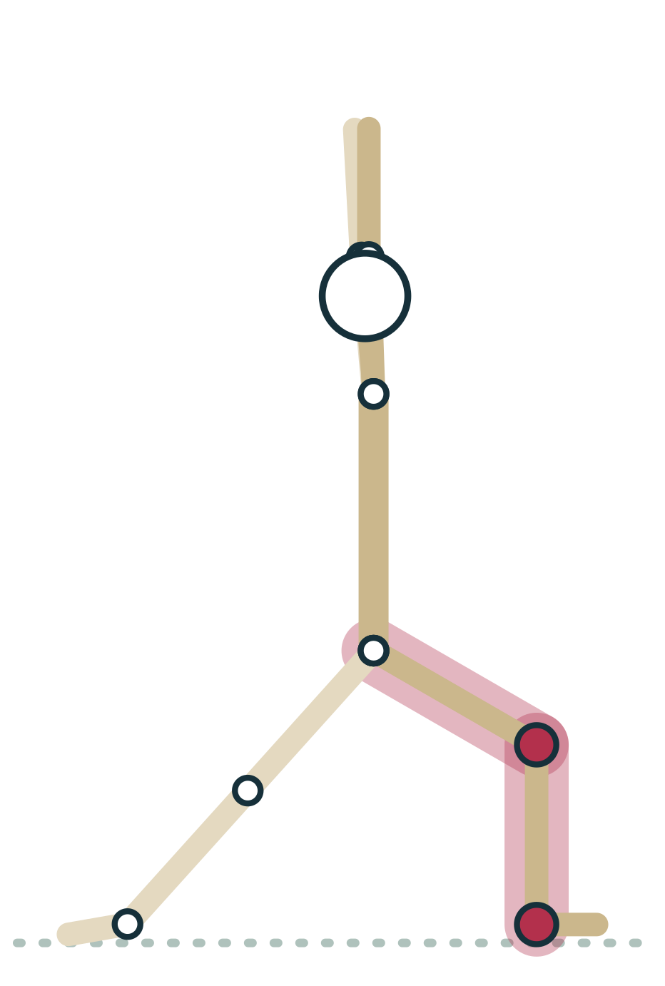
LESSON 3.4
The knee: ligaments, menisci and muscle
Cruciate and collateral ligaments guide the knee
Menisci deepen the flat tibia and spread load
Quadriceps and hamstrings add active control
Loaded twisting of a bent knee is the risk
Plate 17 Warrior I: front knee stabilized over the ankle
Anatomy on the Mat · Dr. Akash Garg, D.C.
33
Notes:
The knee is a good example of both systems working together. The femur sits on a fairly flat tibia, so the bony fit alone is poor. Four main ligaments help: the anterior and posterior cruciate ligaments inside the joint limit the tibia sliding forward and back, and the medial and lateral collateral ligaments on the sides resist side-to-side bending. The menisci, two C-shaped pads of fibrocartilage, deepen the surface and spread load. Then the quadriceps and hamstrings, along with muscles of the hip and calf, add active control. In Warrior I and lunges, the front knee is bent and bearing weight. The situation to avoid is a loaded, bent knee twisting, where the foot stays fixed while the thigh rotates. Cue the knee to track toward the middle toes and let the leg muscles do their share of the work.

Slide 34
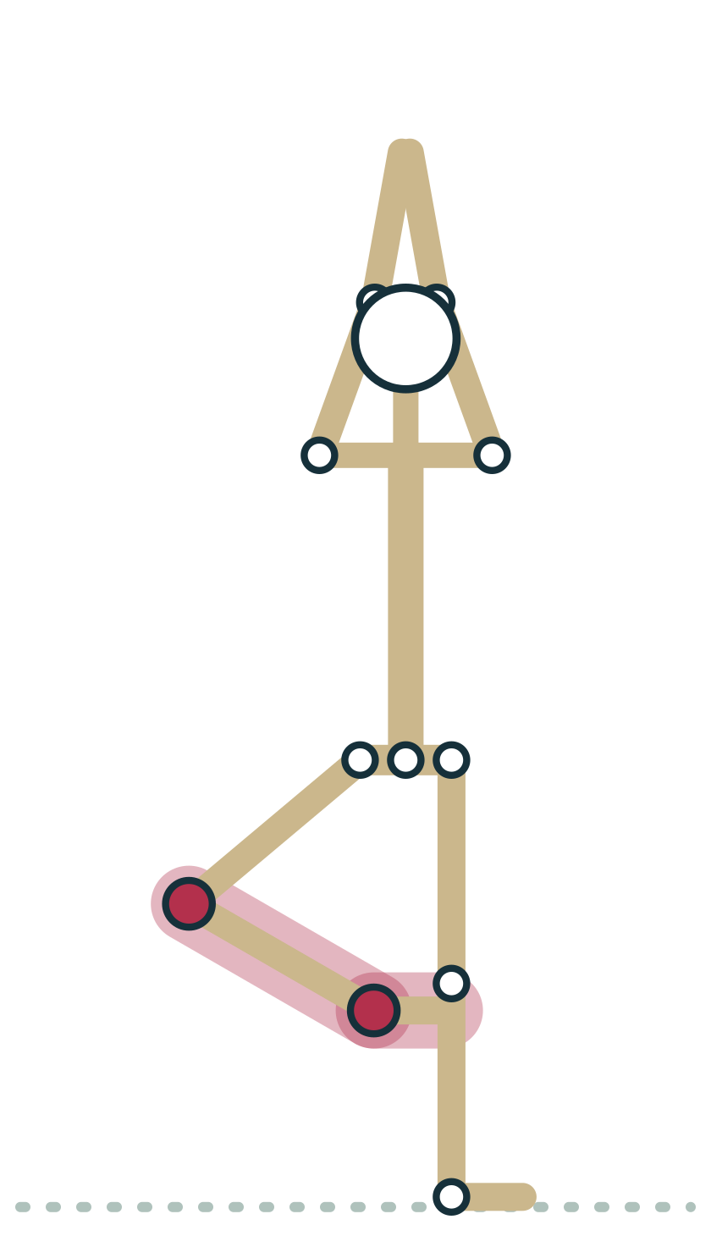
LESSON 3.4 · FEEL IT
Feel it: switch on active stability
1
Stand on one leg in Tree and watch your foot and ankle muscles flicker
2
Come to Plank; let your chest sink between your shoulder blades
3
Now press the floor away and feel the shoulder muscles engage
4
Notice the joint feels steadier when muscles share the load
Plate 18 Tree: constant small muscle corrections at the ankle
Anatomy on the Mat · Dr. Akash Garg, D.C.
34
Notes:
Let's feel active stability at work. Stand in Tree on your left leg and look down at your standing foot. You will see and feel small, constant adjustments in the foot and ankle. That is your nervous system reading information from sensors in the joints and muscles and firing muscles in response, many times a second. Nothing about your bones changed; your balance comes from active control. Now come into Plank. First, let your chest sink so the shoulder blades squeeze together and you hang on the joint. Notice how that feels. Then press the floor away, widen across the upper back and feel the muscles around the shoulder blades and shoulders switch on. Most people feel the joint become steadier and quieter. That shift from hanging on passive structures to supporting with muscle is what we are cueing for.

Slide 35
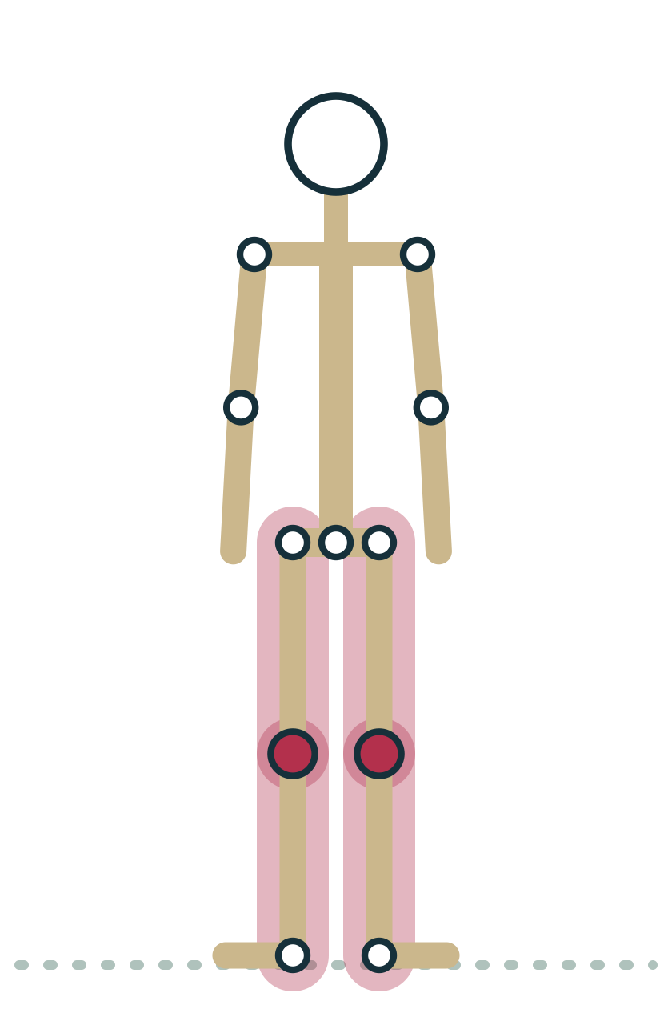
LESSON 3.4 · CUE IT
Micro-bend, then engage
“Soften the knees a touch, then firm the muscles of your legs as if you could hug the bones.”
Why it works A slight bend keeps the knee off its passive end range and lets the quadriceps and hamstrings share the load.
Plate 19 Mountain: knees soft, legs active
Anatomy on the Mat · Dr. Akash Garg, D.C.
35
Notes:
Here is a cue that puts active stability into practice. When students stand with straight legs, some push the knees all the way back into their end range. There the knee is resting on the back of its capsule and its ligaments, which is passive support. A tiny softening of the knee, not a visible bend, takes the joint off that end range. Then asking students to firm their leg muscles brings in active support. The image of hugging the bones is one that many students find helpful. You will use the same principle in the elbows in Plank and Downward Dog, and in the knees in Triangle and standing forward folds. It matters most for students whose joints move past straight, which is the topic of our next lesson. Keep the cue light: we want engagement, not gripping.

Slide 36
LESSON 3.4 · CHECK IT
Why does the shoulder depend more on muscle for stability than the hip does?
Its ligaments are the strongest in the body
Pause the video and choose before you move on.
A
Its large head sits on a small, shallow socket
B
It is a hinge joint
C
Anatomy on the Mat · Dr. Akash Garg, D.C.
36
Notes:
The shoulder is a ball-and-socket joint, not a hinge, so the third option is out. And the strongest ligaments in this comparison belong to the hip, not the shoulder. The key is bony fit. The head of the humerus is large, and the glenoid socket on the shoulder blade is small and shallow. Even with its labrum, it covers only part of the ball. That design gives the shoulder its wonderful range but little passive stability. The four rotator cuff muscles, supraspinatus, infraspinatus, teres minor and subscapularis, wrap the front, top and back of the joint and continuously pull the humeral head into the socket. This is why strength and control work matter so much before loading the shoulders in Chaturanga, arm balances and headstands.

Slide 37
LESSON 3.4 · CHECK IT
Answer
Its large head sits on a small, shallow socket
B
The shallow glenoid gives little bony fit, so the rotator cuff must actively keep the humeral head centred.
Question: Why does the shoulder depend more on muscle for stability than the hip does?
Anatomy on the Mat · Dr. Akash Garg, D.C.
37
Notes:
The answer is B: Its large head sits on a small, shallow socket. The shallow glenoid gives little bony fit, so the rotator cuff must actively keep the humeral head centred.

Slide 38
3.5
LESSON 3.5 · 20 MIN
Hypermobility and hypomobility in the yoga room
See it
Feel it
Cue it
Check it
Anatomy on the Mat · Dr. Akash Garg, D.C.
38
Notes:
Lesson 3.5: Hypermobility and hypomobility in the yoga room. Hypermobility and hypomobility are ends of a spectrum; many people have a mix. The Beighton score is a 9-point clinical screening tool, not a diagnosis. Hypermobility spectrum disorders and hEDS are diagnosed by clinicians, not teachers. Very mobile students need control, strength and work short of end range. Stiff students need props, time and freedom from comparison. Refer students with pain, fatigue or frequent joint instability.

Slide 39
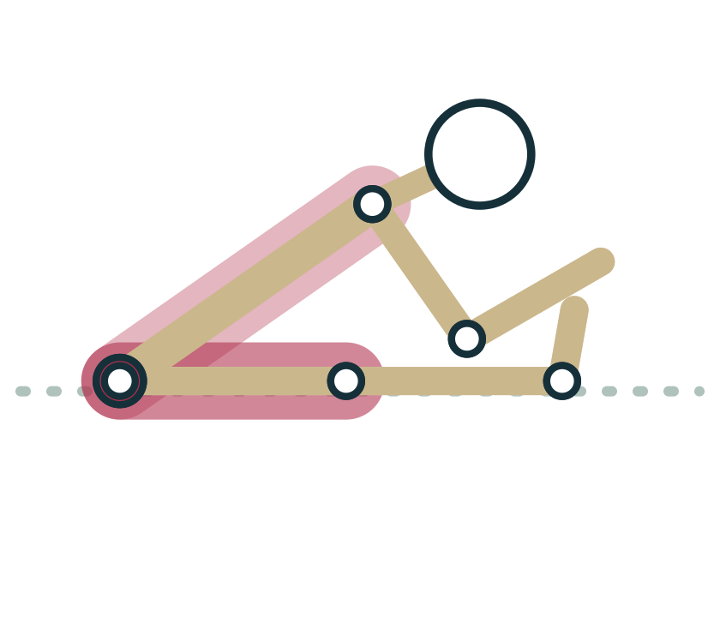
LESSON 3.5
A spectrum, not a switch
Hypermobile: joints move beyond the typical range
Hypomobile: joints move less than the typical range
Both are common and often cause no problems
Yoga rooms tend to attract very flexible people
Plate 20 The same fold can be effortless for one student, out of reach for another
Anatomy on the Mat · Dr. Akash Garg, D.C.
39
Notes:
Joint range sits on a spectrum. At one end are hypermobile joints, which move further than is typical. At the other are hypomobile joints, which move less. Most people are somewhere in between, and many have a mix, perhaps flexible shoulders and stiff hips. Hypermobility is common, especially in younger people and more often in women, and for many it causes no problems at all. It can even be an advantage in dance and yoga, which is one reason yoga classes tend to attract very flexible students. Hypomobility can come from bone shape, tissue stiffness, age, past injury or conditions such as arthritis. Neither end of the spectrum is good or bad in itself. What matters for a teacher is that each end needs a different emphasis: control and strength for the very mobile, patience and props for the stiff.

Slide 40
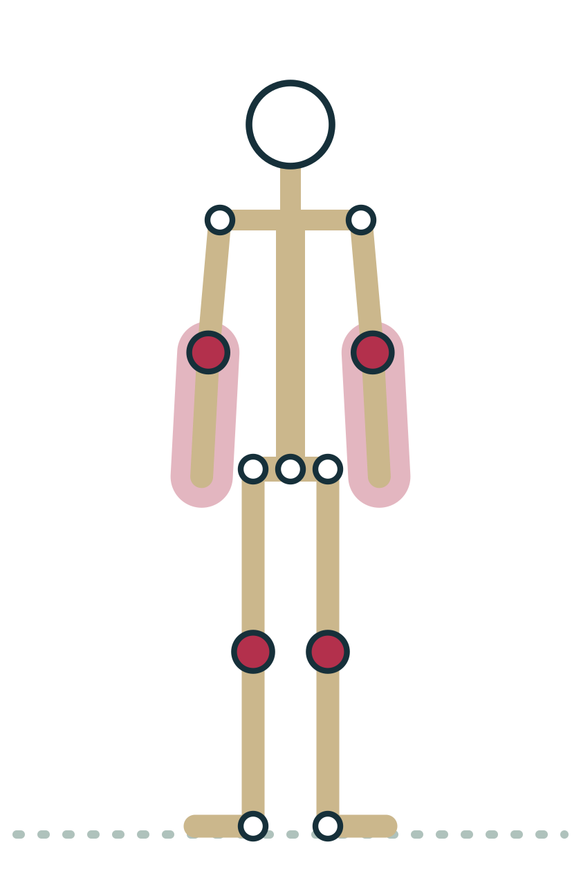
LESSON 3.5
Points on the Beighton score
9
A screening tool clinicians use for generalised joint hypermobility: little fingers, thumbs, elbows, knees, and palms to floor. It is not a diagnosis, and teachers do not score students.
Plate 21 Elbows and knees are among the joints the Beighton score checks
Anatomy on the Mat · Dr. Akash Garg, D.C.
40
Notes:
You may hear students mention the Beighton score. It is a nine-point screening tool that clinicians use to check for generalised joint hypermobility. One point is given for each side for bending the little finger back beyond ninety degrees, bringing the thumb to touch the forearm, elbow hyperextension beyond ten degrees and knee hyperextension beyond ten degrees. That makes eight. The ninth point is for placing the palms flat on the floor with the knees straight. Cut-offs depend on age. A high score shows generalised hypermobility, which on its own is not a disorder. Clinicians also recognise hypermobility spectrum disorders and hypermobile Ehlers-Danlos syndrome, which involve more than flexibility, such as pain, fatigue or frequent joint instability, and are diagnosed through a full clinical assessment. Your role is not to score or label students. It is to teach well and refer.

Slide 41
LESSON 3.5
What you may notice, and what helps
Very mobile student
Stiff student
Knees or elbows push past straight
Sinks into end range, little muscle
Helps: micro-bends, strength, slower pace
Helps: work short of end range
Hits end range early
May strain or hold the breath
Helps: blocks, straps, bent knees
Helps: time and no comparison
Anatomy on the Mat · Dr. Akash Garg, D.C.
41
Notes:
Here is what these patterns can look like on the mat. A very mobile student may lock the knees back in standing poses or hyperextend the elbows in Plank and Downward Dog. They may drop into the deepest version of every pose and hang there on ligaments rather than muscle. Helpful responses include micro-bends at the knees and elbows, strength and balance work, a slower pace, and inviting them to stop before their end range and hold with muscle. A stiff student reaches end range early, may strain, and often holds their breath trying to match the room. Blocks, straps, bent knees, longer holds in comfortable positions, and a clear message that their version is complete all help. Notice that both lists are about adapting the practice. Neither requires you to know anyone's diagnosis.

Slide 42
LESSON 3.5 · CUE IT
Teaching the very mobile student
“Find your deepest point, then come back a little and hold the pose there with your muscles.”
Why it works Working short of end range moves load from ligaments and capsule onto muscle, building the active control that very mobile joints rely on.
Plate 22 Chaturanga: strength matters more than depth
Anatomy on the Mat · Dr. Akash Garg, D.C.
42
Notes:
This cue works well for everyone, but it is especially valuable for hypermobile students. When a very flexible student goes to their deepest point, they are often resting on passive structures, the capsule and ligaments, with muscles doing little. Over time that can leave joints feeling unstable or sore. Inviting them to back off slightly and then hold the pose with muscle shifts the load onto structures that can be trained. It also builds body awareness, which research suggests may be reduced in some hypermobile people. In Chaturanga, for example, going lower is not better. A student who holds a higher Chaturanga with steady elbows and shoulders is working the pose well. Say this to the whole room so no one is singled out, and praise control rather than depth.

Slide 43
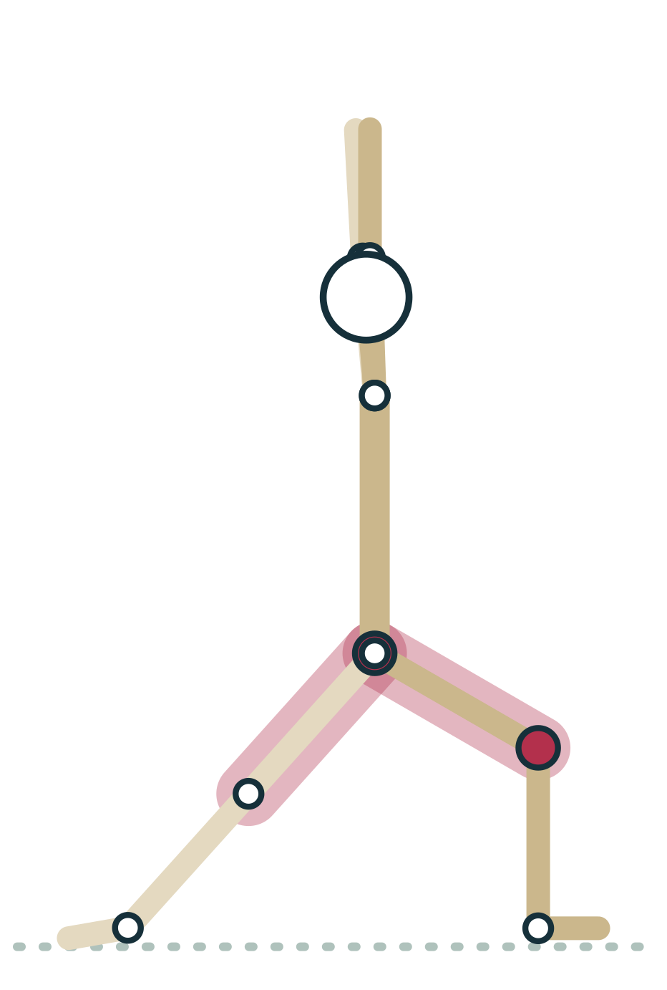
LESSON 3.5 · FEEL IT
Feel it: working short of end range
1
In Warrior I, bend the front knee as deep as you comfortably can
2
Now rise a few centimetres until the legs feel strong
3
Hold for five breaths, feeling muscles rather than joints
4
Compare the two versions: which felt steadier and more active?
Plate 23 Warrior I: hold slightly short of your deepest bend
Anatomy on the Mat · Dr. Akash Garg, D.C.
43
Notes:
Let's try this in your own body. Come into Warrior I and bend the front knee as far as you comfortably can. Notice where you feel the pose. Now rise up a few centimetres, just until the front thigh and back leg feel strongly engaged. Hold there for five breaths and pay attention to what is working. Most people find the second version feels steadier and more muscular, and many find it more tiring, which is the point. Then try the same idea with your elbows in Downward Dog: if they tend to lock past straight, soften them slightly and press through the base of the index fingers. As you teach, you will see that working short of end range is not holding back. It is choosing strength and control over depth, which suits both flexible and stiff bodies.

Slide 44
LESSON 3.5 · CHECK IT
A student says they are very flexible and asks you to test their Beighton score. What should you do?
Score them so you can plan their practice
Pause the video and choose before you move on.
A
Explain it is a clinical tool, offer control-focused options, suggest a health professional if they have symptoms
B
Tell them flexibility means they cannot be injured
C
Anatomy on the Mat · Dr. Akash Garg, D.C.
44
Notes:
The Beighton score is a clinical screening tool, and even in clinical hands it is only one part of an assessment. Scoring a student in class could create a label they carry away, and it is outside a yoga teacher's scope of practice. The right response is warm and practical. Thank them for telling you, explain that the score is something clinicians use, and offer ways to practise that build strength and control, like micro-bends and working short of end range. If they mention pain, fatigue, frequent joint slips or dislocations, suggest they see a doctor or physiotherapist. The third option is simply false: very flexible people are not protected from injury. Some have more joint instability, not less. This answer reflects the core rule of this course: teachers adapt and refer; they never diagnose.

Slide 45
LESSON 3.5 · CHECK IT
Answer
Explain it is a clinical tool, offer control-focused options, suggest a health professional if they have symptoms
B
Teachers do not screen or diagnose; they adapt the practice and refer when there are symptoms.
Question: A student says they are very flexible and asks you to test their Beighton score. What should you do?
Anatomy on the Mat · Dr. Akash Garg, D.C.
45
Notes:
The answer is B: Explain it is a clinical tool, offer control-focused options, suggest a health professional if they have symptoms. Teachers do not screen or diagnose; they adapt the practice and refer when there are symptoms.

Slide 46
3.6
LESSON 3.6 · 20 MIN
Pose lab: reading every joint action in Sun Salutation A
See it
Feel it
Cue it
Check it
Anatomy on the Mat · Dr. Akash Garg, D.C.
46
Notes:
Lesson 3.6: Pose lab: reading every joint action in Sun Salutation A. Read a pose joint by joint: plane, action, limit, stabilizer. Upward Salute: shoulder flexion, elbow extension. Forward Fold: hip flexion, knee extension, spinal flexion; hamstring tension limits it. Chaturanga: elbow flexion and shoulder extension under load; knees down reduces it. Cobra and Up Dog: spinal and hip extension, ankle plantarflexion. Downward Dog: shoulder and hip flexion, knee extension, ankle dorsiflexion.

Slide 47
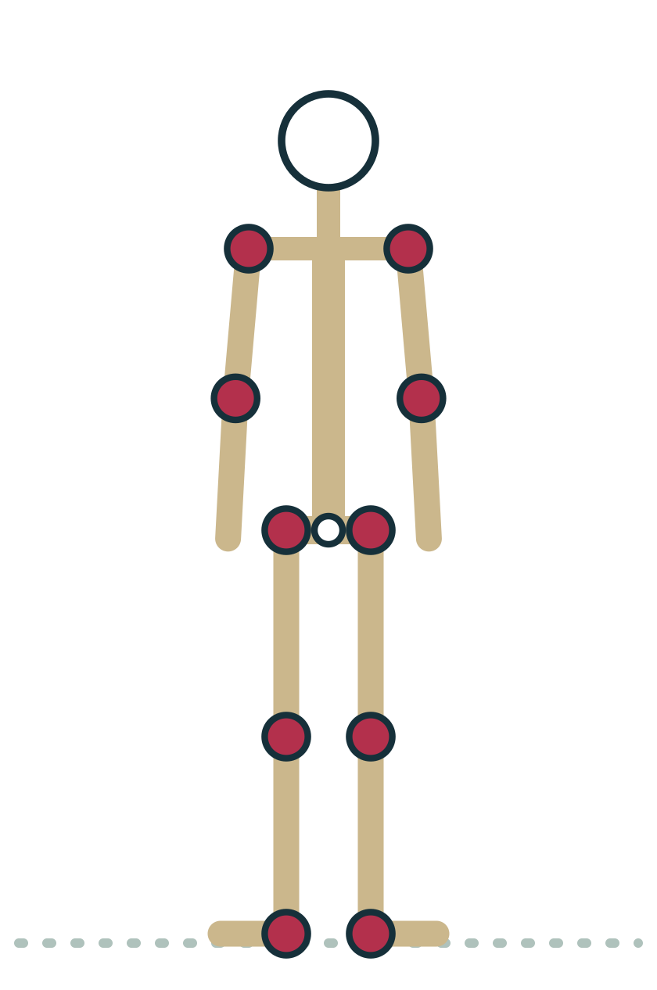
LESSON 3.6
How to read a pose
1
Pick one joint at a time, from ankles upward
2
Name the plane: sagittal, frontal or transverse
3
Name the action: flexion, extension, abduction, rotation
4
Ask what limits it: tension or compression?
5
Ask what stabilizes it: passive structures or muscle?
Plate 24 Mountain: the neutral reference for every joint
Anatomy on the Mat · Dr. Akash Garg, D.C.
47
Notes:
This final lesson pulls the whole module together. You will read Sun Salutation A joint by joint. Here is a simple method. First, choose one joint and work systematically, for example from ankles to knees to hips to spine to shoulders to elbows. Second, name the plane of movement. Third, name the action compared with Mountain, which we treat as the neutral starting point. Fourth, ask what limits the range: is the end created by tension or compression? And fifth, ask what holds the joint steady: passive structures, muscle, or both? You do not need to do all five steps for every joint in every pose. But practising this method a few times trains your eye, so that in a real class you can quickly see which joint is doing what and give a useful cue.

Slide 48
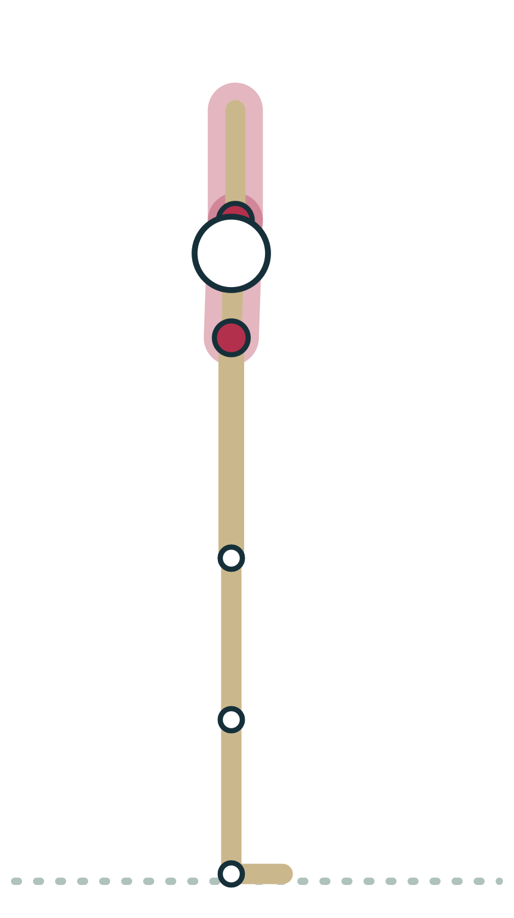
LESSON 3.6
Arms up, then fold forward
Arms up: shoulder flexion, scapulae rotate upward, elbows extend
Forward fold: hip flexion with knees extended
Spine flexes as the fold deepens
Half lift: spine lengthens toward extension, hips stay flexed
Plate 25 Upward Salute: full shoulder flexion
Anatomy on the Mat · Dr. Akash Garg, D.C.
48
Notes:
The sequence begins in Mountain. As the arms sweep up into Upward Salute, the shoulders move into flexion, the arms travelling forward and up in the sagittal plane. The shoulder blades rotate upward to make room, and the elbows extend. Tight chest or back muscles can limit this by tension, and some students find their arms stay slightly forward of the ears; that is fine. Folding forward, the main action is hip flexion, with the knees extended. The limit here is usually tension in the hamstrings at the back of the thighs, and bending the knees reduces it. As the fold deepens the spine also flexes. In the half lift, the hips stay flexed while the spine moves back toward neutral, a gentle extension. Cue bending the knees generously here, so the lift comes from the hips and spine rather than the lower back rounding.

Slide 49
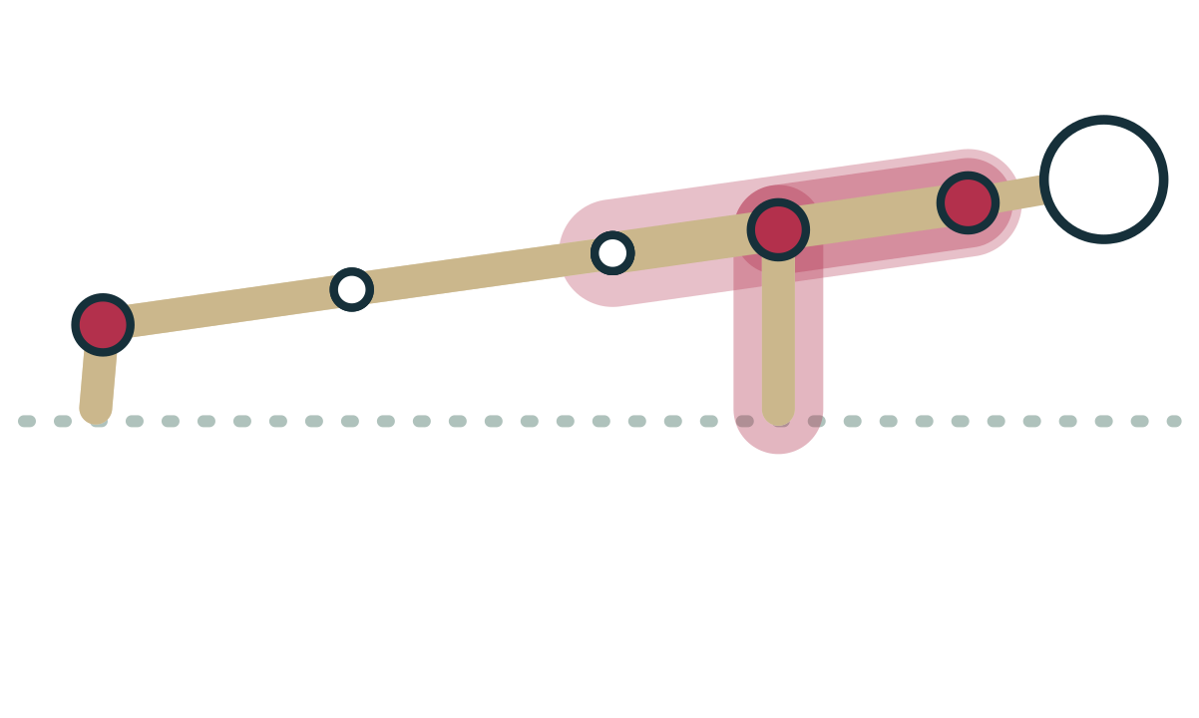
LESSON 3.6
Plank to Chaturanga
Plank: shoulders flexed about ninety degrees, elbows extended
Lowering: elbows flex, shoulders move toward extension
Ankles dorsiflex, toes extend on the floor
Hips and spine held near neutral by muscle
Plate 26 Chaturanga: elbow flexion, shoulders moving toward extension
Anatomy on the Mat · Dr. Akash Garg, D.C.
49
Notes:
Now step or jump back to Plank. The shoulders are flexed roughly ninety degrees relative to the trunk, the elbows are extended, and the ankles are dorsiflexed with the toes bent back against the floor. As the student lowers into Chaturanga, the elbows flex toward ninety degrees and the shoulders move toward extension as the upper arms come back alongside the ribs. This is a weight-bearing position for the shoulder, a joint that depends on active stability, so the rotator cuff and the muscles around the shoulder blades work hard. The hips and spine should stay close to neutral. That is not a joint action, it is stability, provided by the abdominal and hip muscles holding the body like a plank. Lowering the knees is a good option. It shortens the lever and lets the shoulders do the same actions with less load.

Slide 50
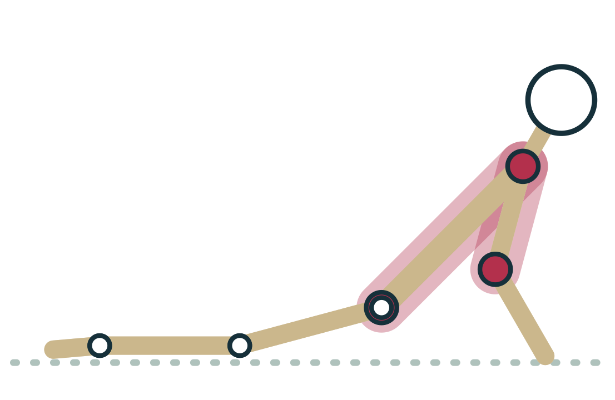
LESSON 3.6
Cobra or Upward-facing Dog
Spine extends; many small joints share the curve
Hips extend with legs long behind
Ankles plantarflex, tops of feet on the floor
Elbows extend in Up Dog, stay bent in Cobra
Plate 27 Cobra: spinal and hip extension
Anatomy on the Mat · Dr. Akash Garg, D.C.
50
Notes:
From Chaturanga the student moves into Cobra or Upward-facing Dog. The main action is spinal extension. Remember the twenty-three discs and the facet joints: the curve should be shared along the spine rather than concentrated in the lower back. The hips are extended with the legs long behind, and the ankles are plantarflexed as the tops of the feet press into the floor. In Cobra the elbows stay bent and the back muscles do most of the lifting. In Up Dog the elbows extend and the arms bear more weight. What limits the backbend? Often tension at the front of the body and hips, and in some students compression at the back of the spine, where the bony parts of the vertebrae come close together. If a student feels a pinch in the low back, cue less height, not more effort.

Slide 51
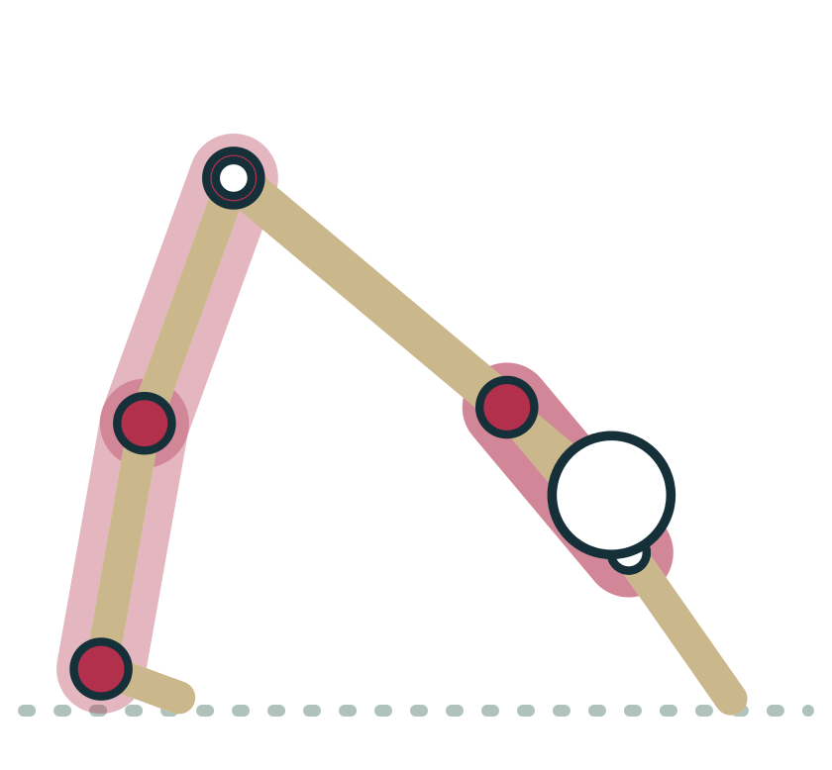
LESSON 3.6
Downward-facing Dog
Shoulders fully flexed, arms in line with the ears
Hips flexed, spine long and near neutral
Knees extend as far as the hamstrings allow
Ankles dorsiflex as heels reach toward the floor
Plate 28 Downward Dog: flexion at shoulders and hips, dorsiflexion at ankles
Anatomy on the Mat · Dr. Akash Garg, D.C.
51
Notes:
Downward-facing Dog combines several actions. The shoulders are in full flexion, the same action as Upward Salute but now bearing weight, so active stability matters again. The elbows are extended; for students whose elbows move past straight, a micro-bend keeps them off end range. The hips are flexed and the spine aims to be long. The knees extend as far as the hamstrings allow, and the ankles dorsiflex as the heels move toward the floor. Where are the limits? Tension in the hamstrings and calves is very common, and bending the knees lets the spine lengthen. Some students are limited at the shoulders instead. Heels do not need to touch the floor; ankle shape and calf length vary. From here the student steps forward, returns through half lift and forward fold, and rises through Upward Salute back to Mountain, repeating the actions in reverse.

Slide 52

LESSON 3.6 · FEEL IT
Feel it: slow-motion Sun Salutation
1
Move through one round at half speed with a partner watching
2
At each pose, pause and name three joint actions aloud
3
Your partner checks: plane, action, limit
4
Swap roles and compare what you each noticed
Plate 29 Forward Fold: pause and name the hip and knee actions
Anatomy on the Mat · Dr. Akash Garg, D.C.
52
Notes:
Now it is your turn. Pair up with another trainee. One of you moves through a single round of Sun Salutation A at about half speed. At each pose, pause and say three joint actions out loud. For example, in the forward fold: hips flexed, knees extended, spine flexed. Your partner listens and checks each one: which plane is it in, is the action named correctly, and what is limiting the range? Then swap roles. You may be surprised how much you notice when you slow down, like the moment the shoulders change from flexion to extension as you lower from Plank, or how the ankles go from dorsiflexed to plantarflexed as you roll over the toes. Write down anything you disagreed on and bring it back to the group. Reading joint actions quickly is a skill, and this kind of practice is how it grows.

Slide 53
LESSON 3.6 · CHECK IT
Moving from Plank into Upward-facing Dog, what happens at the ankles?
They move from dorsiflexion to plantarflexion
Pause the video and choose before you move on.
A
They move from plantarflexion to dorsiflexion
B
They stay in neutral
C
Anatomy on the Mat · Dr. Akash Garg, D.C.
53
Notes:
Picture the feet. In Plank the toes are tucked under, the heels reach back and the ankles are dorsiflexed, meaning the top of the foot and the shin are closer together than in standing. As the student rolls over the toes into Upward-facing Dog, the tops of the feet come to the floor and the ankles plantarflex, pointing the feet. Some students find rolling over the toes uncomfortable or impossible because of ankle or toe stiffness. The simple alternative is to flip the feet one at a time. This transition is a nice reminder that Sun Salutation A moves nearly every major joint through a range, which is part of why it works so well as a warm-up. When you can describe what every joint is doing in this sequence, you can read almost any vinyasa class.

Slide 54
LESSON 3.6 · CHECK IT
Answer
They move from dorsiflexion to plantarflexion
A
In Plank the toes are tucked and the ankles dorsiflexed; in Up Dog the tops of the feet press down, so the ankles plantarflex.
Question: Moving from Plank into Upward-facing Dog, what happens at the ankles?
Anatomy on the Mat · Dr. Akash Garg, D.C.
54
Notes:
The answer is A: They move from dorsiflexion to plantarflexion. In Plank the toes are tucked and the ankles dorsiflexed; in Up Dog the tops of the feet press down, so the ankles plantarflex.

Slide 55
MODULE 3 REVIEW
Key terms
Joint (articulation) | Any place where two or more bones meet, such as the hip where the femur meets the pelvis in Warrior II.
Fibrous joint | Bones joined by dense fibrous tissue with little or no movement, like the skull sutures that stay still in every headstand prep.
Cartilaginous joint | Bones joined by cartilage that allows slight movement, like the intervertebral discs that each add a little to Cat and Cow.
Pubic symphysis | The fibrocartilage joint at the front of the pelvis; it can feel tender in wide-legged poses, especially in pregnancy.
Synovial joint | A freely movable joint with a fluid-filled cavity inside a capsule, such as the shoulder in Downward Dog.
Articular cartilage | The smooth hyaline cartilage covering bone ends inside a synovial joint, letting the knee glide as you bend into Chair.
Synovial fluid | Thick fluid inside a synovial joint that lubricates it and nourishes the cartilage; movement such as a gentle warm-up helps circulate it.
Joint capsule | The fibrous sleeve enclosing a synovial joint; locking the knees back in Mountain rests the joint on the back of its capsule.
Ligament | A band of dense connective tissue joining bone to bone, limiting extreme range, like the strong hip ligaments that tighten as you stand upright.
Hinge joint | A synovial joint moving in one axis, flexion and extension, like the elbow bending in Chaturanga.
Pivot joint | A synovial joint that rotates around one axis, like the neck turning to look up in Triangle.
Anatomy on the Mat · Dr. Akash Garg, D.C.
55
Notes:
Key terms for review. Joint (articulation), Fibrous joint, Cartilaginous joint, Pubic symphysis, Synovial joint, Articular cartilage, Synovial fluid, Joint capsule, Ligament, Hinge joint, Pivot joint

Slide 56
MODULE 3 REVIEW
Key terms (continued)
Ball-and-socket joint | A synovial joint moving in three axes including rotation, like the hip rotating outward in Tree.
Flexion and extension | Flexion closes a joint angle and extension opens it; Forward Fold flexes the hips, Cobra extends the spine.
Abduction and adduction | Abduction moves a limb away from the midline and adduction toward it; the front hip abducts in Warrior II.
Dorsiflexion and plantarflexion | Dorsiflexion brings the top of the foot toward the shin, as in Downward Dog; plantarflexion points the foot, as in Cobra.
Range of motion | How far a joint can move in a given direction, such as how far the thigh lifts toward the chest in a knee hug.
Tension | An end of range created by tissue reaching its stretch limit, felt as a stretch opposite the movement, like the hamstrings in a fold.
Compression | An end of range created by parts meeting, bone on bone or soft tissue on soft tissue, felt as a pinch, like the front of the hip in a deep squat.
Passive stability | Support from structures that need no effort: bony fit, capsule, ligaments, labrum and menisci, like the deep hip socket in standing poses.
Active stability | Support from muscles switched on by the nervous system, like the rotator cuff holding the shoulder steady in Plank.
Hypermobility | Joint range beyond the typical; common and often harmless, but very mobile students benefit from micro-bends and control, for example in Downward Dog.
Beighton score | A 9-point clinical screening tool for generalised joint hypermobility; it is not a diagnosis, and teachers do not score students.
Anatomy on the Mat · Dr. Akash Garg, D.C.
56
Notes:
Key terms for review. Ball-and-socket joint, Flexion and extension, Abduction and adduction, Dorsiflexion and plantarflexion, Range of motion, Tension, Compression, Passive stability, Active stability, Hypermobility, Beighton score

Slide 57
MODULE 3 REVIEW
Myths to retire
With enough practice, anyone can reach the full expression of any pose.
Bone shape varies between people and ends some ranges by compression. Stretching cannot reshape adult bone, so some shapes are simply not available to some bodies.
More flexibility always means healthier joints.
Very mobile joints can rely heavily on ligaments and capsule at end range. They benefit from strength and control, and flexible students are not protected from injury.
A pinch in a pose means you need to stretch harder.
A pinch usually signals compression, where parts meet. More effort will not change it; a different angle or a prop is the right response.
The sacroiliac joint regularly slips out of place and a teacher can put it back.
The SI joint moves only a few degrees and is held by very strong ligaments. Pain here needs a qualified health professional, not a manual adjustment from a yoga teacher.
Locking the knees straight is the most stable way to stand.
Locking rests the knee on its capsule and ligaments. A slight softening with active leg muscles shares the load with muscle.
Anatomy on the Mat · Dr. Akash Garg, D.C.
57
Notes:
Common misconceptions and what is actually true.

Slide 58
End of Module 3
Before the next module: work through the study guide, the flashcards and the interactive exercises, then run the module in the Anatomy Chase.
kashee12345.github.io/anatomy-on-the-mat
Anatomy on the Mat · Dr. Akash Garg, D.C.
Notes:
Wrap up and point trainees to the module resources.

