Slide 1


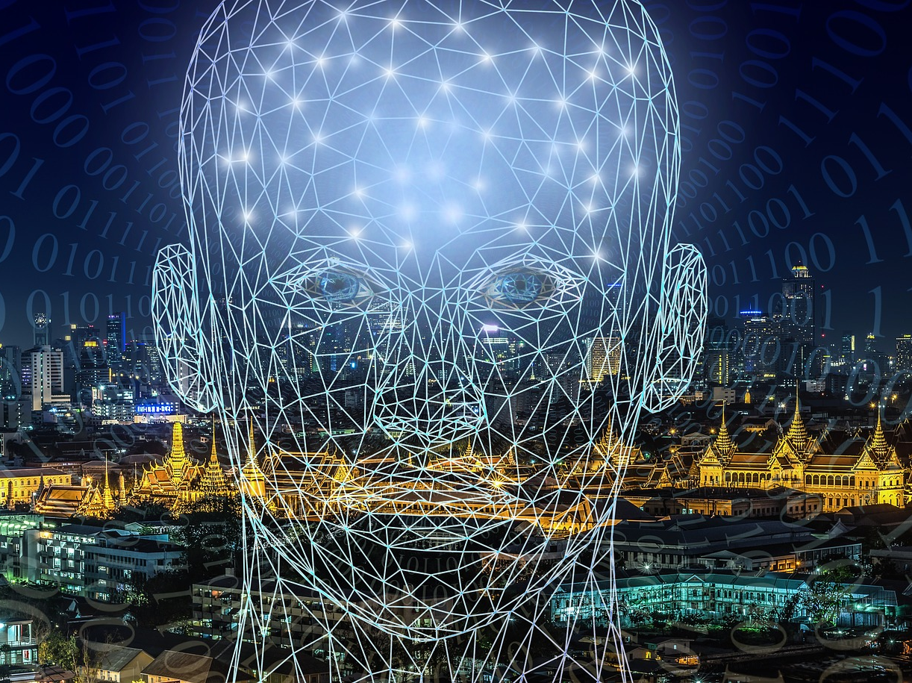
Generative AI: Unlocking the Future of Creativity
This Photo by Unknown Author is licensed under CC BY

Slide 2
Understanding Artificial Intelligence (AI)
AI simulates human intelligence by learning from vast amounts of data.
Discriminative AI: Classifies data (e.g., spam filters).
Generative AI: Creates new data, such as text, images, and code.
Example:
Discriminative AI: Is this an image of a nest or an egg?
Generative AI: Draw an image of a nest with three eggs in it.

Slide 3
The Power of Generative AI
Generative AI uses deep learning techniques like:
Generative Adversarial Networks (GANs)
Variational Autoencoders (VAEs)
Transformers (e.g., GPT models)
Diffusion Models

Slide 4
How Generative AI Works
• AI is trained on large datasets to recognize patterns.
1
• It generates new outputs based on learned relationships.
2
• Uses probability distributions to create coherent and high-quality results.
3

Slide 5
Evolution of Generative AI
1950s
Early machine learning algorithms explored content generation.
1990s
Neural networks improved AI’s creative capabilities.
2010s
Deep learning accelerated AI development.
2014
GANs introduced by Ian Goodfellow.
2018
OpenAI introduced GPT models.

Slide 6
Modern Generative AI Tools
Text Generation: ChatGPT, Gemini
Image Generation: DALL-E 2, MidJourney
Video Generation: Synthesia
Code Generation: GitHub Copilot, AlphaCode

Slide 7
Retrieval-Augmented Generation (RAG)
A widely used approach in business applications to manage private datasets.
Benefits:
Fast and efficient information retrieval
Enhanced search accuracy
Improved security for sensitive data.

Slide 8
Traditional AI vs Generative AI
Analyzes & predicts vs. Creates new content
Focuses on classification vs. Produces creative outputs
Extracts insights vs. Generates multimedia and text.

Slide 9
Generative AI in IT and DevOps
Enhances software delivery by automating repetitive tasks.
AI tools improve code quality (GitHub Copilot, Synk).
AI creates synthetic test cases for debugging.
Automates CI/CD pipelines for efficient deployment.

Slide 10

Generative AI in Entertainment & Gaming
AI enables synthetic content creation:
Music, scripts, and videos
Personalized content generation
Game development tools (e.g., SideFX Houdini for AR/VR)

Slide 11
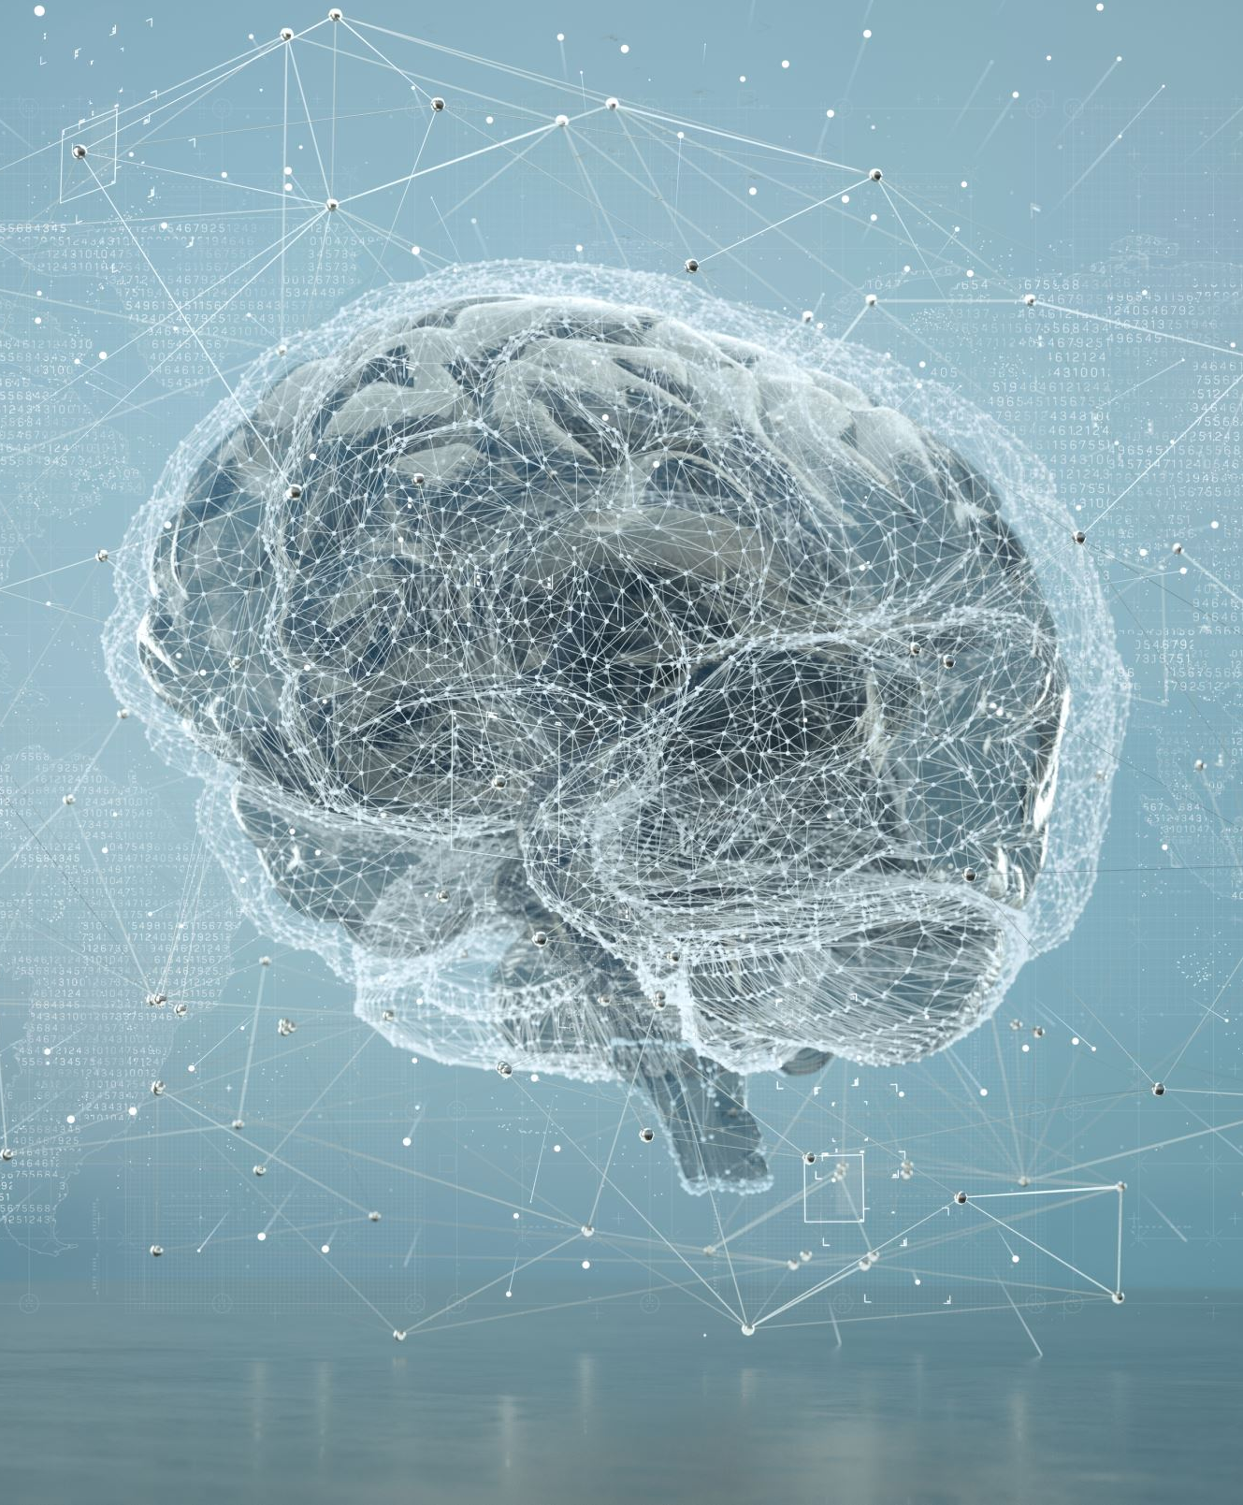
Generative AI in Education & E-Learning
AI provides personalized learning experiences.
Automated grading & feedback.
Example: Duolingo uses AI to improve language learning.

Slide 12
Generative AI in Banking & Finance
AI-powered banking assistants (e.g., KAI-GPT).
AI predicts stock trends via financial analysis.
AI helps with fraud detection and risk management.

Slide 13
Generative AI in Healthcare
AI enhances medical diagnostics with synthetic images.
AI speeds up drug discovery.
AI virtual doctors assist in telemedicine.

Slide 14
Generative AI in Human Resources
AI automates hiring, screening, and HR tasks.
AI-driven analytics improve employee performance reviews.
Future automation could replace 60-70% of tasks by 2060.

Slide 15
AI Tools for Text Generation
Popular Models:
GPT (OpenAI), PaLM (Google)
AI Tools:
ChatGPT (conversational AI)
Google Bard (real-time research AI)

Slide 16
AI Tools for Image Generation
AI Image Generators:
DALL-E (OpenAI), Stable Diffusion, Adobe Firefly
Applications:
Style transfer, sketch-to-image transformation, medical imaging.

Slide 17
AI Tools for Audio & Video Generation
AI Speech Generation:
LOVO, Synthesia, Murf.ai
AI Music Creation:
Meta's AudioCraft, AIVA
AI Video Creation:
Runway AI (used in Hollywood films).

Slide 18
AI Tools for Code Generation
AI-powered code assistants:
GitHub Copilot, IBM Watsonx Code Assistant
Capabilities:
Code completion and optimization
Automated documentation and debugging.

Slide 19
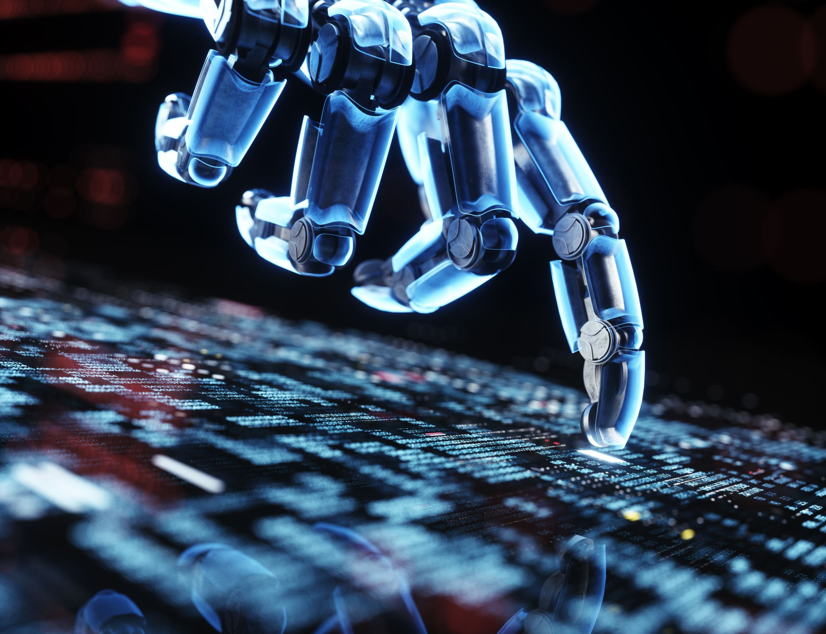
Conclusion & Future of Generative AI
Generative AI is transforming industries.
Future Directions:
- AI-human collaboration
- Stronger AI regulations
- Expanding AI to space research and robotics.
Next Steps:
- Experiment with AI tools
- Stay updated with AI advancements
- Apply AI in real-world projects.

