Slide 1

Instructor Dashboard for E-Learning Systems using Machine Learning

Slide 2




TEAM MEMBERS
Mehboob Ali
M Iqbal Malik
Kashif Ali Rabbani
Supervisor
S2402AE256
MEMBER
BC210200009
MEMBER
BC210200101

Slide 3



Project Scope
Objective
Develop a machine learning-based instructor dashboard.
Focus
Predicting student performance and enhancing e-learning with actionable insights.

Slide 4



Key Functional Requirements
Data Pre-processing: Cleaning, integration, and feature extraction.
Model Training and Testing: Selection and evaluation of machine learning algorithms.
Dashboard: Interactive UI for performance visualization.

Slide 5
Non-Functional Requirements
Performance, Security, Reliability, Usability, and Maintainability
For example, system uptime of 99.9% and scalability for concurrent users.

Slide 6
Use Case Overview
Examples of key use cases:
Explore Dataset
Predict Student Performance
Visualize Performance

Slide 7
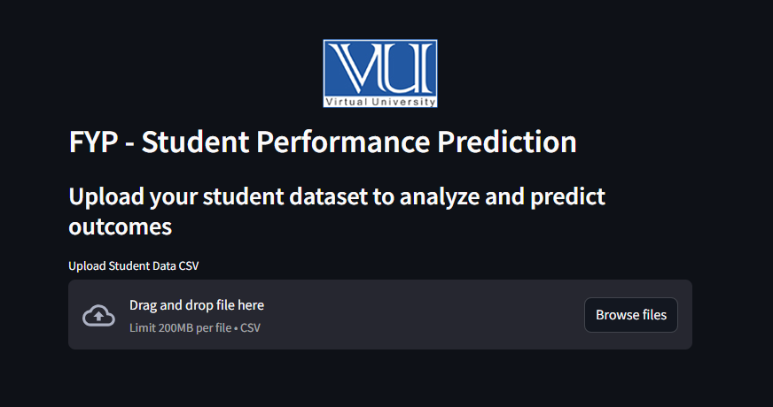
UI Snapshot

Slide 8
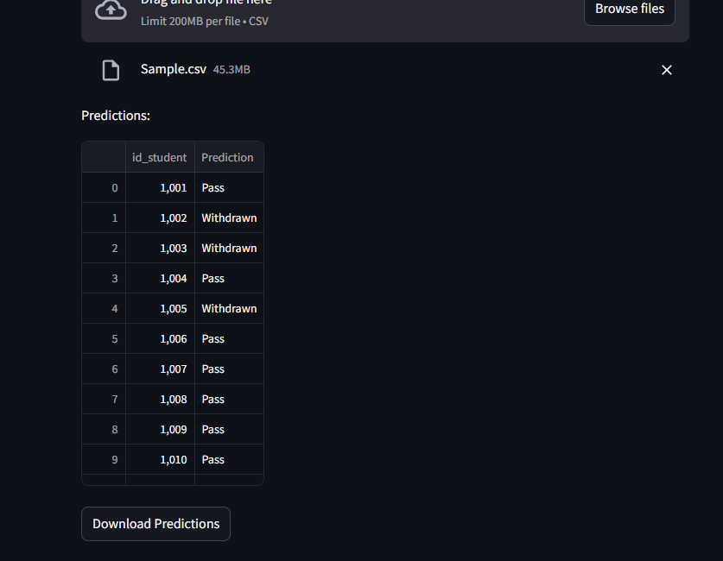
Dashboard Output

Slide 9
Future Work
Integrate with Learning Management Systems (LMS) for seamless data retrieval.
Explore advanced analytics like deep learning or NLP for enhanced insights.
Implement real-time adaptive learning recommendations.
Develop a mobile application for instructors' easy access.

Slide 10
Conclusion
The Instructor Dashboard uses machine learning to predict student performance and provides actionable insights.
Built with Python, Scikit-learn, and Streamlit, the system is scalable and user-friendly.
Enhancing the e-learning experience for instructors.

Slide 11
“ Thanks For your valuable time ”

