Slide 1
FUSE Lab Interview Presentation

Slide 2
Agenda
Introduction
Education
Work Experience
Achievements
Research Experience
Motivation

Slide 3
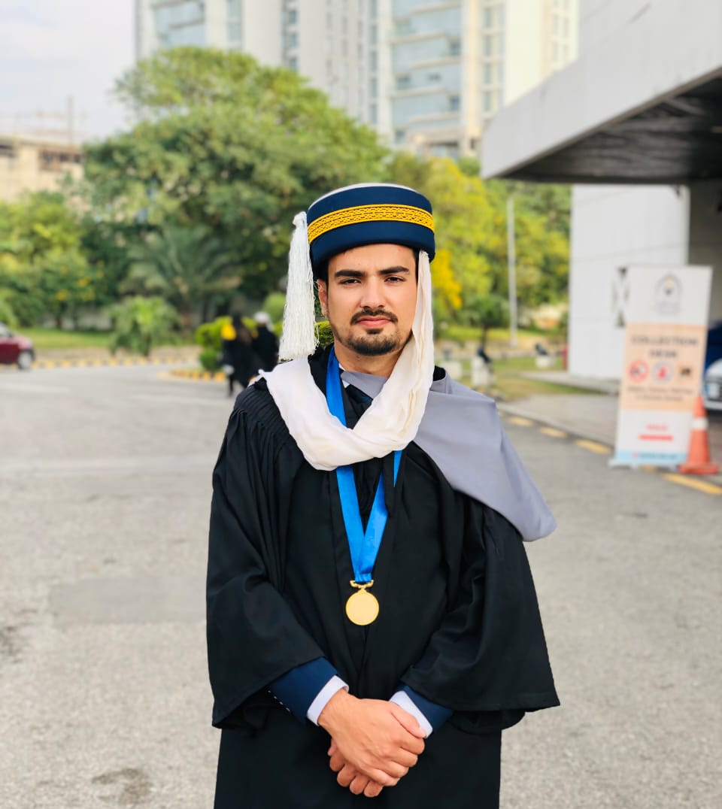
Introduction
I am Syed Mohammad Kashif
From Rawalpindi, Pakistan
I am 24 years old (31st May, 2001)
Master’s student at Wuhan University, China
I like Cricket and Gym.

Slide 4
Education
Master’s Studies:
Final year master’s student in Software Engineering at Wuhan University
CGPA 3.61/4.0 (91% marks)
Bachelor’s Studies:
Bachelor’s degree in Software Engineering from Riphah International University
CGPA 3.98/4.0

Slide 5
Work Experience
Software Engineer at Information Services Department (ISD) at Riphah International University.
Software Engineer at CricFlex (Project-based)
Teaching Assistant in OOP and DSA courses (internship)

Slide 6
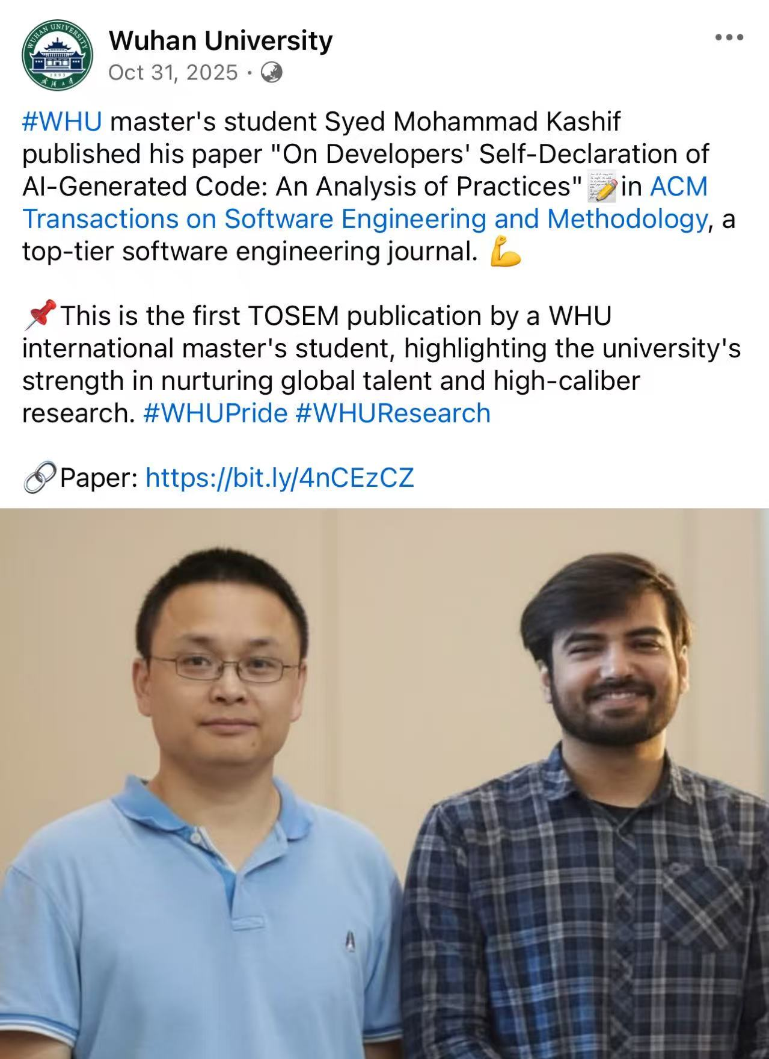
Achievements
First WHU international master’s who published in CCF-A journal (TOSEM)

Slide 7
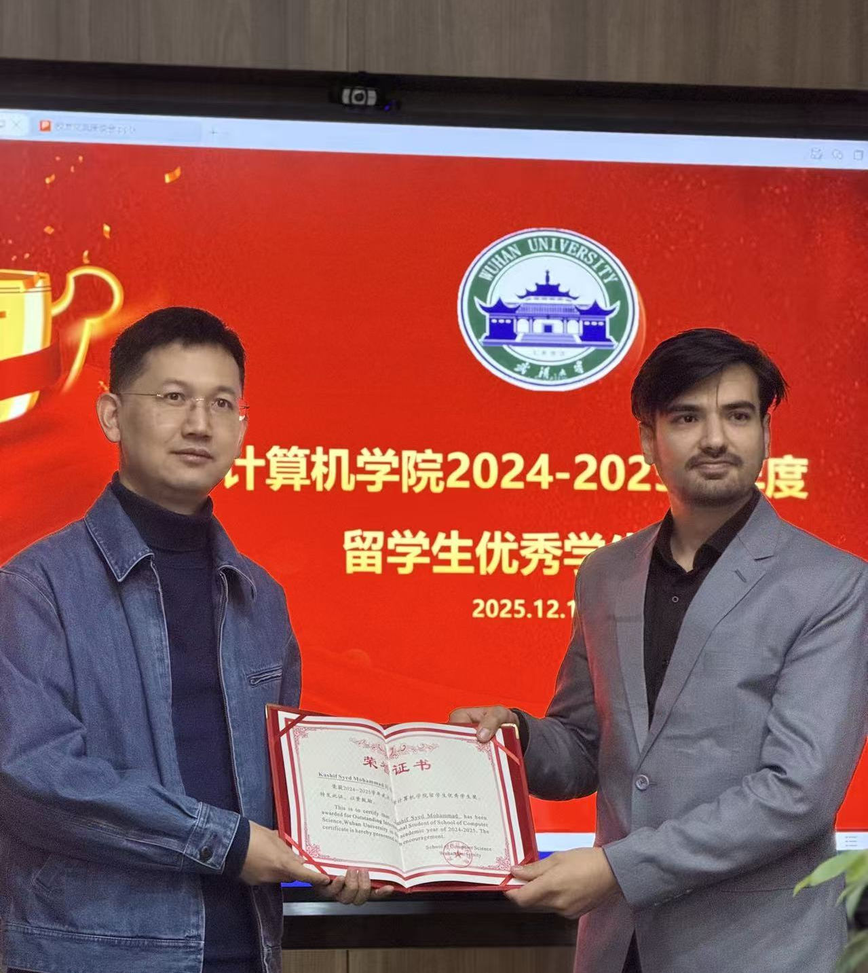
Achievements
Outstanding International student award
China Scholarship Council Fully Funded Scholarship
Gold Medal in my bachelor’s degree.

Slide 8
Research Experience (First Study)
Worked with Prof. Liang Peng and Prof. Amjed Tahir.
Self-declared AI-generated code is inspired from self-declared technical debt.
Designed a mixed methods empirical study including mining data from GitHub and a follow-up practitioner’s survey.
Completed the paper, “On Developers’ Self-Declaration of AI-Generated Code: An Analysis of Practices”.
RQ1: How do developers self-declare AI-generated code in their projects?
RQ2: Do developers self-declare AI-generated code in practice? Why or why not?

Slide 9
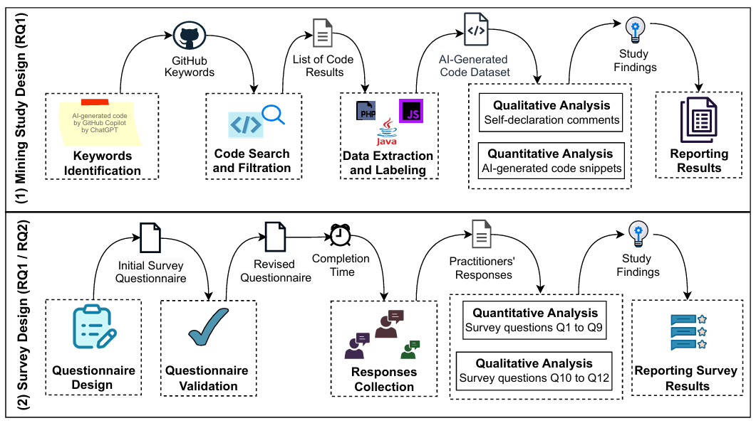

Slide 10
Research Experience (Results)
Most practitioners use simple self-declaration comments to self-declare AI-generated code.
The occurrences of self-declared AI-generated code in GitHub repositories are low. The trend indicates a steady increase in self-declaring AI-generated code among developers.
Practitioners self-declare AI-generated code to track it for future code review and debugging.
Practitioners do not self-declare AI-generated code because they review and modify the code before integrating into their projects.

Slide 11
Research Experience (Second Study)
For my thesis, I am researching AI-powered IDEs (Cursor) to generate large-scale projects and identify design issues in project-level code.
RQ1: Can Cursor generate large-scale projects?
RQ2: What design issues are likely to appear in large-scale projects generated by Cursor?

Slide 12
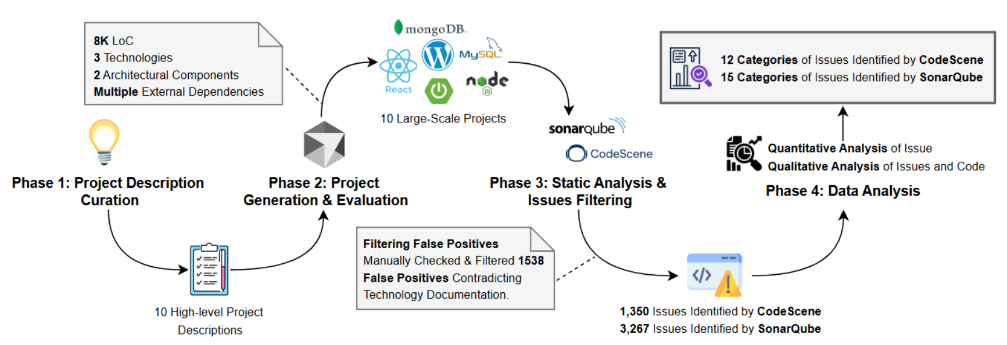

Slide 13
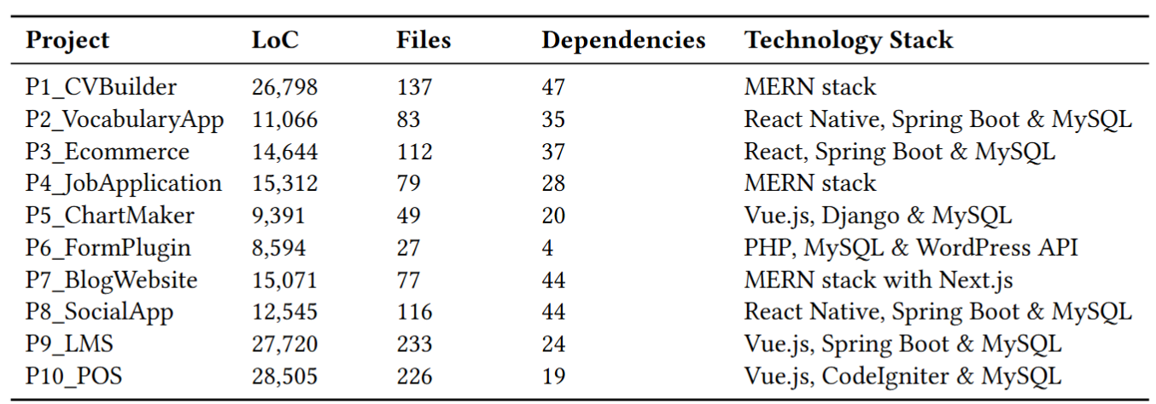
Research Experience (Results)

Slide 14
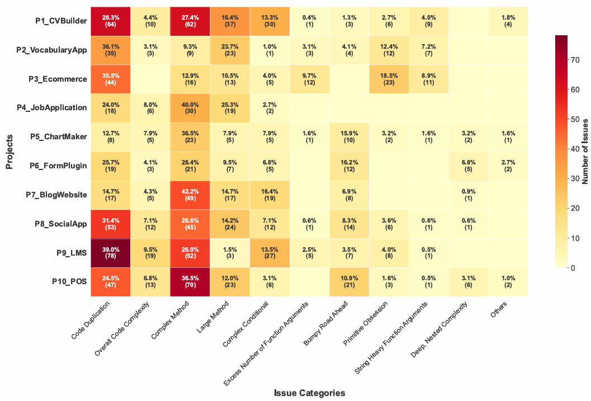

Slide 15
Research Experience
Now designing an autonomous multi-agent system for code refactoring
Orchestrator agent — Coordinates the workflow and invoke tools
Analyzer agent — Analyzes code issues
Refactoring agent — Generates refactored code
Validator agent — Validates refactored code

Slide 16
Motivation
My Research Interest is aligned with the goals of FUSE Lab. My research interest include empirical methods in software engineering and AI4SE (LLMs and autonomous agents for SE tasks)
My research experience, work experience and education background is in software engineering
FUSE Lab has collaboration with Meta
Delft University of technology is a top ranked university
This position is aligned with my long term career goals

Slide 17
Thank you

