Slide 1
MediCare Appointment
Management System
Advanced Database Management Systems
Student name: ____________________
Student ID and batch: ____________________
01
Notes:
Introduce the coursework and your own name. Explain that this is a local Oracle database application. Source: assessment brief pages 1 to 3. Suggested presentation duration is 8 to 10 minutes plus demonstration.

Slide 2
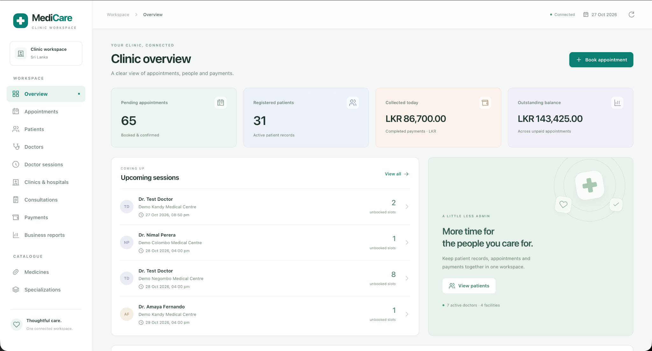
System scope
Doctor and patient records
Sessions and appointments
Consultations and prescriptions
Payments and five reports
02
Notes:
The platform links doctors, patients and facilities. Registration, scheduling, consultation, prescriptions and payment records all use the same Oracle data. Source: evidence E01 and coursework brief page 2. The overview totals are captured sample values rather than fixed performance claims.

Slide 3
Application and database architecture
React and Vite provide the staff workspace on port 5173
Node.js and Express expose the API on port 4000
Oracle Free runs in Docker with the MEDICARE schema
MC_API and MC_REPORTS keep business rules in PL/SQL
03
Notes:
React calls /api through the Vite development proxy. Express validates and binds inputs. The service uses node-oracledb Thin mode and a pool to access MEDICARE in FREEPDB1 on port 1521. MC_API performs business operations and MC_REPORTS produces reports. Sources: backend/src/config.js, oracle.js, service.js and frontend/vite.config.js.

Slide 4
ER model for scheduling
DOCTORS
1 : 0..N
DOCTOR_SPECIALIZATIONS
1 : 0..N
SPECIALIZATIONS
PK doctor_id
PK FK doctor_id
PK FK specialization_id
PK specialization_id
1 : 0..N
CLINICS
1 : 0..N
DOCTOR_SESSIONS
PATIENTS
PK clinic_id
PK session_id
FK doctor_id, clinic_id
PK patient_id
1 : 0..N
1 : 0..N
APPOINTMENTS
PK appointment_id
FK session_id, patient_id
04
Notes:
This editable diagram summarizes seven of the twelve tables. Each appointment references one session and one patient. A session references one doctor and one facility. DOCTOR_SPECIALIZATIONS resolves the many to many relationship. Physical SQL cardinalities permit zero links, while doctor creation and full editing through the API require at least one specialization. Source: 01_medicare_schema.sql and backend validation.js.

Slide 5
ER model for clinical records and payments
APPOINTMENTS
PK appointment_id
1 : 0..N
1 : 0..1
PAYMENTS
CONSULTATIONS
PK payment_id
FK appointment_id
PK consultation_id
FK UK appointment_id
1 : 0..1
MEDICINES
1 : 0..N
PRESCRIPTION_ITEMS
1 : 0..N
PRESCRIPTIONS
PK medicine_id
PK FK prescription_id
PK line_no
FK medicine_id
PK prescription_id
FK UK consultation_id
05
Notes:
This diagram adds five tables to APPOINTMENTS, giving twelve in total. Unique foreign keys permit one consultation per appointment and one prescription per consultation. DDL alone permits a prescription with no lines. MC_API.save_prescription requires at least one item and saves all rows atomically. Source: schema and save_prescription in 02_business_logic.sql.

Slide 6
Normalization and integrity
Separate rows hold specializations, medicine items and payments
Primary and foreign keys protect record relationships
Unique indexes protect occupied appointment slots
agreed_fee preserves the booking fee when session fees change
06
Notes:
Explain the stated functional dependencies. Separate medicine details from prescription instructions. Explain that agreed_fee records the historical amount accepted at booking, so it is a fact about the appointment. Conditional unique indexes enforce only non-cancelled slot and patient participation. Source: 01_medicare_schema.sql.

Slide 7
PL/SQL implementation
Procedures handle bookings, visits and payment changes
Functions calculate patient age and appointment balance
An explicit cursor processes session cancellations
Five triggers normalize data and protect history
Exceptions return errors and roll back failed operations
07
Notes:
MC_API has eleven public procedures and two public functions. patient_age and appointment_balance calculate values. cancel_session declares c_bookings FOR UPDATE and uses WHERE CURRENT OF. Five triggers normalize values and protect history. MC_REPORTS has five SYS_REFCURSOR procedures. Source: 02_business_logic.sql.

Slide 8
Transactions and the overpayment rule
SELECT ... FOR UPDATE
Check the remaining balance
Reject an excessive amount
Insert the accepted payment
Procedure savepoint and rollback
API commit on success
API rollback on failure
Cross-row payment rules run inside MC_API
08
Notes:
record_payment locks the appointment row before reading its balance. This serializes payment changes using the same parent lock. It rejects a payment above the balance before INSERT. A procedure failure rolls back to its savepoint. The API commits success and rolls back failure. Business rules require MC_API, since the owner account can bypass packages with arbitrary DML. Sources: MC_API.record_payment and backend/src/service.js.

Slide 9
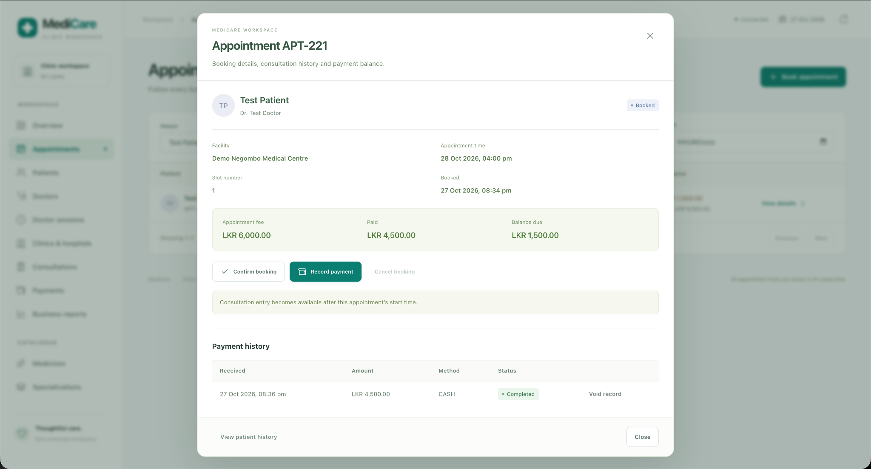
Partial payment evidence
LKR 6,000
Appointment fee
LKR 4,500
Completed payment
LKR 1,500
Remaining balance
09
Notes:
Evidence E03 shows appointment APT-221 for Test Patient and Test Doctor. The fee is LKR 6000 and the completed CASH payment is LKR 4500, leaving LKR 1500. Explain that voiding retains the original record but removes its amount from completed totals. The app does not charge a real card or send a bank transfer.

Slide 10
Five business reports
Appointment summary by date, clinic and status
Doctor workload with booking outcomes
Clinic revenue from completed payments
Outstanding balances for unpaid appointments
Patient consultation and prescription history
10
Notes:
MC_REPORTS opens a SYS_REFCURSOR for each report. The API fetches and closes it before releasing the connection. Revenue uses payment dates and completed payments. Date ranges include both selected calendar dates. Patient history may return several rows for one visit because each medicine line contributes a row. Source: MC_REPORTS and evidence E07 to E11.

Slide 11
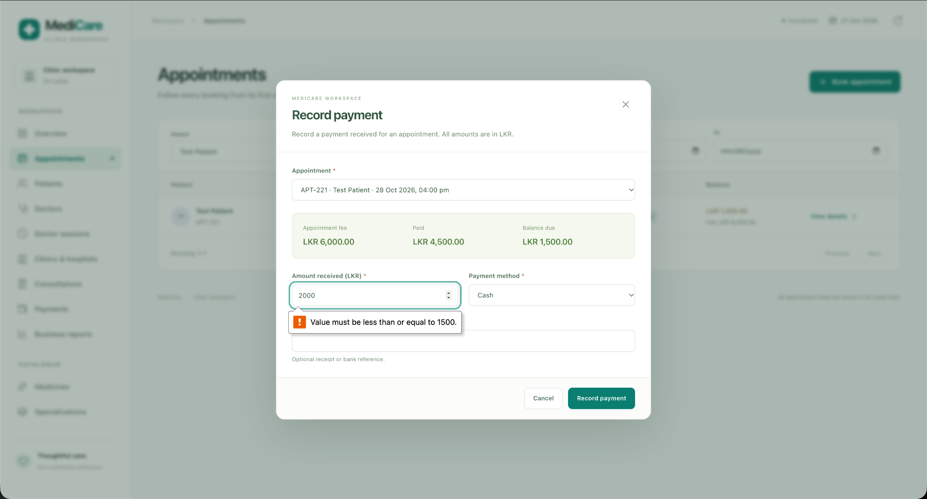
Validation and testing evidence
Browser form validation
Direct API request
LKR 2,000 against LKR 1,500 due
ORA-20110
Payment exceeds the
outstanding balance.
Balance stayed LKR 1,500
No extra payment saved
11
Notes:
E04 shows browser max validation. A separate direct POST /api/payments with appointment_id 221, amount 2000 and CASH returned Oracle error ORA-20110. The user confirmed no extra payment and an unchanged LKR 1500 balance. Live smoke checks passed. Backend 27 tests use simulated connections. Frontend 11 unit tests and build passed in the authoring environment. True concurrent-client testing remains additional work.

Slide 12
Live demonstration
1 Patient and doctor registration
2 Session availability and appointment booking
3 Partial payment and overpayment rejection
4 Started appointment consultation and prescription
5 All five reports and patient history
12
Notes:
Keep Docker, the backend and frontend running. Use fictional data. A consultation requires a pending booking whose start time has passed, so prepare a separate eligible appointment. A future booking can demonstrate booking and payments. Use readable fictional clinical notes rather than the temporary test entries in the earlier screenshots.

Slide 13
Current scope and future improvements
The local system covers the required core operations
Test records and payment entries are synthetic
Authentication and external payment integration remain future work
Further checks include concurrent booking and backup recovery
13
Notes:
The main local workflows and reports have passed the walkthrough checks. Do not claim all possible negative paths or concurrent races were tested. The current app has no login or external payment gateway. Future work includes a restricted application database account, authentication, backup/restore validation and true concurrent booking tests. Conclude by opening the working system and the SQL source for questions.

