Slide 1
KEYBOARDING
Class : S.E. (CSE)
Batch : S2
Mini Project Group No.: 05

Slide 2
MINI PROJECT GROUP MEMBERS
Kashinath Kallappa Mali.
Susmit Tanaji Shrikhande.
Shahaji Babaso Chavan.
Rohan Dattanand Revankar.

Slide 3
UNDER THE GUIDENCE
Mr.C.G.Kokane.

Slide 4
TECHNICAL INFORMATION…
Project Area :
Intelligent system and Searching, Path-finding Techniques.
Problem Statement :
How many keystrokes are necessary to type a text message ?
Objective :
There are many virtual keyboards running on devices. On particular devices they give four to five keys to operate this virtual keyboard. Since to find the no. of key strokes we have chosen this problem.

Slide 5
TECHNICAL INFORMATION…
Abstract:
Developing a C++ program to calculate the minimal number of key strokes required to type a given word.
Related Ideas:
BFS searching technique.
Shortest path finding technique.

Slide 6
VIRTUAL KEYBOARD
Technique to display keyboard on Screen
Operating – Touch or Keys
Keys – Individual Keyboard
Arrow and Selection Key

Slide 7
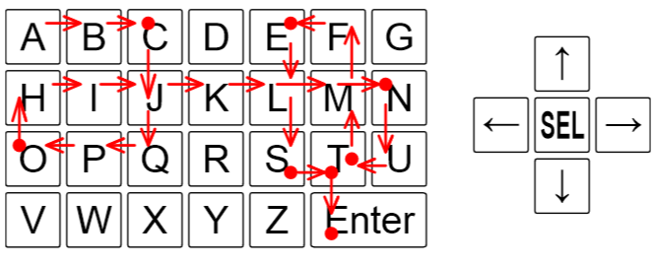
KEYBOARD LAYOUT

Slide 8
In This Problem...
INPUT –
Virtual Keyboard – No. Of keys & Layout Provided by User
Word which has to be type
IN SYSTEM –
Keys – Four Arrow keys & One Select Key
OUTPUT –
No of keystrokes to typing a user given word

Slide 9
CONSTRAINTS
User Can Give...
Any type of keyboard layout & word to be type.
Keyboard Must Contains ' * ' as enter button.
User Can't Give...
Two Same Labled Keys in Keyboard.
If it wants to give same labelled keys then there must be link is present i.e. these keys are must be in same row or same column or both.

Slide 10
INPUT MODULE
Two integers r & c (1 ≤ r,c & r,c ≤ 50)
Word - Non-empty string of at most 10000 of the available characters other than the asterisk(*).

Slide 11
PROCESS MODULE
Find the first letter in the given word, in the keyboard.
Move the pointer on the location of required letter.
Press select button and count the strokes of pressed keys for an output.

Slide 12
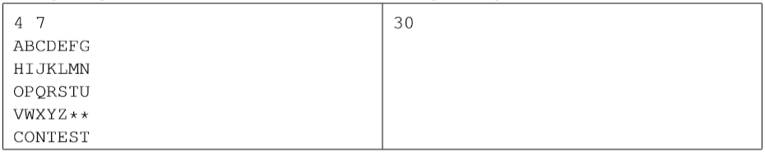
OUTPUT MODULE
Display the minimal number of strokes necessary to type the whole text, including the Enter key at the End.

Slide 13
TECHNICAL REQUIREMENT
The minimum requirement for our project are
Hardware Requirements-
Computer - Processor- PIV with 1.90Ghz & above
Keyboard, mouse ,monitor.
RAM –
256MB & above
HDD –
20GB & above
Operating System –
Ubuntu / DOS / Windows XP and above.
Software –
g++ compiler, Net-beans IDE etc.

Slide 14
CONCLUSION
By developing this software we are calculating minimum no. of keystrokes for typing the given word.

Slide 15
REFERENCES
Website –
www.acmicpc.com
Book –
‘Complete Reference C++’ by Herbert Schildt

Slide 16
THANK YOU…!

