Slide 1

JAVA Programming Project Presentation
Project Title: Vehicle Rental Booking and Payment Management System
Course: Java Mini Project
Student Name & Roll No: Kashini.K & 25bcs125
Department: Computer Science
Mentor : Mr.Aravind

Slide 2
Introduction
JAVA Programming Project Presentation
This project is a Vehicle Rental Booking System developed using Java Swing.
It allows users to book vehicles (Bike, Car, Van) easily.
Includes login authentication, booking form, and calendar view.
Helps manage rental records efficiently instead of manual booking.
Useful for small rental businesses.

Slide 3
Objective
JAVA Programming Project Presentation
To design a GUI-based vehicle booking system.
To implement login authentication.
To calculate rental cost automatically.
To store and manage booking details.
To display bookings using a calendar interface

Slide 4
Problem Statement
JAVA Programming Project Presentation
Manual booking systems are:
Time-consuming
Error-prone
Difficult to track records
No proper system to:
Manage customer details
Track booking dates
Store payment and proof
This project solves these issues using automation.

Slide 5
System Requirements
JAVA Programming Project Presentation
Hardware Requirements:
Processor: Intel i3 or higher
RAM: 4GB minimum
Storage: 500MB
Software Requirements:
OS: Windows / Linux
Language: Java
IDE: Eclipse / IntelliJ / NetBeans

Slide 6
System Design
JAVA Programming Project Presentation
The system consists of:
Login Page
Booking Form
Calendar View
Workflow:
User logs in
Enters booking details
Calculates amount
Saves booking ,Views bookings in calendar

Slide 7
Module Description
JAVA Programming Project Presentation
Login Module:
Validates username and password
Booking Module:
Collects customer and vehicle details
Processing Module:
Calculates rental amount
Storage Module:
Stores booking using HashMap
Calendar Module:
Displays bookings date-wis

Slide 8
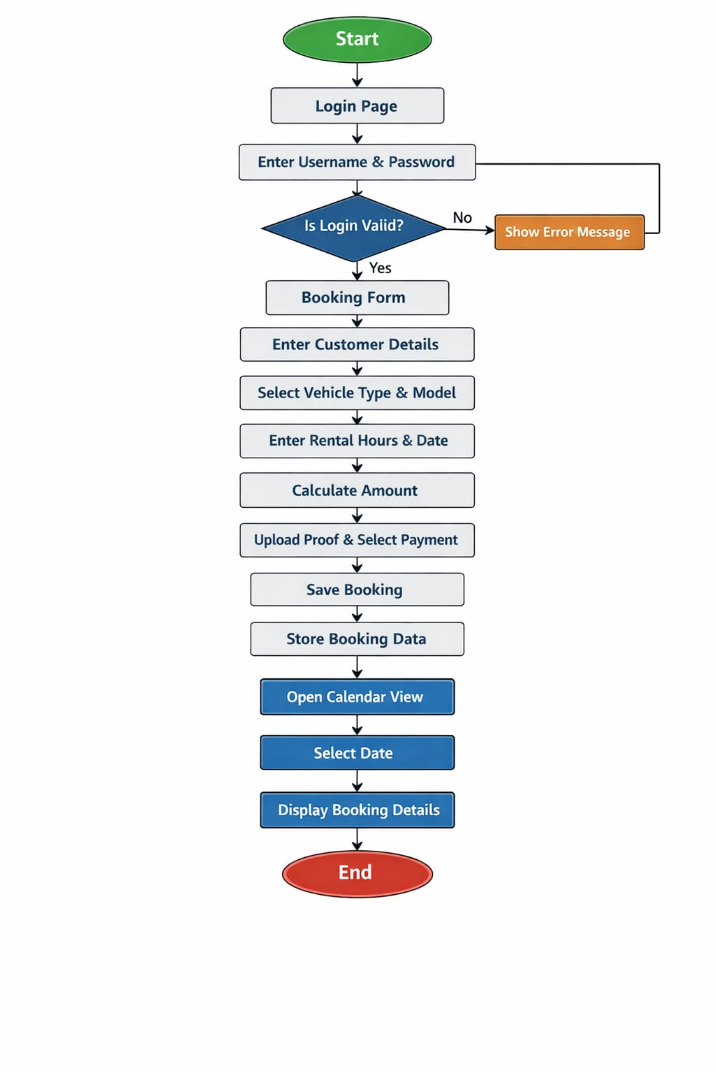
Algorithm / Flowchart
JAVA Programming Project Presentation
Start
Login validation
Enter booking details
Calculate amount
Save booking
Store in data structure
Display in calendar
Stop

Slide 9
Implementation
JAVA Programming Project Presentation
Technologies used:
Java Swing (GUI)
Event Handling
Collections (HashMap, ArrayList)
Features implemented:
Login authentication
Vehicle selection
Auto amount calculation
File upload (PDF proof)
Calendar navigation

Slide 10
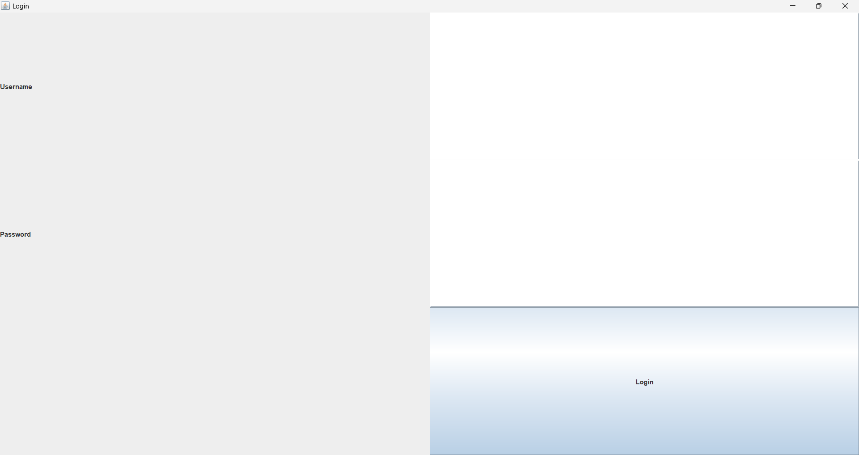
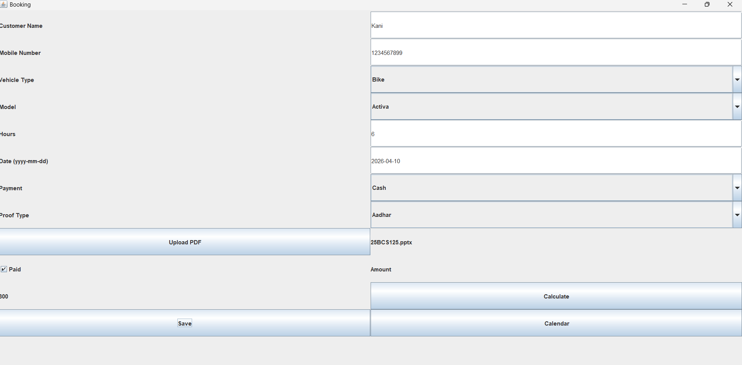
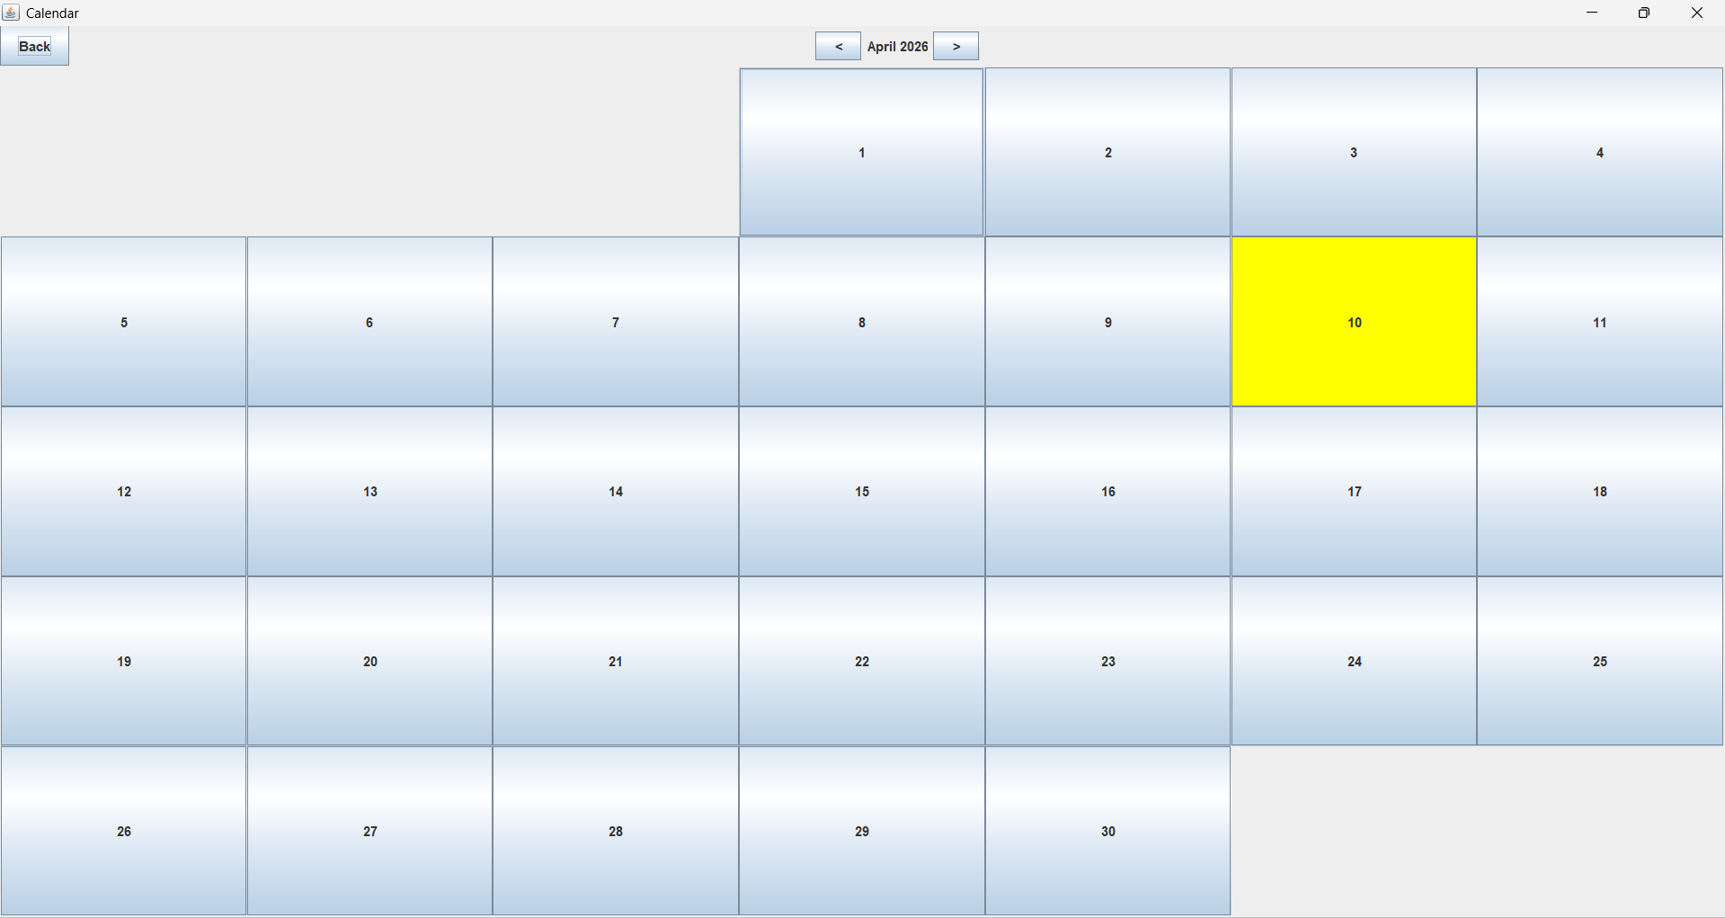
Output Screens
JAVA Programming Project Presentation
•

Slide 11
Results & Discussion
JAVA Programming Project Presentation
Successfully created a working booking system.
Users can:
Book vehicles
Calculate cost
View bookings by date
Challenges faced:
Designing GUI layout
Managing calendar logic
System works efficiently for small-scale use.

Slide 12
Conclusion & Future Enhancement
JAVA Programming Project Presentation
Conclusion:
Project meets all objectives
Improved Java GUI and logic skills
Provides simple booking management
Future Enhancements:
Improve UI design
Add online payment integration
Generate booking receipts

Slide 13
References / Acknowledgement
JAVA Programming Project Presentation
References:
Java Programming – E. Balagurusamy
Oracle Java Documentation
Online tutorials
Acknowledgement:
• Thanks to my guide and department

Slide 14
Thank You
Questions & Discussions

