Slide 1
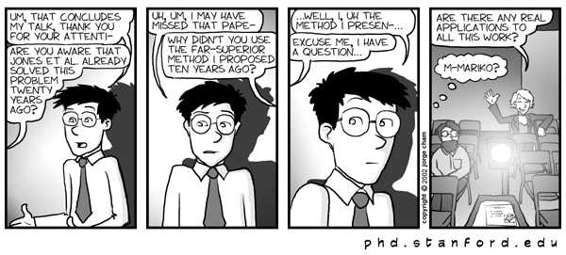
Presentation Skills
Dr Katherine Selby and Hilary M Jones

Slide 2
In this session
What makes a good presentation?
Planning, Preparing and Practice
Performing – vocal techniques, body language
Problems and how to overcome them
PowerPoint: the pros and cons

Slide 3
Terrible presentations…
In your groups, think of a bad presentation or lecture you have seen.
Why was it bad?
What went wrong?

Slide 4
So what makes a good presentation?

Slide 5
Oral presentation skills
Tried and tested structure:
Tell them what you’re going to tell them.
Tell them.
Tell them what you’ve told them.
Simple! And yet only ~10% bother.

Slide 6
Planning, Preparing and Practice
To plan, prepare and practice for a good presentation you need to know:
Who are the audience?
What will they WANT to know?
Why are they here?

Slide 7
Questions to ask
What is the main aim?
What is my subject matter?
Who will the audience be?
How much time do I have?
Where will the presentation be held?
What equipment will I have?

Slide 8
Planning – What information will you include?
Must include
Useful
Extra*
* Useful for answering questions

Slide 9
What to think about in preparation
Structure
Handouts
Equipment
Visuals
Practicalities

Slide 10
How will you remember what to say?
Notes
Cards
Script
Visual prompts
Nothing…

Slide 11
Final Preparations and double-checks
Handouts
Equipment
Graphics
Practicalities relating to the venue etc
Back-up plans

Slide 12
Practice
Practice your presentation at least:
By yourself
In front of a friend/colleague
Time your presentation and remember that you may talk faster if you are nervous.
But make the presentation natural

Slide 13
Performing
What can we learn from an opera singer?
How does he make sure his words are heard?
What are his body language & posture like?
How does he make the audience feel involved?
Is he passionate about what he’s singing? How can you tell?

Slide 14
When things go wrong…
In your groups, identify as many things as possible that could go wrong in giving a presentation

Slide 15
The pros and cons of PowerPoint

Slide 16
PowerPoint Pros
Easy to plan and organise
Slide sorter gives easy reordering
Speaker’s notes lead you through
Can incorporate other software and weblinks
Portable
Good for graphics (usually)

Slide 17
PowerPoint Cons
PowerPoint tempts otherwise sensible
people to do unprofessional, or downright
embarrassing things with their data…

Slide 18
PowerPoint Cons
Some people insist on typing word for word what
they are going to say into the PowerPoint slide, or
worse, pasting sections of a paper or report onto
the slide. They then turn around and, with their
backs to the audience read the slide out to the
bewildered and increasingly restless audience. In
the old days this just wasn’t possible, but if
nowadays if you’re a bit nervous PowerPoint may
tempt you into writing your whole script onto the
screen.

Slide 19
PowerPoint Cons
Other people can’t resist the zany animations
They think it’s interesting, but the truth is…
We’ve all seen it before
(yawn)

Slide 20
PowerPoint Cons
You might think about some interesting colour schemes
To make your data stand out

Slide 21
PowerPoint Cons
But a simple colour scheme is better

Slide 22


PowerPoint Cons
Avoid low-resolution images
And text on top of images, which is distracting and difficult to read.

Slide 23
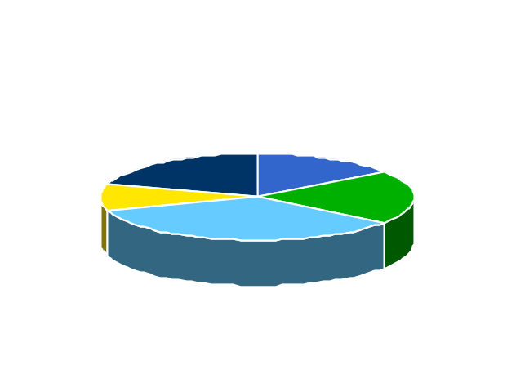
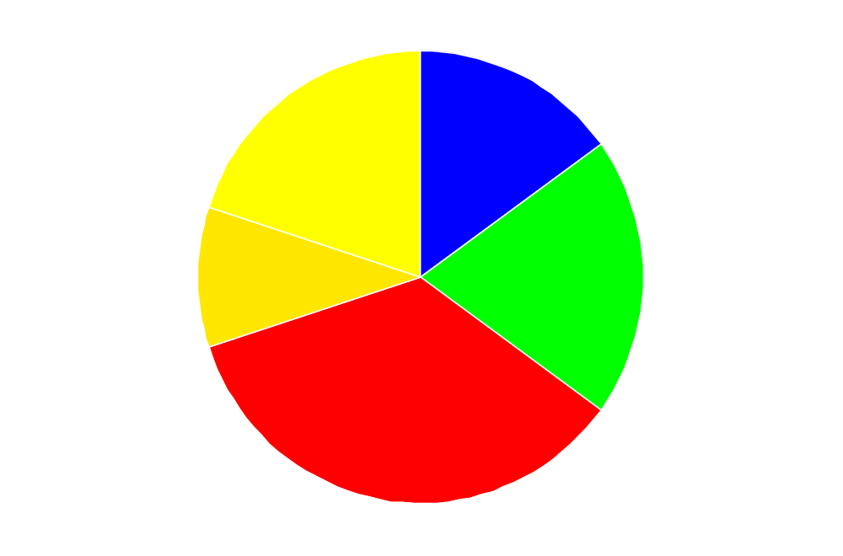
Simplest is almost always the best
Preferred fruit of group of 20 children

Slide 24
Graphs, Charts and Tables
Legends
Axes
Lines
Shading
Fonts
Too much information?
Overcrowded tables?
Parameter X Parameter Y Parameter Z
0.001 2.456655 5.678887
0.002 78.3543 2.567575
0.003 67.9876 1.00812
0.004 109.678 0.00765
0.005 12.98723 134.987
0.006 2.11655 5.678887
0.007 73.3753 45.9875
0.008 67.9876 1.00812
0.009 119.628 0.00765
0.010 12.98723 112. 872

Slide 25
Summary
Find out as much as you can about what will be expected of you (audience, venue, time, who else is speaking)
Plan, Prepare and Practice
Use appropriate technologies
Remember the opera singer – be passionate, be heard, and make your audience feel involved.

Slide 26
Useful references
http://www.smallbusinesscomputing.com/biztools/article.php/684871
http://www.marshall.edu/it/cit/Presentations/2002/WVNET/Preventing_Death_by_PowerPoint.pdf

