Slide 1

 | HMCS_ | PAGE NO.
HMCS | FIXTURE DESIGN STANDARD
REV:00
1/30
FIXTURE DESIGN GUIDE LINE
CONFIDENTIAL
This engineering standard is a business secret owned and/or administrated by Hero MotoCorp Limited. And any act to copy, use or transfer this engineering standard without prior approval constitutes illegal misconduct.

Slide 2

2/
Document Information :
Prepared by: NILIP SWAIN
Reviewed by:
Approved By :
Version of Guideline :
Revision No. | Modification | Updated by | Reviewed by | Approved By | Date
00
This drawing is a business secret of Hero MotoCorp Ltd.
and/or the company herein, and any act to copy ,use or transfer
this drawing without prior approval constitutes illegal misconduct.

Slide 3
3/30
Welding Fixture ;
1. It is a work holding device that holds, supports and locates the work piece for a specific operation of welding. The Fixture play important role to make consistent accurate part assembly.
Major Sub assemblies for welding Fixture’s:-
Frame Body, Swing arm
Pedal brake,
Main stand assembly
Side assembly
5) Front cowl
6) Saree guard
7) Engine guard LH & RH
8) Bar rider comp step
9) Handle bar assembly
10)Rear Grab Assembly
11) Step Pillion assembly
12) Link assembly engine hanger

Slide 4
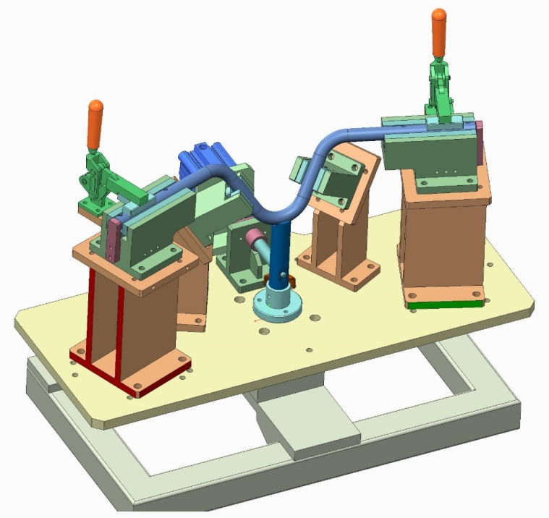
3/30
Fixture Picture’s:-
Part
Clamp
Resting Block
Riser Block
Fixture Location

Slide 5
3/36
Accuracy Standard in Fixture design:-
General Accuracy standard for Fixture Design :-
The General Accuracy in Sub assembly should be ±0.5 max.
The Accuracy level of Fixture decided from part accuracy it should be considered as a 30% of part Tolerance.
All different Block machining & accuracy driven from design.
Blocks accuracy also depends on machining operation in different machine’s. Like CNC , Wire cut, Tool Room.
Dowel Hole accuracy should be ±0.02 or H7 .
Open hole Tolerance should be +0.2 for block.
Standard Item Should be in ±0.03 max.
Part Location items should be controlled as per drawing and Locating pin having minimum clearance ±0.02 .
Base plate Mounting hole & Datum accuracy should be in ±0.02 .

Slide 6
3/36
Process Flow:-
Data Downloading
Drawing Study
Part DFMEA
Team Communication
Approval
Fixture Material
Ist Level Concept
Concept Review
Final Concept
Machining Review
Bom Preparation
Bom Release
Inspection Data

Slide 7
3/36
Data Downloading :-
Open the Product life cycle management system.
Ensure the Request receive from design.
Update the Proto Request in Design List
Put the target Date as per existing resource.
Project location define in server & make the folder.
Downloading the 2d & 3d.
If it’s a assembly file then save with integrated Catia.
Ensure all catia part file has been saved at server location.
Open the assembly file & confirm all part file available.

Slide 8
3/36
Drawing Study:-
Open the 2d drawing.
Check the standard is mention in the drawing.
Ensure the Rev number in drawing.
Rev number is same with earlier then no need to make Design.
Confirm the material mention the drawing.
Match material with Existing stock.
Special material have mentioned in the drawing then send for requirement.
Check after Welding operation's in drawing .Like Coating,Painting etc.
If any special coating required then inform to Management for Costing.

Slide 9
3/36
Drawing Study:-
Picture:-

Slide 10
3/36
Part DFMEA:-
Part design having with Proper Method(Like Tangent surfaces & sheet metal Command).
Make printout of 2D .
Discuss with manufacturing Team what is feasible for Manufacturing.
Highlighted with different color what Tolerance is not Feasible.
Make list out all issue .
Each & every issue will be discuss with team.
Make Process flow chart for raise the issue will come.
Make Partial Trial with any other component if the part process flow having issue.
Verify the Trial report.
Trial result feedback should be consider for design.
Capacity analysis with Team all Toolling & machine available with us for manufacturing.
Discuss all points with STL.
Take decision for all points.

Slide 11
3/36
Team Communication:-
Make Highlight all Points.
Target Date according Design and consideration with all points should be informed.
Share all points with designer .
Provide Manufacturing feasible Tolerance in picture.
All points which required changes should be ensure.
Share the process feasibility report if Part not possible in manufacturing.
Ensure all detail should be share with Concern person.
All Team member should also have a same communication in Copy.
Ensure all welding feasibility of Part's, if any issue then communicate with same process.
Share the Welding Fixture & Torch approach picture for showing the feasibility.

Slide 12
3/36
Approval Process:-
Share the Meeting Calendar as per availability.
Make printout of 2D .
Discuss with manufacturing Team what is feasible for Manufacturing.
Highlighted with different color what Tolerance is not Feasible.
Make list out all issue .
Each & every issue will be discuss with team.
Make Process flow chart for raise the issue will come.
Make Partial Trial with any other component if the part process flow having issue.
Verify the Trial report.
Trial result feedback should be consider for design.
Capacity analysis with Team all Toolling & machine available with us for manufacturing.
Discuss all points with STL.
Take decision for all points.

Slide 13
3/36
Fixture Type selection:-
Part Accuracy level is very Low like 1 to 2 mm then consider for Laser Fixture.
Laser fixture can be assemble with in day.
Laser fixture’s uses for low accuracy part’s.
Nucron Fixture can be used for welding if quantity is very less .
For Profile Fixturing Nucron is best solution.
Nucron fixture can be also used hand jig.
Nucron/ Euroll Fixturing having less weight for Handling.
Mild Steel Fixture is used for Strong holding & robust.
Heavy welding can easily control with M.S fixturing.
Consistency is also a major point of M.S Fixturing.
But handling is also a big concern of M.S fixturing.
Accuracy can be easily maintained in Nucron, M.S , Euroll.
But the Clamping with heavy force is difficult & damage the Fixture.

Slide 14
3/36
Ist Level Concept:-
Study the earlier Concept if available so that can save the time in design.
Check the part number if same part earlier manufactured then released the same design for save the time.
Start the Fixture design as per welding & manufacturing feasibility analysis report.
Insert the Part's assembly in Catia.
Fix the geometry of Part assmebly.
Insert the standard Base Plateas per part length & width 3d and fix it Round figure dimension (Like 50mm).
Insert the Standard L block & other's for supporting.
Ensure Minimum use of customize block & max use of standard block.
Design the Block at datum position.
Design the block at every position of resting & holding the part.
Make hole at all Block which is directly mount the bottom plate for dowel locating & mtg. as well.
Ensure Dowel hole clearance should be 20 micron or H7 Tolerance.
Make all Tapping of fastners as per standard availble Qty in stock( M10,M8.M6).
In all Block Dowel hole should be in both end & Mtg. hole should be in centre.
Cut the Block as per profile.
Design the two block atleast for resting the tube at both end.

Slide 15
3/36
Ist Level Concept:-
Design the resting Block and arrest each bending of tube.
Design in such a way the Notching reference could be taken for machining.
Design the fixture for multipurpose (Like Nothcing, Drilling, profile cutting, Welding, Bending gauge, Part gauge).
Ensure resting should also locate the part & very near to welding for avoid the distortion.
Make clearance as per part manufacturing.(Standard Practice 0.3 total for tube).
Design the Block as per minimum material requirement.
Ensure PIN should be locate the part & self as well in block.
Design hexagonal head type pin for location.
Avoid the design of Clamp if standard Dammler Clamp could use that place.
Ensure Clamp should be design at against resting for avoiding distortion of force.
Ensure the Easy ejection of part's after welding.
Try to make maximum 3D machining instead of 5 axis machining.
The same communication discuss the manufacturing Team before starting the work.

Slide 16
3/36
Concept Review with Mfg. Team :-
Compile all Points for Meeting.
Book Meeting Calendar with data for discussion.
Ensure all Manufacturing Team will join.
Show the easy Ejection of full welded part.
Ensure all Location points are covered as per highlighted in drawing.
Ensure the clamping system in Fixture.
Discuss all Welding sequence consider for Fixture designing.
Show the all marked Welding Points & weld approach after design.
Discuss all detail with Team & convince all functional points.
Filter all Points & incorporate in design.
Discuss whole Process has been approached during design.

Slide 17
3/36
CNC & Machining Review :-
Open the BOM for CNC review.
Check the Profile of Block.
Block open in Catia.
Apply material Command in Block.
Set the Cursur . Then see the Negative angle.
If found its Negative then having issue for manufacturing.
Discuss with CNC & if its important then send to 5 Axis.
Change the material sizes in Block’s if its finish in stock

