Slide 2
Industrial Training Retail Sales & Business Performance Analysis Dashboard

Slide 3
1.Introduction
2.Company Details/ STIPHEND Details
3.Objectives of Internship
4.Project /Task Overview/ Problem Statement
5.Technical Skills Acquired/ to be acquired
6.Challenges Faced
7.Achievements and Contributions
8.Learning and Insights
9.Industry Trends and Observations
10. Project Modules
11.Methodology Used
12.Result/Output (till now with screenshots)
13.Conclusion and future scope
14.References

Slide 4
Introduction & Objectives
About the Project
Beginner-Level Data Analyst internship project — converting raw retail transaction data into clear, actionable business insights
Business question: How is the retail business performing — which products, categories, and regions drive revenue and profit?
Objectives
Clean and validate a raw transactional dataset
Calculate core business KPIs (Sales, Profit, Orders, AOV, Margin)
Analyze performance across time, category, product, region & customer
Build a filterable, formula-driven Excel dashboard
Translate findings into evidence-based business recommendations
This project is Level 1 of 3 — Beginner (completed) → Intermediate → Advanced

Slide 5
Company & Internship Details
Organization
ShadowFox — Data Analyst Internship Program
Mentor
Aakash S
Program Structure
Multi-level internship: Beginner → Intermediate → Advanced
Current Stage
Beginner-Level project — completed
Mode
Remote / self-paced project-based internship
Note: Please verify organization/mentor details are accurate before final submission.

Slide 6
Project Overview & Problem Statement
“How is the retail business performing, and which products, categories, and regions are driving revenue and profit — and where are the opportunities for improvement?”
Dataset Scope
Synthetic retail/e-commerce dataset, built to mirror a realistic export (disclosed, not real company data)
15 months of transactions: January 2024 – March 2025
5 product categories · 4 regions · 386 unique customers · 5 payment methods
2,233 raw records → 2,189 cleaned records
Deliverables
Cleaned dataset + formula-driven Excel dashboard + documented insights & recommendations

Slide 7
Technical Skills Acquired
D
Data Cleaning & Validation
F
Excel Formula Design
Handling duplicates, missing values, invalid entries, and inconsistent formatting
SUMIFS, COUNTIFS, SUMPRODUCT, INDEX/MATCH, RANK for live aggregation
K
KPI Design
V
Dashboard & Visualization
Defining and calculating business-relevant performance metrics
Building filterable dashboards with linked charts and KPI cards
P
Python (pandas)
I
Business Insight Writing
Structured data generation, inspection, and cleaning documentation
Turning numbers into evidence-based, actionable recommendations

Slide 8
Project Modules
1
Data Collection & Inspection
2
Data Cleaning & Transformation
3
KPI Calculation
4
Multi-Dimensional Analysis (Monthly / Category / Product / Region / Customer)
5
Dashboard Design
6
Insights & Recommendations

Slide 9
Methodology Used
Business Problem
Data Collection
Inspection & Cleaning
Transformation & KPIs
Analysis
Dashboard
Insights & Recommendations
Every KPI and analysis table is built as a live Excel formula referencing the cleaned dataset directly — the workbook recalculates automatically if the source data changes.

Slide 10
Data Cleaning & KPI Highlights
Data Cleaning Summary
2,233 raw records → 25 duplicates removed → 11 invalid-date rows removed → 8 invalid-value rows removed
Category & Region spelling/casing standardized; missing Customer Name and Discount values filled rather than dropped
Final cleaned dataset: 2,189 records
₹91.1L
Total Sales
₹22.1L
Total Profit
2,189
Total Orders
386
Customers
₹4,163
Avg Order Value
24.2%
Profit Margin

Slide 11
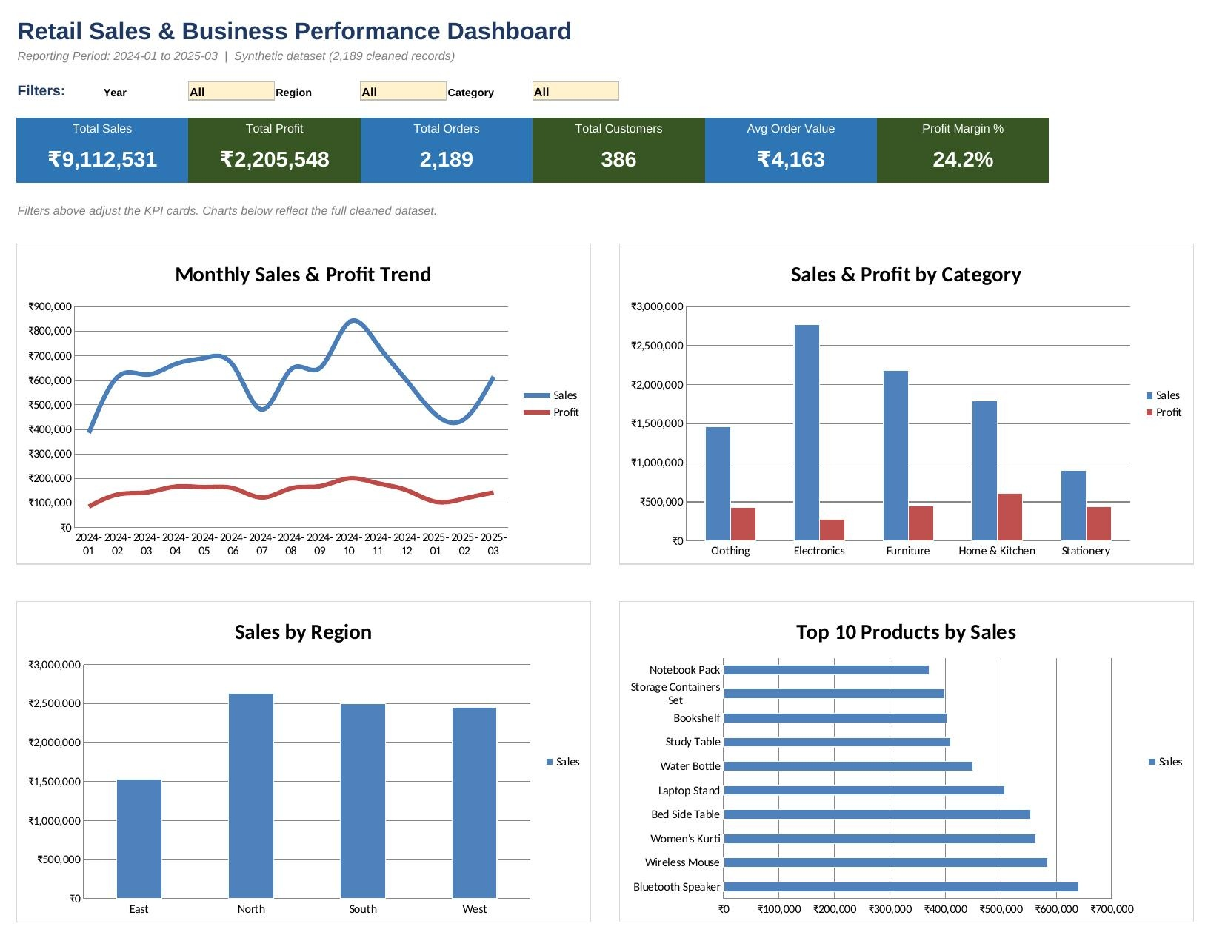
Result / Output — Excel Dashboard
Live dashboard: 6 KPI cards, 3 dropdown filters (Year / Region / Category), and 4 linked charts

Slide 12
Key Business Insights
⚠
Electronics drives the most revenue (₹27.68L) but has the lowest profit margin of any category (10.1%)
↓
Discounts above 20% erode margin; the 30% tier is unprofitable on average (-0.6% margin)
↑
October–November is a clear seasonal sales peak, consistent with festive-season demand
♥
81% of customers (314 of 386) are repeat buyers — retention is the stronger revenue driver
Full detail (10 insights with evidence): documentation/insights.md

Slide 13
Challenges Faced
Handling realistic data-quality issues without over-correcting — e.g. deciding to fill missing discounts with 0% rather than dropping those rows
Designing dashboard filters that update KPI cards live using formulas, without native Excel PivotTables/Slicers
Keeping every KPI and chart formula-driven and auditable, rather than hardcoding computed values
Deciding cleaning rules that don't silently distort genuine business data — for example, choosing not to recompute Sales/Profit from Quantity × Price, since that could overwrite legitimate point-of-sale pricing rules

Slide 14
Achievements & Contributions
Built a fully formula-driven, auditable Excel dashboard with live filters
Documented every single data-cleaning decision with real numbers
Delivered 10 evidence-based insights and 7 actionable recommendations
Structured the entire project in a clean, GitHub-ready repository format
Produced a complete project report, methodology write-up, and video walkthrough

Slide 15
Learnings & Industry Observations
Key Learnings
High sales does not equal high profit — margin must be tracked alongside revenue, not instead of it
Clean, well-documented data is the foundation every downstream KPI and chart depends on
A transparent, formula-based dashboard is easier to trust and explain than a set of static numbers
Industry Observations
Retail and e-commerce analytics increasingly relies on interactive dashboards for fast, filterable decisions rather than static monthly reports
Profitability-aware reporting (not just revenue) is now standard practice in retail analytics

Slide 16
Conclusion & Future Scope
The business shows healthy overall profitability (24.2% margin) on a loyal, well-distributed customer base — but performance is uneven beneath the surface: the top category and top product by revenue are both below-average earners, and heavy discounting is actively destroying margin at the highest tiers.
Future Scope
Intermediate Level (next): customer segmentation, RFM analysis, cohort/retention analysis
Advanced Level: predictive modeling, sales forecasting, and automated reporting

Slide 17
References
Tools Used
Microsoft Excel — KPI formulas, aggregation tables, charts, dashboard
Python (pandas, numpy, openpyxl) — dataset generation and cleaning documentation
Dataset
Synthetically generated for this project; explicitly disclosed as synthetic, not real company data
Project Documentation
data_cleaning.md · methodology.md · insights.md · recommendations.md (project repository)

