Slide 1
AUCML · End-Semester Case Study Project
Low-Lead ECG Screening
Evaluating diagnostic accuracy retention with wearable-style reduced-lead signals using machine learning
21,388
12 → 1
3
0.925
PTB-XL ECGs
leads compared
ML models
12-lead macro AUROC (LightGBM)
Kashish Chelwani
Course TE7483 · AIML Department · Symbiosis Institute of Technology, Pune
Notes:
Introduce yourself and the project. One-line pitch: wearables record 1 to 6 ECG leads, hospitals use 12. We measure, on 21,000+ real clinical ECGs, how much screening accuracy survives when you throw leads away, and how noise and calibration change the picture.

Slide 2
Why reduced-lead ECG matters
Wearables are everywhere; the 12-lead ECG is not
The gold standard
The wearable reality
The open question
A 12-lead ECG needs 10 electrodes, a trained technician and a clinic visit. Many patients are only recorded after symptoms appear.
Smartwatches record lead I; handheld devices give 6 limb leads; patches 1-3 leads. They can screen continuously, at home, at low cost.
Which heart conditions can still be detected from fewer leads and noisier signals, and how much accuracy is lost?
Refined problem statement
Quantify the loss in multi-label diagnostic accuracy (5 PTB-XL superclasses) when a 12-lead ECG is reduced to 6, 3 or 1 lead, with and without simulated wearable noise, using calibrated and explainable classical ML models, delivered as a screening-support prototype.
Low-Lead ECG Screening · AUCML ESE
2
Notes:
Phase-I idea was 'ECG classification'. Refinement: we turned it into a measurable question, accuracy retention as leads are removed, which is exactly the trade-off a wearable maker or a screening programme faces.

Slide 3
Objectives, scope and stakeholders
1
Classify 5 superclasses: normal, MI, ST/T change, conduction disturbance, hypertrophy
In scope
Public PTB-XL data · 10 s resting ECGs · lead subsets of clinical recordings · simulated noise · screening support (flag for review).
2
Measure accuracy retention for 12 → 6 → 3 → 1 leads
3
Stress-test with simulated wearable noise (24, 12, 6 dB SNR)
4
Compare Logistic Regression, Random Forest and LightGBM
Stakeholders
Patients using wearables · primary-care & rural screening camps · cardiologists triaging · device makers choosing lead count · researchers.
5
Deliver calibrated probabilities and SHAP explanations in a web demo
Low-Lead ECG Screening · AUCML ESE
3
Notes:
Out of scope: diagnosis, real wearable recordings, arrhythmia rhythm classes. Being explicit about scope is part of responsible ML in healthcare.

Slide 4
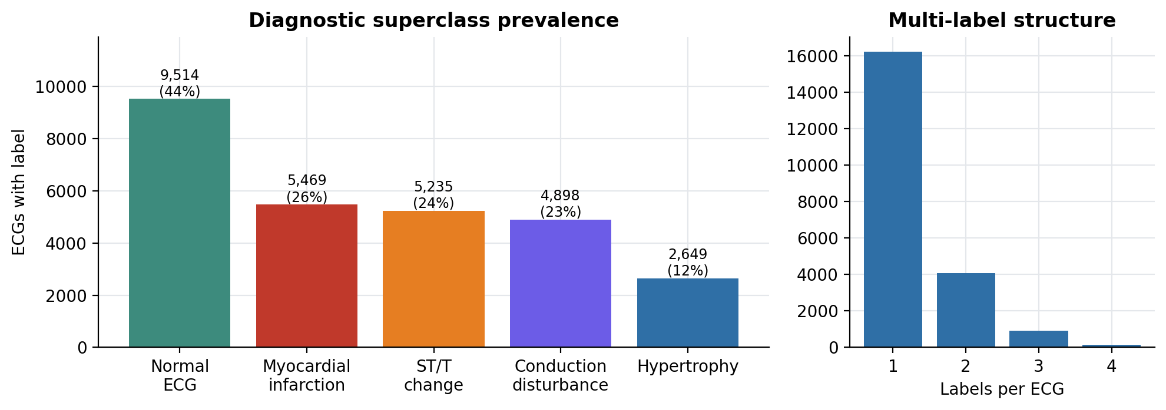
Dataset: PTB-XL v1.0.3
PhysioNet, CC BY 4.0 · Wagner et al., Scientific Data 2020
21,388
labelled ECGs used
18,617
patients
12 × 1000
leads × samples (10 s @ 100 Hz)
24%
Target: multi-hot vector of 5 superclasses derived from SCP-ECG statements with diagnostic = 1 (411 ECGs without a diagnostic superclass dropped). Patient-wise official folds: 1-8 train (17,084), 9 validation (2,146), 10 test (2,158).
ECGs with >1 label
Low-Lead ECG Screening · AUCML ESE
4
Notes:
Attributes: signal (12 leads), age (mean 59), sex (52% male), SCP codes with likelihoods, and strat_fold. Folds are patient-wise and label-stratified, so the same patient never appears in train and test.

Slide 5
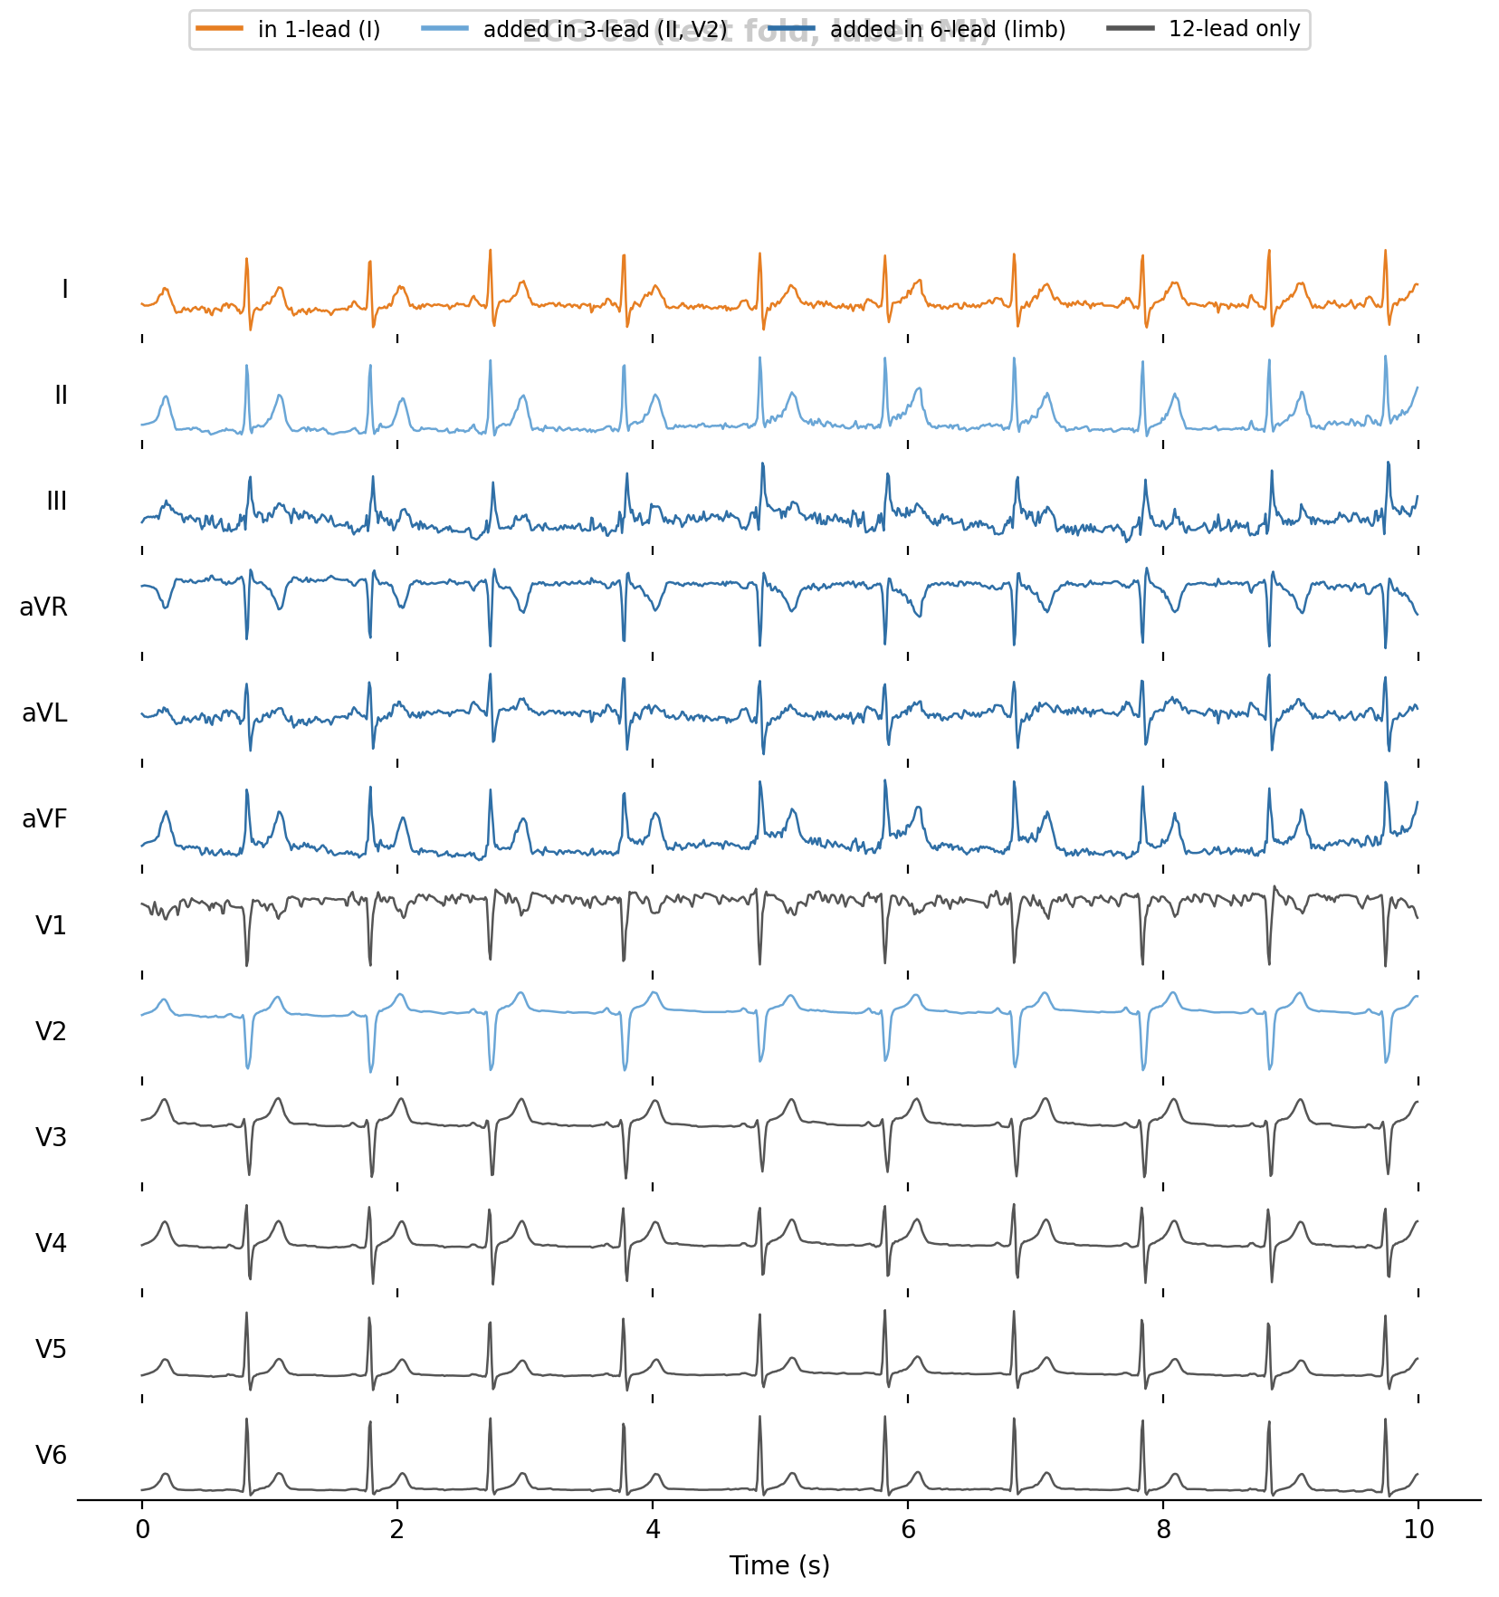
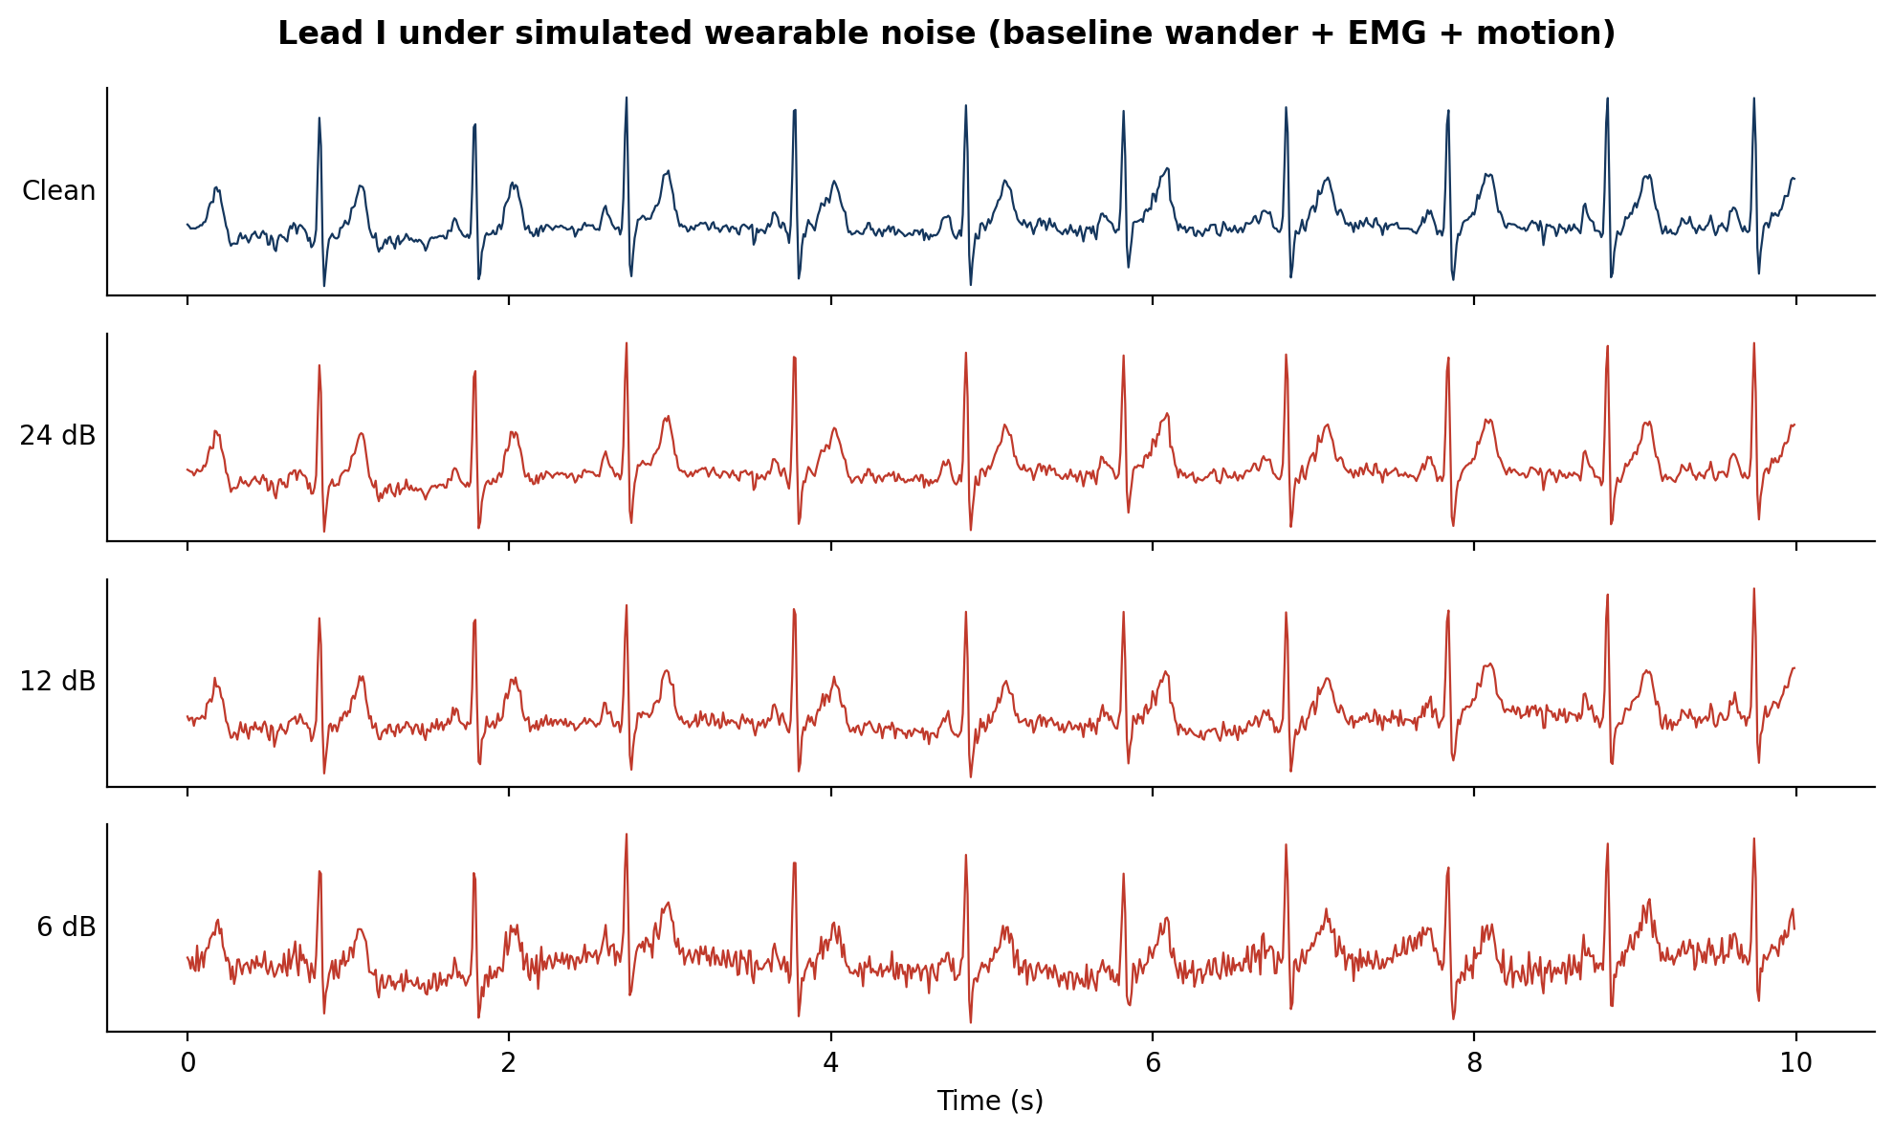
Simulating wearable devices
Same ECG, fewer leads, more noise
Configuration | Leads | Real-world analogue
12-lead | all 12 | clinical 12-lead ECG
6-lead | I, II, III, aVR, aVL, aVF | 6-lead handheld device
3-lead | I, II, V2 | 3-lead patch
1-lead | I | smartwatch
Noise = baseline wander + muscle (EMG) + motion artefacts
Low-Lead ECG Screening · AUCML ESE
5
Notes:
Lead III, aVR, aVL and aVF are mathematically derived from I and II, which is why cheap 6-lead devices need only 3 electrodes. Noise is added only to the test set, so models trained on clean data are stressed like a deployed device would be.

Slide 6
Preprocessing and feature engineering
48 interpretable features per lead
▸ Band-pass 0.5-40 Hz (3rd-order Butterworth, zero-phase) removes baseline drift and high-frequency noise
▸ QRS detection polarity-independent derivative-energy detector with adaptive threshold
▸ Median beat built from all beats (-250 ms to +450 ms around R) for robust morphology
▸ Missing values 0.15% of feature cells (beats not detectable); median-imputed inside each model pipeline
▸ No leakage imputer, scaler, calibrator and thresholds are all fitted on training/validation folds only
Rhythm
Morphology
HR, RR std, RMSSD, pNN50
P, Q, R, S, QRS width/area
ST-T
Spectral
ST level & slope, T amplitude/area
band powers, entropy
Statistics
Beat template
std, skew, kurtosis, percentiles
14-bin median-beat shape
Column names are LEAD__feature, so a reduced-lead model simply uses its leads' columns.
Low-Lead ECG Screening · AUCML ESE
6
Notes:
Why hand-crafted features instead of a CNN? 2-credit course scope, CPU-only, and above all interpretability: SHAP on named clinical features (ST level, Q depth) can be checked against cardiology knowledge.

Slide 7
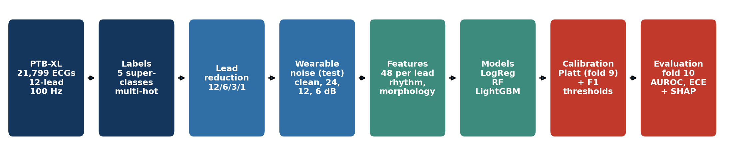
Methodology and ML pipeline
Logistic Regression
Random Forest
LightGBM
Linear baseline with standardised features and class-balanced weights. Fast, transparent coefficients.
300 bagged trees, balanced subsampling. Captures non-linear interactions, robust to outliers and noise.
Gradient-boosted trees (500 rounds, lr 0.03). State of the art for tabular data; native missing-value handling.
Low-Lead ECG Screening · AUCML ESE
7
Notes:
Multi-label: one binary model per class (one-vs-rest). Every model is trained on folds 1-8, Platt-calibrated on fold 9, thresholded for best F1 on fold 9, and only then scored once on fold 10. 3 models x 4 lead sets = 12 trained systems, each tested at 4 noise levels.

Slide 8
Implementation
Reproducible: one notebook from raw data to every figure in this deck
LowLead_ECG_Screening.ipynb
1-4 data, labels, exploration
5-7 filtering, beats, 48 features,
wearable noise
8-11 3 models x 4 lead sets,
calibration, evaluation, noise
12-15 SHAP, export, report, slides
streamlit_app.py → interactive demo
tests/ → unit tests (pytest)
Streamlit demo app
Pick a held-out PTB-XL ECG or upload a CSV · choose device (12/6/3/1 lead) · add noise · see calibrated probabilities, flagged categories and per-ECG SHAP reasons.
Stack: Python 3.11 · scikit-learn · LightGBM · SHAP · wfdb · Streamlit · Plotly
Versioned on GitHub, deployed on Streamlit Community Cloud
Models exported as portable JSON (no pickle version issues)
Low-Lead ECG Screening · AUCML ESE
8
Notes:
Live demo here (2 minutes): select an MI example, switch 12-lead to 1-lead, then add 6 dB noise, and show how the MI probability and the SHAP reasons change.

Slide 9
Result 1: discrimination by lead count
Macro AUROC on the held-out test fold (clean signals)
What it shows
LightGBM 12-lead: 0.925
95% CI 0.918-0.931
1-lead: 0.827
Best model per configuration - 12-lead: LightGBM; 6-lead: LightGBM; 3-lead: LightGBM; 1-lead: LightGBM.
Low-Lead ECG Screening · AUCML ESE
9
Notes:
AUROC is threshold-free and robust to class imbalance; macro averaging gives each of the 5 classes equal weight so rare HYP counts as much as common NORM. CIs: 500 bootstrap resamples.

Slide 10
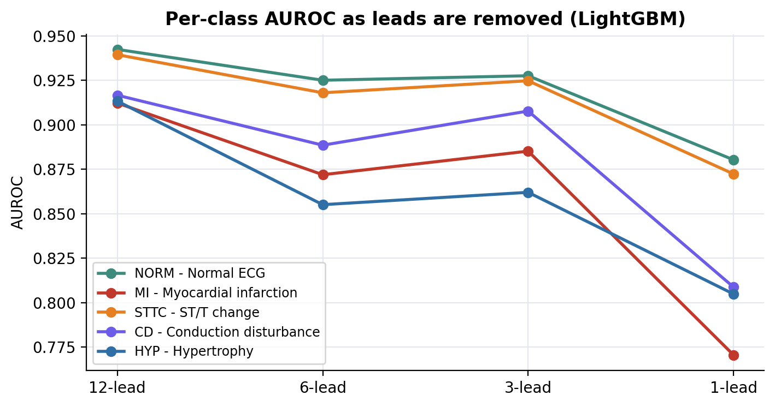
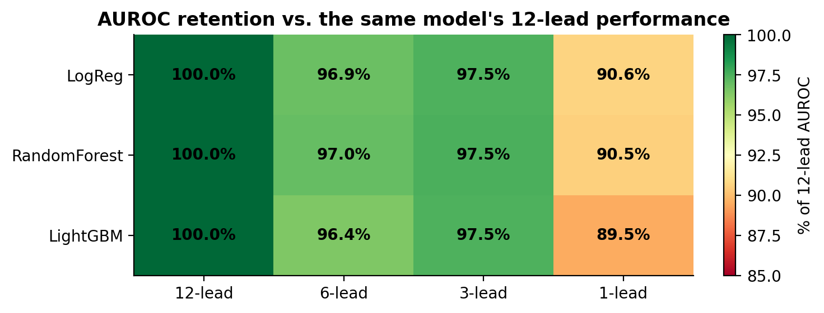
Result 2: how much accuracy is retained?
LightGBM, % of its own 12-lead macro AUROC
96.4%
97.5%
89.5%
6-lead · 6-lead handheld device (limb leads)
3-lead · 3-lead patch (I, II, V2)
1-lead · smartwatch (lead I)
ΔAUROC -0.033 (95% CI -0.039 to -0.029), a statistically significant loss
ΔAUROC -0.023 (95% CI -0.028 to -0.019), a statistically significant loss
ΔAUROC -0.097 (95% CI -0.107 to -0.088), a statistically significant loss
Low-Lead ECG Screening · AUCML ESE
10
Notes:
Statistical test: paired bootstrap on the same test patients, comparing each reduced set to 12-lead for the same model. If the CI of the difference excludes 0 the loss is significant. Per class, MI is hurt most with a single lead.

Slide 11
Result 3: which diagnoses survive lead reduction?
Class | 12-lead | 6-lead | 3-lead | 1-lead | 1-lead retention
NORM · Normal ECG | 0.942 | 0.925 | 0.928 | 0.880 | 93.4%
MI · Myocardial infarction | 0.912 | 0.872 | 0.885 | 0.771 | 84.5%
STTC · ST/T change | 0.939 | 0.918 | 0.925 | 0.872 | 92.9%
CD · Conduction disturbance | 0.917 | 0.889 | 0.908 | 0.809 | 88.2%
HYP · Hypertrophy | 0.913 | 0.855 | 0.862 | 0.805 | 88.1%
Most affected
Most robust
MI (Myocardial infarction) keeps only 84.5% of its 12-lead AUROC with lead I. Its signs (Q waves, ST shifts) are localised to chest or inferior leads that a watch cannot see.
NORM (Normal ECG) keeps 93.4%. Global changes (heart rate, QRS width, overall amplitude) are visible in any lead.
Low-Lead ECG Screening · AUCML ESE
11
Notes:
Clinical link: MI territory is localised (anterior → V1-V4, inferior → II, III, aVF), so lead I alone misses it. Conduction problems widen the QRS in every lead. Highlighted row = largest loss.

Slide 12
Result 4: robustness to wearable noise
LightGBM trained on clean ECGs, tested on noisy ECGs
AUROC drop at 6 dB
12-lead: −0.007
6-lead: −0.005
3-lead: −0.010
1-lead: −0.010
Most noise-sensitive: 1-lead.
Fewer leads = less redundancy to average noise away.
Low-Lead ECG Screening · AUCML ESE
12
Notes:
SNR 24 dB is a good-contact wearable, 6 dB is a heavily moving arm. Noise mixes baseline wander (breathing), EMG (muscle) and motion transients and is reproducible via seeds.

Slide 13
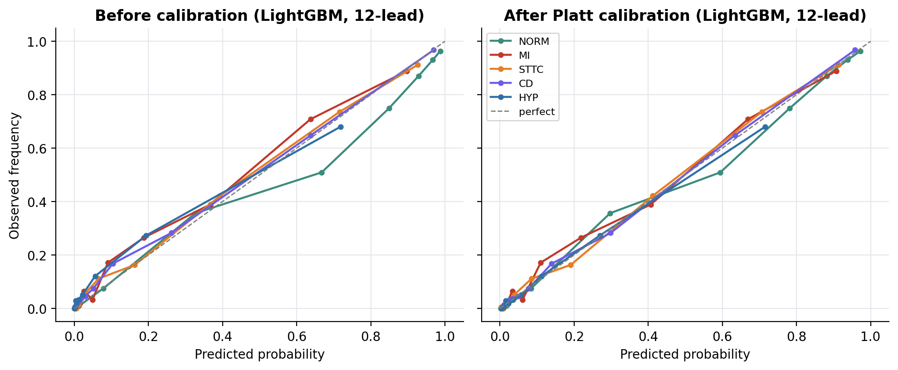
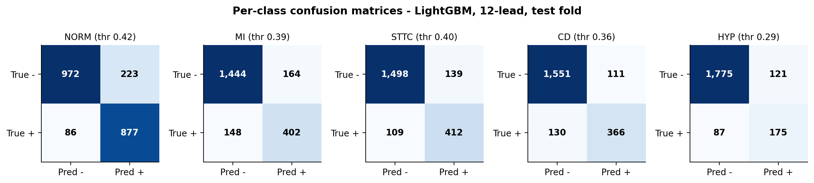
Result 5: calibrated, trustworthy probabilities
0.031
ECE before calibration (12-lead)
0.017
ECE after Platt scaling
Low-Lead ECG Screening · AUCML ESE
13
Notes:
ECE = average gap between predicted probability and observed frequency. For screening, a calibrated 0.30 should mean about 30% of such patients truly have the condition, which lets a clinic set its own referral threshold. Thresholds shown were tuned for F1 on fold 9.

Slide 14
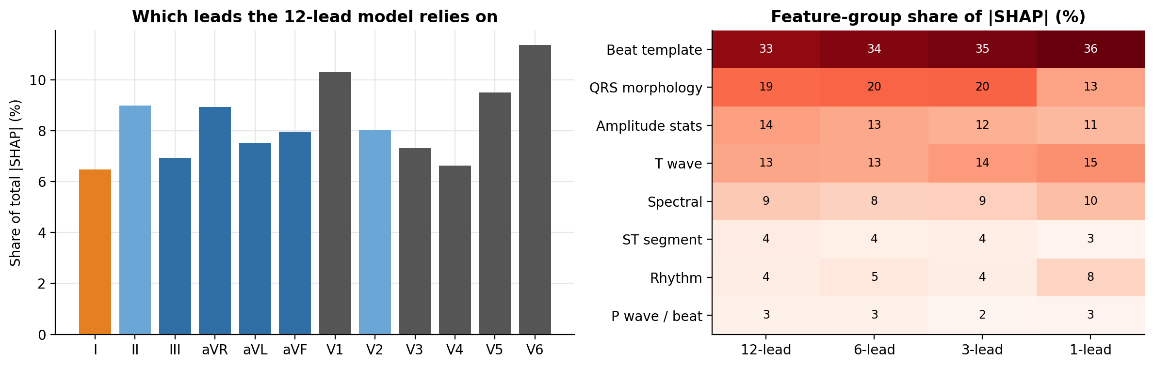
Result 6: explainability with SHAP
What the models look at, per lead and per feature group
12-lead model: lead V6 carries 11% of attribution; top features V6: T amplitude, aVF: beat shape bin 4, aVL: Q depth.
1-lead model: top features I: T amplitude, I: T max, I: beat shape bin 9.
Low-Lead ECG Screening · AUCML ESE
14
Notes:
SHAP (TreeSHAP for LightGBM) splits each prediction into feature contributions in log-odds. Aggregating by lead tells a device designer which electrodes matter; the app shows the same breakdown for each individual ECG.

Slide 15
Comparative analysis
All models, test fold, clean signals
Model | AUROC 12 | AUROC 1 | Retention 1 | AUPRC 12 | F1 12 | F1 1 | ECE 12
LogReg | 0.897 | 0.813 | 90.6% | 0.754 | 0.703 | 0.590 | 0.023
RandomForest | 0.910 | 0.824 | 90.5% | 0.779 | 0.718 | 0.605 | 0.019
LightGBM | 0.925 | 0.827 | 89.5% | 0.817 | 0.744 | 0.614 | 0.017
12-lead, LightGBM | Sensitivity | Specificity | F1
NORM | 0.911 | 0.813 | 0.850
MI | 0.731 | 0.898 | 0.720
STTC | 0.791 | 0.915 | 0.769
CD | 0.738 | 0.933 | 0.752
HYP | 0.668 | 0.936 | 0.627
Reading the table
AUROC: ranking quality, threshold-free. AUPRC: precision under imbalance. F1: at the tuned threshold. ECE: probability reliability. Retention: share of the model's own 12-lead AUROC.
Low-Lead ECG Screening · AUCML ESE
15
Notes:
Tree ensembles usually beat the linear baseline because diagnostic patterns are non-linear combinations (e.g. ST elevation only matters together with Q waves).

Slide 16
Limitations and responsible use
▸ Not real wearables reduced leads are subsets of clinical recordings with ideal electrode placement
▸ Simulated noise real motion artefacts and dry-electrode contact vary more
▸ Single-centre data PTB-XL comes from one German hospital (1989-1996); external validation needed
▸ Coarse labels 5 superclasses hide sub-types (e.g. anterior vs inferior MI)
▸ Screening only a flag must be confirmed with a full 12-lead ECG and a clinician
Safeguards built in
• Disclaimer on every app page
• Calibrated probabilities, not hard labels
• Per-ECG SHAP reasons
• Patient-wise test split
• Bootstrap CIs on every headline number
Low-Lead ECG Screening · AUCML ESE
16
Notes:
Be ready to discuss bias: age and sex distribution, and why a screening tool should favour sensitivity (missing an MI is worse than a false alarm).

Slide 17
Conclusion and future scope
▸ Reducing to the 6 limb leads retained 96.4% of 12-lead AUROC, the 3-lead set (I, II, V2) 97.5%, and a single smartwatch-style lead I 89.5%.
▸ Removing leads hurt MI (Myocardial infarction) the most: with lead I alone it kept only 84.5% of its 12-lead AUROC, while NORM kept 93.4%.
▸ Under strong simulated wearable noise (6 dB SNR) macro AUROC fell by 0.007 for 12 leads and 0.010 for 1 lead; the 1-lead configuration was the most noise-sensitive.
Future scope
• 1-D CNN / transformer on raw signals
• Train with noise augmentation
• Validate on real smartwatch ECGs
• Lead-specific attention to recover MI
• Rhythm classes (AF) and edge deployment
0.925
0.892
0.901
0.827
12-lead AUROC
6-lead AUROC
3-lead AUROC
1-lead AUROC
Screening-support prototype · not a diagnostic device
Notes:
Close with the answer to the research question in one sentence, then invite questions.

Slide 18
References
[1] Wagner P. et al. PTB-XL, a large publicly available electrocardiography dataset. Sci Data 7, 154 (2020).
[2] Goldberger A. et al. PhysioBank, PhysioToolkit and PhysioNet. Circulation 101(23), e215-e220 (2000).
[3] Strodthoff N. et al. Deep learning for ECG analysis: benchmarks and insights from PTB-XL. IEEE JBHI 25(5), 1519-1528 (2021).
[4] Ke G. et al. LightGBM: a highly efficient gradient boosting decision tree. NeurIPS (2017).
[5] Lundberg S., Lee S.-I. A unified approach to interpreting model predictions. NeurIPS (2017).
[6] Platt J. Probabilistic outputs for support vector machines. Advances in Large Margin Classifiers (1999).
[7] Pedregosa F. et al. Scikit-learn: machine learning in Python. JMLR 12, 2825-2830 (2011).
[8] Moody G., Muldrow W., Mark R. A noise stress test for arrhythmia detectors. Computers in Cardiology 11 (1984).
Low-Lead ECG Screening · AUCML ESE
18

