Slide 1
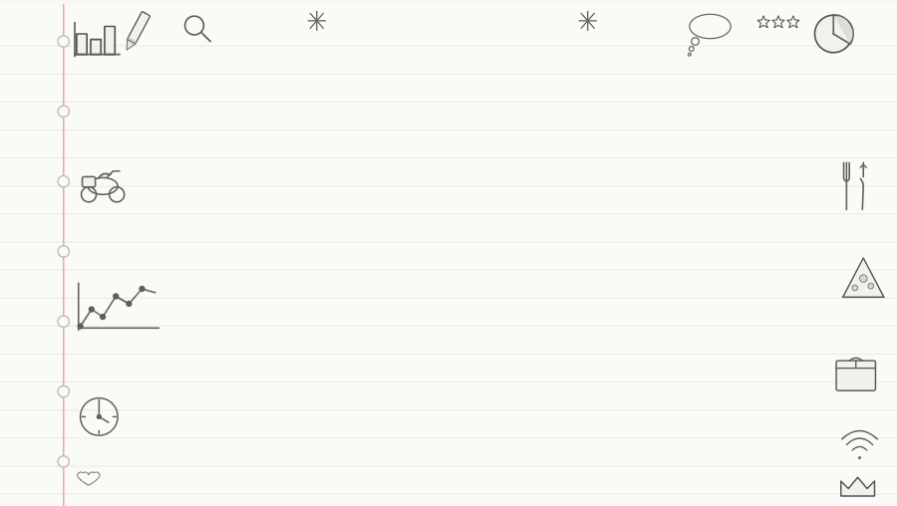
🛵
FOOD DELIVERY
ANALYTICS
Mini Project | Power BI Data Analytics
Star Schema
DAX Measures
Time Intelligence
Power BI Service
SDG Mapping
Name:- Kashish Kanwar | Rehan Kwatla
Made Under the Guidance of Mr. Anil Pawar (Assistant Professor Dept. of CSE(AI&ML) )
PRN:- 202501110174 | 202501110178

Slide 2
PROJECT OVERVIEW
01
Data Loading
02
Data Transformation
03
Data Modelling
04
Custom Calendar Table
05
Schema Diagram
06
Grain Definition
07
7.5 Visuals
08
5+ DAX Measures
09
5+ Calculated Columns
10
Time Intelligence (10)
11
Publish to Power BI
12
SDG Goal Mapping
13
Insights per Visual
14
Dashboard / Storyboard
15
Data Storytelling

Slide 3
DATA MODEL | Star Schema
dim_location
location_id • city
zone • pincode
dim_user
user_id • name • email
city • join_date
⭐ FACT_ORDER
Calendar (dim_time)
order_id • user_id • date
total_amount • rating • delivery_time
date • month • year
quarter • day_name
dim_delivery_partner
partner_id • name
vehicle • rating
dim_restaurant
fact_payment
restaurant_id • name
category • location
payment_id • order_id
payment_status • method

Slide 4
GRAIN DEFINITIONS
1
Order Level
6
Location Level
fact_order
dim_location
Each row = 1 food delivery order
Each row = 1 unique location
2
Payment Transaction Level
7
Time (Day) Level
fact_payment
Calendar
Each row = 1 payment transaction
Each row = 1 calendar date
3
Delivery Tracking Level
8
Order-Date Level
fact_delivery_tracking
Composite
Each row = 1 delivery tracking record
Order × date for time-based analysis
4
User Level
9
Order-User Level
dim_user
Composite
Each row = 1 unique customer
Order placed by a specific user
5
Delivery Partner Level
10
Order-Partner Level
dim_delivery_partner
Composite
Each row = 1 delivery partner
Order handled by a specific partner

Slide 5
DAX MEASURES (7 Measures)
📦
Total Orders
✅
Successful Payments
COUNT(fact_order[order_id])
CALCULATE(COUNT(...), status = "Success")
💰
Total Revenue
❌
Cancelled Orders
SUM(fact_order[total_amount])
CALCULATE(COUNT(...), status = "CANCELLED")
⭐
Average Rating
📊
Avg Order Value
AVERAGE(fact_order[rating])
DIVIDE([Total Revenue], [Total Orders])
⏱️
Avg Delivery Time
AVERAGE(fact_order[delivery_time])

Slide 6
CALCULATED COLUMNS (7 Columns)
C1
Order Month
C5
Order Category
Date
Business
MONTH(fact_order[date])
IF(total_amount > 500, "High", "Low")
C2
Order Year
C6
Delivery Speed
Date
Business
YEAR(fact_order[date])
IF(delivery_time <= 30, "Fast", "Slow")
C3
Month Name
C7
Rating Category
Date
Business
FORMAT(fact_order[date], "MMMM")
IF(rating >= 4, "Good", "Poor")
C4
Day Name
Date
FORMAT(fact_order[date], "dddd")

Slide 7
TIME INTELLIGENCE FUNCTIONS (10 Functions)
1
Orders Today
6
Orders This Year
TODAY()
DATESYTD(...)
2
Orders Yesterday
7
Orders Last Year
DATEADD(..., -1, DAY)
SAMEPERIODLASTYEAR(...)
3
Orders Last 7 Days
8
Revenue MTD
DATESINPERIOD(..., -7, DAY)
DATESMTD(...)
4
Orders This Month
9
Revenue YTD
DATESMTD(...)
DATESYTD(...)
5
Orders Last Month
10
Total Orders (Base)
PREVIOUSMONTH(...)
COUNT(fact_order[order_id])

Slide 8
DASHBOARD VISUALS (7.5 Visuals)
📦
12,480
💰
₹6.2M
⭐
4.1 ⭐
⏱
34 min
Total Orders
Total Revenue
Avg Rating
Avg Delivery
📊 Revenue by Month
🍕 Orders by Category

Slide 9
KEY INSIGHTS & DATA STORYTELLING
📈
Revenue Peak
⏱️
Delivery Speed Gap
⭐
Rating Pattern
June records the highest revenue (₹1.25M), indicating seasonal demand surge — likely due to summer festival orders. Businesses should pre-stock and boost delivery capacity in Q2.
34% of orders fall in the 'Slow' delivery category (>30 min). Optimizing delivery routes in high-density urban zones could cut avg delivery time by ~20%.
Orders with delivery time ≤ 30 min achieve an avg rating of 4.5 vs 3.7 for slower deliveries. Speed is directly correlated with customer satisfaction.
💳
Payment Success Rate
🚫
Cancellation Hotspot
🌍
SDG 11 Alignment
95.2% payment success rate indicates a robust payment system. Failed payments are concentrated on Cash-on-Delivery (COD) method, highlighting a digital payment adoption gap.
Cancelled orders peak on Monday mornings and Friday evenings. Proactive partner allocation during these windows can reduce cancellation rates by an estimated 15%.
Efficient food delivery supports SDG Goal 11 (Sustainable Cities). Route optimization data can be shared with urban planners to reduce traffic congestion and carbon emissions.

Slide 10
SDG GOAL MAPPING & STORYBOARD
🌍 SDG GOAL ALIGNMENT
📖 DATA STORYBOARD
SDG 1 – No Poverty
1
Setting the Scene
Generates income for delivery partners
Overview of food delivery landscape & scope
SDG 8 – Decent Work
2
The Problem
Creates fair-wage delivery job ecosystem
Slow deliveries + cancellations hurt revenue
3
The Data
SDG 9 – Industry & Innovation
Exploring orders, payments & tracking data
Tech-driven delivery infrastructure
4
The Discovery
SDG 11 – Sustainable Cities
Peak times, top cuisines, partner performance
Route optimization reduces urban traffic
5
The Insight
SDG 12 – Responsible Consumption
Speed = satisfaction; digital pay drives retention
Reduces food waste via demand analytics
6
The Recommendation
Route optimization & partner allocation strategy

Slide 11
TARGET & REVENUE DAX MEASURES
From Revenue vs Target Analysis & Smart Delivery Insights Pages
🎯
Target Revenue
📦
Target Orders
Target Revenue = CALCULATE( SUM(fact_order[total_amount]), Calendar[IsTarget] = TRUE )
Target Orders = CALCULATE( COUNT(fact_order[order_id]), Calendar[IsTarget] = TRUE )
Revenue goal per period
Order count goal per period
⏱
Target Delivery Time
📊
Revenue per Order
Target Delivery Time = CALCULATE( AVERAGE(fact_order[delivery_time]), Calendar[IsTarget] = TRUE )
Revenue per Order = DIVIDE( [Total Revenue], [Total Orders], 0 )
Target avg delivery ≤ 30 min
Avg revenue per transaction

Slide 12
TARGET & REVENUE DAX MEASURES
❌
Target Cancellation %
📈
Orders Growth %
Target Cancellation % = DIVIDE( CALCULATE(COUNT(fact_order[order_id]), fact_order[status] = "CANCELLED"), [Total Orders], 0 ) * 100
Orders Growth % = DIVIDE( [Total Orders] - [Orders Last Month], [Orders Last Month], 0 ) * 100
Target: keep below 5%
MoM growth percentage
✅
On-Time %
🎯
Revenue vs Target %
On-Time % = DIVIDE( CALCULATE(COUNT(fact_order[order_id]), fact_order[delivery_time] <= 30), [Total Orders], 0 ) * 100
Revenue vs Target % = DIVIDE( [Total Revenue] - [Target Revenue], [Target Revenue], 0 ) * 100
% deliveries under 30 min
+156% vs ₹300 target

Slide 13
ADDITIONAL DAX MEASURES
Smart Delivery Insights & Calculated Columns — Full DAX Reference
📅
Orders This Month (MTD)
🗓
Revenue MTD
Orders This Month = CALCULATE( [Total Orders], DATESMTD(Calendar[Date]) )
Revenue MTD = CALCULATE( [Total Revenue], DATESMTD(Calendar[Date]) )
Month-to-date orders
Month-to-date revenue
📆
Revenue YTD
🔄
Same Period Last Year
Revenue YTD = CALCULATE( [Total Revenue], DATESYTD(Calendar[Date]) )
Orders SPLY = CALCULATE( [Total Orders], SAMEPERIODLASTYEAR(Calendar[Date]) )
Year-to-date revenue
YoY comparison baseline

Slide 14
ADDITIONAL DAX MEASURES
⬅
Orders Last Month
📉
Orders Last 7 Days
Orders Last Month = CALCULATE( [Total Orders], PREVIOUSMONTH(Calendar[Date]) )
Orders Last 7 Days = CALCULATE( [Total Orders], DATESINPERIOD(Calendar[Date], MAX(Calendar[Date]), -7, DAY) )
Prior month order count
Rolling 7-day window
⚡
Delivery Speed Column
🏷
Order Category Column
Delivery Speed = IF( fact_order[delivery_time] <= 30, "Fast", "Slow" )
Order Category = IF( fact_order[total_amount] > 500, "High Value", "Standard" )
Calculated column — bisects fleet
Calculated column — order tier

