Slide 1
JIET INSTITUTE OF ENGINEERING AND TECHNOLOGY
Reckon4.0 Project
On
Transmission line fault detection
Submitted by:-
Nilu jhala
Kunal soni
Kashish kothari

Slide 2
CONTENT:-
TITLE OF PROJECT
INNOVATION
INTRODUCTION
COMPONENTS
ORIGINALITY
SOCIAL IMPACTS
MARKET READINESS
CONCLUSION

Slide 3
TITLE OF PROJECT:-
TRANSMISSION LINE FAULT DETECTION
INNOVATION:-
Fault identification is performed by comparing the PSCAD(Positive Sequence Current Angle Difference) of the corresponding node with the PSCADs of remaining nodes and the maximum PSCAD identifies the faulty line. Simulations are carried out in MATLAB/SIMULINK and results are given for the five-area power system.

Slide 4
INTRODUCTION:-
A fault in electrical equipment is defined as a defect in its electrical circuit due to which the current is diverted from the intended path. Faults are generally caused by mechanical failure, accidents, excessive internal and external stresses, etc. The fault impedance is low, and the fault currents are relatively high. During the faults, the power flow is diverted towards the fault and the supply to the neighboring zone is affected. Voltages become unbalanced. It is necessary to detect the fault as early as possible that is why a kit is being made using a microcontroller to make its process faster. It will detect the following four major faults and will give a trip signal to the relay. The four faults detected by the model are Overcurrent fault, undercurrent fault, Sparking and UV detection, and Phase Failure faults. Purpose: This research aims to develop a device used to detect faults in the line and isolate the connected system or instrument connected to it

Slide 5

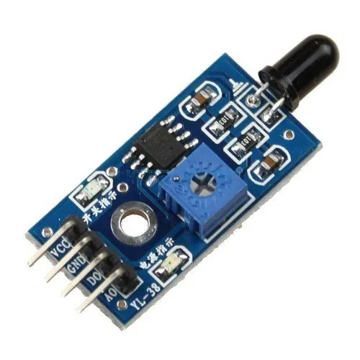
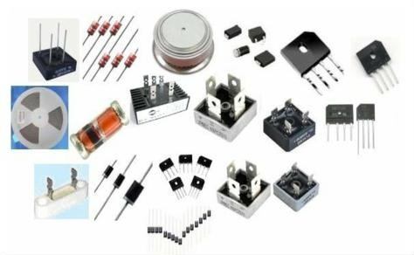
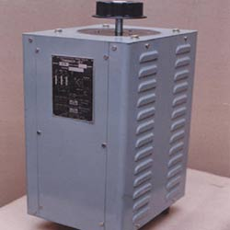
COMPONENTS :-
Transformer :- 3-Phase Autotransformer
Rectifier
Regulator
Arduino uno
Flame detector, Smoke detector , Spark detector , UV detector
Relay driver IC ULN 20003
Relay
Fault switch
Poles
Transmission wires

Slide 6
ORIGINALITY:-
The transmission line is the most important part of the power system. Transmission lines have a principal
amount of power. The requirement for power and its allegiance has grown up exponentially over the
modern era, and the major role of a transmission line is to transmit electric power from the source area to
the distribution network. The explosion between limited production and a tremendous claim has grown the
focus on minimizing power losses. Losses like transmission loss and conjecture factors such as
physical losses to various technical losses, Another thing is the primary factor has a reactive power and
voltage deviation are momentous in the long-range transmission power line. Essentially, fault analysis is
a very focusing issue in power system engineering to clear faults quickly and re-establish the power
system as quickly as possible on minimum interruption. However, the fault detection that interrupts
the transmission line is a challenging task to investigate the fault and improve the system's reliability The transmission line is susceptible given all parameters that connect the whole power system.
This paper presents a review of transmission line fault detection.

Slide 7
SOCIAL IMPACT:-
Lighting:- Lightning affects the performance of power lines by both direct and indirect effects where the transient high voltages may cause flashover on the electrical equipment on the power line. Direct lightning strikes, may intercept with line conductors, towers, or shielding wires. Due to this reason the sparking produce and the transmission line get defaulted.
Heavy winds:- Wind loading considered in the design of overhead transmission lines is based on extreme values of synoptic boundary layer wind. High-intensity winds such as tornadoes or thunderstorm downbursts often hit lines in off-design conditions, causing failures of towers and even sometimes transverse cascades.

Slide 8
3. TREES:-
In high winds, trees and their debris can be blown onto power lines, causing the lines to short-circuit, and can also cause significant damage to our electrical equipment, resulting in power cuts.
People that come into contact with this path (by touching, climbing, trimming, or cutting down the trees) put themselves at serious risk of being electrocuted or receiving significant electrical burns, Trees near power lines are also a serious fire risk in dry weather conditions; leaves or branches touching lines can catch fire!
4. Car accident:-
When a vehicle hits a transmission pole or a transformer a power line can fail. There is a high risk of severe electric shock in the panic after an accident, one could easily fail to notice a fallen power line. Each year, accidents in which motorists hit power poles have the potential to bring live power lines to the ground. Tragically, many drivers and passengers who survive the impact are electrocuted when they attempt to leave the vehicle.
Other causes are:-
Animals
Punctured insulator
Partial discharges not controlled
Contaminated insulator and so on…..
so this transmission line fault detection method helps to indicate the serious risk which is caused by the above reasons.

Slide 9
Conclusion:-
Transmission line fault could not be avoided in an electrical power system, some protection devices are needed to protect the expensive equipment in electric power systems before the fault occurrence. But after the fault occurs once on the system we must determine fault locations and types for maintaining the system.

