Slide 1

Language Identification from Audio under Severe Speaker Bias
NNTI Winter Term Project 2025-26
Presented by-
Kashish Mendiratta
Muhammad Saqib

Slide 2
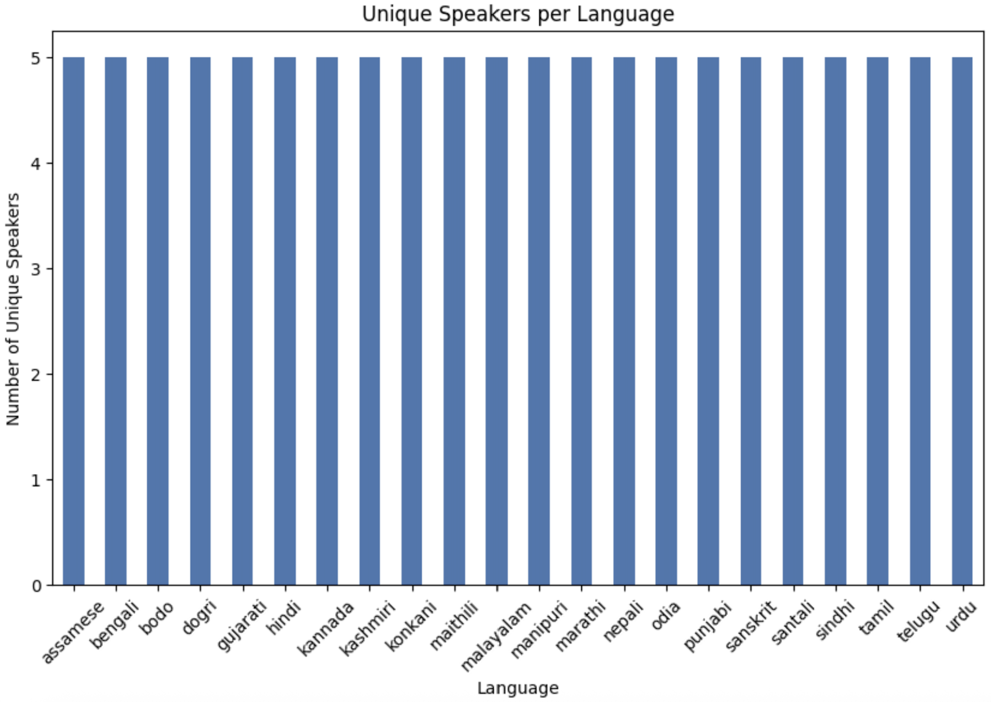
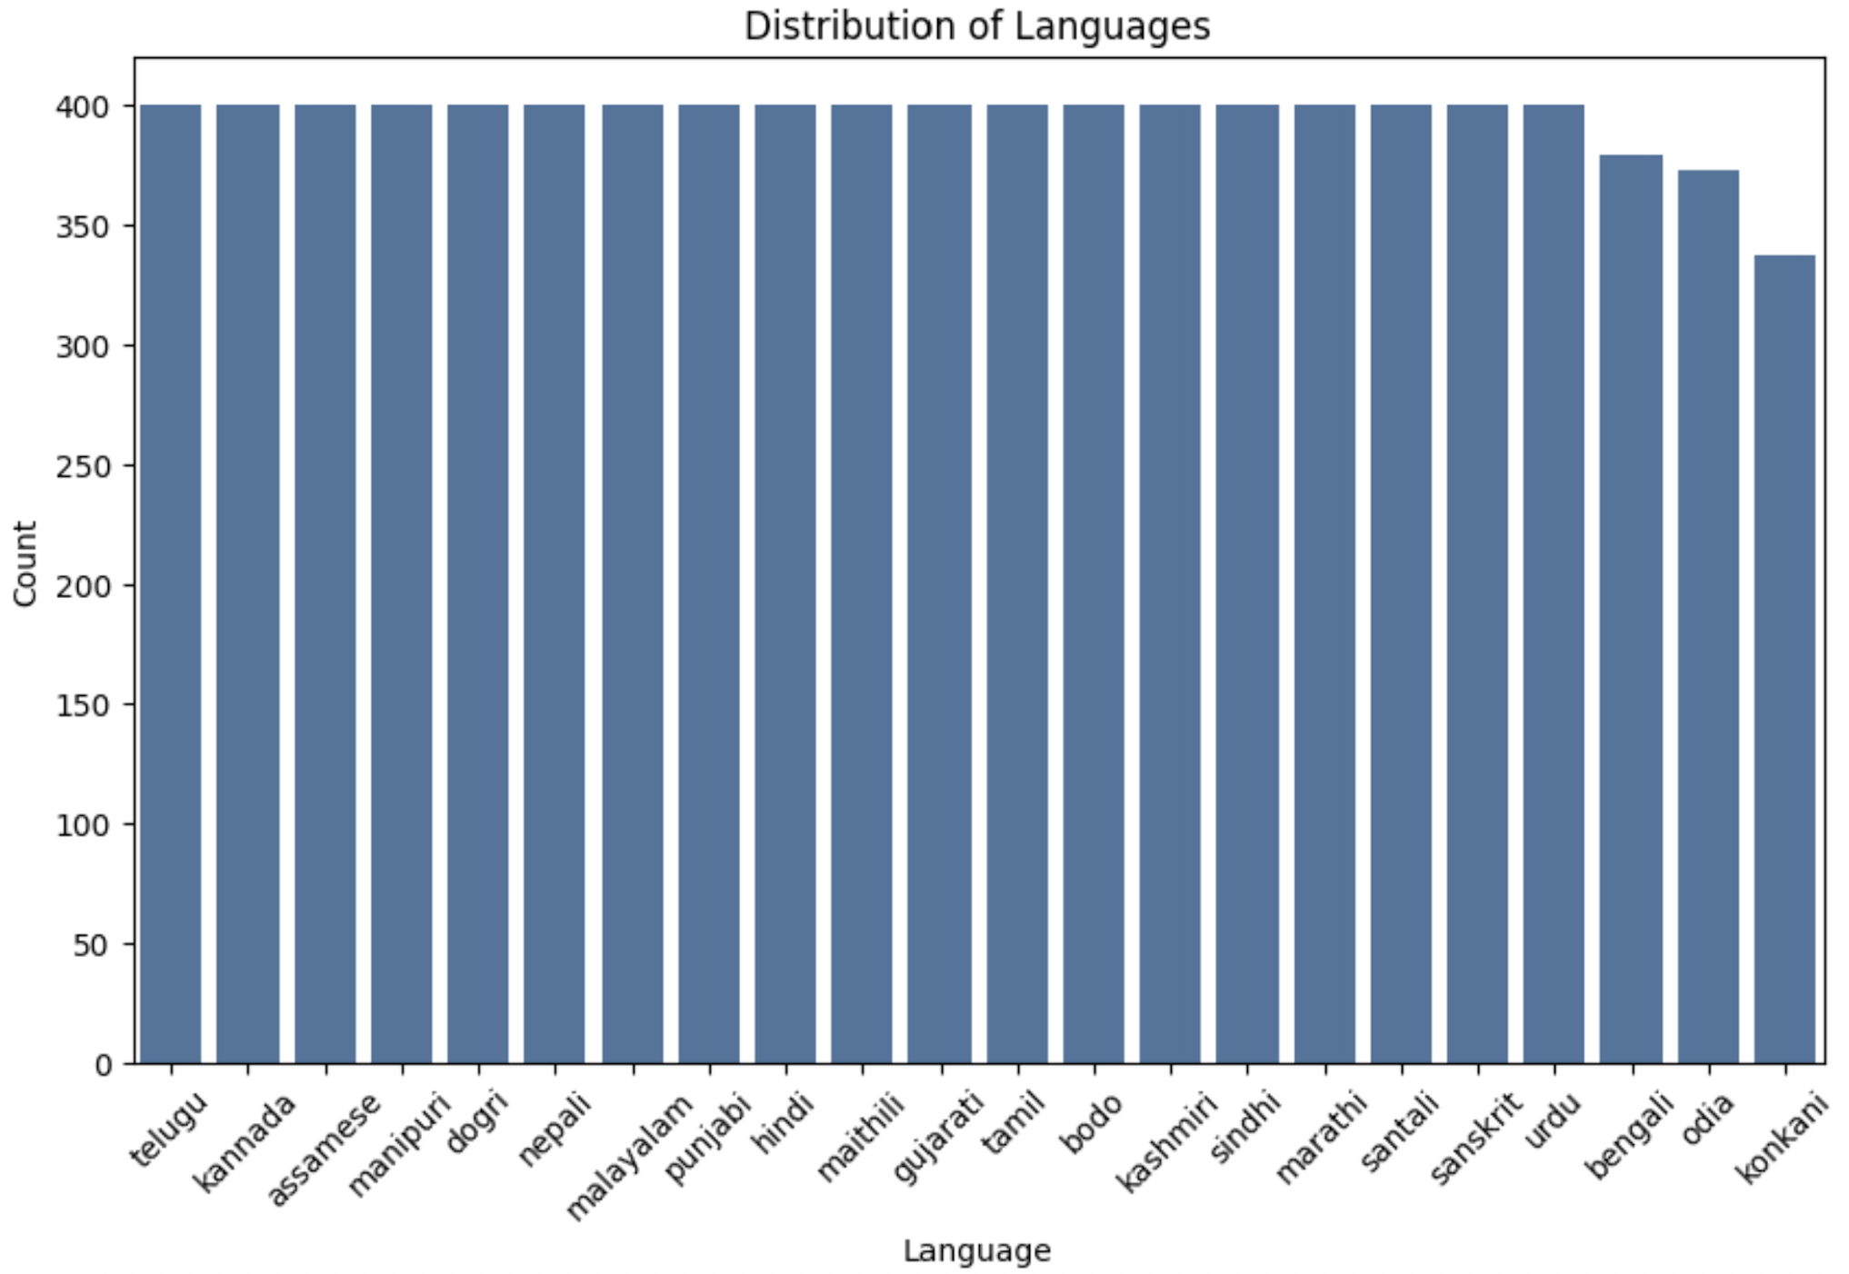
INTRODUCTION
22 Indian languages - difficult low-resource setting.
Short utterances
Limited training data.
Our goal- not only to improve the score, but to understand what model was accurately learning.

Slide 3
DATASET AND EXPLORATORY DATA ANALYSIS
400 samples per language
Training split- 8689 samples
Validation split- 1650 validation, 1650 test samples.
Each item includes an audio path, language label, speaker ID, and some additional metadata.
Only 5 speakers per language.
Notes:
The first result from EDA was that the dataset is
roughly balanced by language. This means class
imbalance is not the main issue. The second, much
more important result was that speaker diversity is
extremely small. Every language is tied to a tiny
set of speakers, which makes it easy for the model
to associate a language with a handful of voices.

Slide 4
REPRODUCING AND IMPROVING BASELINE

Slide 5
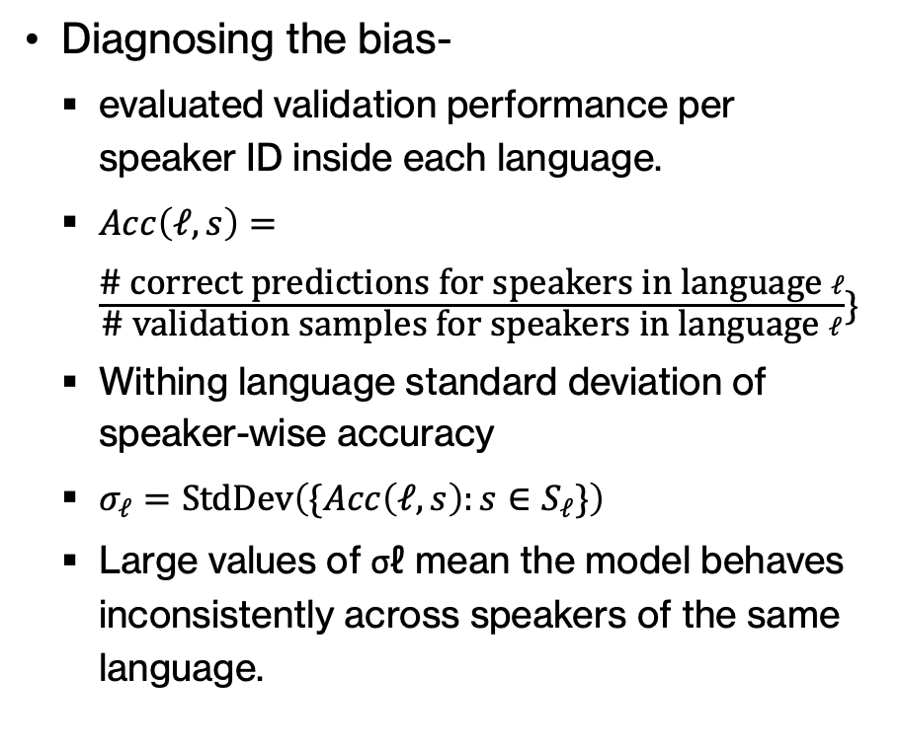
ADDRESSING SPEAKER BIAS
Diagnosing the bias-
evaluated validation performance per speaker ID inside each language.
$Acc\left(ℓ,s\right)=\frac{\text{\# }\text{correct} \text{predictions} \text{for} \text{speakers} \text{in} \text{language} ℓ}{\text{\# }\text{validation} \text{samples} \text{for} \text{speakers} \text{in} \text{language} ℓ}\}$
Withing language standard deviation of speaker-wise accuracy
$σ_{ℓ}=\text{StdDev}\left(\{Acc\left(ℓ,s\right):s∈S_{ℓ}\}\right)$
Large values of σℓ mean the model behaves inconsistently across speakers of the same language.
Inference-
A clear example was Assamese.
One speaker ID was classified very well, while others from the same language were much less reliable
Notes:
Since the language label is the same for all of them, the large spread cannot be explained by language difficulty alone. It suggests that the model had adapted better to some voices than to others
The same kind of spread appeared in other languages as well. This is why we argue that the main bias in the dataset comes from limited speaker diversity. Speakers that are acoustically more similar
to the ones the model adapts to tend to perform much better, while others suffer even though they belong to the same class.

Slide 6
AUGMENTATION EXPERIMENTS
SpecAUGMENT
XLS-R Model Waveform Augmentation
Augmentation with replacement
Augmentation with sample addition
Selective Augmentation

Slide 7
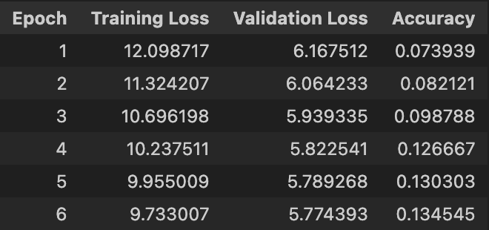
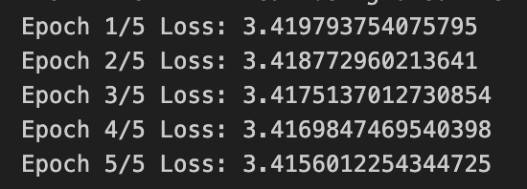
SpecAUGMENT
XLS-R
Waveform
training loss decreased during optimization, the validation accuracy dropped.
Loss hardly decreased, accuracy near random guess.
In one run the original training
set contained 8689 examples and 4344 samples were augmented, increasing the dataset size to 13033 examples.
Notes:
SpecAugment- A likely explanation is that aggressive masking removed phonetic cues that are necessary to distinguish languages, especially given the relatively small dataset size.
XLS-R- The obtained accuracy (5%) is significantly lower than the reported baseline accuracy (31%). Additionally, most languages show zero precision and recall. This suggests that there may be an issue in the training configuration or implementation of the XLS-R pipeline.

Slide 8
Generic augmentation gave only modest gains, reaching 30.85% validation accuracy and 31.58% test accuracy in one MMS run. The best result came from the third strategy, selective augmentation, which improved top-1 accuracy to 43.4%. This matched the earlier error analysis: the model benefited more when we targeted the weak decision boundaries instead of perturbing all classes in the same way.

Slide 9
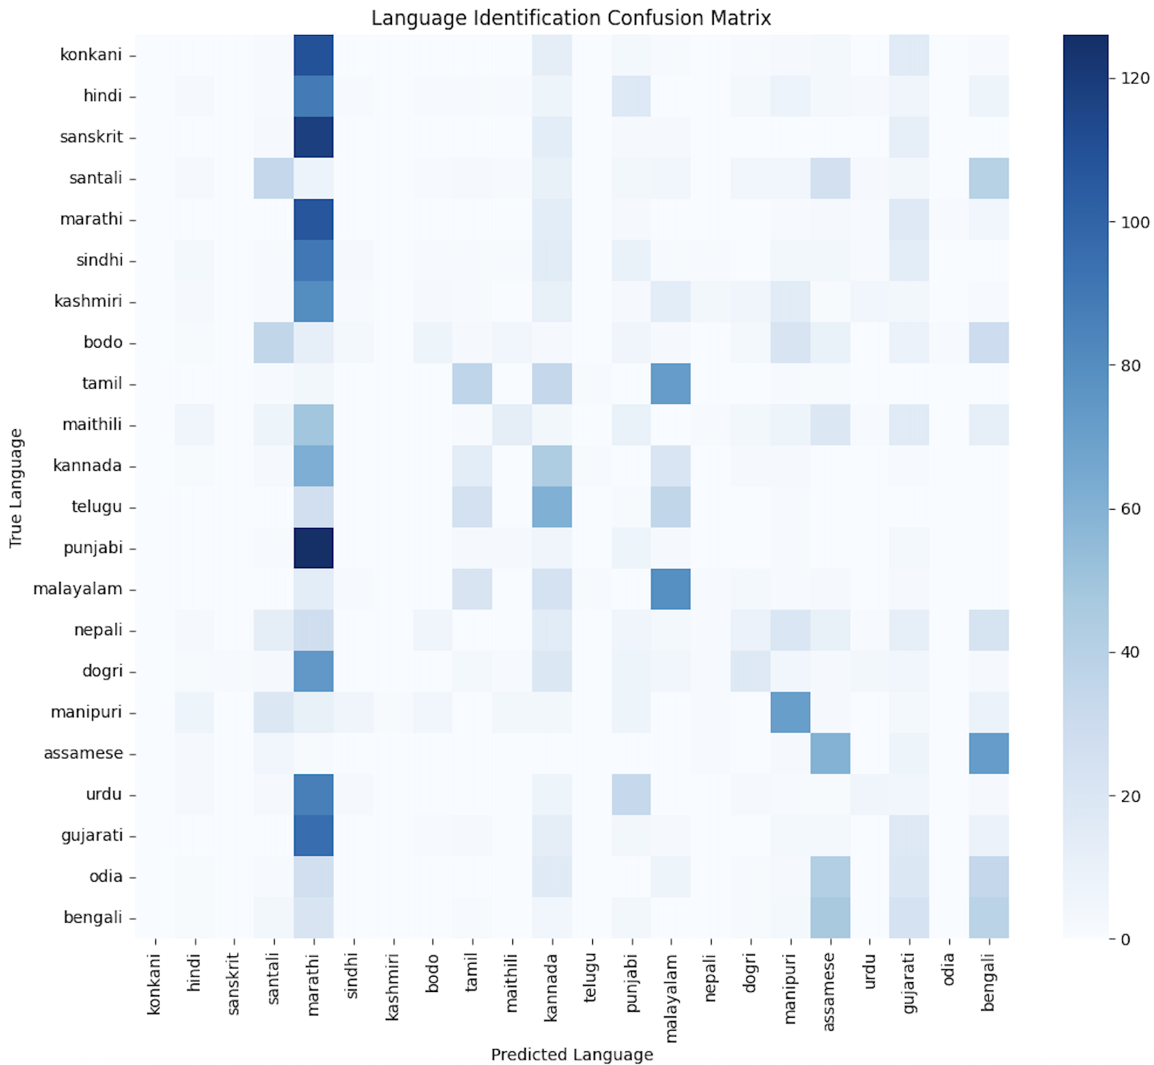
ANALYSIS
CONFUSION MATRIX
A strong prediction bias toward certain languages is visible.
two important challenges of the task: acoustic similarity between related languages and the strong speaker bias caused by the limited number of speakers per language.

Slide 10
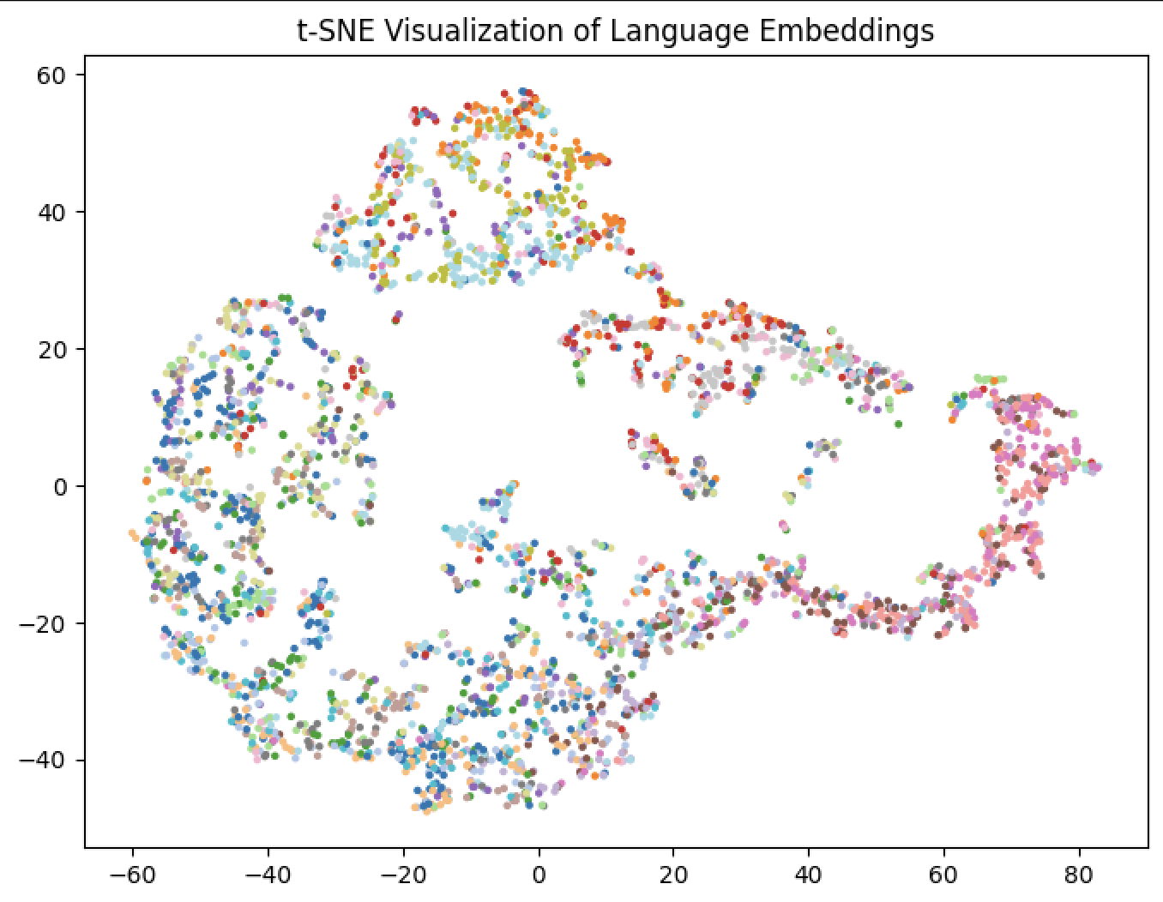
ANALYSIS
t-SNE VISUALISATION
the final-layer embeddings using t-SNE dimensionality reduction.
many samples from different languages appear intermixed.
The learned embeddings are not strongly language-specific and that the model captures more general acoustic characteristics.

Slide 11
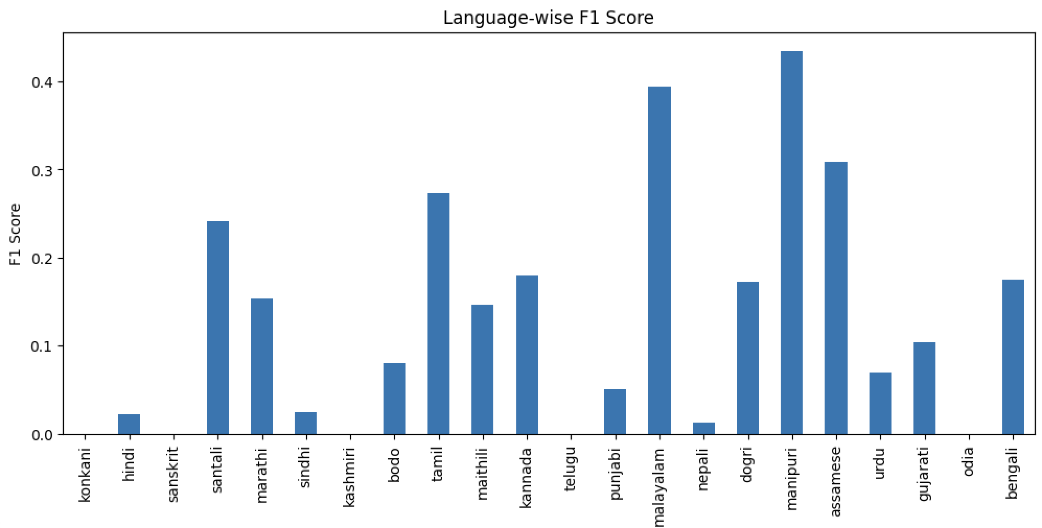
ANALYSIS
LANGUAGE-WISE F1 SCORES
The behaviour is consistent with the confusion matrix analysis and reflects the acoustic similarity between several languages in the dataset.

Slide 12
CONCLUSION
Our baseline MMS model achieved 23.8% validation accuracy, which is significantly higher than random chance but still limited by the dataset constraints.
The relatively low macro F1 score indicates that performance varies substantially across languages.
The best result came from the third strategy, selective augmentation, which improved top-1 accuracy to 43.4%.
The results highlight the importance of dataset diversity for speech classification tasks.

Slide 13
REFERENCE
PyTorch/Torchaudio. Audio Data Augmentation Tutorial. https://docs.pytorch.org/audio/stable/tutorials/audio_data_augmentation_tutorial.html
Matthew Baas, Benjamin van Niekerk, and Herman Kamper. Voice Conversion With Just Nearest Neighbors. In Proceedings of Interspeech, 2023.
Daniel S. Park, William Chan, Yu Zhang, Chung-Cheng Chiu, Barret Zoph, Ekin D. Cubuk, and Quoc V. Le. SpecAugment: A Simple Data Augmentation Method for Automatic Speech Recognition. In Proceedings of Interspeech, 2019.
Tom Ko, Vijayaditya Peddinti, Daniel Povey, and Sanjeev Khudanpur. Audio Augmentation for Speech Recognition. In Proceedings of Interspeech, 2015.
Alexei Baevski, Yuhao Zhou, Abdelrahman Mohamed, and Michael Auli. wav2vec 2.0: A Framework for Self-Supervised Learning of Speech Representations. In Advances in Neural Information Processing Systems (NeurIPS), 2020.
Arun Babu, Qiantong Wang, Andros Tjandra, and others. XLS-R: Self-Supervised Cross-Lingual Speech Representation Learning at Scale. In Proceedings of Interspeech, 2022.
Vineel Pratap, Qiantong Xu, Anuroop Sriram, and others. Scaling Speech Technology to 1000+ Languages. arXiv preprint arXiv:2305.13516, 2023.
Thomas Wolf, Lysandre Debut, Victor Sanh, Julien Chaumond, and others. Transformers: State-of-the-Art Natural Language Processing. In Proceedings of EMNLP, 2020.
Yaroslav Ganin and Victor Lempitsky. Unsupervised Domain Adaptation by Backpropagation. arXiv preprint arXiv:1409.7495, 2014.
Yanai Elazar and Yoav Goldberg. Adversarial Removal of Demographic Attributes from Text Data. arXiv preprint arXiv:1808.06640, 2018.

