Slide 1

Welcome
This Photo by Unknown author is licensed under CC BY.

Slide 2


TEXT FORMATING
This Photo by Unknown author is licensed under CC BY-NC.

Slide 3
KEY FEATURES
Grammatical errors
Availability of content
User's friendly
Chat Bot

Slide 4
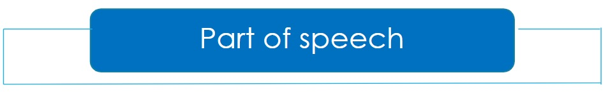

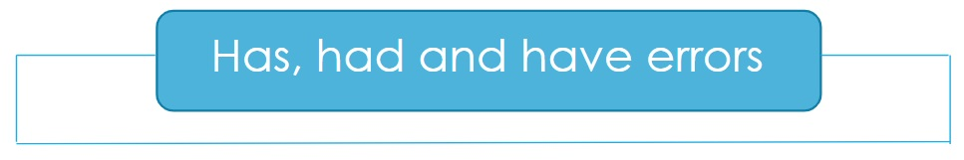

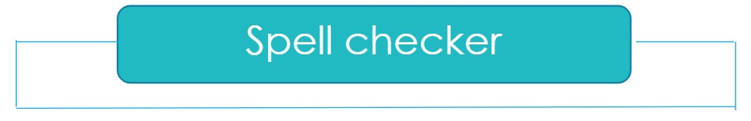
Grammatical errors

Slide 5
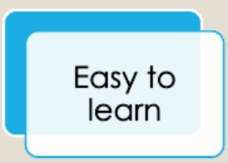
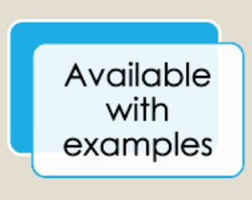
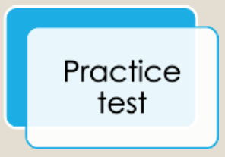
Availability of content

Slide 6
User's friendly
Take user's input
File scanning and checking.
User can copy their text
No word limit.

Slide 7




CHAT BOT

Slide 8

FURTHER IMPROVEMENT
Content download.
Scanning of all formats of file.
Online live learning platform.

Slide 9

Thank you

