Slide 1
Project Presentation of Co-Op Project at Industry (Module-2)
On
Learning Log
Kashish Goyal , Aastha , Chaitanya Verma
2210990496 , 2210991128 , 2210991453
Supervised By
Dr. Rajat Takkar
Department of Computer Science and Engineering,
Chitkara University, Punjab

Slide 2
Introduction
Overview:
In today’s digital‑first environment, students, interns, and professionals often find it difficult to maintain a structured record of their daily learning. Their notes are usually scattered across diaries, documents, and unorganized digital files, making it hard to track growth, evaluate performance, or analyze learning patterns.
For organizations, this lack of structure reduces visibility into an individual’s day‑to‑day progress, limiting a manager’s ability to assess engagement or provide timely feedback. This leads to poor accountability and breaks continuity in the learning process.
To address these gaps, Learning Log provides a centralized, organized platform for documenting daily learning activities—promoting consistency, transparency, and meaningful performance insights. It supports continuous learning while strengthening responsibility and productivity in professional environments.
‹#›

Slide 3
Technology Used
Backend Framework: Spring Boot for fast, secure, and scalable
server‑side processing
Frontend Framework: React.js for a smooth, interactive, and user‑friendly UI
Database: MySQL to securely store user logs, profiles, and activity records
Authentication: JWT‑based authentication to ensure safe and authorized user access
API Communication: RESTful APIs for efficient and consistent data exchange between client and server
Generative AI: Integrated AI models to provide automated summaries and smart tagging for a more personalized learning experience.

Slide 4
Problem Statement And Objective
Problem Statement:
Organizations often lack a structured system for interns and professionals to record their daily learning and activities. As a result, progress tracking becomes inconsistent, documentation is scattered, and managers have limited visibility into day‑to‑day performance. This reduces accountability, affects productivity, and weakens the overall learning culture. A centralized platform is needed to ensure organized logging, transparency, and continuous learning.
Objectives:
Create a centralized platform for structured daily learning logs.
Improve accountability and productivity through consistent tracking.
Enable secure, role‑based access for interns, mentors, and admins.
Support easy communication and timely feedback.
Provide real‑time visibility into progress for better monitoring.
Strengthen organizational learning culture through regular documentation

Slide 5
Implementation
• Gathered and documented requirements for creating a centralized system with role‑based access and daily learning logs.
• Designed the system architecture using Spring Boot for the backend, React.js for the frontend, and MySQL as the database.
• Created REST API endpoints, authentication flow using JWT, and database schema for users and log entries.
• Developed backend modules for login, user roles, and log management, along with frontend components for dashboards and daily entries.
• Integrated frontend and backend through RESTful APIs to ensure smooth and secure data communication.
• Performed manual and automated testing to verify functionality, data accuracy, and user experience.
• Optimized performance, improved validation, and refined UI elements for better usability and consistency.

Slide 6
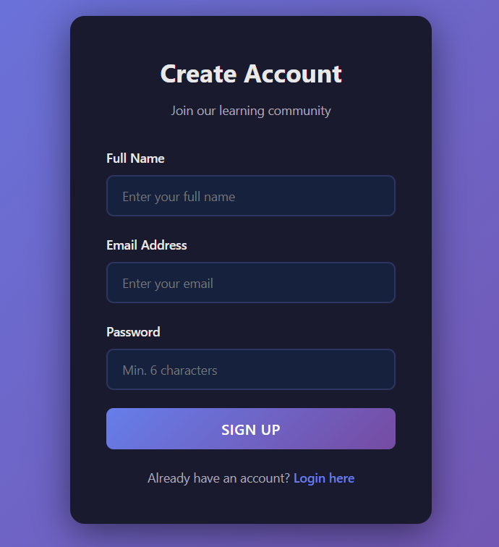
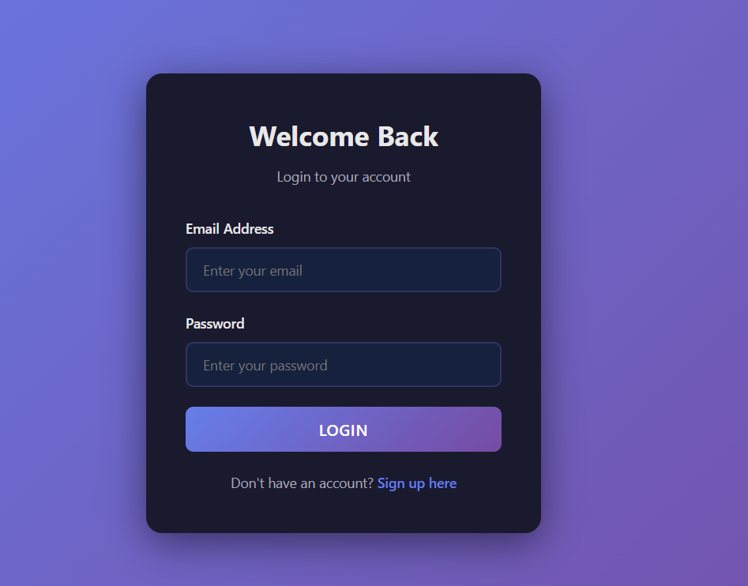
UI Design
LOGIN / SIGNUP

Slide 7
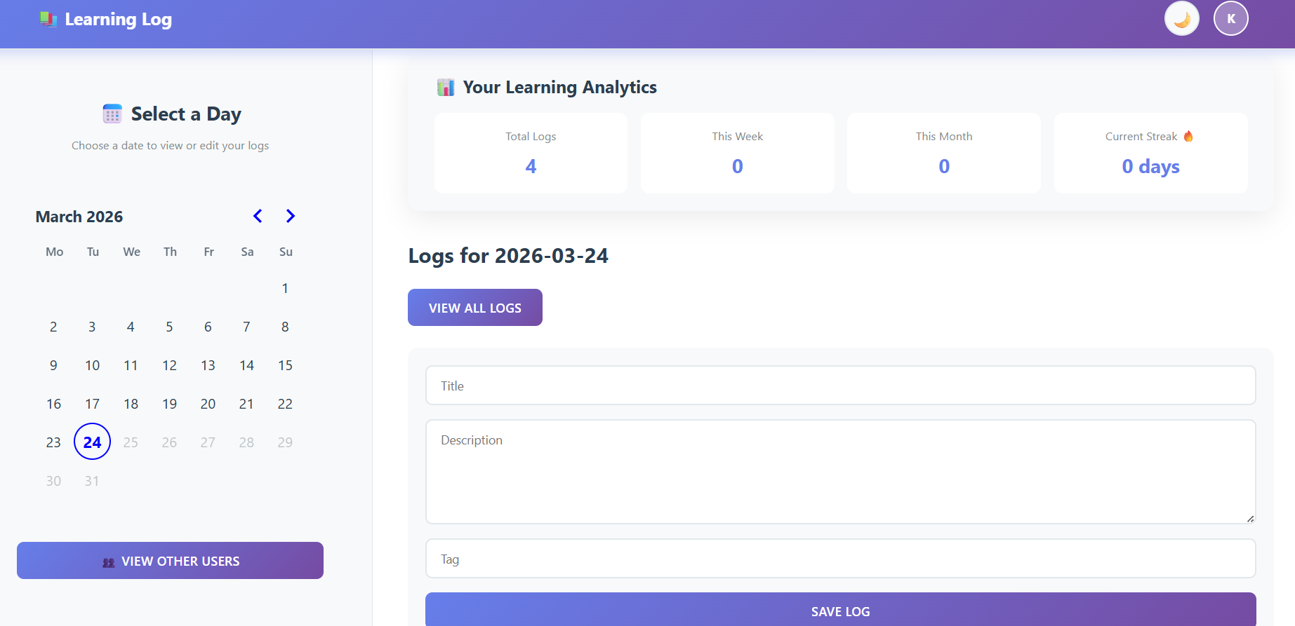
UI Design
Home Page

Slide 8
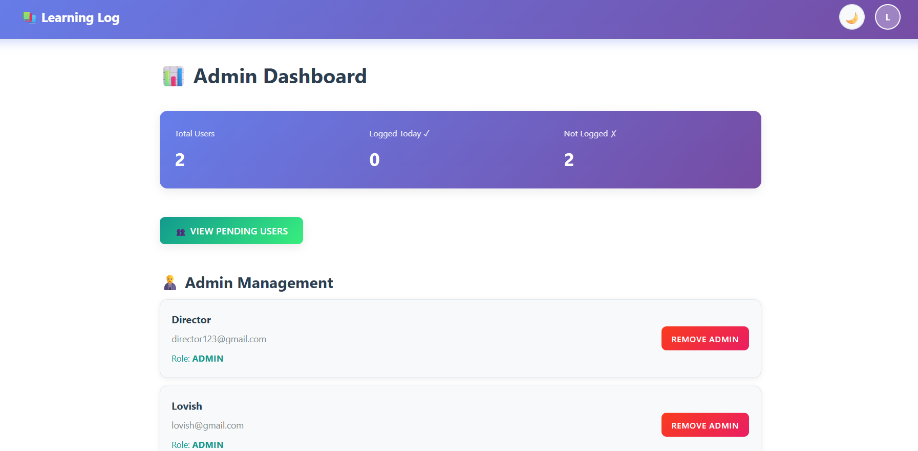
UI Design
Admin Dashboard

Slide 9
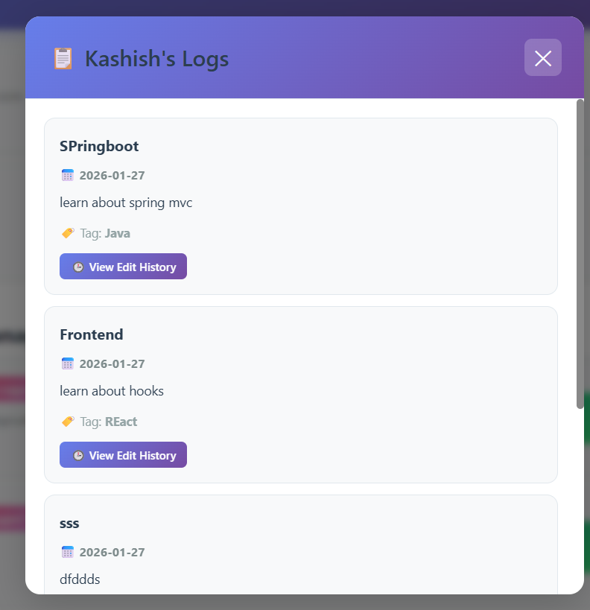
UI Design
User’s Log

Slide 10
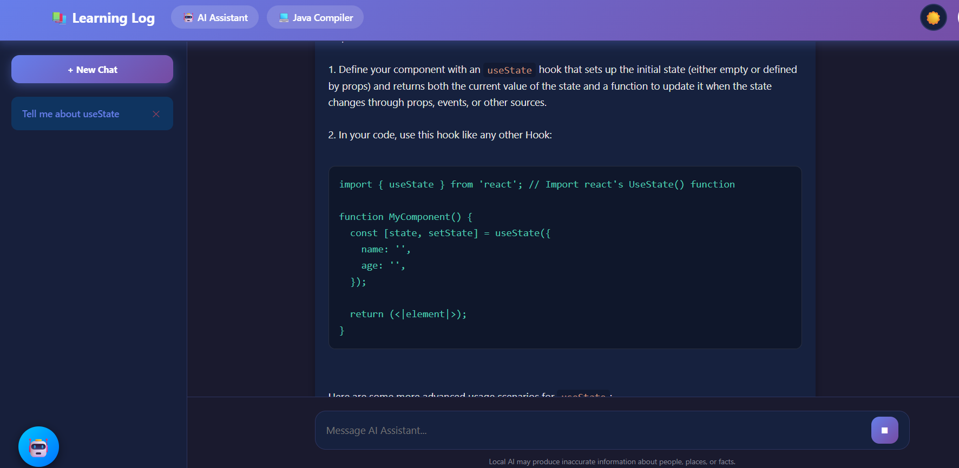
UI Design
AI Chatbot

Slide 11
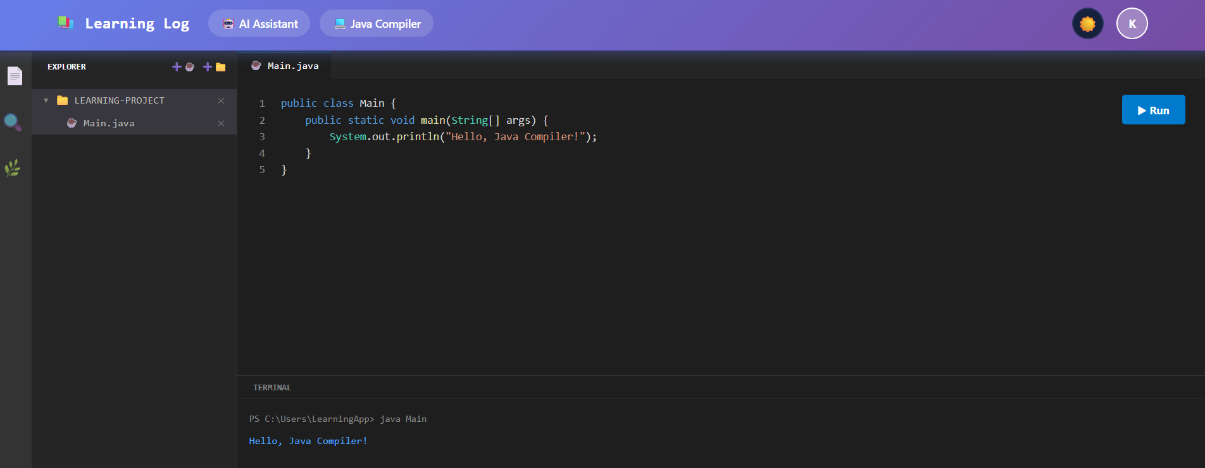
UI Design
Java Compiler

Slide 12
Result
• Centralized Documentation: All daily learning logs and activities are stored in one secure platform, reducing scattered notes and improving consistency.
• Improved Transparency: Managers and mentors gain clear visibility into each intern’s progress, enabling timely feedback and better monitoring.
• Enhanced Collaboration: Users can view others’ logs (based on permissions), helping them catch up on missed concepts and learn from different approaches.
• Higher Accountability: Built‑in reminders encourage users to maintain regular updates, improving discipline and continuity in learning.
• Better Productivity: Structured logging and role‑based access reduce manual tracking effort and streamline communication between interns and administrators.
• Organized Learning Culture: The platform supports a more systematic, accountable, and growth‑focused learning environment within the organization.

Slide 13
Conclusion
The Learning Log project successfully delivered a centralized and secure platform for documenting daily learning activities within an organization. By replacing scattered manual methods with a structured system, it improved consistency, visibility, and accountability among interns and employees. Role‑based access, organized dashboards, and reminder features enhanced productivity and encouraged continuous learning. Overall, the platform strengthened communication between users and administrators while fostering a more transparent and disciplined learning culture.
Overall, the project not only streamlined daily learning documentation but also contributed to building a more disciplined, productive, and growth‑oriented learning culture within the organization.

Slide 14
Future Scope
The Learning Log System can be further enhanced to provide a more intelligent and engaging learning experience. Some potential improvements are:
1. AI-Powered Learning Assistance
The system can be integrated with AI models to generate automatic summaries of daily logs, provide personalized study recommendations, and identify weak areas. This will help users learn more efficiently and maintain consistency.
2. Advanced Analytics Dashboard
Future versions can include detailed insights such as weekly and monthly performance trends, subject-wise analysis, and productivity tracking. Visual tools like graphs and heatmaps can help users better understand their progress.
3. Social and Collaborative Features
The platform can be expanded to include community features such as sharing learning logs, participating in group discussions, and maintaining learning streaks. This will encourage peer interaction and accountability.
These enhancements can transform the system from a simple tracking tool into a comprehensive learning and productivity platform.

Slide 15
Reference
Spring Boot Official Documentation(spring init) – Backend development and REST API guidelines.
React.js Official Documentation – UI components and frontend architecture.
MySQL Documentation – Database design and query management.
JWT Documentation – Token‑based authentication standards.
Visual Studio Code Documentation – Development and debugging resources.
Selenium Documentation – Automation testing reference.
Articles and case studies on learning platforms and digital activity‑tracking systems.

Slide 16
Thank You
‹#›

